Slide 1
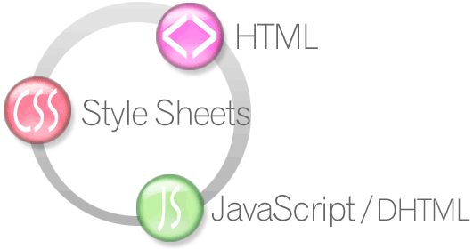

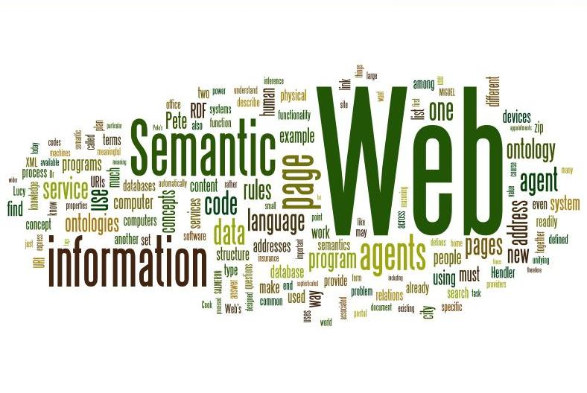
Semantic Web
How to Use HTML Elements properly
Doncho Minkov
Technical Trainer
http://minkov.it
Telerik Software Academy
http://academy.telerik.com

Slide 2

Table of Contents
Web Page
HTML, CSS and JavaScript
The Semantic HTML
HTML5 Semantic Tags
Other Semantics

Slide 3

Web Page

Slide 4

The Elements of a Web Page
A Web page consists of:
HTML markup
CSS rules
JavaScript code
Images
Other resources
Fonts, audio, video, etc…

Slide 5
The Elements of a Web Page: HTML Markup
The HTML is used to define the content of a web page
Not the layout
Not the decorations
HTML's role is to present the information in a meaningful manner
Like a paper document
Define headers, paragraphs, textboxes, etc…
Not define size, color and/or position

Slide 6
The Elements of a Web Page: CSS Rules
Cascading Style Sheets (CSS) is the way to make a web page pretty
Define style rules
Define the layout of the elements
Define the presentation
The CSS files are attached to a web page and the browser applies these styles to elements

Slide 7
The Elements of a Web Page: JavaScript Code
JavaScript is the programming language of the Web
It is used to make web pages dynamic by adding / removing HTML Elements, applying styles, etc..
Like CSS the JavaScript files are attached to a web page

Slide 8





The Elements of a Web Page: Other Resources
Other resources are needed for a web page to run properly
Images, audio files, video files
Flash / Silverlight controls

Slide 9
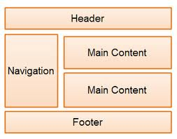
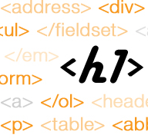
The Semantic HTML

Slide 10
Semantic HTML
Semantic HTML is the use of HTML markup to reinforce the semantics of the information in webpages
Rather than merely to define its presentation
Semantic HTML is processed by regular web browsers as well as by many other user agents
CSS is used to suggest its presentation to human users

Slide 11

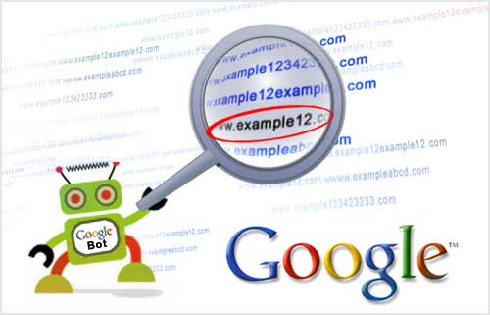
Why Use Semantic HTML?
Semantic HTML is:
Easier to read by the developer
Easier to render by browsers
A way to show the SEO engines the correct content

Slide 12
How To Write Semantic HTML
Just follow some rules when creating a complete web site
Use HTML5 semantic tags
<header>, <section>, <nav>, <article>, <aside>, <footer>
Use Headings when you need to point something out
In increasing order, staring with <h1>
Do not use empty tags
Like a clearing div

Slide 13

HTML5 Semantic Tags

Slide 14
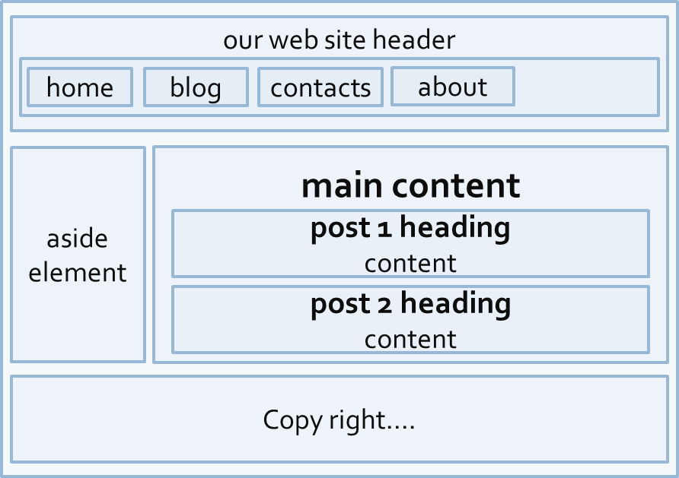
HTML5 Semantic Tags
HTML5 introduces semantic structure tags
Imagine the following site:
This is a common Web page structure
Used in 90% of the web sites

Slide 15
HTML5 Semantic Tags (2)
This can be created using all kind of HTML Elements
<div>, <span>, even <p>
Browsers render invalid/wrong/pseudo valid HTML
The correct way is to use the HTML 5 semantic tags:
You can find more about semantic tags at http://pavelkolev.com/html5-snippets/
<header> … </header>
<section> … </section>
<aside> … </aside>
<footer> … </footer>

Slide 16

Other Semantics
Headings, ems, strongs

Slide 17
Other Semantics
Headings
Always use headings (h1-h6) when you need a heading or title
Like in a MS Word document
Google uses it to mark important content
Strong <strong> vs. Bold <b>
<b> does not mean anything
It just makes the text bolder
<strong> marks the text is "stronger" than the other, surrounding text

Slide 18
Other Semantics (2)
Emphasis <em> vs. Italic <i>
Emphasis does not always mean, that the code should be italic
It could be bolder, italic and underlined
All the styles for the emphasis text should be given with CSS
Not by HTML

Slide 19
Semantic Web
http://academy.telerik.com

Slide 20
Homework
Refactor the refactoring-homework.html web page and make its HTML semantic
Create a web page using semantic HTML by the design in homework-design-1.pptx
Create a web page using semantic HTML by the design in homework-design-2.pptx
*Note: do not try to make the same styles in Exercise 4 and Exercise 5
Just the content

