Slide 1





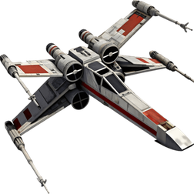
KAKSHA · satellite collision risk predictor: manoeuvre or monitor, two days out
TEAM NAME : The Good Engineers
TEAM LEADER : Chirag
TRACK : Software
PROBLEM STATEMENT CODE : SW-5

Slide 2


Problem and opportunity
The problem
• Satellites and debris pass at kilometres per second. Operators get conjunction data messages (CDMs) with a collision probability (Pc) that changes for days, and must decide early whether to manoeuvre.
• A manoeuvre costs fuel and mission time; a missed one can end a satellite (Iridium 33 and Cosmos 2251 collided in 2009).
• Dangerous events are rare: in ESA's held-out set, 150 of 2,167 events end high risk (Pc ≥ 10⁻⁶).
• The obvious rule, "trust the latest message", misses 35 of those 150 at two days out (our measurement on ESA data).
How KAKSHA is different
• A decision, not just a number: manoeuvre or monitor, with a calibrated probability, a range for the final risk and the three reasons behind it.
• Honest evaluation: ESA's real data and own score, split by event, nothing closer than 2 days; we reproduce ESA's published baseline score exactly.
• The operator sets the fuel-against-risk line and sees what it costs.
USP: decisions you can check
Retrained on recent events, two days out:
23 missed instead of 35, for 37 more manoeuvres
Official ESA split: not beaten yet (results slide)

Slide 3
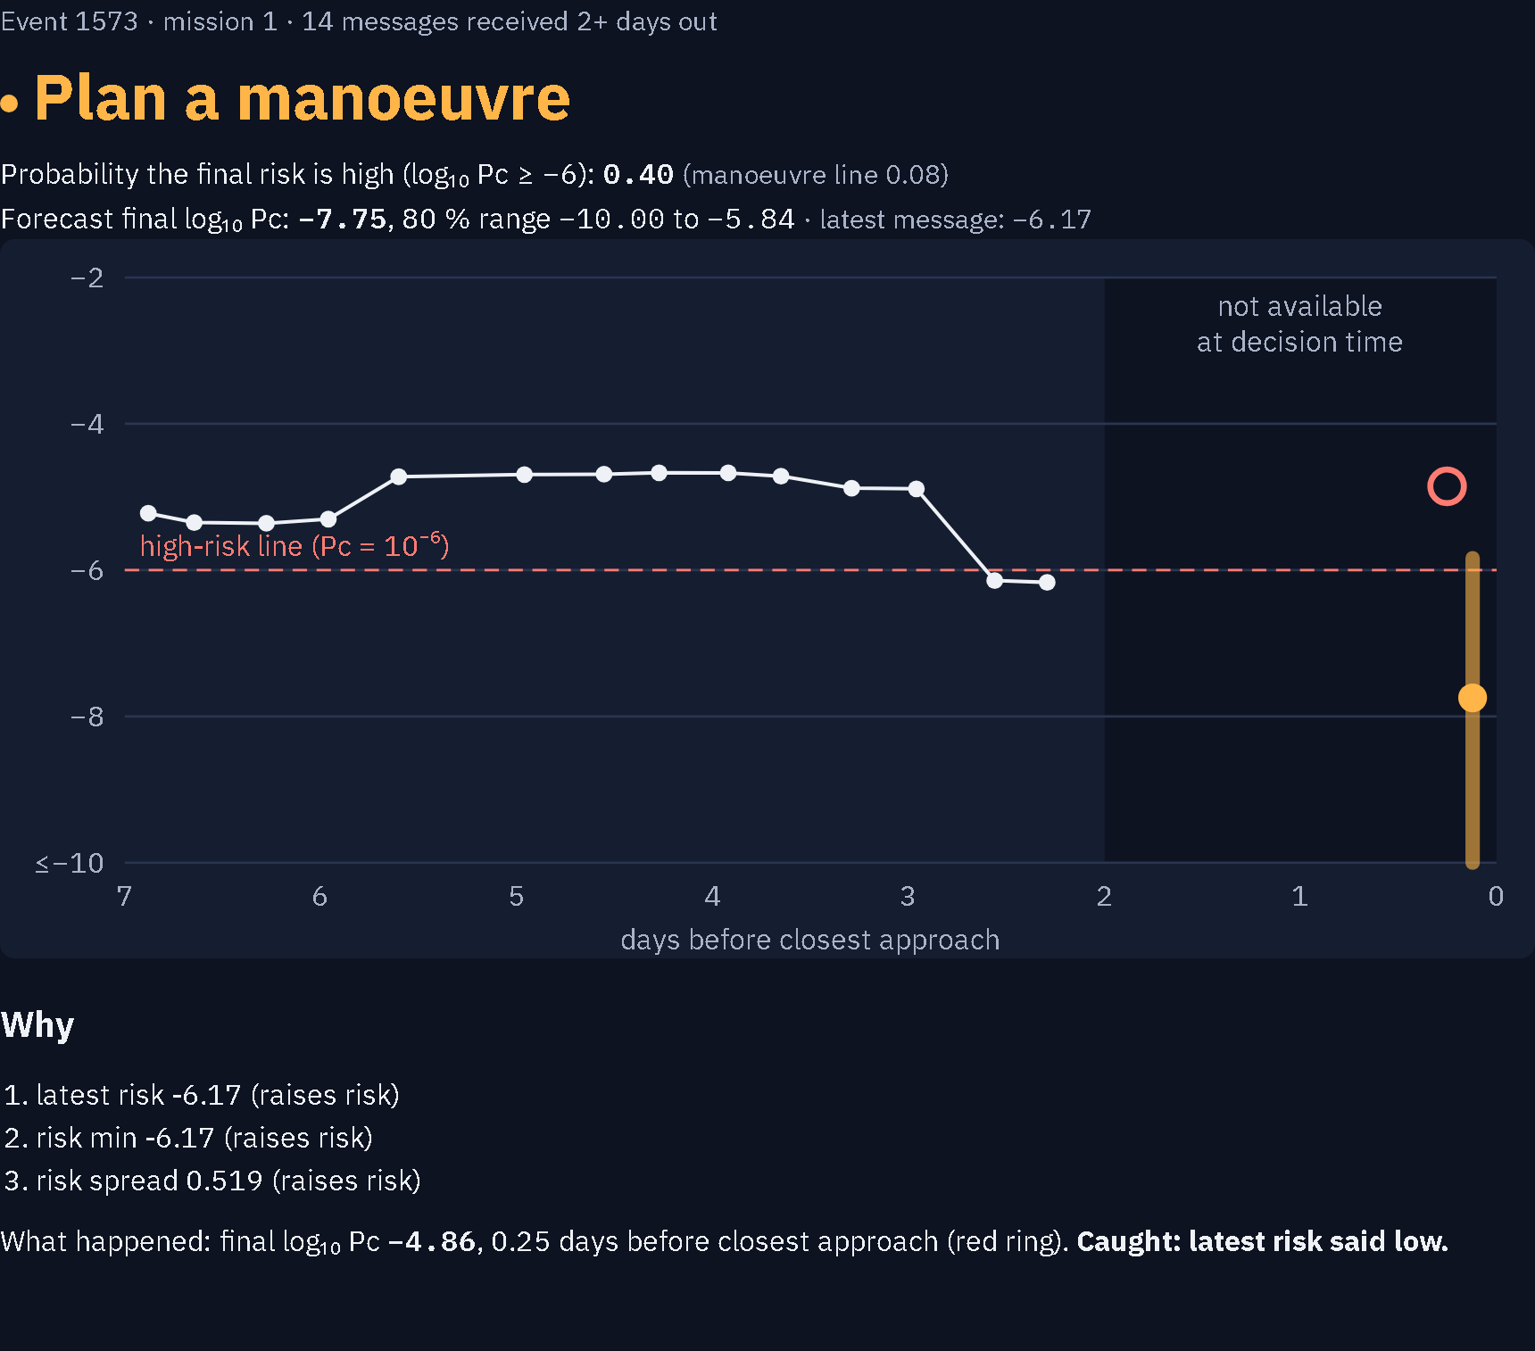
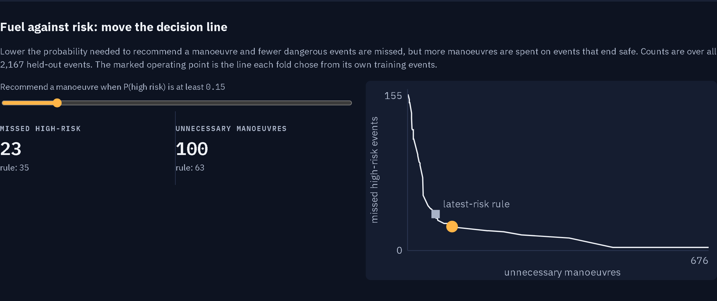

Features
Real screenshots. Event 1573: latest message just under the line; KAKSHA said manoeuvre; final risk over 10x above it
1. Recommendation with confidence
Plan a manoeuvre or monitor, P(final risk high), and an 80 % range for the final risk.
2. Risk history with the 2-day cutoff
Every message for the event; the last two days are greyed out because they arrive too late.
3. Reasons
The three features that pushed this event's probability up or down.
4. Reveal and honest filters
Show what really happened; list our catches, our misses and our unnecessary manoeuvres.
5. Fuel-against-risk slider
Move the line, see missed events against unnecessary manoeuvres.

Slide 4

Process flow: one close approach, from first warning to decision
What the operator does with KAKSHA (top) and what KAKSHA does underneath (bottom)
CDMs arrive
every few hours,
7 days to closest approach
T − 2 days
decision point; later
messages not used
KAKSHA forecast
P(high risk), range,
three reasons
Operator decides
plan a manoeuvre
or keep monitoring
Final CDM
outcome logged,
model retrained
Keep events whose last CDM is within
1 day of closest approach
Drop every message < 2 days out
(code refuses them)
154 features: latest message +
trends; boosted trees; calibration
Line chosen to maximise F2
(misses cost more than false alarms)
Score with ESA's metric:
MSE on high-risk / F2
Measured on 2,167 ESA held-out events: retrained on recent events, KAKSHA misses 23 high-risk events where the latest-message rule misses 35; on ESA's official split it does not beat the rule. Use case: a flight-dynamics operator manoeuvring only where it matters.

Slide 5
Architecture
Every box exists and runs today (github.com/thegoodengineers/kaksha)
Data
ESA Collision Avoidance
Challenge dataset
(Zenodo, CC-BY-4.0)
get_data.py:
download + MD5 check
Events
kaksha.py
usable-event filter
2-day cutoff guard
154 event features
ESA metric (L, F2)
Model
train.py
LightGBM classifier
isotonic calibration
F2-chosen manoeuvre line
range + reasons
Evidence
results/*.csv
metrics, calibration,
trade-off, predictions
RESULTS.md generated
from the CSVs
Console
server.py (FastAPI)
/api/events
/api/event/{id}
/api/summary
web/index.html + SVG
Quality gates
pytest: cutoff, no event on both sides, metric, published
baseline reproduced · GitHub Actions on every push
Operator
browser console, 0 axe-core accessibility problems;
later: live CCSDS CDM feed in, decision log out
Modular on purpose: the model is one file behind a fixed feature table, so a sequence model can replace it without touching the console.

Slide 6

Technologies
Layer | What we use | Why
Language | Python 3.11 | One language from data to API; fits a 24-hour build
Data | pandas, NumPy | 103-column CDM tables, per-event grouping
Model | LightGBM gradient-boosted trees | Strong on tabular data, fast, gives per-event reasons
Calibration | scikit-learn isotonic regression | Probabilities that mean what they say
Uncertainty | Empirical (split-conformal style) range | No distribution assumed
API | FastAPI + Uvicorn | Three JSON endpoints, typed, quick
Console | Plain HTML, CSS, SVG charts | No framework; loads instantly; accessible
Quality | pytest, GitHub Actions, axe-core | Leakage, metric and accessibility checks on every push
Data source | ESA Kelvins dataset on Zenodo | Real CDMs, real labels, published baseline to beat

Slide 7
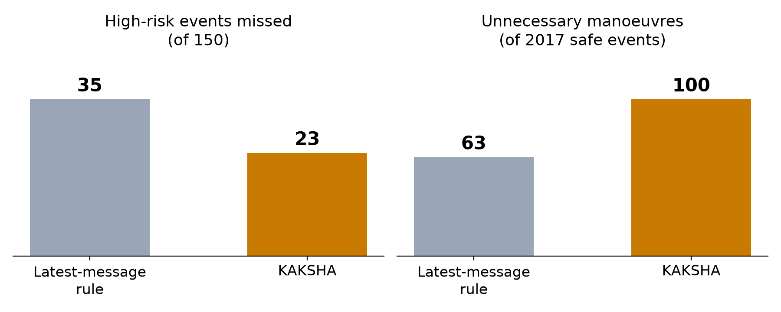
Extra 1: what we measured (ESA held-out events, two days out)
2,167 events, 150 high risk. ESA's score L = MSE on high-risk events / F2, lower is better.
1. Retrained on recent events (LightGBM)
2. ESA's official split: not beaten
Two picks, each chosen only by 5-fold CV on ESA's train events, scored on the test set once:
Latest-CDM baseline: L 0.694 · MSE 0.513 · F2 0.739
Latest + shrunk ridge correction: L 0.728 · MSE 0.526 · F2 0.723
Rule set: L 1.021 · MSE 0.705 · F2 0.691
Said plainly
ESA's train and test events differ: when the latest message said high risk, 261 of 308 train events ended low but only 63 of 178 test events, so train-only tuning does not carry over. Retraining with recent events (5 folds by event, no event scored by a model that saw it) is what helps. Calibrated: Brier 0.032 vs 0.045. Earlier exploratory test scorings are logged and not counted. ESA's winner scored 0.556.

Slide 8
Extra 2: our 24-hour plan for Round 2
We start from a working, tested baseline, so the 24 hours go into making the model and the console better
Hours | What | Owner
H0–3 | Data pipeline, re-run baseline and tests | Abhijeet
H3–10 | Sequence features over the CDM history; per-mission calibration | Chirag
H10–16 | Console: fleet view of all open events, decision log | Bhumika
H16–20 | Evaluation: re-score, wider ranges where high-risk; cost slider in fuel terms | Abhijeet, Chirag
H20–23 | Demo story (event 1573), pitch rehearsed twice with a timer | Ayush
H23–24 | Buffer; recorded backup of the demo | Everyone
Rule for the 24 hours: every number we show comes from a script run that day.

Slide 9

References
• ESA, Collision Avoidance Challenge dataset, Zenodo, doi:10.5281/zenodo.4463683 (CC-BY-4.0).
• Uriot T., Izzo D., Simões L. F. et al., "Spacecraft collision avoidance challenge: design and results of a machine learning competition", Astrodynamics 6, 2022 (arXiv:2008.03069): rules, metric, published scores.
• Ke G. et al., "LightGBM: a highly efficient gradient boosting decision tree", NeurIPS 2017.
• Zadrozny B., Elkan C., "Transforming classifier scores into accurate multiclass probability estimates", KDD 2002 (isotonic calibration).
• Lei J. et al., "Distribution-free predictive inference for regression", JASA 2018 (split-conformal ranges).
• CCSDS 508.0-B-1, Conjunction Data Message, Blue Book, 2013.
• NASA Orbital Debris Program Office, Orbital Debris Quarterly News 13(2), April 2009 (Iridium 33 / Cosmos 2251 collision).
Code, results and tests: github.com/thegoodengineers/kaksha · Team: The Good Engineers (Chirag, Bhumika, Ayush, Abhijeet)

