Slide 1


Company Bankruptcy Prediction
ML 02
Cohort -07

Slide 2


List of Contents
01
02
03
04
Who We Are?
Business Case
Learning
EDA and Learning
05
06
07
Model Training
Model Performance
Future Improvements

Slide 3

Our Team
Bakary Sanogo
Doren Chan
Oshinee Mendis
Shripad Tak

Slide 4
About Dataset:
Company Bankruptcy Dataset
Source: Taiwan Economic Journal for the years 1999–2009
Instances: 6,819 companies
Features: 96 financial ratios (e.g., debt ratio, net profit margin, ROA)
Target: Binary label — 1 for bankrupt, 0 for non-bankrupt
Class Distribution: Bankruptcy cases represent approximately 3.23% of the dataset

Slide 5
Limitations
Time Span (1999 - 2009)
Only Taiwanese companies
Business Case
Why ?
Learning about the factors impact a bankruptcy,
Business Owners- Mitigate actions in their own business
Lenders- Accurate decision Making, Reduce Risk
Employees- Job Security
Company Management- Mitigating Action Plan
Policy Makers- Create safe guard Policies
Academia & Research Institutes- Deep observe
Regulatory Authority- Legal actions

Slide 6
EDA and Learning
Dataset : very messy data set with a lot of special characters
Missing data: none
Outliers: the IQR-rule : ( Q1-1,5*IQR , Q3 +1,5*IQR )
Imbalance data =>
- Principal Component Analysis PCA (poor result)
- Handling imbalance class issue with SMOTE
- Variance method for feature selection ( poor result)
- ANOVA feature selection - picking top 10 features (good result)

Slide 7

Model Type | Pros | Notes
Logistic Regression | Interpretable, fast | struggles with non-linear problems and can over fit on high-dimensional data
Random Forest | Handles non-linearity, robust | Use for feature importance
XGBoost | High accuracy, fast training | Great for tabular data
Deep Learning NN (Neural Network Model) | Flexible, scalable | Try with dropout + batch norm

Slide 8
Our model uses a layered neural network to identify patterns, with 64 and 32 neurons capturing key features.
To avoid overfitting, dropout layers randomly “turn off” parts of the network during training, keeping the model robust.
It outputs a probability score predicting the target outcome.
Trained using an optimized method (Adam) and stop early once the model stops improving—ensuring efficiency and avoiding unnecessary training.
Validation on separate data confirms the model’s reliability before deployment.
Model Training

Slide 9
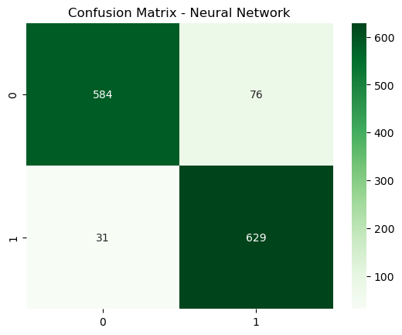
Model Performance
2.
High-risk companies are identified early and with strong sensitivity : Recall: 95%
Unnecessary reviews for healthy companies are kept low : Precision: 89%
Predictions remain consistently accurate across the test dataset : Accuracy: 92%
A strong balance is maintained between catching failures and avoiding false alarms : F1 Score: 92%
Financially distressed companies are clearly separated from stable ones : ROC-AUC: 0.967
Missed bankruptcies stay minimal while overall classification remains robust :

Slide 10
Future Improvements Add Explainability (SHAP) to show why a company is predicted as risky
Shift from binary label → risk probability bands (Low / Medium / High)
Expand dataset with more years or external economic indicators
Develop a stakeholder dashboard for decision-making
Future Improvements

Slide 11

Thank You

