Slide 1
Using ATtiny85 as Rubber Ducky for Keystroke Injection
Hamza Haroon

Slide 2
Sequence
Rubber Ducky Overview
What is ATtiny85?
Task: Goal
Task: Overview
Task: Code
Task: Demo

Slide 3
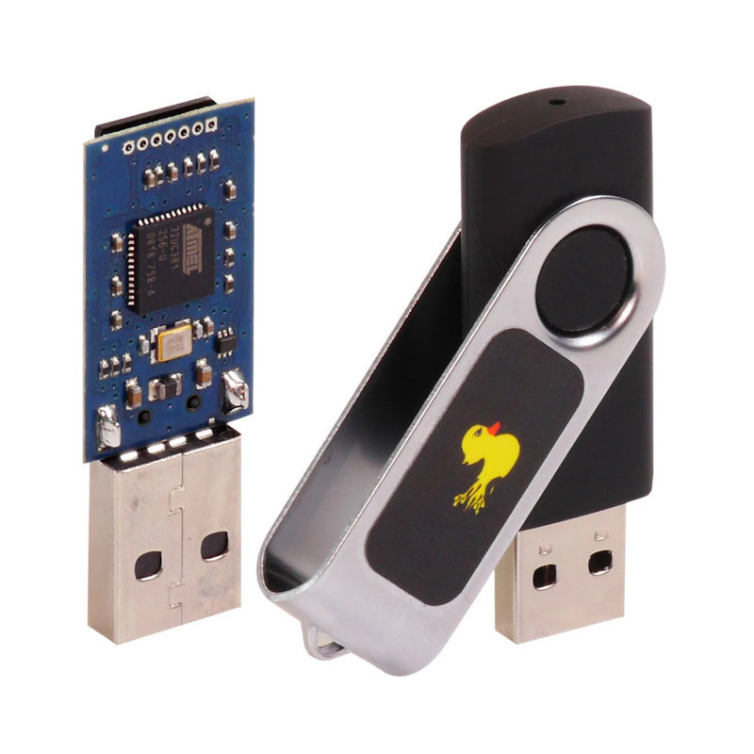
Rubber Ducky Overview
A USB-based attack tool disguised as an innocent flash drive.
Utilizes a pre-programmed script to execute a series of commands automatically upon insertion into a USB port.
Does not require any software installation or user interaction, making it stealthy and difficult to detect.
Can be programmed with various payloads to collect sensitive data, install malware, or create backdoors.

Slide 4
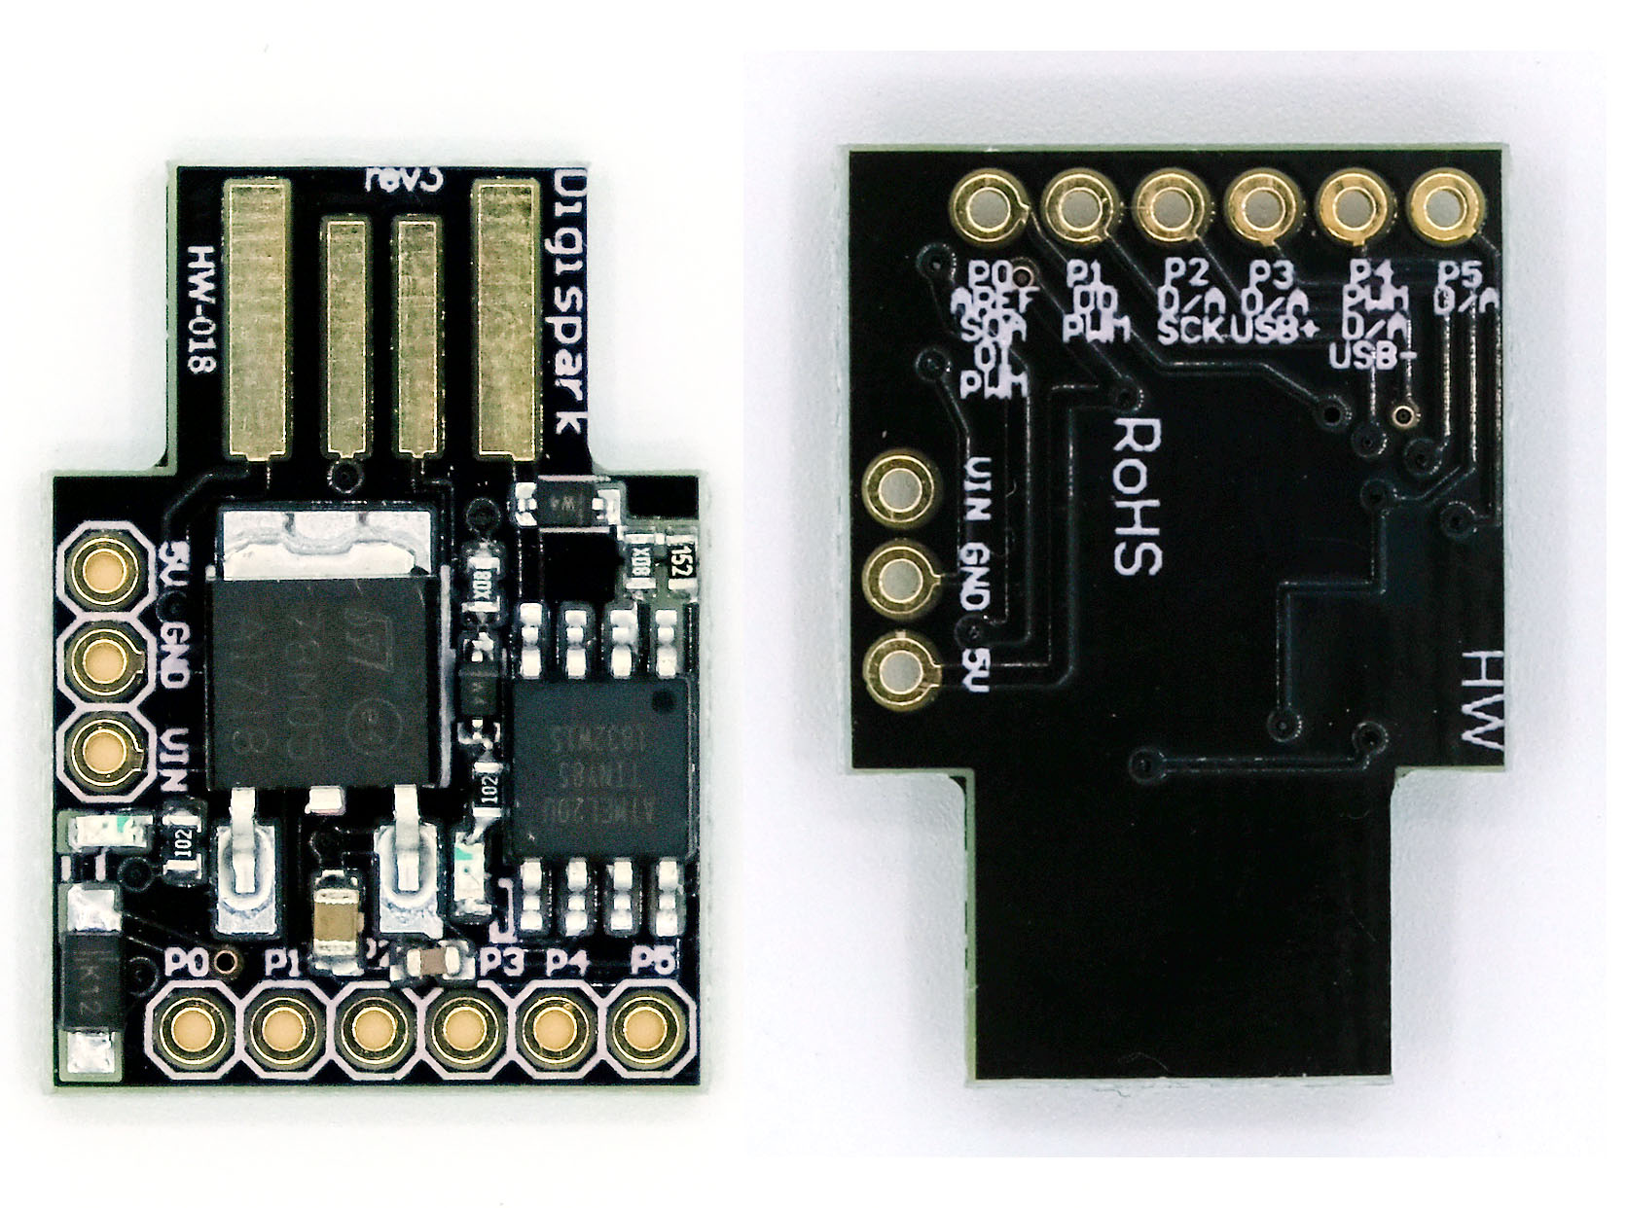
What is ATtiny85?
A compact, low-power microcontroller chip from the Atmel AVR family
Possesses 8KB of programmable flash memory and 512 bytes of SRAM for code storage and data manipulation
While it is a legitimate microcontroller but can be used as Rubber Ducky
Programmable using various languages including C++, C, AVR Assembly Language

Slide 5
Task: Goal
Functional Requirement is to change the Wallpaper of a PC/Laptop using ATtiny85

Slide 6
Task: Overview
It works with Windows XP, Vista, 7, 8, 8.1, and 10.
It acts as a USB keyboard to execute predefined keyboard sequences.
The main functions of the script include:
Taking a screenshot of the desktop.
Setting the screenshot as the wallpaper.
Hiding the desktop icons.
Use the script in a controlled and authorized environment.

Slide 7
Task: Code
The loop() function contains a series of DigiKeyboard commands to automate specific tasks on a connected computer.
The code emulates a sequence of key presses to perform the following actions:
Opens Microsoft Paint by pressing the Windows key + R, typing "mspaint," and pressing Enter.
Saves an image as the wallpaper by pressing Alt + F, K, F, Alt + F, X, followed by Windows key + Shift + V, and then pressing the Q key six times, and finally pressing Enter.
The script enters an infinite loop, effectively keeping the DigiSpark board in a standby state.

Slide 8
Task: Code
The loop() function contains a series of DigiKeyboard commands to automate specific tasks on a connected computer.
The code emulates a sequence of key presses to perform the following actions:
Opens Microsoft Paint by pressing the Windows key + R, typing "mspaint," and pressing Enter.
Saves an image as the wallpaper by pressing Alt + F, K, F, Alt + F, X, followed by Windows key + Shift + V, and then pressing the Q key six times, and finally pressing Enter.
The script enters an infinite loop, effectively keeping the DigiSpark board in a standby state.

Slide 9
Task: Demonstration

