Slide 1
Predicting Credit Defaults with Amazon SageMaker
Class University

Slide 2
Question of the Day
What are some advantages and disadvantages for using a cloud service to train machine learning models?

Slide 3
Exploratory Data Analysis
Ideas to try:
Identify categorical variables and encode them
Look for missing data values
Decide whether to estimate missing values or drop the column altogether
Look at correlation of attribute columns with the target column

Slide 4
Categorical Variable Encoding
To convert categorical variables to numeric ones an encoding method is used.
Two popular encoding methods are:
Label Encoding
One-hot Encoding

Slide 5
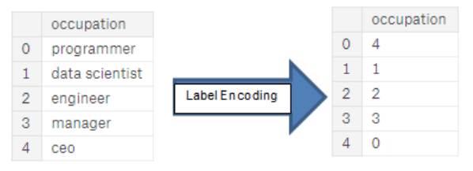
Label Encoding
Notes:
Label encoding is the process of assigning each distinct categorical value with an integer representation. If we encode multiple times we have no guarantee of the encoding order.

Slide 6
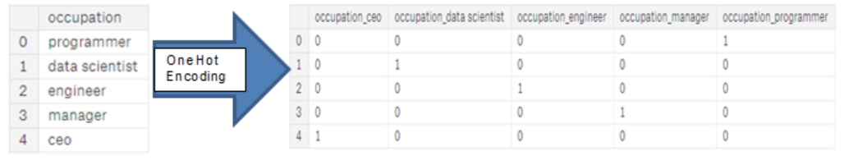
One-hot Encoding
Notes:
One-hot encoding creates a vector the length of the number of distinct values. Each value is then an identity vector.
It is advisable to use one-hot encoding for categorical variables with more than 2 distinct values.

Slide 7
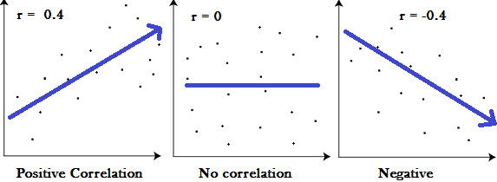
Pearson’s correlation coefficient
Notes:
A value r represents the degree by which two variables correlate. If r is positive it indicates that if one variable moves positively. If r is negative the variables have an inverse relationship. One variable moves positively and the other negatively. If r is 0 there is no correlation. We can use Pearson’s coefficient to determine if two variables could have a correlation.
In the mtcars dataset we shall look at how the columns are related to the target.

Slide 8
Imputation
Missing values can be replaced for an attribute that is missing data.
Has a particular value just been deleted?
The mean can be used for a substitution value
A value from a regression could be used
There are many imputation techniques

Slide 9
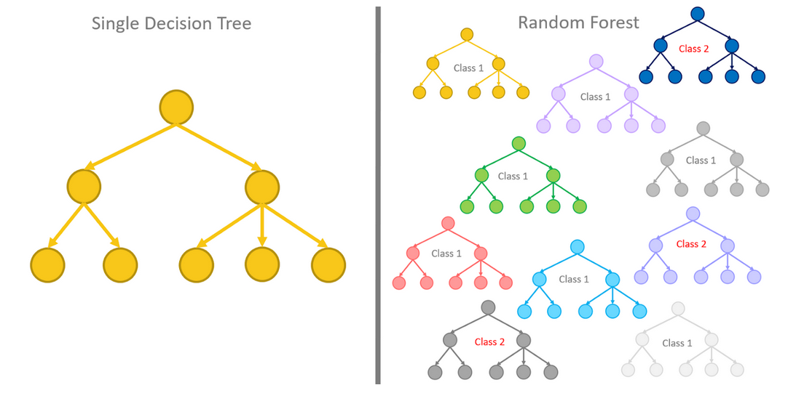
Random Forest
Notes:
A random forest is a collection of decision trees that are each trained on a subset of the training data.

