Slide 1
COVID Contact Tracing Report: Côte d’Ivoire

Slide 2
Level 1

Slide 3
Hello I sell cars

Slide 4
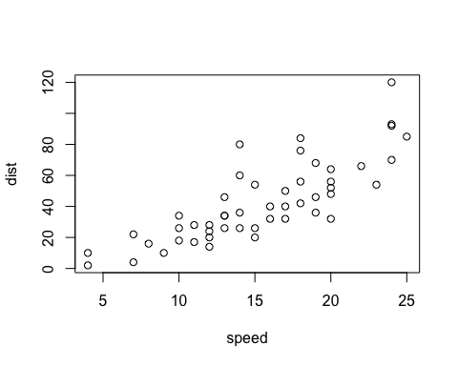

Slide 5
Level 2
Hello I sell cars

Slide 7
Level 1

Slide 8
Hello I sell cars

Slide 10
Level 2
Hello I sell cars

Slide 12
Level 1

Slide 13
Hello I sell cars

Slide 15
Level 2
Hello I sell cars

