Slide 1
COVID-19 Contact Tracing Report

Slide 2
VALUE BOX SUMMARIES

Slide 3
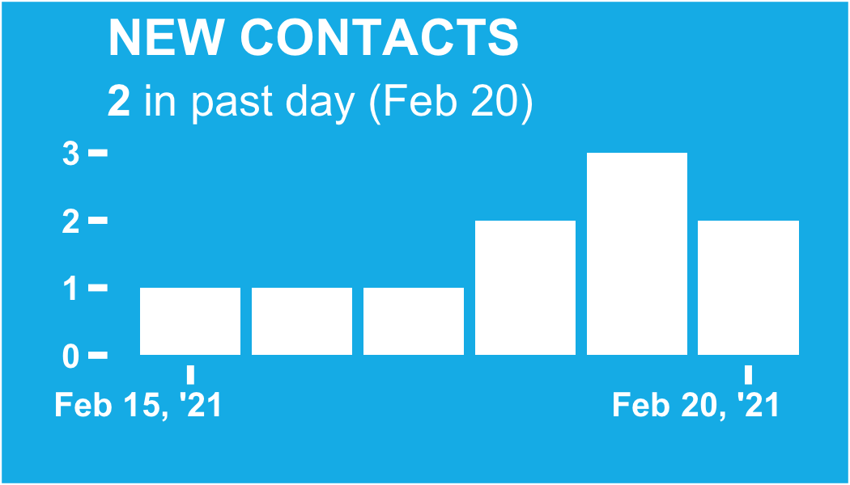

Slide 4
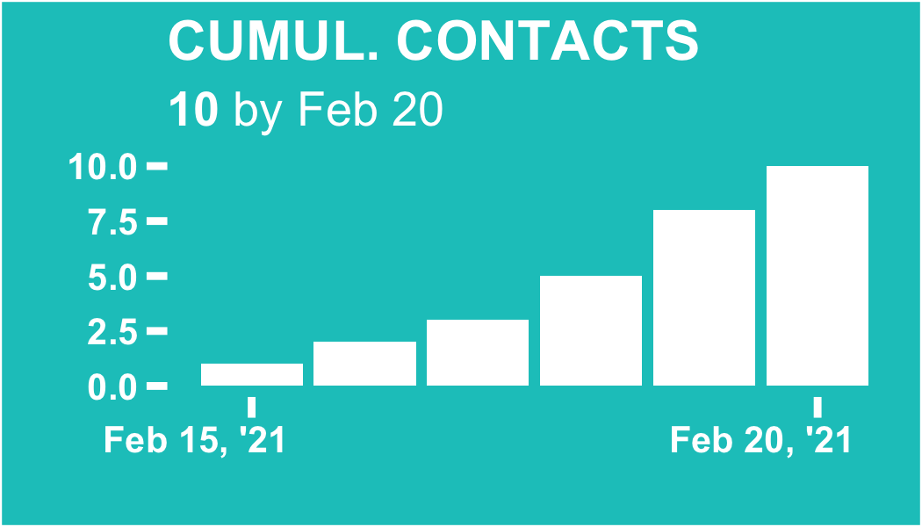

Slide 5
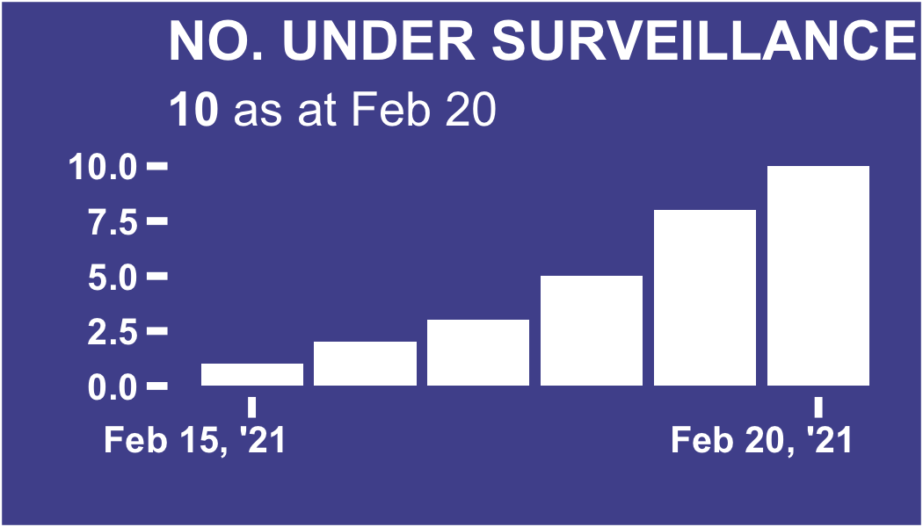

Slide 6
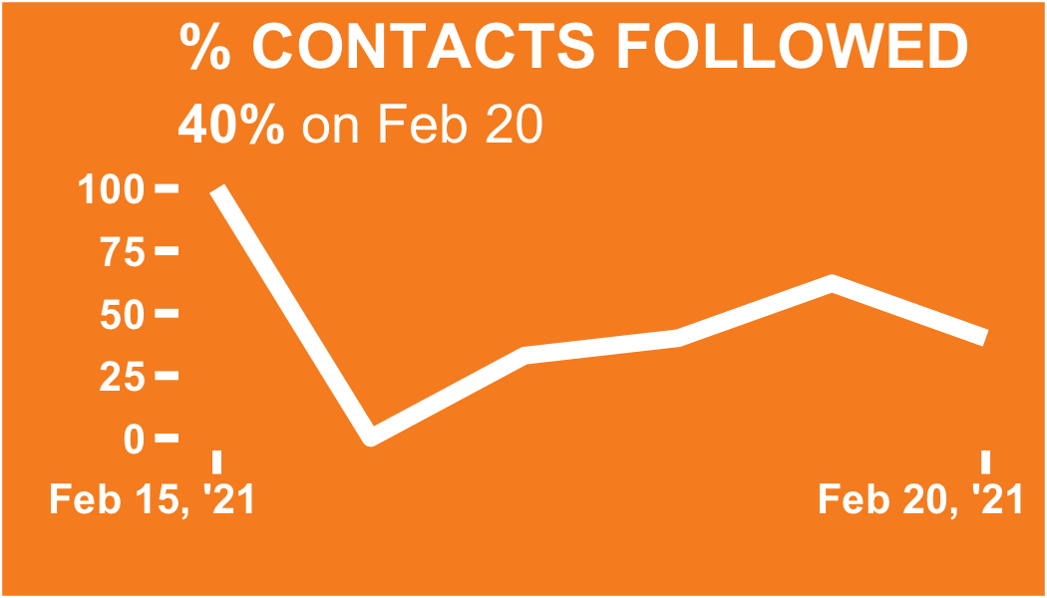

Slide 7
DATA PERTAINING TO ALL CONTACTS

Slide 8
Regional breakdown

Slide 9
Regional breakdown bar chart

Slide 10
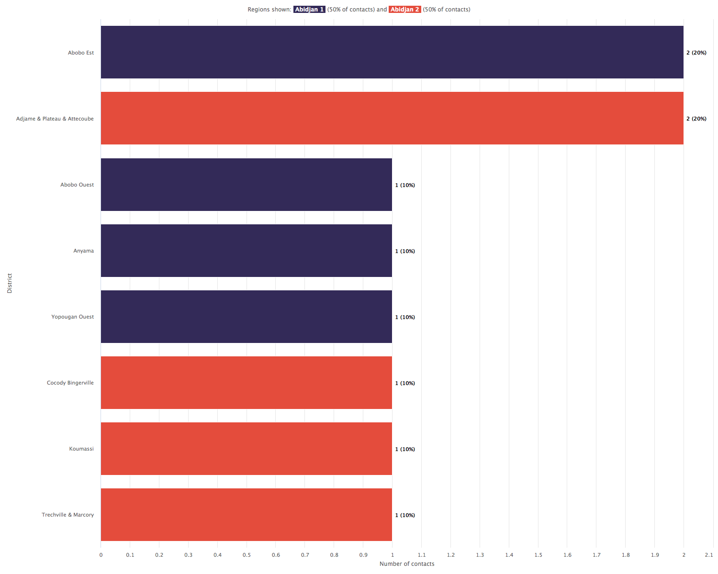

Slide 11
Regional breakdown sunburst plot

Slide 12
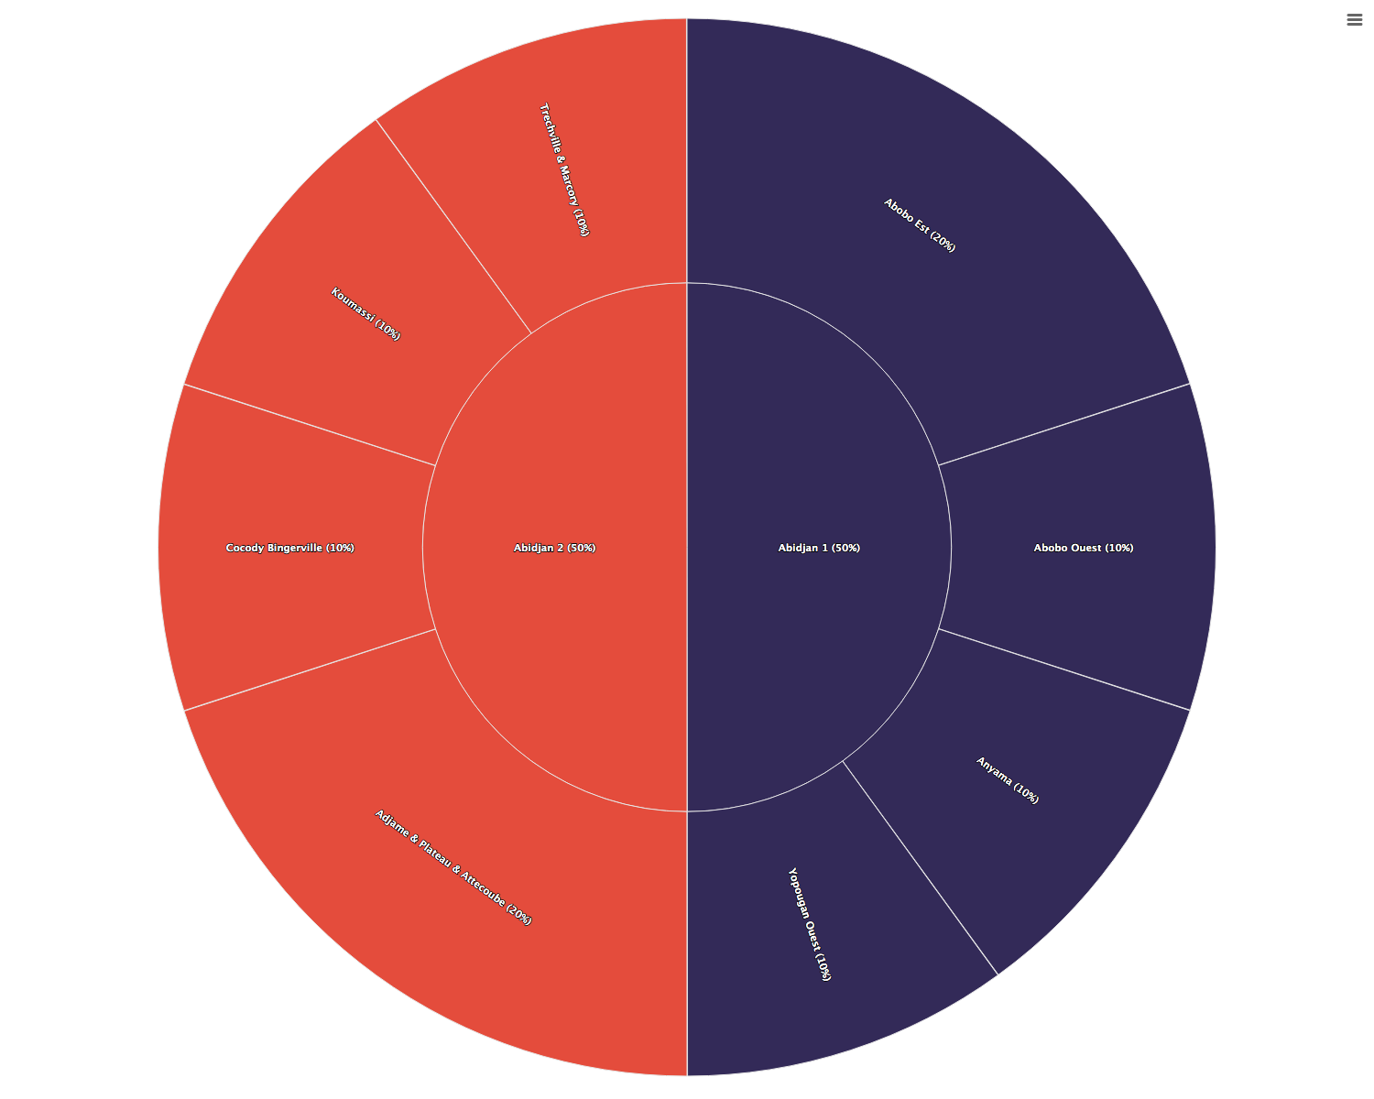

Slide 13
Regional breakdown table

Slide 14
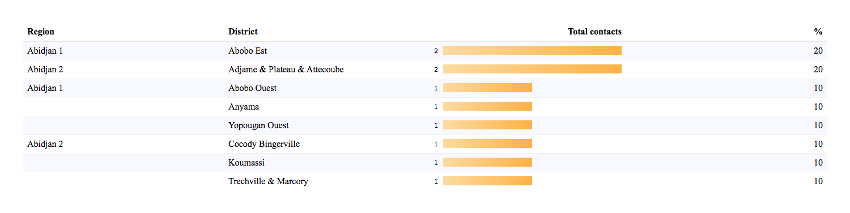

Slide 15
Regional trends

Slide 16
Regional trends absolute counts

Slide 17
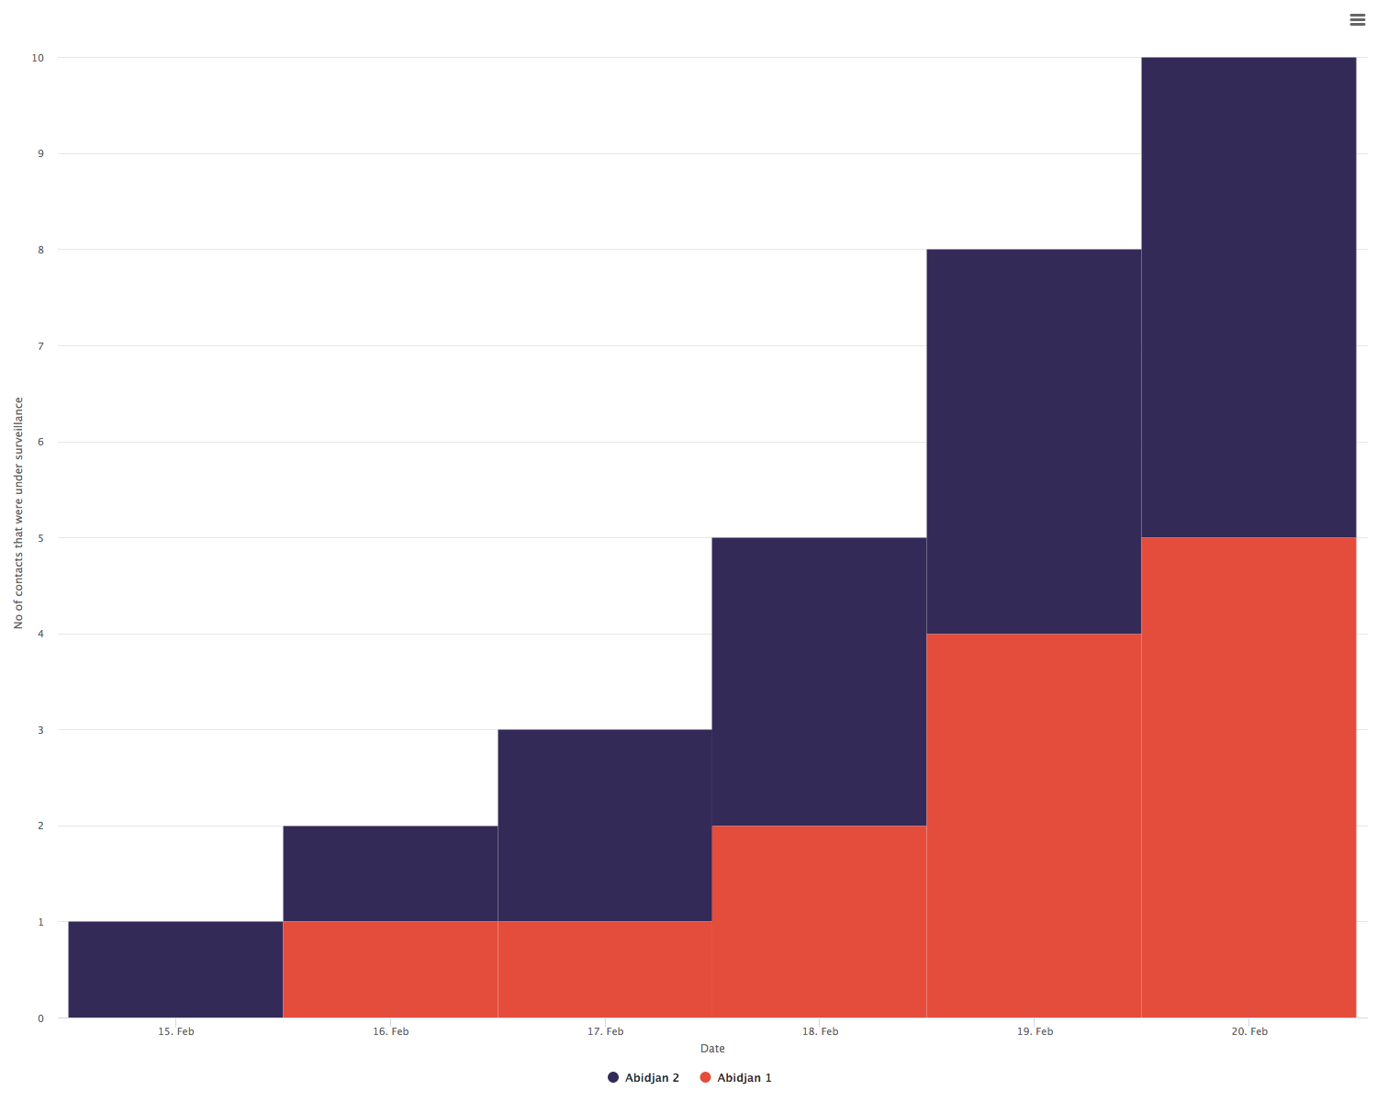

Slide 18
Regional trends relative proportions

Slide 19
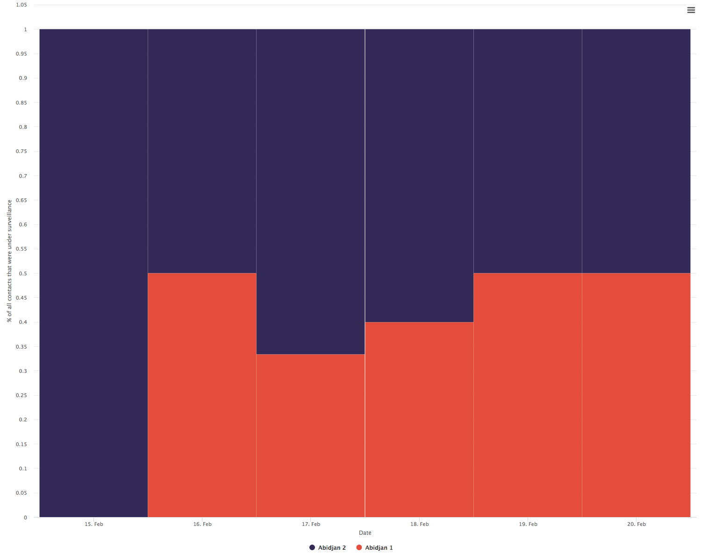

Slide 20
Contacts per case

Slide 21
Contacts per case donut plot

Slide 22
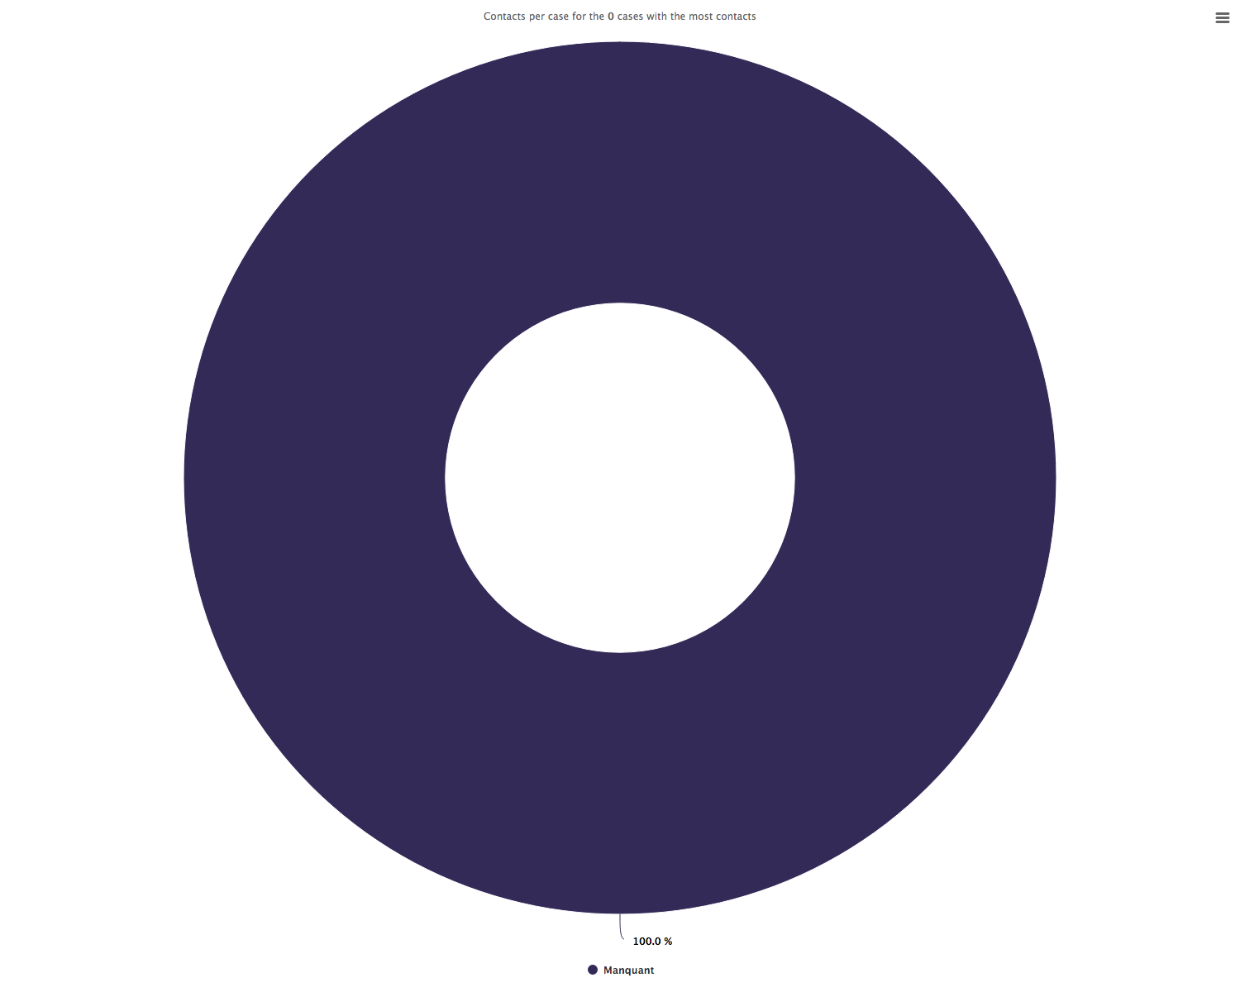

Slide 23
Contacts per case bar chart

Slide 24
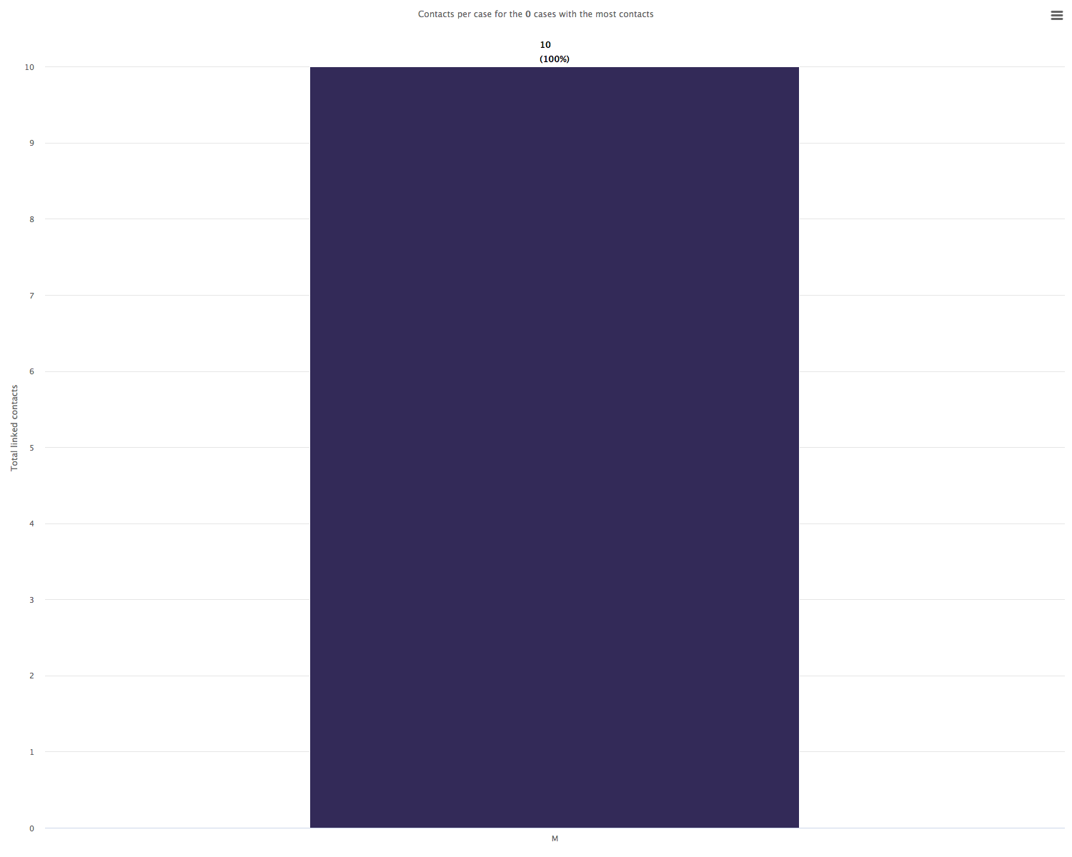

Slide 25
Case-contact relationships

Slide 26
Case-contact relationships donut plot

Slide 27
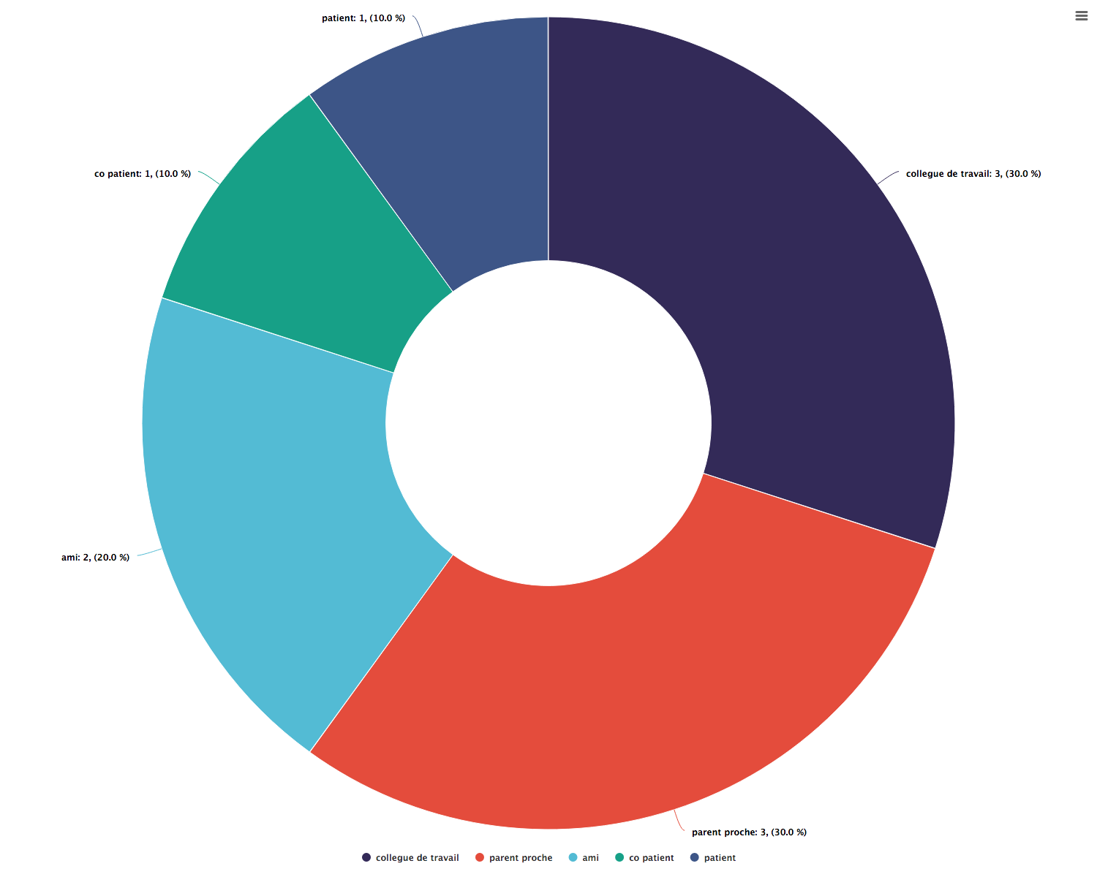

Slide 28
Case-contact relationships bar chart

Slide 29
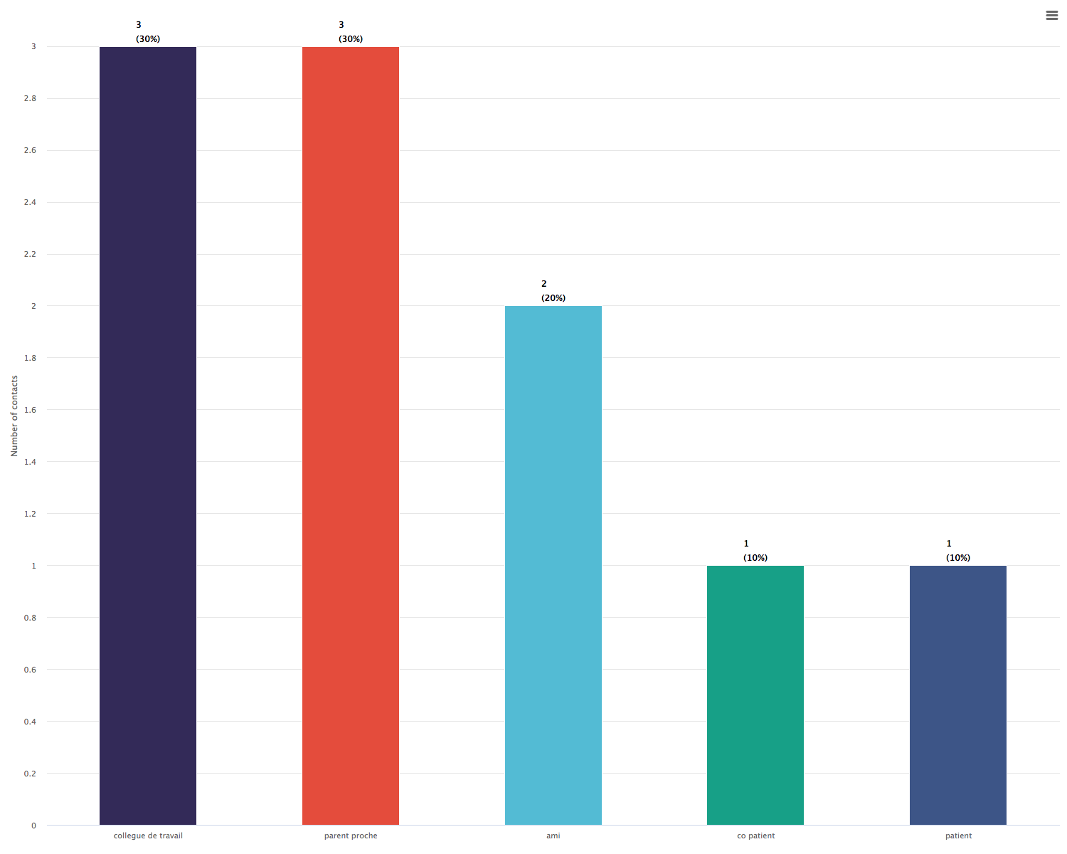

Slide 30
DATA PERTAINING TO ACTIVE CONTACTS

Slide 31
Follow-up timelines

Slide 32
Follow-up summary bar chart

Slide 33
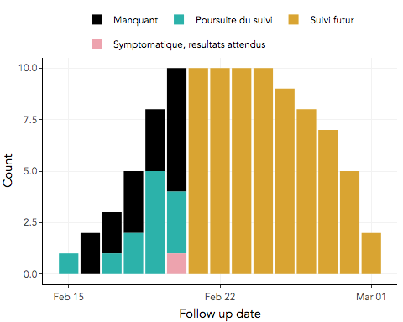

Slide 34
Follow-up timeline snake plot

Slide 35
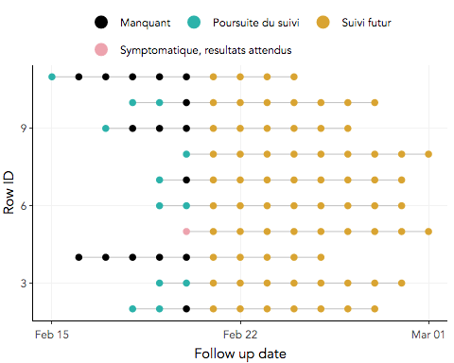

Slide 36
Contacts not seen recently

Slide 37
Loss to follow-up, past 3 days
List of contacts not seen

Slide 38
