Slide 1
COVID-19 Contact Tracing Report

Slide 2
VALUE BOX SUMMARIES

Slide 3
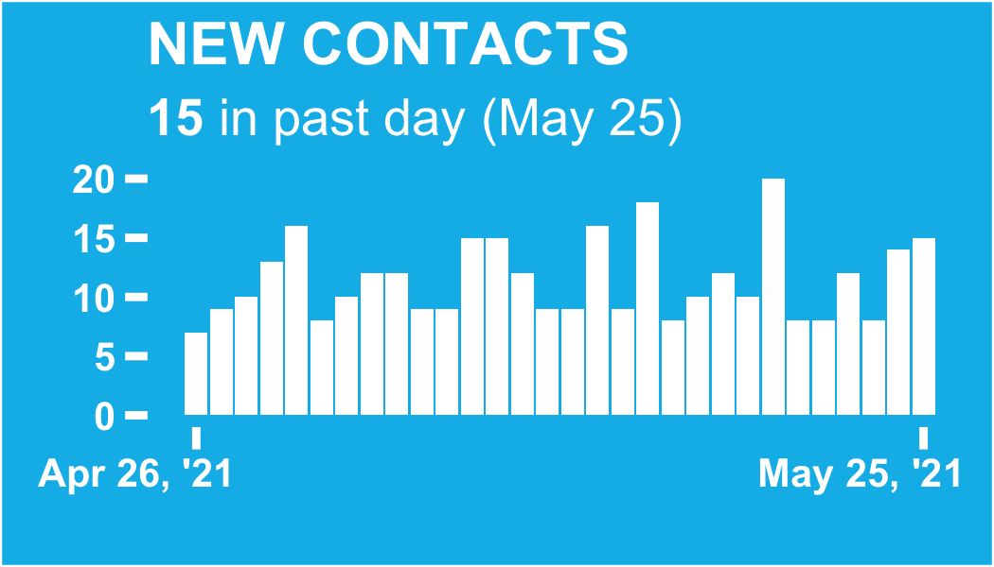

Slide 4
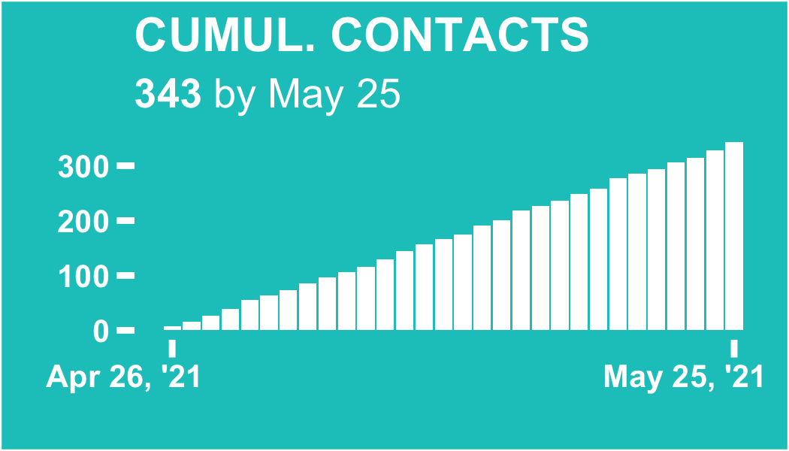

Slide 5
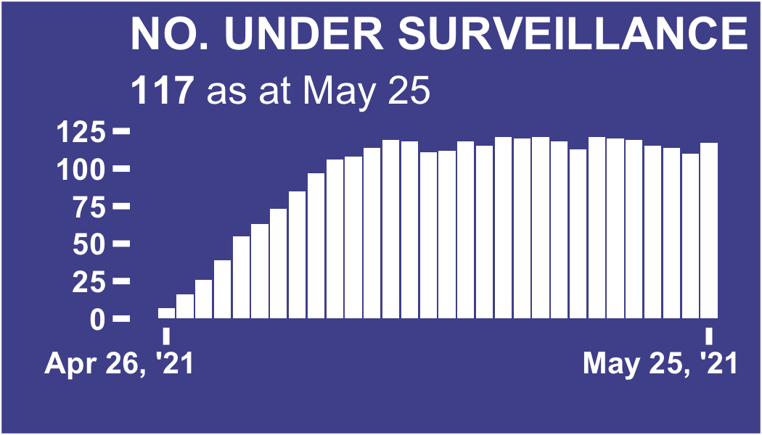

Slide 6
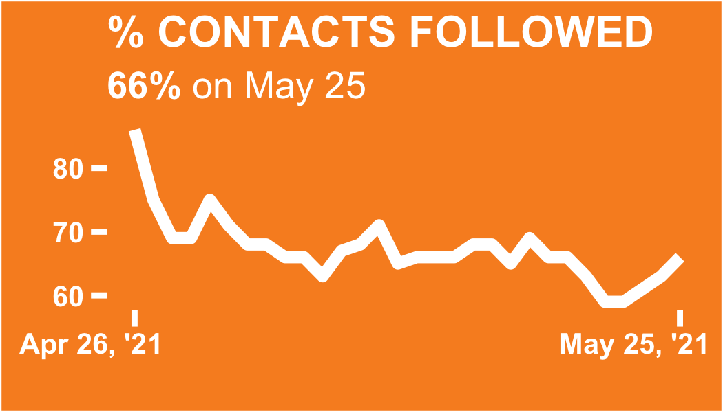

Slide 7
New contacts (starting follow-up on May 25, 2021)

Slide 8
ℹ: The table and plots show the count of the new contacts (contacts commencing follow-up) on the selected date of review. Follow-up begins the day after the last interaction with a confirmed or suspected case
The level 1 division with the most new contacts in the past day is Big City, with 10 contacts (66.7% of the total)

Slide 9
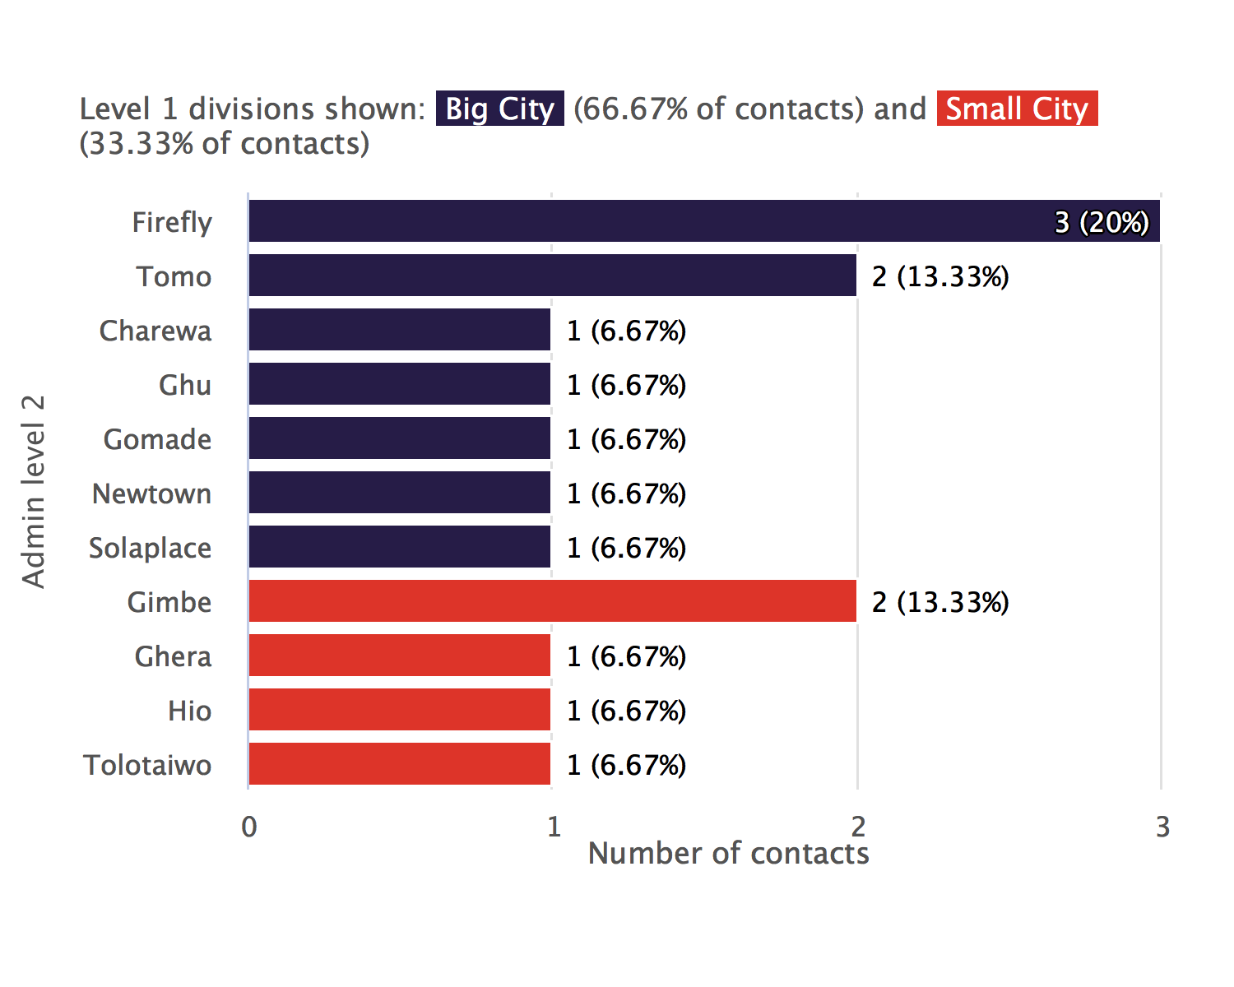
New contacts bar chart

Slide 10
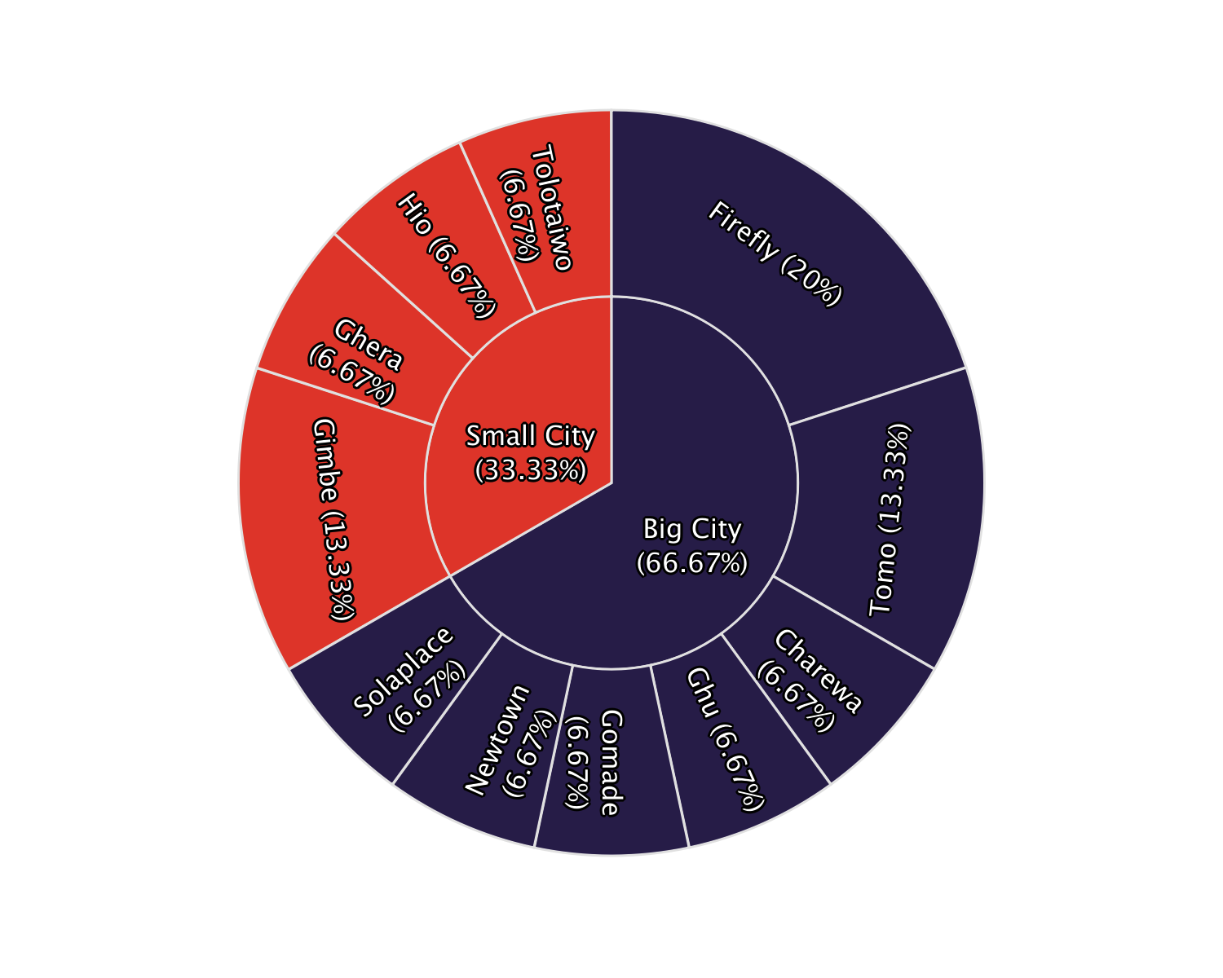
New contacts sunburst plot

Slide 11
New contacts table
Admin level 1 | Admin level 2 | New contacts today | %
Big City | Firefly | 3 | 20
Big City | Tomo | 2 | 13.3
Big City | Charewa | 1 | 6.67
Big City | Ghu | 1 | 6.67
Big City | Gomade | 1 | 6.67
Big City | Newtown | 1 | 6.67
Big City | Solaplace | 1 | 6.67
Small City | Gimbe | 2 | 13.3
Small City | Ghera | 1 | 6.67
Small City | Hio | 1 | 6.67
Small City | Tolotaiwo | 1 | 6.67
Total | - | 15 | 100

Slide 12
New contacts, trend over time

Slide 13
ℹ: The plots show the number of new contacts on each day, that is, the number of contacts on their first day of follow-up.
The day on which the highest number of new contacts commenced follow-up was May 19, 2021, with 20 contacts that day.

Slide 14
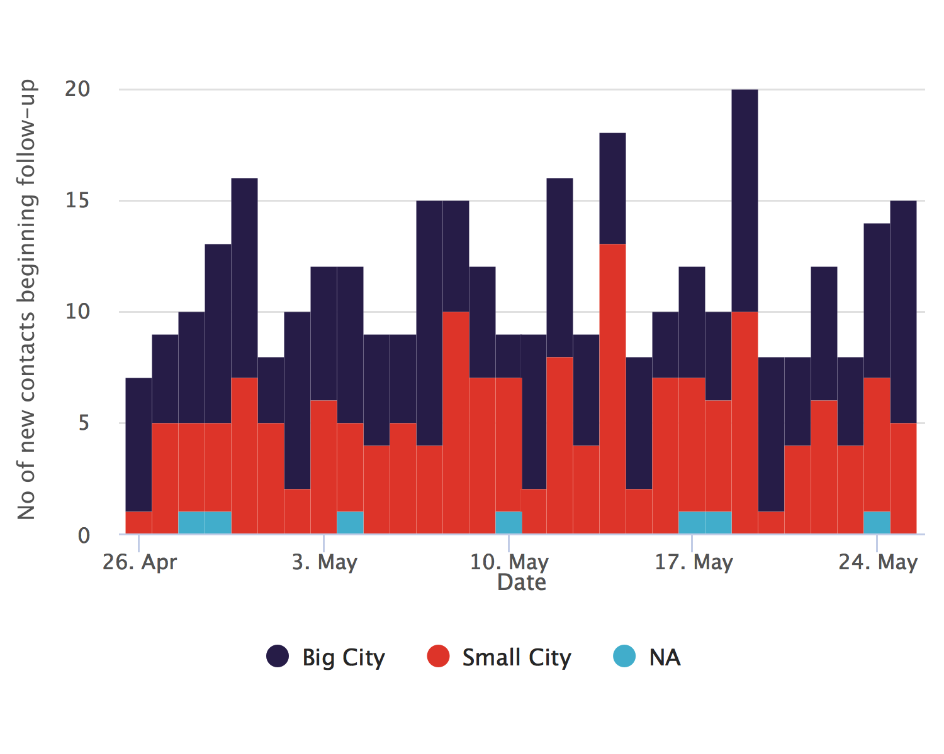
Absolute numbers

Slide 15
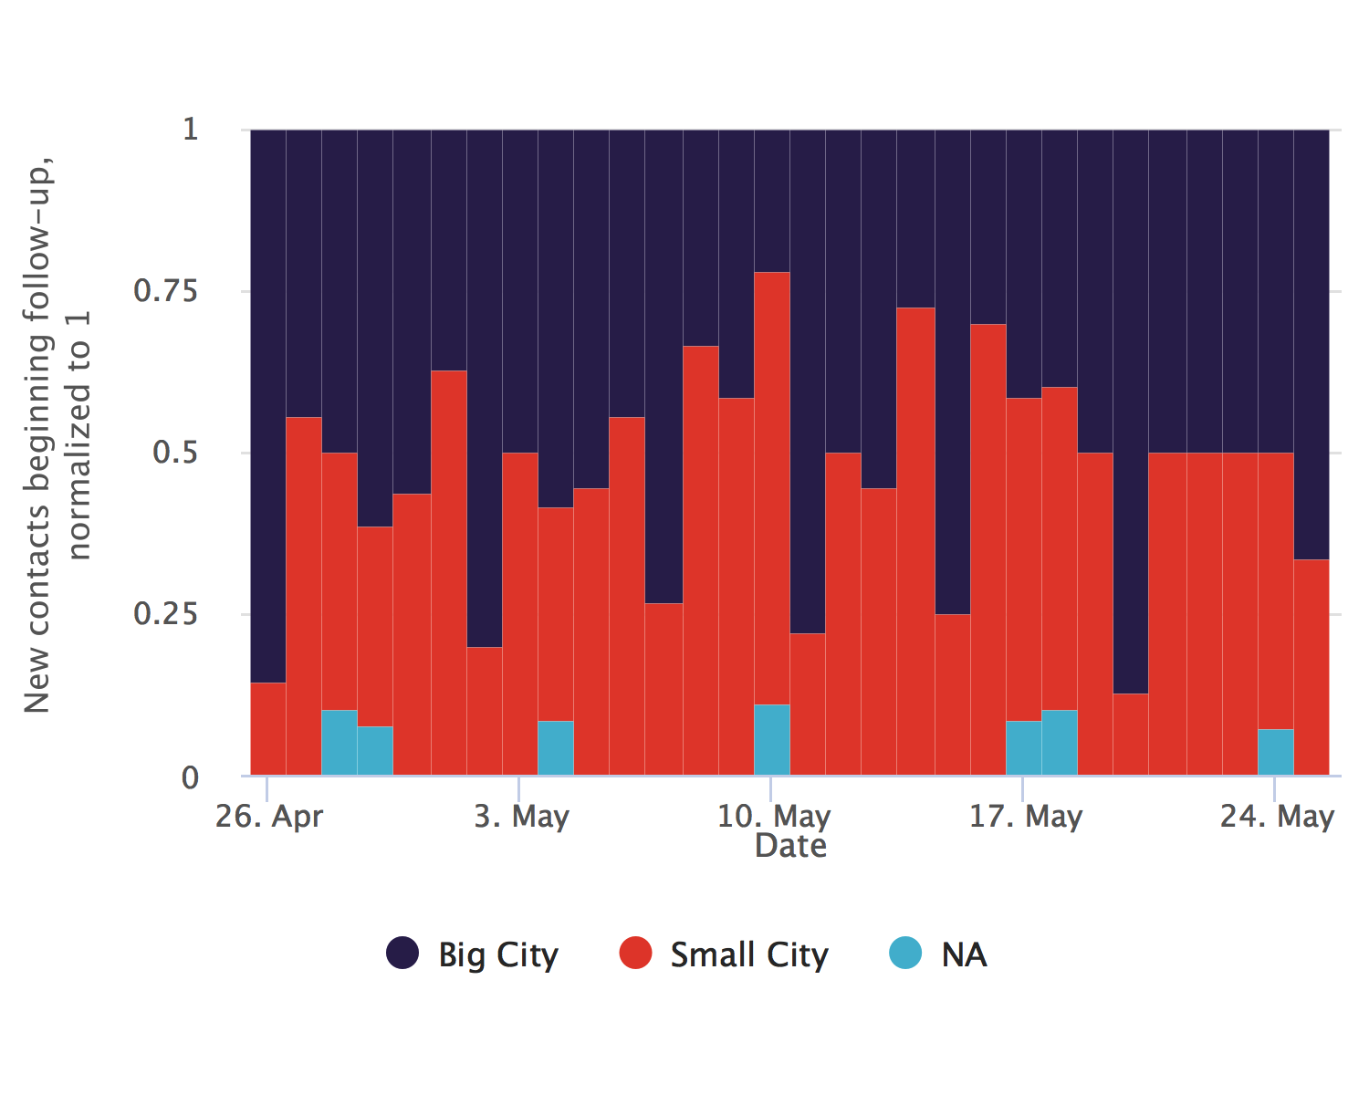
Relative proportions

Slide 16
Total/cumulative contacts (as at May 25, 2021)

Slide 17
ℹ: The table and plots show the count of all contacts recorded in each level 1 division since database inception.
The level 1 division with the most total contacts since database inception is Big City, with 179 contacts (52.2% of the total)

Slide 18
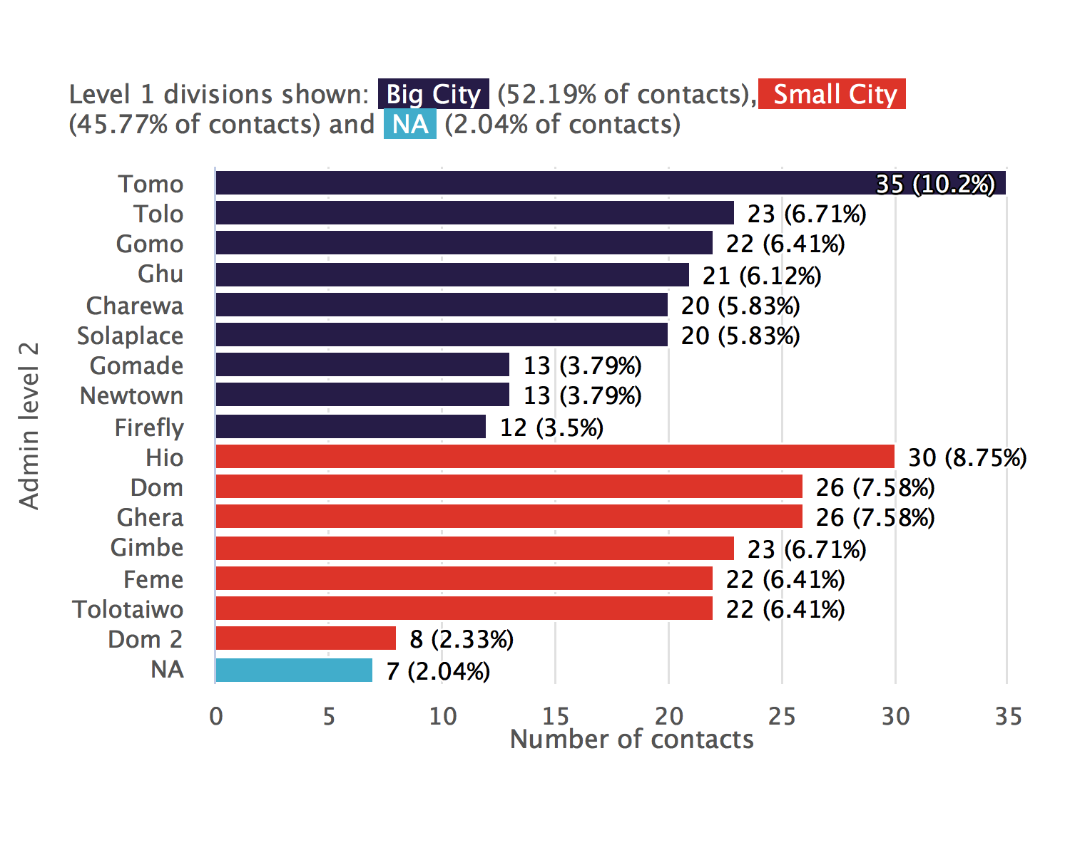
Cumulative contacts bar chart

Slide 19
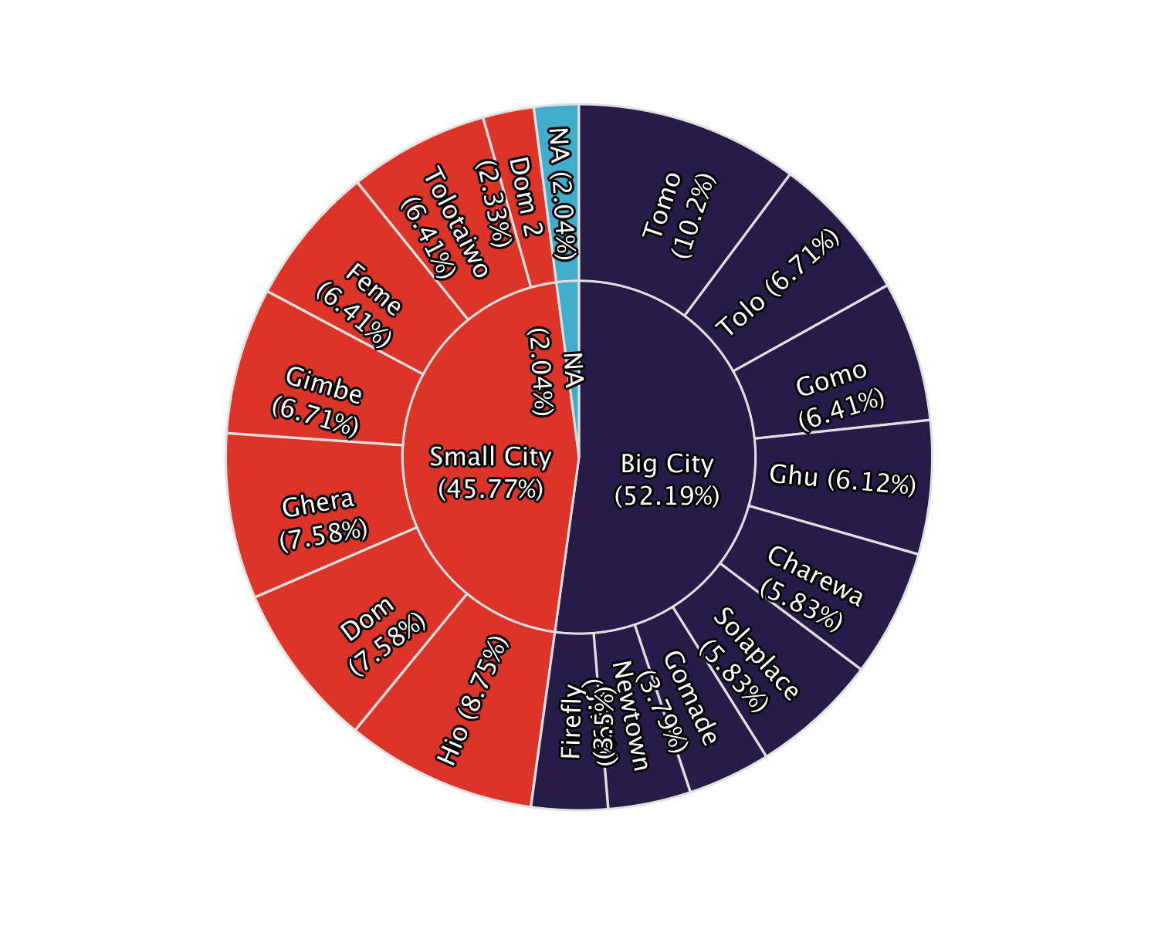
Cumulative contacts sunburst plot

Slide 20
Cumulative contacts table
Admin level 1 | Admin level 2 | Total contacts | %
Big City | Tomo | 35 | 10.2
Big City | Tolo | 23 | 6.71
Big City | Gomo | 22 | 6.41
Big City | Ghu | 21 | 6.12
Big City | Charewa | 20 | 5.83
Big City | Solaplace | 20 | 5.83
Big City | Gomade | 13 | 3.79
Big City | Newtown | 13 | 3.79
Big City | Firefly | 12 | 3.5
Small City | Hio | 30 | 8.75
Small City | Dom | 26 | 7.58
Small City | Ghera | 26 | 7.58
Small City | Gimbe | 23 | 6.71
Small City | Feme | 22 | 6.41
Small City | Tolotaiwo | 22 | 6.41
Small City | Dom 2 | 8 | 2.33
NA | NA | 7 | 2.04
Total | - | 343 | 100

Slide 21
Total/cumulative contacts, trend over time

Slide 22
ℹ: The table and plots show the count of cumulative contacts over time.
Today, Big City has a cumulative count of 179 contacts. Seven days ago, there were 141 contacts (a 27 % increase)

Slide 23
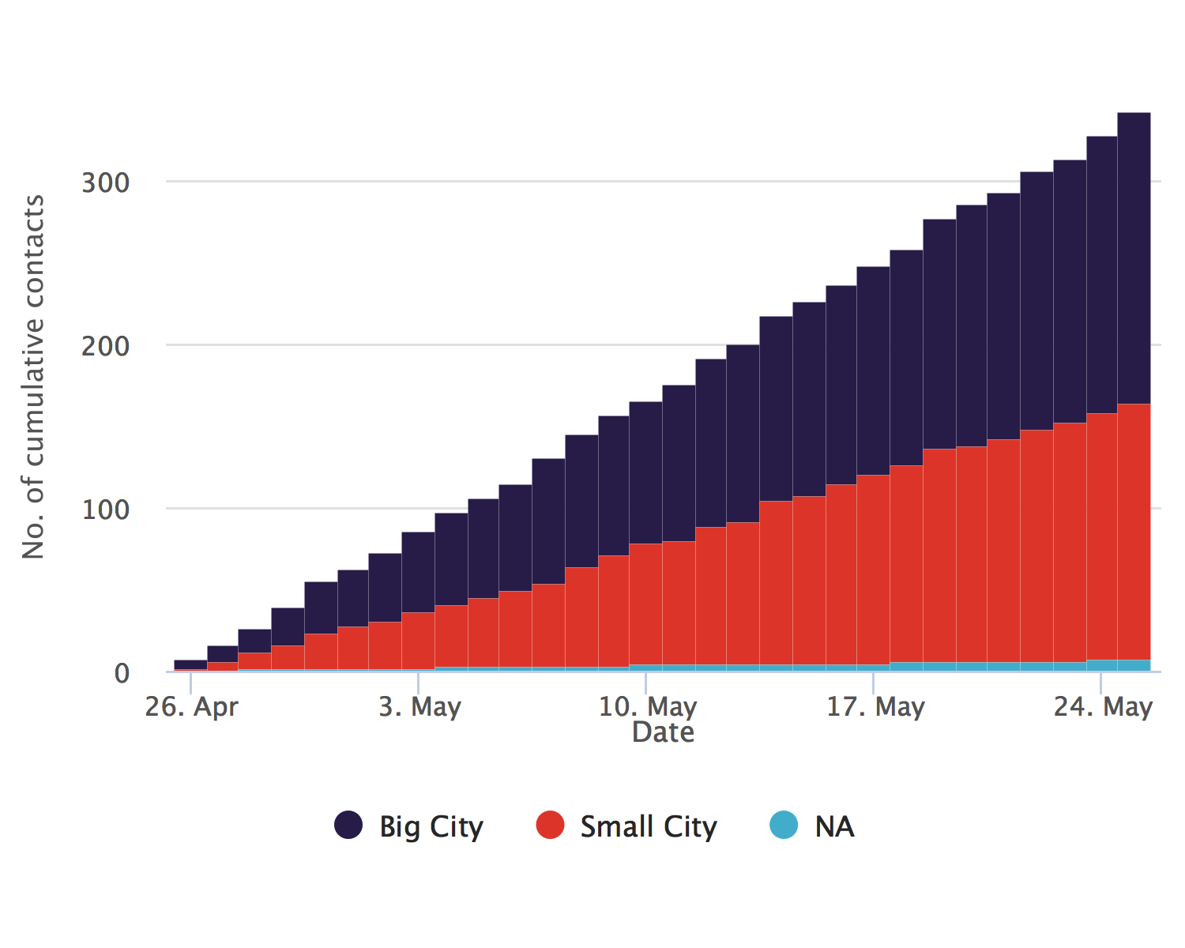
Absolute numbers

Slide 24
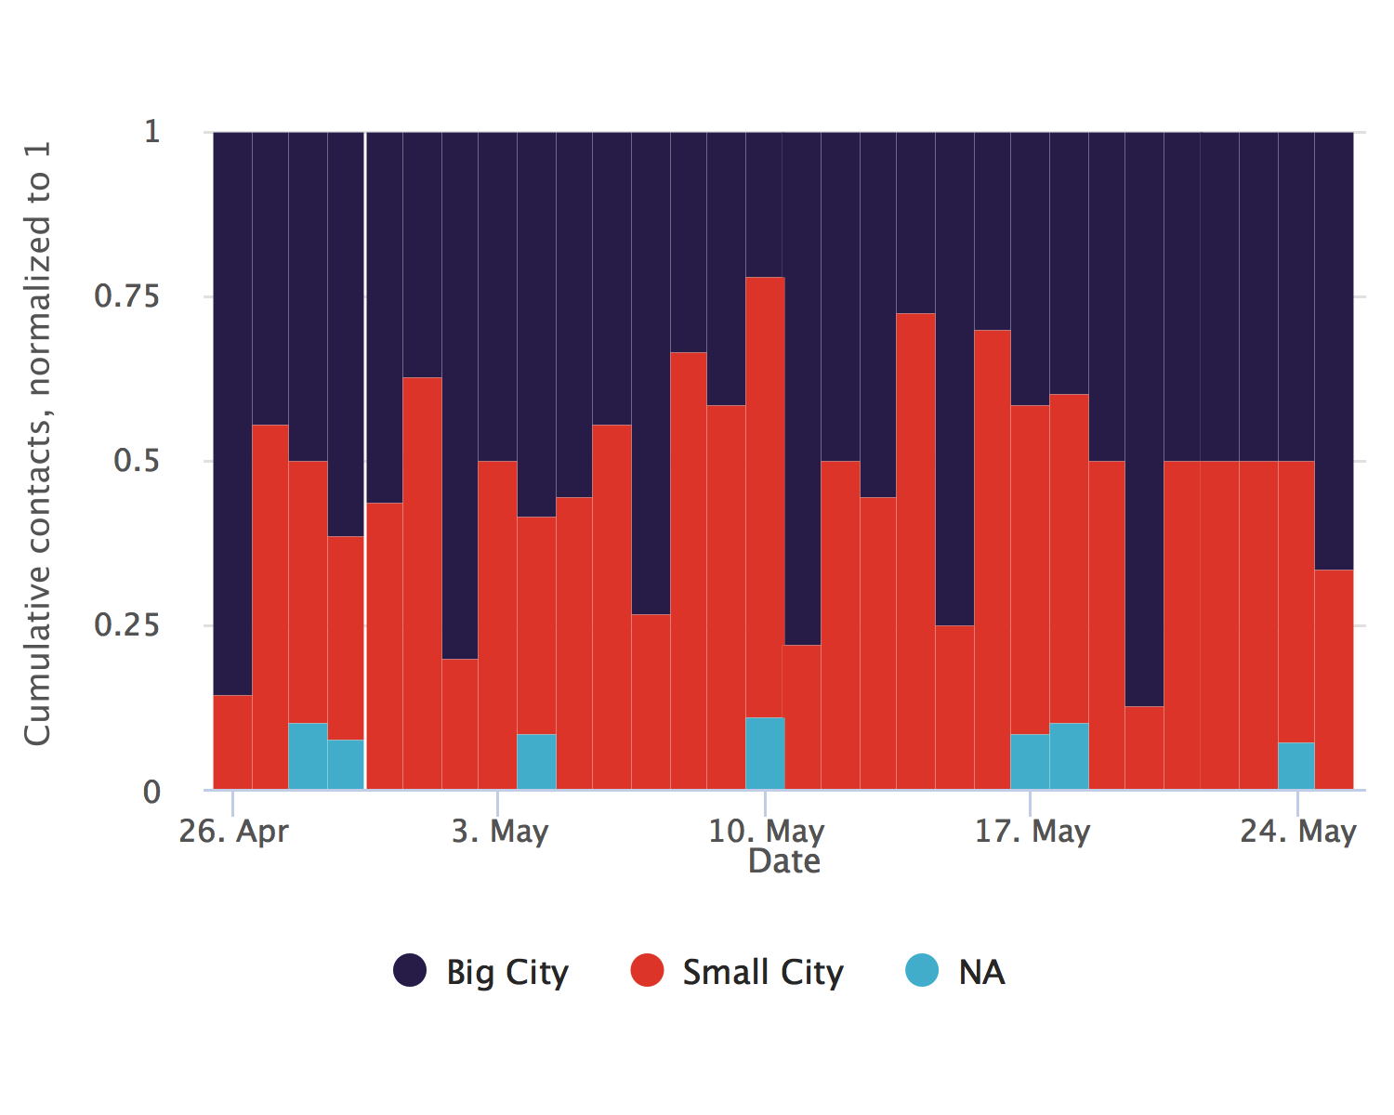
Relative proportions

Slide 25
Contacts under surveillance (as at May 25, 2021)

Slide 26
ℹ: The table and plots show the count of contacts currently under follow-up.
The level 1 division with the most contacts under surveillance at present is Big City, with 179 contacts (52.2% of the total)

Slide 27
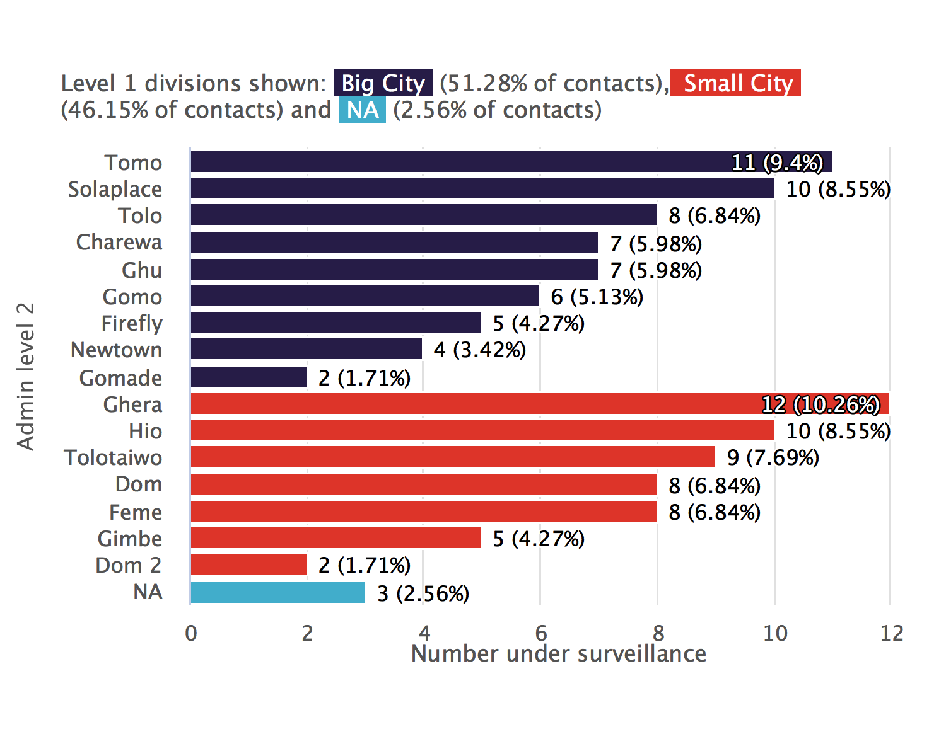
Contacts under surveillance bar chart

Slide 28
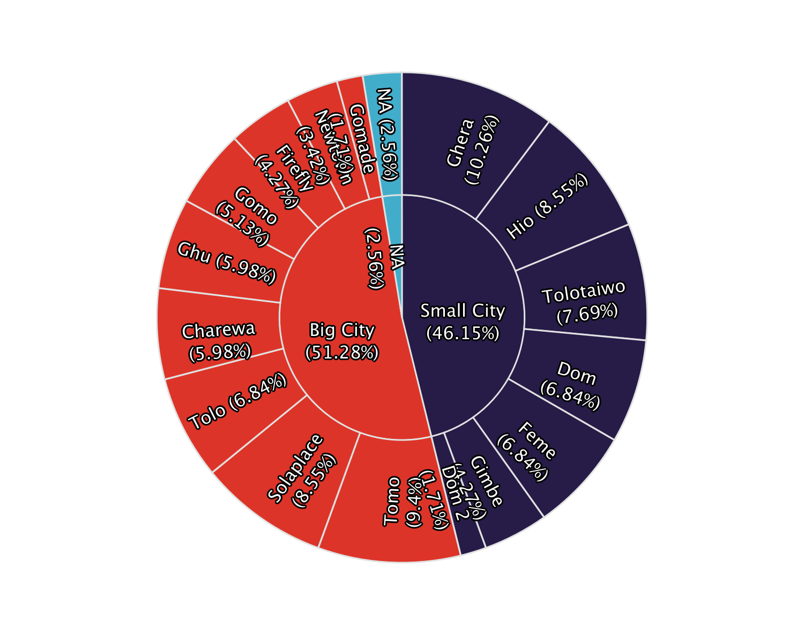
Contacts under surveillance sunburst plot

Slide 29
Contacts under surveillance table
Admin level 1 | Admin level 2 | No. under surveillance | %
Big City | Tomo | 11 | 9.4
Big City | Solaplace | 10 | 8.55
Big City | Tolo | 8 | 6.84
Big City | Charewa | 7 | 5.98
Big City | Ghu | 7 | 5.98
Big City | Gomo | 6 | 5.13
Big City | Firefly | 5 | 4.27
Big City | Newtown | 4 | 3.42
Big City | Gomade | 2 | 1.71
Small City | Ghera | 12 | 10.3
Small City | Hio | 10 | 8.55
Small City | Tolotaiwo | 9 | 7.69
Small City | Dom | 8 | 6.84
Small City | Feme | 8 | 6.84
Small City | Gimbe | 5 | 4.27
Small City | Dom 2 | 2 | 1.71
NA | NA | 3 | 2.56
Total | - | 117 | 100

Slide 30
Contacts under surveillance, trend over time

Slide 31
ℹ: The plots show the number of contacts under surveillance on each day, whether or not they were successfully contacted.
The day on which the highest number contacts were under surveillance was May 14, 2021, with 121 contacts under surveillance.

Slide 32
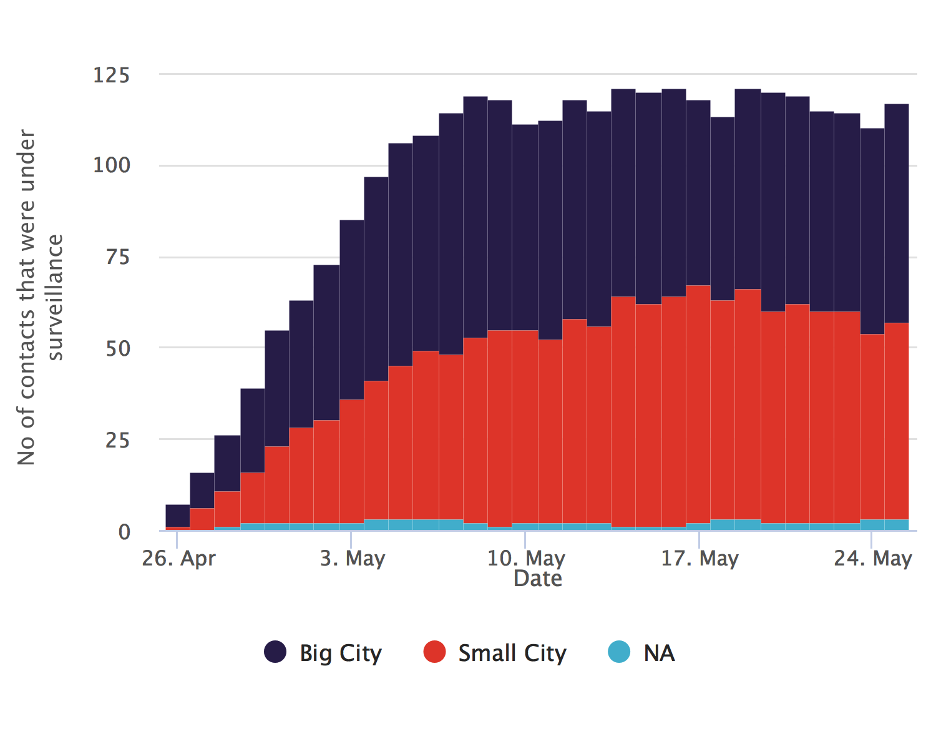
Absolute numbers

Slide 33
Relative proportions

Slide 34
Contacts per case

Slide 35
ℹ: The plots show the number of contacts linked to each case.
The median number of contacts per case is 8, (IQR:15-14) with a minimum of 1 and a maximum of 16

Slide 36
Contacts per case, table
Contacts per case for the 20 cases with the most contacts
Case ID | Total linked contacts
Manquant | 16
CAS20 | 15
CAS15 | 14
CAS19 | 14
CAS34 | 14
CAS29 | 13
CAS8 | 13
CAS21 | 12
CAS25 | 12
CAS38 | 12
CAS1 | 11
CAS7 | 11
CAS9 | 11
CAS36 | 10
CAS14 | 9
CAS26 | 9
CAS3 | 9
CAS39 | 9
CAS5 | 9
CAS10 | 8

Slide 37
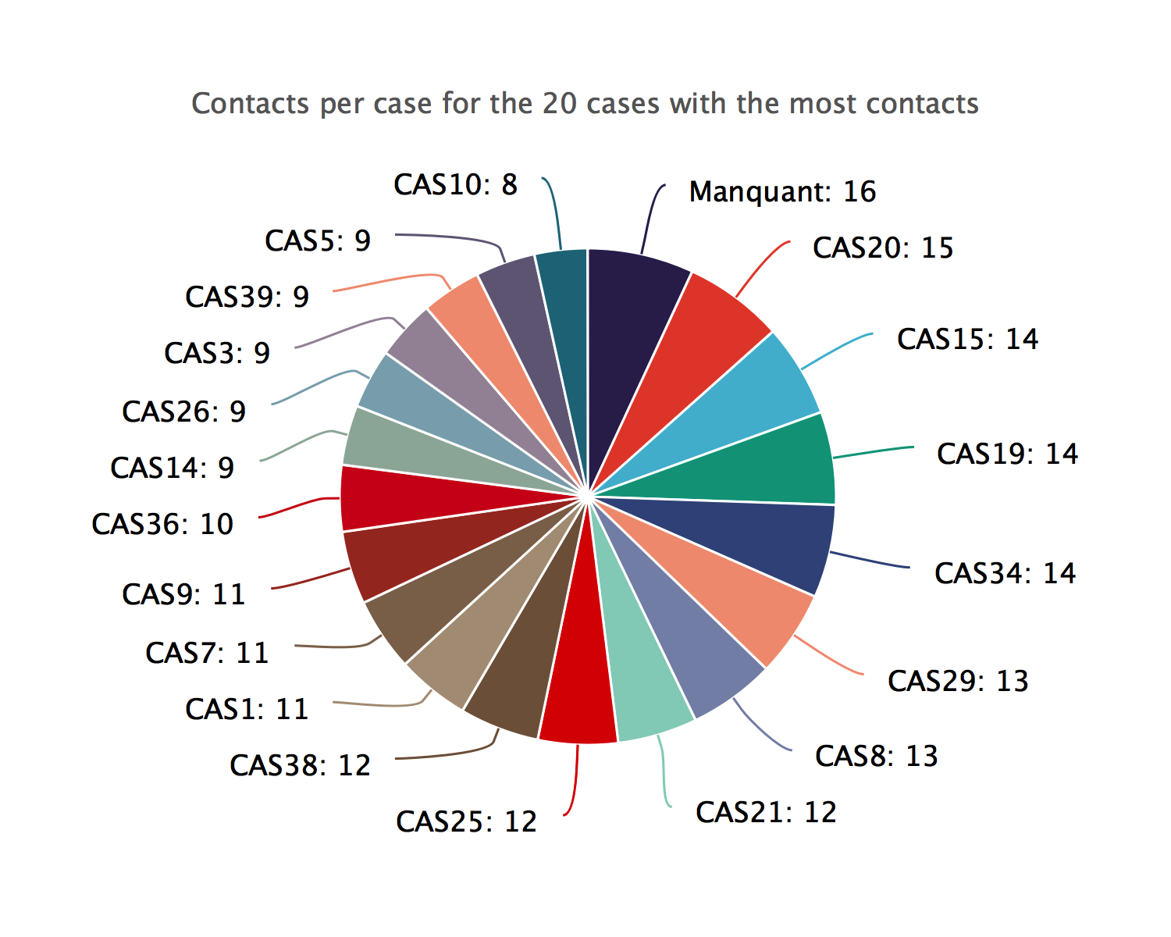
Contacts per case, donut plot

Slide 38
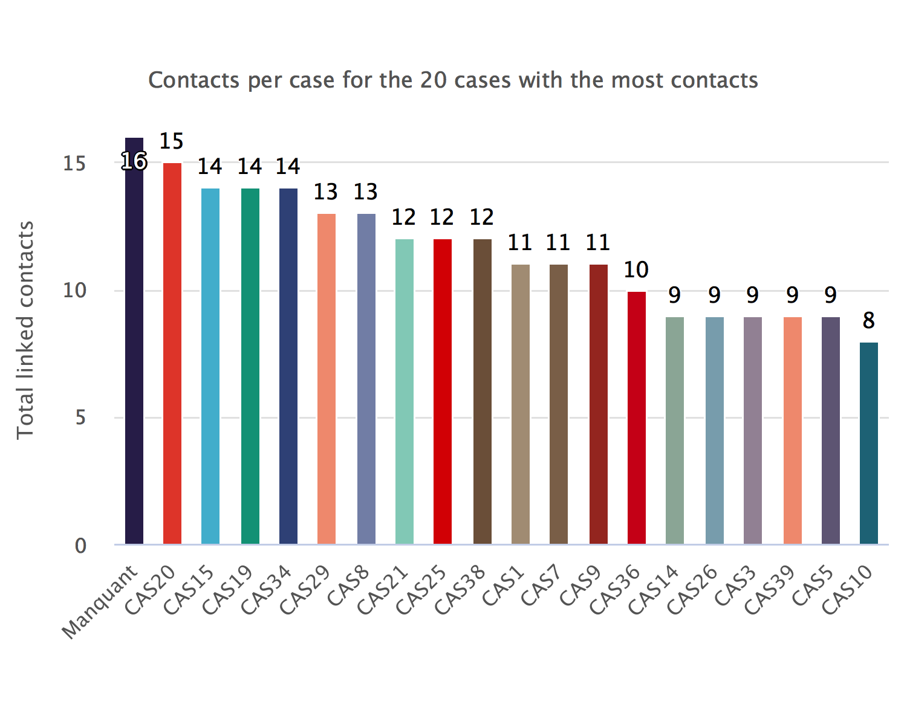
Contacts per case, bar chart

Slide 39
Case-contact relationships

Slide 40
ℹ: The plots show the number of contacts per type of link. The categories have been cleaned and condensed. Access the data in tabular form by clicking on the top-right button.
The most common link category is ‘parent proche’, with 53 contacts (15.45%).

Slide 41
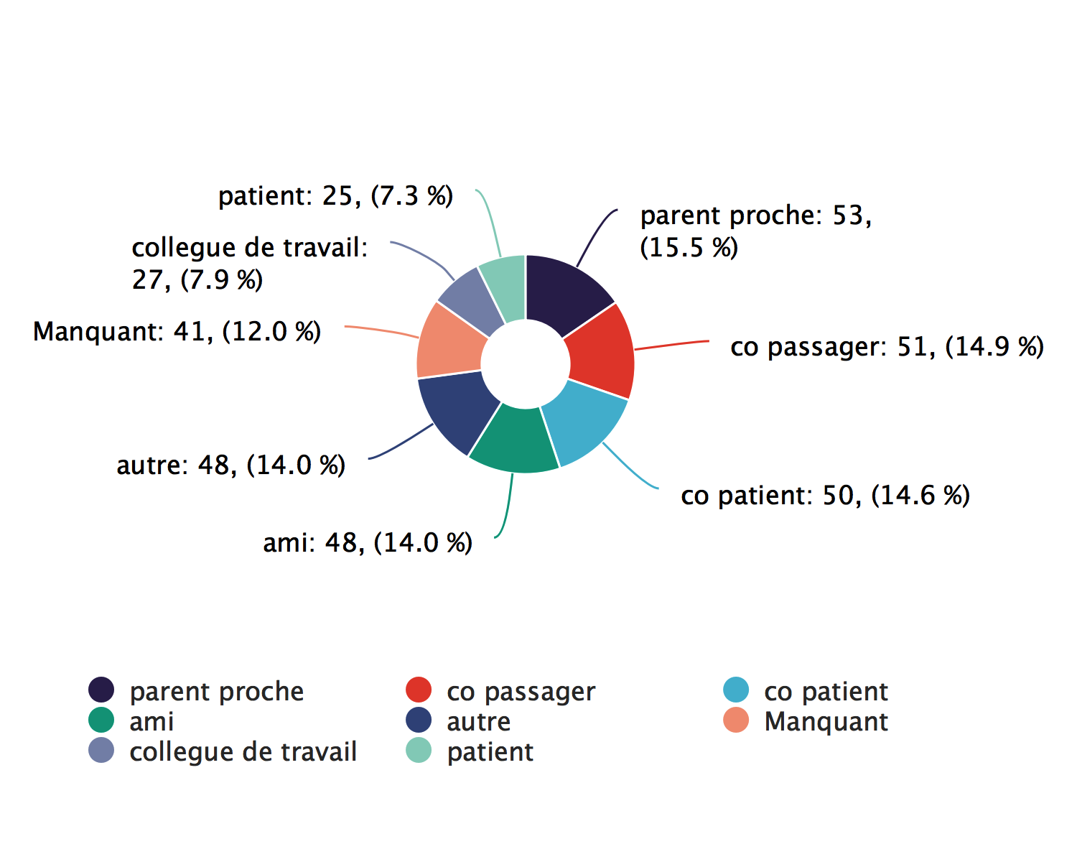
Case-contact relationships, donut plot

Slide 42
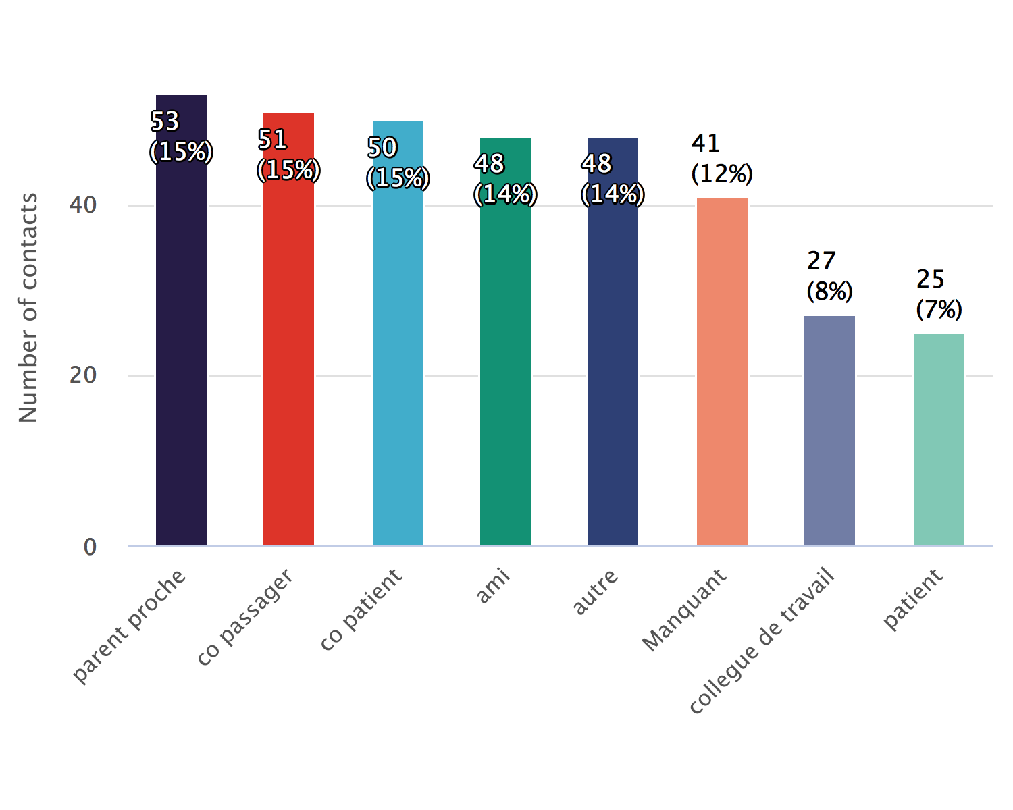
Case-contact relationships, bar chart

Slide 43
Follow-up timelines

Slide 44
ℹ: The plots track the status of each active contact over all 10 days of follow-up.
There are 117 active contacts

Slide 45
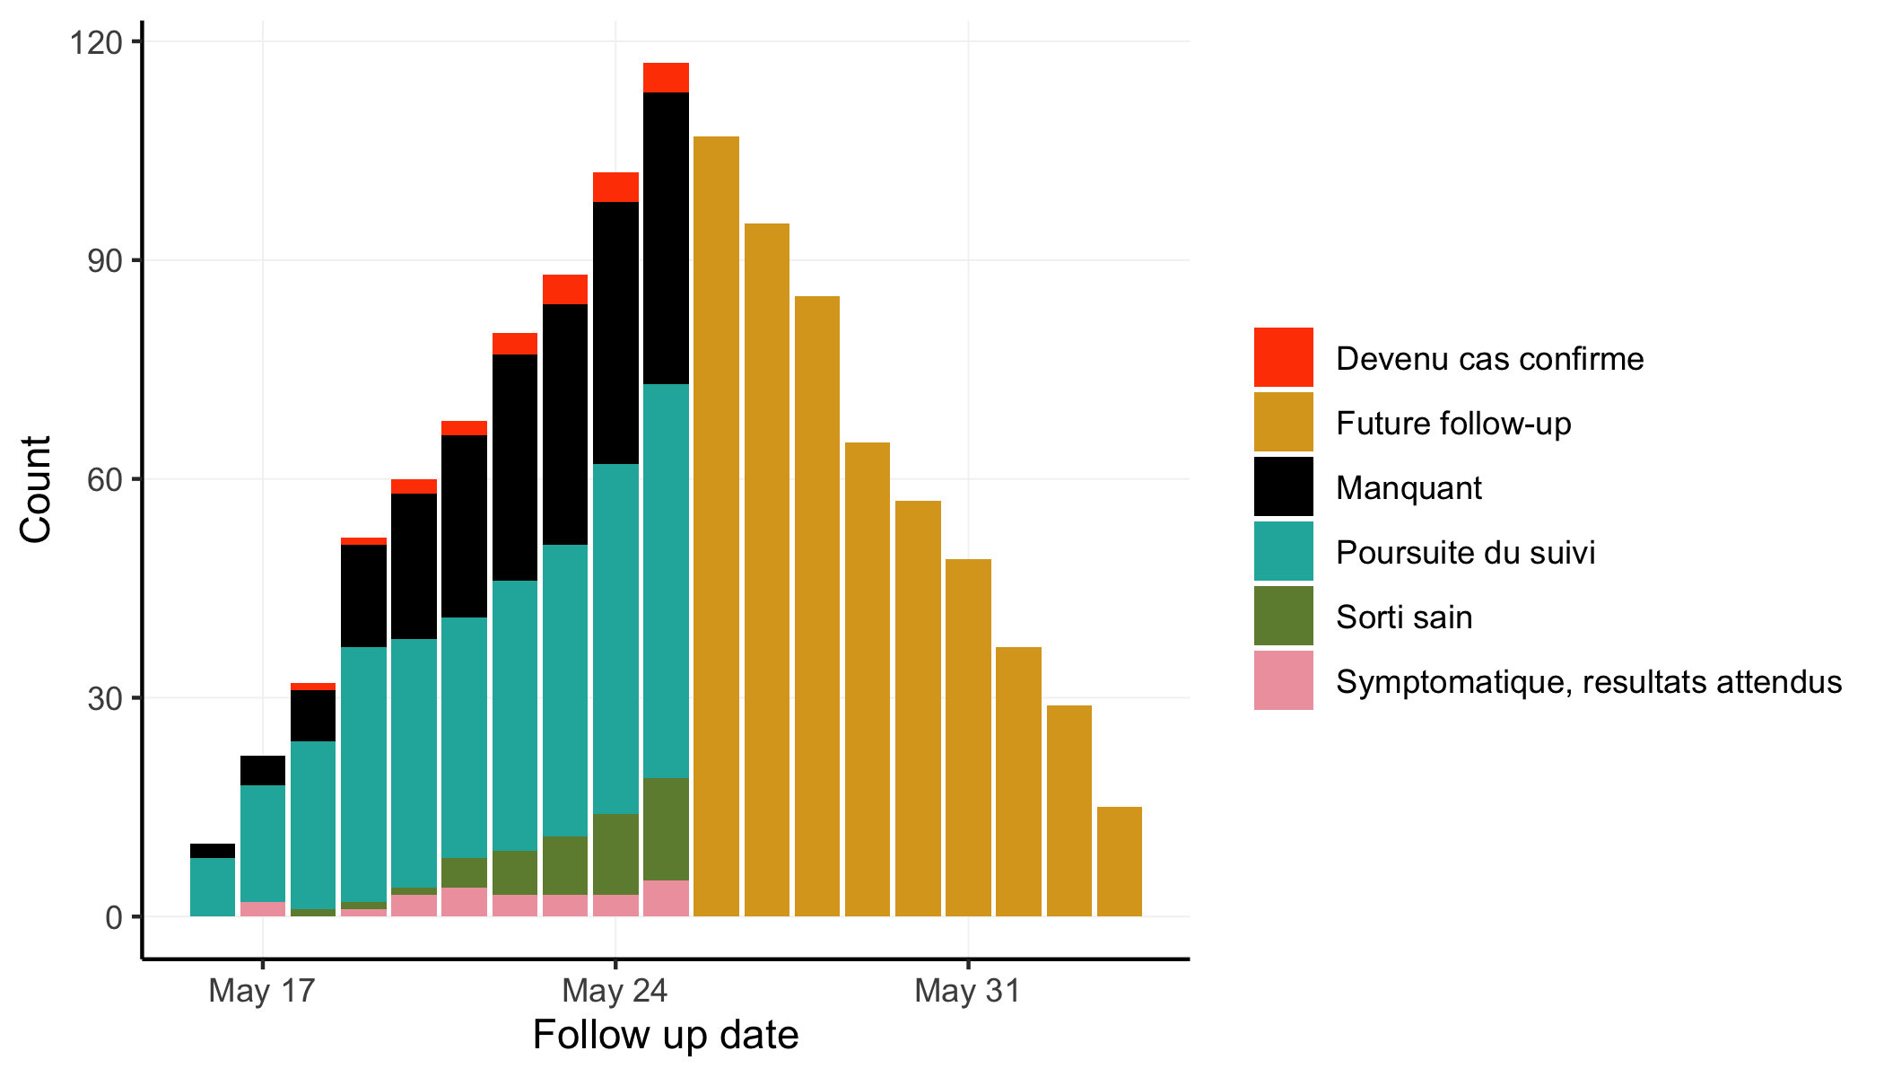
Follow-up summary bar chart

Slide 46
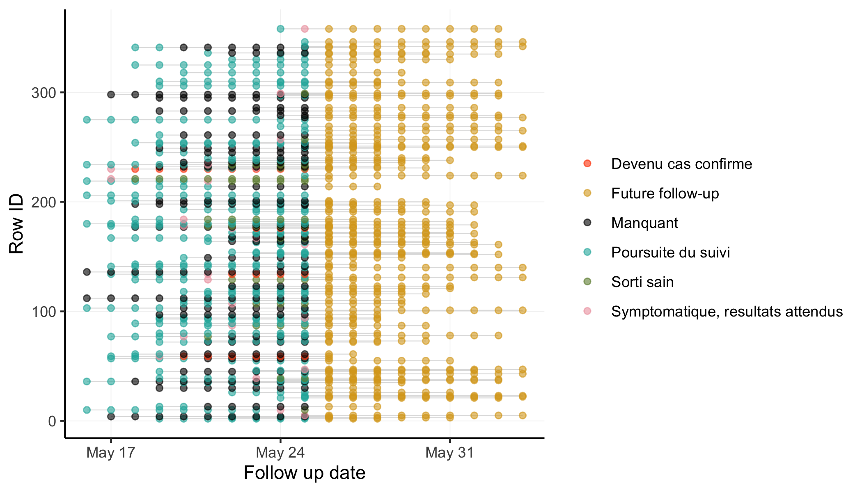
Follow-up timeline snake plot

Slide 47
Contacts not seen recently

Slide 48
ℹ: The tables track the contacts who should be under surveillance but have not been followed for an extended period.
4 contacts have not been seen for the past three days.

Slide 49
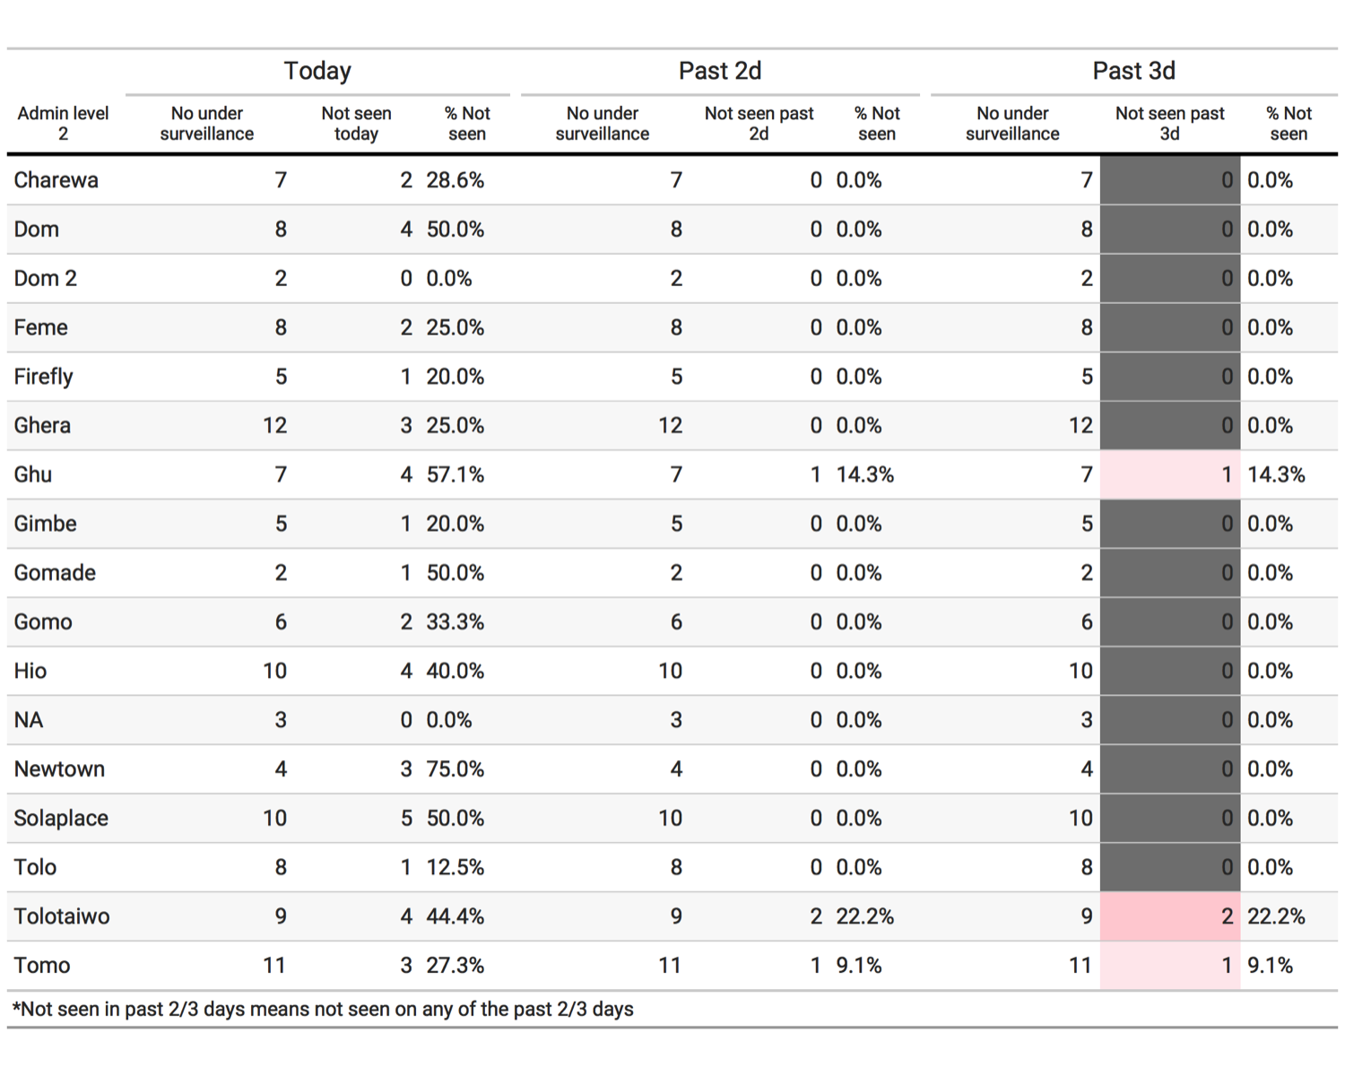
Loss to follow-up, past 3 days

Slide 50
List of contacts not seen
ID
Civ35
Civ102
Civ111
Civ135

