Slide 1
FOR THE TECHNICAL TEAM
The Grassroots
Technical overview
Architecture, the data model, the status engine, operations, and where the seams are if you intend to build on it.
◆ The data in every screenshot is invented. The seed is generated by tools/gen_seed.py purely to exercise the functions in testing and demos. Treat every figure as a fixture, never as a result.
github.com/thegrassroots/platform

Slide 2
ARCHITECTURE
There is no application server
The browser downloads a handful of static files and does everything locally: it builds the database, computes every status, projects the map and renders every chart. Every other fact about this platform follows from that one decision.
index.html App shell — classic <script> tags, no modules, no bundler
styles.css Visual system (light / dark)
schema.sql Canonical SQLite DDL — the source of truth for the model
data/world.js Simplified Natural Earth 110m outlines → window.WORLD
js/seed.js The sample database (~6.9 MB) → window.SEED
js/db.js IndexedDB store mirroring schema.sql → window.DB
js/app.js UI: map, projection, facets, insights, status engine
tools/gen_seed.py Regenerates js/seed.js (deterministic)
tools/proc_world.py Regenerates data/world.js from GeoJSON
One runtime dependency MapLibre GL JS 4.7.1, from unpkg, draws the basemap. Everything else is vanilla JavaScript against native browser APIs. Scripts load in dependency order — seed, db, app — each with a ?v= cache-busting token. Bump the token whenever you change a file, or returning browsers keep running the old copy.

Slide 3
THE STORE
"SQLite" without SQLite
Browsers have no SQLite engine, and the platform avoids heavyweight dependencies — which rules out sql.js and WASM. So js/db.js implements a relational store over IndexedDB, with a hot in-memory copy for fast joins and filters.
Compatible by construction
It round-trips
The API the UI reads
Identical tables, keys and columns to schema.sql. The DDL is real and loads directly: sqlite3 rbm.db < schema.sql
DB.exportSQL() emits INSERT statements that load into a database created from schema.sql. That is the exit route — there is no lock-in to argue about.
DB.tables.<table> is an array of plain objects per table; DB._idx carries the lookups. Note: there is no DB.all().
DB.tables.user // whole table, as objects
DB._idx.userByUsername // lookup by key
DB._idx.countryByIso
DB.insert / DB.persist / DB.remove

Slide 4
DATA MODEL
Thirteen tables, one results chain
result is self-referential via parent_id: an Impact has Outcomes, an Outcome has Outputs. Every primary KPI hangs off an Output. Plan-scoped vs universal. Results and projects carry a plan_id; the app scopes the whole view to one active plan. Countries, regions, users, donors and beneficiary measures are shared across every plan.
plan
region --< country
programme --< result (plan-scoped, self-referential:
| impact > outcome > output)
+--< indicator (baseline, target,
| means of verification)
+--< measurement (the activities)
Table | Holds | Table | Holds
plan | Development plans | project | Country-scoped, donor-funded
region | The six continents | result | Impact / Outcome / Output
country | All 237 countries | indicator | KPIs with baseline & target
programme | The 56 with projects | project_kpi | Which primaries a project reports
user | section: hq | co | measurement | The activities themselves
donor | Funders + colour | beneficiary_type | The measure list
beneficiary — who benefited from a given measurement, by type and value — is the thirteenth.

Slide 5
THE STATUS ENGINE
Two metrics, computed on every render
This is the heart of the platform. Status is never stored and never chosen — it is derived from the reported data each time it is displayed.
Progress — ignores time
Performance — against the clock
progress = (current − baseline) ÷ (target − baseline)
performance = progress ÷ elapsed_fraction
0% is the baseline, 100% is the target. Negative means the result regressed below where it started.
elapsed_fraction = (today − start) ÷ (end − start), clamped to [0.02, 1]
Over Track
> 100%
Worked example. A 12-month KPI, target 12, at end-June (≈0.5 elapsed): 3 done → 25% ÷ 0.5 = 50% performance (behind). 6 done → 50% ÷ 0.5 = 100% (on pace).
On Track
75 – 100%
At Risk
50 – 74%
Off Track
0 – 49%
Under Track
< 0% — regressed below baseline
No Data
nothing reported yet
Both metrics share the same bands, because 0% is always the baseline and 100% always the target. The map toggle picks which one colours the view.

Slide 6
ROLL-UP
One report moves every number above it.
KPIs attach to Outputs. Output status rolls up to Outcome, Outcome to Impact, Impact to Plan. A single measurement logged against one KPI in one country re-derives the whole chain above it — with no consolidation step, because nothing was ever stored to consolidate.
Activity
→
KPI
→
Output
→
Outcome
→
Impact
→
Plan
Everything to the right of the first box is derived. Nothing in it is typed by anyone.
◆ In the demo seed: 15,084 invented measurements across 3,217 indicators, 2,968 results and 56 country programmes — generated to prove the roll-up works at scale, not to report anything.

Slide 7
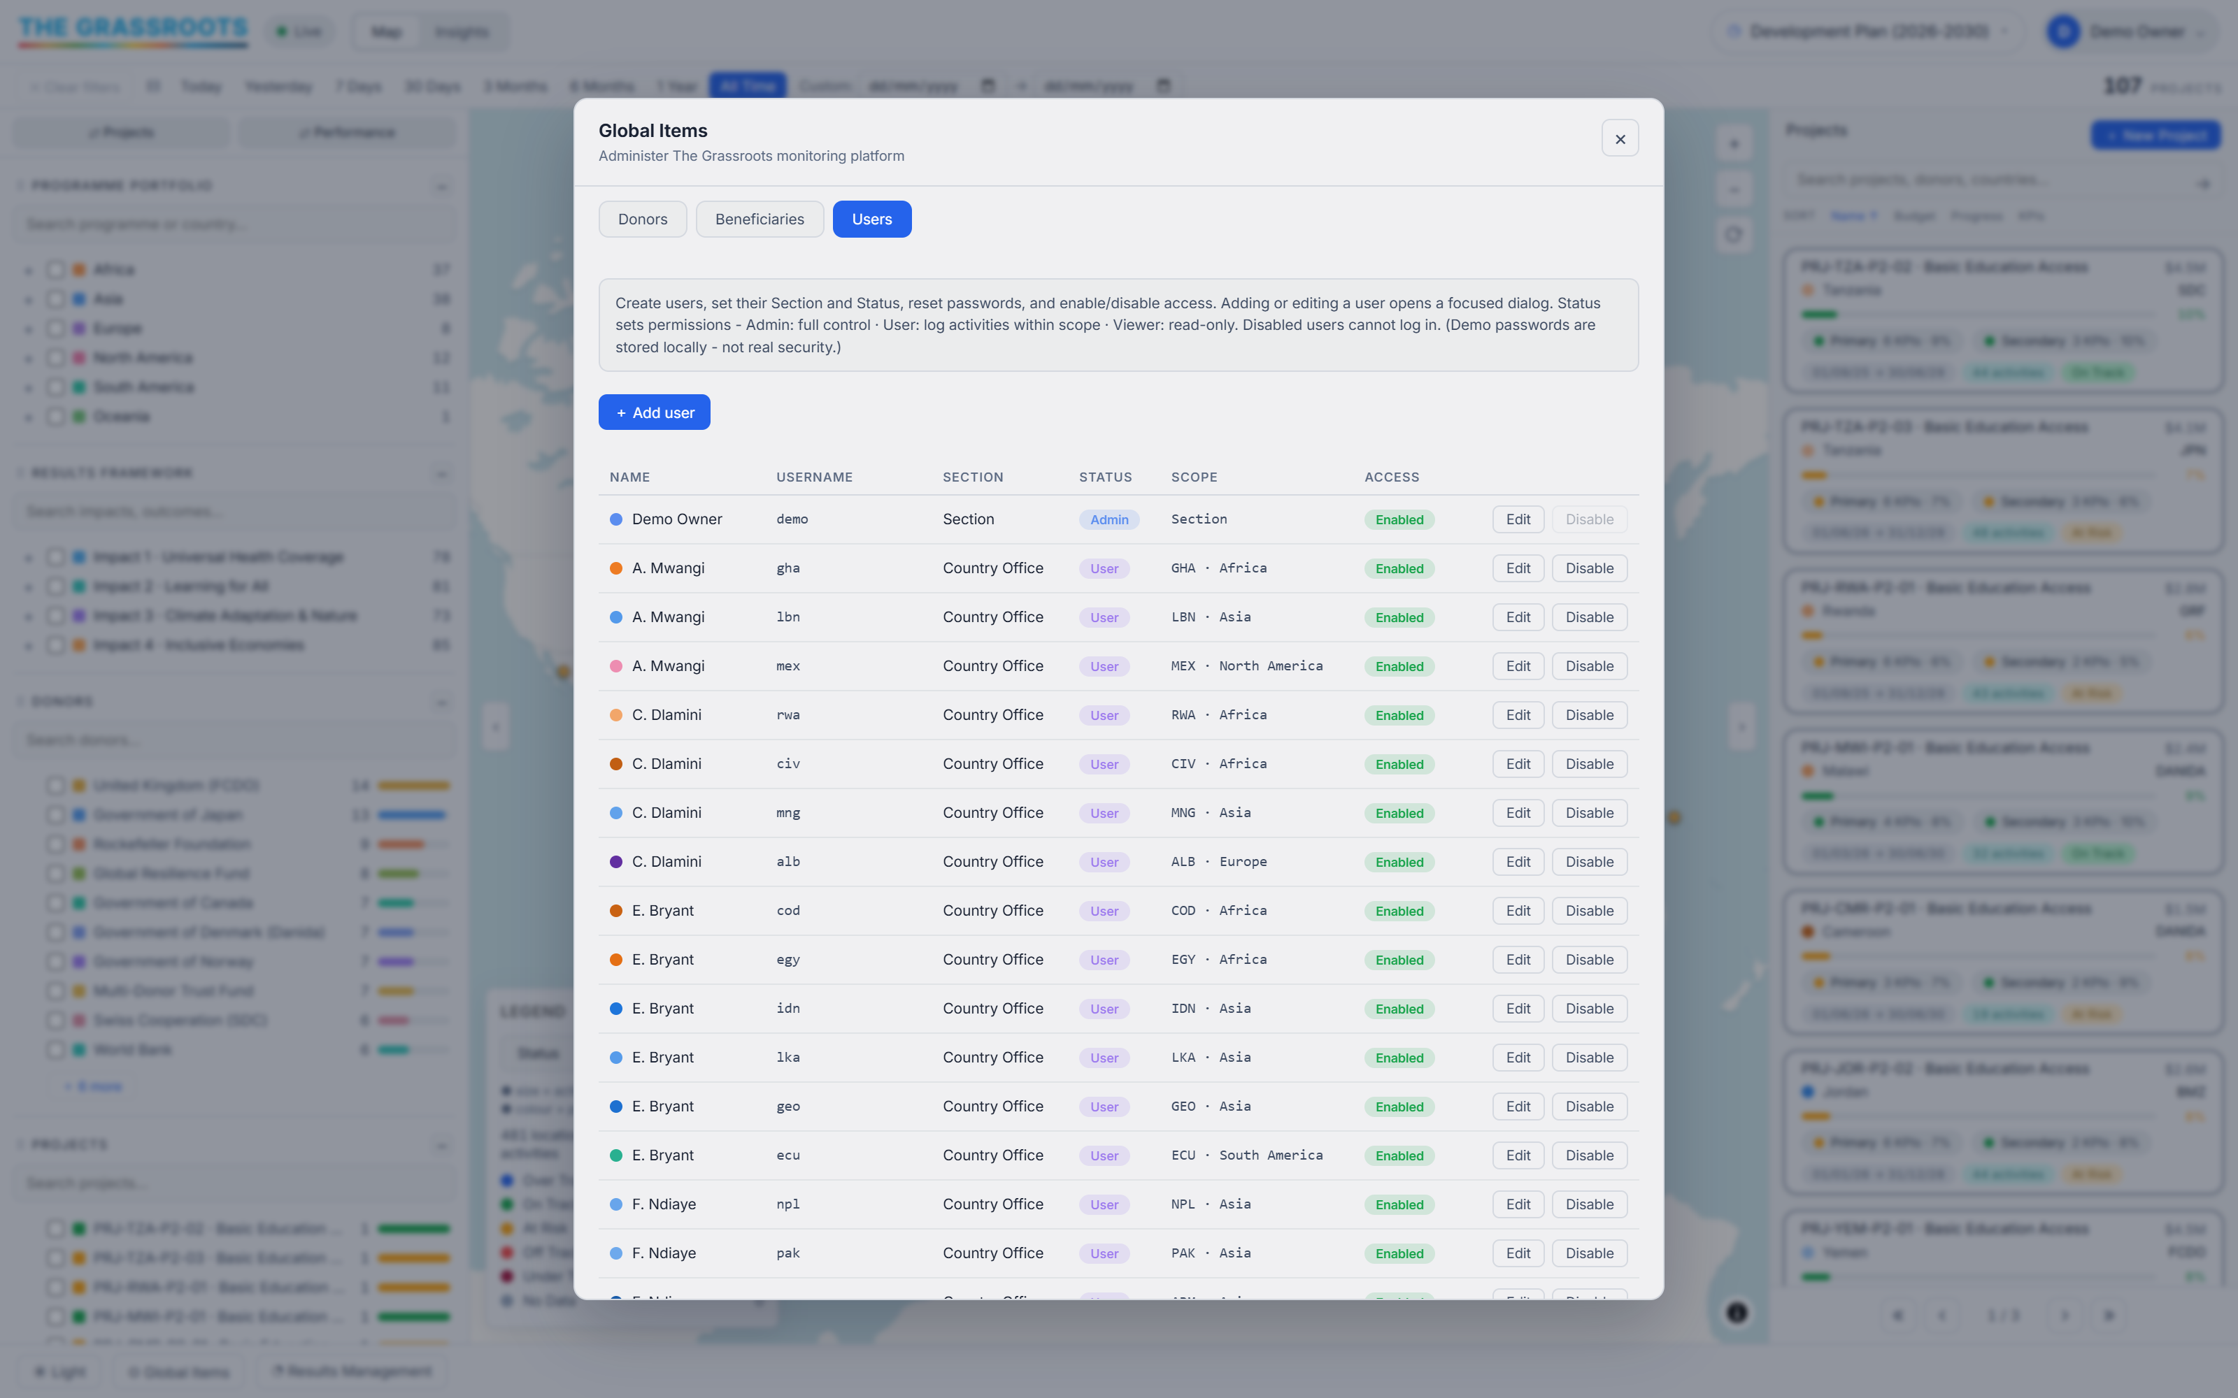
ACCESS
Two orthogonal fields
section — where they sit hq: the central Section, may report on any country. co: a Country Office, scoped to its own country. Region and country apply only to this section. status — what they may do admin: full control, including users and the framework.
user: log activities within scope.
viewer: read-only.
◆ DEMO DATA
Implementation note. section is a data value constrained by schema.sql — CHECK section IN ('hq','co') — and it also drives a body class, sec-hq / sec-co, that CSS keys off. Changing the vocabulary means changing the schema, the seed, the permission checks and the class together. Sign-in is demo-grade: the password is stored in plain text in the seed and equals the username. It gates the UI. It is not a security control and must never be treated as one.

Slide 8
DATA LIFECYCLE
Seeding, reseeding and getting out
Seed on first load
The content stamp
Getting out
The app seeds IndexedDB from window.SEED the first time it runs. The store is grassroots_v1.
The seed carries a short SHA-1 of its payload in window.SEED_STAMP. db.js compares it with the one it last persisted; if they differ, it drops the database and reseeds. A regenerated seed therefore reaches every browser on next load — no manual reset, no DB_NAME change.
DB.exportSQL() emits INSERTs matching schema.sql. Load them into sqlite3 and you leave with a database.
DB.reset() // wipe and re-seed from window.SEED
DB.exportSQL() // → INSERT statements matching schema.sql
python tools/gen_seed.py # rebuild js/seed.js (deterministic)
python tools/proc_world.py # rebuild data/world.js from GeoJSON

Slide 9
THE DEMO SEED
How the invented data is made
gen_seed.py is deterministic: a seeded mulberry32 PRNG means the same input always produces the same seed, byte for byte. It reads tools/cities.json — a real-settlement gazetteer from the GeoNames cities1000 dump — so demo activities land on genuine coordinates.
What the seed contains | Count | Note
Plans | 2 | 2021–2025 (closed) and 2026–2030 (in flight)
Country programmes | 56 | Out of 237 selectable countries
Results | 2,968 | Impacts, outcomes and outputs across both plans
Indicators | 3,217 | Including project-local secondary KPIs
Measurements | 15,084 | The activities
Beneficiaries | 12,259 | Across 11 measures
Projects | 212 | Donor-funded, country-scoped
Users | 62 | 6 Section + 56 country offices — all fictional
◆ A trap worth knowing THEME_BENEFICIARIES is keyed on the PROJECT_THEMES strings. Rename a theme without remapping it and every project silently falls back to the default three beneficiary types. The generator will not error. The data just quietly gets thinner.
Everything above is synthetic. The only real-world data is the place names and coordinates.

Slide 10
NETWORK
Three things reach out. Nothing sends data.
What | From | Why
MapLibre GL JS 4.7.1 | unpkg.com | Renders the vector basemap
Basemap style + tiles | CARTO (OpenStreetMap data) | The map under the bubbles
Settlement search | photon.komoot.io | Live place lookup when logging an activity
There is no application backend and no telemetry. The database never leaves the browser.
◆ Licence obligation — do not remove the map credit The basemap is OpenStreetMap-derived and ODbL requires the credit to stay visible. It is inherited from the CARTO style and shown, collapsed, bottom-right of the map. It has already been removed twice in this codebase's history — once in CSS, once in the map options. Do not add a customAttribution. MapLibre builds its credit list from customAttribution plus every used source's, and dedupes only by exact string match — so a custom credit differing by one character renders the credit twice. Inherit the source's; do not supply your own.

Slide 11
EXTENDING IT
Where the seam is
If you intend to make this multi-user, js/db.js is the clean cut. It already presents a table-oriented API over IndexedDB; reimplement that module against a real API and the UI does not need to know.
The schema already exists
The engine is portable
Auth must be built
schema.sql is real, tested SQLite DDL. The server-side model is not a design exercise — it is written.
The status engine is pure computation over indicator + measurement rows. It can move to the server or stay on the client, unchanged.
Not extended — built. What is there now is a UI gate against a plaintext password, and nothing more.
House rules worth keeping
el(tag, cls, text) sets textContent — markup handed to it renders as a literal "<b>" on screen. Use elHTML() for the few notes that need emphasis, and esc() anything interpolated.
Bump the ?v= token in index.html whenever you change a JS or CSS file.
#basemap must have no z-index. Giving it one opens a stacking context that traps the map credit's links under the SVG overlay — visible, but unclickable.

Slide 12
TROUBLESHOOTING
The five things that will happen to you
My changes do not show up
The browser is running a cached copy. Bump the ?v= token on the changed file in index.html.
The data looks stale after regenerating
Check window.SEED_STAMP actually changed — the auto-reseed keys on it. A byte-identical payload will not move it.
The map credit appears twice
Something added a customAttribution back. Inherit the CARTO source's credit instead.
The credit does not appear at all
MapLibre only paints it once the source is marked used, which needs the style to finish painting. If the basemap has not rendered, neither will the credit.
A country office user sees nothing
Expected — co users are scoped to their own country. Check user.country_iso3 is set.

Slide 13
THE SHORT VERSION
A real platform, on invented data.
The architecture, the schema, the status engine and every function are production-shaped. The portfolio inside them was generated to prove they work. Read the two apart, and it is easy to judge what is here and what would still need building.
Run it
Read it
Try it
python -m http.server 8777
schema.sql first, then js/db.js, then the status engine in js/app.js
thegrassroots.github.io/platform — demo / demo
github.com/thegrassroots/platform · grassrootstrack@outlook.com
◆ The full written manual, with the workflows step by step, ships alongside this deck.

