Slide 1


THE GRASSROOTS
See what changes
on the ground.
Every programme, every project, every community you serve — on one live map, with a clear answer to the only question that matters: is it working?
A live demonstration — with sample data. Every figure inside is invented, created only to show how the platform works. Nothing reports on real programmes.
thegrassroots.github.io/platform
Notes:
Open with the promise, not the product. Then say the sample-data line out loud before anything else.

Slide 2



THE REALITY WE ALL KNOW
The work happens in villages.
The picture arrives a year later.
Between a community and a headquarters sit spreadsheets, email chains and reporting templates. By the time the annual report is assembled, the moment to act has passed.
Leaders fly blind between reports
Teams drown in reporting
Good news travels; bad news hides
Decisions about money and people get made months before the evidence arrives to support them.
Field staff spend their evenings compiling spreadsheets instead of serving communities. Every funder wants a different format.
When progress is typed into a report by hand, trouble stays invisible until it is too late to fix cheaply.
Notes:
Name their pain in their words. No product yet.

Slide 3
IMAGINE INSTEAD
One living picture of everything —
from a single village to the national plan.
A field worker records one activity: what happened, where, who benefited. That is the last time anyone touches it. From there, the platform itself moves the numbers — through the project, the programme and the plan.
A village activity
→
The project
→
The country programme
→
The national plan
Reported once. Counted everywhere. Instantly.
Notes:
This is the whole idea of the platform in one slide. Pause on it.

Slide 4
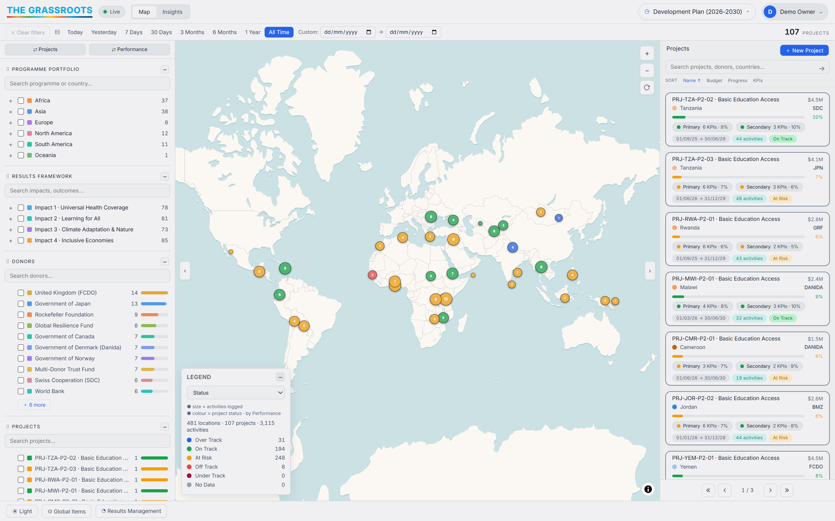


YOUR PORTFOLIO, LIVE
The whole operation on one screen
SAMPLE DATA
Every country, every project, every activity — placed where it really happened.
Colours tell you health at a glance: green on track, amber at risk, red off track.
Ask anything — one region, one funder, one theme — and the whole screen answers.
Sample data — the geography is real, the projects are invented.

Slide 5

THE PART THAT CHANGES MEETINGS
Traffic lights nobody can argue with
In most reports, someone chooses the colour. Here, no one does. The platform compares what was promised with what was delivered — and with how much time has passed — and awards the colour itself.
Ahead
On track
At risk
Off track
Past the target already
Set to deliver on time
Slipping — act now, cheaply
Needs intervention today
The clock is part of the answer. Halfway through the year with a quarter of the target delivered is not "25% done" — it is a warning. The platform sees that on its own, months before a written report would say it.

Slide 6
THE QUESTION EVERY FUNDER ASKS
Where will we land when the plan ends?
Traffic lights say how things stand today. The Forecast goes further: it reads the pace of every indicator — how fast the numbers have actually moved, month by month — and projects it to the end of the plan. Not one guess: three honest scenarios, redrawn every time the field reports.
Best case
Realistic
Worst case
Where the numbers land if delivery holds its strongest recent pace to the end.
Where today's pace actually lands — the number to plan around.
If the pace slips — a warning delivered early, not a surprise delivered late.
Risk leads the page. The target most likely to be missed sits at the top — with months still on the clock and budget still in hand. And the Forecast is honest about itself: where reporting history is thin, it says its confidence is low rather than pretending to certainty.

Slide 7
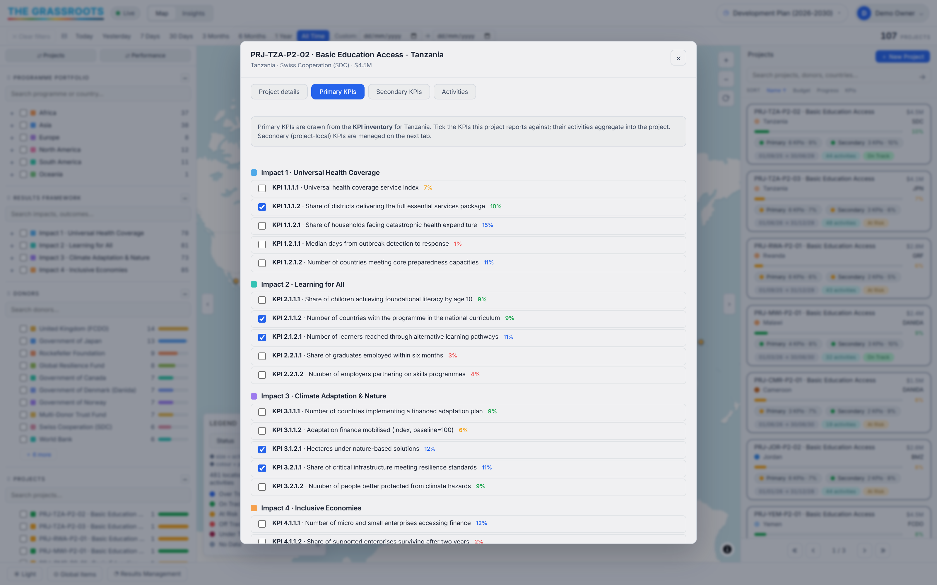
ACCOUNTABILITY
Results and money, on the same page
Every project shows its funder, its budget, its dates — and the results it signed up to deliver. When a funder asks "what did our contribution achieve?", the answer is already on screen: their projects, their communities, their outcomes — filtered in one click. No scrambling before the donor meeting. No reconciling three spreadsheets that disagree.
SAMPLE DATA
Value for money stops being a slogan when you can see it.

Slide 8



AND FOR THE PEOPLE DOING THE WORK
Reporting that takes minutes,
not evenings.
Say what happened
Say where
Say who benefited
Pick the result it counts toward and enter the number.
Start typing a town or village — the platform finds the real place and pins it on the map.
Women, children, persons with disabilities, refugees — counted at the moment of reporting, not estimated later.
That is the entire job. Everything above it — every total, every chart, every traffic light — updates by itself.

Slide 9





LEAVING NO ONE BEHIND
Not just how many — who
Every activity records the people it reached, broken down the way your commitments are written: by gender, by age, by disability, by displacement. So "inclusive" becomes a number you can stand behind, not an adjective.
Women & girls
Children & youth
Persons with disabilities
Refugees, IDPs & host communities
Ask the hard question in one click: "Show me only what reached persons with disabilities in the north-east last quarter." The map, the numbers and the charts all answer together — in the meeting, not a month after it.

Slide 10
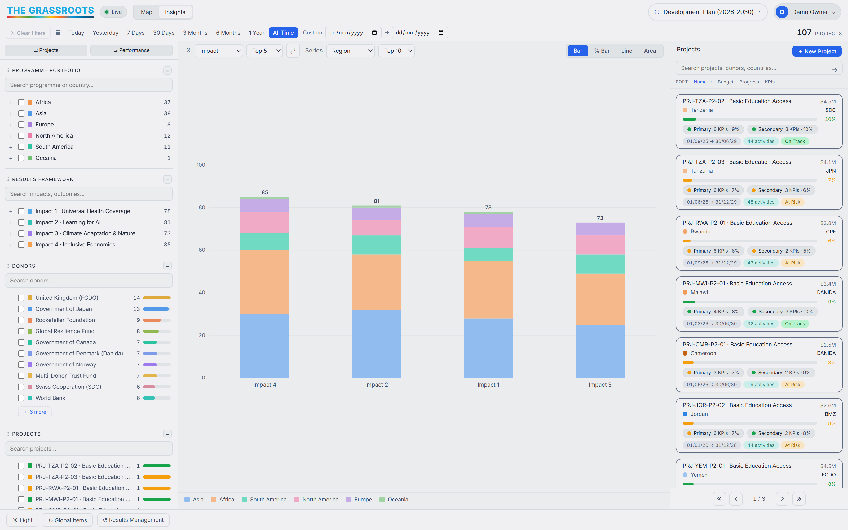
FOR THE BOARDROOM
Briefing-ready answers, on demand
SAMPLE DATA
Which region is delivering? Which funder's portfolio is struggling? Which goal is falling behind? Every one of those is a single click — a live chart drawn from the same numbers the field reported, not a slide assembled the night before. When the minister, the board or the donor asks a follow-up, you answer it in the room.

Slide 11
AND THE REPORTS DELIVER THEMSELVES
Every lead receives their report —
written, attached and sent.
Written by the platform
A forecast rides along
Sent to the right person
Each month, a results report for every plan, project, funder, region and country — drawn from the same live numbers as the map.
A second brief projects every target to the end of the plan — best, realistic, worst — and says what to do now to stay on track.
Every scope has a named lead. One click, and each lead receives a personal email with their two PDFs attached.
No compiling, no chasing, no formatting — the monthly reporting round that used to eat a week is over in a minute.

Slide 12




DESIGNED FOR YOUR REALITY
No procurement. No installation. No training week.
The platform opens like a web page, because it is one. If someone on your team can use a browser, they can use this — today.
Opens in a browser
Ready in seconds
Your data stays yours
Familiar from the first minute
Any modern computer. Nothing to install, nothing for IT to approve.
Open the address, sign in, and the whole demonstration portfolio is in front of you.
What you enter lives with you — it is not shipped off to someone else's system.
A map, filters and traffic lights. If you have used a travel website, you already know how.
It works the same in a ministry in the capital and an office two hours from the nearest paved road.

Slide 13


WHERE THIS STANDS TODAY
What you are looking at — plainly
Real and working now
Honest about the rest
The map, the traffic lights, the reporting flow and the charts all work — this is a live system, not a mock-up
Loaded with a full sample portfolio: two national plans, 56 countries, hundreds of projects
Open to anyone, on any browser, right now
Every figure inside is sample data — invented to demonstrate the functions, never a report on real work
Today it is a demonstration for one user at a time; connecting whole teams is the next step
A mobile app for offline field areas is on the horizon, not in hand
We would rather you hear the limits from us than discover them yourselves.

Slide 14
SEE IT FOR YOURSELF
Two minutes in the demo says more
than any presentation.
Open it on your own screen. Filter to one country. Click a village. Watch the whole picture answer.
thegrassroots.github.io/platform Sign in: demo / demo
Talk to us grassrootstrack@outlook.com
And remember as you explore: the portfolio inside is sample data, invented to show you the functions.

