Slide 1


GCC OVERVIEW
Global Capability Centre
Design, Build, Operate, Transfer
Mitigating the risks of building a captive centre offshore — how Trilogy delivers DBOT, with a transparent costing model and a fixed management fee.
Human Led · Ai-enabled
Trilogy GCC · A Trilogy Group Company
sales@trilogybpo.com · trilogybpo.com
1

Slide 2
Agenda
01
Company overview — Trilogy GCC
05
The solution — DBOT
02
Why South Africa
06
Implementation phases
03
Three routes offshore
07
Benefits & commercial model
04
Business risks of a captive
08
Case studies & next steps
Trilogy GCC · Commercial-in-confidence
proposal.trilogybpo.com/GCC
2

Slide 3
01 — Company overview
Move beyond outsourcing. Establish a Global Capability Centre in South Africa that functions as a seamless extension of your headquarters.
Build your own centre
20–30% vs BPO
Design, Build, Operate, Transfer — a risk-mitigated path to a Center of Excellence in South Africa.
Global capability centres / captives deliver 20–30% cost savings versus offshore outsourcing.
Digital & autonomous
1,000+ FTEs
Unique digital and autonomous platforms to reduce headcount while improving CX.
Owned and operated footprint across Cape Town and Johannesburg — never franchise.
Trilogy GCC · Commercial-in-confidence
proposal.trilogybpo.com/GCC
3

Slide 4
Our achievements
Trilogy's 20-year track record speaks to our ability to deliver results at scale — creating jobs, building infrastructure, and pioneering technology across the BPO industry.
45K
20+
Jobs created
Years of experience
Significant positive impact on South Africa's economy and communities over 20 years.
Two decades of proven value delivery across multiple industries and geographies.
8
36
Years in AI / ML
Blue-chip centres built
Developing AI, ML platforms, analytics solutions, and digital automation tools.
Contact centres successfully built and launched for blue-chip companies across SA.
Trilogy GCC · Commercial-in-confidence
proposal.trilogybpo.com/GCC
4

Slide 5
Why South Africa?
South Africa has consistently been ranked as the second most attractive BPO location globally. Source: McKinsey
Cost efficiency meets quality
Cape Town: the premium hub
Up to 60% lower operational costs than UK/USA markets — wage arbitrage without compromising quality.
Leading BPO destination with rapid growth, exceptional infrastructure, and the largest skilled talent pool in the region.
#2 globally
GMT+2
95%+
Most attractive BPO location (McKinsey)
1–2 hrs from UK · extended US coverage
English proficiency with neutral accents
Top-3
Young talent
Full CX stack
Global BPO destination for three consecutive years
Educated, professional workforce ready to deliver
Voice, tech support, digital and advanced CX
Trilogy GCC · Commercial-in-confidence
proposal.trilogybpo.com/GCC
5

Slide 6
Three routes offshore
Companies can establish an offshore capability centre in South Africa — for any type of operation — in one of three ways.
1
2
3
Outsourcing
Captive, own resources
Captive with local partner — DBOT
Outsource to a competent and credible partner in South Africa under an outsourcing contract.
Establish a captive centre in South Africa with your own resources — full ownership, full localisation risk.
Establish a captive with a local partner as a phased Design, Build, Operate and Transfer approach.
FOCUS OF THIS BRIEF
Trilogy GCC · Commercial-in-confidence
proposal.trilogybpo.com/GCC
6

Slide 7
The business case — five risk areas
Establishing a captive offshore has clear financial benefits — and inherent risks that can destroy the value proposition. DBOT is designed to mitigate all five.
01
02
03
04
05
Localisation
Financial
Business
Implementation
Ongoing ops
Labour law, equity, location, culture, protocol and contractual pitfalls.
CAPEX for infrastructure, IT, telephony, connectivity and facilities — and shortened ROI pressure.
Defocusing management; standing up HR, finance, facilities, legal and ops IT offshore.
Speed to go-live, scope creep, travel, recruitment and training costs.
Performance management, fix-it travel, transferring onshore practices to local management.
Trilogy GCC · Commercial-in-confidence
proposal.trilogybpo.com/GCC
7

Slide 8
The solution — DBOT hybrid
Outsourcing
+
Captive on internal resources
=
DBOT hybrid
DBOT — Design, Build, Operate and Transfer — is a phased turnkey approach with a highly qualified team of internal and local experts, mitigating captive risk while keeping a path to ownership.
D
DESIGN
B
BUILD
O
OPERATE
T
TRANSFER
Due diligence, gap analysis, solution design, implementation, change and project plans.
Total solution implemented at the location of choice, governed by a project team.
Full operational strategy run for a defined period to stabilise operations.
Operations, technology, facilities, people, knowledge and IP transferred to you.
Trilogy GCC · Commercial-in-confidence
proposal.trilogybpo.com/GCC
8

Slide 9
Implementation — phase by phase
DESIGN
BUILD
OPERATE
TRANSFER
• Comprehensive due diligence
• Local practices gap analysis
• Optimal solution design
• Implementation & change plans
• Project management plan
• Site & IT build-out (turnkey)
• Agent lifecycle framework
• Recruitment, training, incubation
• Workforce optimisation & QA
• Go-live readiness gates
• Full operational strategy
• Integrated management system
• KPI / SLA measurement
• Governed through an MSA
• Stabilise quality & service levels
• People & knowledge transfer
• Technology, facilities & IP
• Flexible timing (e.g. 24/36 mo)
• Optional ongoing support
• Overflow · BC/DR · benchmarking
Trilogy GCC · Commercial-in-confidence
proposal.trilogybpo.com/GCC
9

Slide 10
Business benefits — how DBOT mitigates risk
1
Risk-averse localisation model
2
Limited CAPEX — or an option for no CAPEX
3
Speed to offshore markets and implementation
4
Speed to the cost savings anticipated
5
Instant access to local admin, legal and financial resources
6
Instant access to local business practices and infrastructure
7
Mitigates labour legislation, unions and performance-management risk
8
Aligned incentives — fixed management fee, not headcount tax
Trilogy GCC · Commercial-in-confidence
proposal.trilogybpo.com/GCC
10

Slide 11
Commercial model
Transparent costing by DBOT phase, plus a fixed management fee — always with a path to ownership.
Transparent costing + fixed fee
CAPEX — green-field build
• Costed openly by Design / Build / Operate / Transfer
• Transfer typically at 24 or 36 months
• Trilogy management fee is fixed — decoupled from headcount
• You keep the savings from efficiency and automation
• Assumptive model sized on seats, bodies, ratios and location
Customer meets the CAPEX for site, equipment and facilities. Full ownership of assets from day one.
OPEX — Trilogy rent-to-own
Full bill of materials on a 36-month payment plan. Site, equipment and facilities are owned by the client at month 36. Chosen by a number of our GCC customers.
Trilogy GCC · Commercial-in-confidence
proposal.trilogybpo.com/GCC
11

Slide 12
Where GCC sits in Trilogy's offerings
Three pathways to elevate CX — outsourcing, owning a GCC, or AI/digital platforms. GCC delivers the additional 20–30% beyond BPO labour arbitrage.
Offshoring BPO
Global Capability Centres
AI & Digital Platforms
Voice to Digital to Autonomous CX
Design, Build, Operate & Transfer
Human in the loop
Outsource to Trilogy in South Africa with modern platforms ready — just add humans.
Build your own capability centre with Trilogy's DBOT methodology and local expertise.
Award-winning AI-enabled digital and autonomous platforms for service, sales and collections.
40–60% saving vs captive UK / outsourced UK
Additional 20–30% vs outsourced SA BPO
Further savings through digital & AI deflection
Trilogy GCC · Commercial-in-confidence
proposal.trilogybpo.com/GCC
12

Slide 13
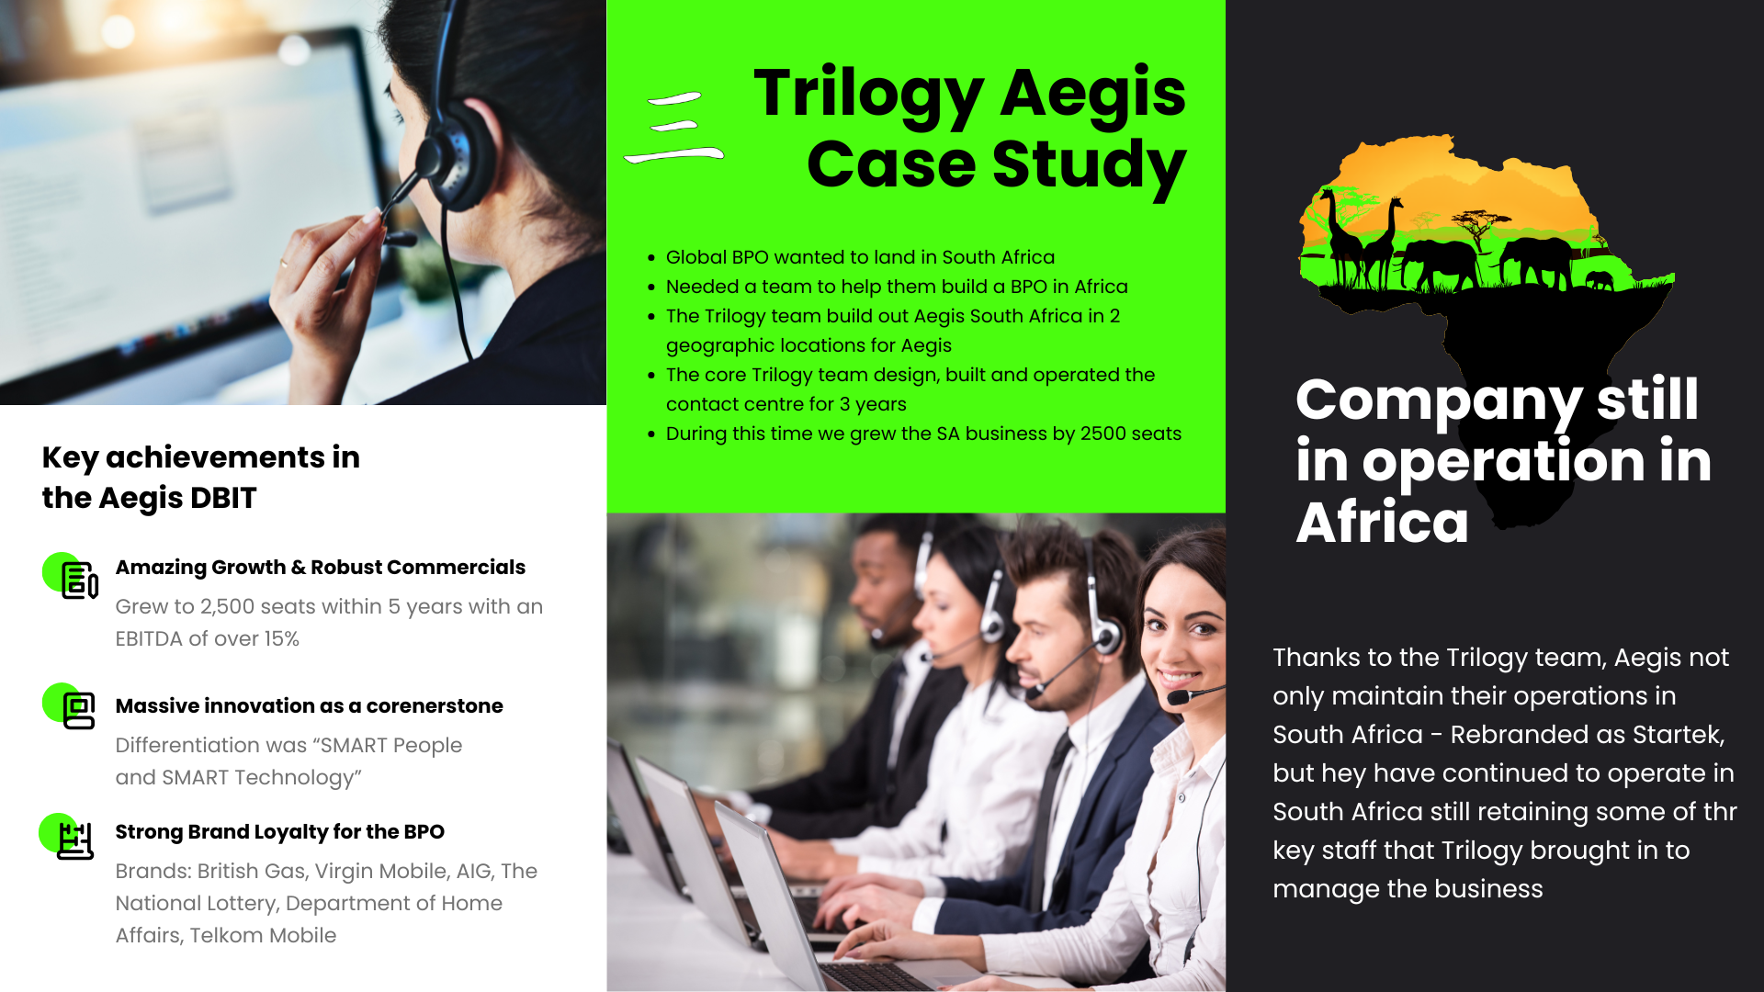
Case study — Aegis South Africa (now Startek)
• Designed, built and operated in two SA locations
• Grew by 2,500 seats within 5 years
• EBITDA of over 15%
• Brand still operating successfully as Startek
• Proof that DBOT can scale a lasting in-country operation
Trilogy GCC · Commercial-in-confidence
proposal.trilogybpo.com/GCC
13

Slide 14
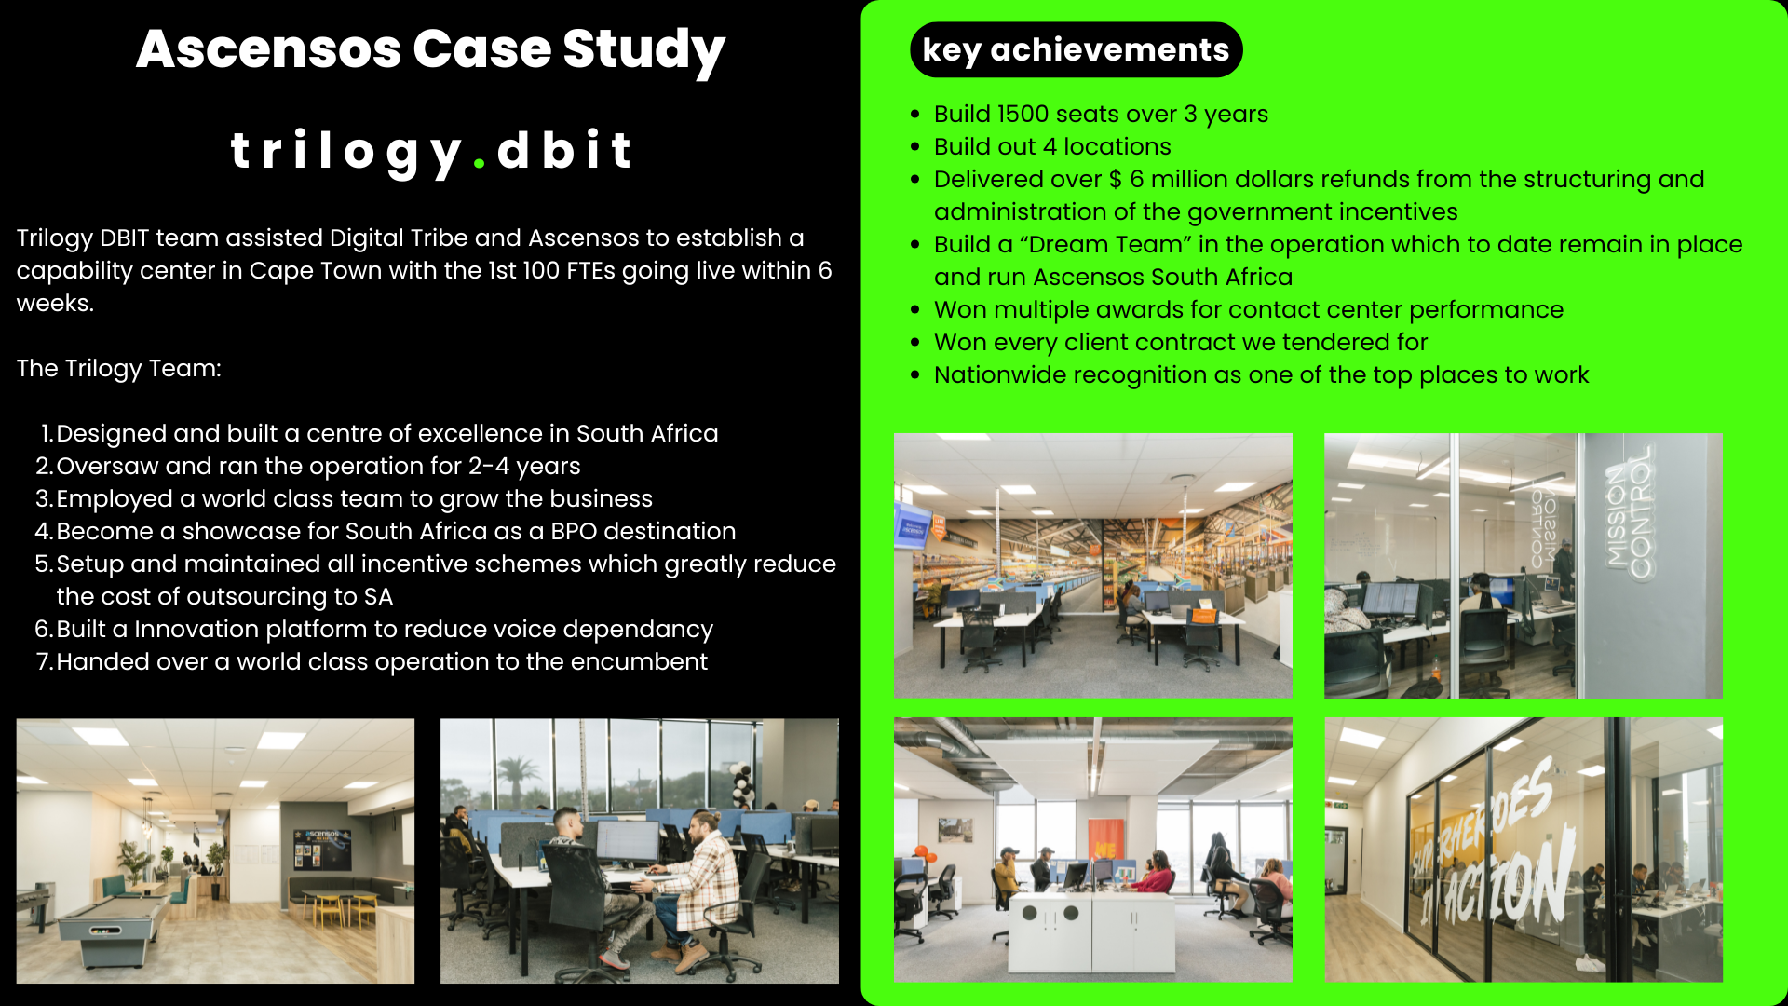
Case study — Ascensos
• First 100 FTEs live in Cape Town within six weeks
• 1,500 seats over 3 years across 4 locations
• $6M+ in government incentives secured
• Designed and built a centre of excellence
• Operated 2–4 years, then handed over a world-class operation
Trilogy GCC · Commercial-in-confidence
proposal.trilogybpo.com/GCC
14

Slide 15
South African footprint
Every site is Trilogy owned or leased and operated directly — never via franchise or affiliate. Your operation fits seamlessly into our current Cape Town base.
Century City
Head Office — Pinelands
Newtown
Rosebank
Cape Town
Cape Town
Johannesburg
Johannesburg
300 seats
1,500 seats
400 seats
250 seats
Trilogy GCC · Commercial-in-confidence
proposal.trilogybpo.com/GCC
15

Slide 16
Let's build your GCC
Design, Build, Operate, Transfer — from South Africa for UK, US and global brands.
sales@trilogybpo.com
trilogybpo.com · proposal.trilogybpo.com/GCC
Trilogy CX (Pty) Ltd · Commercial-in-confidence
16

