Slide 1

Trilogy BPO: Accelerated CX. Decades of Expertise, Ready to Scale
High-performance contact center operations in South Africa—just add humans.

Slide 2


How and Where We Operate
With over 25 years of combined experience, our leadership team has deep expertise supporting SA, UK and USA markets while helping prominent global brands successfully establish operations in South Africa. We understand the complexities of offshore expansion and bring proven methodologies to every engagement.
Geographies Covered
Verticals Covered
Functions Covered
Our leadership team has over 25 years of experience supporting predominantly the UK and USA markets, helping prominent brands successfully land in South Africa. We provide seamless service delivery across time zones with native English-speaking talent.
Our team has previously worked with Thames Water, British Gas, Vodafone, John Lewis, Aldi, KFC, and Virgin, among others. We possess intimate knowledge of telecommunications, utilities, insurance, retail, healthcare, technology, and e-commerce sectors.
We have over 25 years of customer service experience with a globally awarded team. We maintain a focused, niche offering to ensure excellence in every engagement.
Customer Service & IT Support
Chat Commerce & Digital Engagement
Technology & E-Commerce
Back-Office Administration
Healthcare & Insurance
Digital & AI Enablement
Retail & Telecommunications
Automation & RPA Implementation
Utilities & Financial Services

Slide 3


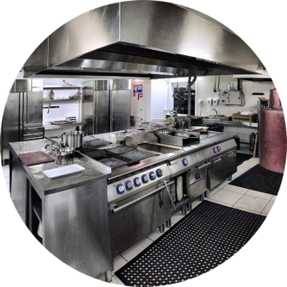



Digital Contact Centers
We provide state-of-the-art digital solutions, deployed and ready, in a world-class contact center environment to assist our customers on their journey to digital customer experience. Outsource to us and service, sell, retain, and collect debt from your customers on a fully automated AI/ML predictive and engagement platform, with a human agent in the loop to fulfill the process.
Data & AI Driven Automation
Human, Digital & AI Orchestration
Ai Incubator & Test Kitchen
Our platforms leverage advanced machine learning and AI to predict customer needs, optimize routing, and automate routine interactions while maintaining service quality.
Seamlessly blend human expertise with digital channels and AI capabilities to deliver optimal outcomes for every customer interaction.
Our innovation lab continuously develops and tests new solutions, ensuring you always have access to cutting-edge customer experience technologies.
Award-Winning Excellence
Boutique Service with High Customer Care
Industry Expertise
Our globally recognized team delivers exceptional results through innovative solutions and unwavering commitment to quality.
We combine personalized attention with enterprise capabilities to deliver experiences that exceed expectations.
Deep knowledge in telecommunications, retail, motor vehicles, and utilities ensures we understand your business challenges and opportunities.

Slide 4
Why AI-Enabled BPO Beats Traditional Outsourcing
AI works only when it's operationalised. BPO is the fastest way to do that safely
The problem with "old-school" BPO
Trilogy's operating model
Labour-only scaling increases cost linearly
Channel shift and automation are often bolt-ons
AI projects fail when CX teams are removed from operations
Human-in-the-loop AI: agents supervise, override, and handle exceptions
Digital-first CX: deflects demand before it hits expensive voice queues
Automation inside operations, not beside them
AI and automation can reduce contact-centre operating costs by 20–30% when embedded into workflows
Source: McKinsey – “Next Best Experience”

Slide 5



















Vertical Expertise
Proven Track Record with World-Class Brands
Trilogy's leadership team has built and run over 40 contact centers for some of the world's best-known brands. We were the first company in South Africa that a UK brand chose to partner with for outsourcing. The second company to outsource to South Africa also selected the Trilogy team and has subsequently remained and grown their operations in the country.
This pioneering experience gives us unmatched insight into the challenges and opportunities of offshore customer service delivery. Our deep vertical expertise spans telecommunications, utilities, retail, fast food, insurance, and technology sectors, allowing us to hit the ground running with proven playbooks and best practices.
Global Brands
Local Brands

Slide 6
Our Achievements
Two decades of consistent excellence in the BPO industry has positioned Trilogy as a trusted partner for global brands. Our track record speaks to our ability to deliver results at scale while maintaining the highest standards of quality and innovation.
45K
20
Jobs Created
Years of Experience
Our team has created 45,000 jobs over the past 20 years, making a significant positive impact on South Africa's economy and communities.
Two decades of proven track record in providing exceptional value to our customers across multiple industries and geographies.
8
36
Years in AI/ML
Blue Chip Centers Built
Eight years of experience developing AI and Machine Learning platforms, analytics solutions, and digital automation tools.
Successfully built and launched 36 contact centers for blue chip companies in South Africa over 20 years.

Slide 7
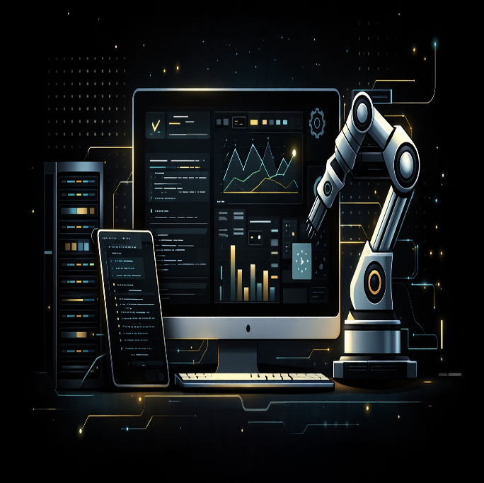
Trilogy AI Test Kitchen for BPO
Prove value. Reduce risk. Then scale with confidence.
Trilogy’s Test Kitchen is a controlled, real-data experimentation environment where AI, automation, and digital deflection are proven before deployment — not theorised, not PowerPointed.
It exists to answer one question - “What automation will materially reduce cost or improve CX — without breaking live operations?”

Slide 8
The Trilogy Test Kitchen Difference
Not a Lab. Not a POC. Not a Vendor Demo
Most “innovation labs”:
Test fake data
Sit outside operations
Never reach production
Trilogy’s Test Kitchen is operational by design. It combines:
Trilogy Discover – LLM-based learning bot analysing real customer interactions
Genii Analytics – deep root-cause analytics across voice, chat, digital, and back-office
Human-in-the-loop governance from day one
This means:
You find real automation opportunities
You quantify real deflection
You deploy only what works
“Only 30% of AI projects make it past the pilot stage and deliver real business value.”
Source: Gartner
“Organizations that fail to link AI initiatives to measurable business outcomes struggle to scale.”
Source: McKinsey
The Test Kitchen exists to fix this exact failure point

