Slide 1
Menu examples
Application menus a.k.a options menu, Android launches this menu when user presses the menu key on their phone
Options Menu - appears at the bottom of the screen can display up to 6 if more than 6 the 6th menu will show as “More”, when you click on it, it will show the rest of the menus
Context Menus - when user long-press on a widget, context menu will pop up.
How to implement them?
    Options Menu, you will need to implement onCreateOptionsMenu()
    Context Menu, implement onCreateContextMenu() plus
    registering the context menu with the interested widget

Slide 2
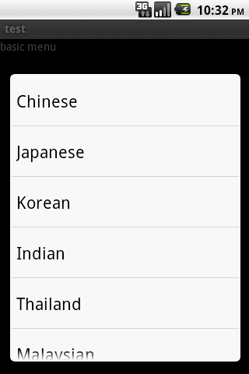
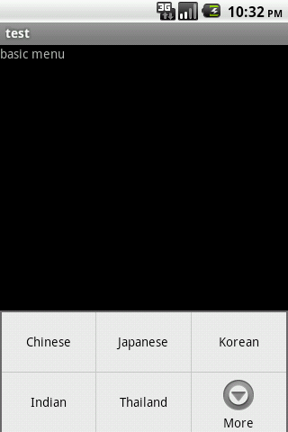

Slide 3
Separate layout from Java
Define Menu items in xml file and save it in res/menu/ folder
Use an inflater to load them into activity
A menu snippet
<?xml version="1.0" encoding="utf-8"?>
<menu xmlns:android="http://schemas.android.com/apk/res/android">
<item android:id=""
android:title=""
android:orderInCategory=""
android:icon="" />
<group android:id=""
android:menuCategory=""
android:visible="">
<item android:id=""
android:orderInCategory=""
android:title="" />
</group>
<item android:id=""
android:orderInCategory=""
android:title="">
<menu>
<item android:id=""
android:title=""
android:visible=""
android:alphabeticShortcut=""/>
</menu>
</item>
</menu>

Slide 4
Item elements are menus and groups represent a collection of menus which can be reacted as a group
Submenus are child menus of a specific menu you can declare them as child of an item, it cannot support another submenu
Every menu item has a set of attributes you can specify to customize menu options.
    Title – name displayed in the menu
    Icon – an icon display above title
    Order – order of the menu
    Enabled – will this menu item be clickable
    Visible – show or not to the user
    Shortcut – press a key to activate a menu item

Slide 5
How to register a context menu for a list of items?
Register a ListView
If your Activity uses a ListView and you want all list items to provide a context menu, register all items for a context menu by passing the ListView to registerForContextMenu(). For example, if you're using a ListActivity, register all list items like this:registerForContextMenu(getListView());

Slide 6
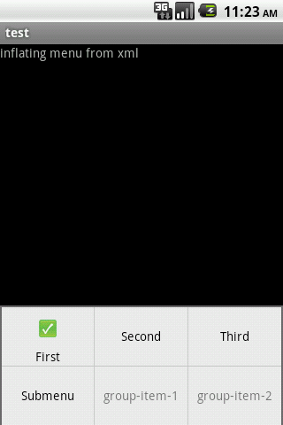
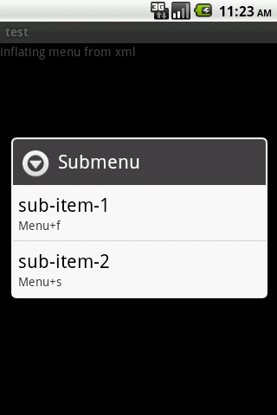

Slide 7
Pop ups! (alerts and toasts)
Popups are implemented by Android system, you can use this little popup to give user a notification.
What Android provides us with are toasts and alerts.
Toasts – operate by its own without user interaction,and it's not aggressive and won't take focus out of user's current activity. Lacking of the ability to interact user, therefore it should be used only in notification kinda messages
You can use either default toast or customize it by supplying it a view.

Slide 8
Toast.makeText(context, message, duration).show().
Remember those javaScript alert windows, it requires user interactions to determine what's next step. If you need this kind of functionality, then you should stick to AlertDialog. It's a modal window, which means it covers part of the screen but also reveals part of the underneath layer. It needs user to instruct what to do. This is ideal for displaying validation message, or deleting a database record.
Here comes the AlertDialog
    A title
    A text message for the body content
    One , two, or three buttons

Slide 9
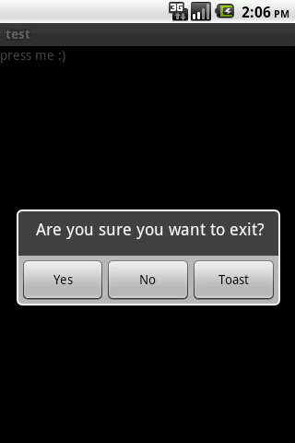
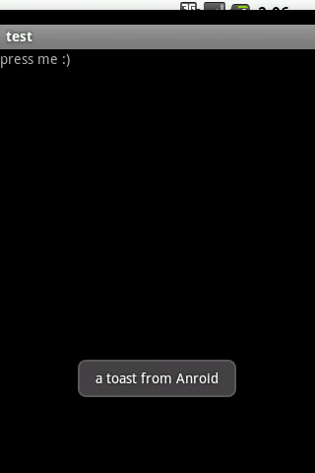
Dialog with Buttons

Slide 10
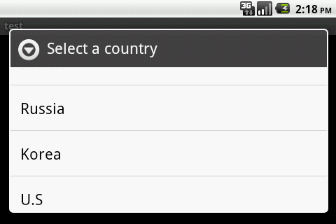
Dialog with list
To create an AlertDialog with a list of selectable items use the setItems() method:
Call setTitle() to add a title to the title bar
DialogInterface.OnClickListener defines action to take when users select an item

Slide 11
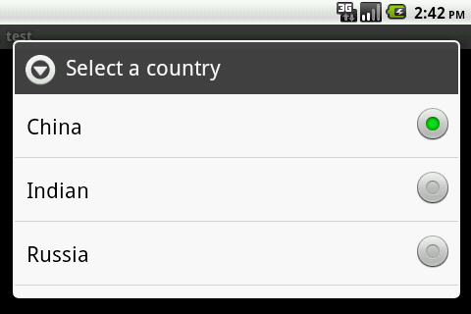
Adding checkboxes and radiobuttons
    SetMultiChoiceItems() to list a multiple choiceitems
    SetSingleChoiceItems() to list single-choice items
    -1 indicates no default item will be selected
final String[] countries = { "China", "Indian", "Russia", "Korea", "U.S" };
AlertDialog.Builder builder = new AlertDialog.Builder(this);
builder.setTitle("Select a country");
builder.setSingleChoiceItems(countries, -1, new DialogInterface.OnClickListener()
{
public void onClick(DialogInterface dialog, int item)
{
Toast.makeText(TestAlertDialogWithAListOfSingleItems.this, countries[item], Toast.LENGTH_SHORT).show();
}
});
builder.create().show();

Slide 12
Remember those Ajax preloaders, we have it in Android too.
ProgressDialog – which is a extension of the AlertDialog that can display a progress animation like a spinning wheel.
    Construct with ProgressDialog dialog = ProgressDialog.show(context, "",
    "Loading. Please wait...", true);
Progress bar – shows the progression with an animated progress bar: like those window installers have
    The same process as we did for progress dialog but we need to set another style to the progress style, by calling setProgressStyle()
    You can increment the amount of progress displayed in the bar by calling either setProgress() or incrementProgressBy() methods respectively

Slide 13
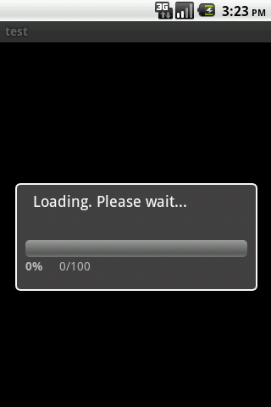
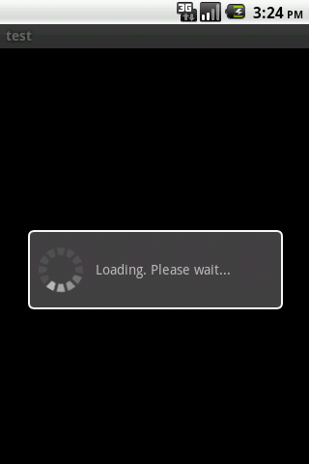

Slide 14
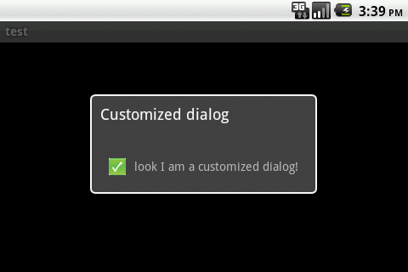
I know you want something personalized
Customized Dialog – means not using default dialog look provided by Android. You can create your own by defining a layout suits your need and apply it for dialog window. You can apply it by calling setContextView() and pass it the layout resource ID

Slide 15
The progress bar is not updating, how to make it work?
Android main UI thread, this is your only resource to deal with UI changes. Your code needs some sort of coordination with the UI thread and let the UI thread do the job for you, and you cannot just use your own thread to do UI modifications. Android doesn't allow you to do so.
UI modifications means adding new widgets to the activity, modify existing widgets, remove widgets from an activity.

Slide 16
Handlers – handler does its job on the main UI thread, so you can communicate with handler to do all UI work on behalf of you. Using handler you can offload work to child threads and retain the responsiveness of the main activity.
What we need to do is create an Handler instance per activity class and communicate with it in either of the following two ways:
    Messaging – by sending messages to a queue
    Runnable – write an runnable class and pass it to the handler object
Messages – in order to handle messages, you will have to implement handleMessage() method inside your handler class. Any UI related operations should come here. Try to minimize UI work, as handleMessage() is running, other threads are blocked

Slide 17
Messages continued
Get an instance of message by calling obtainMessage() on handler, an message instance will be returned from handler's message queue
Then send message to handler's message queue by calling one of the sendMessagexxxx() methods
You can carry data with message to handler's onMessage() by saving your data to a bundle and assign the bundle to the message
You can do your UI thingy in onMessage() method, now it's safe because it's inside handler, which can safely communicate with UI thread.

Slide 18
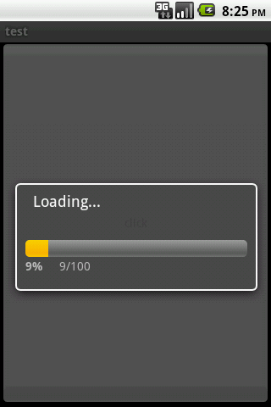
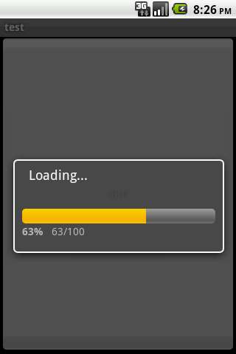
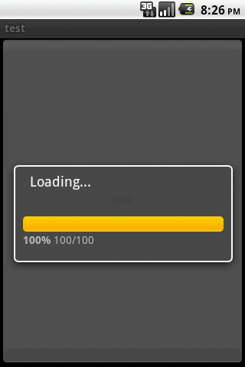
Working progress bar

Slide 19
Is there an alternative way to update progress bar?
Using runnable is another way to achieve same kind of thing, if you don't like to implement onMessage() method on Handler
Implement an old school Runnable, then pass it along to handler class, handler class then runs the runnables for you on the main UI thread.
Push to runnable to event queue by using one of the handlers' postxxxx() methods

Slide 20
Another alternative without using threads and/or handers
AsyncTask enables proper and easy use of the UI thread. This class allows to perform background operations and publish results on the UI thread.
The computation runs on a background thread, and it constantly pushes back to the UI thread.
4 steps,
    Step 1 onPreExecute() executed on UI right after task starts
    Step 2 doInBackground() executes after onPreExecute() returns, heavy computation happens here, can report progress by publishProgress(), values can be captured in onProgressUpdate() step in the UI thread

Slide 21
4 steps continued
    Step 3 onProgressUpdate() executed after invocation of onProgressUpdate(),
    Step 4 onPostExecute() after doInBackground() finishes its work.
    onPreExecute(), onPostExecute() and onProgressUpdate() are all invoked on the UI thread,The value returned by doInBackground() is sent to onPostExecute(),You can call publishProgress() at anytime in doInBackground() to execute onProgressUpdate() on the UI thread
Cautions when use AsyncTask
    Task must be declared in UI thread
    Execute() must be called in UI thread
    Methods in the above 4 steps cannot be called manually
    Task cannot be reused

Slide 22
Rule of thumb for Android UI
Do not block UI thread, ensure responsiveness
Make sure to access the Android UI toolkit only on the main UI thread

Slide 23
What's your preference
Your app should allow user to have their own preferences, things like, do you want to play the game in full-screen mode, turn the music on once the app launches, etc...
Using Shared Preference is one of several ways that Android offers you to save persistent data. Shared preferences store primitive data in key-value pairs
How to use them
    Editor you need an editor to read and write data, get an editor instance by calling SharedPreferences.edit()
    Read by calling readBoolean() and/or readString()
    Write by calling writeBoolean() and/or writeString()
    Once write, don't forget to commit by calling commit() on editor, all changes you committed, will be seen immediately by other components

Slide 24
Acquire preferences
    GetReferences() returns activity-level preferences
    GetSharedPreferences() returns application-level prefererences
    GetDefaultSharedPreferences() returns Android framework level preferences
Let the framework automatically persist preferences for us
    PreferenceActivity provides user activity framework to keep track of preferences, it automatically saves preferences to SharedPreferences as the user interacts with them
    Call getDefaultSharedPrefereces(android.content.Context) with a context(activity) to get an instance of SharedPreferences
    Use XML to define your preferences layout, and add it to res/xml/ give it an arbitrary name and xml as suffix

Slide 25
All the data will be stored in SharedPreferences by Android
Types of preference supported by Android
    CheckBoxPreference provides checkbox widget functionality, stores boolean value
    DialogPreference a dialog-based preference, stores string
    EditTextPreference text editor type of preference, stores string
    ListPreference displays a list of entries as dialog, stores string
    RingtonePreference a preference which allows user to choose a ringtone from the device, stores string
XML allows easier creation of a hierarchy of preferences, PreferenceScreen is the root element in the xml, it represents a PreferenceScreen object, nested PreferenceScreens are allowed, which means these scressn will be displayed in a different screen

Slide 26
You can group preferences by introducing PreferenceCategory to wrap around preferences that belongs to the same group
<PreferenceScreen
xmlns:android="http://schemas.android.com/apk/res/android"
android:key="first">
<CheckBoxPreference
android:key="locale"
android:title="Chinese" />
<PreferenceScreen
android:key="second"
android:title="Locale settings">
<CheckBoxPreference
android:key="prefer English"
android:title="Prefer English" />
</PreferenceScreen>
<PreferenceCategory android:title="category">
<CheckBoxPreference
android:key="musicPref"
android:title="music_title"
android:summary="music_summary"
android:defaultValue="true"/>
</PreferenceCategory>
</PreferenceScreen>

Slide 27
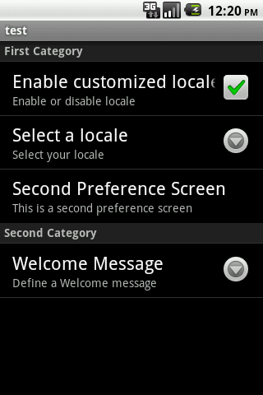
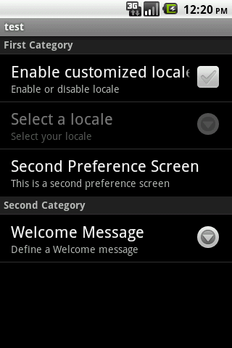
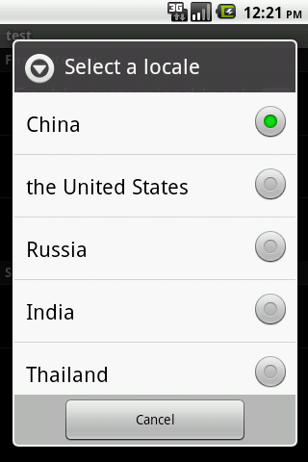

Slide 28
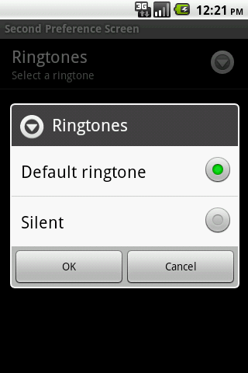
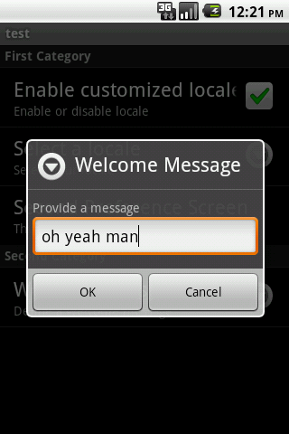
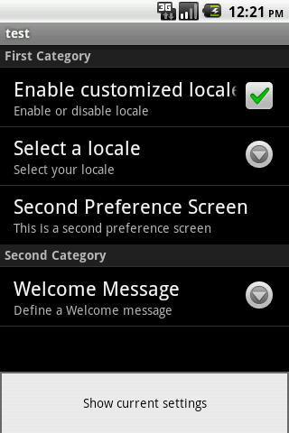
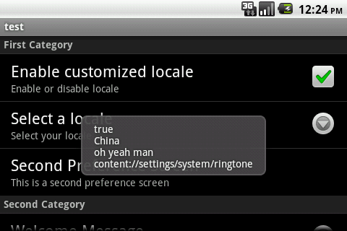

Slide 29
Use File System
Files created by your application can be saved on the device's internal storage.
Visibility of files – files are only visible in your application, other applications and even the user himself cannot view it. Files will be removed when application are uninstalled.
How to use it
    Call openFileOut() to get a FileOutPutStream
    Read or Write from/to the file with read() and/or write()
    Close() to release the stream when done
Keep in mind openFileOut() doesn't support path, you should only give a file name. Our example the file is saved at data/data/test.hello.world/files/file.txt

Slide 30
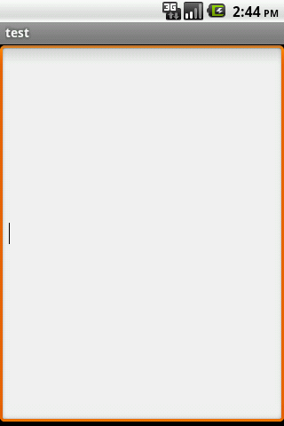
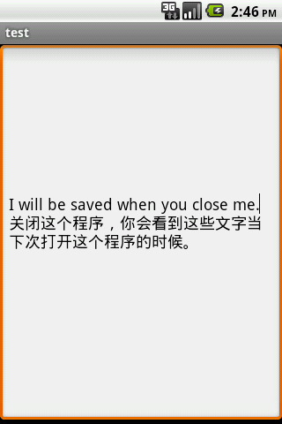

Slide 31
ROF a.k.a read only files
If you need some static list of data, that you don't want to hard code those in Java, you can separate them and write them in a file and put them under res/raw/ foler
Apk file will include them and ship them along with the application.
The files are saved under res/raw/ are read only , you cannot write/delete them.
How to read it
    Call openRawResource() passing the R.raw.fileName resource ID on Resource object, then you can readline() through all the contents in the file
    Other using methods, getFilesDir(), getDir(), fileList() and deleteFile()

Slide 32
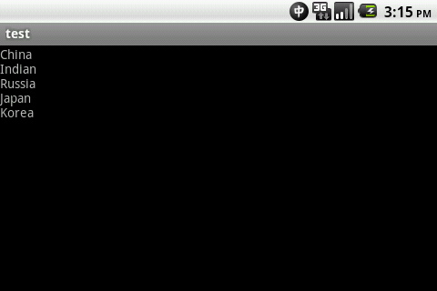
Countries.txt
China
Indian
Russia
Japan
Korea
private void readFile()
{
InputStream countriesRaw = getResources().openRawResource(R.raw.countries);
try
{
InputStreamReader inputStreamReader = new InputStreamReader(countriesRaw);
BufferedReader bufferedReader = new BufferedReader(inputStreamReader);
String string;
StringBuilder stringBuilder = new StringBuilder();
while ((string = bufferedReader.readLine()) != null)
{
stringBuilder.append(string + "\n");
}
countriesRaw.close();
textView.setText(stringBuilder.toString());
}
catch(Exception e)
{
Log.e("", e.getMessage());
}
}

Slide 33
Share files
You can save files to public folders so that they can be used by other applications, and when your application is deleted, the files will be preserved.
Public folders
    Alarms/
    Download/
    Music/
    Movies/
    Notifications
    Podcasts/
    Ringtones/
Use getExternalStoragePublicDirectory() passing it the type of public directory you want. For example, DIRECOTY_MUSIC for accessing the Music/ folder

Slide 34
Database - the light weight way
SQLite is a light weight, and memory efficient emebedded database, which has been used by many projects.
Android supports SQLite natively. Android has its own API rather than the heavy weight JDBC API.
SQL differs with other SQL-92 compliant version with the following diferences.
    Type is not enforced
    Foreign key is not supported
    No nested transactions, some outer joins aren't supports
We don't really need those features in Android app

Slide 35
SQLiteOpenHelper – this is the core class we use to do our database specific jobs, like creating tables, queries
Databases created by your application will be referenced by name, and it's invisible outside of the application
How to create tables
    Subclass SQLiteOpenHelper and execute SQLite command to create tables, views or triggers in onCreate() method
    OnUpdate() will be invoked when we modified the database, such table, view or trigger changes
How to get an database object,
    You can get a readable database by calling getReadableDatabase() and a writable database by calling getWritableDatabase(), database has various SQLite operations
    Query() methods allow you to do projections, selections, grouping.etc...

Slide 36
SQLite query will return a cursor that points to the rows returned from the query. You can iterate through the result set with the cursor.
OnCreate() method will be invoked only when the specific database doesn't exist and it will execute only once when the first time it's running on the device.
How to upgrade database, once you change your DDL, you want to push the change to the database, you can do so by override onUpdate() methods. This method will be invoked when the version number passed to the constructor changes.
Doing CRUDs with database with statements
    Pass SQL statements to db.execSQL(sql statements);

Slide 37
ContentValues and Cursors
You pass content value to database to insert, update and delete records, each content value represents a table record as a map of column names to values, you add key-value pair to content value by calling put(key, value)
Insertion
    ContentValues cv = new ContentValues();
    cv.put(“column”, value);
    .....................................
    db.insert(“table”,”nullColumn”,dv); db.close();
Update
    ContentValues cv = new ContentValues();
    cv.put(“column”, value);
    .....................................
    db.update(“table”,dv, where clause, values); db.close();

Slide 38
Deletion
    db.delete(table, where clause, where arguments)
    db.close()
Queries
    Pass statements to either db.rawQuery() or db.query()
    RawQuery()
      First parameter, query a select statement
      String[] selection not null if a where clause is in selection statements
      If primary key is not named _id,you will have to create an alias in selection as _id, because Cursor is expecting the primary key name as _id, otherwise it throws exception
    Query()
      Distinct – true if you want every row be unique
      Table - name
      Columns – list of columns to return, null for all columns
      Selection – filter declaring which rows to return, null for all rows
      GroupBy, having, orderBy, limit

Slide 39
Utilize cursors
    move(offset) move cursor by a relative amount forward or backward from current index
    MoveToFirst() move cursor to the first row, return false if result set is empty
    MoveToLast() move cursor to the last row, return false if the cursor is empty
    MoveToNext() move cursor to the next row, return false if cursor is already past the last row
    MoveToPosition () move cursor to the specified position, return false if the position is not valid
    MoveToPrevious () move cursor to the previous row, return false if result set is empty or current row is the first row in the result set
    GetCount, getColumnCount, getColumnName.......
    Close() close the cursor, releasing all of its resources and invalidate it.

Slide 40
How to investigate database with using Android API
Where is the db file
    /data/data/package_name/databases/db_name
    Pull database from device
        Adb pull <remote> <local> to transfer file from emulator to a folder on your computer
        Adb push <local> <remote> to transfer local file to emulator
        Or go to Eclipse ADT plugin to push and pull
        You can view dadabase with SQLite Database Browser
        Alternatively you can use SQLite firefox plugin to browse database
        Query the old school way by using console, see the screen shots for more details

Slide 41
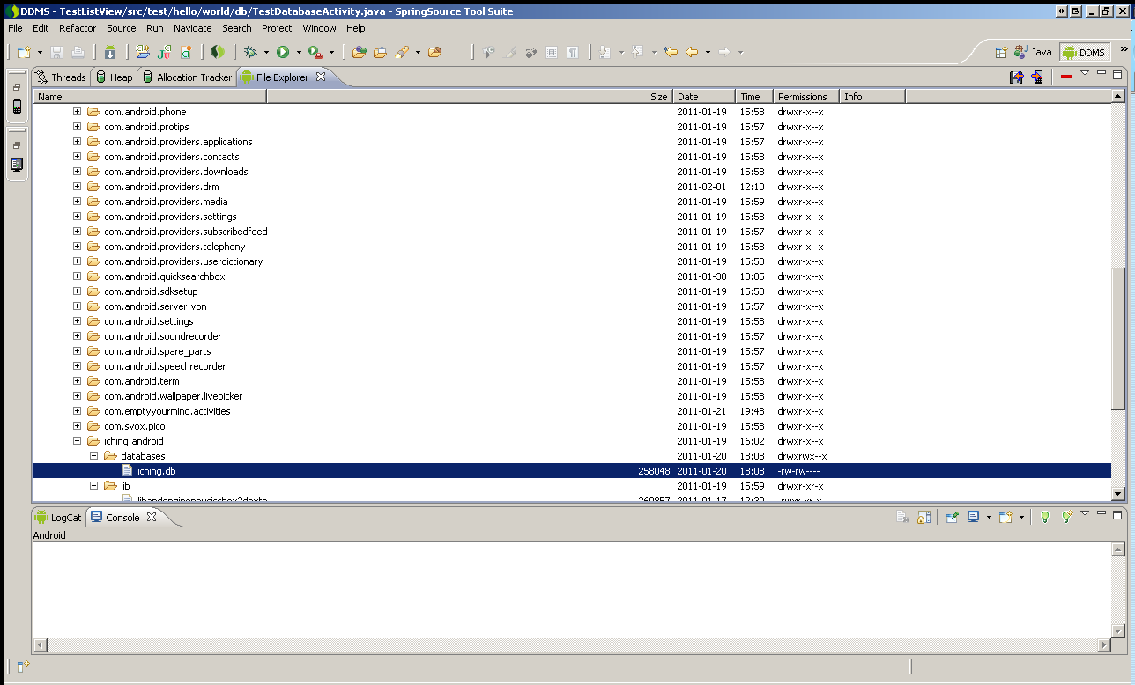

Slide 42
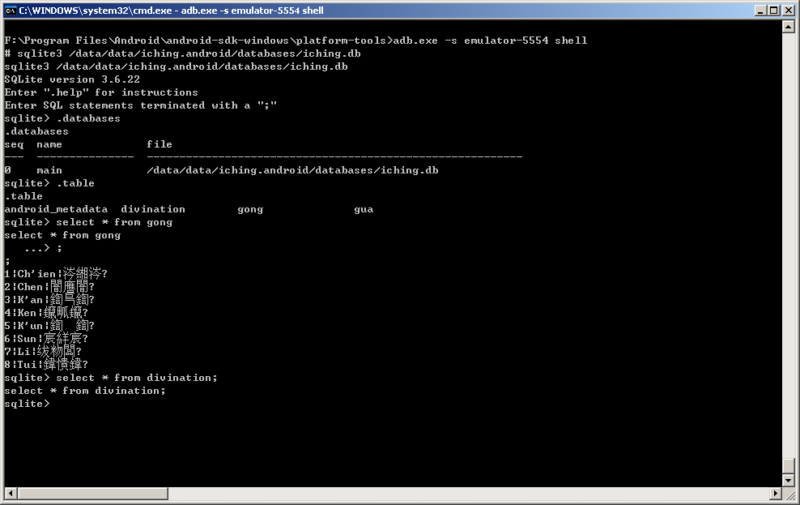

Slide 43
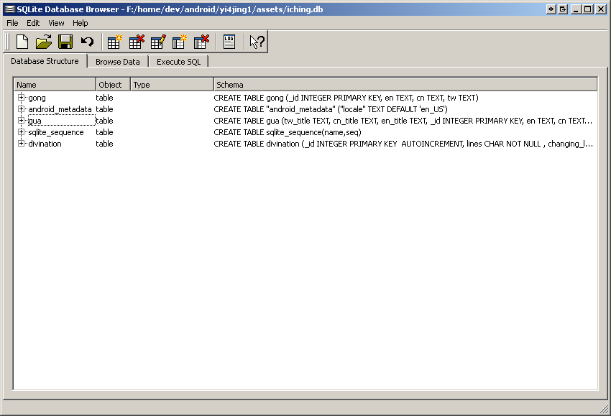

Slide 44
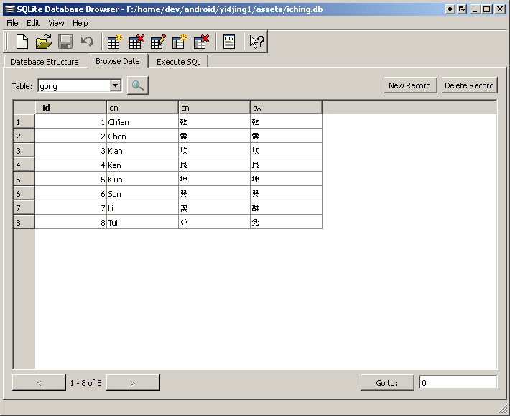

Slide 45
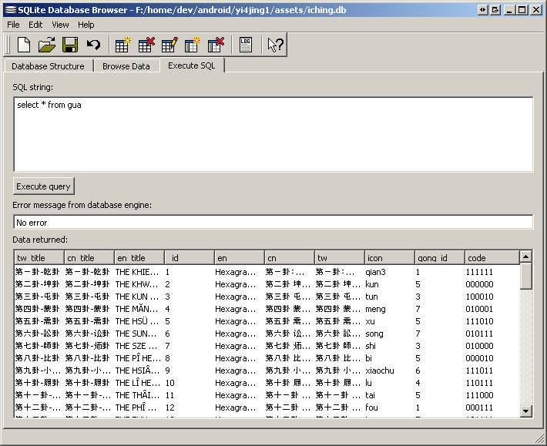

Slide 46
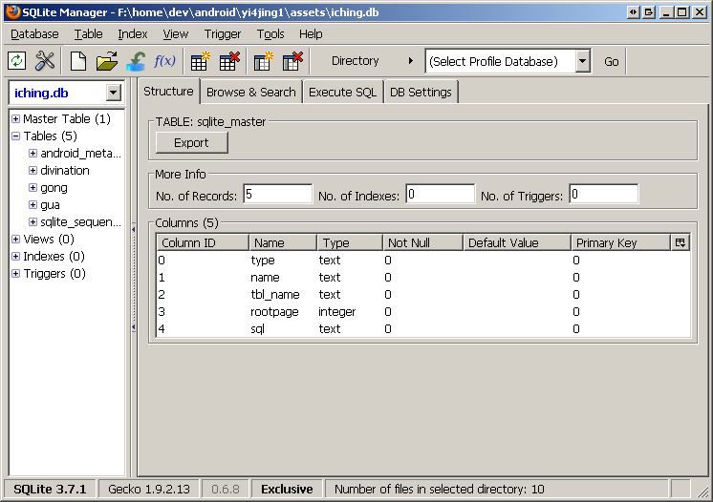

Slide 47
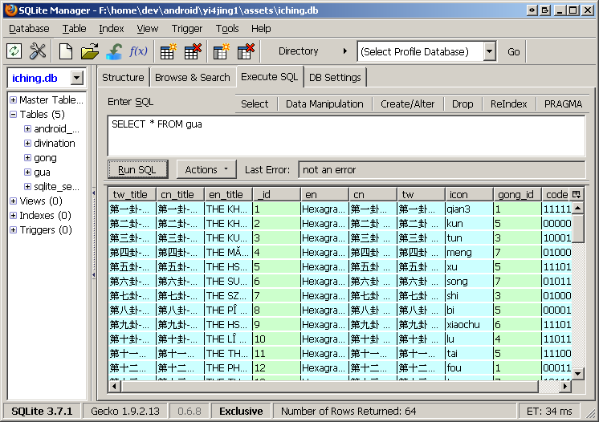

Slide 48
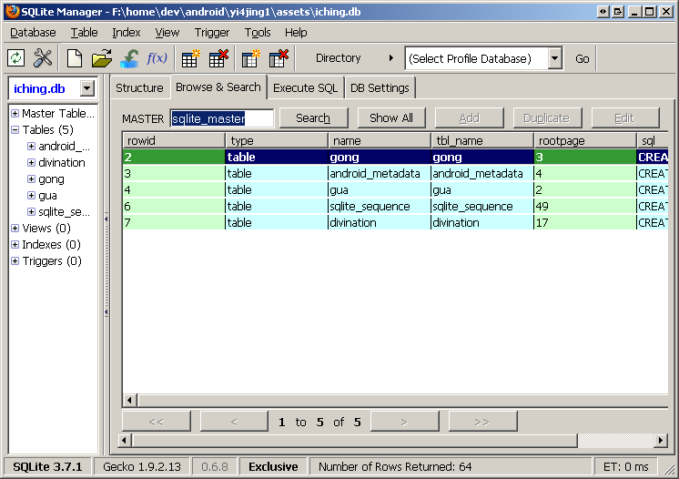

Slide 49
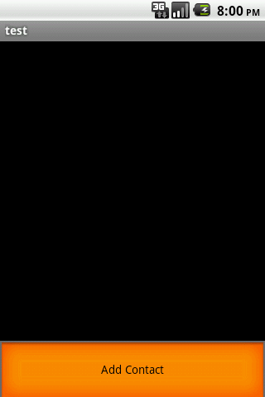
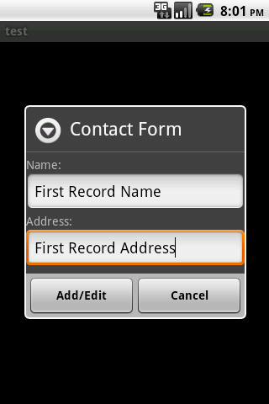
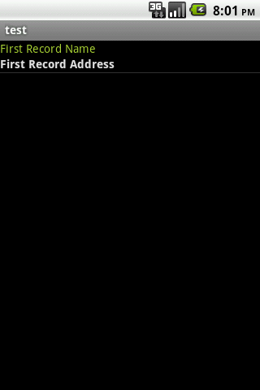

Slide 50
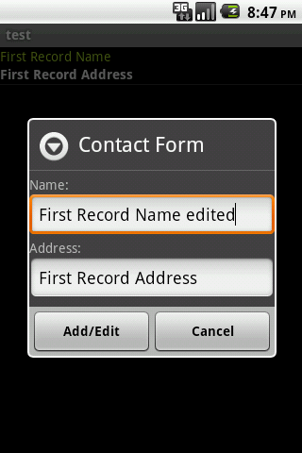
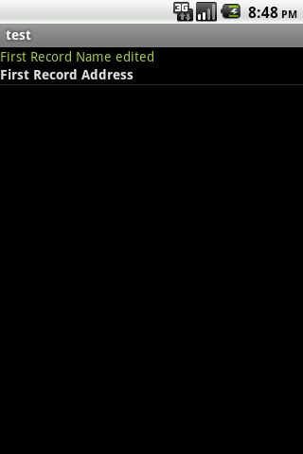

Slide 51
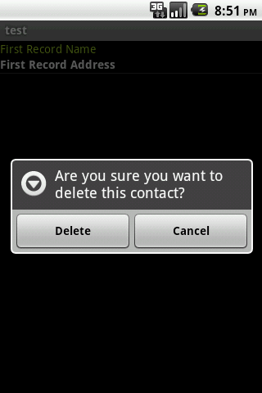


Slide 52
Content Provider
Using content provider is widely used in Android system to retrieve, update, add and delete information. It's been used for bookmarks, Contacts, phone-call logs, and so on.
Content providers make data manipulation available across all application. This mechanism is used to share data across different application.
Android provides a number of pre-built content providers for common data types(audio, video,images, contacts, bookmarks)
You can also provider your own content provider to publish your data for other applications

Slide 53
URI starts with prefix “content://” represents a resource that is provided by a content provider.
With an URI you can do CRUDs with the content provider, you only need to know what a content allows you to do but not the implementation details such as how and where they store the data.
As a content provider designer, it's up to you to decide how you want to persist your data. File system, SQLite database.... Choices are yours
Content provider URI is somewhat like restFul webservice style.
    Every content provider provider a public URI to uniquely identity one of its data set.

Slide 54
    Every URI starts with contents:// so don't forget to always include it at the beginning of every URI
    Because it should be unique, the convention of defining a content URI is to concatenate content:// with the full-qualified class name of the content provider.
    Example – content://test.hello.world.contentprovider
    More conventions
      content://test.hello.world.contentprovider/contacts/1
      content:// mandatory is required and indicating a content provider is serving it
      test.hello.world.contentprovider authority part of the URI, it defines the content provider.
      Contacts optional if the content provider supports only one type of data. It can be a few segements long like “contatcts/family”, “contacts/work”, and “contacts/socialclub”
      1 represents the value of primary key field(_id) of the queried record.
      content://test.hello.world.contentprovider/contacts, all contacts will be requested
Android ships with the following content providers: Browser, CallLog, Contacts, MediaStore,Setings

Slide 55
Let's rewrite last demo with content provider
When use sqlite as your underlying data storage with content provider.
    You are wrapping the communication to the database with content provide instead of talking database directly
    Content provider is a contract between your service and the clients.
    Analogy – content provider vs db
      Query
        content://authority/contacts is like select * from contact
        content://authority/contacts/1 is like select * from contact where_Id = 1
      Query template
        content://<authority>/<data>/<id>
Query within the activities
  ManagedQuery() is available in activity to query content provider

Slide 56
  Five pieces of information are needed to query a content provider
    URI content provider identifier
    Names of data fields you want to return (projection)
    Selection a where clause
    SelectionArgs the arguments to selection, if any ?s are present
    OrderBY, SQL ORDER BY clause
  You can query with the information list above with either ContentResolover.query or Activity.managedQuery(). They both return a cursor object, but managedQuery() version will also manage the life cycle of the cursor, which mean you don't need to explicitly close your cursor after use, requery, unloading it selt. If you use query() method you can still manage it by calling Activity.startManagingCursor() method

Slide 57
With a basis URI how do I append ID and additional path information to it
  ContentUris.withAppenedId() and Uri.withAppenedPath() make it easierto append id to a given URI
    Example
      CONTENT_URI content://authority/contacts
      Convert this to content://authority/contacts/1
      You can do either
        Uri uri = ContentUris.withAppendedId(CONTENT_URI, 1);
        Or
        Uri uri = Uri.withAppendedPath(CONTENT_URI, "1");
      Only difference between these two is withAppendedId takes integer as the second argument, while withAppendedPath takes string

Slide 58
Data turned by query is a set of database records. You can use the cursor to iterate through the data set, how to use cursor, you can read the code for database example we did previously or check the source code for this tutorial
CRUDs are done by the help of the ContentResolver class, which provides applications access to the content model
Adding records, construct a ContentValues Object as we did previously with database example, and pass the ContentResolver
  ContentVaues cv = new ContentValues();
  cv.put(key, value).........
  getContentResolover().insert(uri,vc);

Slide 59
  The insert method will return you an URI pointing to the newly inserted record
      content://authority/contacts/<newID>
  After you finish using the ContentValues, you can call clear() on it to clear all the values you put, and then reuse it for something else
  Update is similar to insertion but with optional where clause and selection arguments, you add the updates to a contentValue object and pass it along with URI to a content resolver
  Deletion call delete() on ContentResolver to delete a record, some records or all records depending on the where clause you passed
  For insertion there is an bulk version which enables user to added multiple values in one shot. The function might not run in one transaction so that the atomicity is not guaranteed, URL + array of CVs

Slide 60
How to create our own content provider
Before you create one, ask yourself Am I going to provide other applications my set of data, if yes, go implement one, otherwise you can just access you data from within your activities, like what we did in our database example
To create your content provider, you need to decide what storage option you want to use, file system, or SQLite database
Then Extend ContentProvider class, and override the methods suit your need
Finally, don't forget to declare your content providers in the manifest file

Slide 61
OnCreate()
  Initialize the provider, you can do initializations here, such as get an instance of SQLiteOpenHelper, this method is called on the application main thread at application launch time. So you should avoid lengthy operations from here
Query()
    Returns a cursor object so that client can use to iterate the requested result set
    This method is for retrieving both collection of data and sing record
Insert()
    Add your insertion logic here. If you want to notify interested party about the change, you should call notifyChange(), once it fires, all the registered observer will be notified that a new record has been added

Slide 62
Update()
  Update existing record/records here, after update, you can optionally call notifyChange() like insert() does
Delete()
  Delete one or more rows depending on the where clause and/or the URI pattern, very similar to update()
GetType()
  Implement this to handle requests for the MIME type of the data from a requested URI. The URI could represent a collection or an instance. In your code you need to add logic to extract this information.

Slide 63
MIME type formats
    Single format
      Single record vnd.android.cursor.item/vnd.packagename.contenttype
      Example
        URI content://packagename/android/123 might return this MIME type: vnd.android.cursor.item/vnd.packagename/phones
    Multiple format
      Multiple records
      vnd.android.cursor.dir/vnd.packagename.conenttype
      Example
        URI content://packagename/android might return this MIME type:
        vnd.android.cursor.dir/vnd.packagename.phones
Define URI for your content provider
  Public static final Uri CONTENT_URI = Uril.parse(“your uri starts with content://”); The string passed to parse() needs to be unique and the best way to do it is use fully-qualified class name in the uri.

Slide 64
Define the column names that your content provider wants to feed the clients. When use SQLite dabatase this means the names should conform to the table field names defined in the DDL. Keep in mind, always define an _id field in your SQLite database tables, give it a type of INTEGER and give it a PRIMARY KEY constraint. In many cases, Android will use this _id a lot. Without it, Android won't register content provider properly
After implementing the content provider, don't forget to include it in the manifest file.
    <provider android:name=".provider" android:authorities="fully_qualified class name;another fully_qualified class name; and so on" />

Slide 65
Using Permissions
<users-permission android:name=”permission”/>
    Permission user grants your application during installation time, otherwise your application won't function correctly
    This permission can only be acquired during the installation phase not while it's running
    android:name – possible values for this element
      Permission defined inside <permission> tag
      Permission specified in other applications
      Permission from Android framework. Such as “android.permission.READ_CONTACTS”
      Suggested naming convention
        Use package (name in lower case) as a prefix then add your permission name
A permission failure will result in a SecurityException being thrown, this is not guaranteed, in case of asynchronous call, the caller won't get notified by an exception.

Slide 66
When your permission is hardware related, be careful about Android Market auto filtering.
  <uses-permission android:name="...CAMERA" />
  when you publish your application with this permission, Android market assumes your application needs CAMERA, and will filter out your application from the device that doesn't have a camera.
  How to control filtering by the Market
    Always explicitly declare hardware features in<uses-feature> element.
    If you want to disable filtering for a particular feature, add android:required=”false” attribute to the <uses-feature> element
    For example
      <uses-feature android:name="android.hardware.camera" android:required=”false”/> to disable filtering camera by Android market

Slide 67
Declare and enforce permissions
Add one or more permission elements inside AndroidManifest.xml
  Sample -
  <permission android:name="packagename.permission_name"
  android:label="@string/permission_label"
    android:icon="drawable resource"
  android:description="@string/permission_desc"
  android:permissionGroup="permission_group"
  android:protectionLevel="protection_level" />
  android:protetionLevel characterizes the potential risk implied in a permission and indicates what the system should do when deciding whether or not to grant the permission
    Possible values are:
      Normal 0 lower-risk permission. Android system will automatically grants this type of permission at installation, without asking for user's explicit approval
      Dangerous 1 higher-risk permission that would give a requesting application access to user's private data or control over the device that negatively impact user. Because this type of permission introduces potential risk, Android system won't automatically grant it to requesting application. Any dangerous permission requested by an application may be displayed to user and require confirmation to proceed.
      Signature 2 a permission that the system grants only if the requesting application is signed with the same certificate as the application that declares the permission. If the certificates match, the system automatically grants the permission.
      SignatureOrSystem 3 don't need this, this is multiple vendors to have applications built into a system image which need to share specific features explicitly because they are built together.

Slide 68
  android:permissionGroup is used to display user the permission. Most of the time we will a standard system group
    android.permission-group.ACCOUNTS
      Access to accounts managed by account mananger
    android.permission-group.COST_MONEY
      Can cost money without user's direct involvement
    android.permission-group.DEVELOPMENT_TOOLS
      Permissions related to development features
    android.permission-group.HARDWARE_CONTROLS
      Permissions provide access to hardware
    android.permission-group.LOCATION
      Permissions to access user's current location
    android.permission-group.MESSAGES
      Permissions to send messages on behalf of user, or intercept messages received by user
    android.permission-group.NETWORK
      Permissions to access to networking services
    android.permission-group.PERSONAL_INFO
      Permissions to access user's private data, such as calendar events, email messages, contact.
    android.permission-group.PHONE_CALLS
      Permissions to intercept outgoing calls, modifying telephony states, reading and modifying phone state
    android.permission-group.STORAGE
      Permissions to access SD cards
    android.permission-group.SYSTEM_TOOLS
      Permissions to system APIs

Slide 69
android:label and android:description can reference to string resources so that they can be localized as needed. These are what use sees when he's viewing the list of permission you application needs. The label should be short. The description should be a concrete description of the permission. Android's convention is two sentences, the first describing the permission, the second describe the risks of granting the permission.
android:name
The name of the permission. This is the name that will be used in code to refer to the permission — for example, in a <uses-permission> element and the permission attributes of application components. The name must be unique, so it should use Java-style scoping — for example, "com.example.project.PERMITTED_ACTION".
android:icon
A reference to a drawable resource for an icon that represents the permission.

Slide 70
Places to enforce your permissions
At the time of a call into the system, to prevent an application from executing certain functions.
When starting an activity, to prevent applications from launching activities of other applications.
Both sending and receiving broadcasts, to control who can receive your broadcast or who can send a broadcast to you.
When accessing and operating on a content provider.
Binding to or starting a service.

Slide 71
Let's enforce permissions
Apply permissions globally
    Add android:permission attribute inside application tag, and specify your permissions there
Activity permissions (applied to the <atctivity> tag)
  Restrict who can start the associate activity, permissions will be checked during Context.startActivity() and Activity.startActivityForResult();If the caller doesn't have the privilege SecurityException will be raised
Service permissions (applied to the <service> tag)
  Restrict who can start and bind to the associated service. The permissions will be checked during Context.startService (),Context.stopService() and Context.bindService(). SecurityException will be raised when the caller doesn't have the permissions.
BroadCastReceiver permissions (applied to the <receiver> tag)
  Restrict who can send broadcasts to the associated receiver. The permission will be checked after Context.sendBroadcast() returns, as the system tries to deliver the submitted broadcast to the given receiver. Permission failure won't result in throwing SecurityException instead the system won't deliver the intent. You can also dynamically supply a permission to a receiver by calling Context.registerReceiver(). You can restrict which broadcast receiver can receive the broadcast by supply a permission when calling Context.sendBroadcast(). When both receiver and broadcaster require a permission, both permission checks have to pass for the intent to be delivered to the associated target.

Slide 72
  ContentProvider permission (applied to <provider>)
    Restrict who can access the data in a content provider.
    You can define two type of permissions
      android:readPermission restricts who can read from the provider
      android:writePermission restricts who can write to the provider
      If a provider is protected with both read and write permission, in case you have only write permission, you still won't read from provider.
    The permission will be checked when you first request it, if you don't have permission, SecurityException will be raised. For query(), you need a read permission, and for insert(), update() and delete() you will need write permission.
    URI permissions (advanced topic)
      Standard permissions are not sufficient for content providers. For example, a mail application has both read and write permission, and attachment needs to be displayed by an image view, but the image view doesn't have permission and it shouldn't.
      The solution to this problem is to add permission to each URI, when starting an activity or returning a result to an activity, the caller can set Intent.FLAG_GRANT_READ_URI_PEMISSION and/or Intent.FLAG_GRANT_WRITE_URI_PERMISION. This grants the receiving activity the permission access the specific data URI in the intent, regardless of whether it has permission to access the data in the content provider.

Slide 73
Services
Service is long-running background process usually doesn't need user's interaction. Like activity, service should be declared in manifest file in order to function correctly. Service might be still running when it's activity is killed by the system due to memory shortage.
Even though service is background process, this doesn't mean it's a separate process nor a thread.
Service is running in the main thread, if you are doing blocking operations like networking, or any CPU intensive operation, it's always a good idea to offload the work to a dedicated thread. So that ANR(Application not respond) won't occur, and make your application fluid and responsive to the user.
Service itself is actually very simple, providing two main features
    A facility to tell the system what it wants to do in the background. This corresponds to calls to Context.startService(), which signify the system to scheduler work for the service to run and stop until stops by service itself or someone stop it explicitly
    A facility for an application to expose some of its functionality to other application. This corresponds to Context.bindService(), which establish a connection between the service with its clients so that clients can operate on it.
    You can make service as simple or complex as your want: from treating it as a local Java object and make direct call on. Or providing a full remoteable interface using AIDL(Android Interface Definition Language advanced topic IPC)

Slide 74
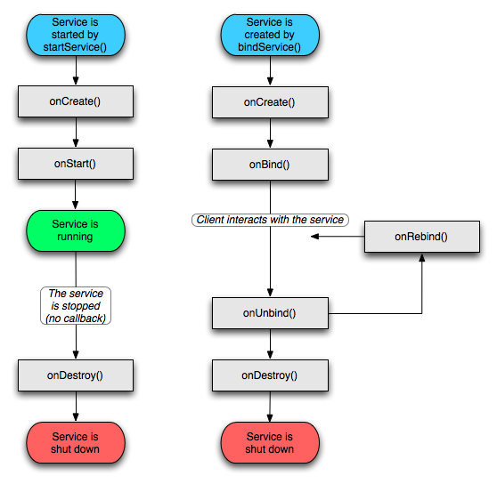
Service Lifecycle

Slide 75
Service can be started in two ways
  Started manually with Contenxt.startService() and stopped by calling Context.stopService(), or Service.stopSelf(), or Service.stopSelfResutl()
    After Context.startService() is called, a service will be retrieved and onCreate() will be called if the service hasn't been initiated , then onStartCommand(). The service now is active and continue running until a stopService() variation is called.
    Different value returned from onStartCommand() implies different service behavior when services starts.
      START_STICKY is used for services that are explicitly

Slide 76
  When clients bind to a service, clients can operate on a service anagrammatically. A connection can be established by calling Context.bindService() and relinquished by calling Context.unbindService(). If the service is not started, the first bindService() call will start it. Service started by Context.startService() can be used by Context.bindService() call. Multiple clients can bind to bind to the same service. In this case, stopService() will stop the service, when the last client's binding is relinquished.

Slide 77
Service Lifecycle methods

