Slide 1
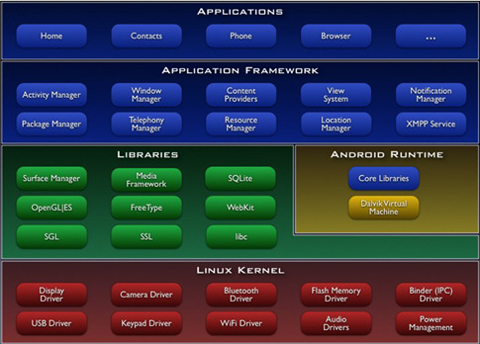
Android architecture

Slide 2
LINUX KERNEL (burgundy)
Linux kernel (abstract layer between hardware and software)
device drivers (Keypad, WiFi, Camera)
memory management,
process management
networking.
However you will never be programming to this layer directly

Slide 3
LIBRARIES (green)
Android native libraries written in C/C++
Surface Manager
2D and 3D graphics
Media codecs
SQL database
Native web browser engine

Slide 4
Android Runtime
Dalvik virtual machines. Dalvik runs dex files, which are converted at compile time from standard class and jar file. Dex files are more compact and efficient than class files, an important consideration for the limited memory and battery powered devices that android targets
The core Java libraries are also part of the Android run time. They are written in Java and a substantial subset of Java 5 SE packages.

Slide 5
Application Framework
Parts of the toolkit are provided by Google, and parts are extensions or services that developer write.
Activity manager is the most important component that manages the life cycle of applications.
Content provider(allows apps to share information)
Resource Manager (manage graphics, layout files)
Notification Manager(status update and beeps)

Slide 6
Application
This is where you application resides calendar, maps, a browser, and contacts. All application are written in Java (C/C++)
Application google writes have to go through the same public API, so you can tell Android to make your application replace standard application if you like.

Slide 7
Project Structure
AndroidManifest.xml application descriptor, define permission, activities, services, and so on.
build.xml, if ant is used to compile application.
default.properties only useful when use ant
src/: java source code
gen/: android generated code.
assets:/ static files, database files,fonts etc...

Slide 8
lib/: native lib extension
libs/: third party lib
res/: resoures, color list, graphics, layout, menu, audio files, localization files, xml
  res/drawable/: images(png, jpeg)
  res/layout/: xml-based UI layout portrait by default
  res/layout-land/: xml-based UI layout landscape
  res/anim/: xml-based animation declaration
  res/color/: xml-based color declaration for reuse purpose
  res/drawable/ res/drawable-hdpi res/drawable-ldpi res/drawable-mdpi density-dependent graphics put here
  res/menu/: xml-based menu items

Slide 9
Continuation of res/ folder structure
res/raw/: audio files
res/values/: styles, themes, attributes, colors, strings, arrays
Values-zh-rCN, values-zh-rTw locale folder for Chinese(simplified and traditional)
res/xml/: settings.xml for preference declaration

Slide 10
bin/: .apk file
bin/yourapp-packagename/: java class files
bin/classes.dex: dalvik executable
bin/xxxx.ap_: zipped application resources
xxxx.apk: contains resoureces.arsc(compiled resources),classes.dex, res,META-INF,lib,assets, AndroidManifest.xml. Digitally signed with debug key in order to run it in emulator, done by eclipse

Slide 11
The manifest file
Always named AndroidManifest.xml for all application.
XML based
Declaring application's components, linking non default Android library and specifying permissions the application needs to be granted.

Slide 12
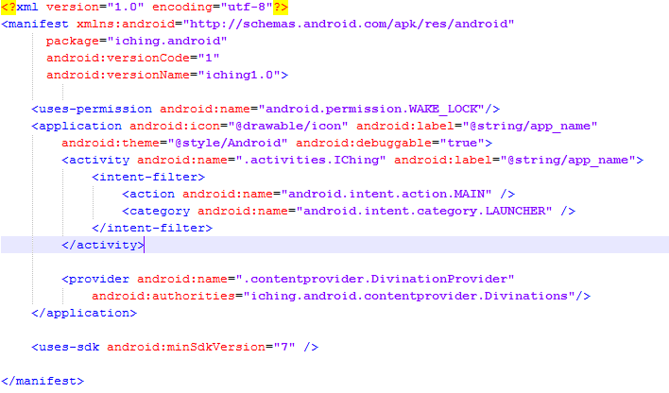

Slide 13
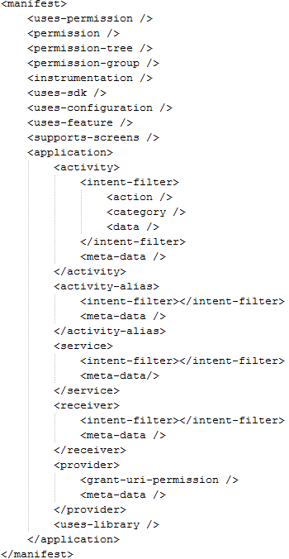

Slide 14
Intent
Three core components of an application – activities, services, and broadcaster receivers – are activated through intents.
A binding mechanism between components in the same or different applications.
It can be treated as a message or an notification and needs attention and an further operation needs to be performed
  Intent can be passed to Context.startActivity(), Activity.startActivityForResult() to launch an activity or get exsiting activity to do something new
  Intent passed to Context.startService() to initiate a service or deliver additional information to ongoing service

Slide 15
Intent passed to Context.bindService() to establish a connection between the caller and the target service. Initiating a service if it's not running
Intents passed to Context.sendBroadcast(), Context.sendOrderedBroadcast(), or Context.sendStickyBroadcast() are delivered to all registered broadcast receiver.
Broadcast intents are always delivered to broadcast receiver and never to activities or services

Slide 16
Dissecting the Intent
Component name - component that should handle this intent. How to use it? Component object can be set by setComponent(), setClass() or setClassName(). Component object is optional
Action – a string name the action to be performed, in case of broadcast intents, this indicated the action took place and is being reported. Intent class predefine some action constants. ACTION_CALL, ACTION_TIMEZONE_CHANGED..... can be set by setAction()

Slide 17
Data - an url to the data to be acted on and the MIME type of that data. ACTION_CALL, the data field would be a tel: URL with the number to call.Action ACTION_VIEW refers to http: URL, the receiving activity will display the content the URL pointing to. Some data type can be inferred, and some would need development to explicitly specify it in the intent object. SetData(), setType() and setDataType() are used for setting data and/or MIMIE type
Category – A string containing additional information about the kind of component that should handle this intent.

Slide 18
For example, CATEGORY_LAUNCHER means it should appear as a top-level application. CATEGORY_CAR_MODE indicates the activity can be used in a car enviroment. AddCategory() and removeCategory() are used for managing categories.
Extras - key-value pairs for carrying additional information to the component handling the intent. PutExtra() is used for adding key-value pair.
Flags – Flags of various sorts. Many instruct the Android system how to launch an activity and how to treat it after launched.(whether it belongs to a recent activities list)

Slide 19
Intention Resolution
Intent group, explicit and implicit
Explicit intents invoke target component by its name. Example category name. Should be used for application internal message, not crossing multiple applications
Implicit intents don't have category name and usually used to activate activities or services in other applications.
Components don't have intent filters can receive only explicit intents
Components with filters can receive both explicit and implicit intents.

Slide 20
Only action, data(both URL and MIME type) and category will be consulted when the object is tested against an intent filter.
Flags and extras are not part of the component resolving process

Slide 21
Intent filters
Nested in activity, activity-alias, service, and/or receiver
<intent-filter android:icon="drawableresource"
android:label="string resource"
android:priority="integer" >
</intent-filter>
Mandatory child element <action>
Optional <category> and <data>
Specify the types of intents an activity, service or broadcaster receiver and respond to

Slide 22
Activities, services and broadcast receivers need intent filters to inform system which implicit intents they can handle
Intent filter is an instance of the ItentFilter class, but we usually define it in AndroidManifest.xml as <intent-filter> elements, and Android will take care of creation of intent filters for us.
Action test – filter with no action element declared will block all intents
  If Intent object with no action declared automatically pass the test if at least one action is defined in the filter

Slide 23
Category test – every category in intent object must match a category in the filter, otherwise testing fails. Android adds “android.intent.category.DEFAULT” to every implicit intents. Therefore, for activities which expect to accept implicate intent have to include “android.intent.category.DEFAULT” in the filters. Only exception is for launchers which need “adnroid.intent.action.MAIN” and “android.intent.category.LAUNCHER”
Data test – Data consists two parts, URI and MIME type. URI consists 4 separate attributes, scheme, host, port and path.
  scheme://host:port/path
  Host + port constitute a URI authority

Slide 24
  When testing a URI, only the parts specified in filter will be compared.
  MIME TYPE “text/*” “video/mpeg|audio/mp3”
Intents with no URI nor MIME type passed the test only if the filter doesn't specify both.
Intents with only URI will pass only if the filter has a matching URI with no type specified, exmples – mailto: tel:
Intents with only MIME type specified only pass filter doesn't have URI defined with a matching MIME type defined.
Intents with both URI and type will pass data part only if its type matches the one listed in the filter and URI testing will be passed if filters have matching URI or if intents has URI consisting “content:” or “file:” and filter doesn't specify a URI

Slide 25
When Intents pass multiple component, System will prompt user to select one
When no component can be used to serve the intents, exception will be thrown.
SUMMARY
We use mostly explicit intents, because we know our target components, implicit intents are intended for cross application communications.

Slide 26
Permissions
Uses-permission – for application to function properly, application needs to monitor SMS messages<uses-permission android:name="android.permission.RECEIVE_SMS" />
Permissions – application requires other applications to have for proper communications
Instrumentation – it declares an Instrumentation class which enables you to monitor application's interaction with the underlying system. It's instantiated before any of the applications components

Slide 27
Uses-library- Specify optional libraries the application must be linked to. Default hooked-in packages are android.app, android.content, android.view and android.widget. If maps are needed, we need to specify it.
Support-screens – specify the screen dimensions the application supports
Activity – implements application UI. All activities must be declared in manifest file.
Activity-alias – as its name suggests it's an alias to an activity, named by targetActivity attribute, and the original activity must be within the same application and declared before alias

Slide 28
Application – declaration of your application.
Manifest – root of AndroidManifest.xml
Path-permission – limit access to content provider by adding permission to the path
Provider – declare content providers and like activities all content providers must be declared in manifest file
Receiver – broadcast receiver declaration. Broadcast receivers are designed to receive intents fired by the system or other applications.broadcast receiver doesn't need to be embedded in the manifest file and can be created in code.

Slide 29
Service – declare a service which does some background long-running jobs. Every service must be declared in manifest file in order to function.
Uses-configuration – specific hardware or software features the application needs. For example trackball, or physical keyboard needed
Uses-sdk – specify an API Level integer to indicate your application's compatibility with different version of android platform.

Slide 30
System Setup
JDK1.6
Eclipse
Android sdk
Android eclipse plugin
Windows

Slide 31
Java SDK - http://www.oracle.com/technetwork/java/javase/downloads/index.html
Eclipse - http://www.eclipse.org/downloads/
Android SDK - http://developer.android.com/sdk/index.html
ADT – go to eclipse and install new software add https://dl-ssl.google.com/android/eclipse/, restart eclipse after ADT installed.

Slide 32
Hello, world
Display “Hello,World” in a pop up window
Use non xml-based layout.
Code everything in Java code
AndroidManifest.xml

Slide 33
<?xml version="1.0" encoding="utf-8"?>
<manifest xmlns:android="http://schemas.android.com/apk/res/android"
package="test.hello.world"
android:versionCode="1"
android:versionName="1.0">
<application android:icon="@drawable/icon" android:label="@string/app_name">
<activity android:name=".Test"
android:label="@string/app_name">
<intent-filter>
<action android:name="android.intent.action.MAIN" />
<category android:name="android.intent.category.LAUNCHER" />
</intent-filter>
</activity>
</application>
<uses-sdk android:minSdkVersion="7" />
</manifest>

Slide 34
package test.hello.world;
import android.app.Activity;
import android.os.Bundle;
import android.view.View;
import android.view.View.OnClickListener;
import android.widget.Button;
import android.widget.Toast;
public class Test extends Activity implements OnClickListener
{
@Override
public void onCreate(Bundle savedInstanceState)
{
super.onCreate(savedInstanceState);
Button button = new Button(this);
button.setText("Click me");
button.setOnClickListener(this);
setContentView(button);
}
@Override
public void onClick(View arg0)
{
Toast.makeText(this, "Hello,World", Toast.LENGTH_SHORT).show();
}
}

Slide 35
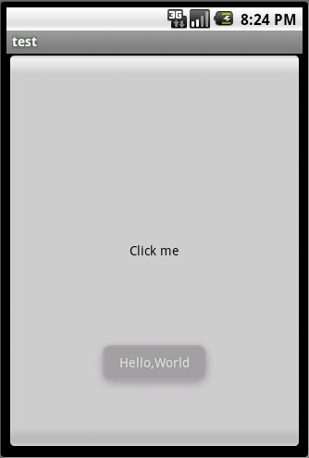

Slide 36
Separate Layout from logic
XML layout is like html page
XML is easier for WYSIWYG editor to interpret, and XML is easier to maintain than Java code as far as layout concern
XML vocabulary for declaring UI elements follow closely to the structure and naming of it counterpart classes and methods. Element name corresponds to Class name and attribute name corresponds to method name.
Layout XML starts with a root element which represents either a View or ViewGroup object.

Slide 37
Layout XML main.xml in res/layout
<?xml version="1.0" encoding="utf-8"?>
<LinearLayout xmlns:android="http://schemas.android.com/apk/res/android"
android:orientation="vertical"
android:layout_width="fill_parent"
android:layout_height="fill_parent"
>
<Button android:layout_width="fill_parent"
android:layout_height="wrap_content"
android:text="Test"
android:textColor="#ffffff"
android:textSize="30sp"/>
</LinearLayout>

Slide 38
Invoke xml layout inside Java
package test.hello.world;
import android.app.Activity;
import android.os.Bundle;
public class Test extends Activity
{
@Override
public void onCreate(Bundle savedInstanceState)
{
super.onCreate(savedInstanceState);
setContentView(R.layout.main);
}
}

Slide 39
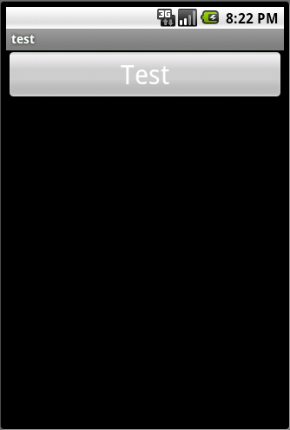

Slide 40
After application compiled, XML layouts will be compiled into View resources. In your activity's onCreate() method, you can use it by calling setContentView(...), and pass it the reference to your layout resource in form of R.layout.xxxx, here xxxx is your XML layout name without the suffix.
ID attribute most elements defined in the layout don't need to be referenced in Java code, in case you do need to reference them, you will have to use the following snippet adnroid:id=”@+id/toBeUsedInJava” so you can reference it in Java like: findViewById(R.id.toBeUsedInJava) @ give android instruction to add toBeUsedInJava in R.java file as a resource

Slide 41
Layout Parameters – layout_width, layout_height, possible values are wrap_content, fill_parent and integer value with measurement. When use integer value try to use as much density-independent pixel units as possible. This will ensure your application will display properly across many device screen sizes.
Layout position-
getLeft(), getTop(), getRight(), getBottom() get the left, top. Right, bottom relative to its direct parent.
Size, Padding and Margins -
Views only support padding but not margins, Viewgroup support margins

Slide 42
Common layouts
FrameLayout – all elements are positioned at top left corner. Subsequent views will be layered over previous views.
LinearLayout – supports horizontal and vertical direction, supports margin, gravity, weight to its children.
TableLayout – position its children into rows and columns.
RelativeLayout – elements are positioned relative to each other. Referenced element must be declared before element references it

Slide 43
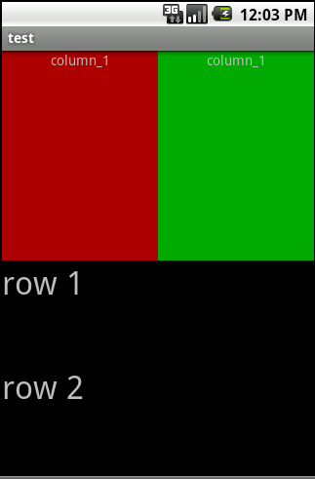
LinearLayout sample
<?xml version="1.0" encoding="utf-8"?>
<LinearLayout xmlns:android="http://schemas.android.com/apk/res/android"
android:orientation="vertical"
android:layout_width="fill_parent"
android:layout_height="fill_parent">
<LinearLayout
android:orientation="horizontal"
android:layout_width="fill_parent"
android:layout_height="fill_parent"
android:layout_weight="1">
<TextView
android:text="column_1"
android:gravity="center_horizontal"
android:background="#aa0000"
android:layout_width="wrap_content"
android:layout_height="fill_parent"
android:layout_weight="1"/>
<TextView
android:text="column_2"
android:gravity="center_horizontal"
android:background="#00aa00"
android:layout_width="wrap_content"
android:layout_height="fill_parent"
android:layout_weight="1"/>
</LinearLayout>
<LinearLayout
android:orientation="vertical"
android:layout_width="fill_parent"
android:layout_height="fill_parent"
android:layout_weight="1">
<TextView
android:text="row 1"
android:textSize="15pt"
android:layout_width="fill_parent"
android:layout_height="wrap_content"
android:layout_weight="1"/>
<TextView
android:text="row 2"
android:textSize="15pt"
android:layout_width="fill_parent"
android:layout_height="wrap_content"
android:layout_weight="1"/>
</LinearLayout>
</LinearLayout>

Slide 44
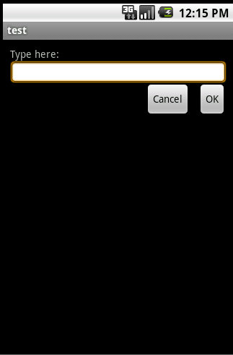
RelativeLayout sample
<?xml version="1.0" encoding="utf-8"?>
<RelativeLayout xmlns:android="http://schemas.android.com/apk/res/android"
android:layout_width="fill_parent"
android:layout_height="wrap_content"
android:padding="10px" >
<TextView
android:layout_width="fill_parent"
android:layout_height="wrap_content"
android:text="Type here:" />
<EditText
android:layout_width="fill_parent"
android:layout_height="wrap_content"
android:background="@android:drawable/editbox_background"
android:layout_below="@id/label" />
<Button
android:layout_width="wrap_content"
android:layout_height="wrap_content"
android:layout_below="@id/entry"
android:layout_alignParentRight="true"
android:layout_marginLeft="10px"
android:text="OK" />
<Button android:layout_width="wrap_content"
android:layout_height="wrap_content"
android:layout_toLeftOf="@id/ok"
android:layout_alignTop="@id/ok"
android:text="Cancel" />
</RelativeLayout>

Slide 45
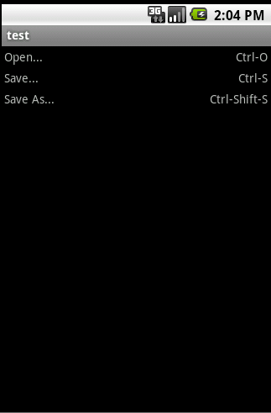
TableLayout sample
<?xml version="1.0" encoding="utf-8"?>
<TableLayout xmlns:android="http://schemas.android.com/apk/res/android"
android:layout_width="fill_parent"
android:layout_height="fill_parent"
android:stretchColumns="1">
<TableRow>
<TextView
android:layout_column="1"
android:text="Open..."
android:padding="3dip" />
<TextView
android:text="Ctrl-O"
android:gravity="right"
android:padding="3dip" />
</TableRow>
<TableRow>
<TextView
android:layout_column="1"
android:text="Save..."
android:padding="3dip" />
<TextView
android:text="Ctrl-S"
android:gravity="right"
android:padding="3dip" />
</TableRow>
<TableRow>
<TextView
android:layout_column="1"
android:text="Save As..."
android:padding="3dip" />
<TextView
android:text="Ctrl-Shift-S"
android:gravity="right"
android:padding="3dip" />
</TableRow>
</TableLayout>

Slide 46
More on layout
ListView - A view that shows items in a vertically scrolling list. The data sources come from the ListAdapter associated with this view.
TabView – A control enables user to swap to views within the same activity or different activities. For tabbed UI, TablHost and TabWidget will be needed and TabHost must be the root node for the layout.
GridView – A view that shows items in two dimensional scrollable grid. The items are automatically populated by a ListAdapter
ScrollView – A view that allows it to be larger than the physical display.

Slide 47
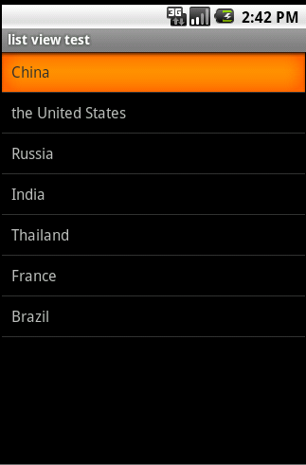
ListView Sample
<?xml version="1.0" encoding="utf-8"?>
<TextView xmlns:android="http://schemas.android.com/apk/res/android"
android:layout_width="fill_parent"
android:layout_height="fill_parent"
android:padding="10dp"
android:textSize="16sp" >
</TextView>

Slide 48
TabView Sample
State-list drawable – drawable object defined in XML to display different image for the same graphic, depending on the state of the object.
<?xml version="1.0" encoding="utf-8"?>
<selector xmlns:android="http://schemas.android.com/apk/res/android">
<!-- When selected, use grey -->
<item android:drawable="@drawable/tab_grey"
android:state_selected="true" />
<!-- When not selected, use white-->
<item android:drawable="@drawable/tab_white" />
</selector>

Slide 49
<?xml version="1.0" encoding="utf-8"?>
<TabHost xmlns:android="http://schemas.android.com/apk/res/android"
android:id="@android:id/tabhost"
android:layout_width="fill_parent"
android:layout_height="fill_parent">
<LinearLayout
android:orientation="vertical"
android:layout_width="fill_parent"
android:layout_height="fill_parent"
android:padding="5dp">
<TabWidget
android:id="@android:id/tabs"
android:layout_width="fill_parent"
android:layout_height="wrap_content" />
<FrameLayout
android:id="@android:id/tabcontent"
android:layout_width="fill_parent"
android:layout_height="fill_parent"
android:padding="5dp" />
</LinearLayout>
</TabHost>

Slide 50
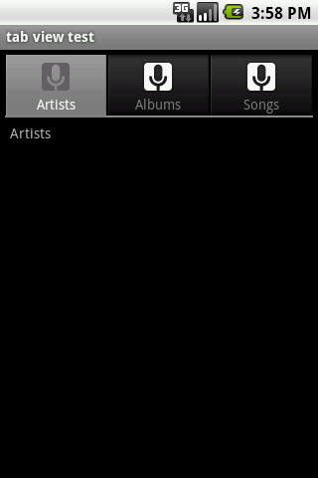
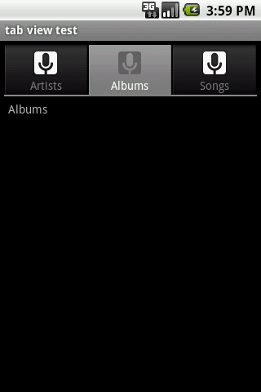
"@android:id/tabs" and "@android:id/tabcontent" are mandatory so that TabHost can reference them.

Slide 51
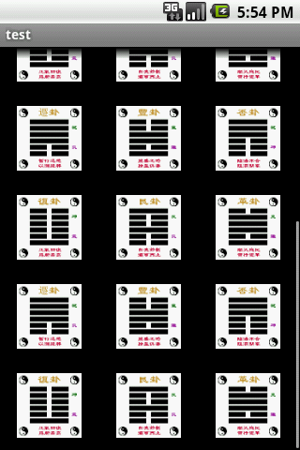
GridView Sampe
<?xml version="1.0" encoding="utf-8"?>
<GridView xmlns:android="http://schemas.android.com/apk/res/android"
android:id="@+id/gridview"
android:layout_width="fill_parent"
android:layout_height="fill_parent"
android:columnWidth="90dp"
android:numColumns="auto_fit"
android:verticalSpacing="10dp"
android:horizontalSpacing="10dp"
android:stretchMode="columnWidth"
android:gravity="center"
/>

Slide 52
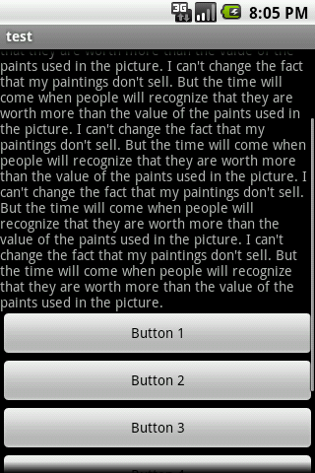
ScrollView Sample
<?xml version="1.0" encoding="utf-8"?>
<ScrollView xmlns:android="http://schemas.android.com/apk/res/android"
android:layout_width="fill_parent" android:layout_height="wrap_content">
<LinearLayout xmlns:android="http://schemas.android.com/apk/res/android"
android:orientation="vertical" android:layout_width="fill_parent"
android:layout_height="fill_parent">
<TextView android:layout_width="fill_parent"
android:layout_height="wrap_content" android:id="@+id/txt" />
<Button android:layout_width="fill_parent"
android:layout_height="wrap_content" android:text="Button 1" />
<Button android:layout_width="fill_parent"
android:layout_height="wrap_content" android:text="Button 2" />
<Button android:layout_width="fill_parent"
android:layout_height="wrap_content" android:text="Button 3" />
<Button android:layout_width="fill_parent"
android:layout_height="wrap_content" android:text="Button 4" />
<Button android:layout_width="fill_parent"
android:layout_height="wrap_content" android:text="Button 5" />
<Button android:layout_width="fill_parent"
android:layout_height="wrap_content" android:text="Button 6" />
</LinearLayout>
</ScrollView>

Slide 53
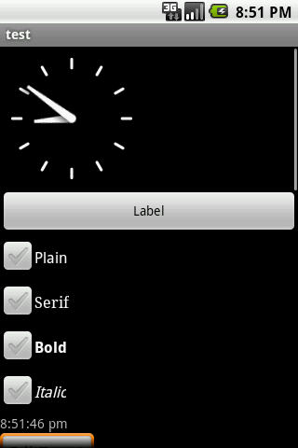
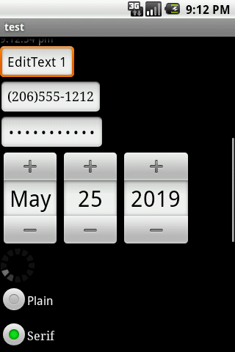
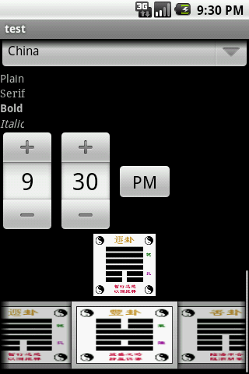
Built-in Widgets

Slide 54
SlidingDrawer control
SlidingDrawer hides content out of the screen and allows the user to drag a handle to bring the content on screen. SlidingDrawer can be used vertically or horizontally.

Slide 55
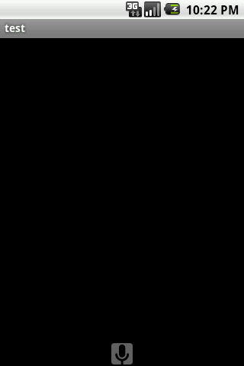
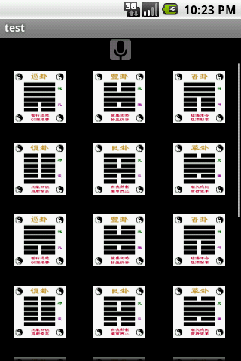
<?xml version="1.0" encoding="utf-8"?>
<FrameLayout xmlns:android="http://schemas.android.com/apk/res/android"
android:layout_width="fill_parent" android:layout_height="fill_parent">
<SlidingDrawer android:id="@+id/drawer" android:handle="@+id/handle"
android:content="@+id/content" android:layout_width="fill_parent"
android:layout_height="wrap_content">
<ImageView android:id="@id/handle" android:layout_width="wrap_content"
android:layout_height="wrap_content" android:src="@drawable/tab_grey" />
<GridView android:id="@id/content" android:layout_width="fill_parent"
android:layout_height="fill_parent" android:columnWidth="90dp"
android:numColumns="auto_fit" android:verticalSpacing="10dp"
android:horizontalSpacing="10dp" android:stretchMode="columnWidth"
android:gravity="center" />
</SlidingDrawer>
</FrameLayout>

Slide 56
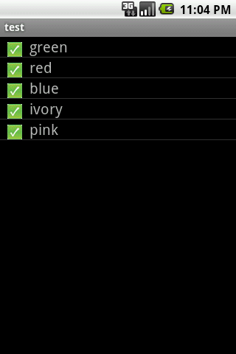
Customize ListView
<?xml version="1.0" encoding="utf-8"?>
<LinearLayout xmlns:android="http://schemas.android.com/apk/res/android"
android:orientation="horizontal" android:layout_width="fill_parent"
android:layout_height="wrap_content">
<ImageView android:id="@+id/icon" android:layout_width="wrap_content" android:layout_height="wrap_content"
android:paddingLeft="10dip"
android:paddingRight="10dip"
android:src="@drawable/gcm"
android:layout_gravity="bottom"
/>
<TextView android:id="@+id/label"
android:layout_width="wrap_content"
android:layout_height="wrap_content"
android:textSize="20sp"
/>
</LinearLayout>

Slide 57
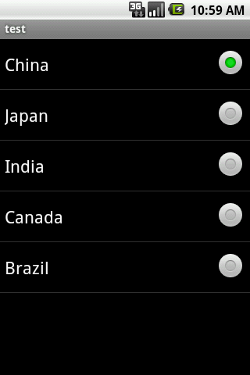
Customized ListView Sample
<?xml version="1.0" encoding="utf-8"?>
<LinearLayout
xmlns:android="http://schemas.android.com/apk/res/android"
android:orientation="vertical"
android:layout_width="fill_parent"
android:layout_height="fill_parent" >
<ListView
android:id="@android:id/list"
android:layout_width="fill_parent"
android:layout_height="fill_parent"
/>
</LinearLayout>

Slide 58
L10N a.k.a localization
Localized application by adding resources to res/ directory, and Android framework will selectively load resources during run-time.
Values/ : is for default locale, and values-zh-rCN is for simplified Chinese.
<?xml version="1.0" encoding="utf-8"?>
<resources>
<string name="open">打开...</string>
</resources>
<?xml version="1.0" encoding="utf-8"?>
<resources>
<string name="app_name">test</string>
<string name="open">Open...</string>
<string name="command">Ctrl-o</string>
</resources>

Slide 59
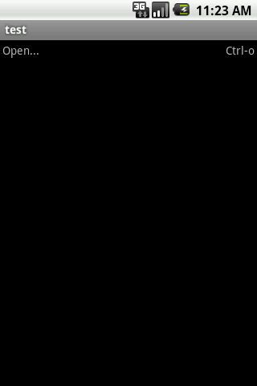
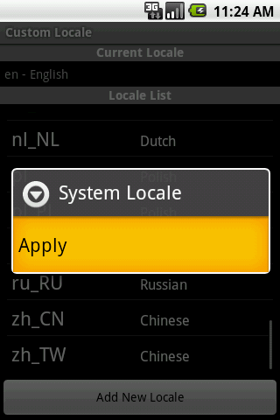
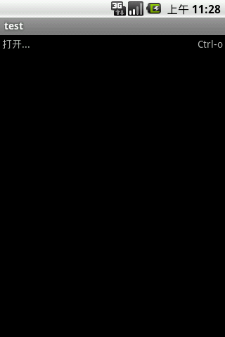

Slide 60
More on resources
Strings, colors, arrays, and dimensions are sitting in res/values.(res/values/)
Graphics are sitting in res/drawable/, res/drawable-hdpi/,res/drawable-mdpi/,res/drawable-hlpi/, depending on what screen density your application supports.
Raw are for audios and videos(res/raw/)
XML are for static XML files sitting in (res/xml/)

Slide 61
Static texts should always be put into resource bundle so it's easier to support i18n and i10n. Android supports simple inline styles which include bold, italic etc...
strings.xml snippet
<?xml version="1.0" encoding="utf-8"?>
<resources>
<string name="app_name">test</string>
<string name="open">Open...</string>
<string name="command">Ctrl-o</string>
</resources>

Slide 62
Access String resoure in Java
getString(R.string.app_name)
Animation
res/anim/ - XML files describe animations.
  Tween Animation – define start and end frame, Android does a series transformations in between.
  Frame Animation – frame-based animation, developer need to specify a sequence of images in order

Slide 63
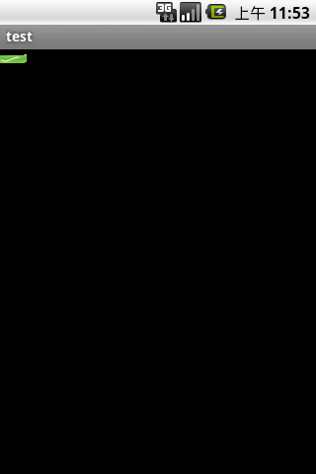
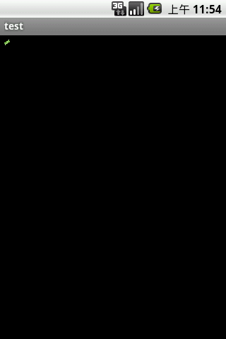

Animation sample
<set xmlns:android="http://schemas.android.com/apk/res/android"
android:shareInterpolator="false">
<scale
android:interpolator="@android:anim/accelerate_decelerate_interpolator"
android:fromXScale="1.0"
android:toXScale="1.4"
android:fromYScale="1.0"
android:toYScale="0.6"
android:pivotX="50%"
android:pivotY="50%"
android:fillAfter="false"
android:duration="700"
android:repeatCount="infinite"/>
<set
android:interpolator="@android:anim/accelerate_interpolator"
android:startOffset="700">
<scale
android:fromXScale="1.4"
android:toXScale="0.0"
android:fromYScale="0.6"
android:toYScale="0.0"
android:pivotX="50%"
android:pivotY="50%"
android:duration="400"
android:repeatCount="infinite"/>
<rotate
android:fromDegrees="0"
android:toDegrees="-45"
android:toYScale="0.0"
android:pivotX="50%"
android:pivotY="50%"
android:duration="400"
android:repeatCount="infinite"/>
</set>
</set>

Slide 64
Color State List Resource
An object can be applied as a color, but will vary as the state of the view changes.
Define XML start with <selector> which consists of <item> elements that define color information of each state of the view.
<?xml version="1.0" encoding="utf-8"?>
<LinearLayout xmlns:android="http://schemas.android.com/apk/res/android"
android:layout_width="fill_parent" android:layout_height="fill_parent"
android:gravity="center">
<Button android:layout_height="wrap_content" android:text="color state list"
android:layout_width="wrap_content" android:id="@+id/Button01" android:textColor="@color/button_color"/>
</LinearLayout>
<?xml version="1.0" encoding="utf-8"?>
<selector xmlns:android="http://schemas.android.com/apk/res/android">
<item android:state_pressed="true" android:color="#ffff0000"/>
<item android:state_focused="true" android:color="#ff0000ff"/>
<item android:color="#ff000000"/>
</selector>

Slide 65
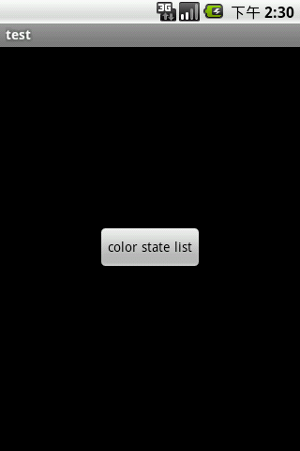
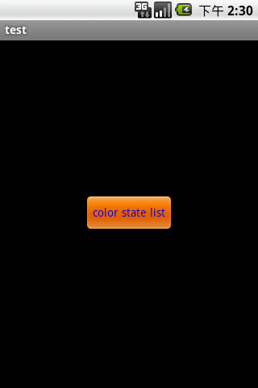

Slide 66
What else can be put into string.xml
String Array
<?xml version="1.0" encoding="utf-8"?>
<resources><string-arrayname="string_array_name">
<item>text_string</item>
</string-array>
</resources>
Plurals- A pair of strings that each provide a different plural form of word/phrase.
<?xml version="1.0" encoding="utf-8"?>
<resources>
<plurals name="numberOfAppsDone">
<item quantity="one">One app done.</item>
<item quantity="other">%d apps done.</item>
</plurals>
</resources>
int count = new Random().nextInt(10);
String appDone = getResources().getQuantityString(R.plurals.numberOfAppsDone, count);

Slide 67
Formatting and Styling-
escaping apostrophes and quotes
<string name="good_example">"This'll work"</string>
<string name="good_example_2">This\'ll also work</string>
<string name="bad_example">This doesn't work</string>
<string name="bad_example_2">XML encodings don&apos;t work</string>
Formatting strings
<string name=”stringToBeFormatted”>Welcom, %1$s</string>
String message = (getResources().getString(R.string.stringToBeFormatted), “new user”);
Basic markup
<?xml version="1.0" encoding="utf-8"?>
<resources>
<string name="welcome">Welcome to <i><u><b>Android</b></u></i>!</string>
</resources>

Slide 68
Dimensions – describing distances, measurements are available in px, in, mm,pt, dip and sp(res/values/xxx.xml)
  Px, in, mm, pt are actual device's physical size
  Dip and sp are density-dependent, they are not device-dependent nor scale-dependent
  <?xml version="1.0" encoding="utf-8"?>
  <resources>
  <dimen name="textview_height">25dp</dimen>
  <dimen name="font_size">16sp</dimen>
    </resources>
    <TextView
    android:layout_height="@dimen/textview_height"
    android:layout_width="fill_parent"
    android:textSize="@dimen/font_size"/>
    Resoureces.getDimension(R.dimen.font_size);

Slide 69
Bool – defines boolean values in XML(res/values/)
<?xml version="1.0" encoding="utf-8"?>
<resources>
<bool name="screen_small">true</bool>
<bool name="adjust_view_bounds">true</bool>
</resources>
Resources.getBoolean(R.bool.screen_small);
<ImageView
android:layout_height="fill_parent"
android:layout_width="fill_parent"
android:src="@drawable/image"
android:adjustViewBounds="@bool/adjust_view_bounds" />

Slide 70
Color – defines color in XML color can be used any where that accepts a hex color value, and also wherever a drawable resource is use, color value always starts with an hash sign. Followed by ARGB, samples #RGB, #ARGB, #RRGGBB and #AARRGGBB(res/value/colors.xml)
  <?xml version="1.0" encoding="utf-8"?>
  <resources>
  <color name="opaque_red">#f00</color>
  </resources>
  Resource.getColor(R.color.opaque_red);
  <TextView
  android:layout_width="fill_parent"
  android:layout_height="wrap_content"
  android:textColor="@color/translucent_red"
  android:text="translucent red"/>

Slide 71
ID – define unique resource ID in XML and Android will create an unique integer for each ID define in the resource.(res/values/xxxx.xml)
<?xml version="1.0" encoding="utf-8"?>
<resources>
<item type="id" name="unique_button" />
</resources>
<Button android:id="@id/unique_button" style="@style/button_style" />
R.id.unique_button
Integer – predefined integer values associated with names that can be referred by name(res/values/xxx.xml)
<?xml version="1.0" encoding="utf-8"?>
<resources>
<integer name="max_age">75</integer>
<integer name="min_age">25</integer>
</resources>
Resources.getInteger(R.integer.max_age);

Slide 72
Integer Array – integer array referenced by name(res/values/xxxx.xml)
<?xml version="1.0" encoding="utf-8"?>
<resources>
<integer-array name="power_of_two">
<item>0</item>
<item>2</item>
<item>4</item>
<item>8</item>
</integer-array>
</resources>
Resources.getIntArray(R.array.power_of_two);

Slide 73
Typed Array – used to created an array of other resources. The items are not required to be the same type. (res/values/xxxx.xml)
<?xml version="1.0" encoding="utf-8"?>
<resources>
<array name="icons">
<item>@drawable/home</item>
</array>
<array name="colors">
<item>#FFFF0000</item>
<item>#FF00FF00</item>
</array>
</resources>
TypedArray icons = Resources.obtainTypedArray(R.array.icons);
Drawable drawable = icons.getDrawable(0);

Slide 74
Drawable
Bitmp png, jpg, and gif (res/drawable/xxx.png)
<ImageView android:layout_height="wrap_content" android:layout_width="wrap_content" android:src="@drawable/myimage" />
XML Bitmap – an alternative way of defining raw bitmap, it supports additional settings
(res/drawable/xxx.xml)
<?xml version="1.0" encoding="utf-8"?>
<bitmap xmlns:android="http://schemas.android.com/apk/res/android"
android:src="@drawable/wallpaper" android:tileMode="repeat" />
Nine-Patch – PNG file centre region is stretchable when content expand the centre regions will grow automatically to accommodate contents. (res/drawable/xxx.9.png)

Slide 75
<Button android:layout_height="wrap_content" android:layout_width="wrap_content"
android:background="@drawable/xxxx" />
XML nine-patch – support dithering while its counter part doesn't (res/drawable/xxx.xml)
<?xml version="1.0" encoding="utf-8"?>
<nine-patch xmlns:android="http://schemas.android.com/apk/res/android"
android:src="@drawable/myninepatch" android:dither="false" />
Layer List – define a list of other drawables that stacks on top of each other. The last item will be on the top(res/drawable/xxxx.xml)

Slide 76
<?xml version="1.0" encoding="utf-8"?>
<layer-list xmlns:android="http://schemas.android.com/apk/res/android">
<item>
<bitmap android:src="@drawable/bottom"
android:gravity="center" />
</item>
<item android:top="10dp" android:left="10dp">
<bitmap android:src="@drawable/sencond_layer"
android:gravity="center" />
</item>
<item android:top="20dp" android:left="20dp">
<bitmap android:src="@drawable/top_most_layer"
android:gravity="center" />
</item>
</layer-list>
<ImageView android:layout_height="wrap_content" android:layout_width="wrap_content" android:src="@drawable/layers" />

Slide 77
State List – specify a list of images which will display differently depending on the state of the same graphic (res/drawable/xxx.xml)
<?xml version="1.0" encoding="utf-8"?>
<selector xmlns:android="http://schemas.android.com/apk/res/android">
<item android:state_pressed="true"
android:drawable="@drawable/button_pressed" />
<item android:state_focused="true"
android:drawable="@drawable/button_focused" />
<item android:drawable="@drawable/button_normal" />
</selector>
<Button android:layout_height="wrap_content" android:layout_width="wrap_content"
android:background="@drawable/button" />

Slide 78
Level List – A drawable that manages alternate drawables, depending on the level values set by setLevel() on the drawable, if the maximum value are greater or equal than the level being set the item from the list will be used to stylize the drawable current state.(res/drawable/xx.xml)
<?xml version="1.0" encoding="utf-8"?>
<level-list xmlns:android="http://schemas.android.com/apk/res/android" >
<item
android:drawable="@drawable/level_0"
android:maxLevel="0" />
<item
android:drawable="@drawable/level_1"
android:maxLevel="1" />
</level-list>
View.setLevel() | View.setImageLevel()

Slide 79
Transition Drawable – create fade in and fade out effect between two drawables(res/drawable/xxxx.xml)
<?xml version="1.0" encoding="utf-8"?>
<transition xmlns:android="http://schemas.android.com/apk/res/android">
<item android:drawable="@drawable/on" />
<item android:drawable="@drawable/off" />
</transition>
<ImageButton android:id="@+id/button" android:layout_height="wrap_content"
android:layout_width="wrap_content" android:src="@drawable/transition" />
ImageButton button = (ImageButton) findViewById(R.id.button);
TransitionDrawable drawable = (TransitionDrawable) button.getDrawable();
drawable.startTransition(1000);

Slide 80
Inset Drawable - A Drawable that insets another Drawable by a specified distance. This is used when a View needs a background that is smaller than the View's actual bounds.(res/drawable/xxxx.xml)
<?xml version="1.0" encoding="utf-8"?>
<inset xmlns:android="http://schemas.android.com/apk/res/android"
android:drawable="@drawable/background"
android:insetTop="10dp"
android:insetLeft="10dp" />
Button.setBackgroundResource(R.drawable.insets);

Slide 81
Clip Drawable – drawable clips another drawable based on current level the drawable is at. (res/drawable/xxxx.xml)
<?xml version="1.0" encoding="utf-8"?>
<clip xmlns:android="http://schemas.android.com/apk/res/android"
android:drawable="@drawable/clip"
android:clipOrientation="horizontal"
android:gravity="left" />
</clip>
<ImageView android:id="@+id/image" android:background="@drawable/clip"
android:layout_height="wrap_content" android:layout_width="wrap_content" />
ImageView imageview = (ImageView) findViewById(R.id.image);
ClipDrawable drawable = (ClipDrawable) imageview.getDrawable();
drawable.setLevel(drawable.getLevel() + 1000);
default level 0, maximum level 10000
This drawable is good for progress bar.

Slide 82
Scale Drawable – a drawable that scales up or down another drawable when applied(res/drawable/xxxx.xml)
<?xml version="1.0" encoding="utf-8"?>
<scale xmlns:android="http://schemas.android.com/apk/res/android"
android:drawable="@drawable/logo" android:scaleGravity="center_vertical|center_horizontal" android:scaleHeight="80%” android:scaleWidth="120%" />
Shape Drawable – define shaped in XML (res/drawable/xxx.xml)
<?xml version="1.0" encoding="utf-8"?>
<shape xmlns:android="http://schemas.android.com/apk/res/android"
android:shape="rectangle">
<gradient
android:startColor="#FFFF0000"
android:endColor="#80FF00FF"
android:angle="45"/>
<padding android:left="7dp"
android:top="7dp"
android:right="7dp"
android:bottom="7dp" />
<corners android:radius="8dp" />
</shape>
<TextView
android:background="@drawable/gradient_box"
android:layout_height="wrap_content"
android:layout_width="wrap_content" />
Resources res = getResources();
Drawable shape = res. getDrawable(R.drawable.gradient_box);
TextView tv = (TextView)findViewByID(R.id.textview);
tv.setBackground(shape);

Slide 83
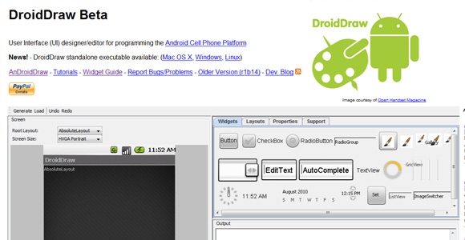
GUI designing tools
User Interface (UI) designer/editor for programming the Android Cell Phone Platform
http://www.droiddraw.org/

Slide 84
Menus
  Option Menus – When user presses Menu button on a physical device, an option menu will pop up
  Context Menu – triggered when user long presses on an visual element
  Creating Option Menu
    Implemtn onCreateOptionsMenu() method
    Add menus by calling add() on the Menu object
    returns MenuItems
    Add shortcut by calling setAlphabeticsShortcut() or setNumericShortcut()
    Create sub-menu by calling addSubMenu()

Slide 85
Get notified when user chooses a menu choice
by calling onOptionsItemSelected()
Creating Context Menu
pretty much the same concept as Option menu, context menu is associated with a widget, you need to register it with a view widget by calling registerForContextMenu() from activities. Implement context menu in onCreateContextMenu() method and figure out which context menu has been clicked, implement onContextItemSelected(). MenuItem.getMenuInfo() hands out ContextMenu.ContextMenuInfo

Slide 86
Inflate a menu
Menu resource defines an application menu which can be inflated with MenuInflater(res/menu/xxxx.xml)
<menu xmlns:android="http://schemas.android.com/apk/res/android">
<item android:id="@+id/item1"
android:title="@string/item1"
android:icon="@drawable/group_item1_icon" />
<group android:id="@+id/group">
<item android:id="@+id/group_item1" android:title="@string/group_item1" android:icon="@drawable/group_item1_icon" />
<item android:id="@+id/group_item2" android:title="@string/group_item2" android:icon="@drawable/group_item2_icon" />
</group>
<item android:id="@+id/submenu" android:title="@string/submenu_title" >
<menu>
<item android:id="@+id/submenu_item1" android:title="@string/submenu_item1" />
</menu>
</item>
</menu>
public boolean onCreateOptionsMenu(Menu menu)
{
MenuInflater inflater = getMenuInflater();
inflater.inflate(R.menu.example_menu, menu);
return true;
}

Slide 87
Style – stylize UI element. Style can be applied to individual view or an activity or application. (res/values/xxxx.xml)
<?xml version="1.0" encoding="utf-8"?>
<resources>
<style name="CustomText" parent="@style/Text">
<item name="android:textSize">20sp</item>
<item name="android:textColor">#008</item>
</style>
</resources>
<?xml version="1.0" encoding="utf-8"?>
<EditText
style="@style/CustomText"
android:layout_width="fill_parent"
android:layout_height="wrap_content"
android:text="Hello, World!" />

Slide 88
Activities and Tasks
An activity presents a visual user interface for one focused endeavor the user can undertake
A task is a stack of activities. All the activities in a task move together as one unit.
Activity's state
  Active: the activity is running and brought to foreground
  Paused: the activity is partially obscure and overlayed by something or a notification
  Stopped: activity is hidden by other activities but it still retains all state and member information.
  Dead: the activity terminated

Slide 89
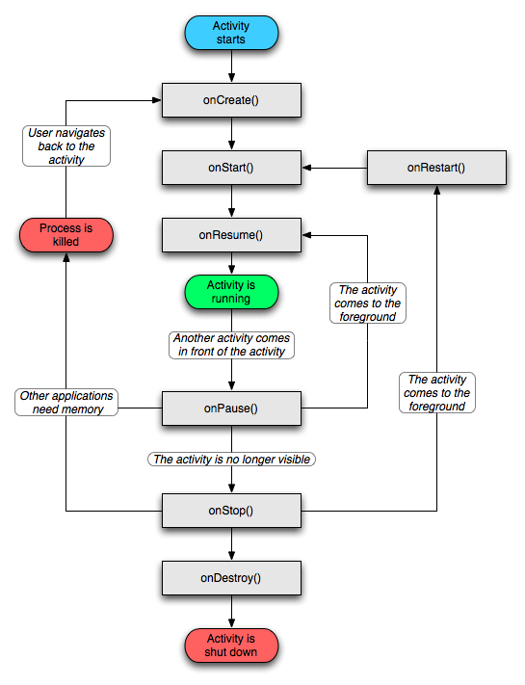

Slide 90
OnCreate() alway followed by onStart()
  Activity first started onCreate() will be called
  You should initialize UI and set up any one-time settings here
OnDestory()
  Will called when finish() is called on activity
  Not guaranteed to be called, in case of short memory, this method will be skipped, so you should release resources you allocate from onCreate() here
OnResume() followed by onPause()
  Called before you activity is brought upfront
OnPause() followed by onResume()/onStop()
  Called when other activity takes place of your current activity, a place to commit your changes

Slide 91
OnRestart() - Called after the activity has been stopped, just prior to it being started again. Always followed by onStart()
OnStart() - called before Activity is visible to the user, followed by either onResume() or onStop()
OnStop() - called when activity is brought to background followed by onRestart() or onDestroy().
OnResume(), onPause(), onStop() and onDestroy() can be killed by sysetm
Only onPause() is guaranteed to be called before the process is killed

Slide 92
Maintaining Application states
To capture application states before it is killed by system, you need to implement onSaveInstanceState() method. Android guarantees to call this method before activity is vulnerable to be destroyed. This method is called before onPause(). You should use Bundle object to record all dynamic states of the underlying activity. You can later use the bundle object in either onCreate() or onRestoreInstanceState() method.
OnSaveInstanceState() and onRestoreInstanceState() are not lifecyle methods. So Android doesn't always call them

Slide 93
Differences between onPause() and onSaveInstanceState(), use onPause() to save persistent data, onSaveInstanceState() to save transient data.
Intents(may think of as intentions)
Except the launcher Activity all other activities need to be reached via intents.
Intent is an event fired to notify Android what should do next.
Android is all about intents and intents receivers.

Slide 94
Intent Routing – for local application, we can use explicit intent, but for external services, you need to leverage Content URI and MIME types to help identity services from a third-party
Launcher Intent Filter
<manifest xmlns:android="http://schemas.android.com/apk/res/android"
package="package">
<application>
<activity android:name=".Main" android:label="Main">
<intent-filter>
<action android:name="android.intent.action.MAIN" />
<category android:name="android.intent.category.LAUNCHER" />
</intent-filter>
</activity>
</application>
</manifest>

Slide 95
Intent with MIME TYPE
<activity android:name=".MimeActivity">
<intent-filter>
<action android:name="android.intent.action.VIEW" />
<category android:name="android.intent.category.DEFAULT" />
<data android:mimeType="audio/mp3" />
</intent-filter>
</activity>
This activity will be launched by an intent with a MIME type MP3 requesting to
Need Example

Slide 96
Launch Activities with Intents
Android activities are communicated with the help of intents.
Starting an activity needs both an intent and how you want to start it.
Naming an activity you want to start with
new Intent(this, YourActivity.class); You need to declare the Activity in manifest file. And Intent filter is not needed in this case.
Intent intent = new Intent(Intent.ACTION_VIEW,
ContentURI.create("http://www.myurl.com"));
startActivity(intent); This will open an build-in browser. Add to manifest file with <uses-permission android:name="android.permission.INTERNET" />

Slide 97
SubActivities
Subactivity is an activity fired from parent Activity with startActivityForResult(Intent, reqCode) and parent activity is waiting for a result returning from subactivity
In parent activity, override onActivityResult(reqCode, resultCode, Intent)
Then in subactivity, finish of push back result and finish the activity with setResult(resultCode, Intent) and finish()
Summary - when you need to open a new screen and get result back from it, than use the function startActivityForResult() instead of startActivity()

Slide 98
Open Web Page within Apps
WebView - A View that displays web pages. This class is the basis upon which you can roll your own web browser or simply display some online content within your Activity. It uses the WebKit rendering engine to display web pages.
Note that, in order for your Activity to access the Internet and load web pages in a WebView, you must add the INTERNET permissions to your Android Manifest XML
<uses-permission android:name="android.permission.INTERNET" />

Slide 99
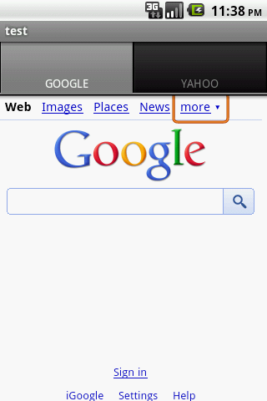
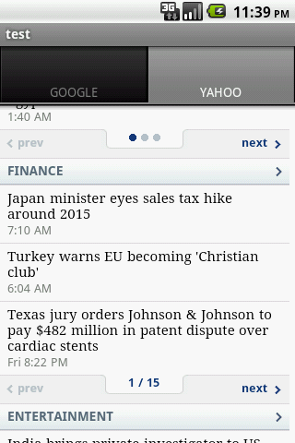
Customized WebView -
  Modifying the WebSettings, such as enabling JavaScript with setJavaScriptEnabled().
  Creating and setting a WebViewClient subclass. It can place the web content within your activities. You can intercept URL with shouldOverrideUrlLoading()

Slide 100
Managing states and layout when orientation changes
When physical device rotates, Android will catch the change, and destroy and redraw the activities when they are viewed next time. It also detects and manages the rotation process but for layout, it's developer's responsibility to make sure it looks consistent on different orientations.
Save the state by call onSaveInstanceState(), and retrieve and restore date from Bundle in either onCreate() or onRestoreInstanceState().
Any widget with state, during screen rotation, android will take care of maintaining the states, states outside of widget, developer needs to maintain the them manually

Slide 101
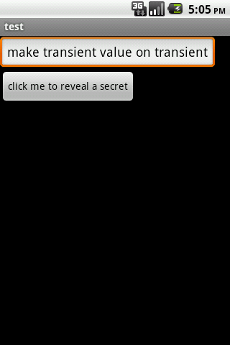

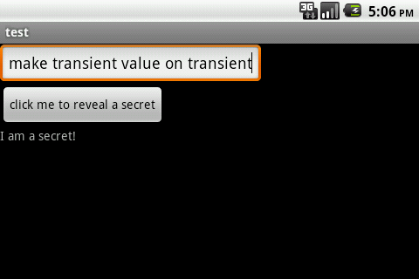

Slide 102
Drawbacks of onSaveInstanceState()
You can only save some state to a Bundle
Data pushed to Bundle must be serialized
Data types that are supported by Bundle are very limited
Is there a way to get an arbitrary Object from a callback?
OnRetainNonConfigurationInstance() comes to the rescue
The context you saved in the method can be retrieved by getLastNonConfigurationInstance()

Slide 103
How does it work?
It returns an object
Get the returned object by calling getLastNonConfigurationInstance() in your onCreate(), restore states by investigating the object
OnRetainNonConfigurationInstance() is good for retaining complex object as opposed to light states that onSaveInstanceState() handles
See the alternative implementation of keeping states by relying on OnRetainNonConfigurationInstance()

