Slide 1
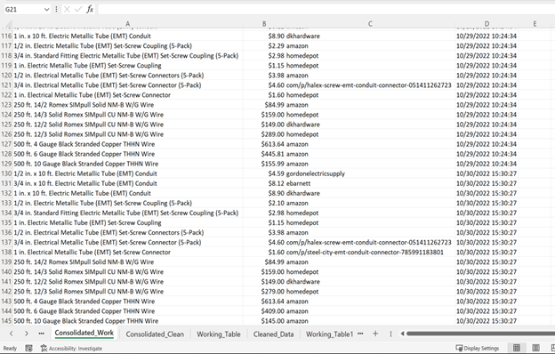
Data is Sourced from Our Own Data Collection, which Began at Project Conception
Since 10/20, data has been collected for materials, pricing, and vendors.
Produces about 50 entries a day.
As of 11/19/2022 we have >1200 lines of data.

Slide 2
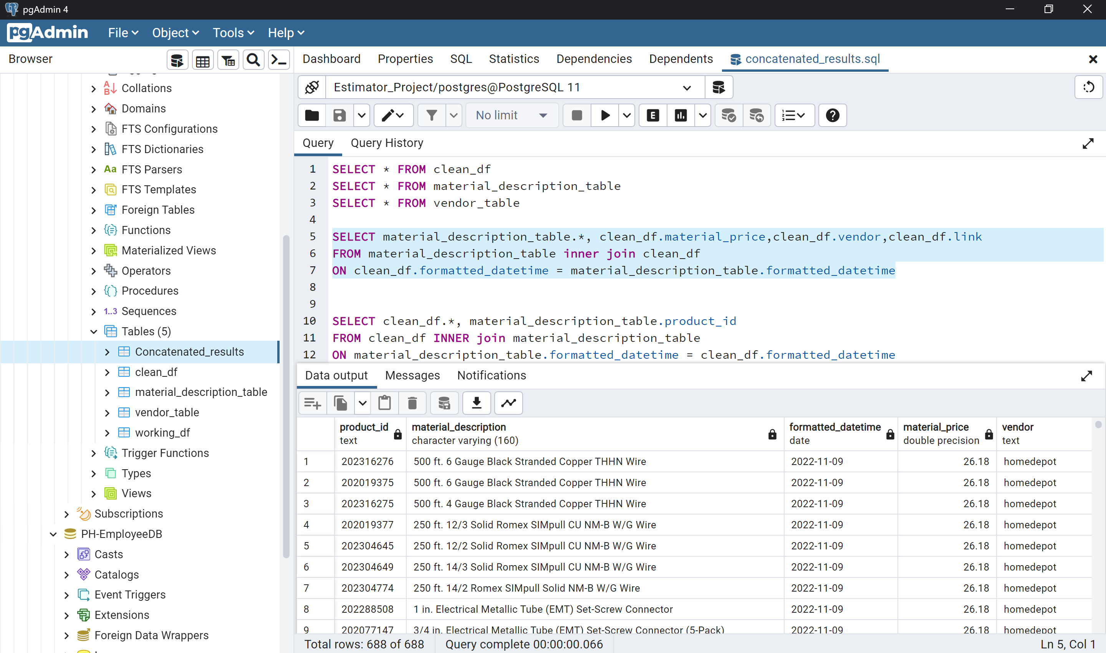
Database Integration
The analysis portion requires a clean set of data.
The tables are joined and a final “Data” table is used for all further analysis.
The final master table includes:
Product_id
Material_description
Formatted_datetime
Material_price
Vendor
Link
Location

Slide 3
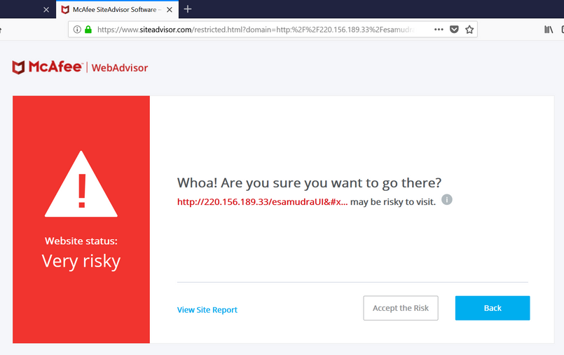
Data Exploration
So Why use APIs over Web Scraping?
Some sites kick you off when you try scraping their site.
A sites HTML update can throw off your pre-programed ‘search and grab’.
Collected data still requires a lot of cleaning.

Slide 4

Data Exploration Process
Feature Selection
Vendor
Region
Day of Week
Raw_materials
Location
zip
Date
Raw_prices
Target = Low Prices
(The above highlighted points have a relationship with price)

Slide 5
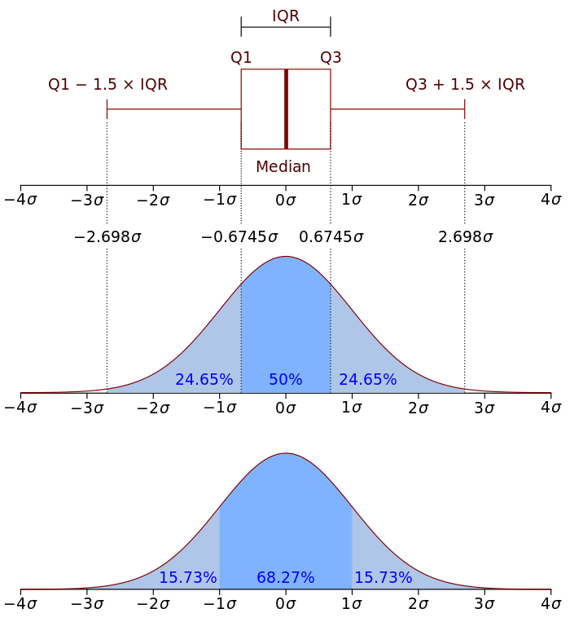
Feature Selection
target_price:
”low price” is <= Q1
“high price” is >= Q3
“about average” is everything else

Slide 6
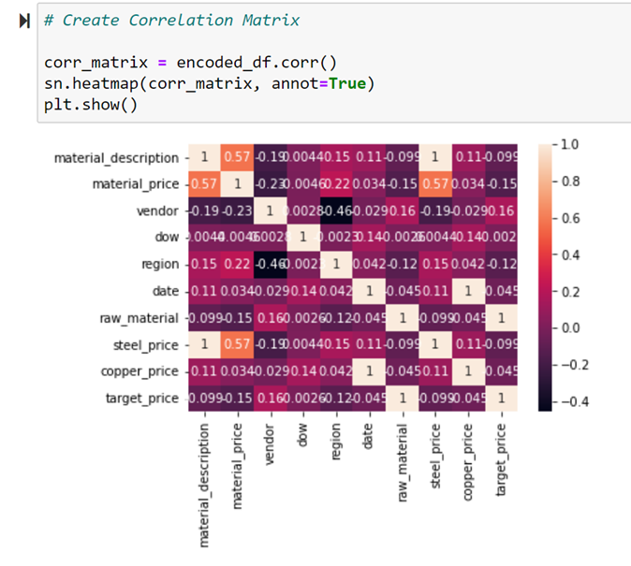
Data Analysis
Shapiro-Wilk test to determine normality (YES)
Pearson correlation:
Conduit and fittings (YES)
#4 wire and #6 wire (YES)
#6 wire and #10 wire (YES)
#10 wire and # 4 wire (YES)
All p-values are less than 0.5.

Slide 7

The Bottom Line
Using our algorithm buying 16 items a day for one year will save you:
$79,690

Slide 8

Machine Learning
(3) Decision Trees and (1) Naïve-Bayes
Made Decision tree models (Success):
predict lowest price by all features (98% accuracy)
predict lowest price by dow (68% and rising)
predict lowest price by region (74% and rising)
Made Naïve-Bayes model (Fail):
predict lowest price by all features (0% accuracy due to user error)
Estimator Project

