Slide 1
Team 14 Data Analytics 2022 Estimator Project
Kijahre Fikiri
Nancy Fujikado
Sarah-Michelle Sanchez
Alexei Mendoza

Slide 2

Topic: Expediting and forecasting price of electrical materials
The supply chain industry utilizes a "hot sheet" (a list of materials and their prices generated once a quarter) to price their materials.
Rise of inflation, ”hot sheets” need to be generated the day the estimate is created.
Increase in pricing frequency leads to excessive hours spent scouring the net searching for current material prices.

Slide 3

Goal: Save on time and money by creating an automated and predictive system
Live HTML/website powered by APIs to search prices of electrical material suppliers.
Generate a website that is updated daily with current material prices
Algorithm will choose the cheapest priced items of the day to populate the table.
ML to predict price fluctuation to determine when material costs increase or decrease.

Slide 4

Questions of Interest
Is there a correlation between the increase in wire costs and the increase in cable costs?
Is there a correlation between the increase in conduit costs and the increase in fittings costs?
Is there a correlation between the days of the week and the increase/decrease in materials costs?

Slide 5
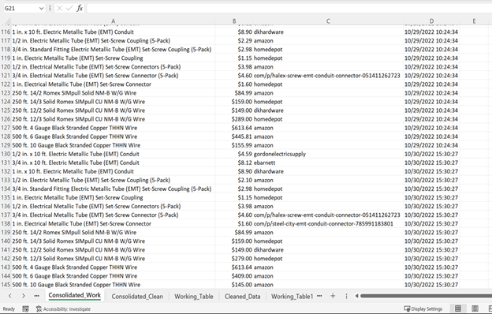
Data is sourced from our own collection starting from project conception
During the beginning stages of the project, data has been collected for materials, pricing, and vendors.
This data will meet the 1000 line minimum needed for machine learning purposes.
As of 11/11/2022 we have >900 lines of data.

Slide 6
Data Exploration
d

Slide 7
ML model will be a logistic regression model
The ML model will utilize two-sampled T-tests to determine: model (In progress) that will establish:
The correlation between cable and wire prices
The correlation between conduit and fittings prices
The goal is to create a model that can predict which day of the week offers lowest price based on prices, vendor and location.
We will be using an unsupervised machine learning model that will sub-categorize the data by material item.

Slide 8
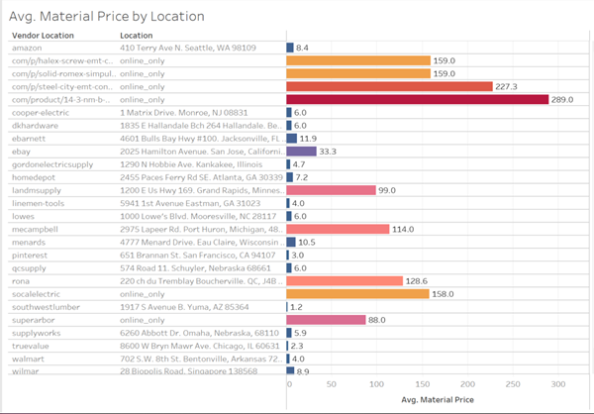
Database Integration
f

