Slide 1
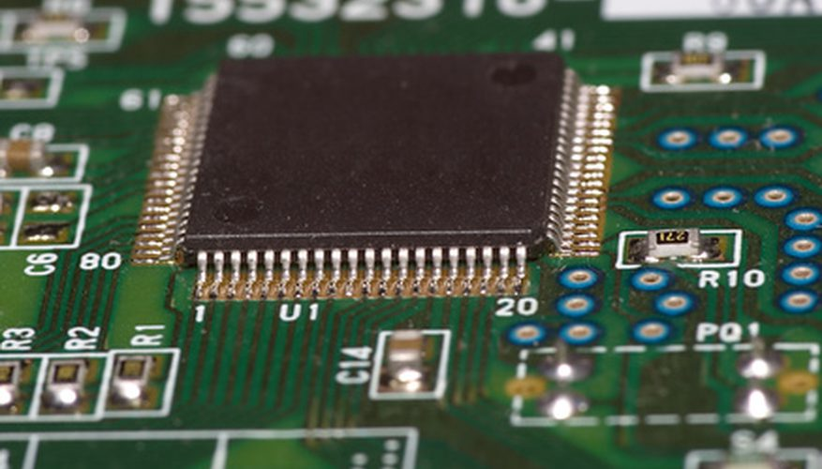
Overhead projector Lamp Life Extender by Zero Voltage Switching
EEE 365- MICROPROCESSOR
Presented By:
Musa Shakib Khan
Romana Yesmin
Fariha Reza Khan

Slide 2
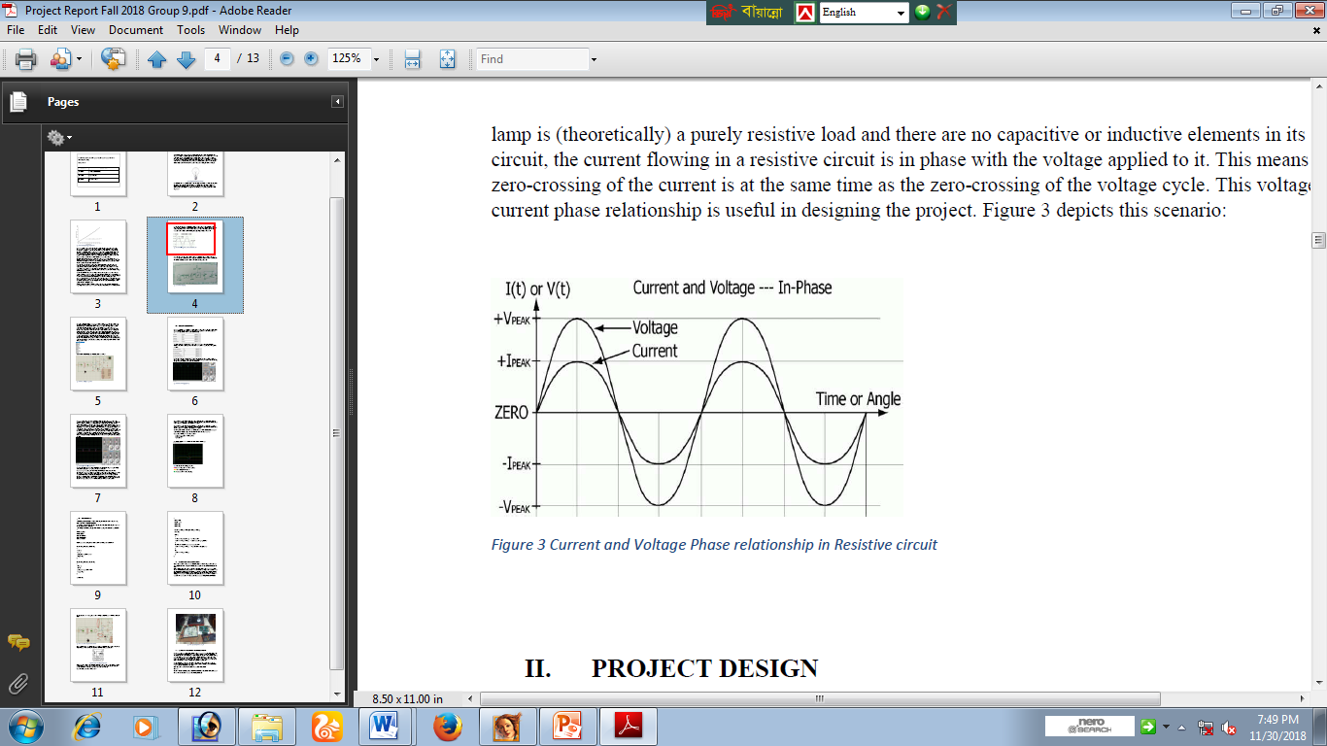
The Problem Statement
1. Low resistance of incandescent lamp during cold environment.
2. Sudden high current (In rush current) when power on.
3. All these causes to reduce the lamp life.
Solution
1. Use of zero-voltage switching
2. At first light turns on at “0” voltage and current(Resistive Load)
3.With increase in current the temperature increases.

Slide 3
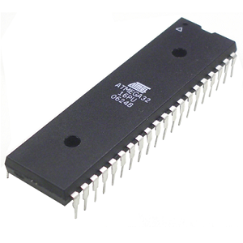
Design of the Project
Project Design includes
Comparator circuit is used to get a square wave signal.
Signal indicates the zero crossing of the voltage and current.
Signal is sent to the microcontroller which toggles at rising or falling edge.
Switch is used for interrupt

Slide 4
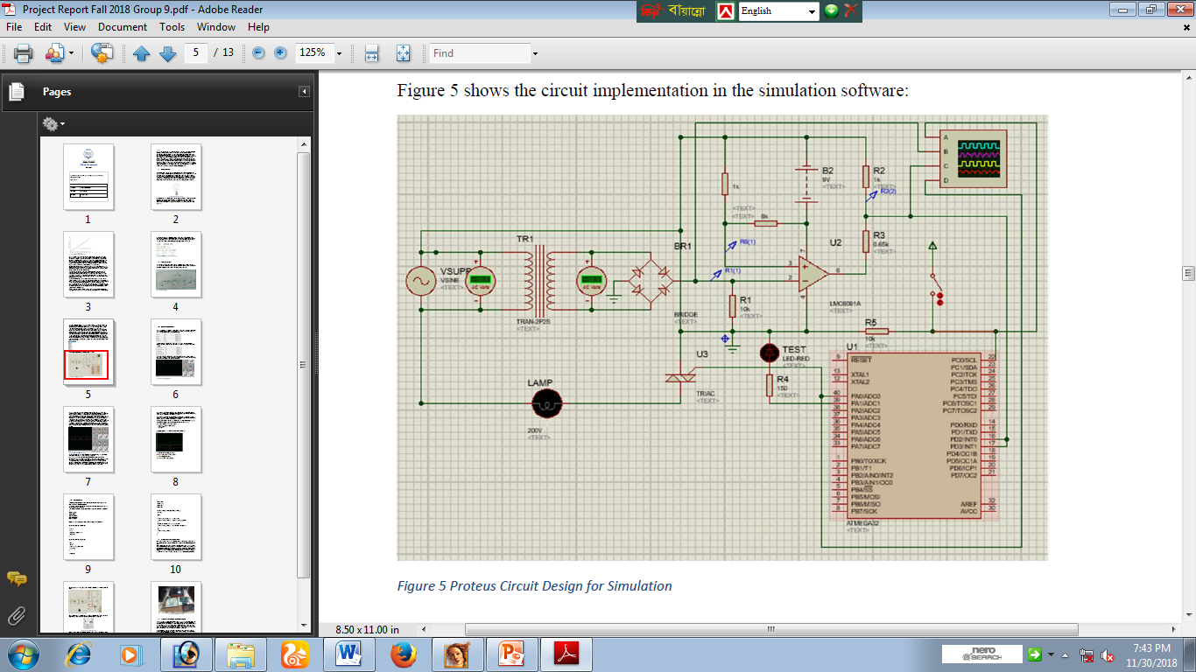
5. Two interrupts are used and works only at zero-crossing
6. Output signal of microcontroller activates/deactivates the TRIAC.

Slide 5
Connection
AC voltage of 220v connected to a transformer to step down the voltage to 12v to power the circuit.
12v AC is then Rectified by the full-wave diode-bridge.
The wave form is a pulsating DC signal.
An Op-Amp is biased by 9v at pin-7 and grounded at pin-4 is used as a comparator circuit.

Slide 6
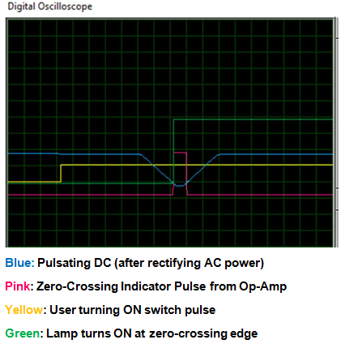
5. The pulsating DC is given into pin2 and pin3 is
connected to a voltage close to zero (1V in real life)
6. When the pulsating DC waveform is level below the
1V, the Op-Amp generates the biasing voltage at pin-6.
7. The output is reduced down to 5v by using resistance
before fed as interrupt into the uC.

Slide 7
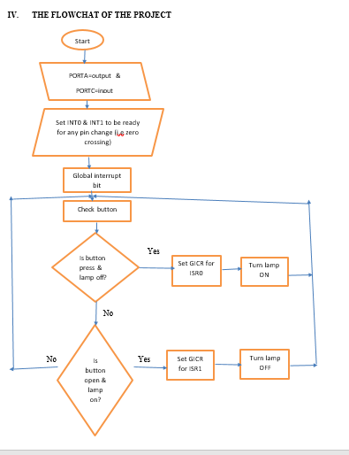
Flowchart of the program

Slide 8
Thank You
Questions??

