Slide 1
Toward a More Inclusive Consumer Finance
Sep. 3, 2021
Yingju Ma, Xingjian Zheng

Slide 2
Research Questions
How does digital credit payment promote financial inclusion?
Why merchants adopt digital credit payment?
How merchants benefit from accepting digital credit payment?
Which merchants benefit more, big sellers or small sellers?
How digital credit payment can accelerate the inclusion for consumers?
How digital credit payment overcome the informational barriers of financial inclusion.
Notes:
什么是？为什么重要？怎么办？意义？

Slide 3
Overview
How does digital credit payment promote financial inclusion?
We document the development of digital credit payment, both on consumer and merchant sides.
Financial inclusion is prompted on an unprecedented scope and speed in China.
Why merchants adopt digital credit payment?
How merchants benefit from accepting digital credit payment, in terms of sales, growth, and stability?
Which merchants benefit more, big sellers or small sellers?
How digital credit payment can accelerate the inclusion for consumers?
Adopt credit payment with digital payment services.
Low information cost allows Fintech companies use mini credit service to create data, promote inclusion at an intensive margin.
Notes:
什么是？为什么重要？怎么办？意义？

Slide 4
1. Inclusive for SMEs
How Fintech concumer credit benefits small & medium merchants?

Slide 5
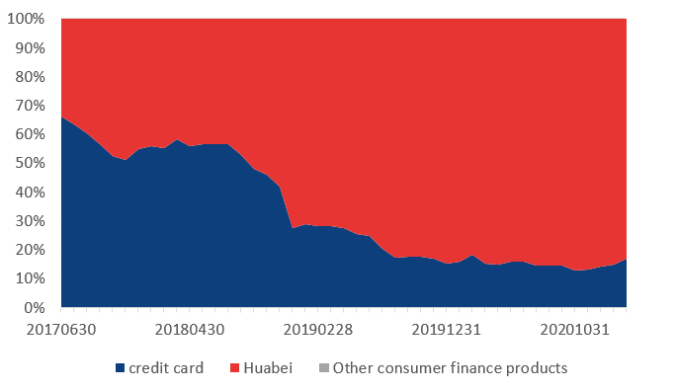
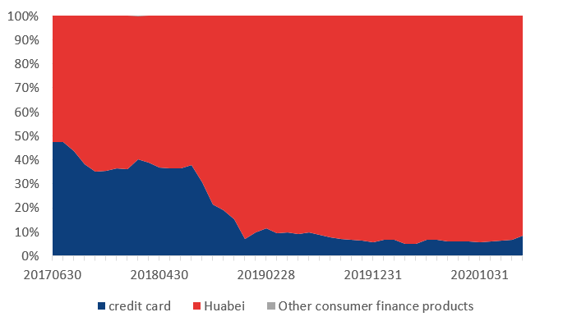
Fintech credit v.s. creditcards
The share of fintech credit payment keeps increasing.
Huabei
Huabei
Credit card
Credit card
Trading amount (million, monthly), in %
Order counts (million, monthly), in %
Notes:
信用卡单笔额度更高；商家 adopt huabei支付的数据数量，从2017 06 到2020；单车来instrument huabei usage；

Slide 6
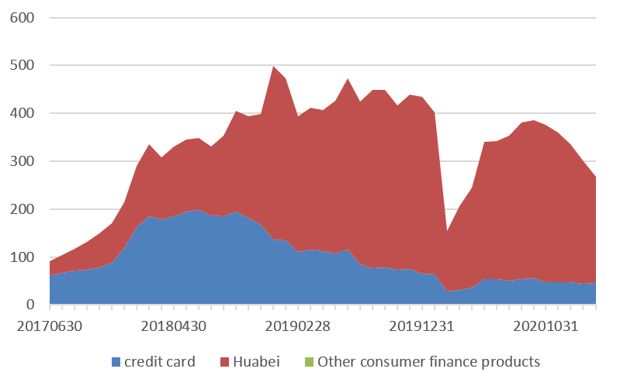
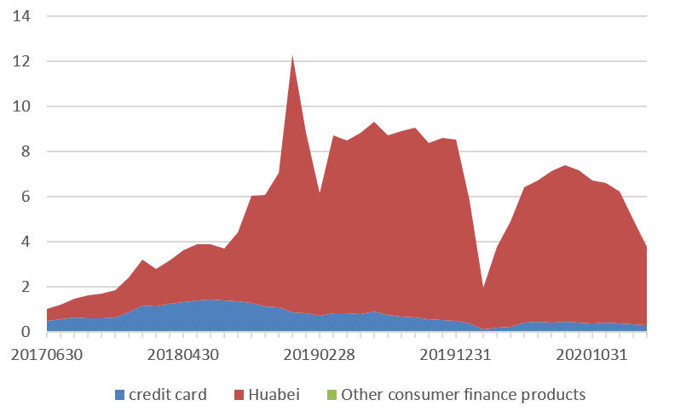
Fintech credit v.s. creditcards
Fintech credit
Credit card
Trading amount (million, monthly)
Order counts (million, monthly)
Notes:
信用卡单笔额度更高；商家 adopt huabei支付的数据数量，从2017 06 到2020；单车来instrument huabei usage；

Slide 7
Summary statistics
small amout; frequent usage;
Consumers (10,000 sample, year 2020)
 | min | Q1 | Median | Mean | Q3 | Max
credit_amt | 20 | 3,600 | 8,800 | 12,143 | 17,300 | 100,000
tot_hb_amt | 0 | 0 | 304 | 1,447 | 1,352 | 25,098
temp_credit_amt | 0 | 0 | 0 | 1,419 | 1,000 | 60,000
Hb_usage | 17,222 | 40,768 | 51,539 | 47,081 | 56,066 | 62,358
HB_accessing | 30,223 | 63,997 | 77,509 | 70,953 | 81,562 | 82,808
Mini_accessing | 671 | 2,236 | 2,752 | 3,360 | 4,246 | 6,939
Mini_usage | 326 | 519 | 844 | 1,085 | 1,372 | 5,274
Merchants (10,000 sample, year 2020)
 | min | Q1 | Median | Mean | Q3 | Max
hb_amt_1m | 0 | 45 | 796 | 5,273 | 3,193 | 79,975,064
xyk_card_amt_1m | 0 | 0 | 0 | 910 | 0 | 13,234,875
hb_order_1m | 0 | 1 | 12 | 106 | 66 | 1,127,113
csr_amt_1m | 1 | 3 | 22 | 165 | 106 | 1,530,531
Notes:
2020年的描述性统计；最好能汇报出population/observation count

Slide 8
Smaller merchants benefit more
Trading share of fintech credit payment grows fater for smaller merchants
ALL merchants experience an increasing share of fintech credit payment.
 |  | Area size |  |  |  |  | Employee number
 |  | <100m² | 100-200m² | 200-500m² | >500m² | Small-Large | <10 | 10-50 | 50-200 | >200 | Small-High
2017 |  | 0.263 | 0.195 | 0.252 | 0.279 | -0.016 | 0.196 | 0.284 | 0.267 | 0.237 | -0.041
2018 |  | 0.282 | 0.253 | 0.292 | 0.292 | -0.010 | 0.266 | 0.280 | 0.296 | 0.277 | -0.011
2019 |  | 0.430 | 0.417 | 0.455 | 0.466 | -0.036 | 0.415 | 0.468 | 0.427 | 0.424 | -0.009
2020 |  | 0.432 | 0.434 | 0.453 | 0.476 | -0.044 | 0.438 | 0.487 | 0.412 | 0.435 | 0.003
 | Annual trade amt
 | Low | 2 | 3 | 4 | 5 | 6 | 7 | 8 | 9 | High | Low-High
2017 | 0.006 | 0.009 | 0.017 | 0.019 | 0.021 | 0.024 | 0.025 | 0.033 | 0.039 | 0.084 | -0.078
2018 | 0.173 | 0.106 | 0.121 | 0.128 | 0.129 | 0.129 | 0.126 | 0.121 | 0.115 | 0.118 | 0.055
2019 | 0.397 | 0.428 | 0.437 | 0.439 | 0.437 | 0.428 | 0.423 | 0.402 | 0.359 | 0.271 | 0.126
2020 | 0.430 | 0.446 | 0.466 | 0.461 | 0.462 | 0.453 | 0.447 | 0.440 | 0.402 | 0.308 | 0.122
Notes:
HB benefit for small firms;8 decile 的数据怎么样；t stat；里面有missing data，所以可能会导致不reliable的结果

Slide 9
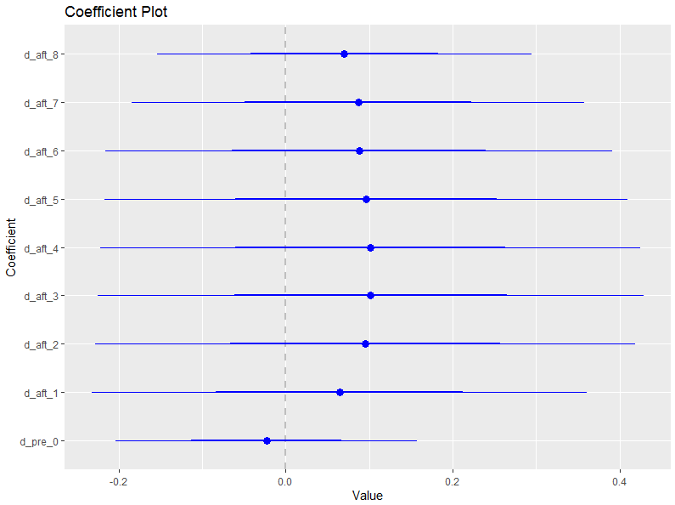
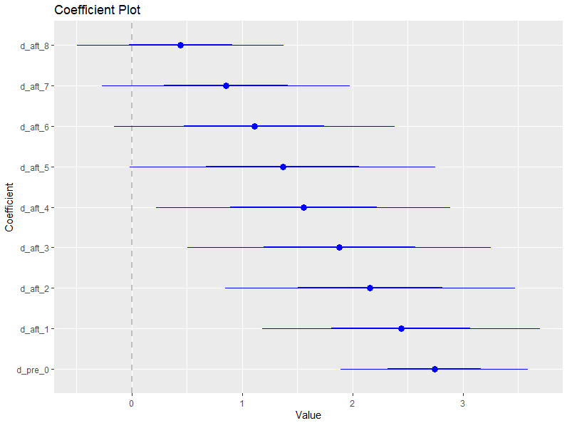
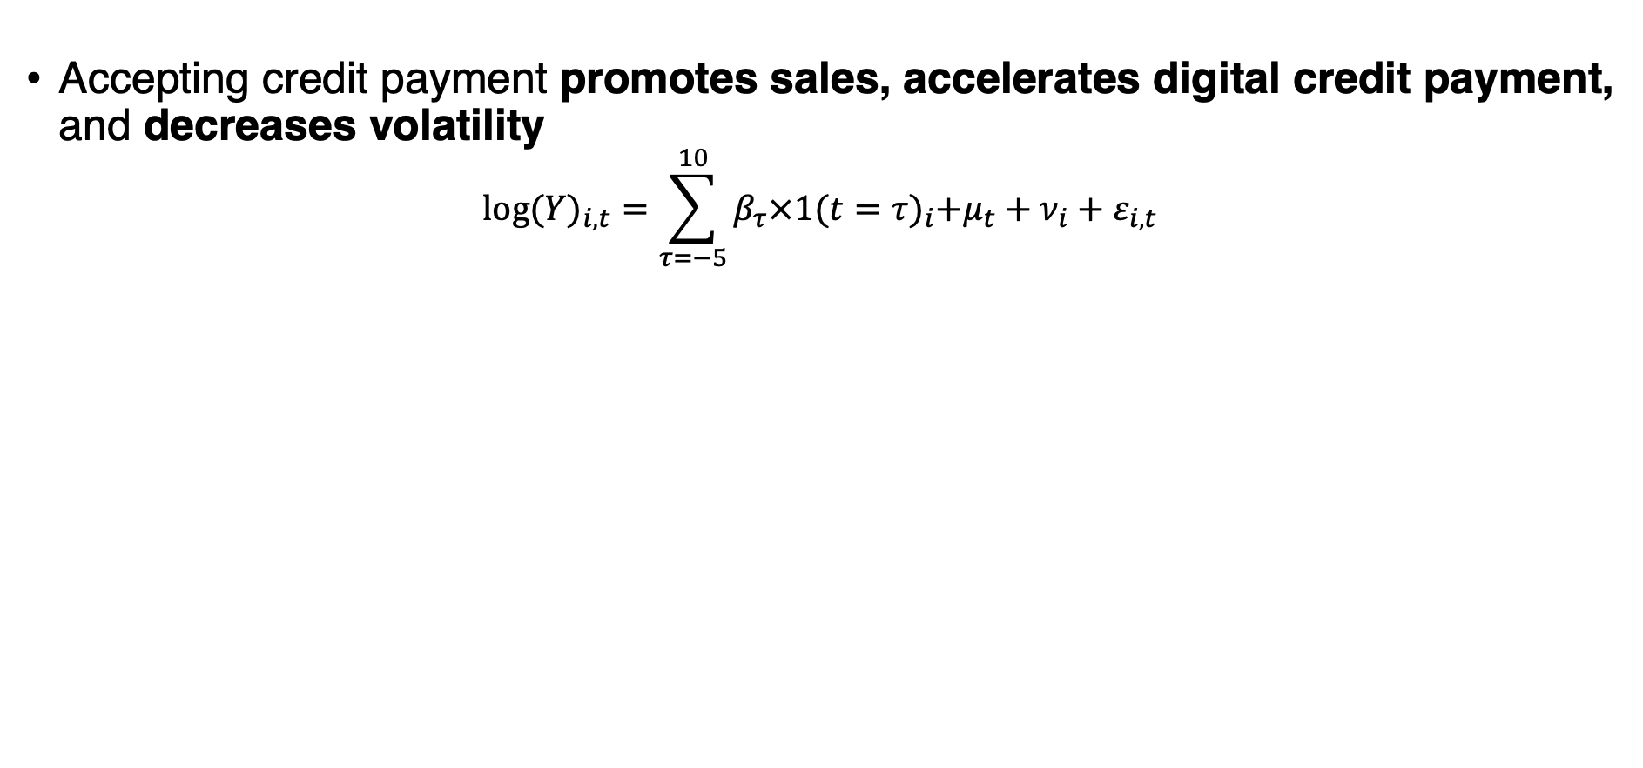
The effects on sales and volatility
Accepting credit payment promotes sales, accelerates digital credit payment, and decreases volatility
$${log⁡(Y)}_{i,t}=\sum_{τ=−5}^{10}{β_{τ}×1{(t=τ)}_{i}+μ_{t}+ν_{i}+ε_{i,t}}$$
${Y=Huabei trd volume}_{i,t}$ （基于花呗的成交额）
${Y=C−Card trd volume}_{i,t}$ （基于信用卡的成交额）
Notes:
其实这张还可以加上对small 的交叉项；trade amt (总的交易金额);和自己比较；放上cc的pre，consumer flow的pre；商家什么时候接受花呗，和consumer 端使用花呗，或者商家什么时候开始使用各种支付方式

Slide 10
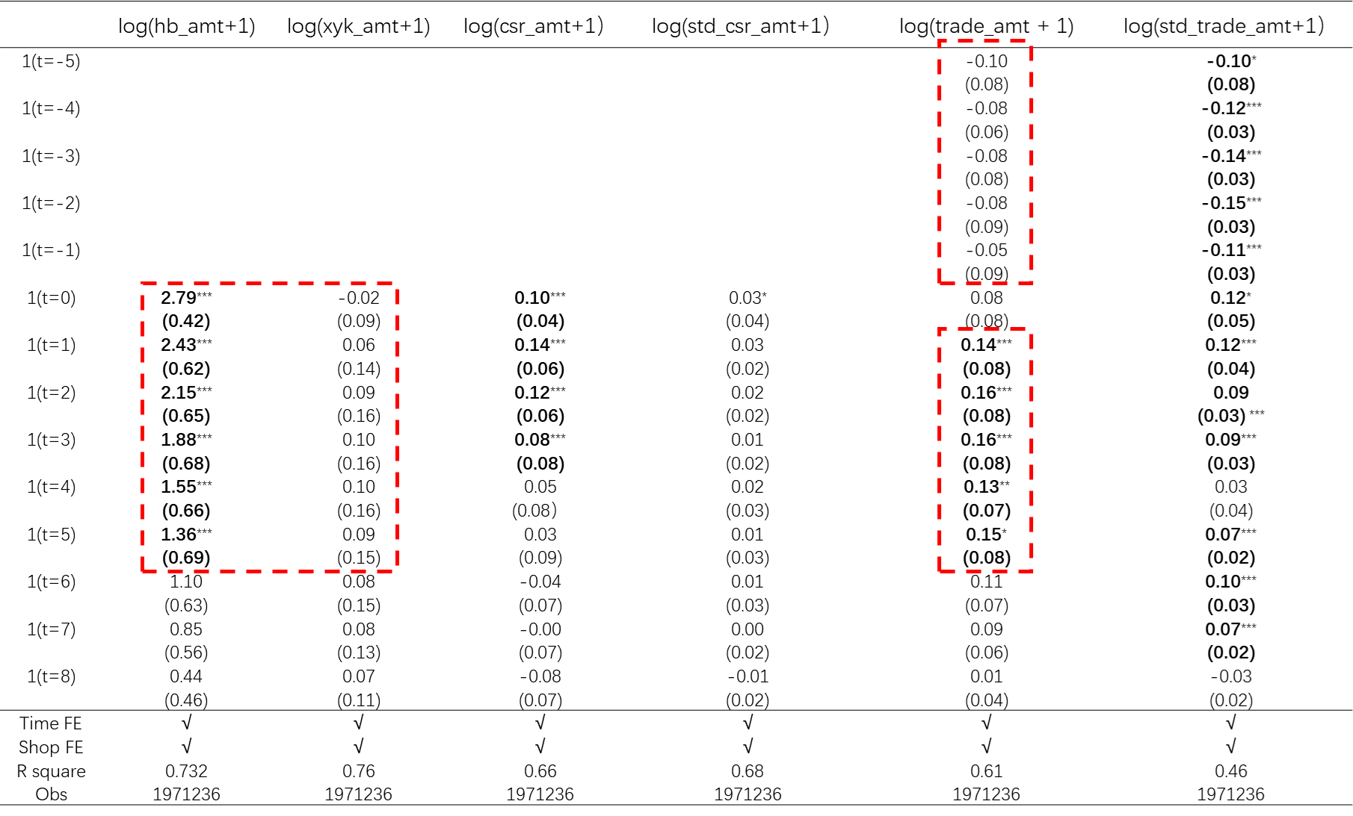

Slide 11

The effects on growth
${Sale_grwoth}_{i,t}={1(is_small)}_{i,t}+1{(hasapproved_HB)}_{i,t}+{1(is_small)}_{i}$× $1{(hasapproved_HB)}_{i,t}$ $+X_{i,t}{+μ}_{t}+ε_{i,t}$
Higher adoption leads to higher trade growth, especially for small firms.
 | trade_growth |  |  |  |  | log(consumer flow+1)
1(accpet HB) | 0.15*** |  | 0.07*** |  | 0.08*** | 1.05*** |  | 1.37*** |  | 1.37***
 | （0.00） |  | （0.00） |  | （0.00） | (0.00) |  | (0.0) |  | (0.00)
1(is_smaller_than_mean) |  | 0.03*** | 0.01*** |  |  |  | 0.76*** | 0.38***
 |  | （0.00） | （0.00） |  |  |  | (0.00) | (0.00)
1(accpet HB) × 1(is_smaller_than_mean) |  |  | 0.03*** |  |  |  |  | 0.70***
 |  |  | （0.00） |  |  |  |  | (0.00)
1(is_smaller_than_median) |  |  |  | 0.01*** | 0.02*** |  |  |  | 0.77*** | 0.38***
 |  |  |  | （0.00） | （0.00） |  |  |  | (0.00) | (0.00)
1(accpet HB) × 1(is_smaller_than_median) |  |  |  |  | 0.02*** |  |  |  |  | 0.71***
 |  |  |  |  | （0.00） |  |  |  |  | (0.00)
Control | √ | √ | √ | √ | √ | √ | √ | √ | √ | √
Time FE | √ | √ | √ | √ | √ | √ | √ | √ | √ | √
R square | 0.02 | 0.03 | 0.02 | 0.02 | 0.02 | 0.71 | 0.04 | 0.19 | 0.04 | 0.20
Obs | 2633874 | 2633874 | 2633847 | 2633847 | 2633848 | 2733874 | 2733874 | 2738874 | 2738874 | 2738874
Notes:
Is_small time varying；hetero；firm FE；

Slide 12
2.Inclusive for consumers
How HB financially include and benefit consumers?
Notes:
mini

Slide 13
Barriers of financial inclusion
Information costs via two aspects
High cost of reaching consumers
Lack of information
Hard Information
Soft Information
Reaching Consumers
Collecting Data
Create Data
Design & offering financial service

Slide 14
Barrier II: Lack of data
A lot of people are credit invisible, not because of bad credit, but no data.
45 mil Americans (22%) are living without a credit score, half of them are adults.
0.3 bil (21.4%) Chinese has no credit data in 2021.
0.88 billion in the credit system in 2015
1.02 billion in 2020
5.8 mil (8.9%) British adults are credit invisible.

Slide 15
Credit Data in China
China has seen a sharp increase in credit coverage in the past three years, and Fintech could be credited.

Slide 16
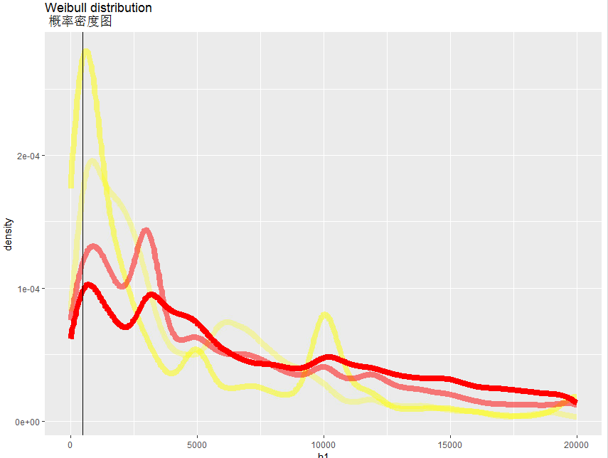
Consumers eventually have higher credit
There’s a second hump in the density plot, suggesting that credit lines have been raised.
Density plot for credit amount of consumers, by year
2020
2019
2018
2017
Notes:
图重合，透明alpha；identify types

Slide 17
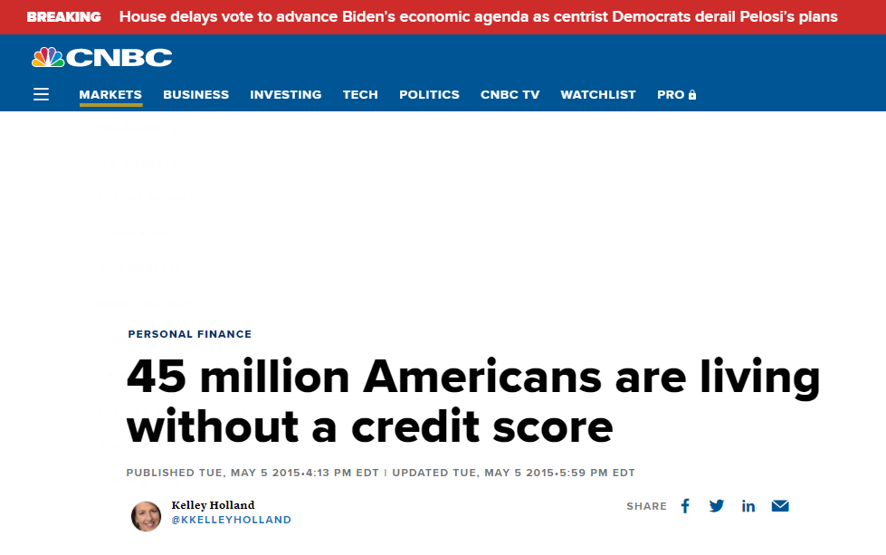
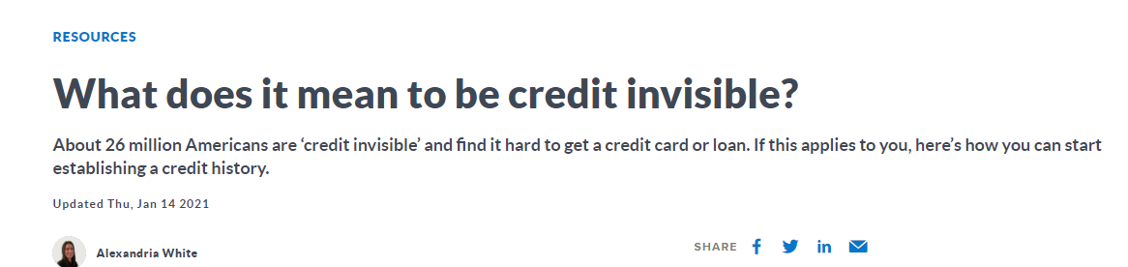
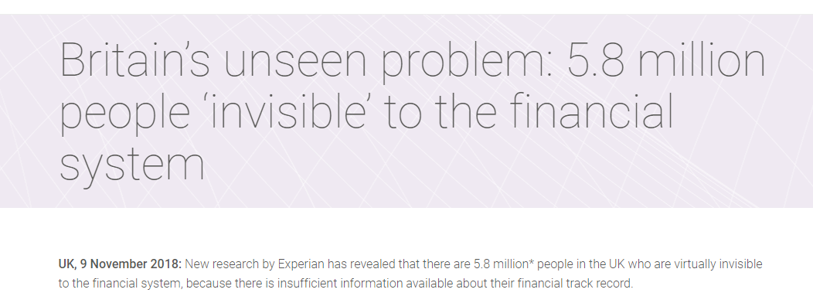
Barrier 2: Lack of data

Slide 18
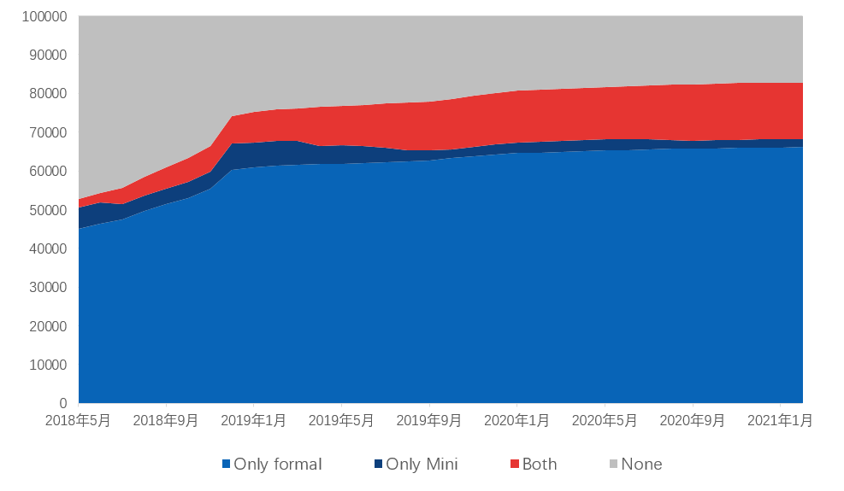
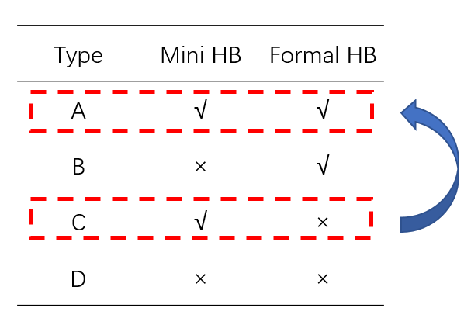
Lack of data? Help build a credit history
Due to its low cost of credit payment service, Fintech can set the credit limit very low, say, $7.
More and more users are served by a larger credit amount via this channel.
Identification strategy

Slide 19
A comparison of credit lines
Fintech provides the most accessible credit limits to consumers.
Company Name | Card Name | Minimum Credit limit (USD) | Credit rating | Credit score limit
Chase | Sapphire Preferred | 5000 | Good/Excellent | 670-850
 | Sapphire Reserve | 10000 | Good/Excellent | 670-851
 | Freedom Unlimited | 500 | Good/Excellent | 670-852
 | Ink Business Preferred | 5000 | Good/Excellent | 670-853
Capital One | Venture Rewards | 5000 | Good/Excellent | 670-853
Citi Bank | Double Cash Card | 500 | Good/Excellent | 670-854
 | Prestige | 30000 | Excellent | 700+
Petal | 2 Visa Credit Card | 500 | Fair/New To Credit | Under 669
US Bank | Secured Visa Card | 300 | Fair/New To Credit | Under 669
Discover it | Cash Back | 300 | Good/Excellent | 670-850
 | Student Cash Back | 500 | Fair/New To Credit | Under 669
Ant Group | Formal HB | 73.5 | Fair | -
 | Mini HB | 7.3 | New To Credit | -
ICBC | Mudan | 147 | Good/Excellent | -
BCM | Biaozhunka | 147 | Good/Excellent | -
BOC | Putongka | 147 | Good/Excellent | -
Notes:
其他国家，其他公司的credit card limit；不用formal；

Slide 20
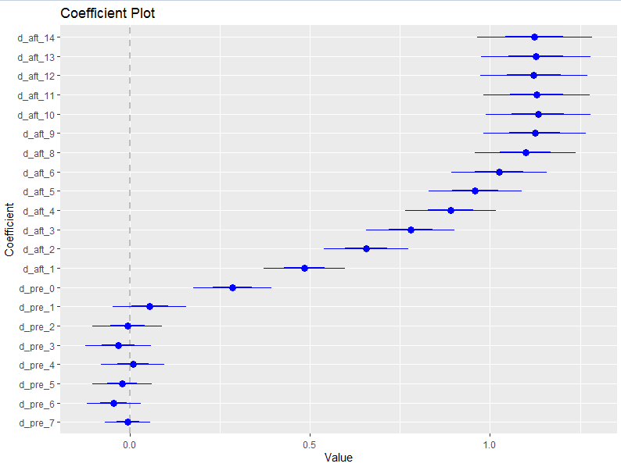
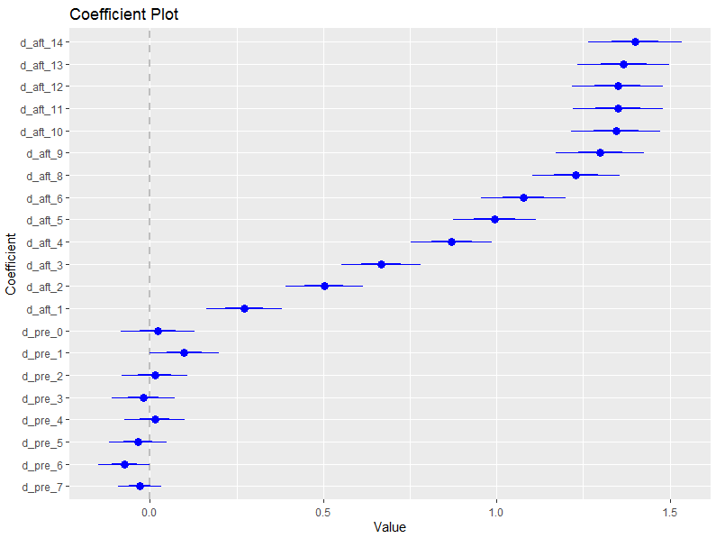



Accessing via Mini HB
${log⁡(Y)}_{i,t}=\sum_{τ=−7}^{14}{β_{τ}×1{(t=τ)}_{i}+μ_{t}+ν_{i}+ε_{i,t}}$
Use to Mini HB leads to more credit issuance (and Fin Inclusion).
${Y=Credit amount}_{i,t}$ （授信）
$${Y=1(Access to HB)}_{i,t}$$
Notes:
这张图recheck；fixed effect，滞后期的数据并不balance；时间可以再长一点，体现出equilibrium；右边的图并不能体现业务逻辑，credit amt；

Slide 21
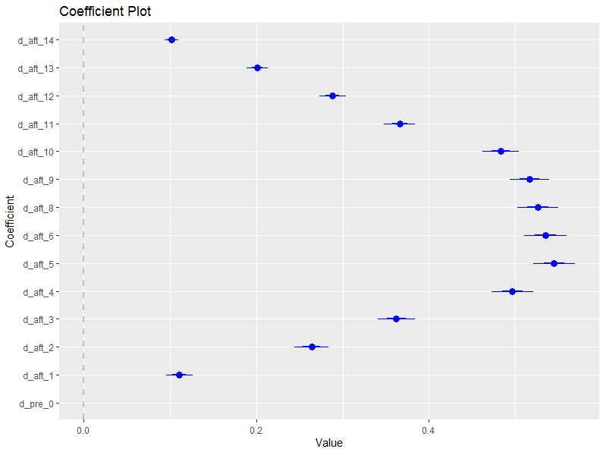
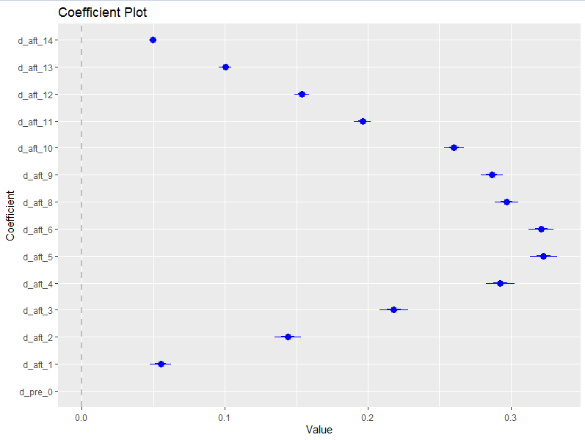

Accessing via Mini HB
${log⁡(Y)}_{i,t}=\sum_{τ=0}^{14}{β_{τ}×1{(t=τ)}_{i}+μ_{t}+ν_{i}+ε_{i,t}}$
Access to Mini HB leads to more credit issuance (and Fin Inclusion), but the impact is much smaller.
${Y=Credit amount}_{i,t}$ （授信）
$${Y=1(Access to HB)}_{i,t}$$
Notes:
这张图recheck；fixed effect，滞后期的数据并不balance；时间可以再长一点，体现出equilibrium；右边的图并不能体现业务逻辑，credit amt；

Slide 22
Identify the effect of mini Huabei
The usage of mini Huabei leads to higher credit lines
Accessing but not using will not lead to financial inclusion
 | 1(Ever accessed formal HB) |  |  |  | log(Credit amt+1)
1(ever used Mini HB) | 0.31*** |  |  |  | 1.41***
 | (0.02) |  |  |  | (0.04)
1(ever accessed Mini) |  | 0.91*** |  |  |  | 7.32***
 |  | (0.00) |  |  |  | (0.02)
log(total HB pay amt+1) |  |  | 0.01*** |  |  |  | 0.11***
 |  |  | (0.00) |  |  |  | (0.00)
log(tot HB pay cnt+1) |  |  |  | 0.02*** |  |  |  | 0.10***
 |  |  |  | (0.00) |  |  |  | (0.01)
Controls | √ | √ | √ | √ | √ | √ | √ | √
Individual FE | × | × | × | × | × | × | √ | √
Time FE | √ | × | √ | √ | √ | × | √ | √
R square | 0.06 | 0.00 | 0.00 | 0.00 | 0.05 | 0.00 | 0.36 | 0.34
Obs | 631315 | 648507 | 631315 | 631315 | 631315 | 648507 | 631315 | 631315
Notes:
先survey最低授信额，迷你花呗降低cost，使；不profitable的business后，主动include；
这个se体现不出来的原因是重复太多次了，所以需要跑一个cross section reg；

Slide 23
Heterogeneous analysis
The usage of mini Huabei mitigate adverse fixed charcteristics
 | log(credit_amt + 1) |  |  |  | ever accessed formal
ever_used_mini | -0.61*** | -0.57*** | -0.41*** | -0.53*** | -0.06*** | -0.04*** | -0.04*** | -0.03***
 | (0.01) | (0.01) | (0.02) | (0.00) | (0.00) | (0.00) | (0.00) | (0.00)
ever_used mini × is student | 0.28*** |  |  |  | 0.04***
 | (0.02) |  |  |  | (0.00)
ever used mini × have real estate |  | 0.29*** |  |  |  | 0.04***
 |  | (0.01) |  |  |  | (0.00)
ever used mini × is low education |  |  | 0.06*** |  |  |  | 0.01***
 |  |  | (0.03) |  |  |  | (0.00)
ever used mini × is senior age |  |  |  | 0.67*** |  |  |  | -0.02
 |  |  |  | (0.01) |  |  |  | (0.02)
Controls | √ | √ | √ | √ | √ | √ | √ | √
Time FE | √ | √ | √ | √ | √ | √ | √ | √
R square | 0.31 | 0.36 | 0.17 | 0.30 | 0.01 | 0.02 | 0.02 | 0.01
Obs | 349040 | 628859 | 48086 | 631315 | 349040 | 628859 | 48086 | 631315

Slide 24
Mini HB and credit overdue
People access Formal HB via Mini HB at the cost of a higher overdue rate. But it is a powerful screening device anyway.
Type | Both | Formal | Mini | None | Mini to Formal | Always MIni | Screening
Population | 14644 | 66099 | 16709 | 17192 | 14644 | 2065 | -
avg_credit_amt | 4691 | 12456 | 155 | - | 4691 | 154.5 | -
avg_usage_amt | 1662 | 3745 | 125 | - | 1662 | 130 | -
avg_overdue amt | 1367 | 3017 | 116 | - | 1367 | 121 | -
Median_overdue_amt | 800 | 1599 | 59 | - | 800 | 67 | -
Overdue ratio | 7.89% | 4.24% | 17.44% | - | 7.89% | 28.58% | 20.69%
Notes:
最后一列的问题；separating equilibrium；type diff足够大，拆开是有价值；overdue表recheck；overdue2次及以上，overdue的learning repay的过程;
Overdue可以画一张图

Slide 25
Appendix A
How to improve Financial Inclusion when there is no data?
Evidence from Mini HB

Slide 26
Background
Mini Huabei
When consumers apply for HB, Alipay assigns them a range between 50-450 or 500-50k according to their financial data and user portrait, i.e., Mini HB or Formal HB.
￥50-450
Yes
Formal HB
Credit worthy?
Mini HB
No
Reject
Apply
No
User
Enough data?
Yes
Formal HB
Yes
Credit worthy?
￥500-50k
No
Reject
Notes:
授信逻辑，是否是同一款产品？如果是同一款产品，那逻辑图不是很合理

Slide 27
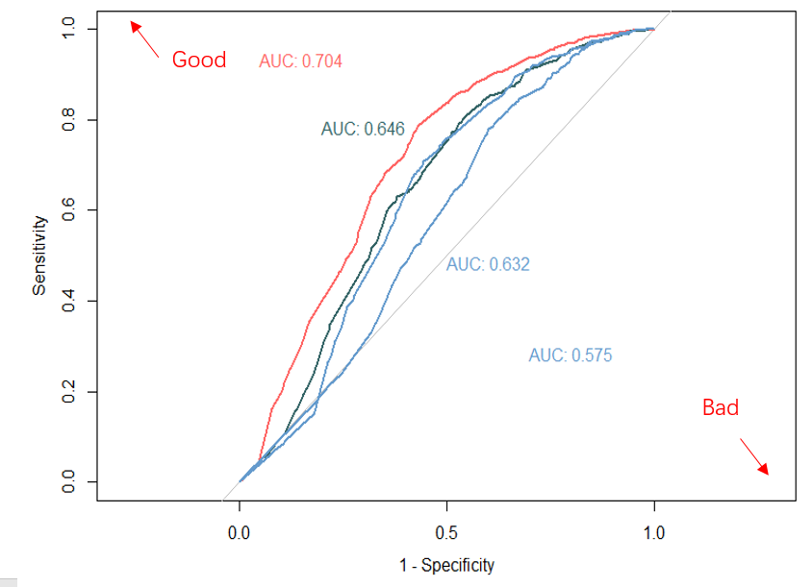
Mini HB and data accumulation
Inter-group AUC
AUC sorted by data accumulation months (≤2， ≤4， ≤9， ≤41)
The shorter the length, the higher prediction precision
Notes:
这张图interpretation有限；用得越多，违约越多；使用频率和逾期的关系；这个估计AUC的方法不是很合理，

Slide 28
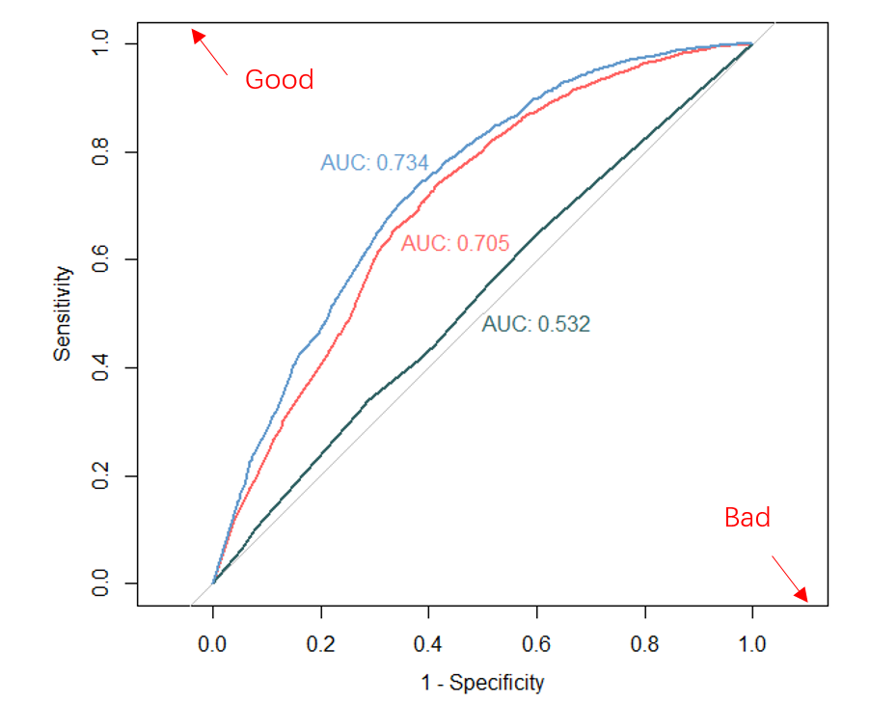
Mini HB and data accumulation
Inter-group AUC
AUC sorted by different groups, red “A”, blue “B”, dark green “C”
As type “A” accumulates more data, the prediction becomes more precise

Slide 29
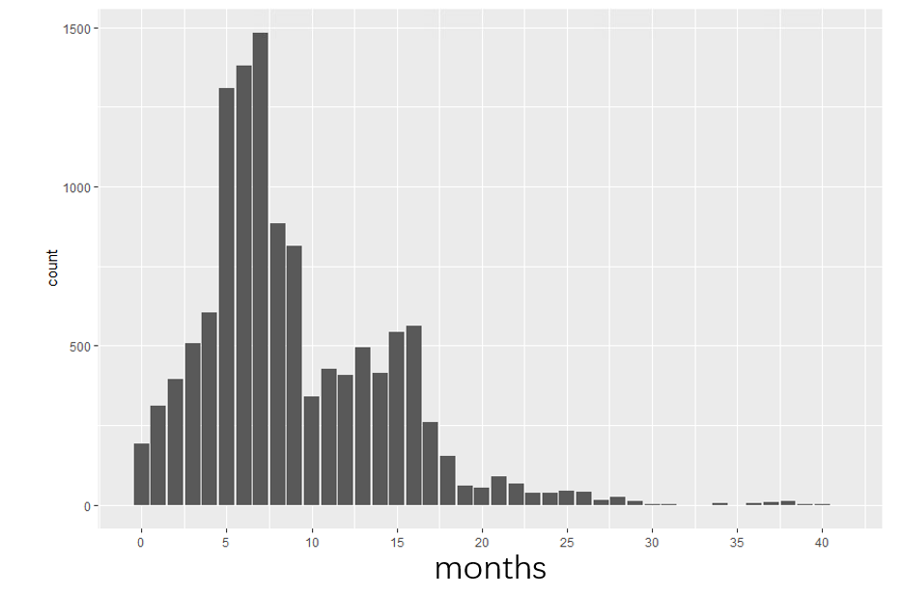
Credit information spillover
When Alipay issues Mini HB to users, banks soon follow.
#bank’s issuance after Alipay makes its action of each month

Slide 30
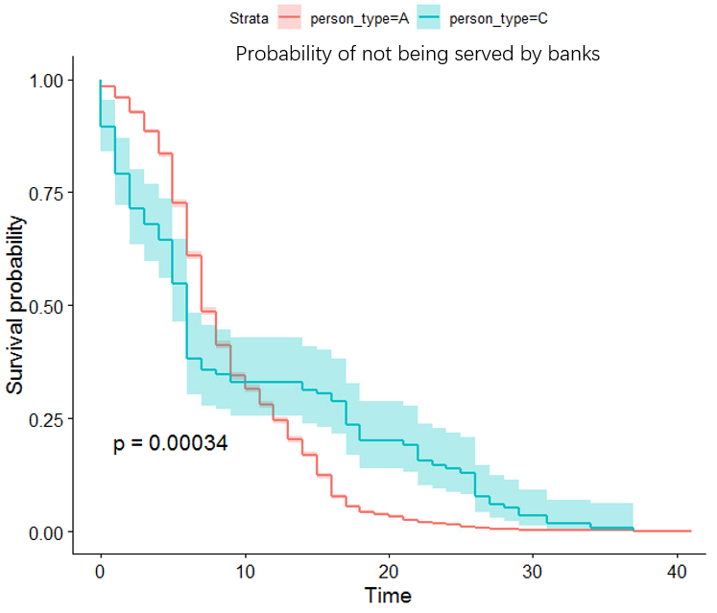
Credit Info spillover: a survival analysis
Banks take on worse borrowers quickly (type C), while failing to identify better borrowers (type A).
Notes:
有可能 联合贷，把坏的给银行，好的留给自己

Slide 31
Appendix B
Two-sided credit payment markets with a PVAR approach

Slide 32

FI on credit-payment markets (CPM)
${merchant_hb_amt}_{i,t}={β×consumer_hb_usage}_{i, t−1}+γ×{merchant_hb_amt}_{i,t−1}+X_{i}+μ_{i}+ν_{t}+ε_{i,t}$
${consumer_hb_usage}_{i,t}={β×merchant_hb_amt}_{i, t−1}+γ×{consumer_hb_usage}_{i,t−1}+X_{i}+μ_{i}+ν_{t}+ε_{i,t}$
There’s a positive network externality in a CPM.
 | mer_hb_amt |  |  |  | con_hb_usage
lag_con_hb_usage | 0.23*** | 0.16*** | 0.09* | 0.09** |  |  | 0.22*** | 0.24***
 | (0.04) | （0.05） | （0.04） | (0.04) |  |  | (0.03) | (0.03)
lag_mer_hb_amt |  |  | 0.39*** | 0.40*** | 0.09*** | 0.071*** | 0.05** | 0.05**
 |  |  | （0.04） | (0.03) | (0.09) | (0.02) | (0.02) | (0.02)
lag_mer_xyk_amt |  |  | 0.02 | -0.01 |  |  | -0.03 | -0.04*
 |  |  | （0.03） | (0.03) |  |  | (0.02) | (0.02)
avg_mer_hb_amt |  |  |  | -0.00* |  |  |  | 0.00
 |  |  |  | (0.00) |  |  |  | (0.00)
intercept | 0.19*** |  |  |  | 0.21***
 | (0.03) |  |  |  | (0.02)
Time FE | × | √ | √ | × | × | √ | √ | ×
City FE | × | √ | √ | √ | × | √ | √ | √
R square | 0.03 | 0.35 | 0.44 | 0.33 | 0.02 | 0.41 | 0.44 | 0.19

