Slide 1

ELIQUIS 360 Support Track 2.0
432US1902166-04-01 06/20

Slide 2



Program Objectives
Initiate a positive patient experience
Ensure cost is not a barrier for those patients for whom the healthcare provider (HCP) has prescribed Eliquis
Assist patients and HCPs with navigating the payer landscape
Ensure all eligible patients can access our offers through the program
Pull-through field sales efforts
432US1902166-04-01 06/20
Notes:
Say: So what are the goals of this programs? Read listed line items.

Slide 3
Program Overview
Reimbursement Services include:
Providing a summary of the patient’s benefits (called a Benefits Review “BR”)
Providing plan-specific forms for Prior Authorizations (PAs) when needed
Providing general information on the appeals process as well as formulary exception requests and tier exception requests
Providing information on financial assistance
Co-Pay and Free Trial Offers (FTO)
Ways to access the program
✓ By Phone 1-855-ELIQUIS (1-855-354-7847) or by Fax 1-855-674-8134
On-line @ www.Eliquis.com
Provider Portal www.eliquis360providerportal.com
432US1902166-04-01 06/20
Notes:
Say: Having those goals means that the E360 program must be very comprehensive, from reimbursement dynamics all the way to accessibility. Reimbursement includes Benefit Reviews program, Prior Auth capabilities, exception requests should the situation call for it and providing information for financial assistance if a patient qualifies. *click* The most-commonly known avenues of E360 is probably the co-pay cards and FTOs, or vouchers. *click* Accessing this program is easier than ever now, with communication choices of using phone, email or real-time web portal options.

Slide 4


Benefits Review Process
Patients who are prescribed Eliquis can have a Benefits Review conducted by a live benefit verification specialist to:
Confirm plan coverage
Payer Requirements (PA, tier exceptions, etc.)
Patient’s estimated out of pocket cost
Eligibility for Eliquis Co-pay Card and/or FTO
So how do you get this all started?
432US1902166-04-01 06/20
Notes:
Say: But let’s begin with an unsung hero for reimbursement: the benefits review process. While not all patients require due diligence to cover their Eliquis, some cases create obstacles for everyone involved, from office staff to patient support team. Unfortunately, these problem situations leave a lasting impression regarding the process and by association, the medication. What better way to partner with your customers than to offer a way to give those troublesome scenarios a “complete workup?” This program involves a benefit verification specialist who will confirm a patient’s coverage, identify payer requirements, estimate out-of-pocket costs and verify eligibility for financial resources such as copay cards and vouchers.
<click to build slide>

Slide 5
Benefits Review Process
Step 1
Patient initiates a BR
Provider initiates a BR
A
B
Eliquis 360 contacts Payer to obtain coverage information
Eliquis 360 calls the patient/provider to review benefits
Step 2
Benefits Reviews can be initiated by:
Patients <85%>
Providers <15%>
432US1902166-04-01 06/20
Notes:
Say: It’s easier than you think to begin such an impactful program. A major perk is the ability for EITHER the patient OR the office can initiate the benefits review process. Statistically it shows that patients tend to be the bulk of the initiators, but what a way for a rep to “partner” with the office personnel to guide them through the initiation process in case that tough scenario is a patient with very little potential to handle such a burden?
<click to build slide>
Say: Whomever gets the ball rolling to the specialist, the next step is the same.

Slide 6
Benefits Review Process
Benefits Reviews typically take up to 24 business hours (Hospital initiated BRs within 4-6 hours)
Eliquis 360 contacts Payer to obtain coverage information
Eliquis 360 calls the patient/provider to review benefits
Step 2
Step 3
432US1902166-04-01 06/20
Notes:
Say: Within an average 24 business hour timeframe, or within 4-6 hours in an account setting, the results are provided to the patient and/or the provider for review. This is a simple process flow, but these steps are more complex when closely reviewed. Lets start with Step 1A, the patient-initiated benefits review.

Slide 7

Patient Driven Benefits Review (BR) Process
(Normal BR) Patient calls Eliquis 360 to activate a card (Co-pay/FTO) or to understand their coverage for Eliquis. The Eliquis 360 live specialist will offer a BR if patient requests a BR, requests coverage details, or expresses financial hardship
Eliquis 360 live specialist explains we need to have their signature to start the process and provides the URL to the patient/caregiver to complete the eSignature.
Eliquis 360 calls patient to explain results once completed.
If the patient would like the Summary of Benefits sent to their provider, Eliquis 360 will send
(BR with restrictions) If returned with coverage restrictions (prior authorization, tier exception, or formulary exception)
Eliquis 360 live specialist explains we need to have their signature to start the process and provides the URL to the patient/caregiver to complete the eSignature.
Eliquis 360 calls patient to explain results along with restrictions
If the patient would like the Summary of Benefits and plan specific forms sent to their provider, Eliquis 360 will send
Eliquis 360 will send plan specific forms to the provider, when available, pre-populated with provider demographic information. Provider MUST complete forms and send to Payer.
432US1902166-04-01 06/20
Notes:
Say: When a patient starts the process, there is only a few differences when restrictions arise. *click* In both scenarios the patient contacts the benefits review specialist through activating a card or just using the review form. That specialist would initiate the review for several reasons but would always require an electronic signature to officially begin the process, usually by providing the URL link to a patient email address. *click*
Ask: Who remembers how long Step 3 takes for that specialist to review the results with the patient? <answer is 24 business hours or 4-6 hours in a hospital> *click*
Say: Here’s where the difference comes in, because sometimes there are restrictions that will need to be responded to by the provider. While the summary of benefits can be opted to send to the patient provider, restrictions require more attention. *click* So E360 specialists will send those extra forms to the provider, pre-filled with office information to be signed.

Slide 8
Provider Driven Benefits Review (BR) Process
(Normal BR) Provider initiates a BR by sending a completed Eliquis 360 enrollment form and Patient Authorization and Agreement (written PAA required)
If patient is present they will physically sign the PAA form
If patient is NOT present, the provider/site will notify patient they need to have their signature to conduct a Benefits Review and direct them to the eSign portal to capture the patient’s signature on the PAA template
Once the PAA is signed the Benefits Review process will continue
Eliquis 360 calls provider to explain results and faxes Summary of Benefits
(BR with Restrictions) If returned with coverage restrictions (prior authorization, tier exception, or formulary exception)
(See above “Normal BR” steps 1-3)
Eliquis 360 calls provider to explain results and faxes Summary of Benefits along with plan specific forms, when available.
Forms will be pre-populated with provider information, when possible
2. Provider MUST complete forms and send to Payer.
3. Eliquis 360 will follow up with the Payer to ensure all documentation is received and to obtain results.
432US1902166-04-01 06/20
Notes:
Say: Now a provider starts the ball rolling just like the patient would, only they need to have the patient sign the form, either physically or electronically. *click* The similarities end when the restrictions emerge upon results review. *click* Now the office must take the forms received, complete them and send them to the payer. E360 specialists will follow up with that payer to make sure everything has been received and obtain the new results to disseminate.

Slide 9
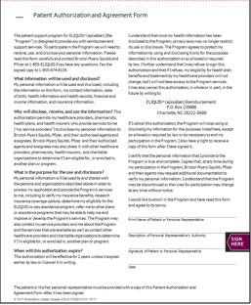
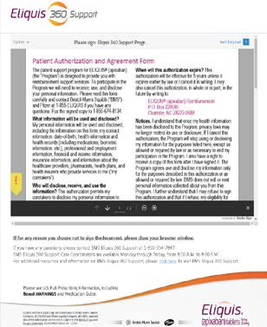
Patient Authorization is Required
All Benefits Review requests require patient authorization before Eliquis 360 can proceed with verifying patient’s benefits.
The patient must physically sign the Patient Authorization and Agreement (PAA) Form
or
The patient must provide an Electronic Signature using eSign capabilities
eSign Portal: www.Eliquis.com/sign
*see following slides for detailed screen shots
432US1902166-04-01 06/20
Notes:
Say: Here is an example of what the patient must sign in order to authorize the start of the process, either in-person or virtually. The next slides will represent how the process appears to the patient.

Slide 10
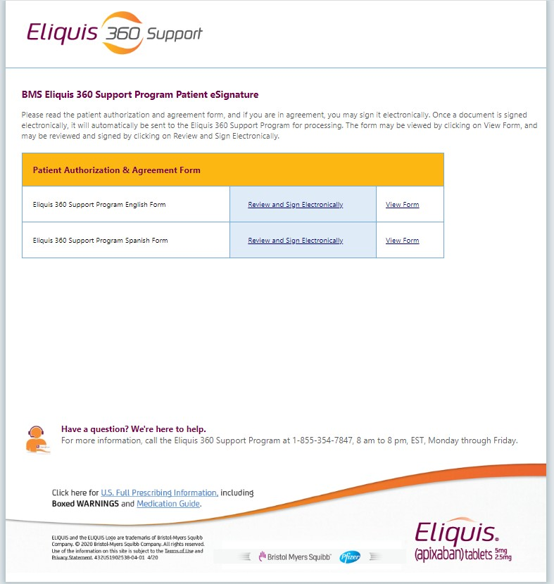
E-sign Screen Shots (1 of 6)
432US1902166-04-01 06/20
10
Notes:
Say: Here’s the link as sent to the patient

Slide 11
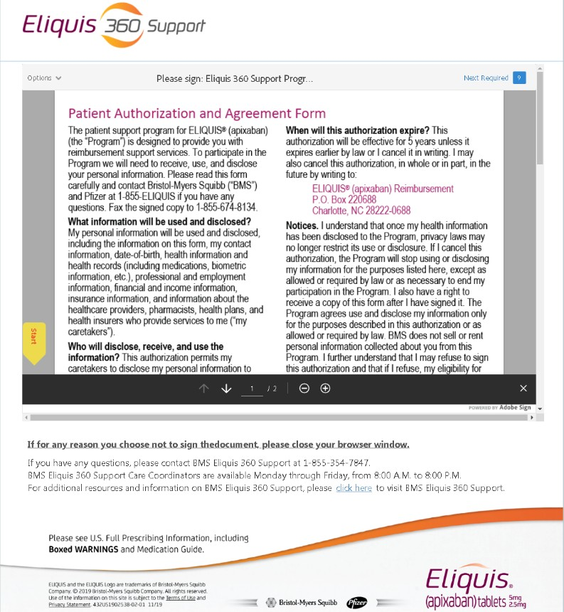
E-sign Screen Shots (2 of 6)
432US1902166-04-01 06/20

Slide 12
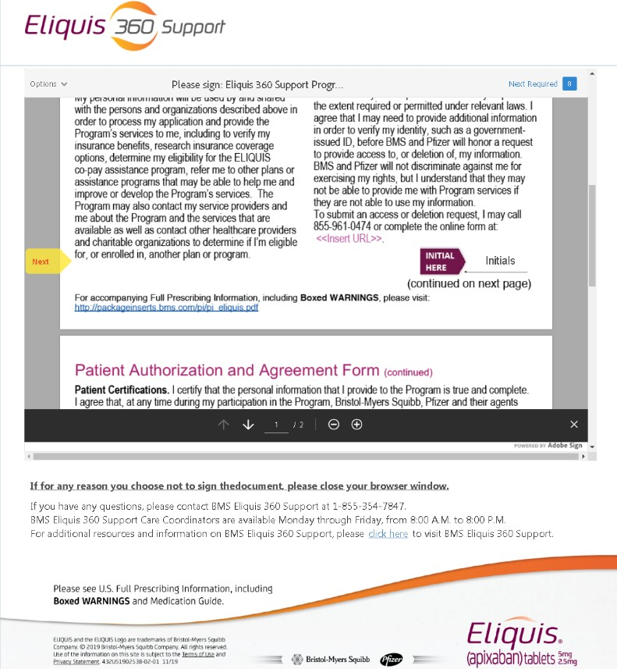
E-sign Screen Shots (3 of 6)
432US1902166-04-01 06/20

Slide 13
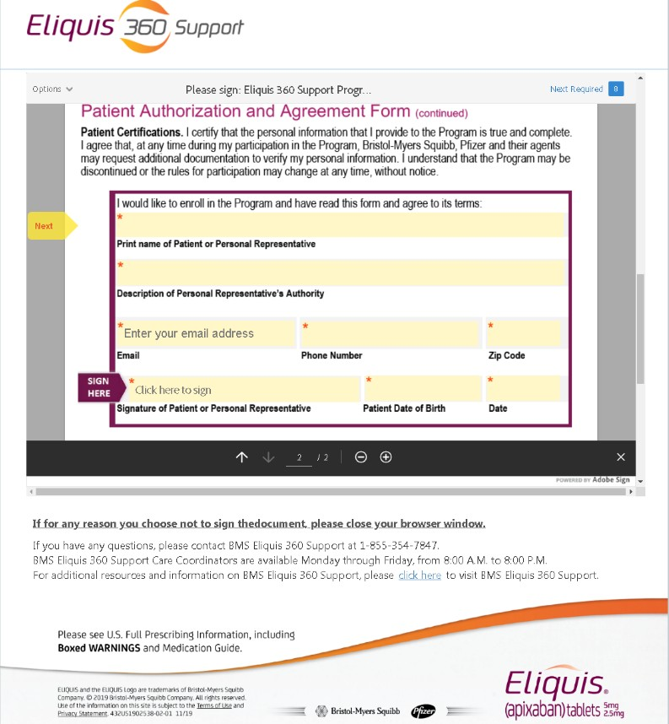
E-sign Screen Shots (4 of 6)
432US1902166-04-01 06/20

Slide 14
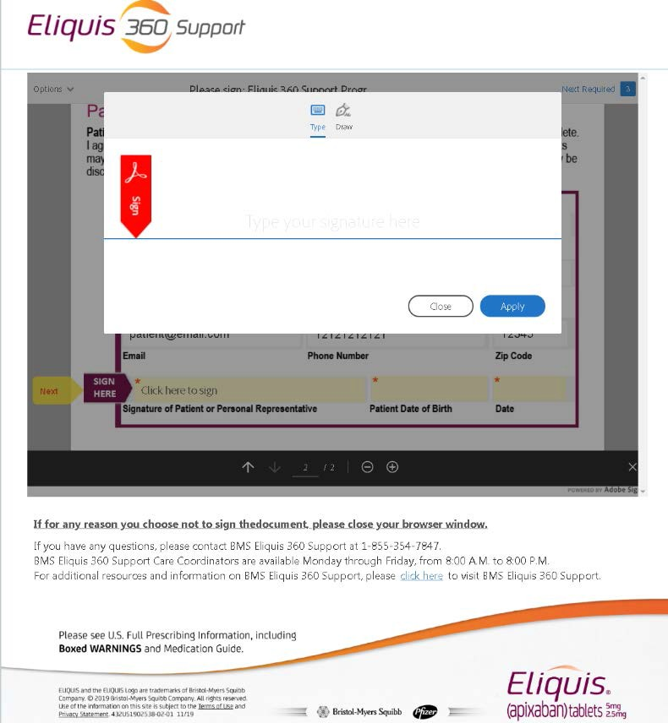
E-sign Screen Shots (5 of 6)

Slide 15
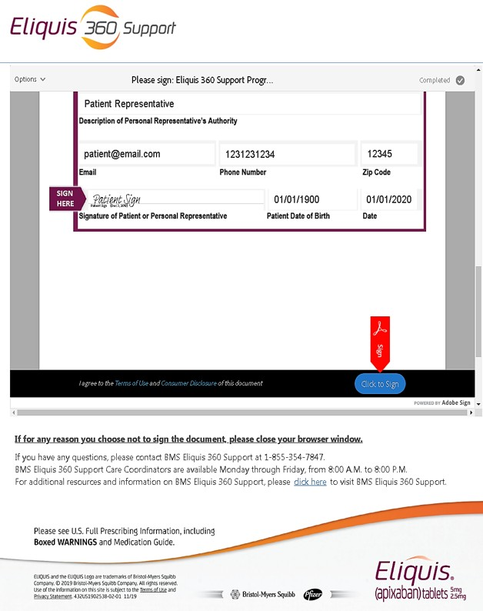
E-sign Screen Shots (5 of 6)

Slide 16
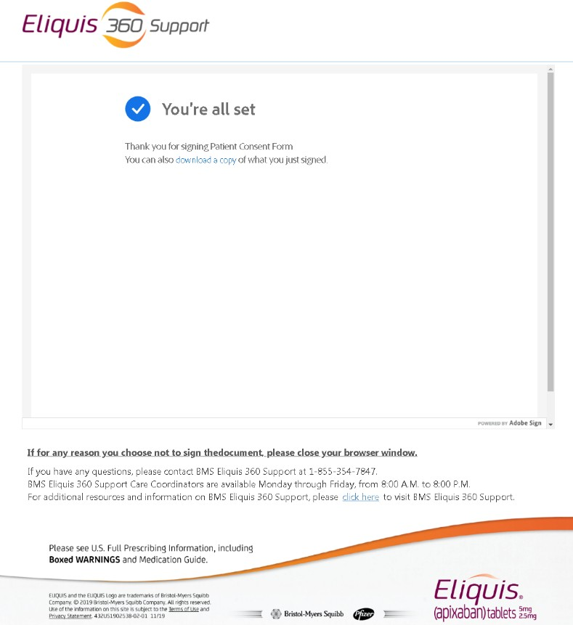
E-sign Screen Shots (6 of 6)

Slide 17




Resource: Benefits Review Carrier
Summary
Benefits Review Carrier
432US1702651-02-01
Description
Carrier that houses the BR forms and an annotated BR form card
Objective
Educates providers about the program’s support services
Provides direction on how to get started
and the steps involved in initiating a BR
Core Message
The BR carrier is the reference guide for all who complete BRs for the patient. Written patient consent must accompany all enrollment form submissions.
Notes:
Say: Now to review the resources field personnel use to support financial options for Eliquis patients starting this benefits review carrier. We’ll review its contents in a second, but the highlight here is how this component is a comprehensive reference guide to the benefits review process and its steps.

Slide 18

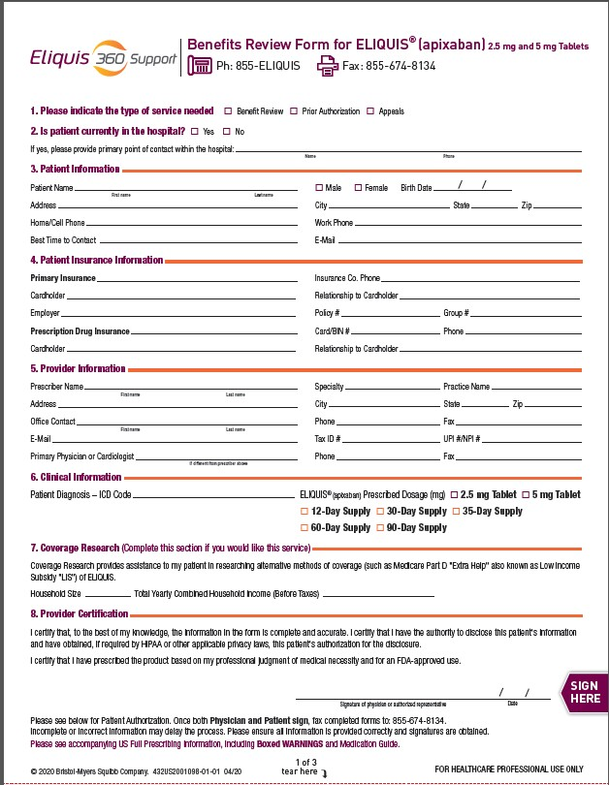
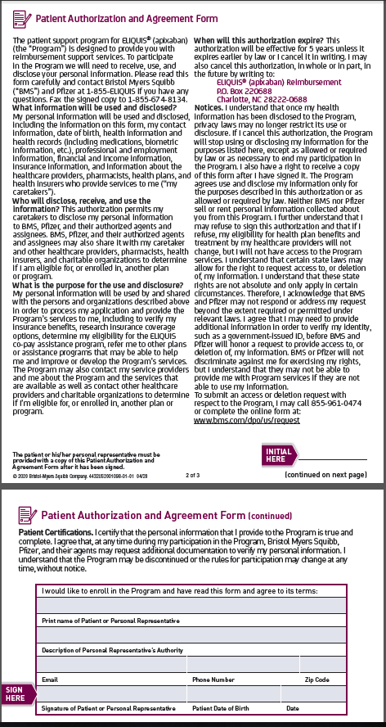
Resource: Carrier Component BR Enrollment Form and PAA
Summary
Front
Back
Description
Tear pad of 15 forms
Form includes enrollment portion and Patient Authorization Agreement (PAA)
Objective
Template designed for HCPs to submit BRs
Vehicle for submitting faxed BR submission
Core Message
The most streamlined way to initiate a BR is to have the patient call 855-ELIQUIS. If the office would like to complete this process, this enrollment form will initiate a patient’s BR. The patient’s signed PAA form must accompany the enrollment form on every submission.
Item #: 432US2001098-01-01
Notes:
Say: So here are pictures of the tear pad forms within the carrier. It makes sense to talk to these given the process we just outlined in detail, because this a fantastic representation of how field personnel can “partner” with office staff through discussing this form and the process it involves for the patient. It contains a tear pad of 15 forms that include an enrollment portion & Patient Authorization Agreement.
<click to build slide>
Say: This is a template designed for the HCP to initiate a benefit review, predominantly through fax submission.
<click to build slide>
Say: <Read core message and discuss>

Slide 19

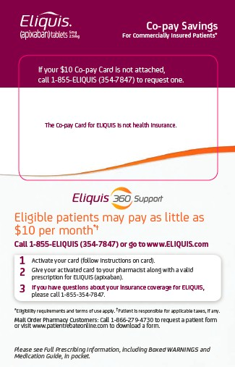
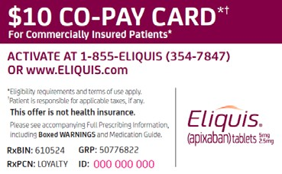
Resource: ELIQUIS® Co-Pay Card and Brochure*
Summary
Vendor: McKesson
Distribution: field sales, www.eliquis.com, and 1-855-Eliquis
Description
$10 a month per 30-day supply (up to 74 tablets for first fill and 60 for subsequent fills)
Commercial patients
Cash-paying and government-insured patients are ineligible for benefit
Annual maximum benefit of $3,800
Activation is required and terms of use apply
Card expires 24 months from activation. Upon expiration, eligible patients may re-enroll
Housed in the tiered holders
Core Message
Eligible patients may pay as little as $10 a month per 30-day supply for up to 24 months
*Eligibility and Terms of Use Apply
Item #: 432US1901420-02-01
Notes:
Say: Let’s discuss the copay card. You can see how it’s distributed multiple ways for patients to access. *click* <Read description listings>
<click to build slide>
Say: The specific messaging behind this item is”Eligible patients may pay as little as $10 a month per 30-day supply for up to 24 months.”

Slide 20
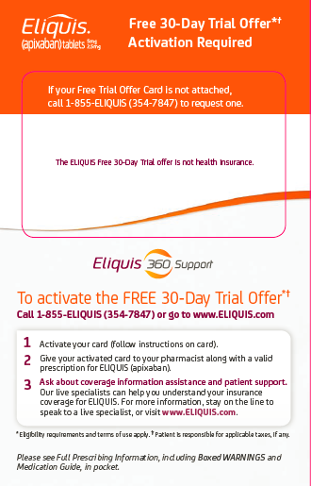

Resource: ELIQUIS® 30-Day FTO Brochure and Card*
Summary
Description
30-day FTO
Medicare D, commercial and cash patients
Can only be used with the patient’s first ELIQUIS® (apixaban) prescription
One use per patient lifetime
Activation is required
In lieu of samples
Housed in the tiered holders
Objective
Provides an alternative to traditional samples in areas that do not accept samples
Core Message
Eligible patients can receive a free 30-day trial of ELIQUIS®
*Eligibility and Terms of Use Apply
Item #: 432US1804284-01-01
Notes:
Say: Here’s another attractive option for first time patients. The FTO brochure is a 30-day option for any patients to receive their first allocation of Eliquis with as little resistance as possible. It can only be used once per patient lifetime. Must be activated. Significant option in lieu of samples. And typically housed in tiered providers that field personnel can distribute with them.
<click to build slide>
Say: This is a viable alternative to traditional samples, especially with the ever-evolving market and restrictive sampling protocols of growing IDNs.
<click to build slide>
Say: The core messaging behind these is “Eligible patients can receive a free 30-day trial of Eliquis.”

Slide 21
















24/7/365 Card Activation Access
1-855-ELIQUIS
Eliquis 360 Live Specialist
available Monday – Friday 8:00 AM to 8:00 PM EST
ELIQUIS.COM
Web Activation
24 hours a day every day
IVR
(Interactive Voice Response)
available 24 hours a day every day
Notes:
Say: Listed here are the 3 ways patients can activate those card options.

Slide 22

Resource: Coverage Assistance Brochure
Summary
Description
Brochure that outlines coverage assistance and patient education options
Objective
Informs patients of available support services
Housed in the tiered holder and travels with the Co-Pay and FTO cards
Core Message
Every offer distributed should include a copy of the coverage assistance brochure
Item #: 432US1802534-01-01
20
Notes:
Say: This resource is a great way to leave behind a physical reminder to an office about how accessible Eliquis can be for their patients.
<read listed line items>

Slide 23
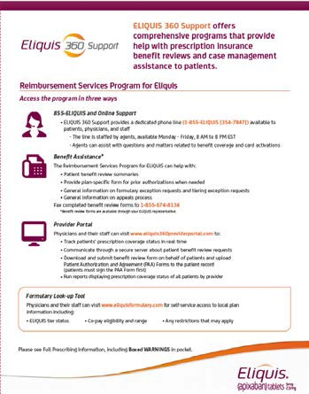
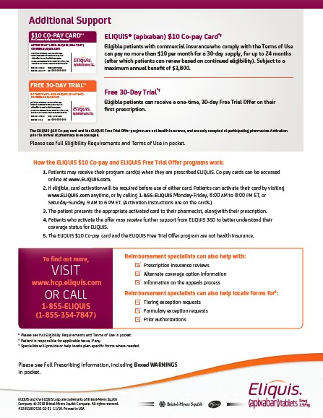
Resource: ELIQUIS 360 Support Sell Sheet
Summary
Description
Leave-behind detailing key features of the ELIQUIS 360 Support program
Objective
To provide physicians and their staff with a handy reference card summarizing key resources available to them and their patients
Core Message
The HCP’s “go to” guide for support phone numbers, resource links and key information regarding reimbursement programs that support ELIQUIS®
Item #: 432US1902358-01-01
Notes:
Say: The Eliquis 360 Support Sell Sheet reviews key financial resources available to patients and the channels to initiate contact for them. *click* This gives the office personnel autonomy to discuss those key options with their patients directly *click* as a “go to” guide reference.

Slide 24







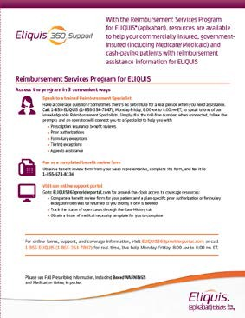
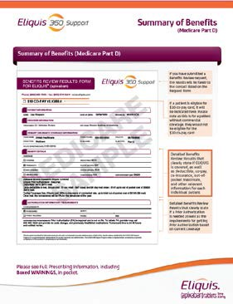
Eliquis 360 Resources On Weborder
Patient-Facing Resources
HCP-Facing Resources
432US1901420-02-01 | English Co-pay Brochure
432US1804284-01-01 | English FTO Brochure
432US1804285-01-01 | English Pre-activated FTO Brochure
432US1901420-03-01 | Spanish Co-pay Brochure
432US1804284-07-01 | Spanish FTO Brochure
432US1804285-15-01 | Spanish Pre-activated FTO Brochure
432US1804285-17-01 | Russian Pre-activated FTO Brochure
432US1804285-13-01 | Arabic Pre-activated FTO Brochure
432US1804285-06-01 | Chinese Pre-activated FTO Brochure
Benefit Review Carrier
432US1702651-02-01
Benefit Review Fax Form Pad
432US2001098-01-01
Coverage Assistance Brochure
432US1802534-01-01
Summary of Benefits Sample Flashcard 432US1903842-02-01
Brochure Holder
432US1603807-01-01
Sell Sheet
432US1902358-01-01
4432US1902166-04-01 06/20
Notes:
<discuss highlights of displayed line items><Reference Web Order>

Slide 25

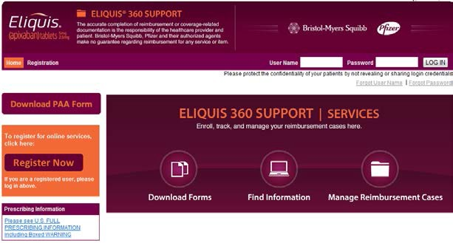
Resource: HCP Provider Portal
Summary
Description
Website that can only be accessed after registration is completed and validated
Objective
Provides an alternative resource for offices preferring to operate in an electronic environment
Core Message
The most efficient way to initiate a benefit review is to have patients call 855-ELIQUIS. If the office would like to submit the enrollment form on the patient’s behalf, the portal is an option
www.ELIQUIS360providerportal.com
Notes:
Say: Now we’ll look at the virtual resources we have available within the E360 arsenal. *click* The provider portal serves as a great way for offices to have many of the previously discussed components at their fingertips. Once an office has registered their information and been validated, they retain capabilities such as initiating the benefits review process electronically. *click* <Read core messaging>

Slide 26

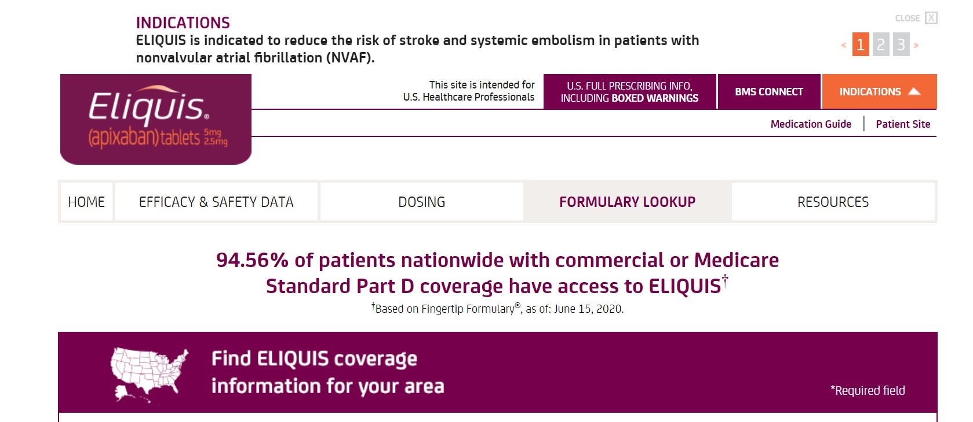
Resource: Formulary Look-up Tool
Summary
Description
Provides HCPs and their staff with
self-service access to tier information, co- pay ranges, restrictions, etc.
Objective
Provides the HCP with access to on-demand coverage information for patients in
their area
Core Message
94.56% of patients nationwide with commercial or Medicare Standard Part D coverage have access to ELIQUIS® (based on Fingertip Formulary 6/15/2020)
www.EliquisFormulary.com
Notes:
Say: Another overlooked resource is the formulary look-up tool, different of course from fingertip formulary. This empowers an office to proactively observe many elements of the formulary coverage for a patient. *click* It offers local coverage capabilities. *click* And it melds well with the core messaging field personnel use to describe Eliquis national coverage.

Slide 27


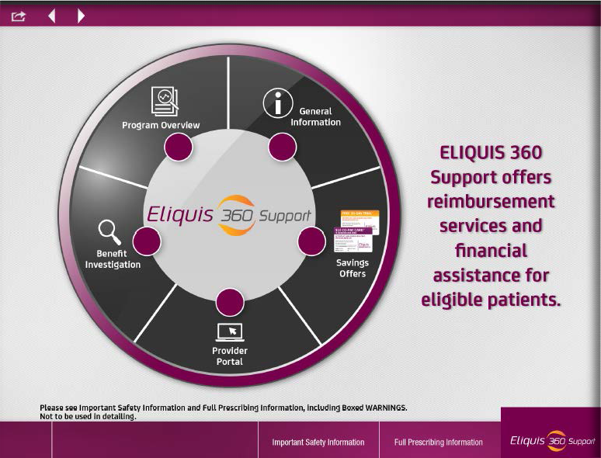
Resource: ELIQUIS 360 Support IVA
Summary
Description
Internally accessed interactive presentation outlining ELIQUIS 360 Support features, tools, and resources. This presentation lives on the Veeva platform for BMS and as an interactive PDF for Pfizer.
Objective
Helps reps walk HCPs and their staff through the ELIQUIS 360 Support program. Allows the rep to easily navigate to specific program features and areas of focus.
Core Message
ELIQUIS 360 Support is a program to help patients start and stay on treatment with ELIQUIS.
Item #: 432US1803695-03-01
Notes:
Say: The iVA is the sales tool field reps use to outline Eliquis 360 support on-site with office staff and HCPs.

Slide 28
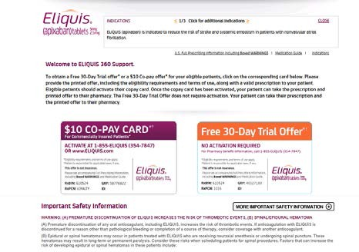
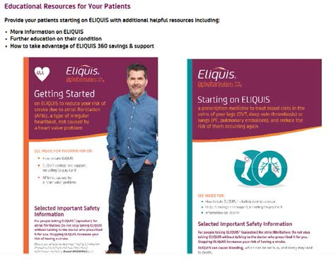
Resource: ELIQUIS 360 Virtual
Resource Program
Summary
Objective:
Support transition-of-care in institutional accounts where access to physical FTO and Co-pay cards is limited or not available
By providing hospital specific URLs with printable:
Eliquis Co-pay cards
Eliquis Pre-activated 30-day Free Trial Offer cards
Patient education materials
Program Criteria:
Account must be verified as a Tier 1 or Tier 2 Alliance Account based on the 2018 Alliance Target List
Account must have limited or no access to physical card brochures hospital wide and there must be a significant cross department desire for access to a URL
Senior Director or Regional Business Director approval is required from both BMS and PFE
Notes:
Say: Here is the optimal virtual resource for institutions to use, where URLs are provided for electronic access to copay cards, FTO cards and patient education. *click* <list qualifying criteria to participate>

Slide 29
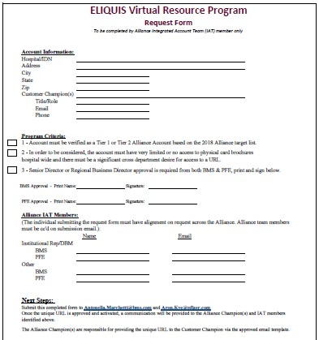

Resource: ELIQUIS 360 Virtual Resource Program
Summary
Process:
Requests should be submitted by completing the
Request Form
Creation of the custom link takes up to 4 weeks
An email will be sent to all individuals on the Request Form with the custom link
One member of the Alliance team should send the custom link to the customer champion via the approved email template with a copy to the Alliance Team
Leave Behind – objective is for field team to share what the custom link is and that it is available within the institution (432US1902127-01-01)
Notes:
Say: Read process overview

Slide 30
Questions?

Slide 31
2021 E360 TBM & DBM Region Points
Region | Retail | Hospital | DBM
Northeast | Carmen Caggiano |  | Hamid Haider
Central East | Amy Bell | Joanna Fanning | James Egan
Greater Mid-Atlantic | Jennifer Boaz Bridgett Hill | Jen Santee | Jeff Skelton
Southeast |  | Rachel Forbito | Billy Woods
North Central | Marne Klinsky | Georgia Goffe | Kristen Warner
Heartland | Laura Armstrong | Teresita Harrison | Tim Hargett
West | Emilia Belotti | Mark Spalding | Brooke Stamatis
432US1902166-04-01 06/20

