Slide 1
dATABASE
MySQL

Slide 2
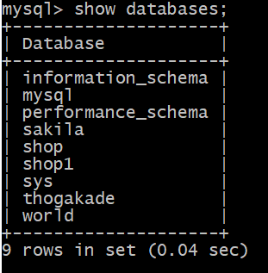
Check databases
First open the cmd and type this statement.
mysql> show databases;
Then you can see this,
These are currently databases in my PC’s memory. You can see databases in your PC’s following this statement.

Slide 3
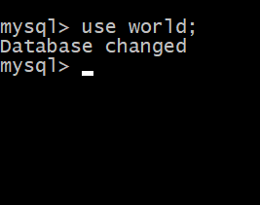
Use currently database
mysql> use world;
Then you can this,
Then you can work in this database. You can try work with your PC’s databases.
Database name

Slide 4
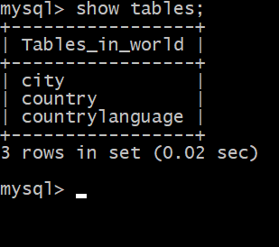
show currently tables
mysql> show tables;
Then you can this,
This tables are in my ijse database. You can see tables in previous you changed database.

Slide 5
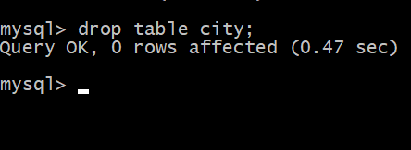
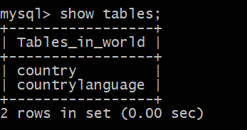
drop table customer
mysql> drop table city;
Table name
Then you can check this,
mysql> show tables;
Then you can see dropped table is not tables list.

Slide 6
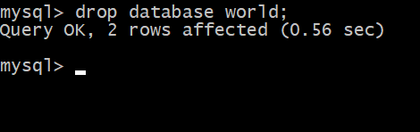
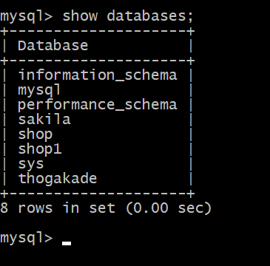
drop database
mysql> drop database world;
Database name
Then you can check this,
mysql> show databases;

Slide 7
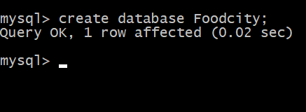
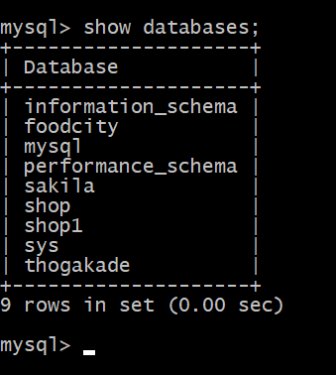
create database
mysql> create database Foodcity;
New Database name
Then you can check this,
mysql> show databases;

Slide 8
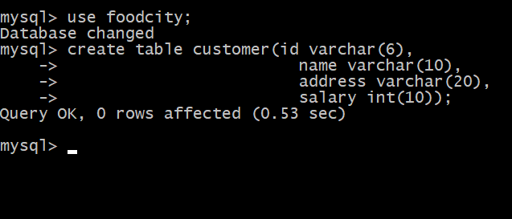
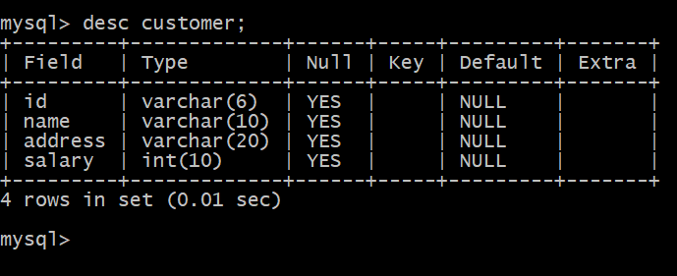
create table
First use a database and then give this statement,
create table customer(id varchar(6),
name varchar(10),
address varchar(20),
salary int(10));
mysql> desc customer;

