Slide 1
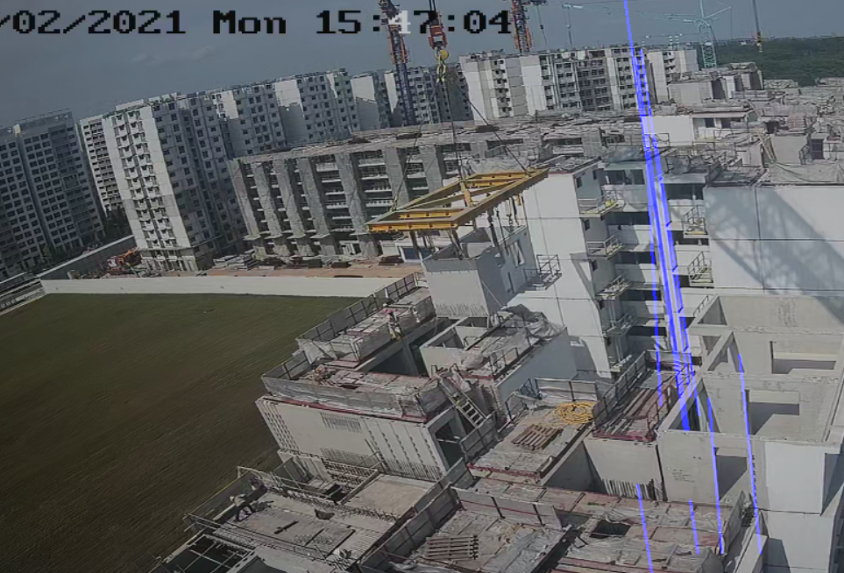

Idea: to obtain lines that are parallel to the gravity direction
Rationale: the direction of the line provides information on the fall path that is in the world coordinate frame
To translate the line to the desired ROI, we will need to find the angle about the vertical
We select angles that are between -15 degrees to 15 degrees depending on the distortion
Image plane vertical
y_diff = y2 - y1
x_diff = x2 - x1
theta = math.atan(x_diff/y_diff)
(x1,y1)
$$Θ$$
Detected line
(x2,y2)

Slide 2
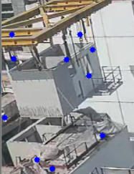
Idea: to obtain lines that are parallel to the gravity direction
Rationale: the direction of the line provides information on the fall path that is in the world coordinate frame
Corner detection provide important 3d visual cues
We can use built-in shi Tomashi corner detection algo to get the corners out
Using the corners detected, we can draw a line the angle determined previously to obtain a possible downward project of the hoist

