Slide 1

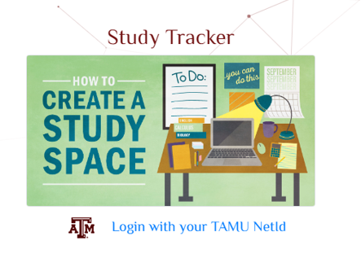
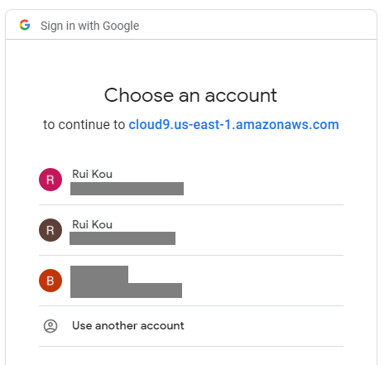
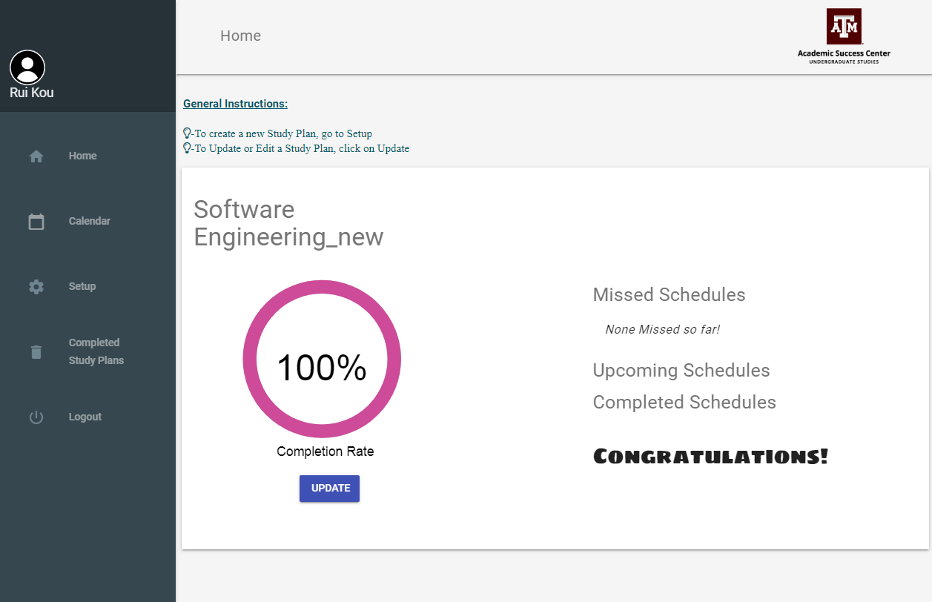
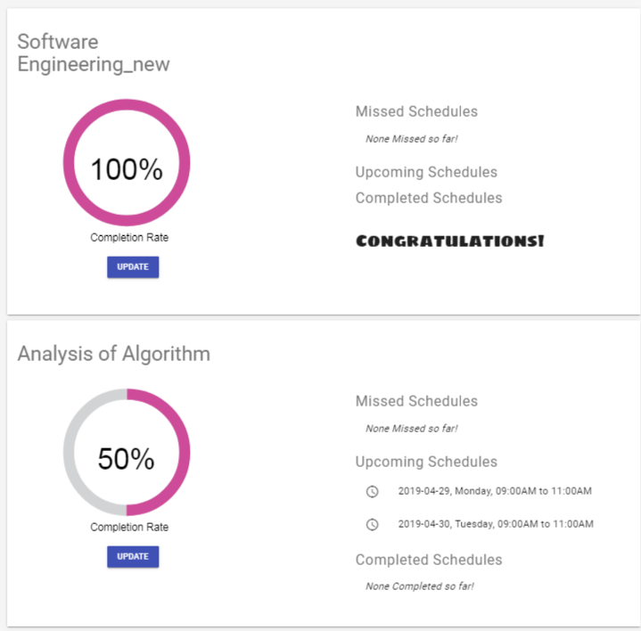
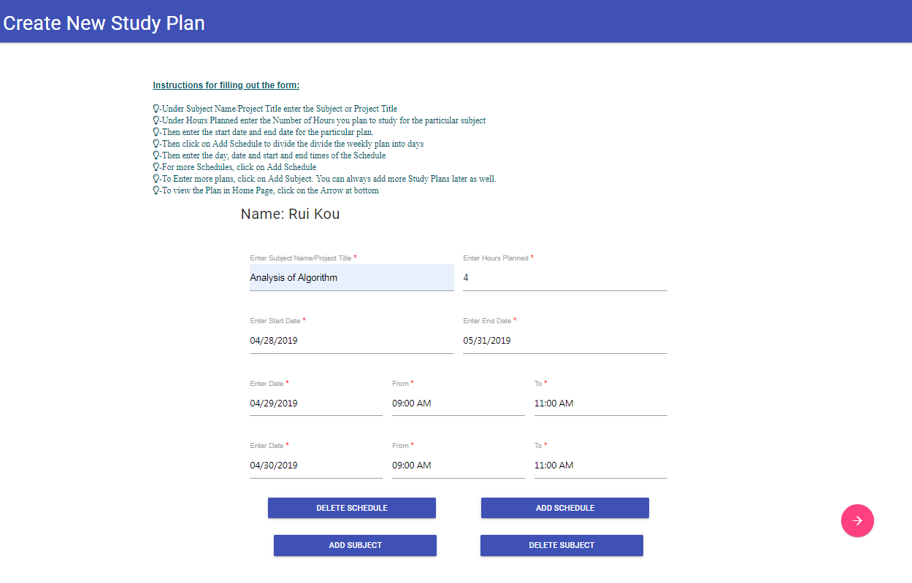
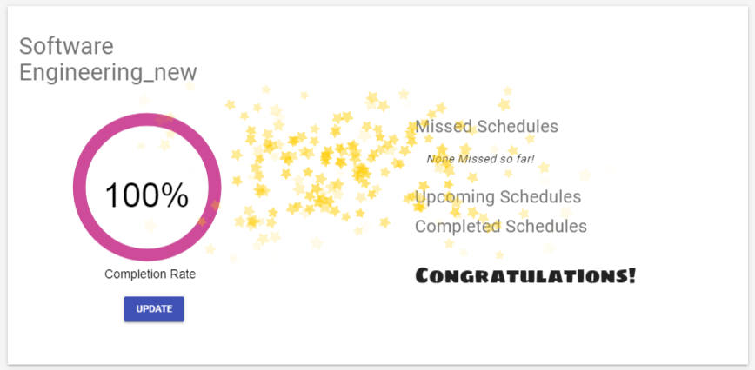

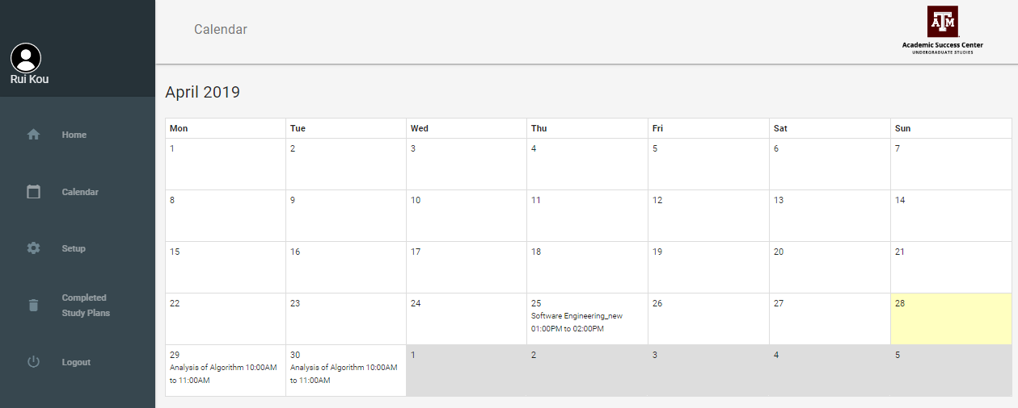
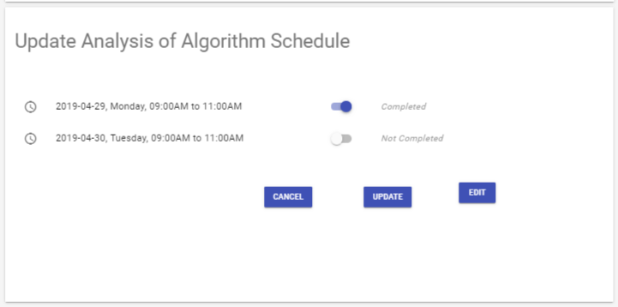



Title: Study Tracker Website for Academic Success Center
Team: Rwby Client: Academic Success Center
Client Representative: Valerie Balester, Lyle Slack
Team Members: Rohan Singh Wilkho, Jia Cheng Liu, Rui Kou
Ritika Kamtam, Harish Krishnamoorthy, Kamalakshitha Aligeri
Introduction
Overall Flow
Study Track Web Page Illustration
●Academic Success Center, Texas A&M University wanted to help its students with a program where the students can make and track their schedules and study plans.
●Their objective is to create an easy to use application to guide/support the time management of undergraduate students
●As a solution, we continue to improve the legacy code of Study Tracker, and deployed the improved code to AWS.
●Study Tracker is a SaaS app built on Ruby on Rails and with open source tools using Agile methodology
●The Study Tracker application developed across four iteration with the results shown in the illustration section
Login Page
Login Page with Animation
Google Authentication
Google Authentication
N
TAMU Net ID and Password ?
Y
Y
Index Page
Index Page with Side Panel
List of Subjects and Schedules
Create New Study Plan
Update/Edit Study Plan
Schedule
Create Subjects (Courses)
All Schedule Completed?
Class Diagram
Create Schedules (study intervals)
N
Y
Create Study Plan Page
●The study Tracker app uses: User table and Subject table, and Subject table
●We illustrate the relationship between the three table in the following class diagram
Congratulation Page
Google Authentication API
Congratulations Page with Animation
Active Record
Study Tracker
User
First Name
Last Name
Email
Has many:
subjects
Subject
Name:String
Start: Date
End: Date
Hours: Integer
Has many:
Schedules
Belongs to:
users
Schedule
Start: Time
End: Time
Hours: Integer
Belongs to:
subject
Calendar Page with Schedules
Allows login only through TAMU Net ID
www.studytrack.ga
Back side of Subject Page
Free Domain
Domain Name System (DNS)
Server Instance with Elastic IP

