Slide 1

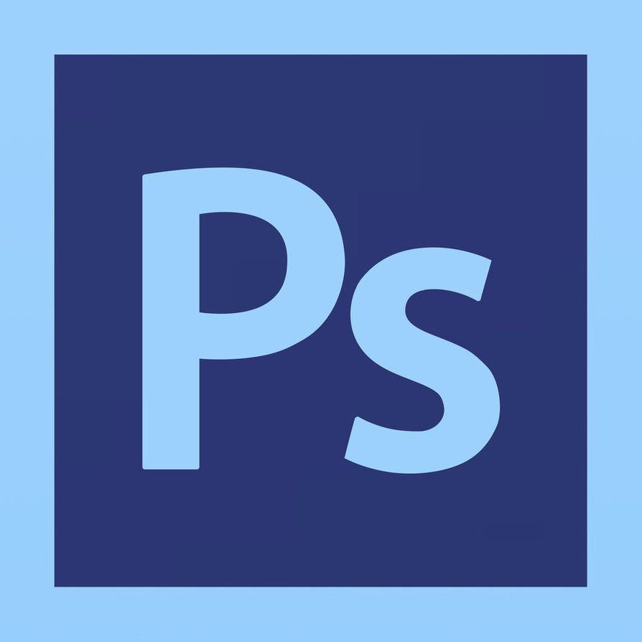
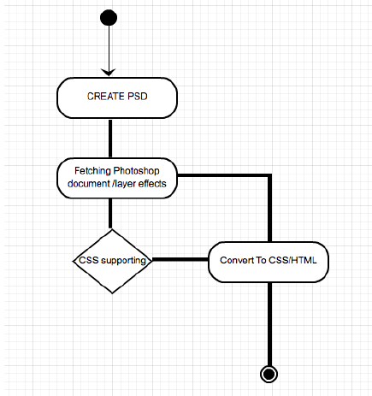
HOIST
Photoshop script to convert designs to CODE
HTML Tags
Text <p> <hi>
img
Div, section
Basic, head, body
Layered
Button
Nav
Etc…
AIM:
To Remove the gap of understanding between graphic designer and developer.
Summary:
“HOIST” is a Photoshop Script plugin to convert a Photoshop Document (PSD) into a html and CSS code used for standard static web page.
A Photoshop Script is an approach to automate Photoshop using its JavaScript object model. Photoshop Application Programming Index (API) allows user to use Photoshop object model to automate filters, functionalities and effects or convert a document into various format. “HOIST”, extracts all the information from the PSD file and converts the possible effect into its HTML and CSS code.
CSS properties
Dimension
Position
Opacity
Style (abbreviated)
Z-index
Etc…
Project By :
HARSH BHATIA (10103487)
Supervisor: Prof. Sanjay Goel

