Slide 1
INTELLIHIRE
From Signals to Semantics
Multimodal Interview Assessment via ML, GenAI & Heuristic Fusion
Harshita Maurya · Sharmili Pednekar · Sannidhi Shetty
Guide: Prof. Sushant Gawade | Universal College of Engineering, Maharashtra
58 Sessions Evaluated
3-Layer AI Architecture
Hugging Face Deployed

Slide 2
01 · INTRODUCTION
What is IntelliHire?
A full-stack, AI-powered virtual interview coaching platform that combines multimodal signal processing, heuristic fusion, classical ML, and generative AI to deliver transparent, job-grounded feedback.
🎙️
🤖
☁️
Audio + Video Analysis
GenAI Teacher Layer
Cloud-Native Deployment
librosa acoustics · MediaPipe face mesh · Real-time HUD
RAG-grounded Groq LLaMA-3 · Rubric-aligned competency scores
Hugging Face Space · Node/Express API · React/Vite frontend
58 Sessions Evaluated
3-Layer AI Architecture
Groq LLaMA-3 Powered
Hugging Face Deployed

Slide 3
01
THE
PROBLEM
Grounding Gap
Generic feedback ignores job-specific requirements. No link between questions and real JD context.
02
Modality Fragility
Deep learning collapses when face tracking fails or audio degrades. No fallback mechanism.
Why existing
interview tools
fall short
03
Black Box Scoring
Neural models give no transparency. Candidates can't understand why they scored low.
IntelliHire solves all three → heuristic fusion + classical ML + GenAI + cloud

Slide 4
LITERATURE REVIEW
1 of 3 · References [1]–[6]
[#]
Author / Year
Approach & Key Contribution
Research Gap
[1]
Bhavani et al.
LLaMA 3.1 + WebRTC + spaCy NLP + Flask + React TS. High user satisfaction (92%) with emotion & confidence scoring.
Limited security; earlier systems lacked personalization.
2026
[2]
Chavan & Jadhav
BERT resume parsing + semantic cosine similarity scoring. Personalized JD-aligned question generation.
Needs speech analysis & emotion detection for better accuracy.
2026
[3]
Kolpe et al.
CNNs for facial emotion, NLP for text, TensorFlow personality recognition. Real-time multimodal coaching.
Traditional approaches lack personalized responses and weakness insights.
2024
[4]
Vinodhini S et al.
Gemini AI + MFCC audio + MediaPipe/OpenFace video + React. Weighted fusion formula; MA analytics dashboard.
Requires more complex architectures and broader linguistic capabilities.
2025
[5]
Singh et al.
GPT/BERT/T5 + Google Cloud APIs. Contextual follow-up Qs using sentiment; modular NLU pipeline.
Effectiveness dependent on transcription accuracy; degrades in noise.
2025
[6]
Verma et al.
MERN + Google Gemini + DeepSpeech. Validated on 200 sessions → 23% interview improvement, 85% confidence boost.
Transcription accuracy drops with non-native accents or noisy environments.
2025

Slide 5
LITERATURE REVIEW
2 of 3 · References [7]–[11]
[#]
Author / Year
Approach & Key Contribution
Research Gap
[7]
Koutsoumpis et al.
Librosa + Parselmouth + OpenFace + S-BERT. 80 handcrafted feature groups; 710-participant crowdsourced dataset.
Test-retest reliability below standards for high-stakes selection.
2024
[8]
Daryanto et al.
GPT-3.5 (simulation) + GPT-4 (dialogic feedback). Qualitative; 19-participant study on reflective learning.
Qualitative focus only; no quantitative efficacy measurement.
2025
[9]
Agrawal et al.
Random Forest + SVC + Multitask Lasso. MIT Interview Dataset (138 videos). 9 behavioral labels classified.
Dataset limited (169 videos); lacks hand movement & posture analysis.
2020
[10]
Jain et al.
GPT-3.5-Turbo LLM. Resume + JD parsing → tailored question generation per role. Session-based workflow.
Prior literature lacked role-based assessment and tailored questioning.
2024
[11]
G A et al.
Generative AI + transformers with attention. 150 expert assessments; correlation coefficient of 0.81.
Early rule-based systems limited in handling diverse open-ended responses.
2025

Slide 6
LITERATURE REVIEW
3 of 3 · References [12]–[16]
[#]
Author / Year
Approach & Key Contribution
Research Gap
[12]
Li et al.
SigLIP2 + emotion2vec + SFR-Embedding-Mistral. MSCMLP fusion + 2-level ensemble. AVI Challenge 1st place.
Balancing contributions from significantly different input modalities.
2025
[13]
Deshmukh et al.
GPT-4 + Whisper API (ASR) + Wit.ai TTS. Dual feedback: per-answer formative + summative final report.
Lacks non-verbal and prosodic cues that human interviewers weigh heavily.
2024
[14]
Bin Nofal et al.
GPT family + RoBERTa sentiment + Unity 3D (VR). 83-student study; fairness analysis re: LLM bias.
Biased feedback risk based on candidate background depending on LLM.
2025
[15]
Gomez & Batham
Multimodal LLM + whiteboard AI. 20 CS students; LeetCode interview simulation with real-time feedback.
Challenges with conversational flow and timing during interactive sessions.
2025
[16]
Sun et al.
GPT-3.5, GPT-4, Google Gemini compared. 29 participants; 6-parameter index. Gemini best quality-speed balance.
GPT-4 speed sensitive to text length; LLMs face occasional misunderstandings.
2025
Key Insight: No prior work combines JD-grounded RAG + deterministic heuristic fusion + HF cloud deployment in a single reproducible pipeline.

Slide 7
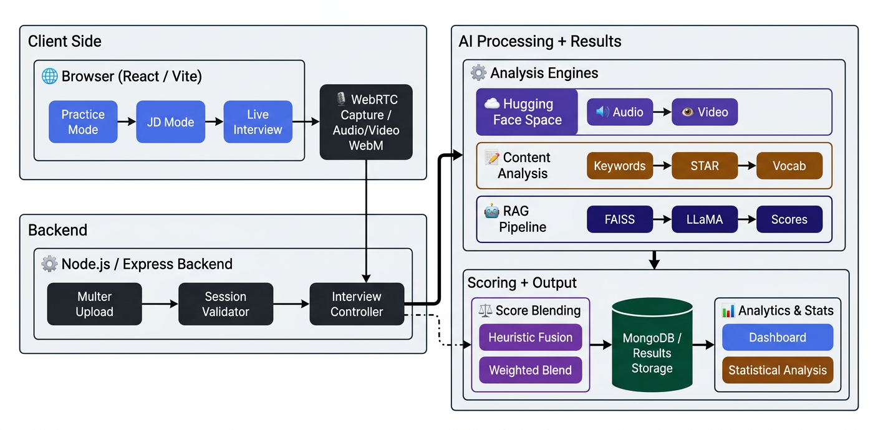
SYSTEM ARCHITECTURE
End-to-end multimodal pipeline · diagram to be inserted by author
+
[ Insert Architecture Diagram Here ]
Your system architecture image will replace this slide.

Slide 8



THREE INTERVIEW MODES
Practice Mode
JD Mode
Live Interview
Individual Drill
Role-Specific Prep
Simulated Interview
Static question library
Paste any job description
Camera + mic capture
AI topic generator
Extract 8 key skills
Real-time HUD metrics
LLM competency scoring
Generate grounded Qs
Heuristic fusion scoring
Instant feedback loop
RAG-teacher feedback
Multi-score blending

Slide 9
HARDWARE / SOFTWARE SETUP
Technology Stack & Environment
⚙️ SOFTWARE STACK
🖥️ HARDWARE & CONFIG
Frontend
React 18 + Vite 5, Tailwind CSS, Recharts, Framer Motion
Browser
Chrome / Edge (WebRTC, MediaRecorder API)
Backend
Node.js / Express, Mongoose, Multer, Groq SDK
Camera
Built-in or USB webcam (640×360 min)
Database
MongoDB (local), FAISS-node (vector index)
Microphone
System mic, 44.1 kHz, echo cancellation on
ML / Audio
Python: librosa, MediaPipe, OpenCV, NumPy, scipy
Backend Host
Localhost / any Node.js server (Port 5000)
GenAI
Groq LLaMA-3.1-8B-Instant (cloud API), RAG pipeline
HF Space
CPU Basic (free tier) — GPU optional
Deployment
Hugging Face Spaces (Gradio + FastAPI), HF free tier
MongoDB
Local 27017 or Atlas cloud URI
Analytics
jStat (Welch t-test), IEEEsession_analysis.py
Audio SR
16 kHz resampled in librosa for feature extraction
React 18.2
Node.js LTS
MongoDB 6
librosa 0.10
mediapipe 0.10
pptxgenjs 4.0

Slide 10
RESEARCH METHODOLOGY
End-to-End Experimental Design
Data Collection
Feature Extraction
1
Browser-captured audio (WebM) + video (WebM) + Speech-to-Text transcription. 58 sessions across Practice, JD, and Live modes (Feb–Mar 2026).
2
librosa: 6 acoustic descriptors at 16 kHz. MediaPipe FaceMesh: eye contact, head pose, smile, blink, gesture. Both stored per-session in MongoDB.
Score Computation
Evaluation & Analysis
3
Heuristic fusion with adaptive weights → logistic calibration. Content scoring: 7 deterministic metrics. RAG teacher: FAISS + BM25 retrieval → Groq LLaMA-3.
4
IEEEsession_analysis.py script for reproducible stats. 95% CI computation. Welch's t-test for inter-session comparison. JD traceability audit.

Slide 11
01
02
AUDIO
FEATURE
EXTRACTION
RMS Energy (dB)
Pitch Statistics F₀
Vocal intensity & projection
Mean & std — variance = instability
03
04
Spectral Centroid
Zero-Crossing Rate
Brightness → articulation clarity
Noisiness & voicing proportion
librosa-based
acoustic signal processing
at 16 kHz sample rate
05
06
Spectral Rolloff 85%
Tempo & Pause Ratio
Frequency enclosing 85% energy
Speaking rate & pause structure

Slide 12
HEURISTIC CONFIDENCE FUSION
Adaptive weighting of audio-visual modalities with logistic calibration
VIDEO SIGNALS
Speech Confidence
ADAPTIVE
WEIGHTS
s_speech = 0.30e + 0.25p + 0.20r + 0.15c + 0.10q
Eye Contact (gaze centering)
Face + Speaking
Head Pose (yaw/pitch/roll)
Video Confidence
w_s = 0.50
w_v = 0.50
s_video = 0.35ec + 0.30hc + 0.15sc + 0.20gc
Smile Dynamics & variability
No Face Detected
Blink Rate — composure proxy
Logistic Calibration
w_s = 1.00
s_cal = σ( s̃ ; k=6, x₀=0.5 )
w_v = 0.00
Gesture magnitude & variance
Face, Not Speaking
Backend Fusion
S_multi = 0.4·Scont + 0.3·Saud + 0.3·Svid
w_s = 0.30
w_v = 0.70

Slide 13
GENAI EVALUATION LAYER
RAG-grounded LLM teacher · Groq LLaMA-3 · Rubric-aligned competency scoring
01
02
03
04
Corpus
Construction
Semantic
Indexing
Teacher
Prompting
Grounding
Metrics
→
→
→
JD text + required skills + question rubric + optional resume → text chunks
FAISS dense embeddings + BM25 lexical fallback → top-k retrieval per query
LLM gets: question + candidate answer + retrieved chunks → rubric-aligned JSON
Citation precision, citation recall, groundedness score stored in MongoDB
Output Competencies: Technical · Clarity · Confidence · Conciseness · Engagement

Slide 14
HUGGING FACE DEPLOYMENT
Python-free backend · Cloud ML inference · Zero code change to switch modes
REQUEST FLOW
PERFORMANCE
1
Node.js submits
Audio analysis
3–5 s
axios POST multipart/form-data → audio + video files
2
HF Space receives
Video analysis
5–10 s
Gradio+FastAPI endpoint /analyze → processes streams
3
ML Inference
Total (warm)
8–15 s
librosa (audio) + MediaPipe (video) → feature dicts
4
JSON response
VoiceAnalysis + FacialAnalysis → backend score pipeline
Cold start
30–60 s
5
Retry logic
3 attempts, exponential backoff: 2s / 4s / 8s → 120s timeout
Max retry timeout
120 s
USE_LOCAL_ANALYZER=true/false — seamless toggle, zero code change

Slide 15
RESULTS
49.6
[45.3, 53.9]
15.5%
PILOT
RESULTS
Mean Score
95% CI
JD Traceability
± 16.6 SD
9 of 58
Score by Source
58
Practice (n=25)
58.4
JD Mode (n=9)
45.4
Live (n=24)
42
SESSIONS
Key Content Metrics
Feb 21 – Mar 7, 2026
Vocabulary Diversity
Coherence Score
91.2 ± 9.6
40.8 ± 19.6
Professional Terms
STAR Method Score
3.3 ± 6.7
16.4 ± 25.9

Slide 16
LIMITATIONS
FUTURE WORK
Limited Contextual Understanding
Security & Identity Assurance Framework (Login Page)
The system lacks the nuanced human ability to interpret organizational culture and specific role-based soft skills.
Implement OAuth 2.0 and JWT-based authentication to ensure secure, role-based access to sensitive user documents.
No Real-time Adaptive Learning
Enhanced Personalization
The architecture does not currently support dynamic model updates or personalization based on ongoing user performance.
Develop adaptive difficulty algorithms that adjust interview complexity based on the candidate's real-time responses.
Scalability Constraints
Real-time Learning from User Interaction
Concurrent user load may lead to increased latency and significant API inference costs for large-scale deployments.
Integrate feedback loops to allow the system to refine its evaluation accuracy through continuous human-in-the-loop validation.
No fairness / bias audit
Voice-based Interview Simulation
The reliance on pre-trained LLMs may introduce latent biases that have not yet been empirically measured or mitigated.
Incorporate speech-to-text and NLP-based vocal analysis to simulate a more realistic and immersive interview environment.
Dependency on Internet and External APIs
Integration with Live Job Data
The absence of a robust authentication layer and advanced encryption presents potential risks to sensitive candidate PII.
Utilize API hooks to fetch real-time industry requirements from platforms like LinkedIn to ensure question relevance.

Slide 17
CONCLUSION
🧩
Unified 3-layer architecture
📊
Pilot evidence
Deterministic content + multimodal ML + GenAI teacher — fully integrated
58 sessions · mean 49.6 ± 16.6 · 95% CI [45.3, 53.9] · JD traceability 15.5%
🛡️
Resilient to signal loss
🔬
Reproducible evaluation design
Heuristic fusion auto-adjusts weights when face or audio is unavailable
Ablation plan + IEEEsession_analysis.py script for future benchmarks
☁️
Cloud-native deployment
HF Space removes Python dependency from Node backend entirely
Thank you — Questions welcome

