Slide 1


Cyber-Bullying Detection
Group- 16
Harshit Pandey (2000290110075)
Harsh Kumar Singh (2000290110071)
Harsh Kumar (2000290110070)
Guide
Mr. Ankit Kr. Saini

Slide 2
Introduction
Bullying is an intentional, aggressive and repeated behavior that could be physical, verbal, sexual or mental.
With rise of social media coupled with the Covid-19 pandemic, cyberbullying has reached all time highs.
As social media usage becomes increasingly prevalent in every age group, most of us rely on this essential medium for our day-to-day communication.
Such large usage means that cyberbullying can effectively impact anyone at anytime or anywhere.
The anonymity of internet makes such attacks more difficult to stop than traditional bullying.

Slide 3
Statistics
On April 15th 2020, UNICEF issued a warning in response to the increased risk of cyberbullying.
As per Times Of India 52,974 incidents of cyber crimes were reported in year 2021 in India.
Around 85 per cent of Indian children have reported being cyberbullied as well as having cyberbullied someone else at rates well over twice the international average.
Nearly 8 out of 10 individuals are subject to the different types of cyberbullying in India. Out of these around 63% faced online abuses and insults, and 59% were subject to false rumours and gossips for degrading their image.

Slide 4
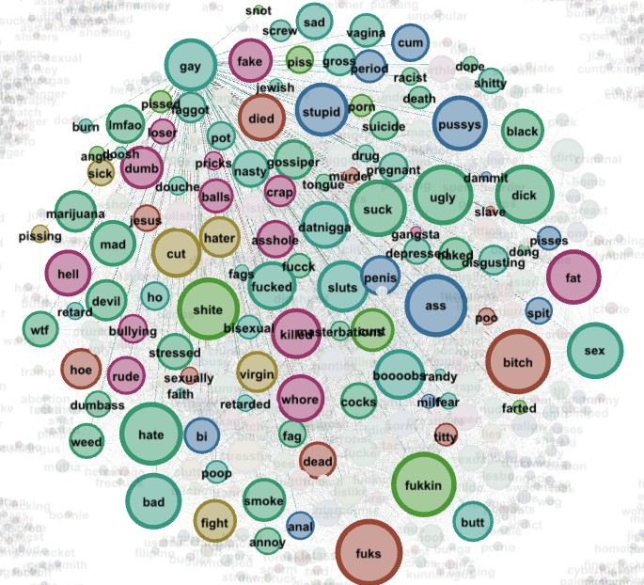
Our aim
Our Aim is to:-
Create a classification model that predict cyberbullying (type & level).
Create a binary classification model to flag potentially harmful posts or messages.
Explore words and patterns associated with each type of cyberbullying.

Slide 5

Technology and frameworks
Python
Machine Learning
Jupyter Notebook
Dataset: Twitter Tweets dataset (Kaggle)
Java/ Kotlin

Slide 6
Recent study and research paper
Cyber Bullying Detection Based on Twitter Dataset
Author: Debajyoti Mukhopadhyay
Published year: 2020
Summary: In this paper, author gave a review about the acceleration of social media and the rise of cyber bullying cases. He has applied various ML algorithms such as CNN, SVM for detecting the pattern.
Rapid Cyber-bullying detection method using Compact BERT Models
Author: Mitra Behzadi, Ian G. Harris, Ali Derakhshan
Published year: 2021
Summary: In this work author presented a new method for cyber-bullying detection, which relied on the basis of transfer learning and fine-tuning compact BERT models. They achieved better results than previous work, without using any metadata. Moreover, the demonstrated method is both fast and reliable, which makes it very suitable for real-time detection of cyberbullying.

Slide 7
References
https://ieeexplore.ieee.org/document/9378065
https://www.researchgate.net/publication/345675295_Cyber_Bullying_Detection_Based_on_Twitter_Dataset
https://ieeexplore.ieee.org/document/9364448
https://ieeexplore.ieee.org/document/9792931
https://ieeexplore.ieee.org/document/9676194
https://ieeexplore.ieee.org/document/9001476

Slide 8

Thank You

