Slide 1
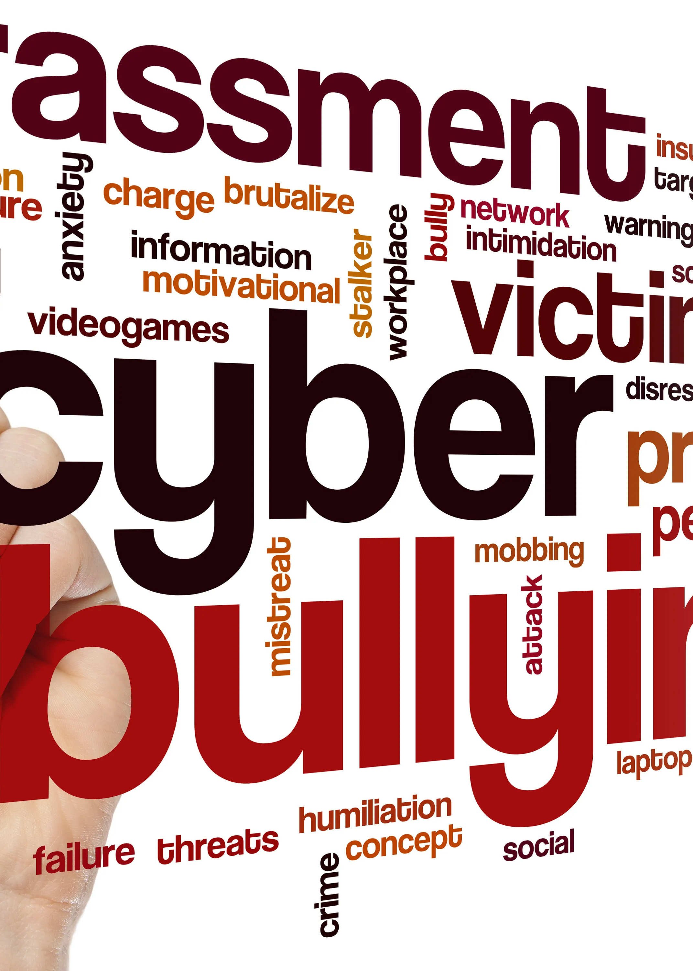

CYBER-BULLYING
DETECTION
Team Member:
Harshit Pandey (2000290110075)
Harsh Kumar Singh (2000290110071)
Harsh Kumar (2000290110070)
Department of Computer Science and Information Technology (CSIT), KIET Group Of Institutions Ghaziabad

Slide 2
Introduction
Bullying is an intentional, aggressive and repeated behavior that could be physical, verbal, sexual or mental.
Cyberbullying is bullying with the use of digital technologies. It can take place on social media, messaging platforms, gaming platforms and mobile phones. It is repeated behaviour, aimed at scaring, angering or shaming those who are targeted.
For example, sending hurtful, abusive or threatening messages, images or videos via messaging platforms.
Face-to-face bullying and cyberbullying can often happen alongside each other. But cyberbullying leaves a digital footprint – a record that can prove useful and provide evidence to help stop the abuse.
Department of Computer Science and Information Technology (CSIT), KIET Group Of Institutions Ghaziabad

Slide 3
Problem Formulation
With rise of social media coupled with the Covid-19 pandemic, cyberbullying has reached all time highs.
As social media usage becomes increasingly prevalent in every age group, most of us rely on this essential medium for our day-to-day communication.
Such large usage means that cyberbullying can effectively impact anyone at anytime or anywhere.[1]
The anonymity of internet makes such attacks more difficult to stop than traditional bullying.
Department of Computer Science and Information Technology (CSIT), KIET Group Of Institutions Ghaziabad

Slide 4
(continued…)
Around 85 per cent of Indian children have reported being cyberbullied.
Nearly 8 out of 10 individuals are subject to the different types of cyberbullying in India. Out of these around 63% faced online abuses and insults, and 59% were subject to false rumours and gossips for degrading their image.[1]
Thus, we need to aware people about what Cyber-bullying is, and also take some measure to prevent it such that we can live in a safe environment without fear of being bullied.
Department of Computer Science and Information Technology (CSIT), KIET Group Of Institutions Ghaziabad

Slide 5
Objective
Our Aim is to:-
Create a classification model that predict cyberbullying (type & level).
Create a binary classification model to flag potentially harmful posts or messages.
Explore words and patterns associated with each type of cyberbullying.[4]
Department of Computer Science and Information Technology (CSIT), KIET Group Of Institutions Ghaziabad

Slide 6


Technology Used
Machine learning algorithms Natural Language Processing
can detect cyberbullying based on patterns and can analyze the language used in online interactions
trends in data. to detect signs of cyberbullying.

Slide 7
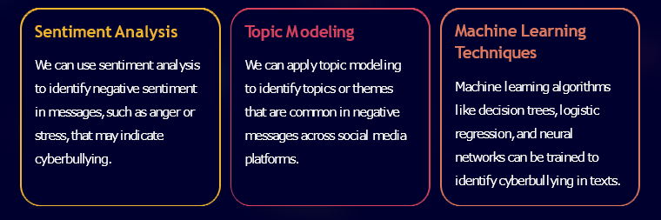
What is Natural Language Processing and How Can It Be Used?
Natural Language Processing (NLP) is an artificial intelligence technique used to understand, interpret and manipulate human language. We can use NLP to detect patterns and topics in social media messages, emails, or posts in blogs that contain cyberbullying content.
stress, that may indicate cyberbullying.

Slide 8

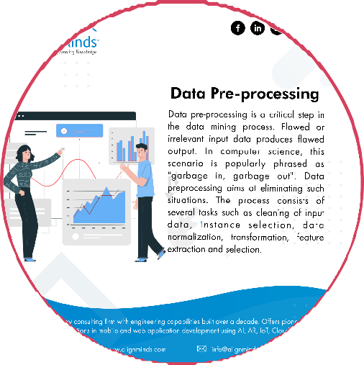

Data Collection and Pre-processing
The success of NLP models depends on the quality of data and the way it is processed. In this section, we will discuss different techniques for data collection and preprocessing that can improve the accuracy of our models.
Data Collection Data Pre-processing Data Cleaning
We can collect data by crawling The first step in data pre-processing Data cleaning involves removing
social media platforms, extracting posts, includes removing stop words, tokenizing, irrelevant data, identifying and
comments, and direct messages, and analyzing stemming or lemmatizing the text, removing handling missing data, and
them to identify cyberbullying patterns. Numbers and special characters for consistency. Dealing with outliers.

Slide 9
Methodology
For training and visualization purpose, we will use cyberbullying_tweets.csv which contains 2 features i.e. Tweet and cyberbullying_type [3]
First, we will clean the data as per our needs such as,
Convert text to lower case.
Remove shorthands (can’t -> cannot , isn’t -> is not)
Normalize spaces
Remove special character, etc
Then we will try to visualize and detect the pattern of tweets that are categorized as “bullying” and mark the most common words out of them which will work as Stop words for our project.[2]
After some EDA, apply various machine learning models and pick the best model out of them.
Department of Computer Science and Information Technology (CSIT), KIET Group Of Institutions Ghaziabad

Slide 10
Literature Survey
Title of the paper with Author(s) Name | Journal/Conf-rence | Year of Publication | Highlights
Dreaddit: A Reddit Dataset for Stress Analysis in Social Media by Elsbeth Turcan, Kathleen McKeown | Journal on Stress Analysis in Social Media | 2019 | In this research paper, they do the Stress Analysis in Social Media as stress is a nigh universal human experience, particularly in the online world. While stress can be motivator, too much stress is associated with many negative outcomes. They uses Dreddit, this dataset consists of 190K posts from five different categories of Reddit communities. They uses preliminary supervised learning methods for identifying stress, both neutral and traditional, and analyse the complexity and diversity of the data and characteristics of each category.
Department of Computer Science and Information Technology (CSIT), KIET Group Of Institutions Ghaziabad

Slide 11
(continued…)
Title of the paper with Author(s) Name | Journal/Conf-rence | Year of Publication | Highlights
Cyberbullying Detection: An Overview | Journal on Cyberbullying detection | 2018 | In this research paper, they provides an outline of cyberbullying, which primarily takes placeon social networking platforms, as well as the problems and difficulties associated with itsdetection The usage of classification techniques, features, and available data sources are addressed inthis research paper The well-known techniques for locating bullying-related keywords within the corpus includenatural language processing (NLP) and machine learning.
Department of Computer Science and Information Technology (CSIT), KIET Group Of Institutions Ghaziabad

Slide 12
References
[1] | K. M. Elsbeth Turcan, "Dreaddit: A Reddit Dataset for Stress Analysis in Social Media," Proceedings of the 10th International Workshop on Health Text Mining and Information Analysis (LOUHI 2019), no. IEEE, pp. 97-107, 2019.
[2] | A. B. Reem Bayari*, "Text Mining Techniques for Cyberbullying Detection: State of the Art," Advances in Science, Technology and Engineering Systems Journal, vol. 6, no. ASTESJ, pp. 783-790, 2021.
[3] | Larxel, "Kaggle," IEEE Bigdata, December 2020. [Online]. Available: https://www.kaggle.com/datasets/andrewmvd/cyberbullying-classification.
[4] | K. M. K. M. L. T. Debajyoti Mukhopadhyay, "Cyber Bullying detection based on Twitter Dataset," Machine Learning for Predictive Analysis, no. Springer Nature Singapore Pte Ltd., pp. 87-94, 2021.
Department of Computer Science and Information Technology (CSIT), KIET Group Of Institutions Ghaziabad

Slide 13
THANK YOU
Department of Computer Science and Information Technology (CSIT), KIET Group Of Institutions Ghaziabad

