Slide 1
CardioLens 3D
Coronary risk studio: CAD and LAD / LCX / RCA stenosis probability on an interactive 3D heart, explained, and agent-ready.
Digital Twin Hackathon · Cardiovascular Risk Visualization & Prediction
Harsh Yadav · Indian Institute of Technology Madras

Slide 2
PROBLEM STATEMENT
Risk is reported as one bare number
Coronary artery disease is a leading cause of death; invasive angiography is the reference test but is costly and not risk-free.
Clinical risk scores give one percentage and little insight into which artery is affected or why.
Clinicians need a transparent estimate per vessel (LAD, LCX, RCA), with reasons and honest limits, before deciding on imaging.
Our answer
Per-vessel probability on a 3D heart, exact SHAP explanations, what-if curves, and a scan reading room, all in one file.
Research prototype for education and decision support. Not a diagnostic device.

Slide 3
HEALTHCARE USE CASE
Where it helps in care
Triage
Rank patients for CT / angiography using routine clinical data.
Shared decisions
Show a patient which vessel is at risk and what drives it.
Teaching
Explore what-if changes (age, diabetes, EF) on a 3D heart.
Imaging support
Calcium-candidate finder on CT; LV volumes and EF from cine MRI.
Research prototype for education and decision support. Not a diagnostic device.

Slide 4
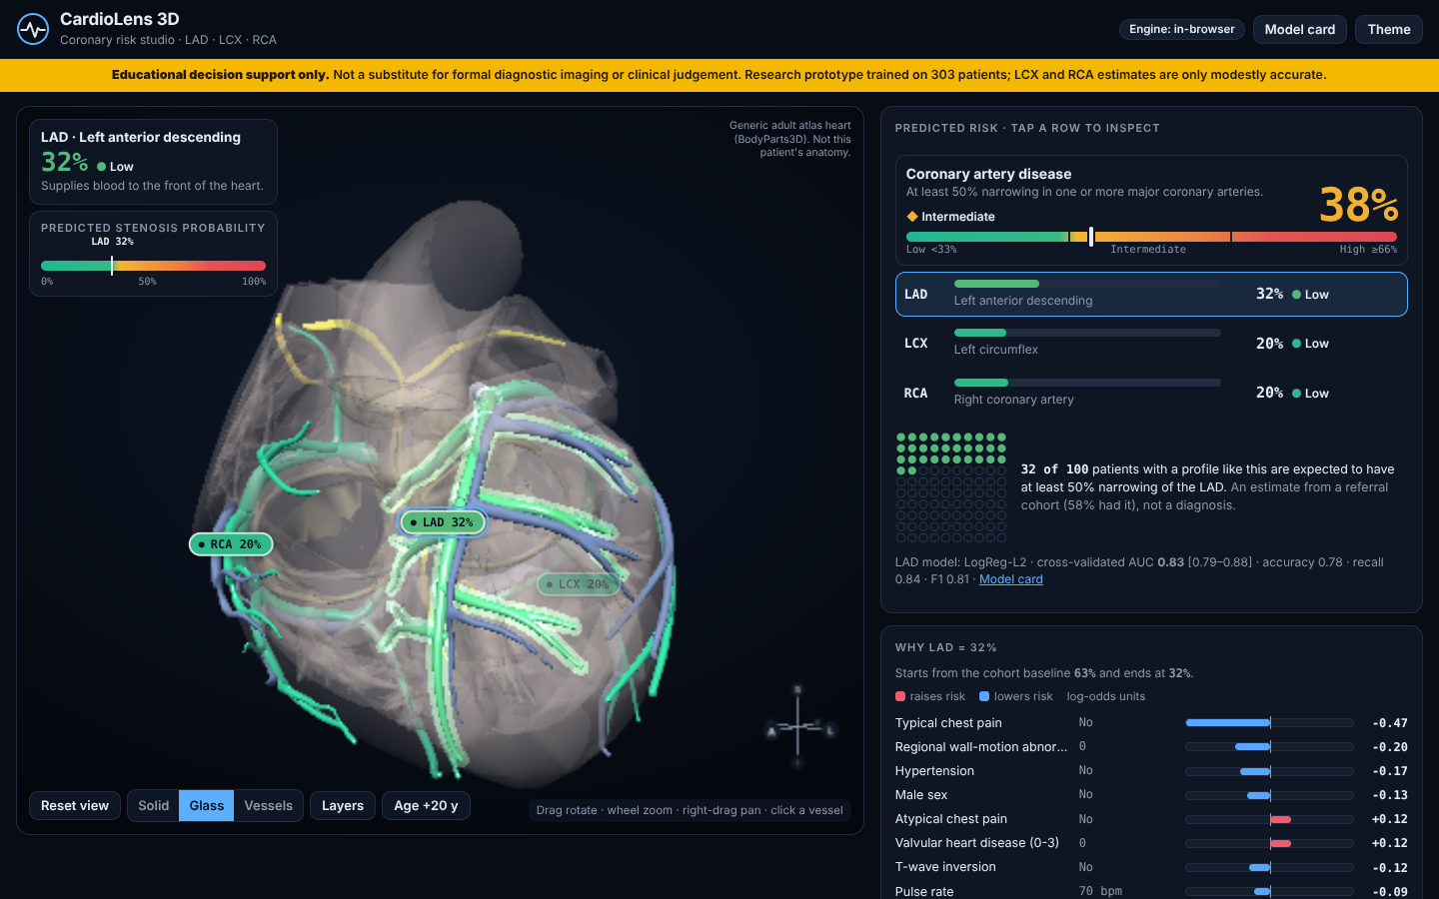
THE SOLUTION
One page: prediction, 3D heart, explanation
Vessel colour = predicted probability (teal → amber → red) plus text and icon
Click a vessel to fly to it; Solid / Glass / Vessels; Age +20 y
Runs in the browser, no GPU, no upload
Self-contained HTML · works offline
Research prototype for education and decision support. Not a diagnostic device.

Slide 5
AI / ML MODEL
Nested cross-validation, honest results
Extension of Z-Alizadeh Sani (UCI #411): 303 patients, 43 inputs
7 model families, 5×5 repeated stratified nested CV, log-loss tuning
Exported: logistic regression (L2; L1 for RCA) → exact SHAP, runs in the browser
Outcome columns never used as inputs (leakage guard); P(vessel) ≤ P(CAD)
JS engine equals scikit-learn to 5.6e-16
Research prototype for education and decision support. Not a diagnostic device.

Slide 6
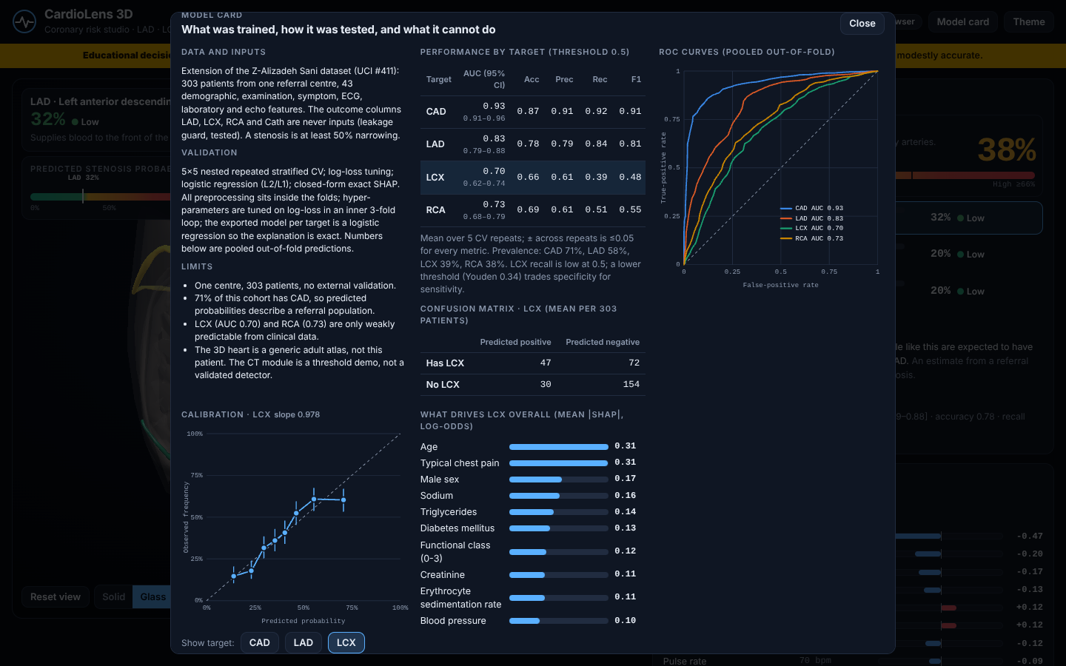
CLINICAL INTERPRETABILITY
Why this probability?
Exact SHAP bars per patient and per clinical domain
What-if curves; out-of-range region hatched
"n of 100 patients like this"
Model card: ROC, calibration, confusion matrix, limits
Disclaimer banner always visible
Research prototype for education and decision support. Not a diagnostic device.

Slide 7
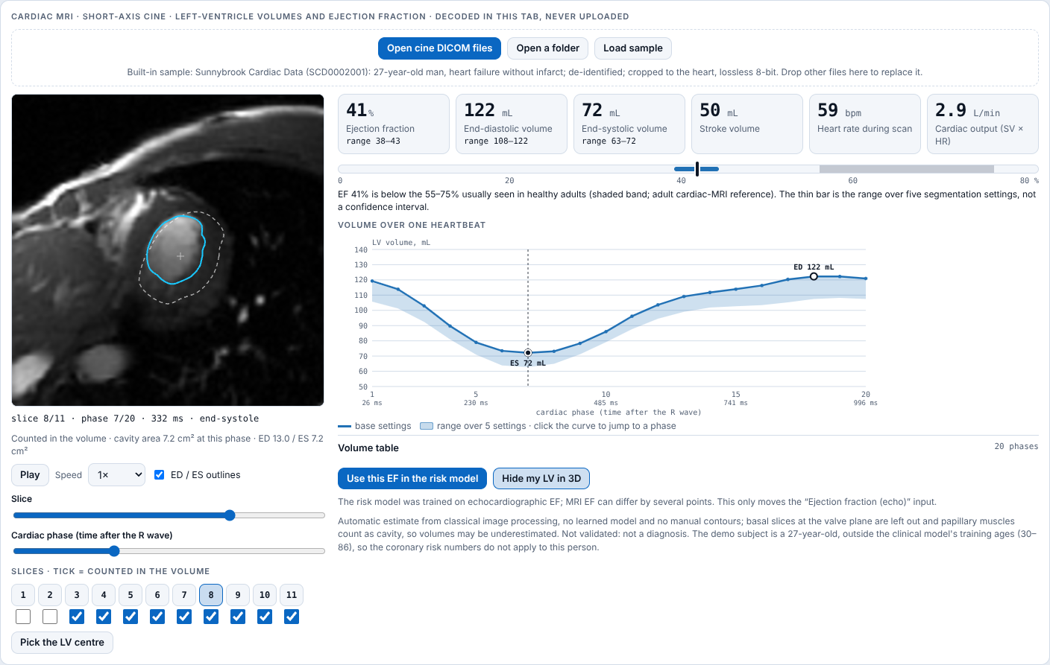
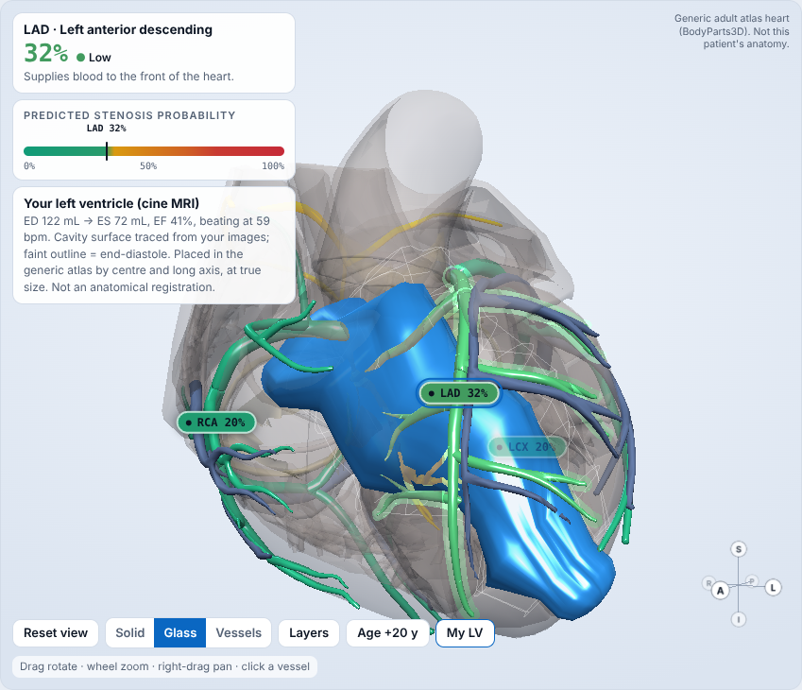
MULTIMODAL
Scan reading room: CT and cardiac MRI
CT: NIfTI / DICOM / zip, calcium candidates, heart box
Cine MRI: LV EDV, ESV, EF, CO → beating LV in 3D
Decoded in the tab, never uploaded
Automatic estimates, not validated
Research prototype for education and decision support. Not a diagnostic device.

Slide 8
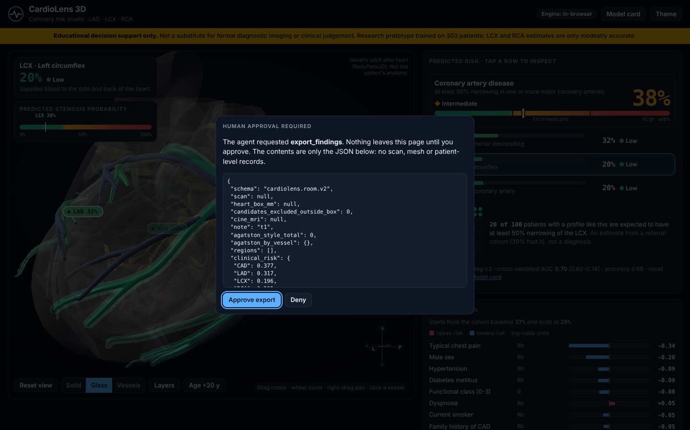
WEBMCP
Agent-native, privacy by design
13 tools on document.modelContext
Results are numbers and metadata only; guard blocks arrays and images
Live meter shows what crossed the boundary
export_findings waits for human approval
Research prototype for education and decision support. Not a diagnostic device.

Slide 9
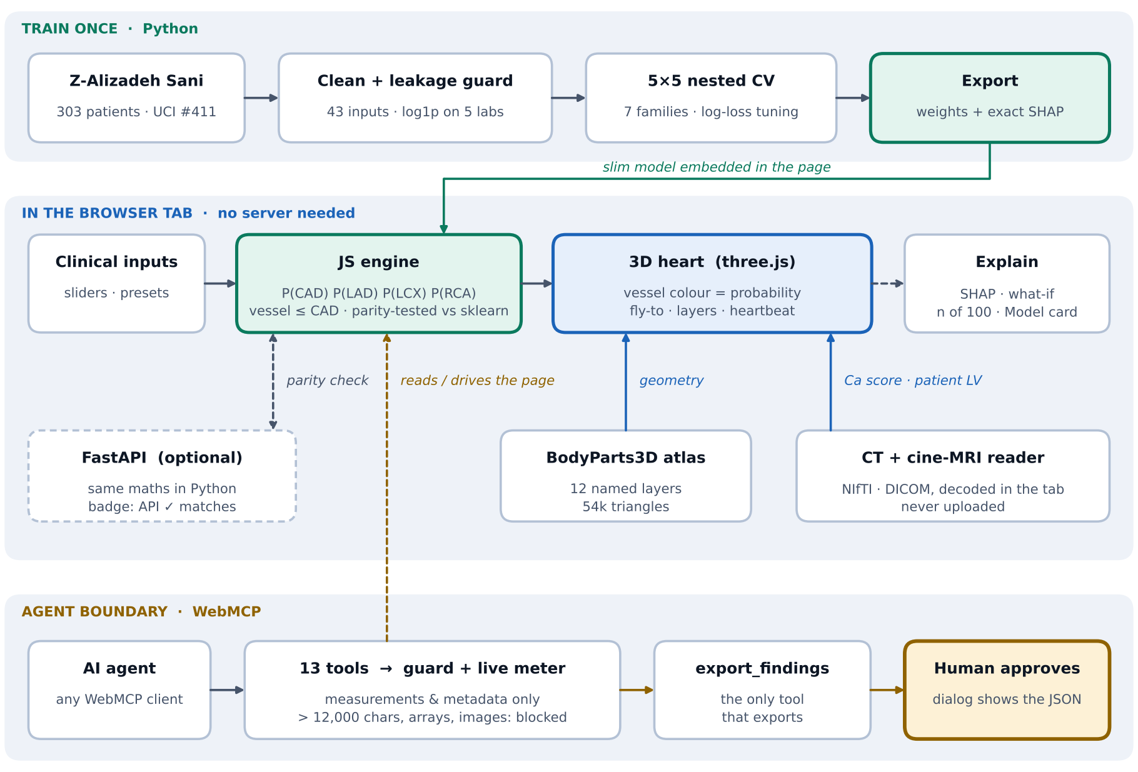
SYSTEM DESIGN
Architecture
Research prototype for education and decision support. Not a diagnostic device.

Slide 10
TECHNICAL IMPLEMENTATION
Technical stack and quality
Python: pandas, scikit-learn, SHAP, FastAPI (optional API)
Frontend: vanilla JavaScript, three.js r128, BodyParts3D atlas, WebMCP
Packaging: one self-contained HTML file; Docker; GitHub Pages / Render
490 automated checks: parity, API, scan, room, DICOM, cine, Chromium browser tests
No third-party requests; CSP restricts the page to its own origin
Research prototype for education and decision support. Not a diagnostic device.

Slide 11
HONEST EVALUATION
Limits and next steps
Single-centre data (303 patients, 71% CAD); no external validation
LCX (0.70) and RCA (0.73) are only weakly predictable
Generic adult atlas, not patient-specific anatomy
CT score and MRI estimates are unvalidated demonstrations
Next: external validation, whole-heart segmentation, clinician study
Research prototype for education and decision support. Not a diagnostic device.

Slide 12
PROJECT RESOURCES
Links
GitHub repository: [URL]
Live demo: [URL]
Demo video (YouTube, unlisted): https://youtu.be/bZg4DH5eqr8
Contact: theharshyadhav@gmail.com
Research prototype for education and decision support. Not a diagnostic device.

