Slide 1
Assembler Tasks for 8,9,15,16 december21

Slide 2
Task for 8th dec wednesday
Task:
0xF0F1F3F4 is saved in memory location of 0x200.
Aim is to find the average of the values at each byte: 0xF2.
Form an assembly code by reaching the memory content.
Store the result at 0x204.
Hint:
Division by four corresponds to right shift the number by two bits in assembly language.

Slide 3
Task for 9th dec thursday
Task:
0xF7F6F5F4 is saved in memory location of 0x200.
Check for the memory content in character level. Find the total number of even and odd characters and save the results in two separate memory locations.

Slide 4
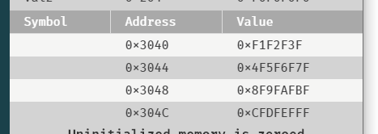
Task for 15th dec wednesday
A)
Sixteen characters are saved in memory starting from 0x3040.
The content will be as follows: 0x0F, 0x1F, 0x2F, 0x3F, 0x4F, 0x5F, …
B)
Form an assembly code to find their average by reaching the memory content. Do not forget to use branching instructions during operations.

Slide 5
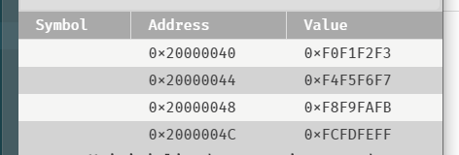
Task for 16th dec thursday
A)
Sixteen characters are saved in memory starting from 0x20000040.
The content will be as follows: 0xF0, 0xF1, 0xF2, 0xF3, 0xF4, 0xF5, …
B)
Form an assembly code to find the total number of odd or even numbers by reaching the memory content. Do not forget to use branching instructions during operations.
Store the result in memory location of 0x30000040.

