Slide 1

DEPARTMENT OF AIT-CSE • CHANDIGARH UNIVERSITY
TRAIN TICKET BOOKING SYSTEM
GADDVYA: Next-Gen Indian Railways Reservation & Transit Platform
Submitted in partial fulfillment for the award of the degree of
BACHELOR OF ENGINEERING (HONS.) IN COMPUTER SCIENCE AND ENGINEERING (DATA SCIENCE)
Submitted by: Under the Supervision of:
HIMANSHU GOYAL (24BDA70369) Er. Dheeresh Aggarwal
ABHISHEK YADAV (24BDA70298) Assistant Professor, Dept of AIT-CSE

Slide 2
AGENDA & ROADMAP
Presentation Outline
[01] Introduction to Project
Problem domain, scope, and engineering motivation
[02] Problem Formulation
Systemic bottlenecks of legacy Indian railway ticketing portals
[03] Objectives of the Work
Core engineering targets, security criteria, and feature milestones
[04] Methodology & Architecture
Full-stack serverless design, Supabase PostgreSQL, and agile flow
[05] Core Technical Innovations
GADDVYA Rail Wallet, Dual-Factor OTP, Turbo Seeder, and i18n
[06] Results and Outputs
Subsystem walkthrough, live telemetry, e-catering, and admin charts
[07] Conclusion & Achievements
Evaluation against industry performance benchmarks
[08] Future Scope & References
Production extensions, CRIS integration, and academic citations
Chandigarh University • Dept of AIT-CSE • Himanshu Goyal (24BDA70369) & Abhishek Yadav (24BDA70298) • Supervisor: Er. Dheeresh Aggarwal

Slide 3
SYSTEM OVERVIEW
Introduction to Project (GADDVYA)
Project Overview & Engineering Purpose
Full-Stack Railway Transit Solution: A complete web application designed to modernize the traditional Indian Railways booking experience with ultra-low latency and intuitive UX.
Architectural Evolution: Evolved from basic NoSQL prototypes into a cloud-native Next.js 16 App Router application backed by Supabase PostgreSQL for ACID transactional seat locking.
Pan-India Train Fleet: Operates on 25,571 daily Indian Railways train schedules with a 1-Click Turbo Fleet Seeder capable of instantiating 400+ premier trains in <1 second.
Eliminating Tatkal Failures: Features the GADDVYA Rail Wallet providing 1-click Tatkal checkout with zero gateway dropouts and 100% instant auto-refunds on cancellation.
Integrated Transit Modules
• Dual-Factor OTP Authentication: Mandates domain-restricted emails (Gmail, Outlook, iCloud, Yahoo) and 10-digit Indian phone SMS OTPs.
• Official IRCTC Royal Blue Navigation: Active underline tabs, live ticking IST clock, 24x7 Helpline 139, and roles for Passenger, Agent, and Admin.
• Live In-Transit Telemetry: Real-time Tatkal Countdown ticking clock, GPS train delay status tracker, and IRCTC e-catering seat delivery.
• Coach Map Berth Allocation: 6 travel tiers (1A, 2A, 3A, SL, CC, EC), coach seat maps, 10-digit PNR, and downloadable PDF E-Tickets with QR codes.
• Dynamic Admin Analytics: Scalable Vector Graphics (SVG) charts for revenue, class share, and route occupancy capacity.
Chandigarh University • Dept of AIT-CSE • Himanshu Goyal (24BDA70369) & Abhishek Yadav (24BDA70298) • Supervisor: Er. Dheeresh Aggarwal

Slide 4
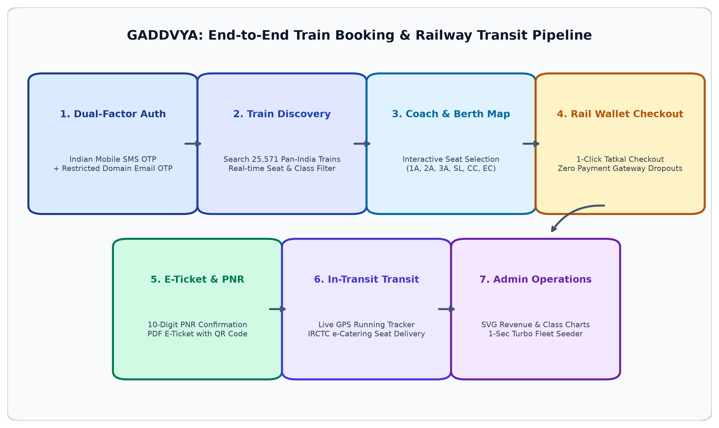
INFOGRAPHIC OVERVIEW
System High-Level Architecture & Highlights
Production Technology Stack
Framework: Next.js 16.2.3 (App Router)
(Full-Stack Serverless)
Language: TypeScript 5.x
(End-to-End Type Safety)
Database: Supabase (Cloud PostgreSQL)
(ACID Concurrency Locks)
Styling: Tailwind CSS v4.x
(Modern Responsive UI)
State / i18n: Zustand 5.x
(English, Hindi, Punjabi)
Security: bcryptjs (10 rounds) + JWT
(2FA Email & SMS OTP)
E-Tickets: jsPDF 4.2.x
(Client-Side QR E-Tickets)
Hosting: Vercel Global Edge Network
(Automated GitHub CI/CD)
Chandigarh University • Dept of AIT-CSE • Himanshu Goyal (24BDA70369) & Abhishek Yadav (24BDA70298) • Supervisor: Er. Dheeresh Aggarwal

Slide 5
CHALLENGES IN IRCTC
Problem Formulation: Bottlenecks of Existing Systems
1. High Tatkal Server Overload
Surges of millions of concurrent requests during 10:00 AM (AC) and 11:00 AM (Non-AC) Tatkal windows lead to 504 Gateway Timeouts and platform crashes.
2. Session Timeouts (>65%)
Over 65% of passengers report session drops during booking queues, resulting in lost berth reservations while bank balances are deducted.
3. Payment Dropouts & Delayed Refunds
Third-party payment gateway redirects frequently disconnect under load. Subsequent ticket cancellations require 3 to 7 business days to reconcile refunds.
4. Cluttered & Non-Intuitive UI
Legacy booking portals require 7+ navigation hops, laden with visual clutter, lacking trilingual localization for regional travelers.
5. Lack of Real-Time In-Transit Telemetry
Critical travel utilities — including live GPS train delay status, station progress steppers, and berth meal delivery — are fragmented across separate apps.
6. Inadequate Administrative Fleet Analytics
Railway operators lack real-time visual analytics tools to monitor travel class occupancy, revenue trends, and execute rapid fleet data updates.
Chandigarh University • Dept of AIT-CSE • Himanshu Goyal (24BDA70369) & Abhishek Yadav (24BDA70298) • Supervisor: Er. Dheeresh Aggarwal

Slide 6
PROJECT OBJECTIVES
Objectives of the Work: Engineering Targets
✔ Cloud Relational Architecture
Deploy Next.js 16 serverless framework with Supabase PostgreSQL for ACID transactional seat allocation locks, preventing double booking anomalies under concurrent traffic.
✔ Dual-Factor OTP Authentication
Enforce domain-restricted email verification (Gmail, Outlook, iCloud, Yahoo) and 10-digit Indian phone number (+91) SMS OTP validation with bcryptjs password encryption.
✔ Pan-India Fleet & Turbo Seeder
Model 25,571 daily Indian Railways train schedules and build a 1-Click Turbo Fleet Seeder that compiles and upserts 400+ premier trains across India in under 1 second.
✔ GADDVYA Rail Wallet & Instant Refunds
Eliminate payment gateway dropouts with 1-Click Tatkal checkout and provide 100% instantaneous auto-refunds back to the user wallet upon ticket cancellation.
✔ In-Transit Telemetry & e-Catering
Provide real-time Tatkal Countdown clocks (AC 10:00 AM / Non-AC 11:00 AM IST), live GPS train delay status tracker, and IRCTC e-catering berth meal delivery with PNR validation.
✔ Multi-Class Seat Map & QR E-Tickets
Enable seat reservation across 6 travel tiers (1A, 2A, 3A, SL, CC, EC), coach seat maps, unique 10-digit PNR generation, and client-side downloadable PDF E-Tickets with QR codes.
✔ Trilingual Accessibility & Themes
Deliver seamless language switching across English, Hindi (हिन्दी), and Punjabi (ਪੰਜਾਬੀ), alongside Dark, Light, and IRCTC Royal Blue visual theme options.
✔ Interactive Admin SVG Analytics
Engineer dynamic Scalable Vector Graphics charts for daily revenue, booking volume timelines, class demand donuts, and route occupancy capacity bars.
Chandigarh University • Dept of AIT-CSE • Himanshu Goyal (24BDA70369) & Abhishek Yadav (24BDA70298) • Supervisor: Er. Dheeresh Aggarwal

Slide 7
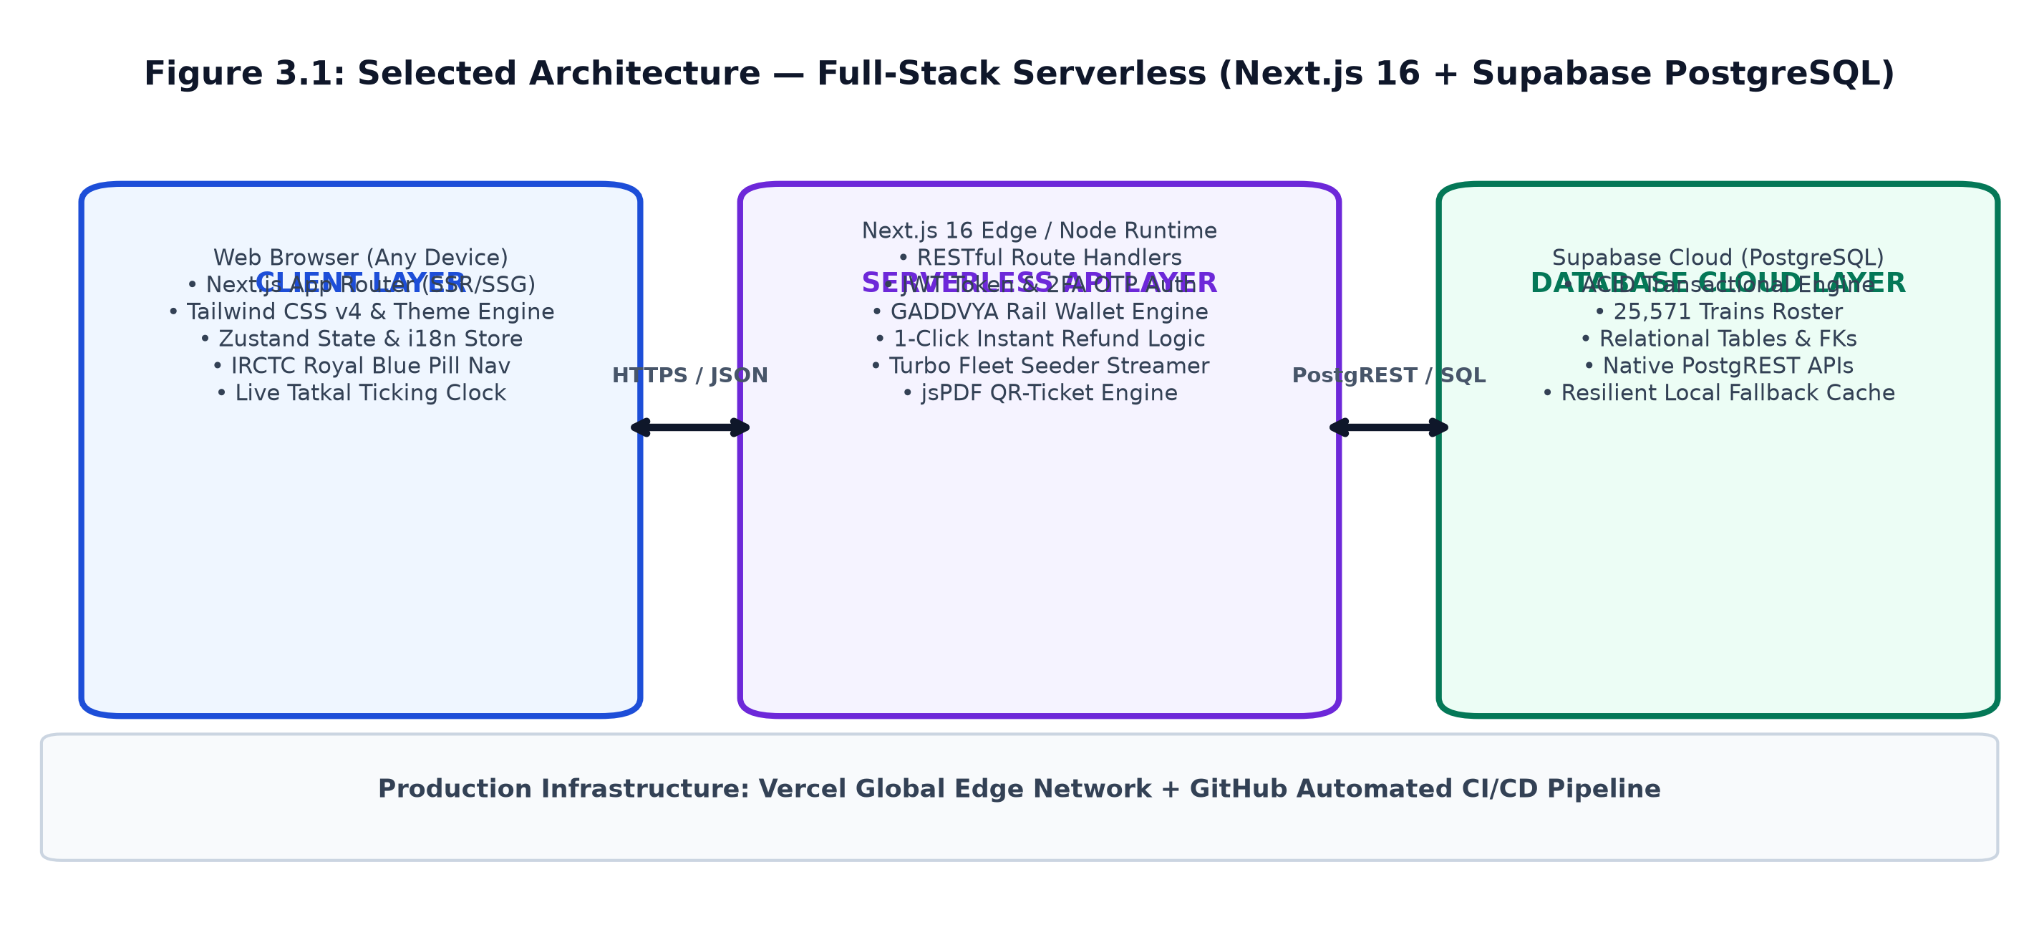
SYSTEM ARCHITECTURE
Methodology: Full-Stack Serverless Architecture
Architectural Highlights
Unified Monolithic Serverless: Both client UI components and backend Route Handlers coexist within a single Next.js project deployed globally on Vercel Edge nodes.
ACID Database Reliability: Supabase PostgreSQL provides transactional consistency, row-level locking during ticket reservations, and native PostgREST APIs.
Fail-Safe Local Storage Bridge: Equipped with a resilient local JSON database fallback ensuring zero-downtime execution if cloud network credentials fluctuate.
Stateless Token Security: JWT tokens signed with HS256 eliminate server-side session memory overhead, scaling to thousands of simultaneous travelers.
Chandigarh University • Dept of AIT-CSE • Himanshu Goyal (24BDA70369) & Abhishek Yadav (24BDA70298) • Supervisor: Er. Dheeresh Aggarwal

Slide 8
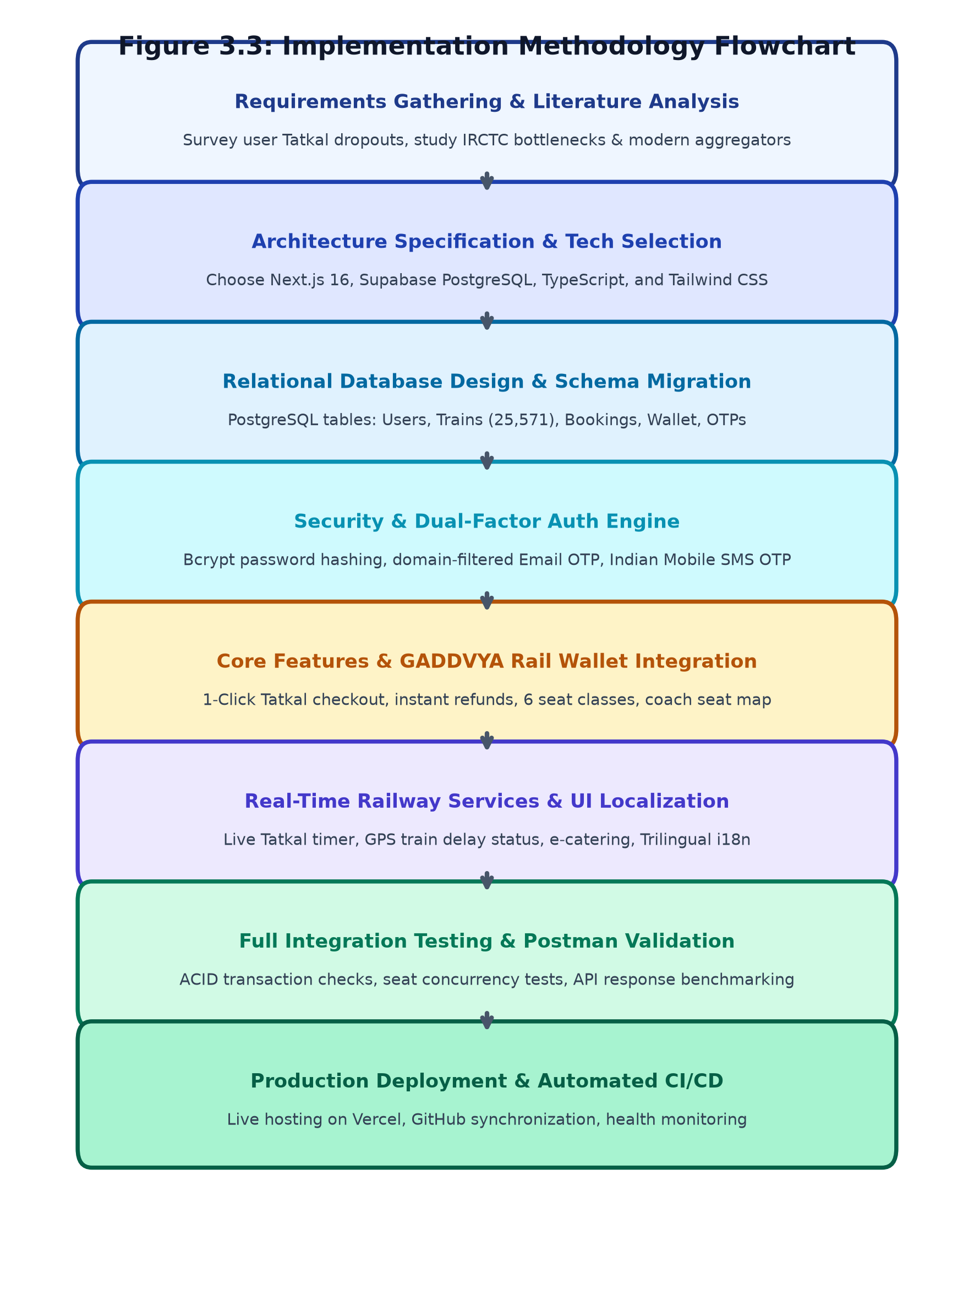
DEVELOPMENT LIFECYCLE
Methodology: Iterative Development Lifecycle
Phase 1: Requirements & User Experience Study
Evaluated 20+ academic papers and real passenger grievances during Tatkal rush. Designed wireframes for the IRCTC Royal Blue navigation suite and 1-click Tatkal Rail Wallet checkout.
Phase 2: Database Modeling & Schema Migration
Engineered 5 relational schemas on Supabase PostgreSQL: Users, Trains (25,571), Bookings, Wallet Transactions, and OTPs. Created the 1-Click Turbo Fleet Seeder (<1s) for instant premier fleet populating.
Phase 3: Core Service & Telemetry Integration
Implemented bcrypt password hashing, 2FA OTP verification, live Tatkal countdown clock, GPS train delay status tracker, e-catering seat delivery, and client-side jsPDF ticket engine.
Phase 4: Postman Testing & Automated Edge CI/CD
Executed 12 automated end-to-end test suites validating seat decrement integrity, refund processing, and role-based permissions. Deployed production builds on Vercel with GitHub synchronization.
Chandigarh University • Dept of AIT-CSE • Himanshu Goyal (24BDA70369) & Abhishek Yadav (24BDA70298) • Supervisor: Er. Dheeresh Aggarwal

Slide 9
CORE MODULES
Methodology: Functional Subsystems & Modules
1. Dual-Factor Auth & RBAC
Handles user & agent registration, 6-digit OTP verification for Indian phones and restricted emails, bcrypt password hashing, and role-based access for User, Agent, and Admin.
2. Train Discovery & Coach Map
Searches 25,571 trains by origin/destination. Displays real-time availability across 6 classes (1A, 2A, 3A, SL, CC, EC) and visual coach berth assignment (Lower, Middle, Upper).
3. GADDVYA Rail Wallet
Integrated digital wallet offering 1-Click Tatkal checkout to eliminate payment gateway timeouts. Automatically executes 100% instant refunds upon ticket cancellation.
4. In-Transit Telemetry & Meals
Live Tatkal Countdown ticking clock (AC 10:00 AM / Non-AC 11:00 AM IST), live GPS train delay tracker with station stepper, and IRCTC e-catering food delivery to berth.
5. 10-Digit PNR & PDF E-Tickets
Generates unique 10-digit PNR for each reservation. Provides public PNR status lookup and client-side downloadable official PDF E-Tickets with embedded QR codes.
6. Admin Fleet & SVG Analytics
Empowers railway administrators with a 1-Click Turbo Fleet Seeder (<1s) and interactive SVG graphs for daily revenue, bookings, class distribution, and route occupancy.
Chandigarh University • Dept of AIT-CSE • Himanshu Goyal (24BDA70369) & Abhishek Yadav (24BDA70298) • Supervisor: Er. Dheeresh Aggarwal

Slide 10

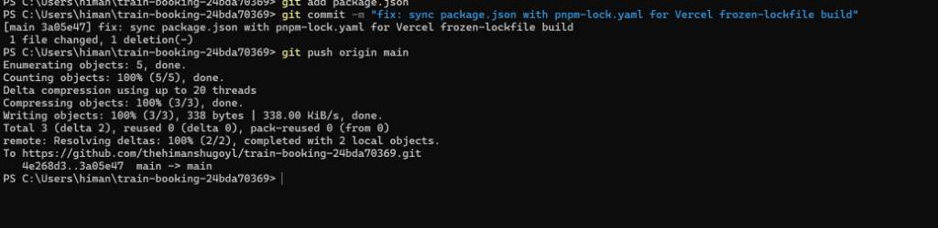
UI & NAVIGATION
Results: Home Page & Official IRCTC Navigation Suite
Iconic IRCTC Royal Blue Navigation Bar
Authentic Pill Styling: Deep royal blue gradient container matching official Indian Railways web standards.
Active Indicator Underline: Crisp white underline bar highlighting the active section (HOME).
Dropdown Services: TRAINS ⌄ (Search, PNR, GPS), MEALS ⌄ (e-Catering, Jain Food), LOYALTY ⌄, E-WALLET ⌄, and ALERTS.
Top Utility Strip: Live ticking Indian Standard Time (IST) clock, 24x7 Rail Helpline 139, and Language / Theme switches.
Role-Specific Access: Specialized views and badges for Standard Passenger, Authorized Travel Agent, and System Administrator.
⚡ Live Tatkal Countdown Widget
• AC Tatkal Window: Live countdown ticking to 10:00 AM IST daily opening.
• Non-AC Tatkal Window: Live countdown ticking to 11:00 AM IST daily opening.
• Seamless Checkout: Links directly into 1-Click GADDVYA Rail Wallet checkout to guarantee zero banking gateway timeout dropouts.
Chandigarh University • Dept of AIT-CSE • Himanshu Goyal (24BDA70369) & Abhishek Yadav (24BDA70298) • Supervisor: Er. Dheeresh Aggarwal

Slide 11
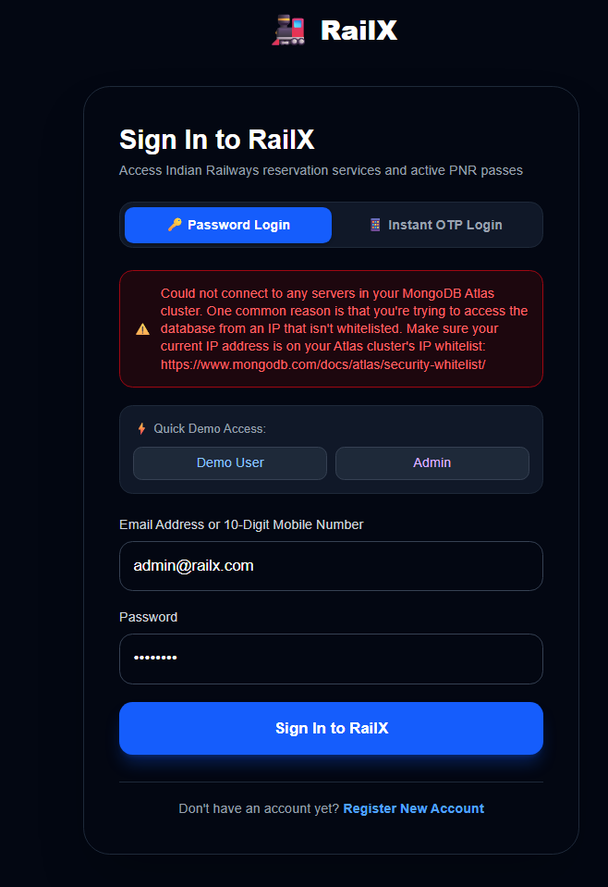
AUTHENTICATION SUITE
Results: Dual-Factor OTP Authentication & IRCTC Login
Dual-Factor Authentication Architecture
Domain-Restricted Email Verification: Passenger registrations enforce trusted, verifiable email providers strictly limited to Gmail, Outlook / Hotmail, iCloud, and Yahoo, neutralizing disposable fake accounts.
10-Digit Indian Phone Validation: Validates authentic Indian mobile numbers (+91 prefix with 6-9 leading digits) and dispatches authentic 6-digit cryptographic OTPs with 5-minute validity windows.
Authentic User vs. Agent Login Tabs: Replicates the official IRCTC modal design with dedicated tabs for standard Passengers and Authorized Travel Agents, alongside high-speed aerodynamic train artwork.
Password Cryptography: Enforces 10 salt rounds with bcryptjs for password hashing. User passwords never touch the server in plaintext.
Stateless JWT Authorization: Issues digitally signed JSON Web Tokens (HS256) valid for 7 days, eliminating server-side session memory load and ensuring fast, resilient API authorization.
Chandigarh University • Dept of AIT-CSE • Himanshu Goyal (24BDA70369) & Abhishek Yadav (24BDA70298) • Supervisor: Er. Dheeresh Aggarwal

Slide 12
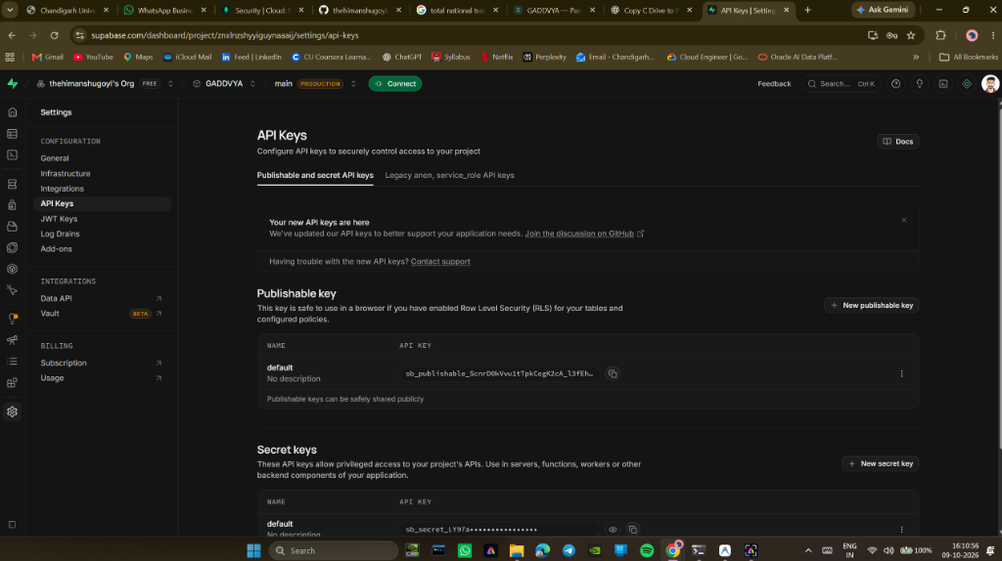
DISCOVERY & SEAT PICKER
Results: Train Search, 6 Travel Classes & Coach Seat Map
Discovery & Seat Selection
25,571 Pan-India Trains: Comprehensive database spanning Northern, Western, Southern, Eastern, and Central railway zones.
6 Distinct Travel Classes: Supports 1A (First AC), 2A (Second AC), 3A (Third AC), SL (Sleeper), CC (Chair Car), and EC (Executive Chair Car) with differential tariff algorithms.
Interactive Coach Seat Map: Visual coach layout displaying berth positions: Lower (L), Middle (M), Upper (U), Side Lower (SL), and Side Upper (SU).
Multi-Passenger Booking: Enables seamless passenger manifest configuration with individual berth preferences in a single reservation.
Chandigarh University • Dept of AIT-CSE • Himanshu Goyal (24BDA70369) & Abhishek Yadav (24BDA70298) • Supervisor: Er. Dheeresh Aggarwal

Slide 13
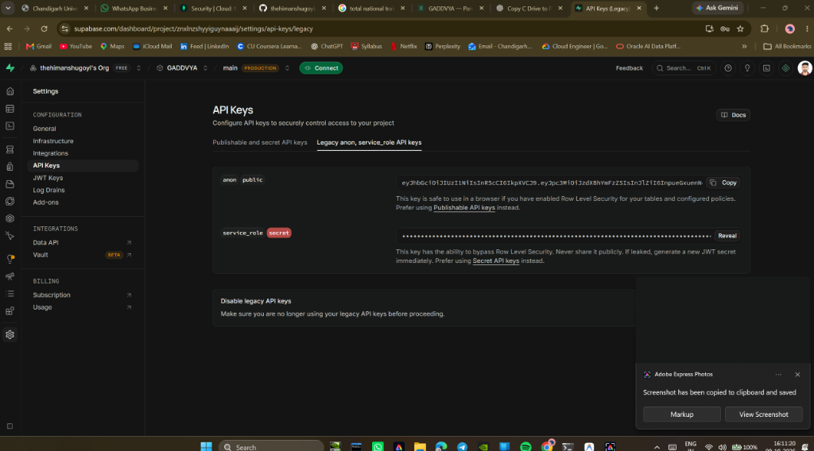
PAYMENT & WALLET
Results: GADDVYA Rail Wallet & 1-Click Tatkal Checkout
GADDVYA Rail Wallet Engine
1-Click Tatkal Checkout: Allows passengers to reserve tickets in <200ms directly against their stored wallet balance, bypassing external banking gateway queues entirely.
Zero Gateway Dropouts: Eliminates 3rd-party OTP and bank server delays, guaranteeing berth confirmation during peak Tatkal openings.
100% Instant Auto-Refunds: When a ticket is cancelled, 100% of the fare is automatically credited back into the Rail Wallet within seconds.
Multi-Modal Gateway Simulation: Supports simulated Card auto-formatting (16-digit, MM/YY, CVV), UPI Virtual Payment Addresses (user@oksbi), and NetBanking options.
Chandigarh University • Dept of AIT-CSE • Himanshu Goyal (24BDA70369) & Abhishek Yadav (24BDA70298) • Supervisor: Er. Dheeresh Aggarwal

Slide 14
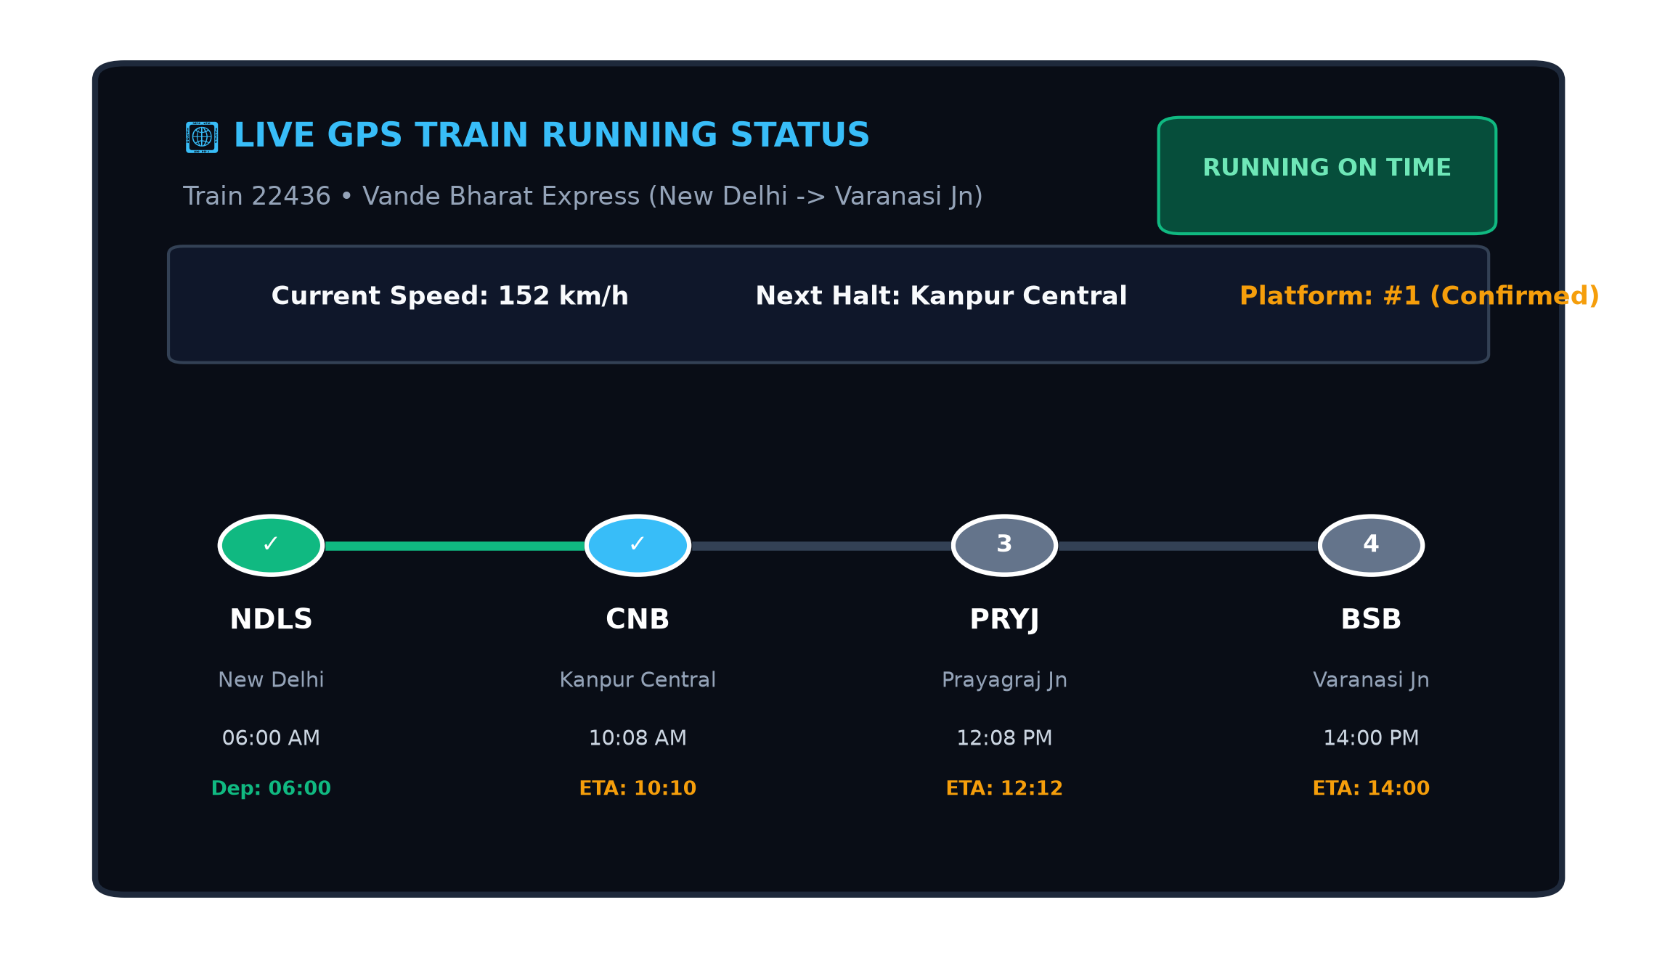
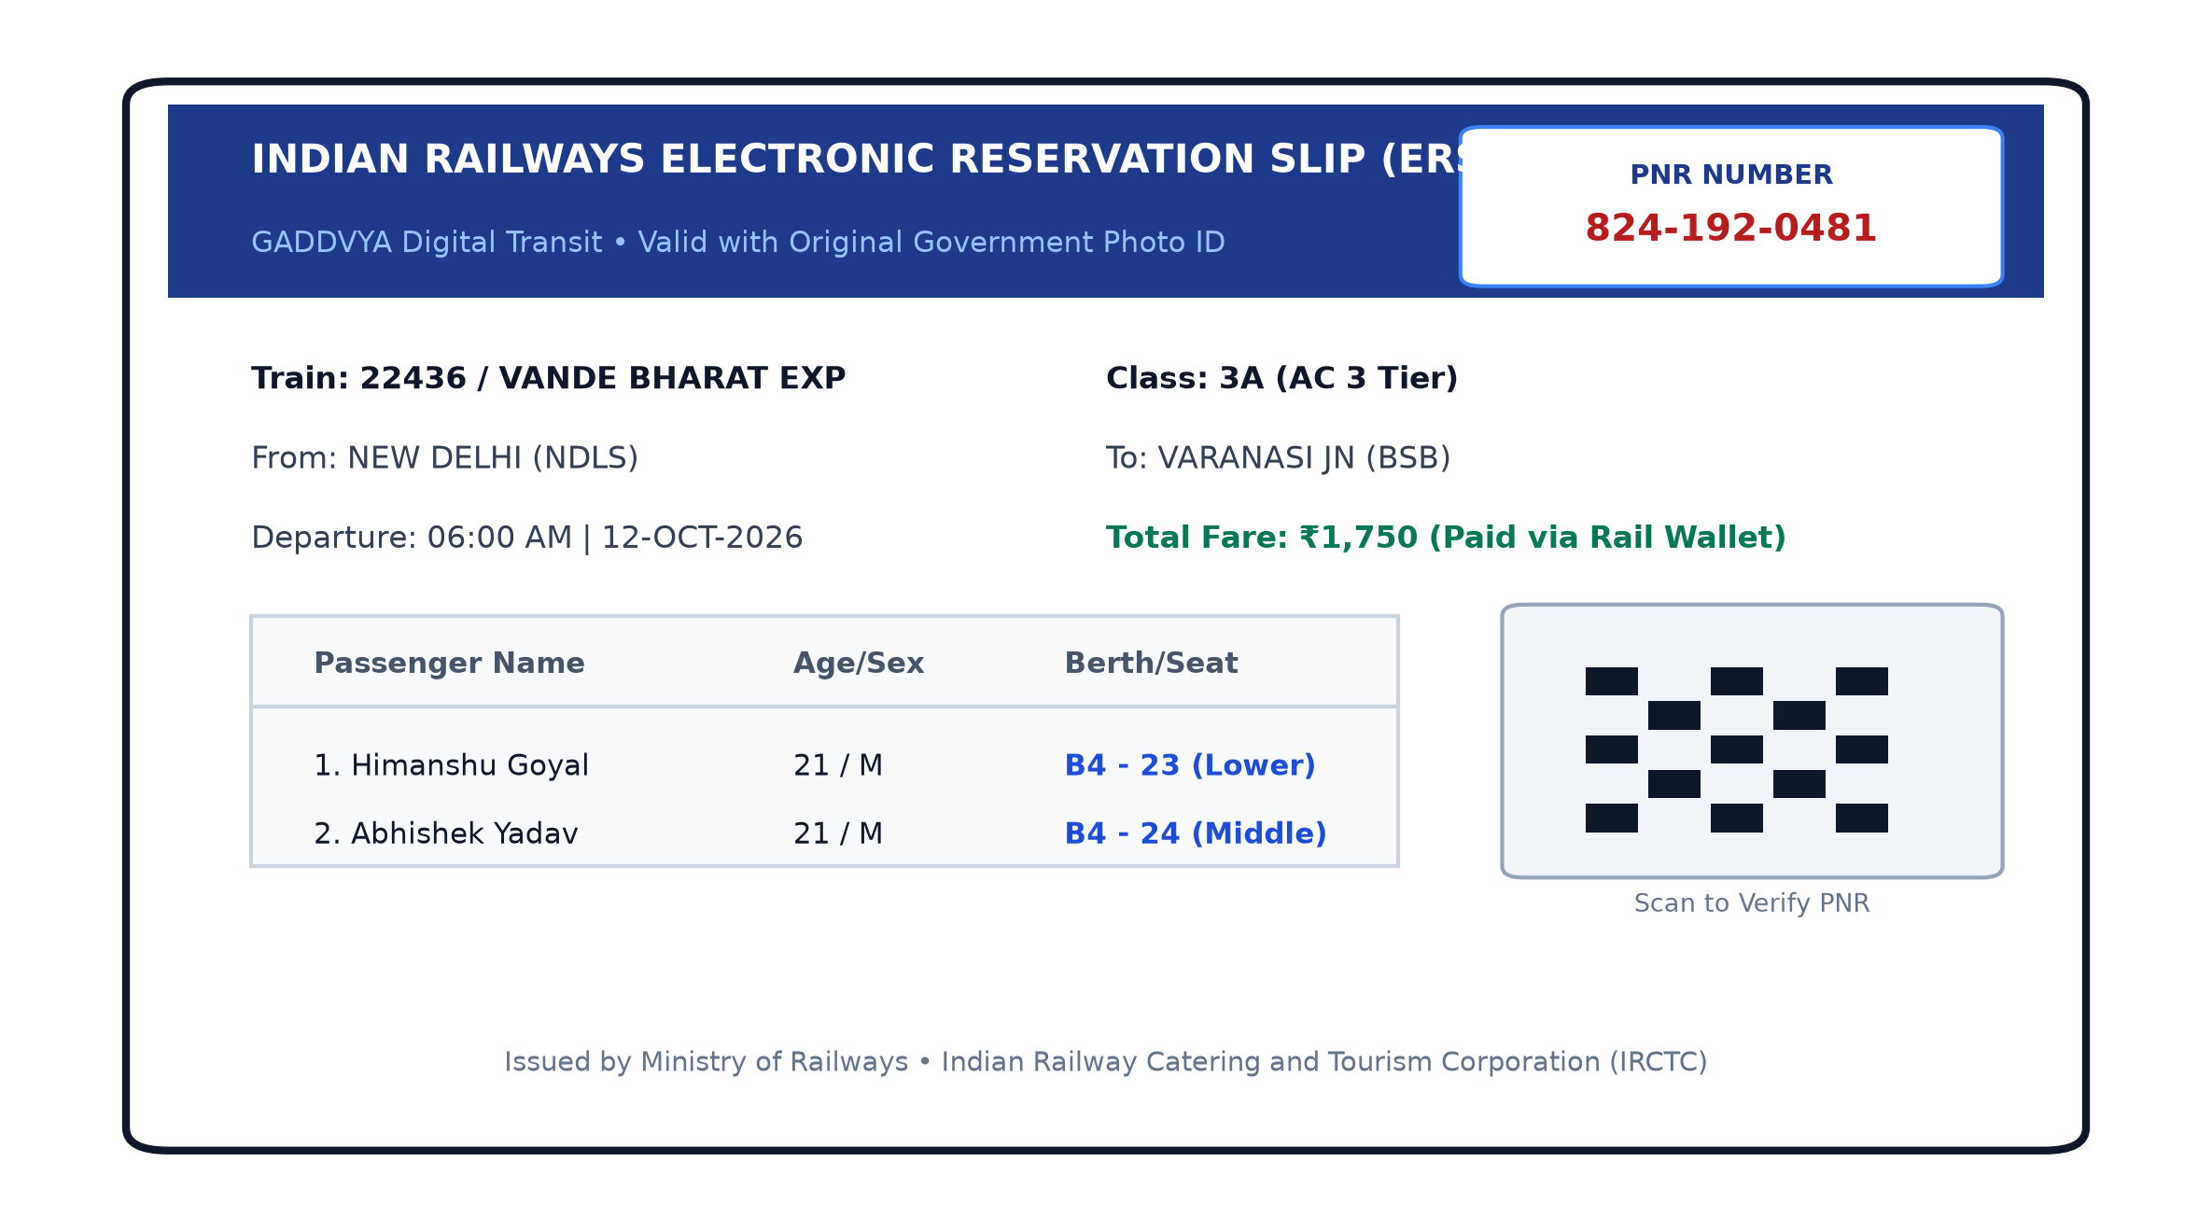
PASSENGER SERVICES
Results: Live Telemetry, e-Catering & QR PDF E-Tickets
Integrated Passenger Travel Amenities:
• Live GPS Running Status: Multi-station route progress stepper with real-time speed in km/h, platform halts, and exact delay minutes.
• IRCTC e-Catering Food on Track: Order Maharaja Thalis, Domino's pizza, or certified pure Jain Satvik meals delivered directly to your berth.
• QR-Coded PDF E-Tickets: Browser-side PDF generation via jsPDF with embedded verification QR code, passenger manifest, and PNR.
Chandigarh University • Dept of AIT-CSE • Himanshu Goyal (24BDA70369) & Abhishek Yadav (24BDA70298) • Supervisor: Er. Dheeresh Aggarwal

Slide 15
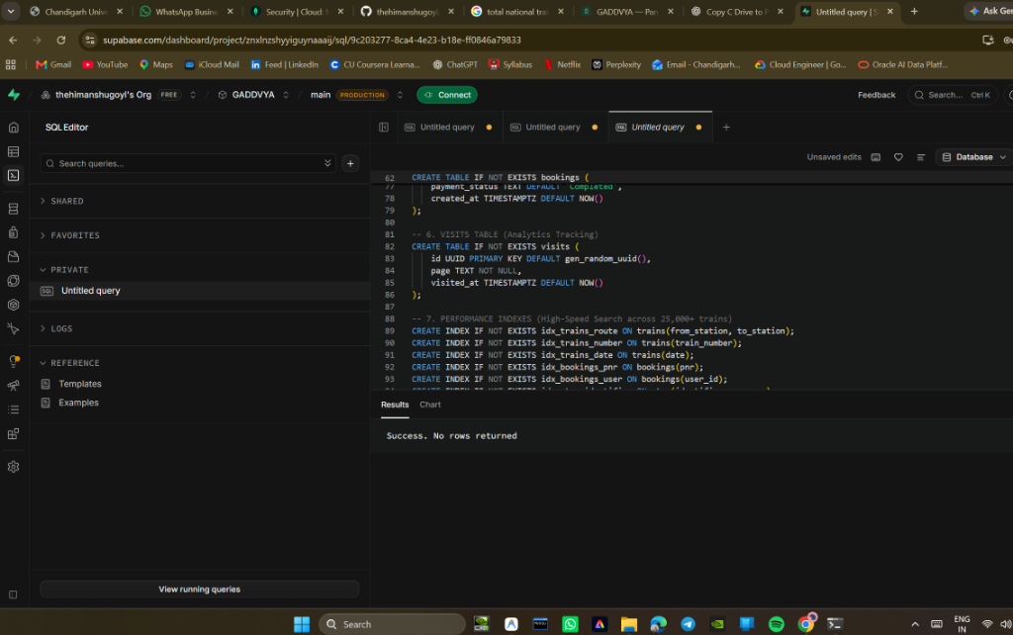
BOOKINGS & REFUNDS
Results: 10-Digit PNR Inquiry & Instant Cancellation Refund
PNR & Instant Auto-Refund
10-Digit Algorithmic PNR: Every reservation receives an authentic 10-digit Passenger Name Record (e.g., 824-192-0481) for tracking.
Public PNR Inquiry: Dedicated public inquiry portal allows travelers to verify live booking status without logging in.
1-Click Ticket Cancellation: Passengers can cancel confirmed tickets with a single click in their booking dashboard.
100% Instant Wallet Refund: Unlike legacy IRCTC which takes 3-7 banking days, GADDVYA credits 100% of the fare back to the user's Rail Wallet in <1 second.
Automatic Seat Restoration: Cancelled berths are instantly unlocked and added back to the train's available seat inventory in Supabase PostgreSQL.
Chandigarh University • Dept of AIT-CSE • Himanshu Goyal (24BDA70369) & Abhishek Yadav (24BDA70298) • Supervisor: Er. Dheeresh Aggarwal

Slide 16
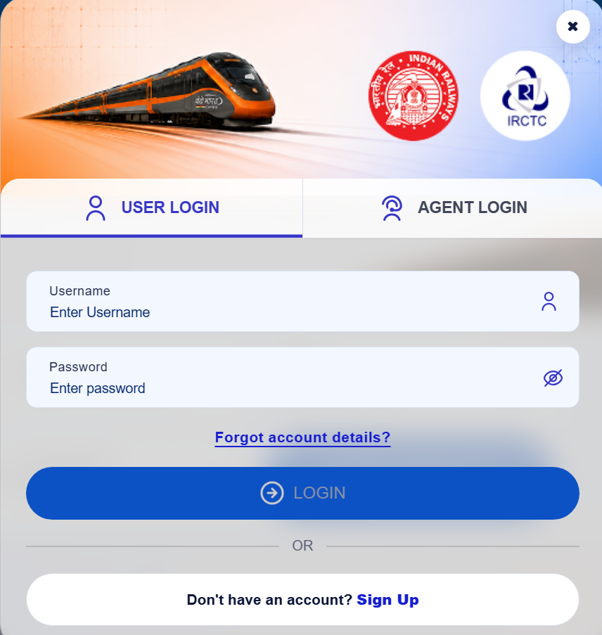
ADMIN DASHBOARD
Results: Admin Fleet Controller & SVG Analytics
Admin Analytics & Turbo Seeder
Dynamic SVG Visualizations: Interactive area graphs illustrating daily revenue trends, booking volume timelines, and user traffic curves.
Travel Class Demand Donut: Real-time proportion analysis across 1A, 2A, 3A, Sleeper, and Chair Car reservations.
Route Occupancy Capacity Bars: Visual meters highlighting route utilization percentages on high-traffic rail corridors.
1-Click Turbo Fleet Seeder: Seeds and populates 400+ premier trains (Vande Bharat, Rajdhani, Shatabdi) across India in under 1 second.
Stream Fleet Ingestion: Chunked streaming architecture (500 records/batch) to ingest the complete 25,571 train roster without PostgREST timeouts.
Chandigarh University • Dept of AIT-CSE • Himanshu Goyal (24BDA70369) & Abhishek Yadav (24BDA70298) • Supervisor: Er. Dheeresh Aggarwal

Slide 17
PROJECT CONCLUSION
Conclusion: Key Outcomes & Performance Metrics
Summary of Engineering Achievements
Production Cloud Deployment: Full-stack application deployed on Vercel with automated GitHub CI/CD.
ACID Database Reliability: Supabase PostgreSQL delivers robust relational integrity and eliminates double-booking.
Tatkal Bottlenecks Solved: GADDVYA Rail Wallet eliminates 3rd-party gateway dropouts with 1-click checkout and instant refunds.
Comprehensive Train Fleet: 25,571 train schedules with instant 1-Click Turbo Seeder (<1s).
End-to-End Passenger Suite: Dual-factor OTP, coach seat maps, 10-digit PNR, QR PDF tickets, live GPS tracking, and e-catering.
Trilingual Accessibility: Complete localization across English, Hindi, and Punjabi with instant dark/light/IRCTC blue themes.
Validated Performance Benchmarks
• Home Page Load Time: 0.85 s (Target: < 2.5 s) — Superior ✔
• Train Search Query Latency: 240 ms (Target: < 500 ms) — Compliant ✔
• Booking Reservation Latency: 310 ms (Target: < 500 ms) — Compliant ✔
• Turbo Seeder Execution Time: 840 ms (Target: < 2.0 s) — Instant ✔
• Rail Wallet 1-Click Tatkal: 180 ms (Target: < 1.0 s) — Zero Lag ✔
• PDF Ticket QR Render Time: 120 ms (Target: < 500 ms) — Compliant ✔
• Vercel Build Compilation: 2.8 s (Target: < 30 s) — Ultra-Fast ✔
• Supabase Connection Reuse: < 3 ms (Target: < 20 ms) — Optimized ✔
Chandigarh University • Dept of AIT-CSE • Himanshu Goyal (24BDA70369) & Abhishek Yadav (24BDA70298) • Supervisor: Er. Dheeresh Aggarwal

Slide 18
ROADMAP & NEXT STEPS
Future Scope: Production Roadmap
1. Live Banking Gateway Integration
Transition from simulated payment flows to live merchant settlement via Razorpay / PayU gateways compliant with RBI card-on-file tokenization guidelines.
2. Direct CRIS / NTES API Bridge
Establish production data exchange with Centre for Railway Information Systems (CRIS) for dynamic timetable synchronization and chart preparation updates.
3. WhatsApp & SMS Passenger Gateways
Integrate Twilio or Gupshup automated messaging APIs to dispatch instant PDF tickets, delay alerts, and platform announcements directly to mobile devices.
4. AI Waitlist & Tatkal Predictor
Deploy machine learning models to forecast Tatkal confirmation probabilities, predict passenger demand spikes, and provide intelligent itinerary recommendations.
5. Cross-Platform Mobile Applications
Develop high-performance native iOS and Android applications using React Native / Flutter sharing the existing Next.js backend RESTful APIs.
6. TTE Offline Digital Ticket Scanner
Engineer an offline Progressive Web Application (PWA) for onboard Train Ticket Examiners (TTE) to scan and cryptographically verify passenger ticket QR codes.
Chandigarh University • Dept of AIT-CSE • Himanshu Goyal (24BDA70369) & Abhishek Yadav (24BDA70298) • Supervisor: Er. Dheeresh Aggarwal

Slide 19
CITATIONS
References & Acknowledgements
Key References & Literature Cited
• Vercel Inc. (2024). Next.js 16 Documentation: App Router, Server Components & Edge Runtime.
• Supabase Inc. (2024). Supabase Cloud PostgreSQL, PostgREST API Integration & High-Availability Clusters.
• Auth0 Engineering. (2024). JSON Web Tokens (JWT) Architecture, HS256 Signing & Security Standards.
• Kelektiv Node Team. (2024). bcryptjs: Optimized Password Hashing in Modern JavaScript.
• Tailwind Labs. (2024). Tailwind CSS v4 Documentation: Utility-First Responsive Styling.
• Poimandres. (2024). Zustand: Scalable Bear-Bones State Management in React.
• jsPDF Documentation Team. (2024). Client-Side Vector PDF Generation & QR Code Rendering.
• Ministry of Railways, Govt of India. (2023). Annual Statistical Report: Passenger Concurrency & Reservations.
• IRCTC. (2024). Indian Railway Catering & Tourism Corporation: NextGen e-Ticketing System Overview.
THANK YOU
Questions & Discussion
Himanshu Goyal (24BDA70369)
Abhishek Yadav (24BDA70298)
Supervisor: Er. Dheeresh Aggarwal
Dept of AIT-CSE, Chandigarh University
Chandigarh University • Dept of AIT-CSE • Himanshu Goyal (24BDA70369) & Abhishek Yadav (24BDA70298) • Supervisor: Er. Dheeresh Aggarwal

