Slide 1
Sovereign AI Substrate
A working foundation for SIDH Part B — measured, governed, sovereign
RFP BID NO GEM/2026/B/7635371 · Part B §4.B · PoC evidence pack · July 2026
Not a chatbot demo — a substrate: every answer cited, every access role-scoped, every action audited.
NSDC SIDH Part B · Sovereign AI Substrate PoC · pre-bid draft

Slide 2
Part B asks for a platform, not a chatbot
6-layer sovereign AI architecture: knowledge graph, Indic corpora, Graph-RAG, sovereign models, 11 AI surfaces, agentic orchestration
Hard contractual guarantees: 100% retrieval citations (KPI 7.2.4), <2% hallucination (7.2.2), P95 <1s (7.2.1), DPDP purpose-binding, complete auditability (4.B.11d)
Named indigenous stack: Sarvam 30B/105B, Saaras ASR, Bulbul TTS, Bhashini — sovereignty is the point
Q1–Q6 milestone calendar with quarterly acceptance gates
Our thesis
Enforce the guarantees ONCE in the substrate.
Every surface — Mentor, Copilots, PASE, dashboards — inherits citations, RBAC, consent and audit for free.
Whoever proves the substrate wins the technical evaluation.
NSDC SIDH Part B · Sovereign AI Substrate PoC · pre-bid draft

Slide 3
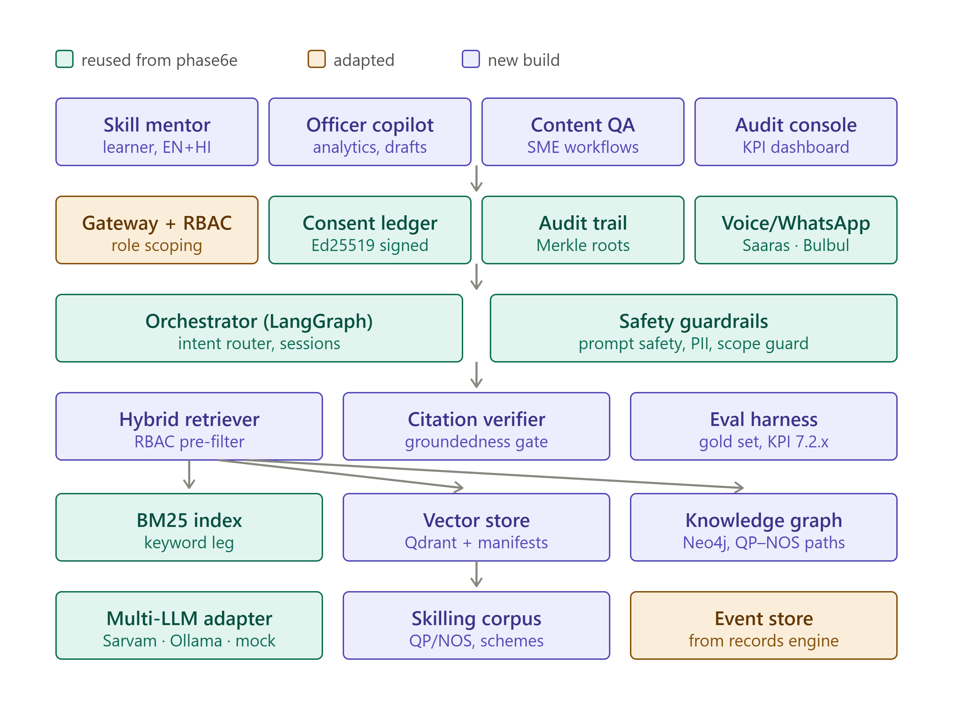
Architecture — built on our hardened Sarvam platform
Reused
Adapted
Consent ledger, signed audit, PII redaction, multi-LLM (Sarvam), voice, WhatsApp
Role model with jurisdiction, skilling events from records engine
New
Why it matters
Knowledge graph, hybrid Graph-RAG, citation gates, eval harness
2–3 weeks saved; governance pre-hardened, not promised
teal = reused hardened platform · purple = new substrate build · amber = adapted
NSDC SIDH Part B · Sovereign AI Substrate PoC · pre-bid draft

Slide 4
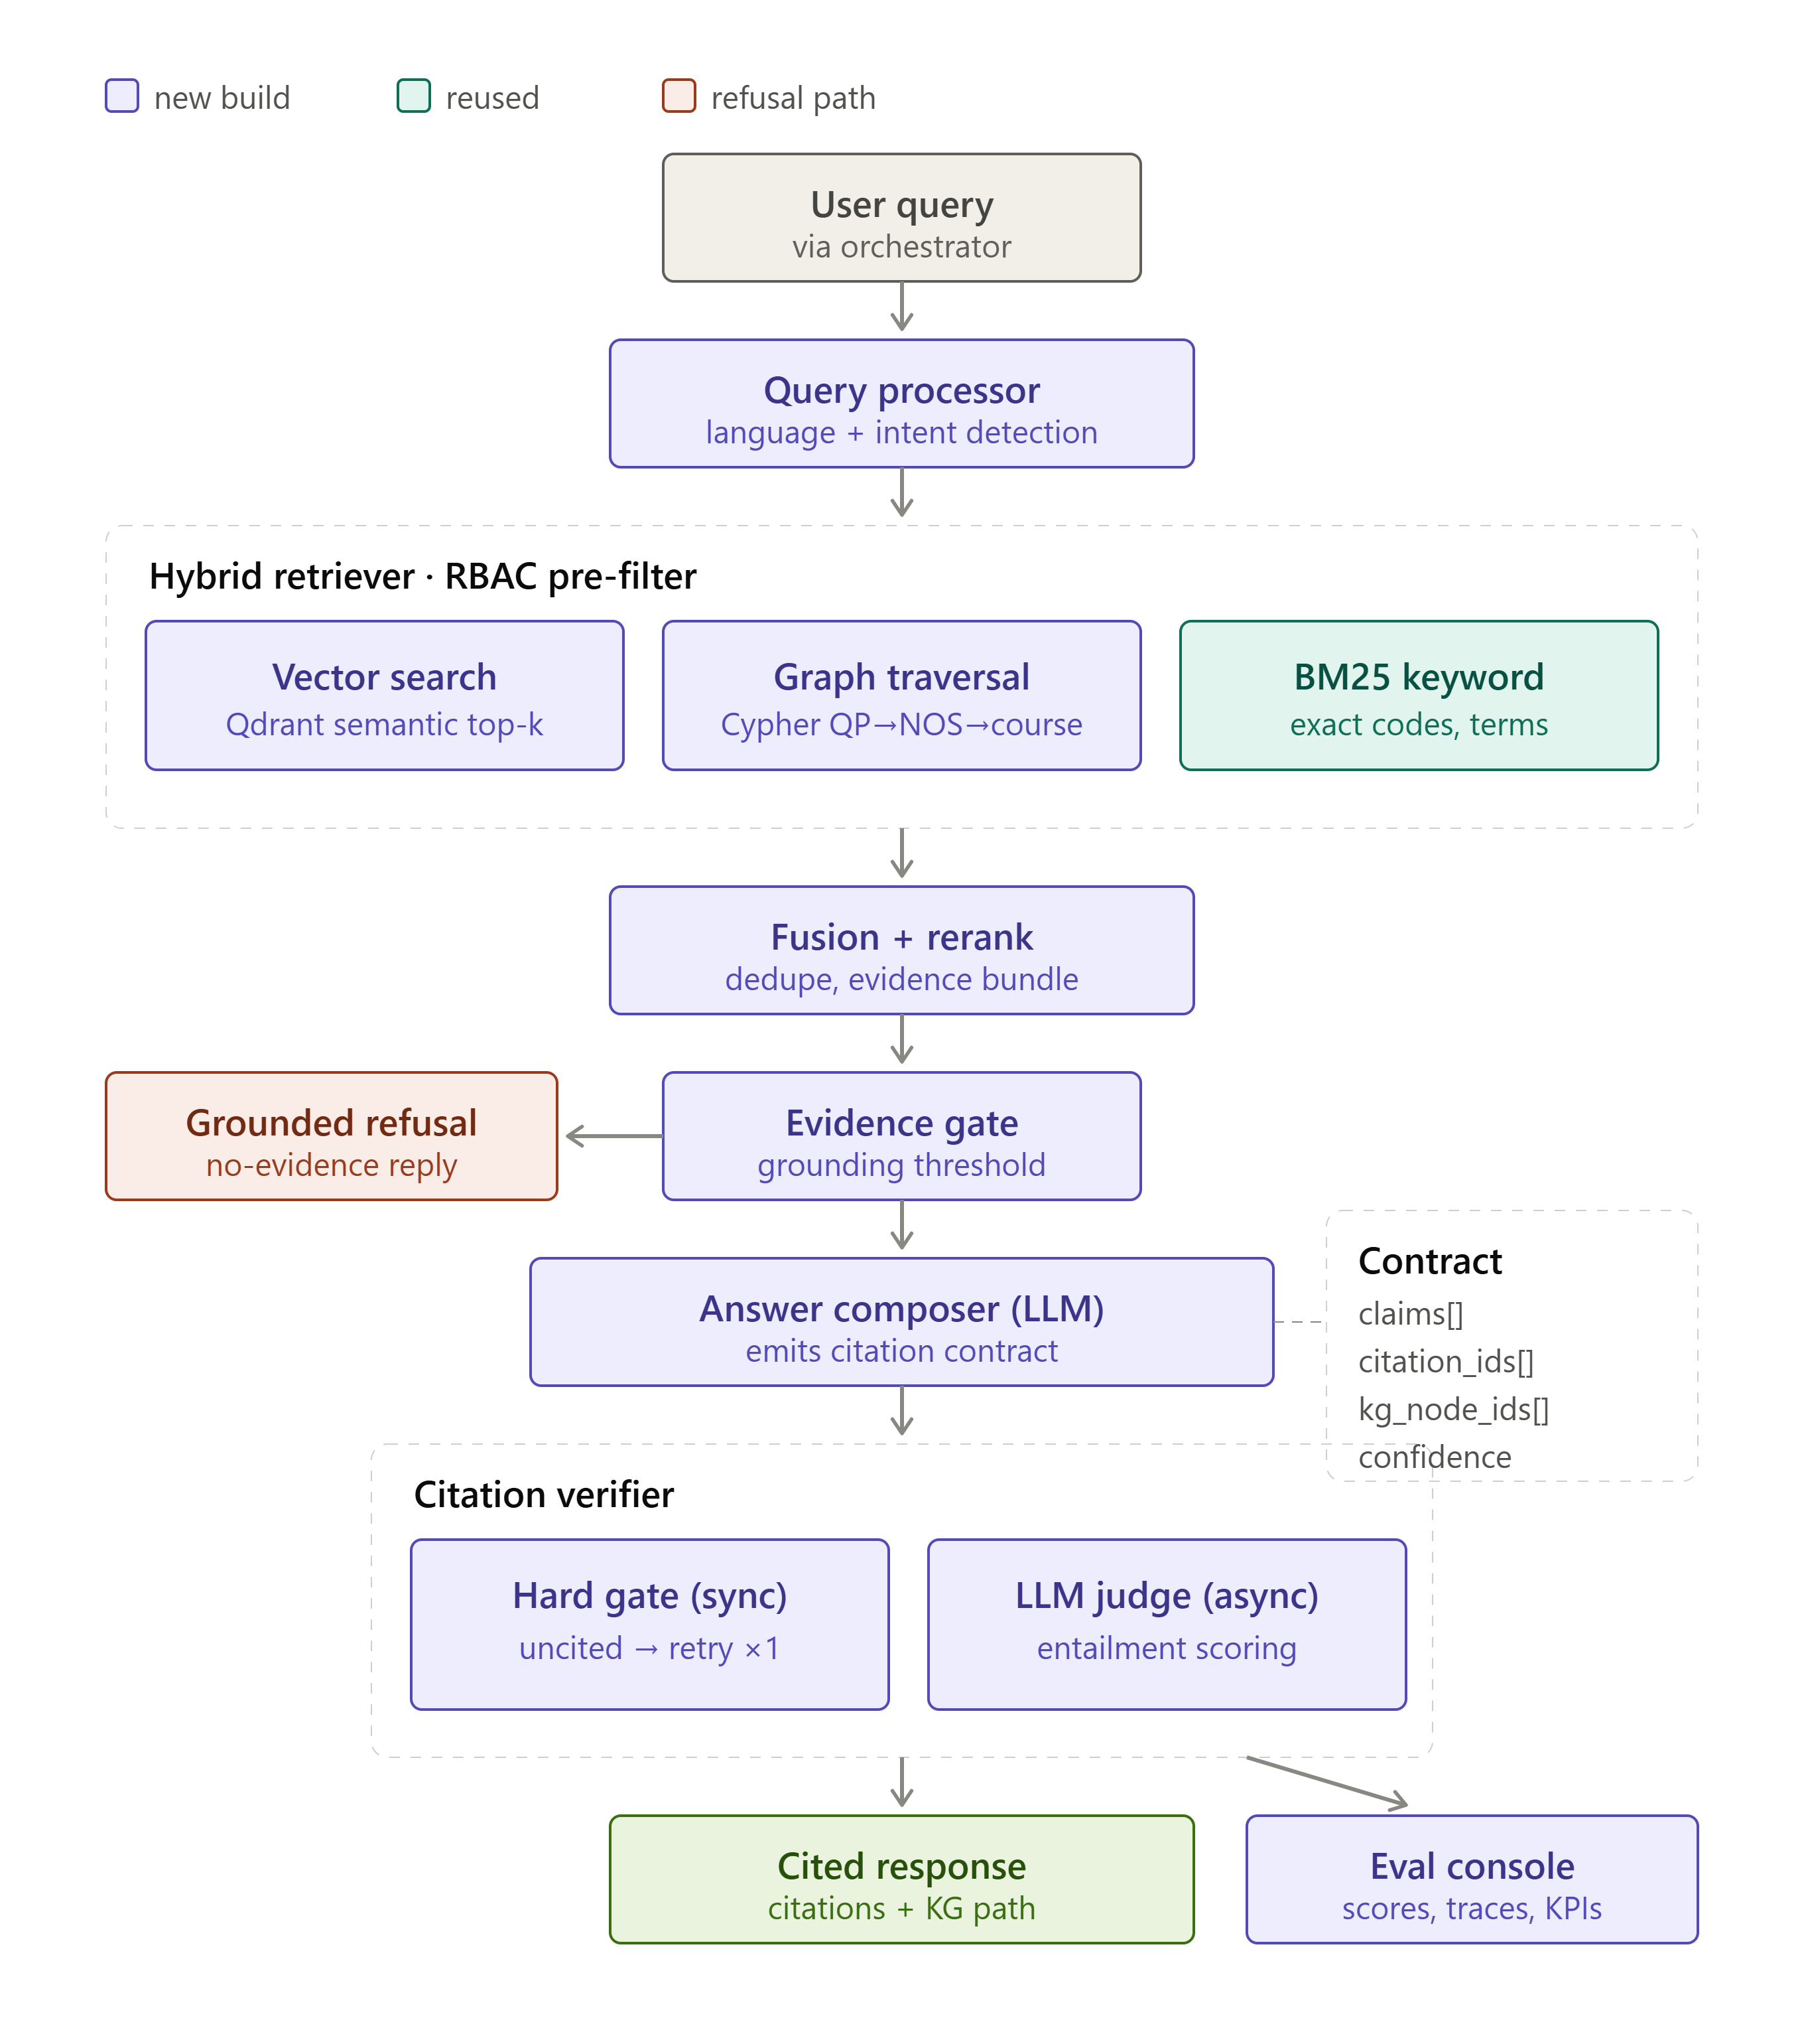
Every answer passes four gates
1 · Safety gate
3 · Citation hard gate
Discriminatory & PII-harvest requests refused before retrieval (EN+HI)
Uncited claims block the answer; cited IDs validated against evidence (spoof-proof)
2 · Evidence gate
4 · Async judge
Refusals decided on retrieval scores — not model honesty
Groundedness scored on 100% of traffic without touching P95
Plus quarantine
Injection payloads neutralised at ingestion — a red-team plant document proves it on every build
NSDC SIDH Part B · Sovereign AI Substrate PoC · pre-bid draft

Slide 5
Measured, not promised — gold-set baseline
100%
100%
93.8%
39 ms
citation completeness (KPI 7.2.4)
RBAC + injection refusal (adversarial, via real API)
refusal correctness on expected-refuse items
pipeline P95 (offline floor config)
40-item versioned gold set, written BEFORE the pipeline was built (eval-first)
RBAC & injection categories executed through the authenticated HTTP API with per-persona tokens
Zero fabricated entities across all runs — the failure mode is conservative refusal, never invention
Residual failures are published & attributed: 10 of 12 close when the multilingual vector leg activates
Hallucination rate (KPI 7.2.2): measured by the async judge once live model is enabled — we show the enforcement mechanism, not an unverifiable number
NSDC SIDH Part B · Sovereign AI Substrate PoC · pre-bid draft

Slide 6
Three personas working today — one substrate
Meena · Learner
Rajesh · Officer
Dr. Iyer · SME
Course & pathway guidance, EN + HI
Per-claim citation chips + KG pathway
Honest 'no evidence' refusals
Feedback thumbs feed the eval set
Jurisdiction-scoped analytics — model never writes SQL
Finds the planted anomaly: attendance 78% → 61% last-30d ⚠
Prompt cannot widen scope (token-injected WHERE clause)
Maker-checker draft notes: human decides, immutable after
NOS-level coverage checks with evidence chunk IDs
Flags courses not declared for a QP
Bloom-tagged item drafts — pending SME sign-off
Content-quality gate per RFP 4.B.8
Live console: /substrate-demo — login, chat, analytics, drafts, audit trail with chain-verification badge, version registry
NSDC SIDH Part B · Sovereign AI Substrate PoC · pre-bid draft

Slide 7
Governance you can inspect, not trust
Signed audit chain
SAICR change gate (4.B.11d)
Every query, refusal, draft & decision — hash-chained, Ed25519-signed, daily Merkle roots. Tampering breaks a live 'chain verified' badge.
No model/index/prompt change ships without a gold-set run. Hard blocks: citations <100% or RBAC <100% = no deploy.
Consent by construction
Zero real learner data
Purpose-bound, time-bound, revocable tokens on every call; DPDP-aligned lineage from source register to answer.
Schema physically rejects non-synthetic learner IDs; analytics serve aggregates only; PII harvests refused & logged.
Deterministic versioning (4.B.1c)
Sovereign by default
Content-addressed index manifests + hashed KG releases; every answer names the exact index state that produced it.
Sarvam-primary model layer; India-resident data plan; zero-egress offline mode demonstrated live.
NSDC SIDH Part B · Sovereign AI Substrate PoC · pre-bid draft

Slide 8
Part B compliance — 27 requirements traced
14
6
7
demonstrated in PoC (code + tests + measurements)
designed — pattern documented / code-complete pending infra
planned — mapped to Q1–Y3 milestone calendar
Full traceability matrix accompanies the bid: RFP §4.B ref → requirement → implementation → KPI → status → evidence
No Part B requirement unaddressed; every 'planned' row anchored to the RFP's own milestone quarters
Six-document proposal pack: architecture blueprint (Q1 deliverable draft), model & system card, SAICR process, DPDP design note, evaluation report, compliance matrix
NSDC SIDH Part B · Sovereign AI Substrate PoC · pre-bid draft

Slide 9
This codebase is the delivery seed — Q1 to Q6
Q1
Q2
Q3
Q4–Q6
Security & DPDP hardening · architecture blueprint · model forking · event schema live
KG v1 + super-taxonomies · corpora v1 · Graph-RAG production · VC migration
Skill Mentor Beta (12 langs) · Officer Copilot Beta · first LoRA adapters · voice Beta
GA 22 languages · Skill Passport v1 · predictive surfaces · orchestration · foundation acceptance
Contracts stay identical at every scale: SQLite→ClickHouse, file log→Kafka, JWT→Keycloak, mock→Sarvam-105B — stores swap, guarantees don't.
NSDC SIDH Part B · Sovereign AI Substrate PoC · pre-bid draft

Slide 10
The substrate is the bid.
Surfaces are cheap once answers are governed.
Working PoC: demoable offline, 20-minute scripted walkthrough
Measured: 100% citations · 100% adversarial refusal · signed audit
Sovereign: Sarvam-native platform already hardened by this team
NSDC SIDH Part B · Sovereign AI Substrate PoC · pre-bid draft

