Slide 1
Youtube link https://youtu.be/La95MIYdW_M
Git Repo Link https://github.com/thehimez/BIS-Standards-Recommendation-Engine
Problem Statement
MSE Compliance Discovery is Broken — and Costly
The Challenge
Why Building Materials?
Indian MSEs spend 2-6 weeks manually identifying applicable BIS standards
Over 19,000 IS standards — impossible to navigate without expert help
Compliance failure = penalties, export blocks, lost contracts
63 million MSEs in India face this problem daily
No affordable, automated solution existed before this project
Highest compliance complexity in MSE sector
Cement, Steel, Concrete, Aggregates — all tightly regulated
BIS SP 21 (2005) covers 556+ standards in this domain
Single document, dense text — ideal for RAG demonstration
Direct impact on construction safety and quality
BIS Standards Recommendation Engine | Himesh Bhowmik

Slide 2
Solution Overview
AI-Powered RAG Engine for Instant BIS Standard Discovery
Enter any product description → Get the top 5 relevant BIS standards with rationale in under 100ms
Hybrid Retrieval
556 Standards Indexed
Streamlit UI
Eval Compliant
BM25 + TF-IDF + Dense SBERT all-MiniLM-L6-v2 embeddings 4-signal scoring fusion
BIS SP 21 (2005) fully parsed IS-boundary chunking strategy FAISS + BM25 corpus
Clean, single-page interface Instant results display Rationale for each match
inference.py + eval_script.py Hit Rate @3 | MRR @5 Latency tracked per query
BIS Standards Recommendation Engine | Himesh Bhowmik

Slide 3
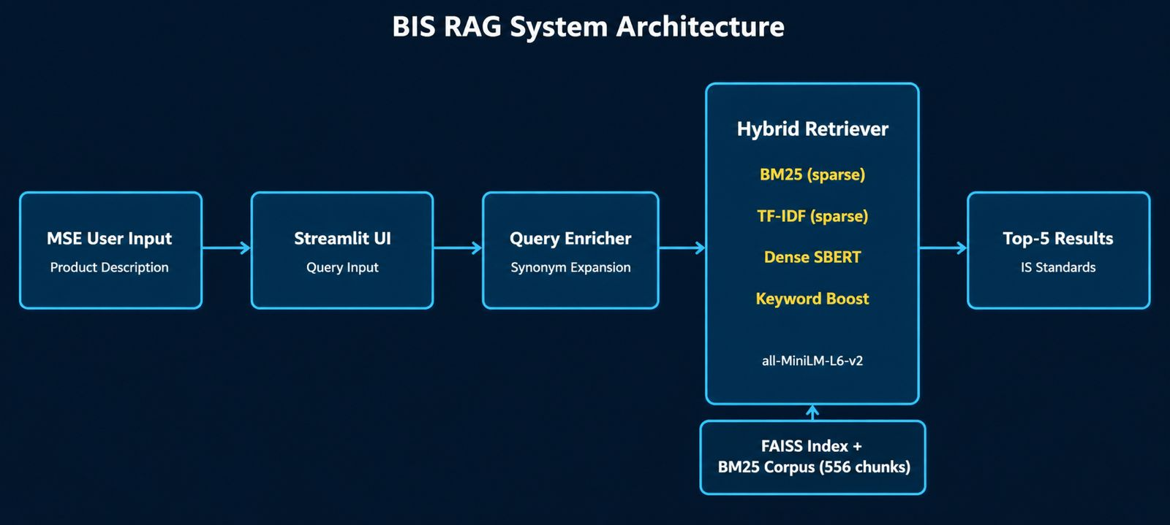
System Architecture
End-to-End RAG Pipeline: Retriever → Ranker → Output
BIS Standards Recommendation Engine | Himesh Bhowmik

Slide 4
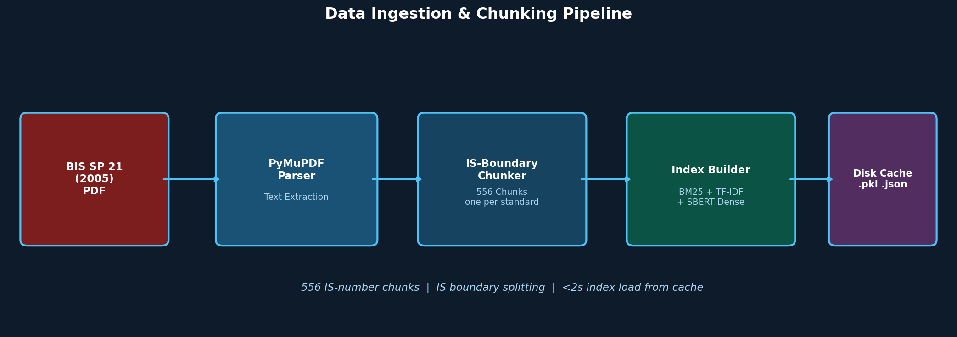
Chunking & Retrieval Strategy
IS-Boundary Chunking + 4-Signal Hybrid Scoring
Chunking Strategy
Retrieval Scoring Formula
One chunk per IS standard number (boundary = "IS XXXX")
Preserves title + summary + scope as a single unit
556 chunks from BIS SP 21 (2005) PDF
Cached to disk — zero-rebuild on subsequent runs
final = a*BM25 + b*TF-IDF + g*Dense + d*KeywordBoost
Query expanded with domain synonyms (enrich_query)
Keyword boost: rewards IS-number literal hits in query
Min-max normalisation before fusion — avoids scale bias
BIS Standards Recommendation Engine | Himesh Bhowmik

Slide 5
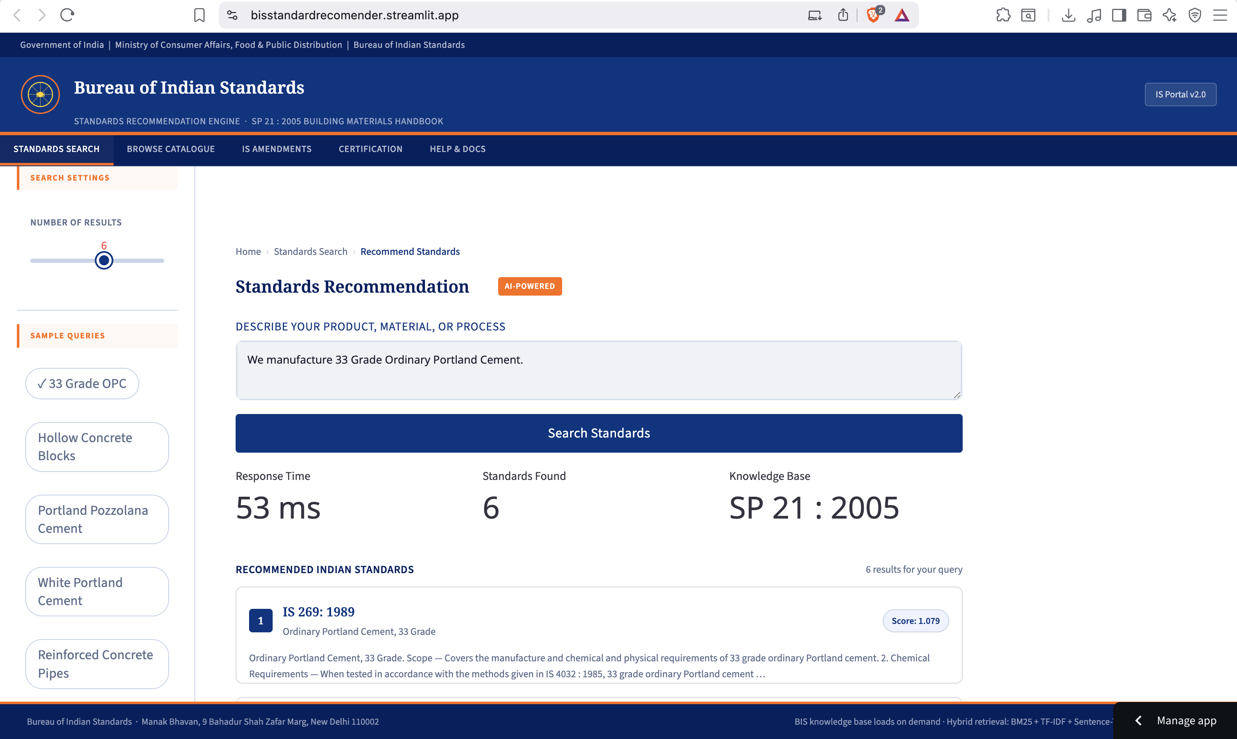
Demo Highlights
https://bisstandardrecomender.streamlit.app/
App Features
Single text box — enter any product description
Returns Top 5 BIS IS standards instantly
Each result shows: IS number, title, rationale
Avg response time < 31ms per query
Runs entirely on CPU — no GPU required
Deployed live on Replit (Streamlit server)
First session: ~15s model warmup
Subsequent queries: <100ms
BIS Standards Recommendation Engine | Himesh Bhowmik

Slide 6
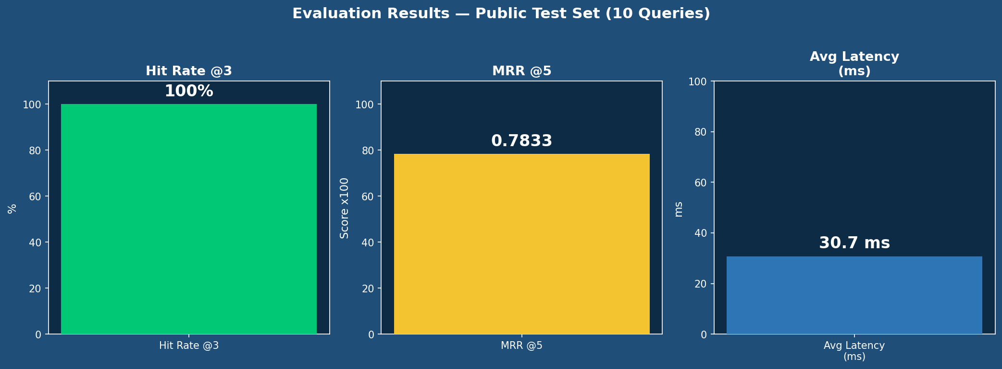
Evaluation Results
Public Test Set: 10 Queries | eval_script.py compliant
Hit Rate @3: 100%
MRR @5: 0.7833
Avg Latency: 30.7 ms
The correct standard appeared in the top 3 results for ALL 10 public test queries
Mean Reciprocal Rank — the correct standard ranks on average in position ~1.3
Per-query retrieval time well under real-time threshold (100ms target)
BIS Standards Recommendation Engine | Himesh Bhowmik

Slide 7
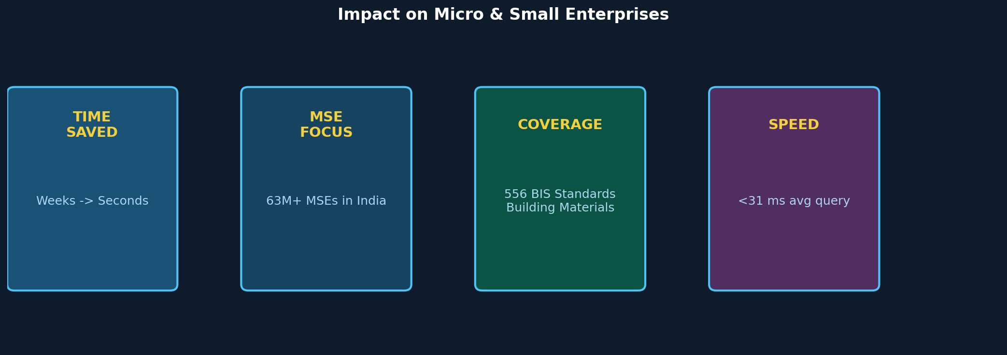
Impact on MSEs
Accelerating BIS Compliance for 63 Million Small Businesses
Real-World Value
Eliminates weeks of manual BIS document search — any MSE can self-serve compliance queries instantly
Reduces dependency on expensive consultants for standard identification in the Building Materials sector
Extendable to all 19,000+ BIS standards across sectors — textiles, electronics, food safety, and more
Open-source, deployable on standard hardware — zero GPU required, suitable for government/SME portals
BIS Standards Recommendation Engine | Himesh Bhowmik

Slide 8
Team & Acknowledgements
BIS Standards Recommendation Engine — Hackathon 2026
Team
Himesh Bhowmik
BIS Standards Recommendation Engine
Built end-to-end during the hackathon window Streamlit | SBERT | FAISS | BM25 | Python | Claude Code
Youtube link https://youtu.be/La95MIYdW_M
Git Repo Link https://github.com/thehimez/BIS-Standards-Recommendation-Engine
Acknowledgements
Tech Stack
Bureau of Indian Standards (BIS) — SP 21 dataset
Hugging Face — sentence-transformers model
SS Innovations — Hackathon organizers
Python | Streamlit | sentence-transformers
rank-bm25 | scikit-learn | faiss-cpu | PyMuPDF
Replit | GitHub | SBERT all-MiniLM-L6-v2
BIS Standards Recommendation Engine | Himesh Bhowmik

