Slide 1
ML and Neural Networks
AI presentation
By Hamza

Slide 2
Machine Learning (ML)
It is an Application of AI.
It enables systems to learn & improve from experience.
It focuses on developing computer programs that can access data and use it to learn for themselves.
Neural Networks
A neural network is a method in artificial intelligence that teaches computers to process data in a way that is inspired by the human brain.

Slide 3
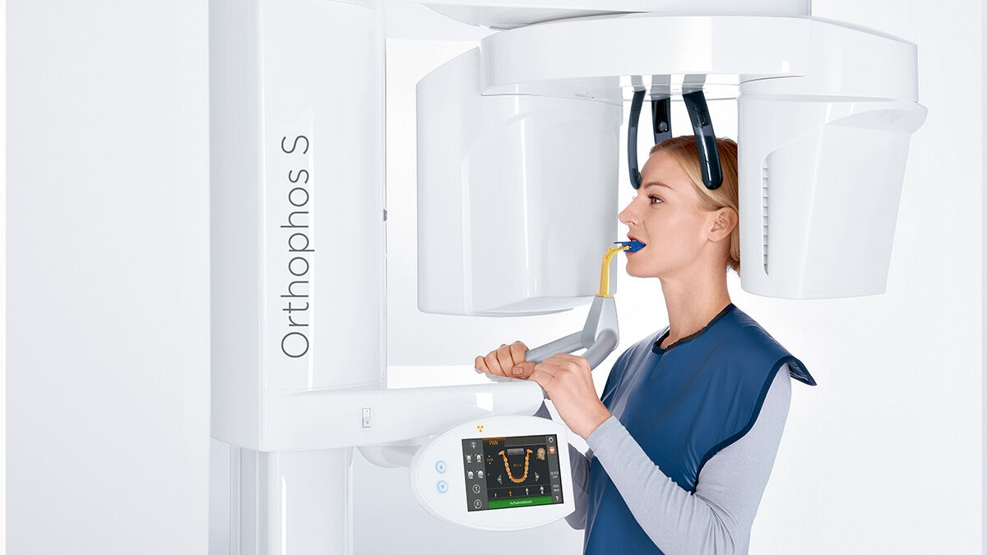
Orthodontics
Digital Imaging
3D X-rays

Slide 4
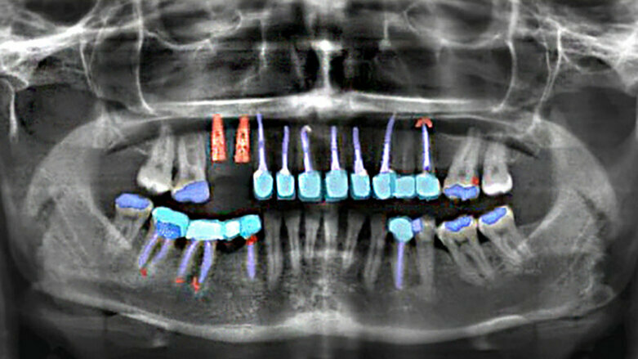
AI based Analysis

Slide 5
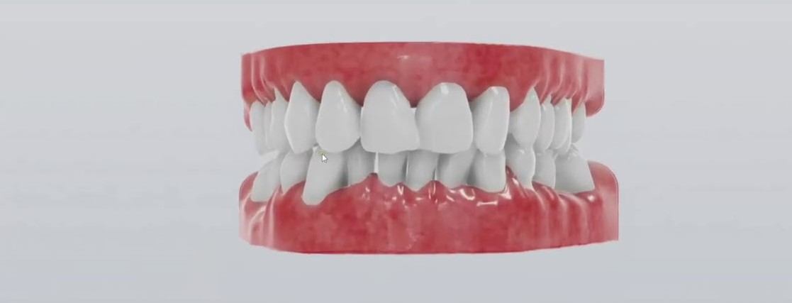
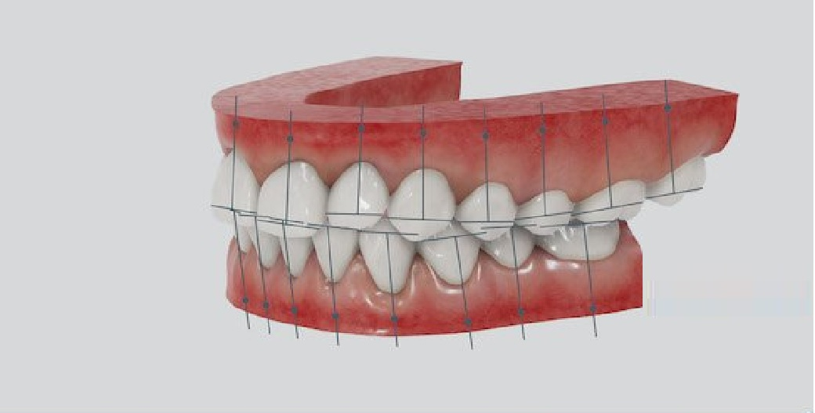
3D Modeling using AI

Slide 6
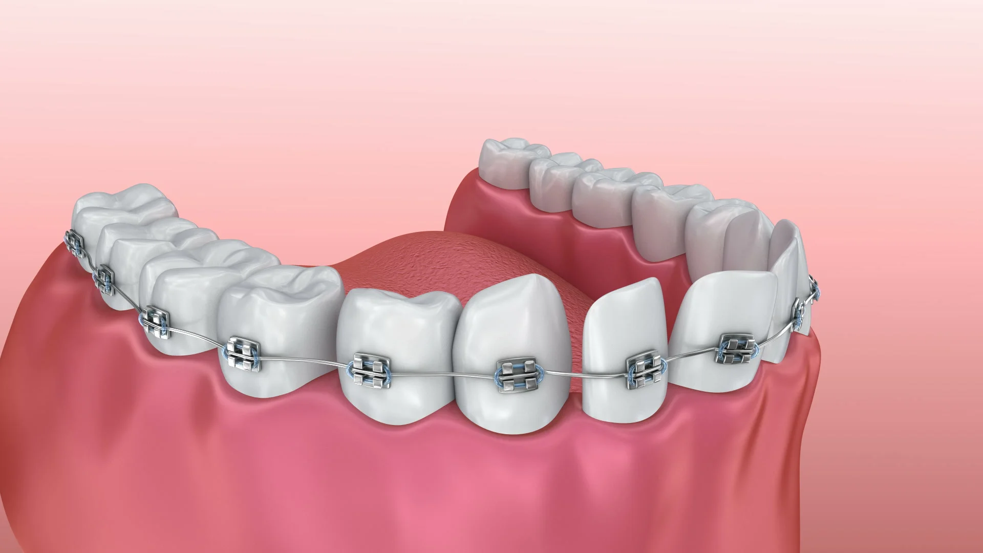
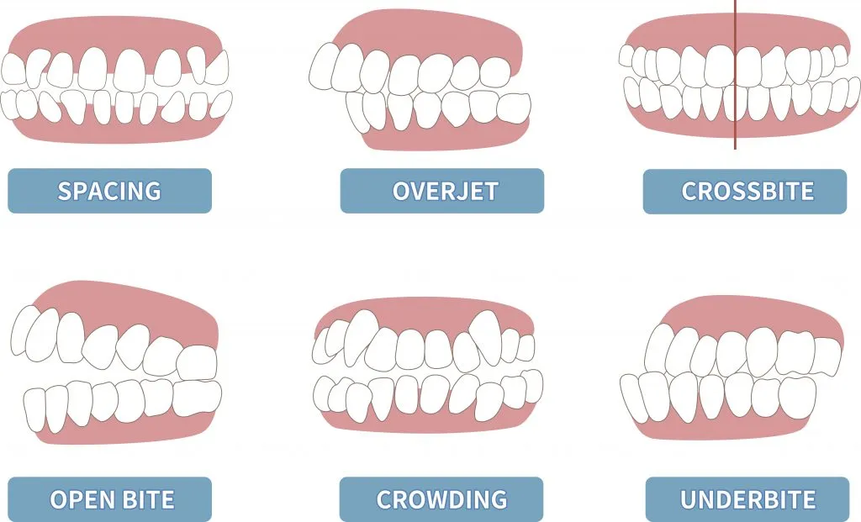
Braces
Braces will straighten your teeth, fix bite issues, and improve the overall appearance of your smile.

Slide 7
Diagnostic Procedure
Spacing
Overbite
Overjet
Crossbite
Alignment
Root canal
filling
Patient
Observation
Diagnosis
Treatment
Outcome
Name
Medical History
Reports
Extraction
Surgery
ML IN Orthodontics

Slide 8
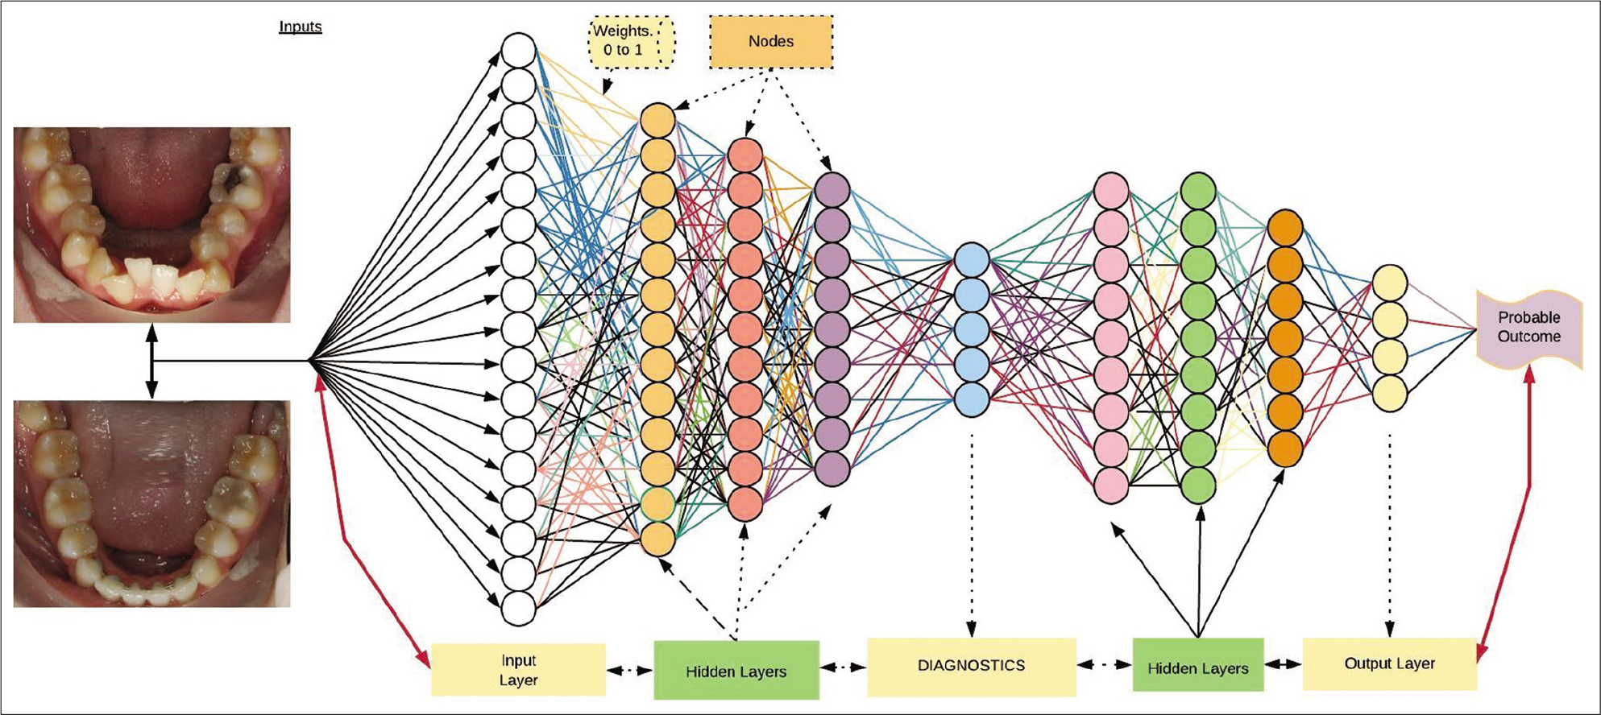
Neural Networks IN Orthodontics

Slide 9
Neural Networks IN Orthodontics
Neural networks consist of nodes referred as neurons.
These nodes require inputs such as amount of overbite, overjet, crossbite etc.
which are initially randomly weighted (0 to 1%) and linked to nodes which calculate the correlation in the input layer.
To further refine the calculations, hidden layers are added
neural networks to strengthen the probabilities that the neural network predictions will be accurate.

Slide 10
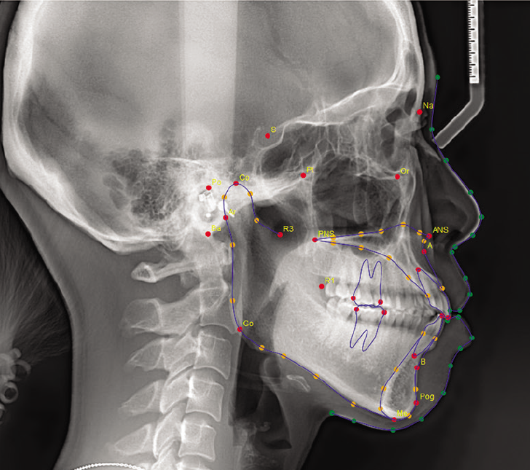
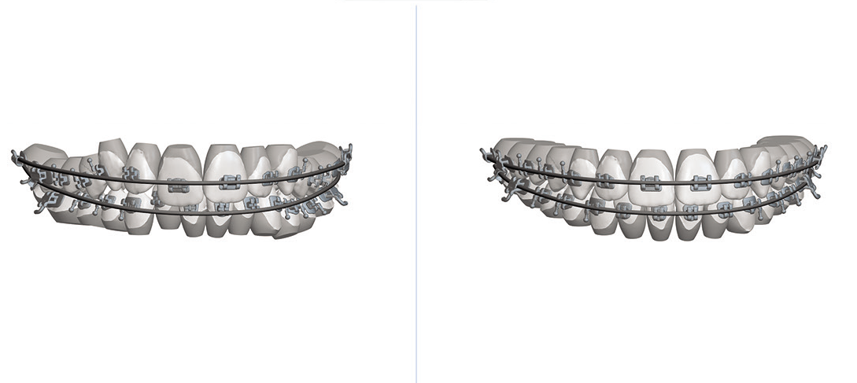

Slide 11
Any Questions?

