Slide 1
Spring Framework 4.x
JTA: Transactions
David Lucas
Lucas Software Engineering, Inc.
www.lse.com
ddlucas@lse.com

Slide 2
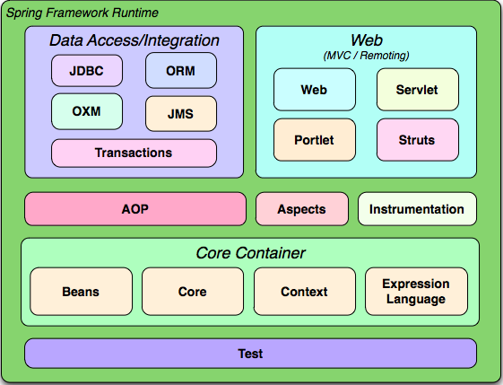

Slide 3
Spring Framework: JTA
JTA: Java Transaction API
Spring provides consistent transaction management for multiple resources
  database
  messaging
  RMI / IIOP
Configured using XML file

Slide 4
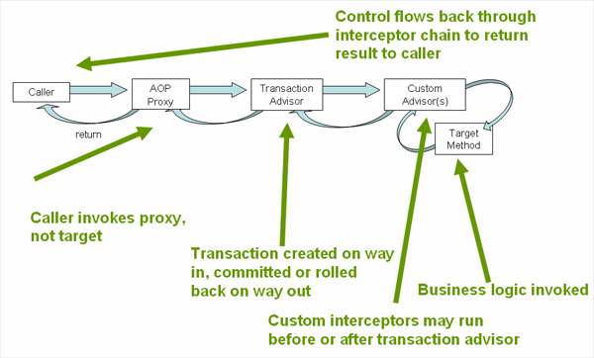

Slide 5
Spring Framework: JTA
Simple DataSource TransactionManager
Not Two Phase Commit
Only Supports JDBC transactions
Local Transaction Support (not Global)
<!-- a PlatformTransactionManager is still required -->
<bean id="transactionManager"
class="org.springframework.jdbc.datasource.DataSourceTransactionManager">
<!-- (this dependency is defined somewhere else) -->
<property name="dataSource" ref="dataSource"/>
</bean>

Slide 6
Spring Framework: JTA
JTA Transaction Manager wraps a real manager
Global Transaction Support (Two Phase Commit)
Automatically finds the real manager in most containers
  WebLogic
  WebSphere
  JBoss
JTA supports transactions in JDBC and JMS.
<bean id="transactionManager" class="org.springframework.transaction.jta.JtaTransactionManager" />

Slide 7
Spring Framework: JTA
@Transactional annotation wraps methods with transaction control using transaction manager calls to begin / commit / rollback
  isolation and propagation level config
  read-only optimization option
  timeout (max time before rollback)
  applied at class or method level
@Transactional(readOnly = false, propagation = Propagation.REQUIRES_NEW)
  public void updateFoo(Foo foo) {
  // do something
  }

Slide 8
Spring Framework: JTA
Propagation provides JTA information about the type of transaction and how it processes with other transaction
  PROPAGATION_REQUIRED: DEFAULT, will create a transaction if one is not already created and will participate if one exists.
  PROPAGATION_REQUIRES_NEW: will create a new transaction and not participate in existing one, if other exists, will suspend it
  PROPAGATION_SUPPORTS: will use transaction if exists, otherwise will not create one (read only operations)
  PROPAGATION_NESTED: will leverage save point or sub transactions if supported by resources.
  Other options that allow for error handling if exception exists or does not

Slide 9
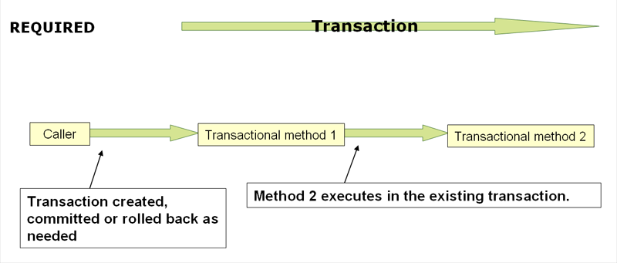

Slide 10
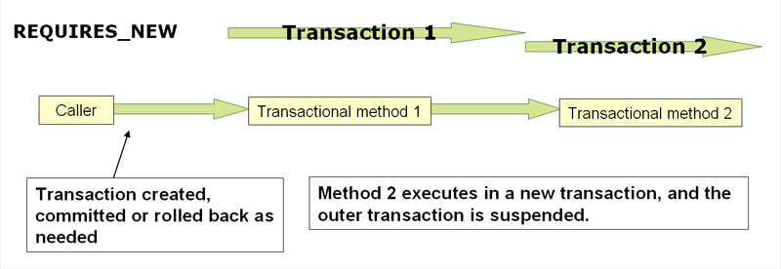

Slide 11
Spring Framework: JTA
Unit Testing can utilize a third party Transaction Manager
Atomikos is open source and very stable
  Transaction Essentials (Apache License 2)
  DataSource wrappers for XA and non-XA connections
  Support for JMS

Slide 12
Spring Framework: JTA
Maven Setup
  add dependency for Atomikos Transaction Essentials Al
  add dependency for Spring TX
  add geronimo-jta
  add geronimo
Properties Setup (application.properties)
    my.account.checking.number=1234567890
    my.account.savings.number=2341567891
    # transaction timeout, 5 minutes in debug
    transaction.timeout=300

Slide 13
Spring Framework: JTA
<bean id="dataSource" name="dataSource,datasource"
class="com.atomikos.jdbc.nonxa.AtomikosNonXADataSourceBean"
lazy-init="true" init-method="init" destroy-method="close" >
<property name="uniqueResourceName" value="NONXADBMS" />
<property name="driverClassName" value="${jdbc.driverClassName}" />
<property name="url" value="${jdbc.url}" />
<property name="user" value="${jdbc.username}" />
<property name="password" value="${jdbc.password}" />
<property name="readOnly" value="false" />
<property name="poolSize" value="1" />
<property name="maxPoolSize" value="4" />
<property name="minPoolSize" value="0" />
<property name="testQuery" value="select 1 from dual" />
</bean>
<bean id="atomikosTransactionManager"
class="com.atomikos.icatch.jta.UserTransactionManager"
init-method="init" destroy-method="close">
<property name="forceShutdown" value="true"/>
<property name="transactionTimeout" value="${transaction.timeout}" />
</bean>

Slide 14
Spring Framework: JTA
<bean id="atomikosUserTransaction"
class="com.atomikos.icatch.jta.UserTransactionImp">
<property name="transactionTimeout" value="${transaction.timeout}" />
</bean>
<!-- Configure the Spring framework to use JTA transactions from Atomikos -->
<bean id="transactionManager"
class="org.springframework.transaction.jta.JtaTransactionManager">
<property name="transactionManager">
<ref bean="atomikosTransactionManager" />
</property>
<property name="userTransaction">
<ref bean="atomikosUserTransaction" />
</property>
</bean>
<!-- enable the configuration of transactional behavior based on annotations -->
<tx:annotation-driven transaction-manager="transactionManager"/>

Slide 15
Spring Framework: LocalTransaction
@Bean
public DataSourceTransactionManager transactionManager() {
DataSourceTransactionManager ds = new DataSourceTransactionManager();
ds.setDataSource(dataSource());
return ds;
}

Slide 16
Spring Framework: JpaTransaction
@Bean
public JpaTransactionManager transactionManager(EntityManagerFactory emf) {
JpaTransactionManager jpa = new JpaTransactionManager(emf);
jpa.setDataSource(dataSource());
return jpa;
}
@Bean
public JpaVendorAdapter jpaVendorAdapter() {
HibernateJpaVendorAdapter jpaVendorAdapter = new HibernateJpaVendorAdapter();
jpaVendorAdapter.setDatabase(Database.H2);
jpaVendorAdapter.setGenerateDdl(true);
return jpaVendorAdapter;
}
@Bean
public LocalContainerEntityManagerFactoryBean entityManagerFactory() {
LocalContainerEntityManagerFactoryBean lemfb = new LocalContainerEntityManagerFactoryBean();
lemfb.setDataSource(dataSource());
lemfb.setJpaVendorAdapter(jpaVendorAdapter());
lemfb.setPackagesToScan(getClass().getPackage().getName());
Properties props = new Properties();
//...
lemfb.setJpaProperties(props);
return lemfb;
}

Slide 17
LAB #1: Transactions
Lab Assignment #1:
We need to add a transfer method to our various objects to
move money from one account to another. Modify the Bank
implementation to support Transactions using the @Transactional method.
public interface Bank {
String getBankName();
double getAccountBalance(String accountNumber);
double creditAccount(String accountNumber, double amount);
double debitAccount(String accountNumber, double amount);
void transfer(String fromAccountNumber,
String toAccountNumber, double amount);
}

Slide 18
LAB #1: Transactions
Lab Assignment #1:
We need to add a transfer method to our various objects to
move money from one account to another. Modify the Bank
implementation to support Transactions using the @Transactional method.
public interface Bank {
String getBankName();
double getAccountBalance(String accountNumber);
double creditAccount(String accountNumber, double amount);
double debitAccount(String accountNumber, double amount);
void transfer(String fromAccountNumber,
String toAccountNumber, double amount);
}

Slide 19
LAB #2: Transactions
Lab Assignment #1 Continued:
1) Step through debugger, do you see the aspect interceptors?
2) Set log4j.properties file to turn on Spring debugging:
#
# Spring
#
log4j.logger.org.springframework=INFO
log4j.logger.org.springframework.tx=DEBUG
log4j.logger.org.springframework.transaction=DEBUG
log4j.logger.org.springframework.transaction.support=DEBUG
log4j.logger.org.springframework.transaction.annotation=DEBUG
log4j.logger.org.springframework.context=INFO
log4j.logger.org.springframework.dao=INFO
log4j.logger.org.springframework.orm=INFO
log4j.logger.org.springframework.jpa=INFO
log4j.logger.org.springframework.jta=DEBUG
log4j.logger.org.springframework.jms=INFO
log4j.logger.org.springframework.jms.connection=INFO
log4j.logger.org.springframework.jms.core=INFO
log4j.logger.org.springframework.jdbc=INFO
log4j.logger.org.springframework.web=INFO
log4j.logger.org.springframework.web.servlet=INFO
log4j.logger.org.springframework.web.servlet.view=INFO
log4j.logger.org.springframework.test.context.junit4=INFO

Slide 20
Spring Framework: Resources
http://www.javaworld.com/javaworld/jw-01-2009/jw-01-spring-transactions.html
http://static.springsource.org/spring/docs/4.3.x/spring-framework-reference/pdf/spring-framework-reference.pdf
http://www.theserverside.com/news/1364527/Introduction-to-the-Spring-Framework
http://www.atomikos.com
Spring In Action, Walls
Pro Spring, Harrop and Machacek

