Slide 1
Personality Prediction
Submitted in the partial fulfillment for the award of the degree of
BACHELOR OF ENGINEERING
IN
Artificial Intelligence and machine learning
Submitted by:
Priya yadav
20BCS6126
Hitesh Kumar
20BCS6157
Under the Supervision of:
Mrs. Lata Gupta
Department of AIT-CSE
DISCOVER . LEARN . EMPOWER

Slide 2
Outline
Introduction to Project
Problem Formulation
Objectives of the work
Methodology used
Results and Outputs
Conclusion
Future Scope
References

Slide 3
Introduction to Project
1.1 PROBLEM DEFINITION:
Knowing your personality helps you answer better the dilemma of how’s and why’s about yourself. You have a certain way and feel a certain way, but often it’s hard to understand why especially when other people aren’t thinking or feeling the same way. Getting insights into your personality helps in career growth by molding yourself accordingly. The main goal of this project is to know you better to excel in different aspects of life. A large portion of the information is accessible to humanitarian organizations that are not organized. Compiling questions for personality analysis and surveying the data collected for personality conclusions is a bit challenging.

Slide 4
1.2 PROJECT OVERVIEW:
Personality prediction is based on identifying the personality of an individual using machine learning algorithms and big 5 models. Personality plays a major role in one’s personnel and professional life. Nowadays, many organizations have also started short listing the candidates based on their personality as this increase the efficiency of the work because the person is working in what he is good at than what he is forced to do. When the statistical analysis is applied to personality survey data, some person words used to describe the person and these words give a summary of the overall character or personality of the person accurately. Users can easily identify their personality from this system.

Slide 5
1.3 HARDWARE SPECIFICATIONS:
Processor – 64-bit eight-core, 2.5GHz per core
RAM – Minimum 4GB required
Hard Disk – SSD or HDD minimum 40GB free space required
Webcam – HD Webcam supporting 720p video recording
1.4 SOFTWARE SPECIFICATIONS:
Edition - Windows 10 Home Single Language
Version - 21H1
Installed on - 16-08-2020
OS build 19043.1526
Experience Windows Feature Experience Pack 120.2212.4170.0
Python installed – version 3.7 to 3.10
Steam lit.
Spyder.

Slide 6
Problem Formulation
We are faced with many challenges which can be overcome by the advancing technology. One such challenge faced by every individual is getting to know their own self better. Knowing your personality helps you answer better the dilemma of how’s and why’s about yourself. You have a certain way and feel a certain way, but often it’s hard to understand why especially when other people aren’t thinking or feeling the same way. Getting insights into your personality helps in career growth by molding yourself accordingly. it's a vivid example of how technologies with a transformative potential like the web bring with them each opportunity to get themselves know better by developing a personality prediction product.

Slide 7
Using the personality surveyed dataset, one will get a charming mix of different personality contents and different connected information like gender, age, grading based on user’s answers to the question that pave the approach for perceptive analysis. The dataset consists of user information that they provided during the survey. Survey question posed to the user by the system brings in a lot of information to preprocess and get inferences from, for the prediction. Operating with the dataset can assist you to perceive the challenges related to information provided by the user data processing and additionally find out about classifiers comprehensively. The foremost downside that, we tend to be acting on as a beginner is to make a model to predict the personality of the user.

Slide 8
Objectives of the Work
Our goal is to develop a way that uses machine learning primarily based on algorithms so that a label is categorified to individual tweets and also the sentimental analysis of identical information might be conducted. The label will either be positive or negative based on the text analysis.
For the machine-learning-based approach, we tend to study a baseline methodology and a few tree-based strategies giving supervised machine learning to train a classifier on the labeled dataset and measure the accuracy of these algorithms.
The planned aim is going to be achieved by dividing the work into the following objectives:
To grasp a user or audience's opinion on a target object by analyzing an enormous amount of text from Twitter.
We can analyze text on completely different levels of detail and also the detail level depends on our goals.
To urge valuable insights in varied fields and conjointly the notion of public.

Slide 9
Methodology used
Personality prediction of a user is a new area that needs more attention. The collected user information has been developed from scratch to prepare for cleanliness. Also, using an element selection technique, important content is removed from the entire content. Third, the information bits are rated according to the data provided to configure the preparation package. Finally, preparation sets marked with individual highlights are provided as an aid to the classification to add additional information such as test sets.
Data Source
Determining the source of information is a critical task to advance the final investigation. User data is collected and on the basis of age, gender, and ratings for personality as parameters. Data is collected on the basis of specific question posed to the user through the interface created.
Personality
Personality refers to individual differences in characteristic patterns of thinking, feeling and behaving. The study of personality focuses on two broad areas: One understands individual differences in particular personality characteristics, such as sociability or irritability. The other understands how the various parts of a person come together as a whole. The personality in this model is classified as 5 big models.

Slide 10
Streamlit
Streamlit is an open source app framework in Python language. It helps us create web apps for data science and machine learning in a short time. It is compatible with major Python libraries such as Scikit-learn, Keras, PyTorch, SymPy(latex), NumPy, pandas, Matplotlib etc. The interface for the user is created using this technique.
HTML
HTML (Hyper Text Mark-up Language) is the code that is used to structure a web page and its content. For example, content could be structured within a set of paragraphs, a list of bulleted points or using images and data tables. The structure of the user interface is described using this technique. HTML elements tell the browser how to display the content.

Slide 11
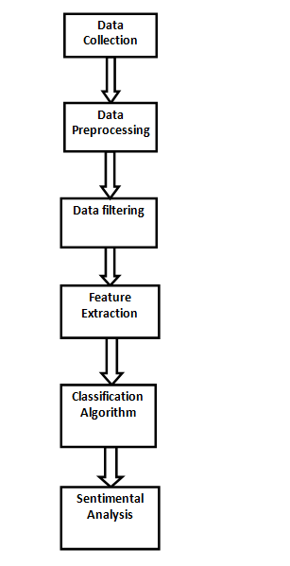
FIG 1: Flowchart representing methodology used

Slide 12
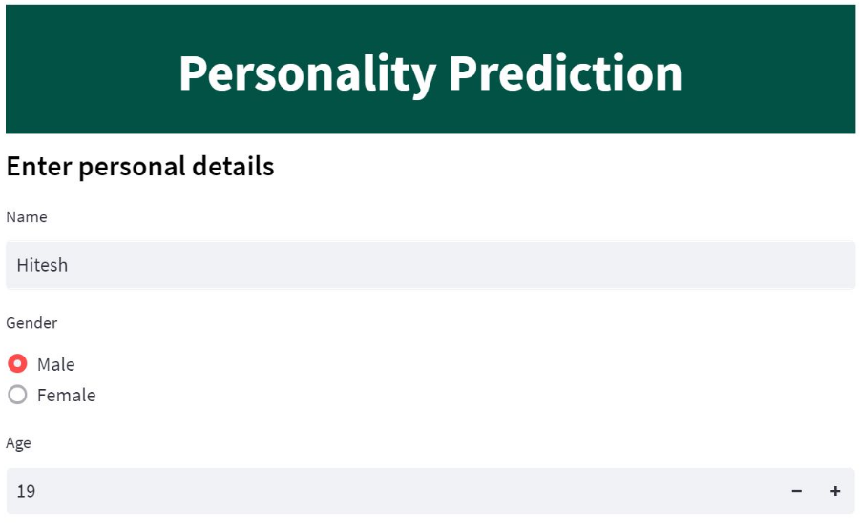
Results and Outputs

Slide 13
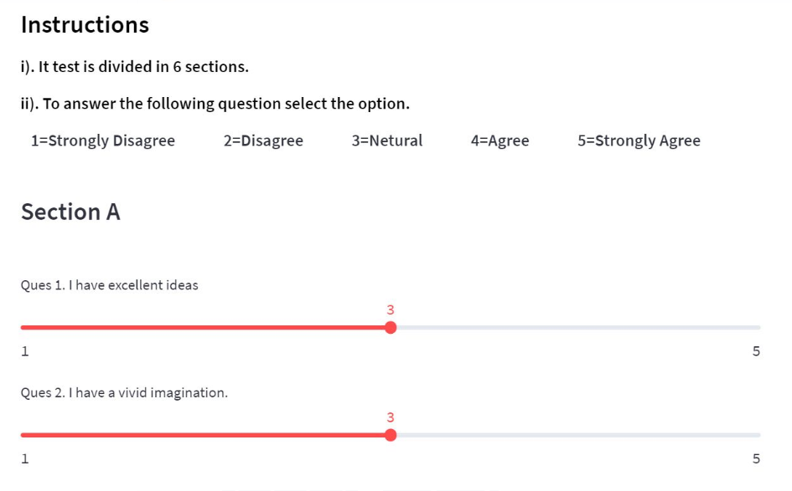

Slide 14
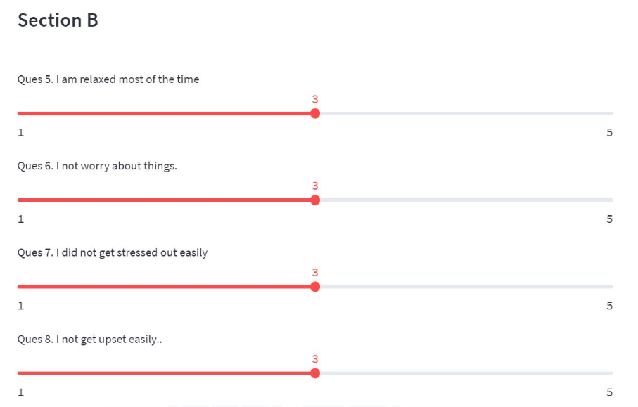

Slide 15
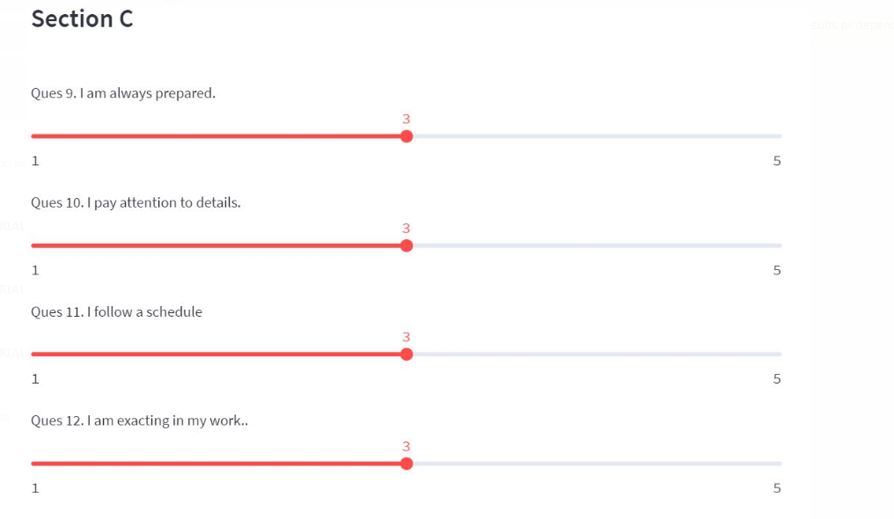

Slide 16
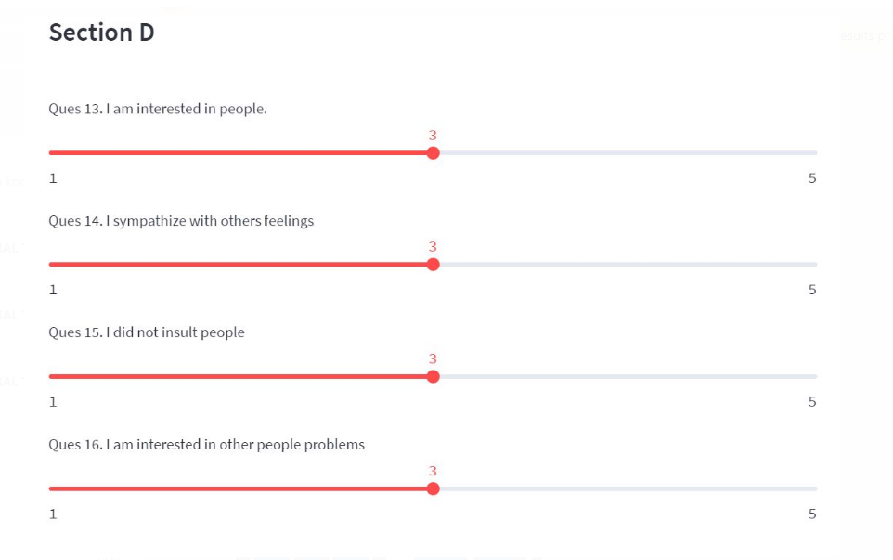

Slide 17
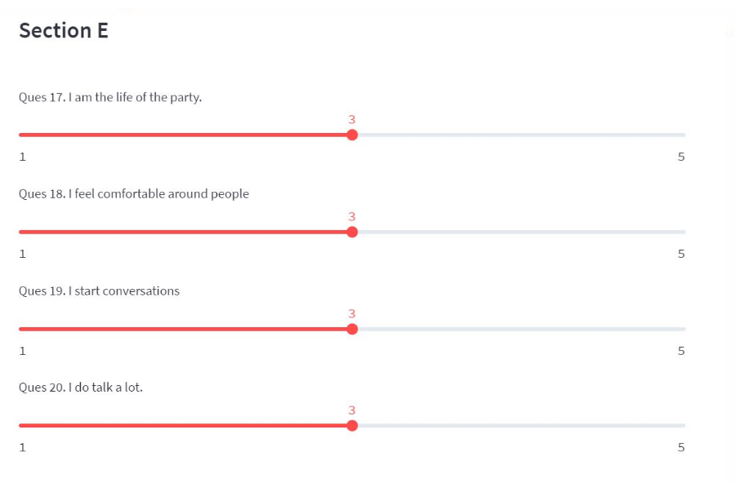

Slide 18
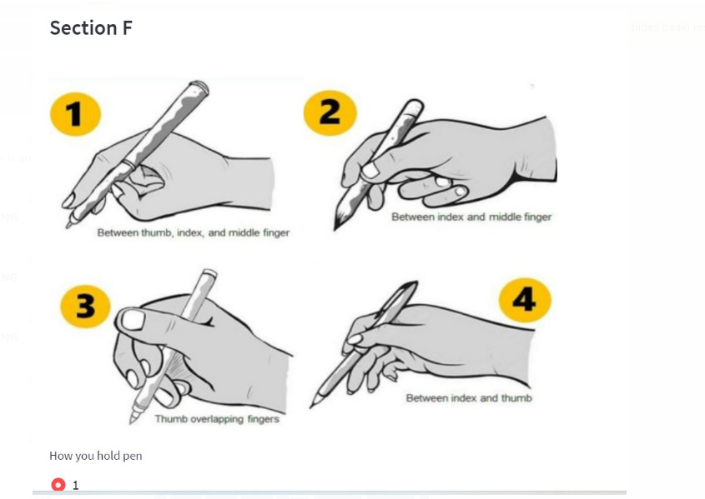

Slide 19
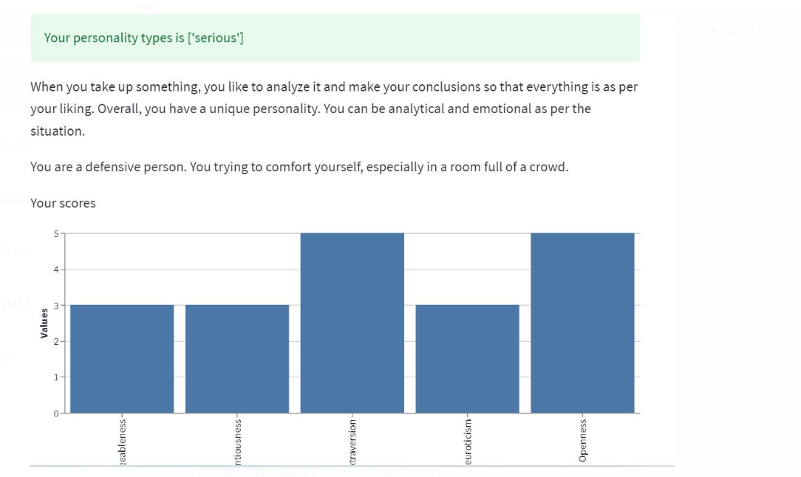

Slide 20
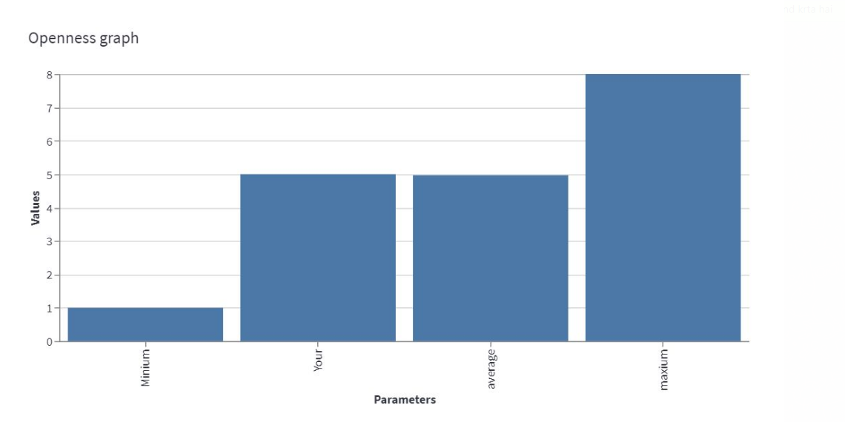

Slide 21
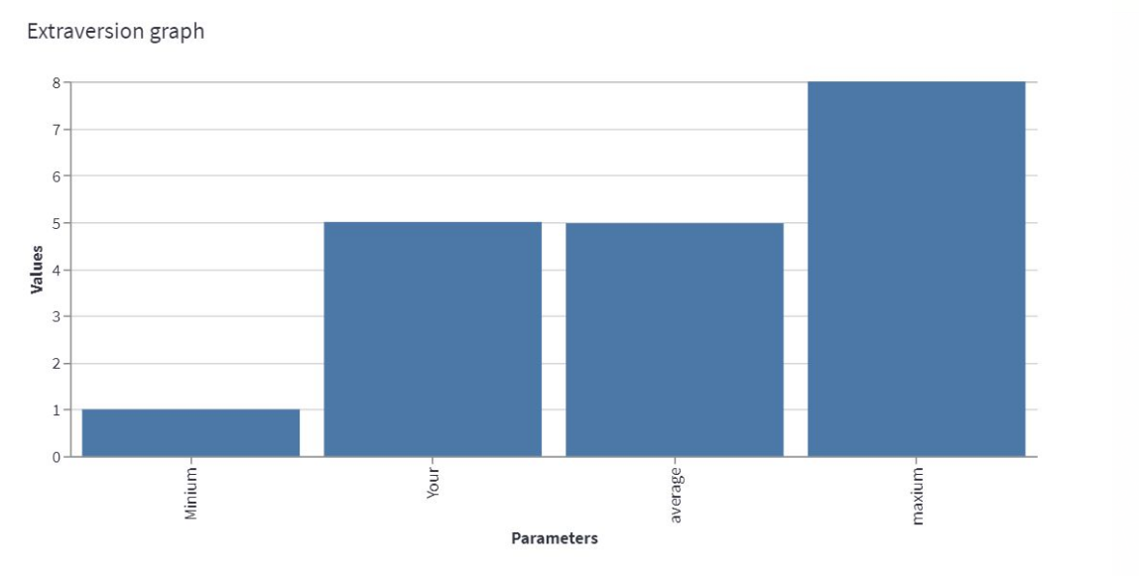

Slide 22
Conclusion
Racist comments have become very frequent on social media platforms like Twitter and may be mechanically detected and stopped to avoid any unfolding. This study considers racism detection from a sentiment analysis perspective and marks racism amplifying tweets by distinguishing negative sentiments. Training and testing dataset collected from GitHub and annotated by utilizing the Text Blob is employed for experiments with many machine learning. Overall, 7.01% of the collected 31,962 train tweets and 17,197 check tweets contain racist comments. Since the negative category is vital to notice racism, a separate analysis indicates that SVM and LR respectively observed 97% and 96% of racist tweets accurately, whereas 3% and 4% of the racist tweets are mislabeled, respectively. Results show that machine learning models SVM and LR show higher performance getting averaged 0.97 and 0.96 accuracy scores respectively, concerning the sentiment analysis for positive and negative categories. The accuracy/ results of every methodology permit us to imagine the potency of the applied technique in several circumstances.

Slide 23
Future Scope
We believe our results would build a brand new reference for future comparative studies. We are going to explore future work diversely, like alternative network structures to extract different options; explore different word embedding’ impact on learning; and integrate user centrical features, like the frequency of a user detected for posting hate speech and also the user’s interaction with others.

Slide 24
References
[1] Asra S., Shubhangi D. C., Personality Trait Identification Using Unconstrained Cursive and Mood Invariant Handwritten Text. International Journal of Education and Management Engineering, 2015, 5(5), 20
[2] Kedar S., Nair V., Kulkarni S., Personality identification through handwriting analysis: a review. Int. J. Adv. Res. Comput. Sci. Softw. Eng, 2015, 5(1)
[3] Ilimini K., Fernando T. G. I., Persons’ personality traits recognition using machine learning algorithms and image processing techniques. Advances in Computer Science: an International Journal, 2016, 5(1), 40-44
[4] Liu L., Preotiuc-Pietro D., Samani Z. R., Moghaddam M. E, Ungar L. H., Analyzing Personality through Social Media Profile Picture Choice. In Tenth international AAAI conference on web and social media (ICWSM), 2016, 211-220.
[5] Sagadevan S., Malim N. H. A. H., Husin M. H., Sentiment Valences for Automatic Personality Detection of Online Social Networks Users Using Three Factor Model. Procedia Computer Science, 2015, 72, 201-208

Slide 25
[7] jagran
[8] Abood N. Big five traits: a critical review. Gadjah Mada Int J Business. 2019
[9] Acheampong FA, Nunoo-Mensah H, Chen W. Transformer models for text-based emotion detection: a review of BERT-based approaches. Artif Intell Rev. 2021.
[10] Adi GYNN, Tandio MH, Ong V, Suhartono D. Optimization for automatic personality recognition on Twitter in Bahasa Indonesia. Procedia Comp Sci. 2018

