Slide 1

SkillSphere – Learn Beyond Limits
A Next-Generation Learning Management System
COLLEGE PROJECT · 2026

Slide 2
The Problem with Traditional Learning
📚 Less Interactive
🗂️ Fragmented Management
Passive learning with minimal engagement or hands-on practice.
Course materials, assignments, and grades scattered across systems.
👥 No Centralized Hub
📉 Poor Progress Tracking
Students and trainers lack a unified platform for collaboration.
No real-time visibility into student performance or learning gaps.
💬 Limited Communication
✍️ Manual Evaluation
Weak channels for feedback, discussion, and peer interaction.
Time-consuming grading processes slow down feedback loops.
"Education needs a smarter, more engaging digital ecosystem."

Slide 3

Introducing SkillSphere
A centralized Learning Management System that seamlessly connects students, trainers, and administrators through one secure, intelligent platform — from registration to certification.
Browse Courses
Complete Quiz
Register
Learn
Create your SkillSphere account
Discover available learning paths
Engage with course materials
Assess your understanding
Every step is designed to be intuitive, trackable, and rewarding — turning learning into a structured, engaging experience.

Slide 4








Key Features at a Glance
Secure Authentication
Multi-Role Dashboards
Role-based JWT login for students, trainers, and admins.
Tailored interfaces for every user type.
Video Learning
Assignments & Quizzes
Stream lessons with progress tracking.
Submit work and take timed online assessments.
Certificates
Progress Analytics
Auto-generated certificates on course completion.
Visual insights into performance and engagement.
Notifications
Leaderboard
Real-time alerts for deadlines and updates.
Rank-based motivation for competitive learners.

Slide 5
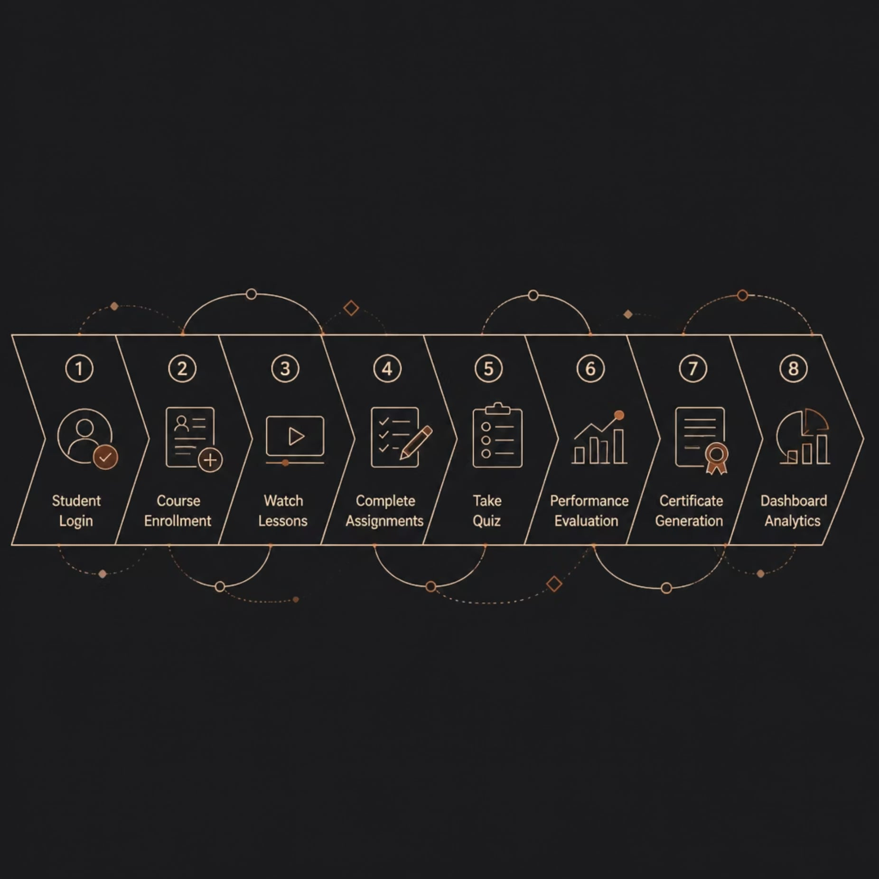
System Workflow
This end-to-end workflow provides an organized and engaging learning experience while tracking every student's progress — from first login to final certification.
Each stage is logged, timestamped, and visible to both students and trainers in real time.

Slide 6
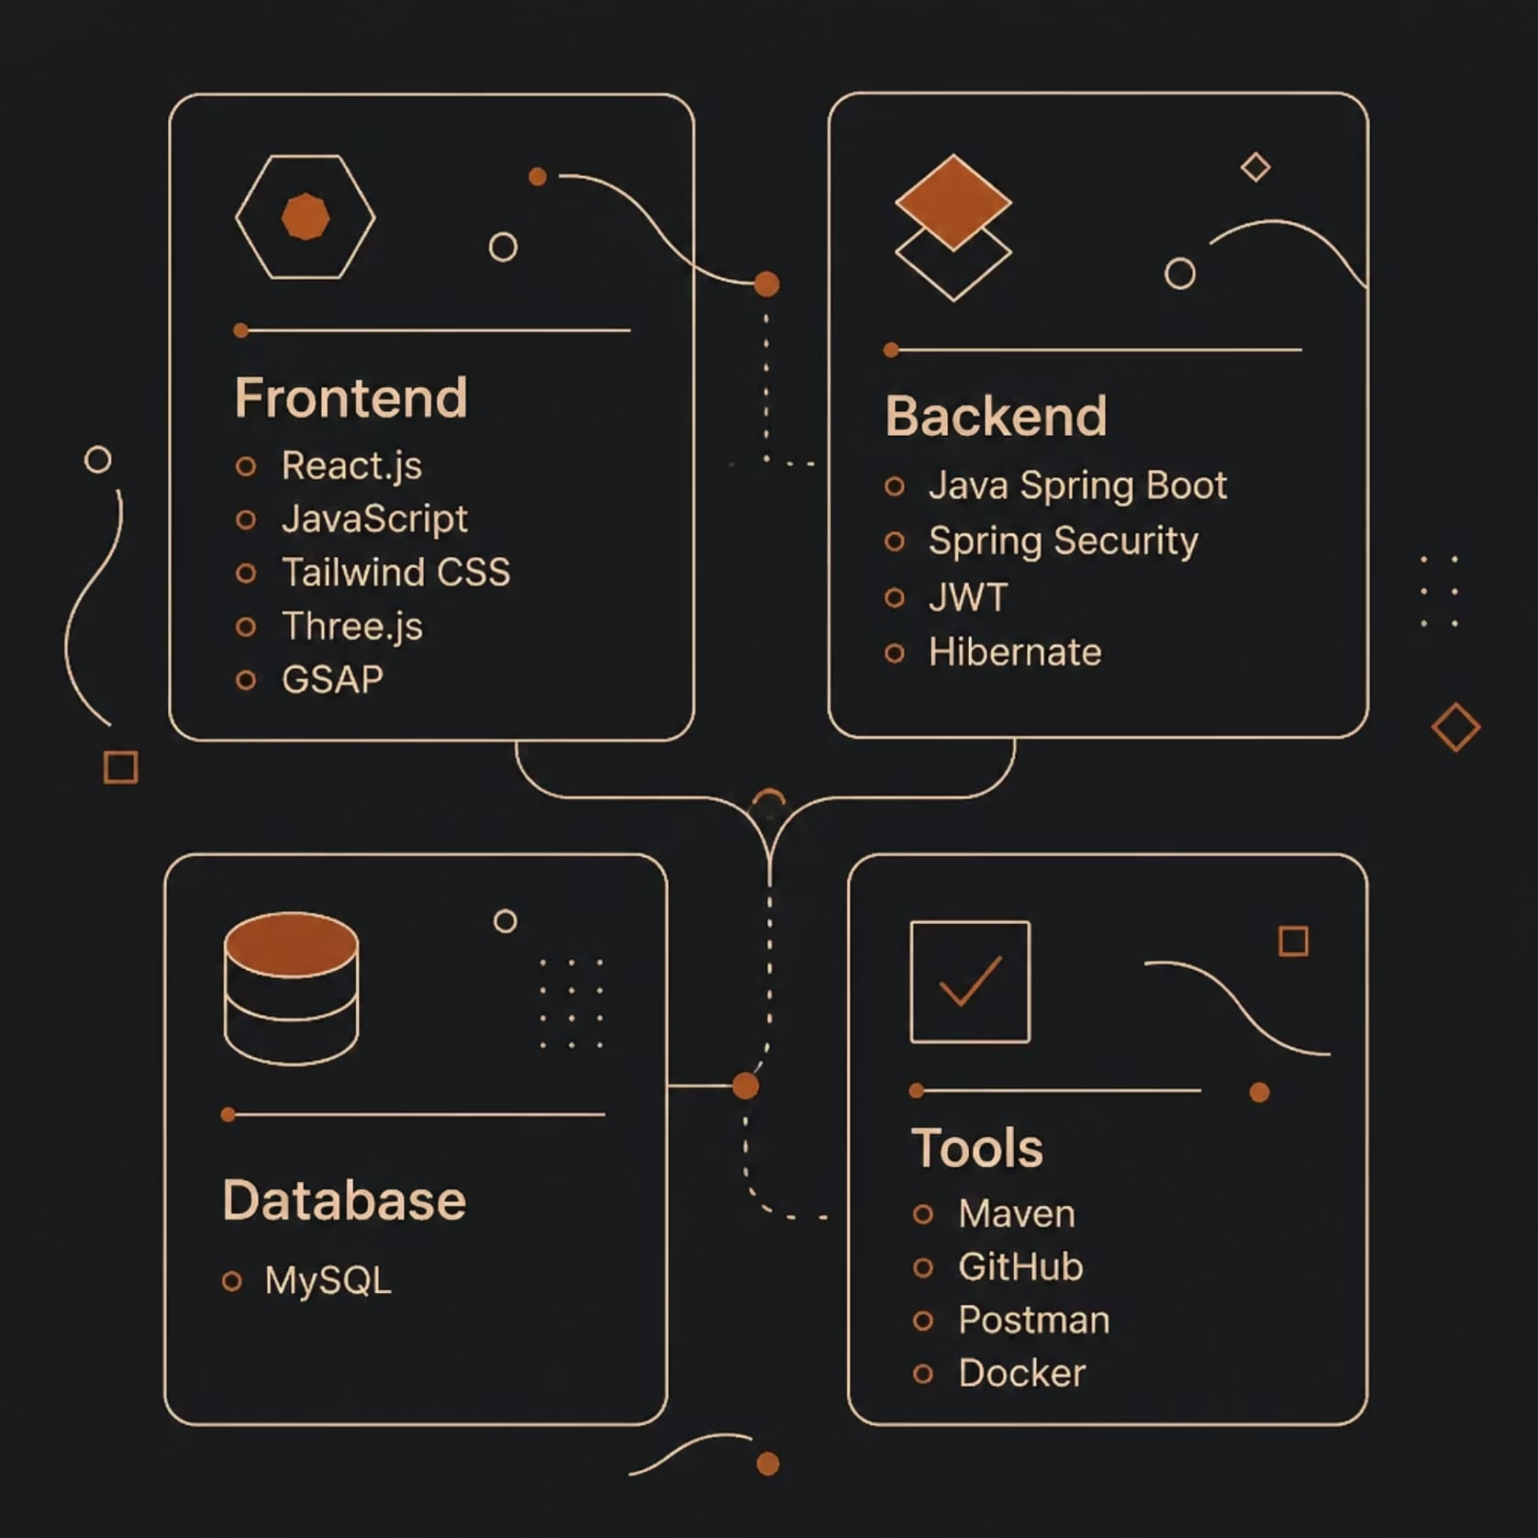

Technology Stack
Built using a scalable REST API architecture with secure authentication and a fully responsive UI — designed for performance and growth.
Frontend
Backend
React.js · JavaScript · Tailwind CSS · Three.js · GSAP
Java Spring Boot · Spring Security · JWT · Hibernate
Database
Dev Tools
MySQL — relational, scalable data storage
Maven · GitHub · Postman · Docker

Slide 7
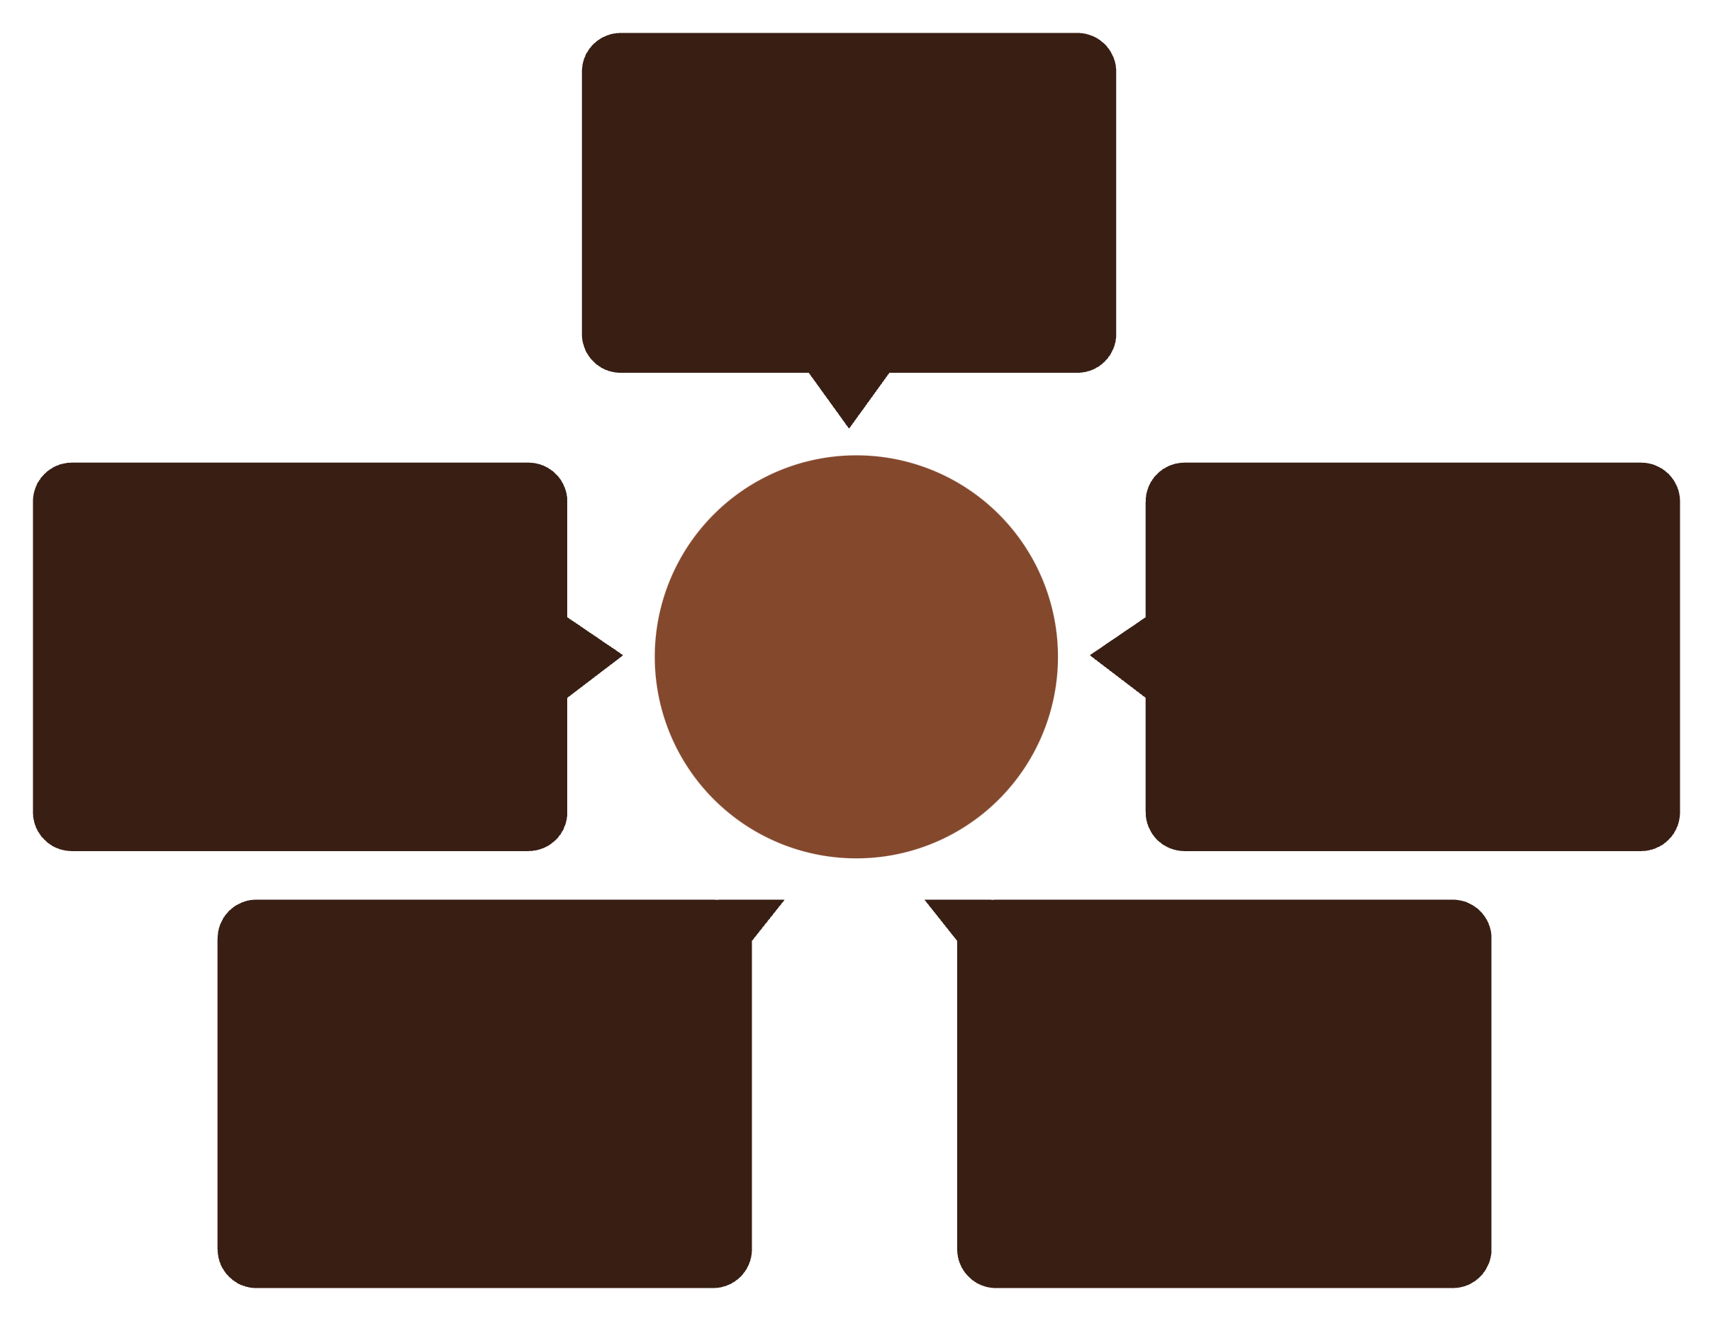
System Architecture
A clean, layered architecture ensures separation of concerns, security, and scalability — from the user interface down to the database.
Users
Students, Trainers, Admins
MySQL Database
Five-layer Architecture
React Frontend
Responsive UI
Data persistence
Spring Boot Backend
REST API
Secure endpoints
Business logic
Each layer communicates through well-defined REST APIs, enabling independent scaling and future feature additions without disrupting the core system.

Slide 8





Why SkillSphere?
Interactive Learning
Engaging lessons, quizzes, and assignments keep learners motivated.
Secure & Role-Based
JWT authentication with distinct access for every user type.
Real-Time Tracking
Live dashboards show progress, scores, and completion rates.
Scalable Architecture
REST API backend built to grow with institutional needs.
"One platform for students, trainers, and administrators."

Slide 9
Future Roadmap
SkillSphere is built to evolve. Here's what's on the horizon to make learning even more powerful and accessible.
Phase 1
1
Mobile Application · Live Virtual Classes
2
Phase 2
Discussion Forums · Gamification & Achievement Badges
Phase 3
3
Cloud Deployment · College ERP Integration
4
Phase 4
Attendance Management · Advanced Learning Analytics Dashboard

Slide 10
Benefits & Conclusion
Key Benefits
In Summary
Improved, interactive learning experience
Higher student engagement and retention
Efficient, centralized course management
Secure, role-based platform architecture
Faster evaluation and feedback cycles
Streamlined administration for institutions
SkillSphere transforms traditional education into a modern, interactive digital learning ecosystem — combining secure technology, an engaging user experience, and efficient academic management into one scalable platform.
Thank You
We welcome your questions and feedback.
QUESTIONS & ANSWERS

