Slide 1

Session Code: BSV308
Using .NET Profile and .NET Contacts Services
Tony East
Lead Program Manager
Microsoft Corporation

Slide 2


Slide 3

Key Takeaways
Understand .NET profile & .NET contacts services
Familiarize you with using the services in your applications
Understand the RoleList document
Feature Preview: Live Contacts

Slide 4













.NET My Services
.NET Inbox
.NET Profile
.NET Calendar
.NET Contacts
.NET Alerts
.NET
ApplicationSettings
.NET Music
.NET Presence
.NET Wallet
.NET Favorite
WebSites
.NET Documents

Slide 5
.NET Profile Intro
Primary store for personal information
  Business card/personal contact record
  Relatively static information
User controls access, gives consent
  Granular access
PUID based – one profile per user

Slide 6
Profile Properties
name, screenName
Address, email address, website
telephoneNumber
workInformation (company, jobTitle, coworkerOrDepartment, …)
picture
specialDate
identificationNumber

Slide 7
More Profile Nodes
languagePreference, timeZonePreference
userReference
  Name, PUID, email for storing relationship
  Categorize as assistant, spouse, etc.
securityCertificate
  Public Key Storage, not Private Key
  Cert Chain can be stored as well
{Any}
  Generally one per blue node
  Free form XML

Slide 8

Putting The User In Control
Profile Service
acme.com
Paul’s
Profile
Tony East
Work Address:
Microsoft Corporation
1 Microsoft Way
Redmond, WA 98052
Home Address
555 Maple
Seattle, WA 98022
Work phone: 425-936-8080
Cell Phone: 425-555-3131
Home phone: 425-555-1212
…
Tony East
Microsoft Corporation
1 Microsoft Way
Redmond, WA 98052
Rhae’s
Profile
Tony’s
Profile
Amy – Role~Friend
Tony East
Work Address:
Microsoft Corporation
1 Microsoft Way
Redmond, WA 98052
Home Address
555 Maple
Seattle, WA 98022
Work phone: 425-936-8080
Cell Phone: 425-555-3131
Home phone: 425-555-1212
…
xyz.com
Tony East
tonyeast@microsoft.com

Slide 9

Using .NET Profile
Ryan Parsell
Software Design Engineer
.NET Profile/Contacts
Microsoft Corporation

Slide 10
String Handling In .NET Services
Localization support in schema
<m:name>
…
  <m:givenName xml:lang=“EN-US" dir=“LTR">Tony</m:givenName>
  …
</m:name>
Web service uses instance of localizable string class

Slide 11
What Just Happened?
Development perspective
  Added web reference to profile service
  Create instance of the service locater
  Query service locater for appropriate profile service
  Execute query method of service to retrieve data
  Traverse profile object model for localizable string
User perspective
  User granted consent
  Form automatically filled

Slide 12
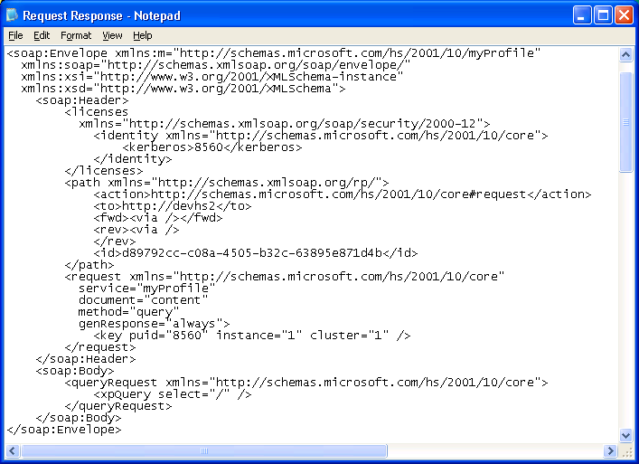
.NET Profile Data - Query

Slide 13
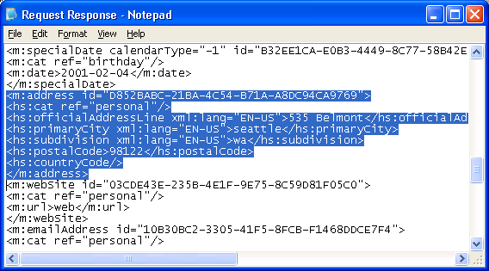
Request Response

Slide 14
Sample Document Fragment
<m:telephoneNumber >
<hs:cat ref=“system#work”/>
<hs:countryCode>1</hs:countryCode> <hs:nationalCode>425</hs:nationalCode>
<hs:number>936-8080</hs:number> <hs:numberExtension>54321</hs:numberExtension>
<hs:pin/>
{any}
</m:telephoneNumber>

Slide 15
.NET My Services
.NET Inbox
.NET Profile
.NET Calendar
.NET Contacts
.NET Alerts
.NET
ApplicationSettings
.NET Music
.NET Presence
.NET Wallet
.NET Favorite
WebSites
.NET Documents

Slide 16
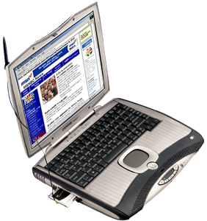

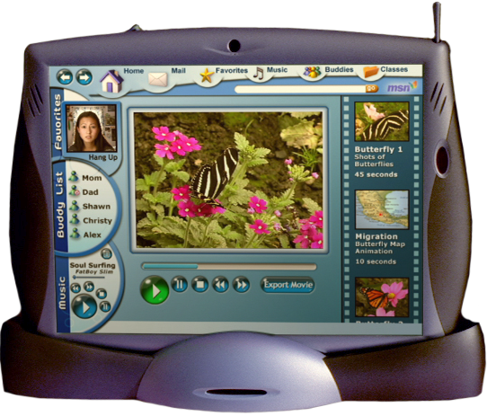

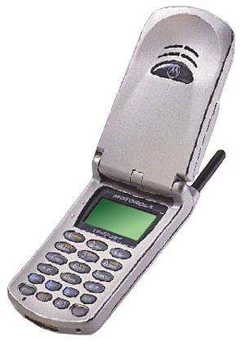
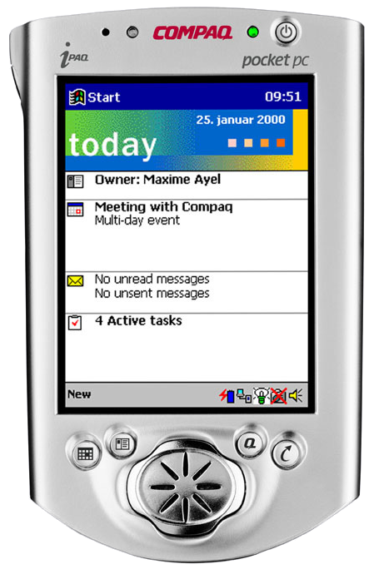
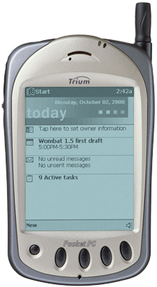
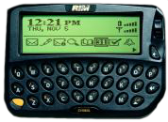
Today’s Contacts
.NET Contacts
.NET My Services
SOAP
Contacts

Slide 17
.NET Contacts Intro
Single place for users to store contact and relationship information for people, businesses and groups
Contacts and contact groups stored together single XML doc
    <myContacts>
    <contact/>
    <contactGroup/>
    …
    </myContacts>
User can grant access to others
  Users & apps
  Controlled by roles

Slide 18
Inside .NET Contacts
Cousin of profile
  More “red” nodes
    givenName, surname, fileAsName, email, phone number
User controls access to contacts list
  Uses roles
  By category per contact
Collections of contacts
  Categories at <contact> level
    <hs:cat ref=“copyToCellPhone”/>

Slide 19
Using .Net Contacts
Ryan Parsell
Software Design Engineer
.NET Profile/Contacts
Microsoft Corporation

Slide 20
Service Benefits
User benefit
  Single master
  Contact list roams everywhere
  Can be accessed & managed by others
Developer benefit
  Improved user experience
    “Ship to”
  Perfect for applications that need:
    Individual/family/group address book

Slide 21
Putting The User In Control
Profile Service
acme.com
Paul’s
Profile
Tony East
Microsoft Corporation
1 Microsoft Way
Redmond, WA 98052
Rhae’s
Profile
Tony’s
Profile
Amy – Role~Friend
Tony East
Work Address:
Microsoft Corporation
1 Microsoft Way
Redmond, WA 98052
Home Address
555 Maple
Seattle, WA 98022
Work phone: 425-936-8080
Cell Phone: 425-555-3131
Home phone: 425-555-1212
…
xyz.com
Tony East
tonyeast@microsoft.com

Slide 22
The roleList Document
Role Templates
  How – available methods
Scope
  What – nodes
Role List
  Who – assigning role & scope combinations

Slide 23
RoleTemplate
Contains list of methods
  Standard & domain specific
Example:
  <roleTemplate name=“rt0” …>
  <method name=“query”… />
  <method name=“insert”/>
  <method name=“replace”/>
  <method name=“delete”/>
  <method name=“update”/>
  </roleTemplate>
rt1 = query

Slide 24
Scope
<scope id=“1">
<shape base=“t“/>
</scope>
<scope id=“2">
<shape base="nil">
<include select="/*[cat/@ref=“system#work"]/>
</shape>
</scope>
<scope id=“3">
<shape base="nil">
<include select="/*[cat/@ref=“system#public"]/>
</shape>
</scope>

Slide 25
roleList
User assigns role
<roleList
<role roleTemplateRef=“rt0”>
<subject userID=“puid-of:Amy”/>
</role>
<role scopeRef=“2” roleTemplateRef=“rt1”>
<subject userID=“appID-of:acme.com”/>
</role>
<role scopeRef=“3” roleTemplateRef=“rt1”>
<subject userID=“appID-of:xyz.com”/>
</role>
</roleList>
More on Role Templates in XMI/Security

Slide 26
Expedia
Simon Tam
Development Manager
Expedia

Slide 27
Preview: Live Contacts
Profile updated
Subscription Negotiated
Subscribers updated
Tony’s Profile
Ryan’s Contacts
555-1212
Rhae
456-9876
456-9876
Bill
Tony
(read only)
555-1212
Ryan’s Device Updated

Slide 28
Live Contacts
Allow users & apps to subscribe to Profile
Changes to Profile are published to subscribers
LiveContact is cached copy
  <m:contact synchronize=“yes“>
Contact Becomes Read Only
  Exceptions: Notes, FileAs, Categories
Profile owner in control
  Publisher manages subscription list
  Publisher controls fidelity through roles
  Standard Role Templates Apply

Slide 29
LiveContacts
Tony East
Lead Program Manager
.NET Profile/Contacts

Slide 30
Benefits Everyone
User perspective
  Transforms Profile from “single store” into “single source”
  Changes transmitted to users & apps
Developer perspective
  Application subscriptions
  Never lose touch with your customers
    (unless they want you to!)

Slide 31
Summary
Improved user experience
  User controls use of data
  User’s data roams
Easy to integrate
.NET My Services allow you to focus on your specialty

Slide 32
Call to Action
Implement .NET passport
Implement .NET alerts
Standardize on kerberos v5
Install the .NET my services SDK
Experiment – integrate into a copy of your current application or service
Write the next killer application
or service!

Slide 33
Q & A

Slide 34
Resources
XMI manual in the .NET My Services SDK
.NET My Services Community beta site
  http://www.betaplace.com
.NET information on MSDN
  http://msdn.microsoft.com/net/

Slide 35

© 2001 Microsoft Corporation. All rights reserved.

