Slide 1

BSV315:
.NET My Services Fabric
Shaun Pierce
Architect
Microsoft Corporation

Slide 2


Slide 3
All Services Are Data Driven
Fundamental concept is these services
represent ‘state’ for a given userId - exposed as
an XML document
Document centric services coupled with common verbs and navigational semantics across services builds the core of this platform asset
  Navigation and selection ­ XPath, XQuery, etc.
  Verbs ­ query, insert, update, delete, replace
This data centric design allows ISVs to manipulate the data, without waiting for service authors to add new methods to get at it
  Departure from traditional client runtime code requirements of getting data

Slide 4
All Services Are
Identity Centric
The XML document a service exposes is merely a view of the user’s data centered around an identity
  Content document exposes it
Each service should have highly partitioned data for an identity
  If the data isn’t identity centric, its not a good candidate for
  a My Services service
Access to a user’s data is decided by the owner
of the data
  Rolelist document controls it
Service specific data global to all users is publicized
  System document exposes it

Slide 5
How Services Get Created
Since services are data driven, they can be described declaratively through schema
The schema for a service declares:
  All elements and attributes
    Ordering
    Minimum and Maximum elements can occur
  Verbs used to access the document
    Methods such as query, update, delete, etc.
  Security of data
    Roles define who can call what methods and what data fidelity
    is allowed for input/output
  Service specific data
    What categories are used at this service
    What transports are supported
    What navigation primitives are supported
Service authors start by creating a schema,
and strive to expose all user’s state within
the document

Slide 6
Schema Drives
The Service Fabric
Once schema is created, it is compiled into an intermediate form
  Similar analogy to compile source -> object files
This form is consumed by service fabric setup utilities to transform logical definition to physical reality
  Similar analogy to link object -> exe phase
  Plugable storage providers actually build the physical layout
    Store could be SQL, in memory, Active Directory, etc.
Service fabric interpreter runs service in accordance with schema
  All requests type checked per schema restrictions

Slide 7
Where’s The Code?
Where exactly did code get written for these services?
In some cases, never…
  For simple services that have no business logic, the fabric interpreter does it all
    myFavoriteWebSites, myLists, myCategories, myDevices, myProfile, myApplicationSettings…
  For more complex services, code still needs to be written for business logic
    myContacts, myAlerts, myInbox, myCalendar

Slide 8
Interesting…But Does
It Affect Me?
Service authors not writing code is interesting, but how does it affect customers and partners?
The service fabric used by all services offers many platform advantages:
  Platform asset is achieved as all services deal with requests and responses the same
  Auditing the privacy and practices of these services is constrained to one thing
  Allows us to fix problems once for higher reliability of service

Slide 9
Communicating With
.NET My Services
All messages are carried via SOAP
  Using SOAP-RP, which has routing info in
  SOAP header
Two transports currently supported
  HTTP, DIME (others via gateway)
Need a license to send messages
  Must be authenticated user and application
We’re not a web page
  Can’t use browser to talk to
  services directly

Slide 10
Authentication
.NET Passport provides the authentication
  Will authenticate userId, applicationId
  Using Kerberos as authentication scheme
  Relives each service from dealing with authentication issues
Every SOAP message must supply the
identity information
  Using SOAP-SEC initiative to describe identity headers and digital signature
Every SOAP message body is encrypted
  Usage of Kerberos session key with encryption algorithm to ensure data is safe
Tickets can be long lived
  Don’t have to hit Passport (authenticator) for every request

Slide 11
Service Directory
Microsoft® .NET My Services .NET Services service serves as directory for all .NET My Services services
For a given identity, each service is listed along with relevant information
  Service location, service specific routing and partitioning information, annotations
Second tier .NET Services supported
  If service doesn’t know answer, it can vector you to a .NET Services that should

Slide 12
Message Flow
Direct
User/app
auth
.NET Passport
Application
lives here
Service
ticket
.NET Services
Device
(PC, PDA, Phone)
Where is
service?
.NET Inbox
Can begin
communicating
directly with
service
.NET Calendar
.NET Lists

Slide 13
Message Flow
Through Web application
Service
ticket
.NET Passport
Initial
logon to
web app
User/app
auth
.NET Services
Web browser
Application
on Web page
Where is
service?
.NET Inbox
GET
request
.NET Calendar
Response
to GET
Can begin
communicating
directly with
service
.NET Lists

Slide 14
my*Service Physical Layout
Load
balancer
Service
fabric
FrontEnd
Data stores
Service
fabric
FrontEnd
Data stores
Service
fabric
FrontEnd
Data stores
Service
fabric
FrontEnd
Subscription
cluster

Slide 15
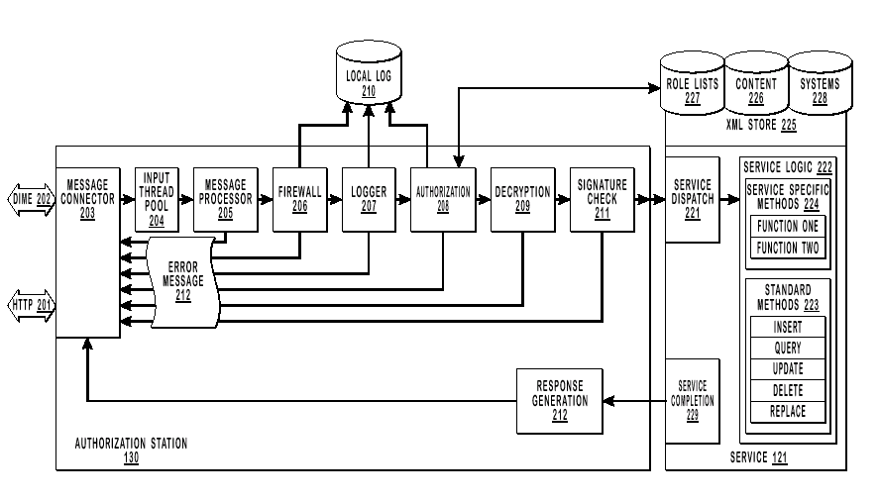
Service Fabric Pipeline

Slide 16
Service Fabric Pipeline
Software pipeline sees all requests
Each stage of the pipeline deals with different facets
of processing a request
Upon initial reception of a request, a memory context is constructed that follows the request through
the pipeline
Each layer in the pipeline validates portions of the request, and adds more info to the context for the
next layer of the pipeline
Extensible configuration to add/remove more layers
in service fabric pipeline
Layers called in reverse order when completing
a request

Slide 17
Early Pipeline Stages
Connector layer talks to transports
  HTTP, DIME transport connectors in use
  Accepts message in full, will throttle reqs
  Sends the responses on completion
Message processor layer cracks XML
  Parse SOAP message to in memory struct
  Only SOAP header parsed at this point
  XML parser is paused and can be restarted by subsequent layers
  Determine what document is being accessed
    Content, roleList, system
  Determine what method is being requested
    Query, update, delete, insert, replace, etc.

Slide 18
Operations Pipeline Stages
Firewall used to block requests
  Every application calling these services must have a license
  Firewall is configurable by operations to turn around any requests from any license should problems occur
Logger used to log portions of requests
  Operations can use logger to record portions of a request
    Billing, problem apps, legal, service problems
    Logger can’t see user data (still encrypted)

Slide 19
Authorization Pipeline Stage
Authorization stage validates tickets
  Using its service key, it can decrypt the identity header exposing:
    Session key obtained during initial user/app auth
    UserId, applicationId, platformId
  Given the session key, it can decrypt the SOAP Body (encrypted by the client application)
Armed with this information, this layer consults (or previously consulted) the roleList document
  Determines if userId/appId can access the data of the targeted userId, and if so with what fidelity
  Scans roleList for a matching subject

Slide 20
RoleList Document
Scopes define shape of data
  Using include/exclude selection criterion
  t means all nodes, nil means empty node set
RoleTemplates as a starting point
  Define what methods can be called
  Can reference scopes to create a base shape
RoleList contains roles
  Can define more scopes
  Roles contain subjects
    Subjects are identities, credentials, appId
    Roles reference scopes and templates to define what methods are callable and the shape of the returned data
Usage of creator
  Standard attribute that knows userId, appId, platformId
  Handy in further subsetting what users can see

Slide 21
Last Pipeline Stages
Mostly a validation layer
Signature check the SOAP message
  Using the SOAP-SEC initiative for signing and checking digital signatures
Throttling of requests
  Code in place to ensure we are not consumed by applications gone awry
Ensuring message size not too big
  DoS attacks
  Communicates with Ops and firewall

Slide 22
Service Processing
If request makes it through all portions of the pipeline without error, the fabric is ready to hand request off to service specific code
  Final check done here to see what document this request is after; if roleList or system ­ we satisfy the request right there
If request is for content document, call the method in question in the service code
  If the method is a standard one (query, update, delete, etc.) and the service code doesn’t want to intercept, the service fabric handles it
  Service specific code can intercept every method call
  Service specific code can add custom methods that are germane to the service. (i.e.; sendInvite, sendMeeting, etc.)
Typical flow of execution on methods that the service handles any preprocessing then calls to the XDB library for parsing and consistency

Slide 23
XDB
Library used by all services
  Does validation of incoming XML
  Parses XPath expressions
  Creates an execution plan
  Hands off to storage engine
  Post process results (apply reshapers)
  Generate textual representation of XML
Storage engine
  SQL, In memory, Active Directory, etc.
  If SQL:
    It can generate SQL code from execution plan
    Execute it on SQL Server
    Get data from SQL and create XMLDOM struct

Slide 24
XDB
XPath semantics
  Subset of w3c XPath
    Supporting major functionality including:
      Axises: child::, descendant::, attribute::
      Constructs: .., |, ., //, *, predicates
      Functions: starts-with, string, date-time, time
      Support many xsd types
  Reshapers
    Sorting, ranging, pruning, other shaping
    We apply intersection of system, roleList, and anything you supplied in the query

Slide 25
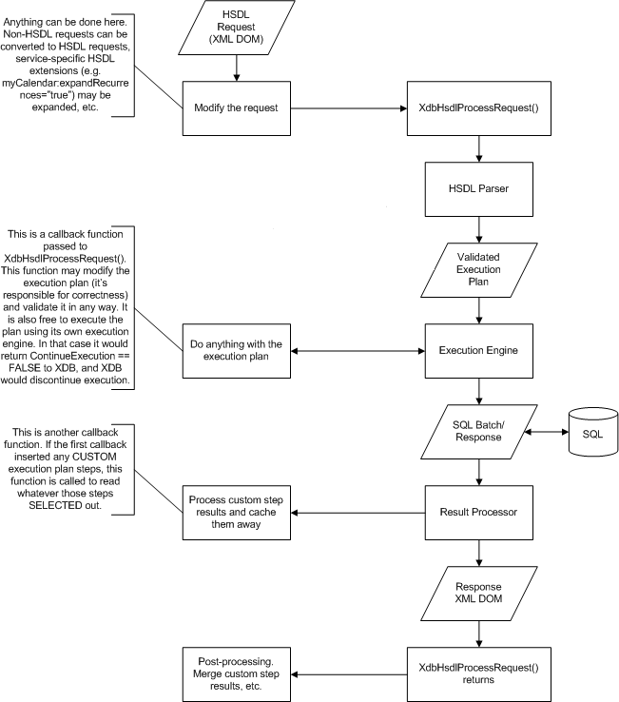
Service/XDB Execution Flow

Slide 26
Execution Plan
Six types of steps:
  SELECT.A ­ select absolute (from the root)
  SELECT.R ­ select relative to a previous SELECT.A
  QUERY ­ retrieve data from the selected location; the shape of the data is supplied ­ doesn’t have to be the entire subtree, and calculations, SORT, and DISTINCT are allowed
  INSERT ­ insert data at the selected location
  DELETE ­ delete data from the selected location
  REPLACE ­ combines DELETE
  and INSERT efficiently

Slide 27
Execution Plan Structure
/postalCode
SELECT.A
/myAddress
/address
PRED
>
98000
SELECT.R
SELF
/primaryCity
SELF
PRED
=
‘Redmond’
INSERT
@xml:lang=’EN-us’
SELECT.R
SELF
DELETE
/subdivision
/xml:lang

Slide 28
Sending Responses
Upon completion of request, the service signals the pipeline and the context is ran thru the layers in reverse order
Responses can be piggy backed on the original request, only sent on faults, or sent asynchronously to address
If there are errors in processing a request, there is a textual fault chain to narrow down where the error is and in what stage of processing it occurred at
Using last chain of the via statement to determine where to send response to

Slide 29
System Document
SystemVersion details version info for this service
Description of roleMap
  Base shapes documented for service
  All roleTemplates are defined
MethodMap
  Definitive list of all methods
SchemaMap
  Where is schema located
WsdlMap
  Where are disco, wsdl, wisl files located
Category definitions
  Additional category definitions for this service

Slide 30
Subscriptions
Subscriptions allow applications to subscribe to a identities content document and be informed when changes occur (only at architected locations)
Subscriptions are nothing more than annotations to content document
When data changes, a subscription notification
is sent
Dedicated cluster of machines use time-date information to determine when fields have changed
We can send these notifications only to
pre-registered URLs
  This polices the validity of the URL
Target address must be directly addressable on the Internet, else use myAlerts

Slide 31
Questions?
mailto:hsfeedbk@microsoft.com

Slide 32
Call To Action
Action
Resource
Read the .NET My Services XMI manual
On your CD at \sdk\docs\NETMyServices.chm
Learn .NET on MSDN
http://msdn.microsoft.com/net
Check out the .NET My Services community beta site
http://www.betaplace.com
  ID: netmyservices
  Password: nmsrocks
Implement .NET Passport today
www.passport.com/devinfo

Slide 33


© 2001 Microsoft Corporation. All rights reserved.

