Slide 1
Introduction chemical modelling with ORCHESTRA, Part III 27 November 2024
Hans Meeussen

Slide 2
Introduction chemical modelling with ORCHESTRA, Part III Hans Meeussen NRG/TU Delft, 27/11/2024
On the menu today:
Very short general intro ORCHESTRA
Show implementation of basic PHREEQC equilibrium and reaction example
Show implementation of basic PHREEQC 1d transport and ion exchange example
ORCHESTRA “phases” by example
Time for questions

Slide 3
Introduce myself
Hans Meeussen
Research scientist at NRG (Nuclear Research and consultancy Group) Petten
Part time associate professor TU Delft, department of Civil Engineering
Education
MSc, PhD Wageningen, Soil chemistry / Software engineering
Research interests
Modelling reactive transport processes
Radionuclide migration in rock, soil and concrete
Model development
Involvement in chemical model development started in Wageningen University ca. 1990 (ECOSAT).
(group Willem van Riemsdijk, developing new adsorption models CD-MUSIC, NICA Donnan, LCD etc.)
ORCHESTRA development started ca. 1994, Macaulay (now Hutton) institute Aberdeen, UK.

Slide 4
Introduction chemical modelling with ORCHESTRA, Part III Hans Meeussen NRG/TU Delft, 27/11/2024
Part 1:
Short general introduction ORCHESTRA
Show implementation of basic PHREEQC example
Description and model file folder can be downloaded from:
www.meeussen.nl/orchestra/getstarted_phreeqc1.pdf
www.meeussen.nl/orchestra/getstarted_phreeqc1.zip
Define chemical systems with GUI
Selecting primary entities/ master species, (in comparison with PHREEQC/ECOSAT, GWB)
Selecting/unselecting reactions from database
Creating charge balanced systems
Equilibrium with solid phases
Saturation indices
Equilibrium with gases
Titrating a system with a range of compositions
Define input
Define output
Compare with PHREEQC results

Slide 5
Introduction chemical modelling with ORCHESTRA, Part III Hans Meeussen NRG/TU Delft, 27/11/2024
Part 2:
Show implementation of basic PHREEQC transport and ion exchange example
Description and model file folder can be downloaded from:
www.meeussen.nl/orchestra/getstarted_phreeqc11.pdf
www.meeussen.nl/orchestra/getstarted_phreeqc11.zip
Define chemical system with GUI (is similar to first example)
Define transport system (not with GUI, but in text)
Define set of cells/nodes
Define tasks that operate on cells (e.g. equilibrium)
Define tasks that operate on cell connections (advection/dispersion)
Define input/output tasks
Define graphical user output
Define input
Define output (which variables, when)
Compare with PHREEQC results

Slide 6
ORCHESTRA, what is similar to other codes…
Can solve chemical equilibrium systems
Can calculate transport
Same application area as PHREEQC, ECOSAT, GEMS, MINTEQ, REAKTORO, GWB ..
Can read PHREEQC thermodynamic database files
Define chemical system interactively
ORCHESTRA, what is different to other codes…

Slide 7
Comparison of standard code structure with ORCHESTRA structure
Chemical system definition
(Substances, reactions …)
Standard code structure
ORCHESTRA structure
Data points
(total concentrations)
Executable code
(Contains chemical model definitions)
Model library
(Contains chemical model definitions)
Executable code
Output data points
(concentrations of individual species etc)
: text
: executable code

Slide 8
Comparison of standard solver structure with ORCHESTRA solver structure
Standard code structure
(e.g. PHREEQC, GEMS, GWB, Visual Minteq, HYTEC, ECOSAT …….)
Chemical model definitions inside executable
ORCHESTRA code structure
Chemical model definitions in external text file(s)
Specific model code (C⁺⁺)
(fixed set of model definitions)
Model object library
(user definable chemical model definitions
variables, expressions, equations)
Generic solver (Java)
(variables, expressions)
: text
Same functionality
: source code

Slide 9
Comparison of standard solver structure with ORCHESTRA solver structure
Standard code structure
(e.g. PHREEQC, GEMS, GWB, Visual Minteq, HYTEC, ECOSAT …….)
Chemical model definitions inside executable
ORCHESTRA code structure
Chemical model definitions in external text file(s)
ORCHESTRA solver can use data (numbers) but also code (variables, expressions, equations) as input!
Databases can contain code as well as parameters
Specific model code (C⁺⁺)
(fixed set of model definitions)
Model object library
(user definable chemical model definitions
variables, expressions, equations)
Generic solver (Java)
(variables, expressions)
: text
Same functionality
: source code

Slide 10
ORCHESTRA: all chemical “knowledge” present in input text file(s)
Model object library text file
contains definitions of e.g.:
Reaction
Master species
Aqueous species
Activity correction models (Davies, Debye Hueckel, SIT etc.)
Solid Phase
Gas Phase
Solid solutions
Ion exchange Vanselow Gaines Thomas, etc..
Surface complexation models (Basic stern, Dzombak and Morel, CD Music, Bradbury Bayens……)
NICA – Donnan distributed log K model
……….
All ORCHESTRA “chemical knowledge” is concentrated here.
www.meeussen.nl/orchestra/objects2024.txt
Advantages:
Users can change/add models without the need to change the solver source code
Solver executable is very small and simple
Model object library
(user definable chemical model definitions
variables, expressions, equations)
Generic solver (Java)
(variables, expressions)
: text
: source code

Slide 11
The structure of ORCHESTRA allows to update the solver independently of the chemical model library (and vice versa)
Model object library (objects2024.txt)
(user definable chemical model definitions
variables, expressions, equations)
Generic solver (Java)
(variables, expressions)
Generic solver (C++)
(variables, expressions)
Generic solver (GPU)
(variables, expressions)
Generic solver
(Native C++ / Rust)
ORCHESTRA solver structure allows:
To change chemical models without changing executable (useful for chemical model development)
To change executable without changing chemical models (useful for developing C⁺⁺ version,
but also useful for possible future developments)

Slide 12
ORCHESTRA structure advantages
Adsorption (and other) models can be added by users without changing source code
Modular: parts can be independently exchanged for newer versions (e.g. C++ and Java version of solver available)
Solver code is very flexible, small, and fast (important for coupling with transport codes and parallel processing)
Coupling with external codes (transport/python) is simple
All chemical models are automatically consistent with transport coupling
Well-suited for developing models that are partly “standard geochemistry” combined with specific physical/biological/kinetic models. (especially in case of feed-back between physical and chemical part)

Slide 13
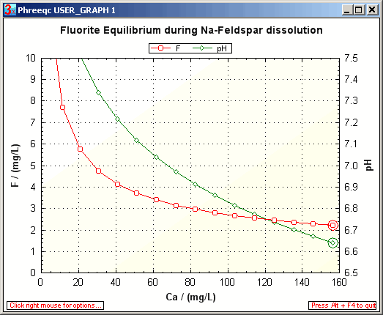
PHREEQC example 1

Slide 14
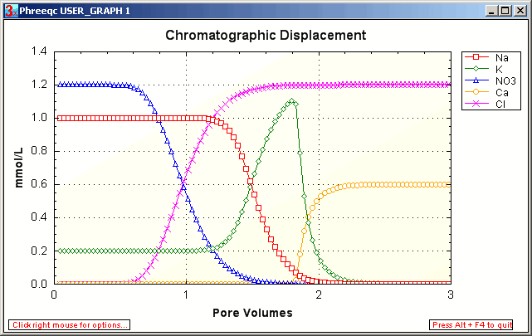
PHREEQC example 2

Slide 15
ORCHESTRA Phases
tot (mol)
Phases represent USER DEFINABLE system compartments with local mass balances for primary entities (e.g. tot, diss, liter, ads)
Phases are connected hierarchically via conversion factors
Parent phases contain sum of mass of all child phases
Example:
Ca.tot will contain total Ca in system in all forms Ca.liter x watervolume
Ca.liter will contain total Ca in mol/l
Ca.solid will contain sum of all solid Ca in mol/l
Ca.ads will contain sum of all adsorbed Ca mol/l
Ca.Site1 will contain all adsorbed Ca to site 1 (fraction)
The phases enable hierarchical mass balances
are useful for output, but also for communication with external codes and for creating adsorption models.
watervolume(l)
liter (mol/l)
1
1
solution (mol/l)
solid (mol/l)
1
1
1
1
aqueous (mol/l)
colloid(mol/l)
ads(mol/l)
min(mol/l)
1
kg/l
diss (mol/l)
particle(mol/kg)
m2/kg
surface(mol/m2)
mol/m2
mol/m2
site1(fraction)
site2(fraction)

Slide 16
ORCHESTRA Phases
tot (mol)
Phases represent USER DEFINABLE system compartments with local mass balances for primary entities (e.g. tot, diss, liter, ads)
Phases are connected hierarchically via conversion factors
Parent phases contain sum of mass of all child phases
Example:
Ca.tot will contain total Ca in system in all forms Ca.liter x watervolume
Ca.liter will contain total Ca in mol/l
Ca.solid will contain sum of all solid Ca in mol/l
Ca.ads will contain sum of all adsorbed Ca mol/l
Ca.Site1 will contain all adsorbed Ca to site 1 (fraction)
The phases enable hierarchical mass balances
are useful for output, but also for communication with external codes and for creating adsorption models.
watervolume(l)
liter (mol/l)
1
1
solution (mol/l)
solid (mol/l)
1
1
1
1
aqueous (mol/l)
colloid(mol/l)
ads(mol/l)
min(mol/l)
1
kg/l
diss (mol/l)
particle(mol/kg)
kg/kg
m2/kg
surface(mol/kg)
surface(mol/m2)
mol/kg
mol/m2
mol/m2
site1(fraction)
site1(fraction)
site2(fraction)

Slide 17
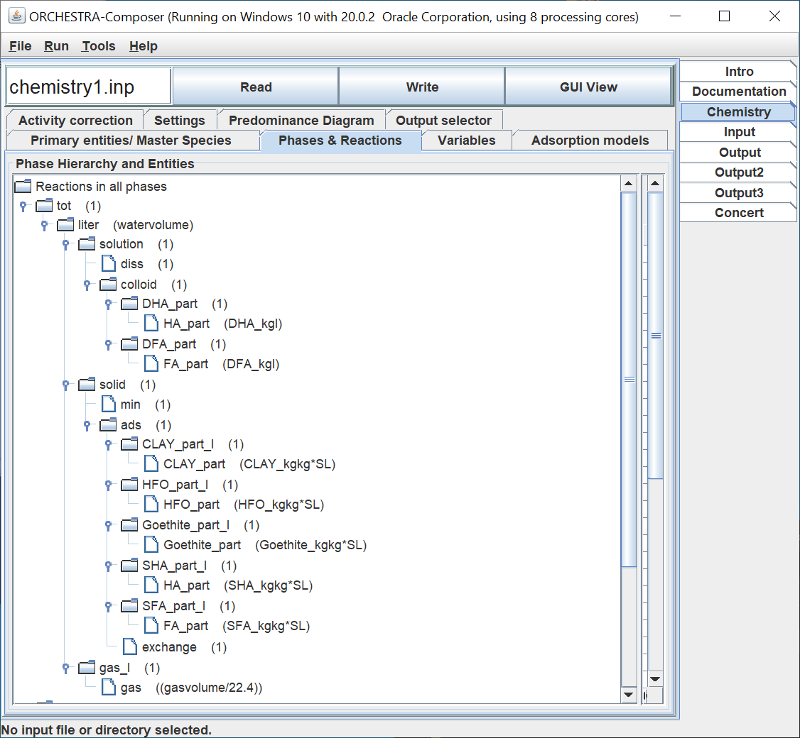
ORCHESTRA Phases
Phases represent system compartments with local mass balances for primary entities (e.g. tot, diss, liter, ads)
Phases are connected hierarchically via conversion factors
Parent phases contain sum of mass of all child phases
Example:
Ca.tot will contain total Ca in system in all forms Ca.liter x watervolume
Ca.liter will contain total Ca in mol/l
Ca.solid will contain sum of all solid Ca in mol/l
Ca.ads will contain sum of all adsorbed Ca mol/l
Ca.Site1 will contain all adsorbed Ca to site 1 (fraction)
The phases enable hierarchical mass balances
are useful for output, but also for communication with external codes and for creating adsorption models.

Slide 18
ORCHESTRA Phases
Phases are user definable
@phase(tot)
@phase(kg)
@phase(liter)
@link_phase(liter, tot, "watervolume")
@link_phase(liter, kg, "1/SL")
@phase(solution)
@link_phase(solution, liter, "1")
@phase(diss)
@link_phase(diss, solution, "1")
@phase(colloid)
@link_phase(colloid, solution, "1")
@phase(DHA_part)
@link_phase(DHA_part, colloid, "1")
@phase(DFA_part)
@link_phase(DFA_part, colloid, "1")
@phase(solid)
@link_phase(solid, liter, "1")

Slide 19
ORCHESTRA Phases
The phases enable hierarchical mass balances
Useful for
Input/Output
For communication with external (transport) codes
For creating adsorption models

Slide 20
Recap of today:
ORCHESTRA, what’s different (compared to ECOSAT, PHREEQC etc.)
PHREEQC equilibrium and reaction example
PHREEQC ion exchange and transport example
How to work with ORCHESTRA “phases”, “entities”, “reactions”

Slide 21
Thank you for your participation!
Presentation will be sent to participants
Next course: to be decided
Possible topics:
Kinetics
Coupling with Python
Other based on you feed-back
Please send comments / suggestions/ feed-back to meeussen@nrg.eu

Slide 23
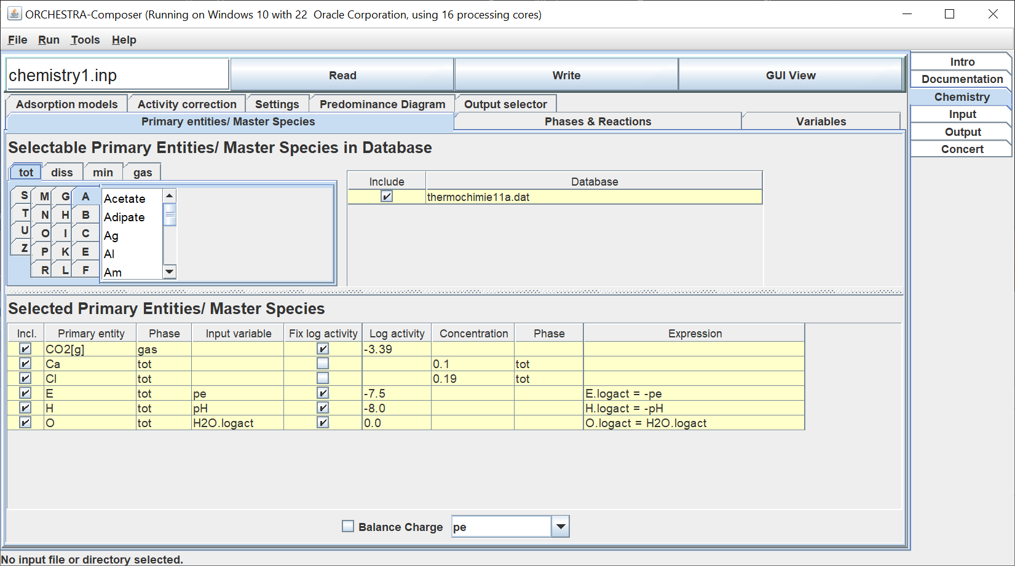
ORCHESTRA: Defining a chemical system with the GUI -creates/edits a text file (chemistry.inp) that contains the complete definition of the chemical system

Slide 24
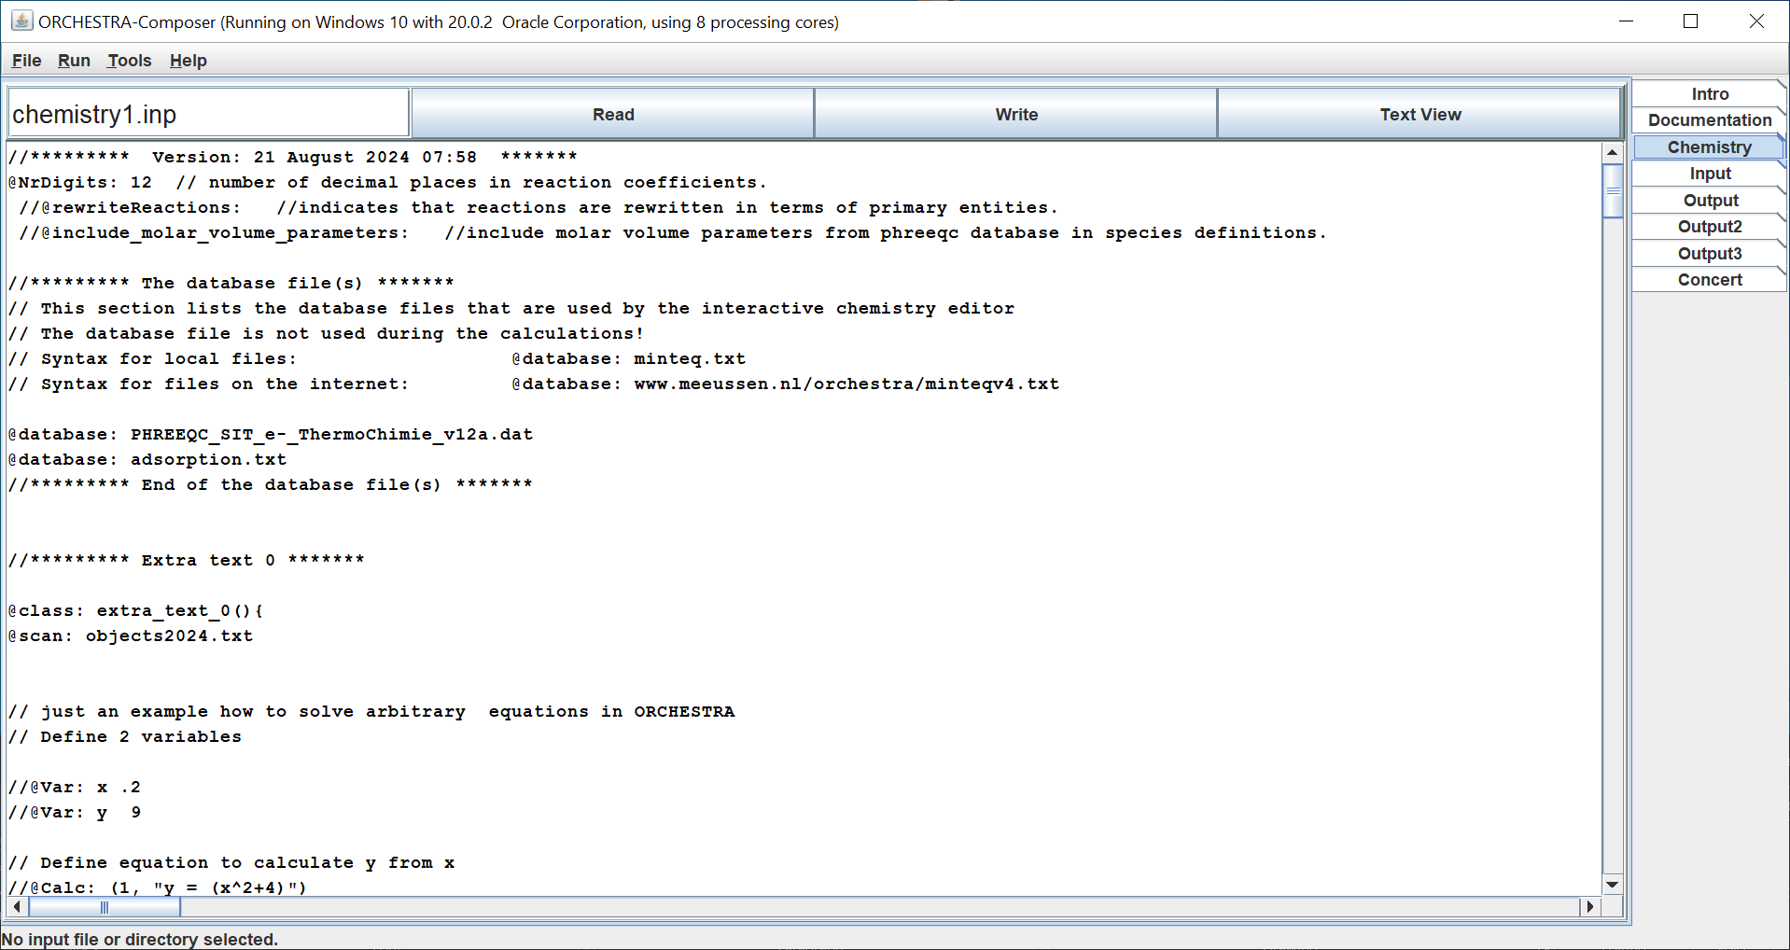
ORCHESTRA: Defining a chemical system with the GUI - creates/edits a text file (chemistry.inp) that contains the complete definition of the chemical system
Select database
Switch between graphical and text view
Thermodynamic database
(thermochimie11a.dat)
(Reactions, constants)
Defining
system
Select substances and reactions
from database
Chemical definition text file
(chemistry1.inp)
@scan: objects2024.txt
Model object library
(objects2024.txt)
(user definable chemical model definitions
variables, expressions, equations)
Running
system
Solver (Java)
(variables, expressions)
Solver (C++)
(variables, expressions)

Slide 25
ORCHESTRA: Defining a chemical system with the GUI - GUI uses thermodynamic database(s) for selection of substances/reactions - GUI creates/edits a text file (chemistry.inp) that contains the complete definition of a chemical system - chemistry.inp text file can also be edited in text mode: switch between GUI view/text View - chemistry.inp text file can be processed by the solver (Java or C++) - thermodynamic database not needed during calculations - input text file is simple computer program in ORCHESTRA language - input file contains variables, expression, equations - temperature dependent logk expressions - kinetic rate expressions

Slide 26
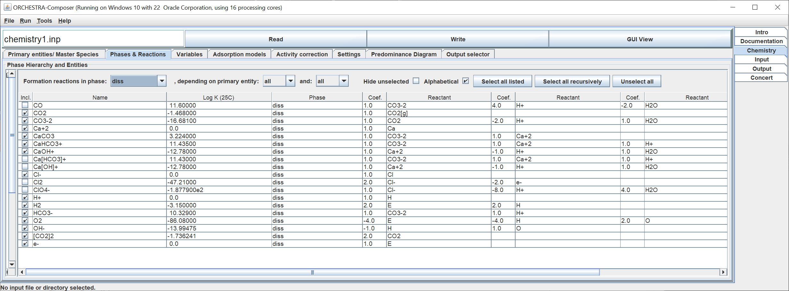
ORCHESTRA: Selection of reactions from database

Slide 27
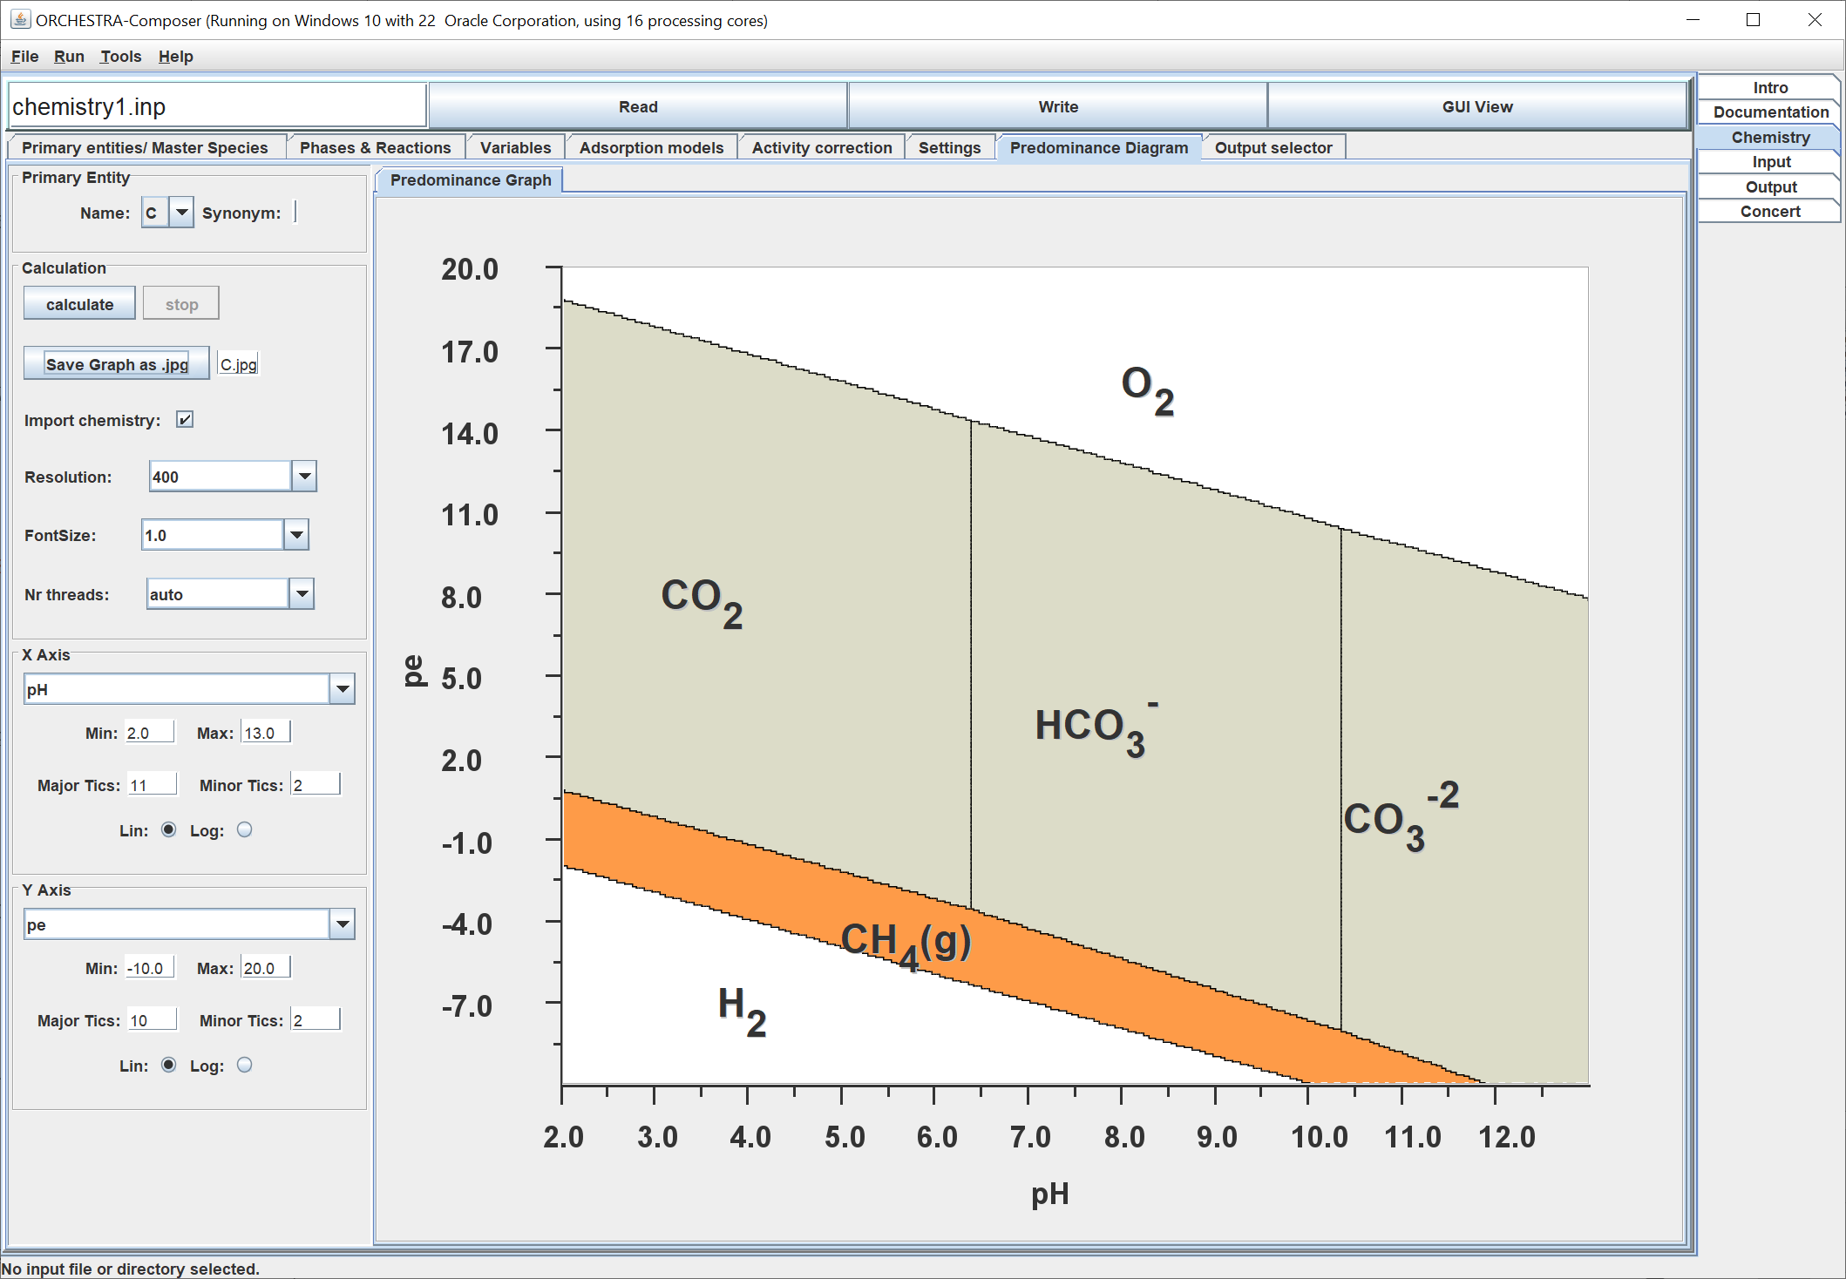
Stability/predominance diagrams
2 input variables (e.g. pH pe)
Calculate equilibrium at each location
Indicate predominant species/form(with highest concentration)

Slide 28
Defining a chemical system
Selection of primary entities
Only independent entities can be selected (automatically)
H, O, and H2O represent water (from PHREEQC database)
Additional components primary entities can be selected from database
Each primary entity -> fixed log activity or fixed total mass balance
Species can be selected
Reactions are defined hierarchically but can be rewritten in terms of primary entities
Activity correction
Charge balance
Predominance diagram

Slide 29
Format input files
User defined list of variables (column headers)
User defined set of datapoints (rows)
Can be pasted directly from Excel
Order columns not important
Values given in input overwrite default values in chemistry file
Var: pH pe Ca.tot . . . .
Data: 7 8.3 1e-3 . . . .
Data: 4 5.7 1.4e-2 . . . .
. . . .
. . . .
. . . .
Serial calculations using a loop / sweep
Sweep{ 21
Swept: pH 2 12 lin
Swept: pe 16 6 lin
}

Slide 30
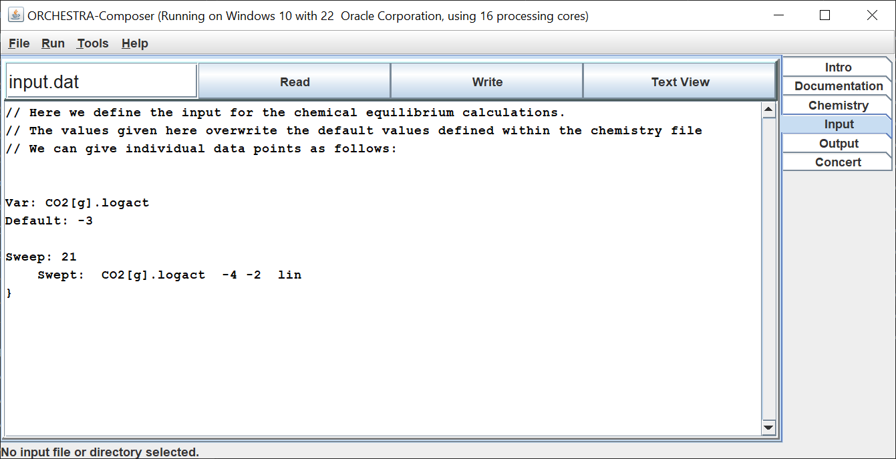
ORCHESTRA: Input text file

Slide 31
Format output files
Basic output
Var: pH pe Ca.tot . . . .
Similar to format input files
Output variables are defined in output file itself!!!!
First row column headers of output file defines output variables and their order
Output can be directly pasted into Excel to create graphs
This is very flexible, (any variable can be requested for output) but you need to know the names of the variables you want!
(consequence of modular orchestra structure: output module has no knowledge of chemistry)
Other options
PHREEQC type output (see demo)
GUI can help with selection of variables

Slide 32
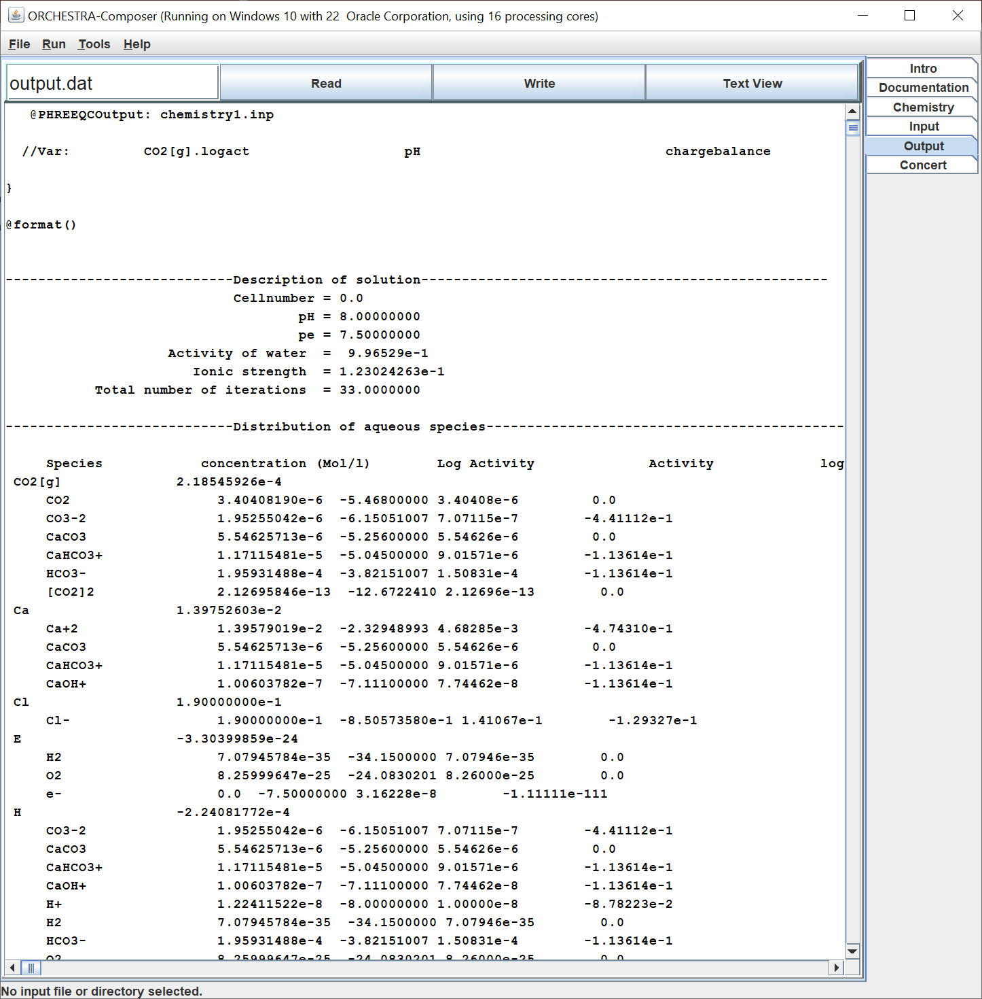
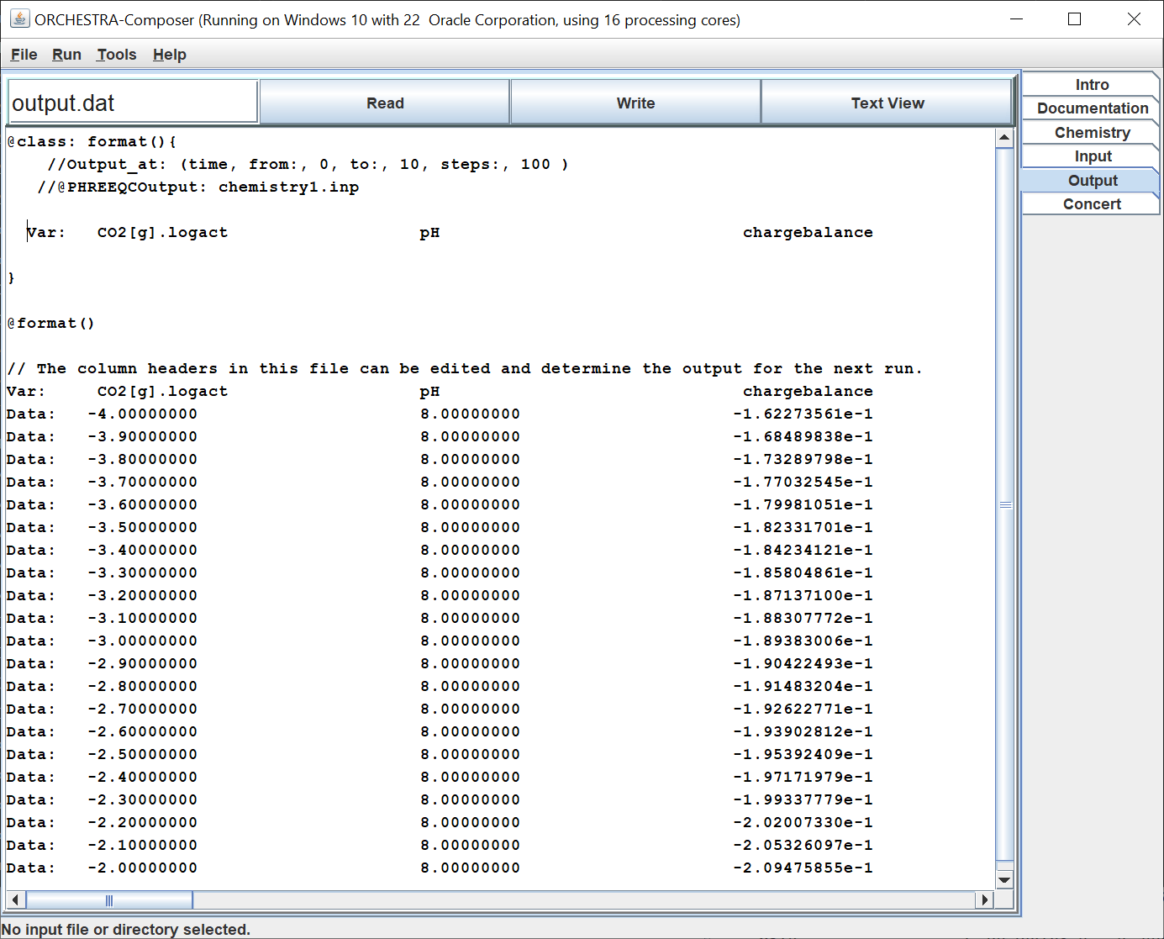
ORCHESTRA: output

Slide 33
Are there any questions about: - defining a chemical system or - defining input output format files?

Slide 34
Part II ORCHESTRA chemical model structure
ORCHESTRA chemical models are composed from a small set of basic building blocks or object classes
This “object oriented” approach:
Ensures consistency and compatibility between models
Makes model definitions very compact
Have a look in the objects2024.txt file (the chemical model library)
Phases
Entities
Reactions
Equations

Slide 35
Part II ORCHESTRA chemical model structure
Basic model building blocks
Equations To solve arbitrary unknown – equation combinations
Entities An abstract “species” with .con and .logact
Phases Hierarchical system compartments in which entities can be present
Reactions Reactions between entities to create new entities
Phases
Entities
Reactions
Equations

Slide 36
ORCHESTRA model building blocks: Entities
Entities are a kind of abstract chemical “species”
Each entity exists in a certain “phase” (with its own mass balance units)
Each entity has the variables: <name>.logact <name>.con
All entity types are automatically compatible with “reactions” and can be used as reactants.
Examples of entity types:
Entity type | represents | Present in phase | .logact | .con
@species | aqueous species | diss | Log activity | Concentration (mol/l)
@mineral | Precipitating mineral | min | Saturation index | Concentration (mol/l)
@gas | gas | gas | Partial pressure | Partial pressure
@surface_site | Surface site | <surface> | Empty fraction | Empty fraction
@surface_species | Adsorbed species | <site> | fraction | fraction
@e_layer | Electrostatic plane | <surface> | Boltzmann factor | 0
@entity(e-, diss, 0) | electron | diss | -pe | 0

Slide 37
ORCHESTRA Primary Entities
Primary entities are similar to master species (PHREEQC) or components (ECOSAT)
Primary entities can be elements e.g. Al (PHREEQC) but also aqueous ions e.g. Al+3 (ECOSAT)
In PHREEQC/ECOSAT primary entities are defined in thermodynamic database
In ORCHESTRA any independent entity can be made primary (The GUI will check independency)

Slide 38
ORCHESTRA model building blocks: Primary Entities
Primary entities have a .logact and .con variable, but they additionally have a mass balance variable for each system phase
For example when Al is selected as primary entity:
Al.diss contains the sum of al Al forms in the diss phase (e.g. sum of Al+3, Al[OH]2+ Al[OH]+ etc.)
Al.tot contains the sum of al Al forms in the tot phase
For example when Al+3 is selected as primary entity:
Al+3.diss contains the sum of al Al+3 forms in the diss phase (e.g. sum of Al+3, Al[OH]2+ Al[OH]+ etc.)
Al+3.tot contains the sum of al Al+3 forms in the tot phase
To calculate the system for each primary entity we need as input a given .logact, or given cumulative mass balance in a certain system phase.
When a primary entity is selected, the GUI shows all possible dependent entities that can be formed and selected from the set of primary entities.

Slide 39
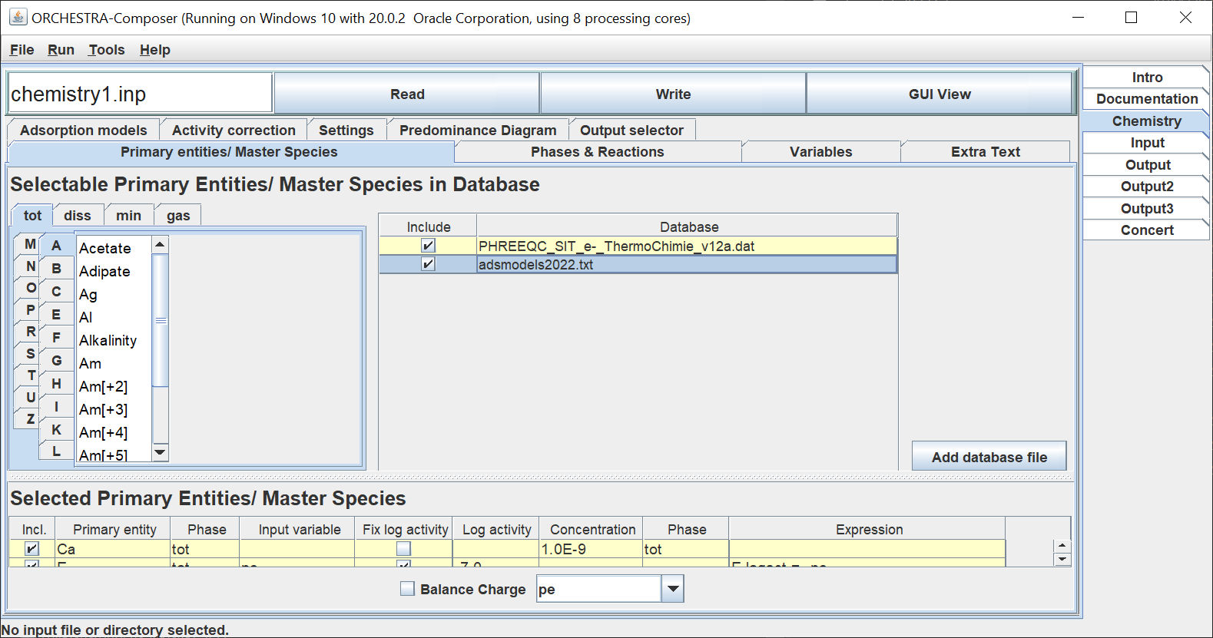
ORCHESTRA adsorption models, how to use them
- Include the file “adsorption_2022.txt” as database in the chemistry file

Slide 40
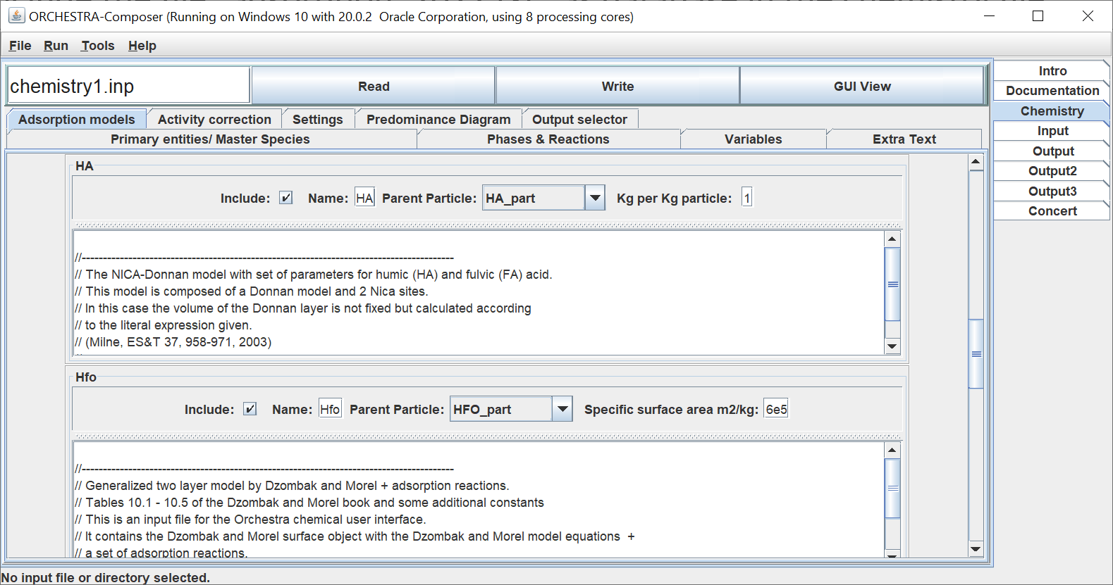
ORCHESTRA adsorption models, how to use them
- Select and connect to appropriate particle

