Slide 1
Tomasz Heimowski
IHS Global
tomek.heimowski@gmail.com
@theimowski

Slide 2
Digit Recognizer Dojo
A Gentle Introduction to Machine Learning

Slide 3
The Goal
Take a Kaggle data science competition
Write some code and have fun
Write a classifier, from scratch, using F#
Learn some Machine Learning concepts

Slide 4
The format
Brief introduction to the problem
You code in teams, I help out

Slide 5
Kaggle Digit Recognizer contest
http://www.kaggle.com/c/digit-recognizer
Dataset of hand-written digits
Goal = automatically recognize digits
Training sample = 50,000 examples
Contest = predict 20,000 “unknown” digits

Slide 6
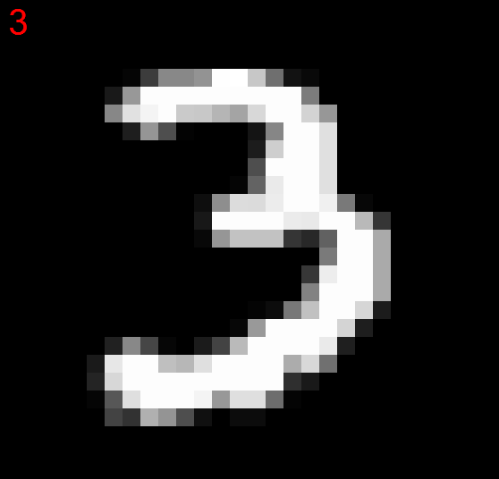
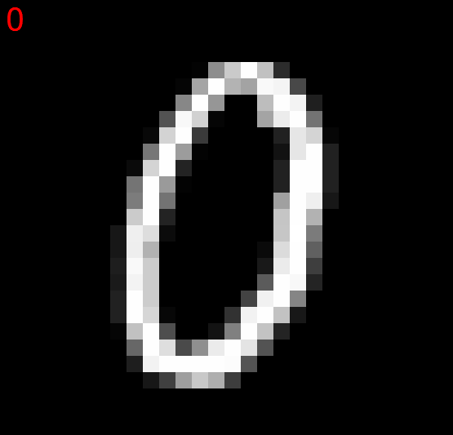
The data “looks like that”

Slide 7
Real sample
28 x 28 pixels
Grayscale (0 = black, to 255 = white)
Flattened: each record = Number + 784 pixels
CSV file
Reduced dataset: 5,000 training, 500 validation

Slide 8
Illustration (simplified 4x4 data)
1,0,0,255,0,0,255,255,0,0,0,255,0,0,0,255,0
Actual number
Each pixel, encoded from 0 to 255

Slide 9
What’s a classifier?
“Give me an unknown data point and I will predict what class it belongs to”
In this case, classes = 0, 1, 2, … 9
Unknown data point = scanned digit, without the class it belongs to

Slide 10
The KNN Classifier
KNN = K Nearest Neighbors
Given an unknown subject to classify,
Lookup all the known examples,
Find the K closest examples,
Take a majority vote,
Predict what the majority says

Slide 11
Illustration: 1-nearest neighbor
Sample
Unknown
0
?
1
Which element in the Sample
is the most similar / closest to
the Unknown item we want to
classify?

Slide 12
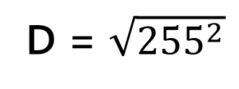
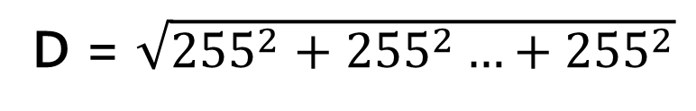
Illustration: 1-nearest neighbor (2)
D = $\sqrt{{255}^{2}+{255}^{2}…+{255}^{2}}$
D = $\sqrt{{255}^{2}}$
We compute the distance between
each element of the Sample, and
the Item we try to classify
Compare images,
pixel by pixel

Slide 13
Illustration: 1-nearest neighbor (3)
The second example is closest,
therefore we predict that the
unknown Item has the same label,
and is a 1
0
1

Slide 14
Questions?

Slide 15
Your mission
Code a 1-nearest-neighbor classifier
Guided script available at:
www.github.com/c4fsharp/Dojo-Digits-Recognizer

Slide 16
A few recommendations
www.github.com/c4fsharp/Dojo-Digits-Recognizer
No need to create new Library Project – just use .fsx
„Alt + Enter” – Execute selected code in interactive
Watch out for whitespaces
Try to avoid red squigglies
When in trouble - ask for help

