Slide 1
WELCOME TO CODE STUDIO

Slide 2
PostgreSQL

Slide 3
BASICS OF DATABASE
1

Slide 4
FUNDAMENTAL SQL COMMANDS
CREATE
INSERT
UPDATE
DELETE

Slide 5
DATA FILTERING
WHERE
ORDER BY
OR,AND,IN
BETWEEN,LIKE,NOT

Slide 6
GROUP BY COMMANDS
SUM,AVERAGE
MIN,MAX
COUNT
GROUP BY,HAVING BY

Slide 7
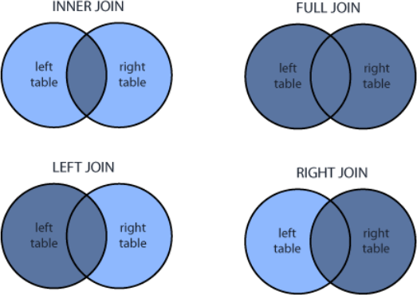
JOINS
INNER JOIN
OUTER JOIN
CROSS JOIN
FULL JOIN

Slide 8
ADNVANCE CONCEPTS
SUBQUERIES
VIEWS
INDEXES

Slide 9
STRING FUNCTIONS
UPPER , LOWET
REPLACE
SUBSTRING
CONCAT

Slide 10
OTHERS
MATHEMATICAL FUNCTIONS
PATTERN LEARNING
DATE AND TIME METHODS

Slide 11



Instagram
LinkedIn
Twitter
theindianinnovation
https://www.linkedin.com/in/praveen-rai-011098
thepraveenrai

Slide 12
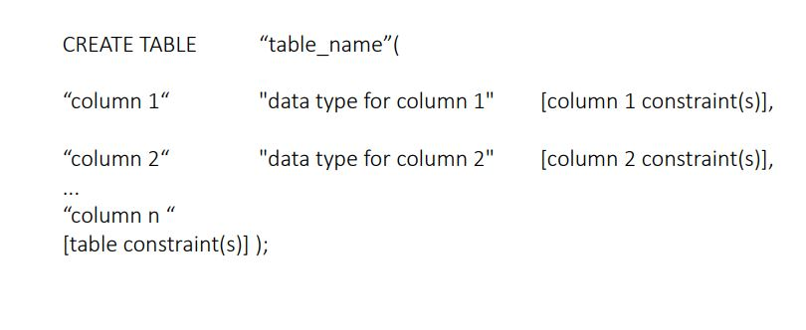
CREATE COMMAND

Slide 13
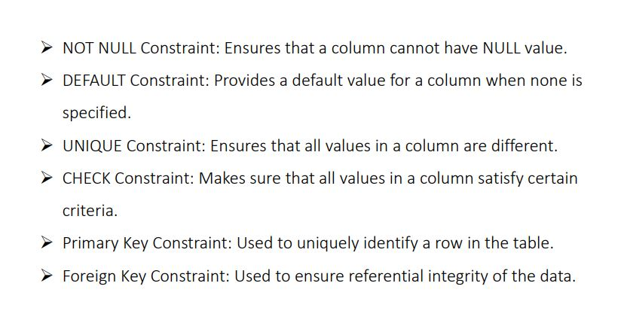
CONSTRAINTS

Slide 14
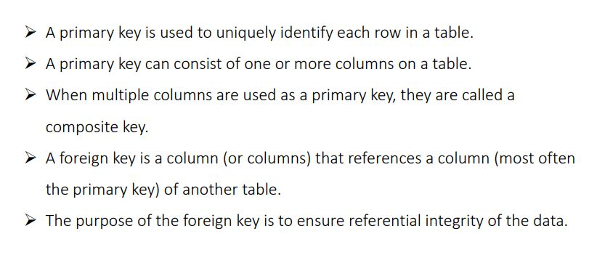
KEYS

Slide 15
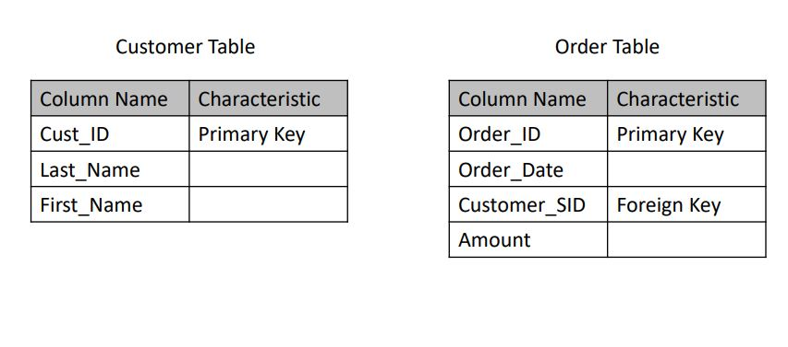
EXAMPLE

Slide 16
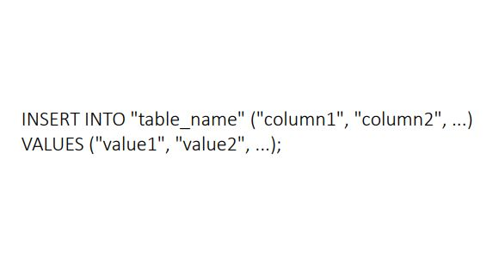
INSERT COMMAND

Slide 17
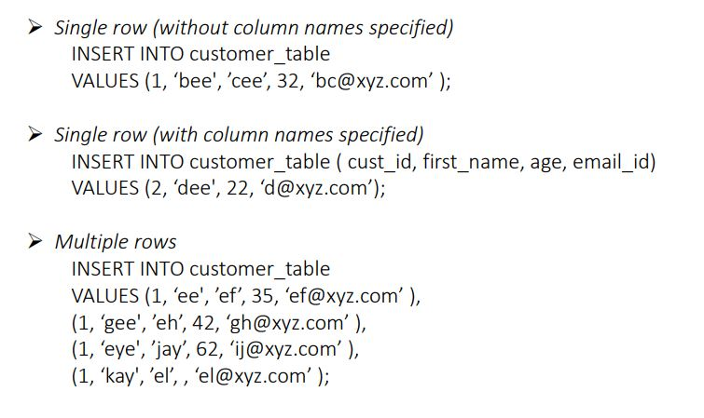
INSERT COMMAND

Slide 18
SELECT
The SELECT command is used to fetch the data from a database table which returns this data in the form of result tables.
These result tables are called result-sets.

Slide 19
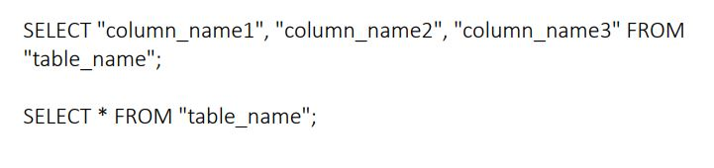
SELECT

Slide 20
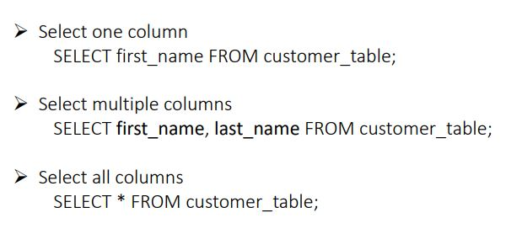
SELECT

Slide 21

SELECT DISTINCT
The DISTINCT keyword is used in conjunction with SELECT statement to eliminate all the duplicate records and fetching only unique records.

Slide 22
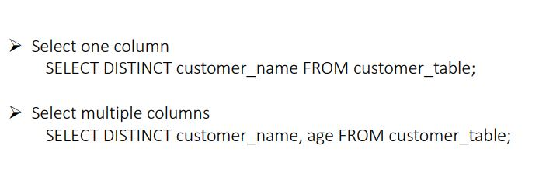
SELECT DISTINCT

Slide 23
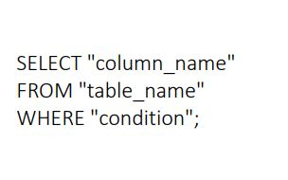
WHERE

Slide 24
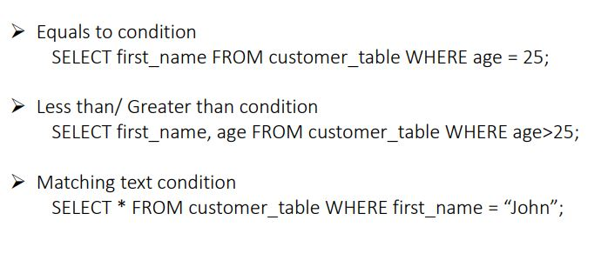
WHERE

Slide 25
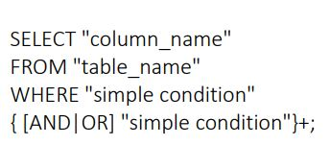
AND & OR

Slide 26
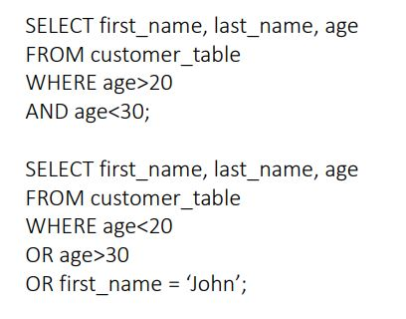
EXAMPLES

Slide 27
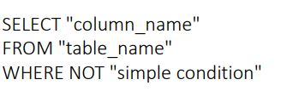
NOT

Slide 28
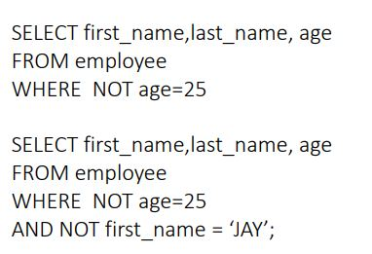
EXAMPLES

Slide 29
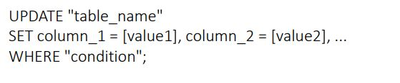
UPDATE

Slide 30
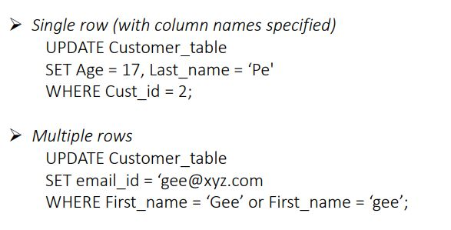
EXAMPLES

Slide 31
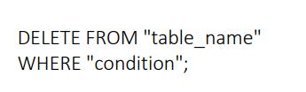
DELETE

Slide 32
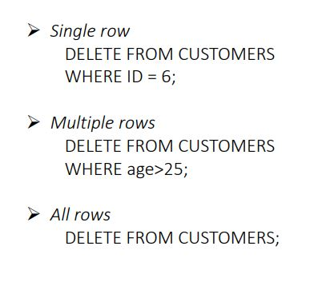
EXAMPLES

Slide 33
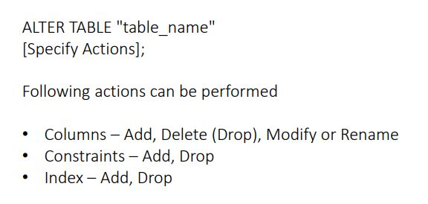
ALTER

Slide 34
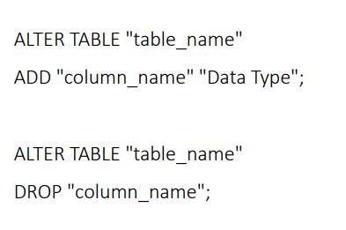
COLUMN : ADD/DROP

Slide 35
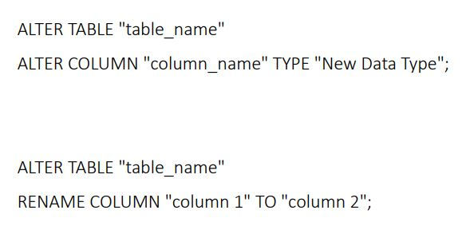
COLUMN : MODIFY/RENAME

Slide 36
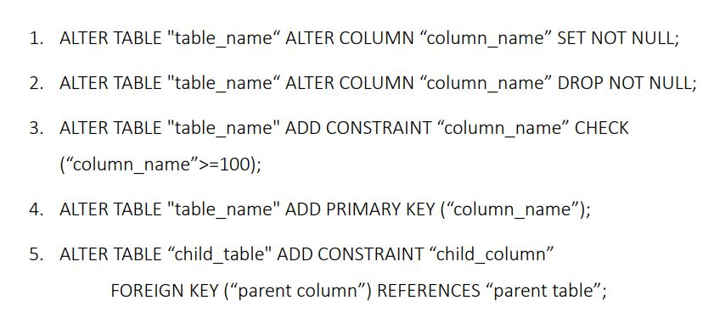
CONSTRAINT : ADD/DROP

