Slide 1

The Future of Freelance: Unlocking Skill Exchange Possibilities
Explore the evolving landscape of freelance work and the emerging possibilities for skill exchange.

Slide 2
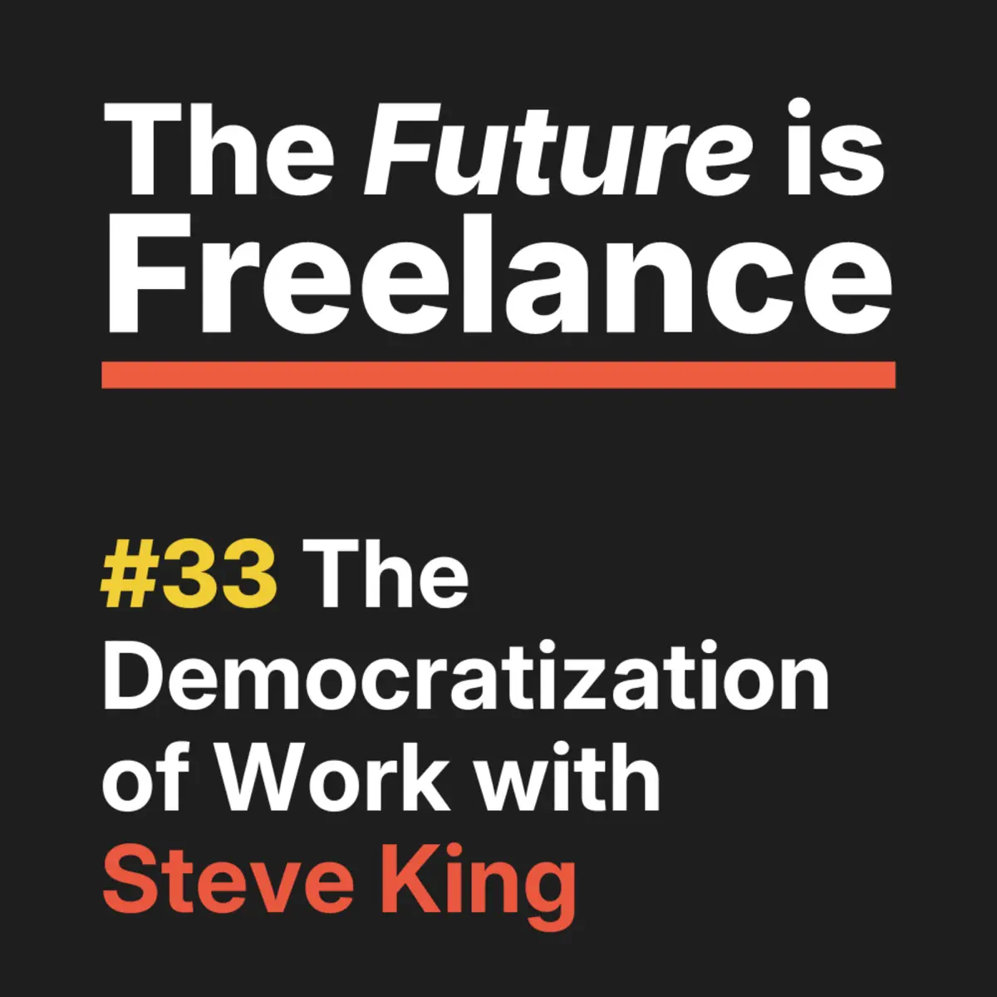
Welcome to the Future of Freelance
Introducing a revolutionary platform that empowers freelancers to exchange skills and collaborate like never before. This platform provides a seamless and efficient way for freelancers to connect, share their expertise, and work together on projects that drive innovation and push the boundaries of their respective fields.

Slide 3




The Freelance Landscape
THE RISE OF FREELANCING
REMOTE WORK OPPORTUNITIES
More individuals are opting for the flexibility and independence of freelance work, seeking to balance work-life integration.
The shift to remote work has expanded the freelance job market, allowing professionals to work from anywhere and access global opportunities.
SKILL-BASED COLLABORATION
Businesses are increasingly seeking specialized skills and expertise, leading to a growing demand for skill-based freelance collaborations.
DIVERSIFIED INCOME STREAMS
Freelancers can leverage multiple income streams, providing financial stability and the ability to experiment with different projects.
THE FREELANCE LANDSCAPE IS RAPIDLY EVOLVING, OFFERING INDIVIDUALS THE FREEDOM TO PURSUE THEIR PASSIONS AND BUSINESSES THE OPPORTUNITY TO ACCESS SPECIALIZED SKILLS ON-DEMAND. AS THE DEMAND FOR SKILL-BASED COLLABORATION CONTINUES TO GROW, THE FUTURE OF WORK IS BECOMING INCREASINGLY FLEXIBLE AND ADAPTABLE.

Slide 4



Introducing the Skill Exchange Platform
FREELANCER REGISTRATION
PROJECT BIDDING
SECURE PAYMENTS
FREELANCER RATINGS AND REVIEWS
FREELANCER SUPPORT AND RESOURCES
Provide a simple and intuitive process for freelancers to create their profiles, showcase their skills, and share their portfolios on the platform.
Enable freelancers to easily search for and bid on relevant projects, allowing them to showcase their expertise and competitiveness.
Implement a secure and transparent payment system that ensures timely and reliable transactions between clients and freelancers.
Allow clients to provide feedback and ratings on freelancers' work, helping other users make informed decisions when selecting talent.
Offer a range of support services and educational resources to help freelancers improve their skills, grow their businesses, and navigate the platform effectively.

Slide 5
Unlock Your Potential
SKILL DEVELOPMENT
NETWORKING OPPORTUNITIES
Access a vast library of online courses, tutorials, and workshops to upskill in your area of expertise or explore new domains.
Connect with a vibrant community of like-minded freelancers, entrepreneurs, and industry professionals to expand your network and discover new opportunities.
GOAL ACHIEVEMENT
FREELANCE MARKETPLACE
Set personalized goals, track your progress, and receive tailored recommendations to help you achieve your freelance ambitions.
Showcase your services, bid on projects, and build a successful freelance career by connecting with clients who value your unique skills and expertise.

Slide 6




Collaborative Success Stories
EMILY THOMPSON
SAMANTHA LEE
AMIR PATEL
SOPHIA GONZALEZ
Small Business Owner
Freelance Designer
Software Engineer
Marketing Consultant

Slide 7
The Power of Skill Exchange
Percentage increase in freelancer earnings from using the skill exchange platform
85%
81%
78%
72%
GRAPHIC DESIGN
WEB DEVELOPMENT
CONTENT WRITING
VIRTUAL ASSISTANCE

Slide 8







Streamlined Workflow
INTUITIVE INTERFACE MASTERY
PROJECT ORGANIZATION EFFICIENCY
COLLABORATIVE TASK MANAGEMENT
SEAMLESS DOCUMENT INTEGRATION

Slide 9
Join the Skill Exchange Revolution
DISCOVER UNIQUE SKILLS
Explore a diverse range of specialized skills from graphic design and web development to language tutoring and virtual assistance.
CONNECT WITH TALENTED INDIVIDUALS
Join a vibrant community of freelancers, each bringing their unique expertise to the table.
OFFER YOUR OWN EXPERTISE
Showcase your skills and experience, and connect with clients seeking your specialized services.
EARN FLEXIBLE INCOME
Set your own rates, work on your own schedule, and enjoy the freedom and flexibility of the freelance lifestyle.
BUILD YOUR PORTFOLIO
Collaborate on projects, gain valuable experience, and grow your professional reputation within the Skill Exchange community.

Slide 10


























