Slide 1
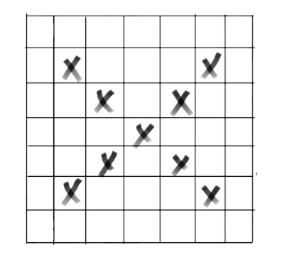
0 | 0 | 0 | 0 | 0 | 0 | 0
0 | 1 | 0 | 0 | 0 | 1 | 0
0 | 0 | 1 | 0 | 1 | 0 | 0
0 | 0 | 0 | 1 | 0 | 0 | 0
0 | 0 | 1 | 0 | 1 | 0 | 0
0 | 1 | 0 | 0 | 0 | 1 | 0
0 | 0 | 0 | 0 | 0 | 0 | 0
2 | 0 | 1 | 0 | 1
0 | 3 | 0 | 1 | 0
1 | 0 | 3 | 0 | 1
0 | 1 | 0 | 3 | 0
1 | 0 | 1 | 0 | 2
1 | 0 | 0
0 | 1 | 0
0 | 0 | 1
3 | 1 | 1
1 | 3 | 1
1 | 1 | 2
0.95 | 0.73 | 0.73
0.73 | 0.95 | 0.73
0.73 | 0.73 | 0.88

