Slide 1
Infrared (IR) Spectroscopy

Slide 2
Introduction
IR spectroscopy is the study of interaction between infrared radiations and matter.
IR radiations refers broadly to that part of electromagnetic spectrum between visible and microwave region.
The principle of IR spectroscopy is related to the vibrational and rotational energy of a molecule.
Absorption of IR radiation causes an excitation of molecule from a lower to the higher vibrational level.
Each vibrational level is associated with a number of closely placed rotational level.
Therefore the IR spectroscopy is also called as “vibrational-rotational spectroscopy”

Slide 3
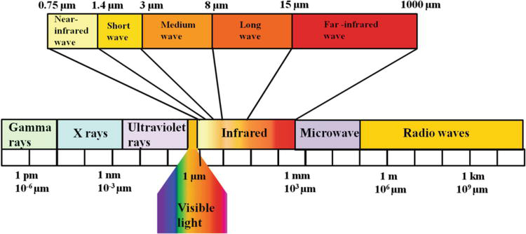

Slide 4
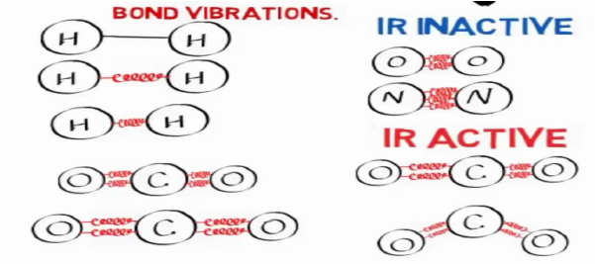
Criteria for a compound to be IR Active
All the bonds in a molecule are not capable of absorbing IR energy but those bonds which are accompanied by a change in dipole moment will absorb in the IR region and such transitions are called IR active transitions.
The transitions which are not accompanied by a change in dipole moment of the molecule are considered as IR inactive.
When the frequency of the IR radiation is equal to the natural frequency of vibration, the molecule absorb IR radiation.

Slide 5
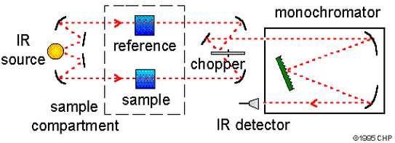
Instrumentation
Radiation Source
IR radiation is usually produced by electrically heating a Nernst filament (mainly composed of oxides of zirconium, thorium and cerium) or a globar (rod of silicon carbide) to 1000-1800°C.

Slide 6
The infrared radiation of successively increasing wavelength is used. The radiation from the source is divided into sample and reference beams of equal intensity by beam divider.
Sample and Reference Cells
Reference and sample beams pass through the reference cell and sample cell, respectively.
Alkali metal halide such as NaCl, NaBr, KCl and KBr are most commonly used as these are transparent to most of the IR region.
Attenuator and Comb (Photometer)
The reference beam passes through the attenuator and the sample beam through the comb.

Slide 7
Then the two beams can be alternately reflected out of the optical system and to the entrance slit of the monochromator with the help of several mirrors.
Thus, the photometer combines the reference and sample beams into a single beam of alternating segments. The comb allows balancing of the two beams.
Monochromator
The combined beam passes through the prism or grating of the monochromator which disperses the beam into various frequencies.
The prism or grating rotates slowly, it sends individual frequency bands to the detector, thus allowing a scan of frequency bands.

Slide 8
Gratings give better resolutions than prisms consist of a series of parallel and straight thin lines on a smooth reflecting surface
The spacing between lines is of the order of few angstrom (Ä) depending on the desired wavelength range.
Detector and Amplifier
The detector is a thermocouple which measures radiant energy by means of its heating effect that produces current.
Due to difference in the intensity of the two beams falling on the detector, an alternating current starts flowing from the detector to the amplifier where it is amplified and relayed to the recorder.

Slide 9
MOLECULAR VIBRATIONS
There are 2 types of vibrations
Stretching vibrations
Bending vibrations
1. Stretching vibrations
Vibration or oscillation along the line of bond
Change in bond length
Occurs at higher frequency: 4000-1250 cm⁻¹
2 types:
a) Symmetrical stretching
b) Asymmetrical stretching

Slide 10
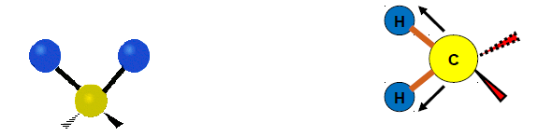
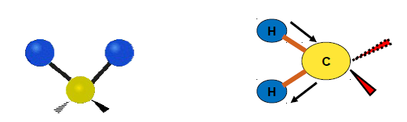
Symmetrical stretching. In this mode of vibration, the movement of atoms with respect to the common (or central) atom is simultaneously in the same direction along the same bond axis.
Asymmetrical Stretching. In this vibration, one atom approaches the common atom while the other departs from it.

Slide 11
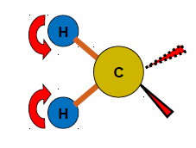
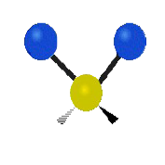
2. Bending Vibrations
In such vibrations, the positions of the atoms change with respect to their original bond axes.
Bending vibrations are of four types:
(a) Scissoring. In this mode of vibration, the movement of atoms is in the opposite direction with change in their bond axes as well as in the bond angle they form with the central atom.

Slide 12
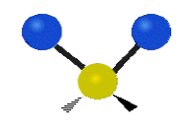
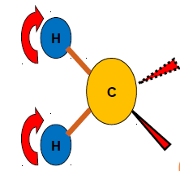
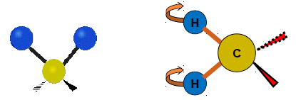
(b) Rocking: In this vibration, the movement of atoms takes place in the same direction with change in their bond axes .
Scissoring and rocking are in-plane bending's.
(c) Wagging: In this vibration, two atoms simultaneously move above and below the plane with respect to the common atom.

Slide 13
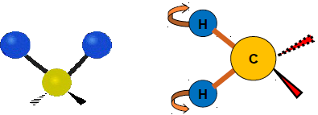
(d) Twisting: In this mode of vibration, one of the atom moves up and the other moves down the plane with respect to the common atom.
Number of Fundamental Vibrations
The IR spectra of polyatomic molecules may exhibit more than one vibrational absorption bands.
The number of these bands corresponds to the number of fundamental vibrations in the molecule which can be calculated from the degrees of freedom of the molecule.

Slide 14
The degrees of freedom of a molecule are equal to the total degrees of freedom of its individual atoms.
Each atom has three degrees of freedom corresponding to the three Cartesian Coordinates (x, y and z) necessary to describe its position relative to other atoms in the molecule.
A molecule having n atoms will have 3n degrees of freedom.
In case of a nonlinear molecule, three of the degrees of freedom describe rotation and three describe translation.
The remaining (3n - 3 - 3) = 3n - 6 degrees of freedom are its vibrational degrees of freedom or fundamental vibrations

Slide 15
In case of a linear molecule, only two degrees of freedom describe rotation and three describe translation.
Thus, the remaining (3n - 2 - 3) = 3n – 5 degrees of freedom are vibrational degrees of freedom or fundamental vibrations.
Vibrational degrees of freedom for CO₂
Number of atoms (n) = 3
Total degrees of freedom (3n) = 3 x 3 = 9
Rotational degrees of freedom = 2
Translational degrees of freedom = 3
Therefore, vibrational degrees of freedom = 9 - 2 - 3 = 4
CO₂ molecule have four theoretical fundamental bands

Slide 16
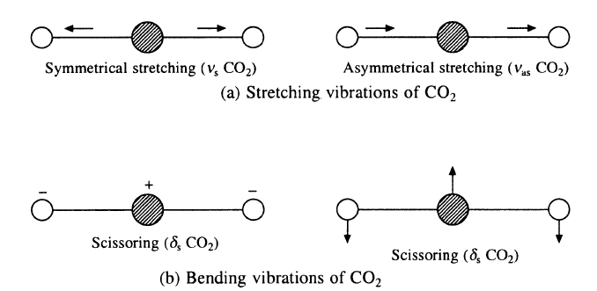
The carbon dioxide molecule is linear and has four fundamental vibrations (3 x 3)- 5 = 4.
Thus, four theoretical fundamental bands are expected but actually it shows only two.
The symmetrical Stretching vibration in carbon dioxide is IR inactive because it produces no change in the dipole moment of the molecule.
The two bending vibrations are equivalent and absorb at the same wavenumber (667.3 cm⁻¹).

Slide 17
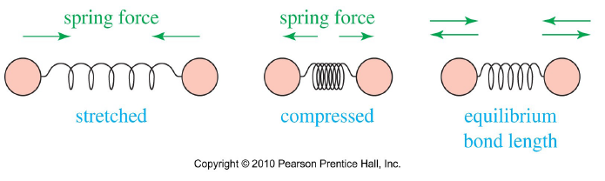
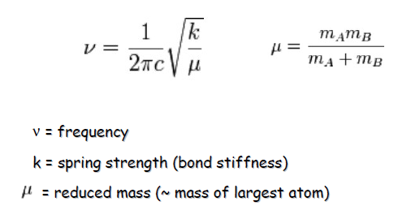
Calculation of Vibrational Frequencies
The stretching vibrations of two bonded atoms may be regarded as the vibration of two balls connected by a spring, a situation for which Hooke's law applies.
k = 5 X 10⁵ dynes/cm for single bonds and approximately twice and thrice of this value for double and triple bonds

Slide 18
Factors Affecting Vibrational Frequencies
The value of absorption frequency is shifted if the force constant of a bond changes with its electronic structure.
Frequency shifts also takes place on working with the same substance in different states (solids, liquids and vapour).
A substance usually absorbs at higher frequency in a vapour state as compared to liquid and solid states.
There are 4 factors that affect the vibrational frequencies of bonds:
1. Coupled vibration
2. Electronic effects
3. Hydrogen bonding
4. Bond angle

Slide 19
1. Coupled vibration
For an isolated C-H bond, only one stretching vibrational frequency is expected but a methylene group shows two absorptions corresponding to symmetrical and asymmetrical stretchings
This is because there is mechanical coupling or interaction between the C-H stretching vibrations in the CH₂ group.
Asymmetric stretching vibrations occur at higher frequencies or wavenumbers than the symmetric stretching vibrations.
These are called coupled vibrations since these vibrations occur at different frequencies compared to CH2 group.

Slide 20
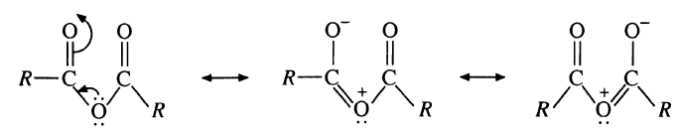
In case of acid anhydrides, two C=O stretching absorptions between 1850-1800cm-1 and 1790-1745cm-1 with a difference of about 65cm-1 (due to symmetric and asymmetric stretching)
The interaction is very effective because of the partial double band character in the carbonyl oxygen bonds due to resonance which also keeps the system planar for effective coupling.
Asymmetric stretching in acyclic anhydride is more intense whereas symmetrical stretching band is more intense in cyclic anhydrides.

Slide 21
Requirements:
For interaction to occur, the vibrations must be of same symmetry species.
There must be a common atom between the groups for strong coupling between stretching vibrations.
For coupling of bending vibrations, a common bond is necessary.
Interaction is greatest when coupled groups absorb, individually, near the same frequency.
Coupling is negligible when groups are separated by one or more carbon atoms and the vibrations are mutually perpendicular.

Slide 22
2. Electronic Effects
Changes in the absorption frequencies for a particular group take place when the substituents in the neighborhood of that particular group are changed.
The frequency shifts are due to the electronic effects which include:-
Inductive effect
Mesomeric effect
Strength (force constants) of a particular bond is changed by these effects and hence its stretching frequency is also changed with respect to the normal values.

Slide 23
Inductive effect
The introduction of alkyl group cause +I effect which results in the lengthening or the weakening of the bond and hence the force constant is lowered and the wave number of absorption decreases.
Formaldehyde (HCHO) = 1750cm⁻¹
Acetaldehyde (CH3CHO) =1745cm⁻¹
Acetone (CH3COCH3) = 1715cm⁻¹
The introduction of an electronegative atom or group causes -I effect which results in the bond order to increase. Thus, the force constant increases and hence, the wave number of absorption increases.
Acetone (CH3COCH3) = 1715cm-1
Chloroacetone (CH3 CO CH2Cl) = 1725cm-1
Dichloro acetone (CH3 CO CHCl2) = 1740cm-1
Tetrachloro acetone (Cl2 CH2 CO CHCl2) = 1750, 1778cm-1

Slide 24
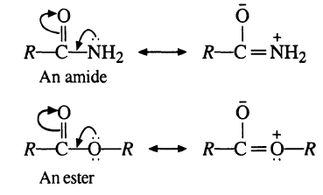
b) Mesomeric effect
They cause lengthening or the weakening of a bond leading in the lowering of the absorption frequency. It is found in conjugated systems.
More will be the conjugation, less will be the bond strength and lower will be the wave number.
Amides show ʋ_{c=o} band at a lower frequency than that of esters. Due to lesser electronegativity of nitrogen than oxygen, its lone pair of electrons are more readily involved in resonance than that of oxygen.
In some cases, where the lone pair of electrons present on an atom is in conjugation with the double bond of a group, the mobility of a lone pair of electron matters.

Slide 25
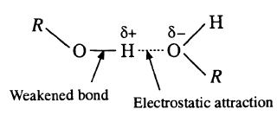
3. Hydrogen bonding
It occurs in any system containing a proton donor (X-H) and a proton acceptor.
The stronger the hydrogen bond, the longer the O-H bond, the lower the vibration frequency and broader and more intense will be the absorption band.
The N-H stretching frequency of amines are also affected by hydrogen bonding as that of the hydroxyl group but frequency shifts for amines are lesser than that for hydroxyl compounds.
Because nitrogen is less electronegative than oxygen so the hydrogen bonding in amines is weaker than that in hydroxyl compounds.

Slide 26
There are two types of hydrogen bonding
Intermolecular Hydrogen Bonding
Intra-molecular Hydrogen Bonding
The H- bonding which is between two different molecules is called intermolecular H-bonding.
The H-bonding which is within the same molecules is called intra-molecular H-bonding.
Intermolecular H-bonding gives rise to broad bands, while intra-molecular H-bonds give sharp and well defined bands.
The inter and intra-molecular bonds can be distinguished by dilution.
Intra-molecular H-bonding remains unaffected by dilution and as a result the absorption band also remains unaffected, whereas in intermolecular, bonds are broken on dilution and as a result there is a decrease in the bonded O-H absorption.

Slide 27
In case of amines, the N-H stretching is at 3500cm-1 in dilute solutions while in condensed phase spectra, absorption occurs at 3300cm-1.
In aliphatic alcohols, a sharp band appears at 3650cm-1 in dilute solutions due to free O-H group while a broad band appears at 3350cm-1 due to H-bonded -OH group.
4. Bond angle
The carbonyl stretching frequency in cyclic ketones having ring strain is shifted to a higher value.
The C-CO-C bond angle in strained rings is reduced below the normal value of 120° (acyclic and six-membered cyclic ketones have the normal C-CO-C angle of 120°).
This Ieads to an increase in s character in the sp2 orbital of carbon involved in the C=O bond. Hence, the C=O bond is shortened (strengthened) resulting in an increase in the Vc=o frequency.

Slide 28
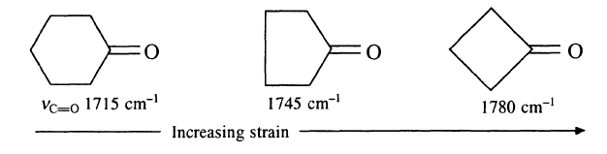
This increase in the s character of the outside sp2 orbital is there because it gives more p character to the sp2 orbitals of the ring bonds which relieves some of the strain, as the preferred bond angle of p orbitals is 90°.
In ketones where C-CO-C angle is greater than the normal angle (120°), an opposite effect operates and they have lower Vc=o frequency. For example, in di-t-butyl ketone, where the C-CO-C angle is pushed outward above 120°, has very low Vc=O frequency (1698 cm-1).

Slide 29
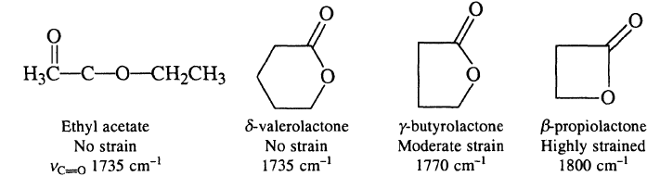
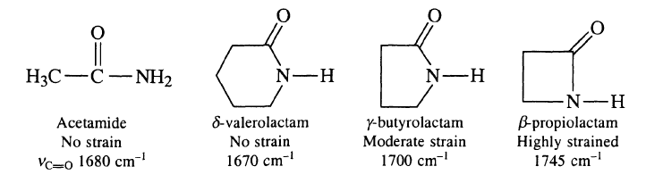

Slide 30
Interpretation of Infrared Spectra
(i) 3200-3650 cm-1
The appearance of medium to strong absorption bands in this region shows the presence of hydroxyl or amino groups.
These bands arise from ʋ_{O-H} or ʋ_{N-H} vibrations. The position, intensity and width of the bands indicate whether the group is free or intermolecularly hydrogen bonded or intramolecularly hydrogen bonded.
A medium band due to =C-H stretching also appears near 3300 cm-1.
(ii) 3000-3200 cm-1
Absorption bands due to =C-H stretching and aromatic C-H stretching appear in this region. These bands are of medium intensity.

Slide 31
(iii) 2700-3000 cm-1
In this region, usually a complex band or bands appear near 2850 cm-1 due to stretching vibrations of C-H bonds of saturated groups, i.e. -CH3, -CH2 or CH- .
The appearance of weak but sharp bands near 2700-2900 cm-1 due to ʋ_{c-H} indicates the presence of aldehyde, methoxyl or N-methyl groups.
A broad ʋ_{O-H} band present in the 2700-3000 cm^{– 1} region is characteristic of hydrogen bonded -COOH groups.
(iv) 2000-2700 cm-1
Groups of the type XΞY, X=Y=X, etc. absorb in this region and exhibit bands of variable intensities. For example, bands due to C Ξ C Stretching appear in the region 2100-2260 cm- 1 and that due to CΞN Stretching appear in the region 2200-2260 cm-1 .

Slide 32
Isocyanates absorb in the region 2240-2275 cm-1 due to N = C = 0 stretching.
Besides these, ʋ_{o-H}, ʋ_{N-H} and ʋ_{s-H} bands of carboxylic acid dimers, amine salts and thiols (or thiophenols), respectively also appear in this region (2000-2700 cm-1).
(v) 1600-1900 cm-1
Strong absorption bands in the upper part of this region are due to C=O stretching. Aldehydes, ketones, carboxylic acids, esters, amides, acid anhydrides, acyl halides, etc. absorb strongly in this region due to C=O stretching.

Slide 33
FINGERPRINT REGION
In IR, the region below 1500 cm-1 is rich in many absorption bands and the region is known as fingerprint region.
Here the number of bending vibrations are usually more than the number of stretching vibrations.
In this region, small difference in the structure and constitution of a molecule results significant changes in the absorption bands.
Many compounds show unique absorption bands in this region and which is very useful for the identification of the compound.
Fingerprint region can be sub-divided into three
i. 1500-1350 cm-1
Here doublet near 1380 cm-1 and 1365 cm-1 shows the presence of tertiary butyl group in the compound.

Slide 34
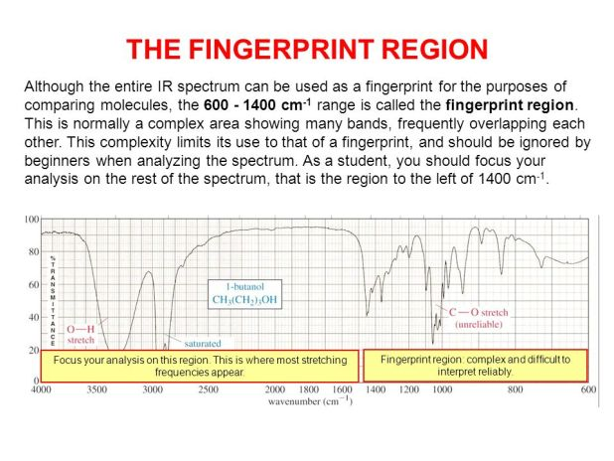
ii. 1350-1000 cm⁻¹
All classes of compounds having groups like alcohols, esters , lactones, acid anhydrates show characteristic absorptions (s) due to C – O stretching.
iii. Below 1000 cm⁻¹
Distinguishes between cis and trans alkenes and mono and disubstitutions at ortho, meta, para

Slide 35
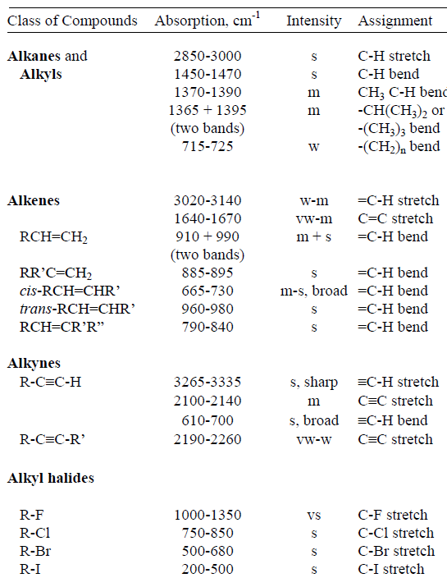
CHARACTERISTIC INFRARED ABSORPTION BANDS OF FUNCTIONAL GROUPS

Slide 36
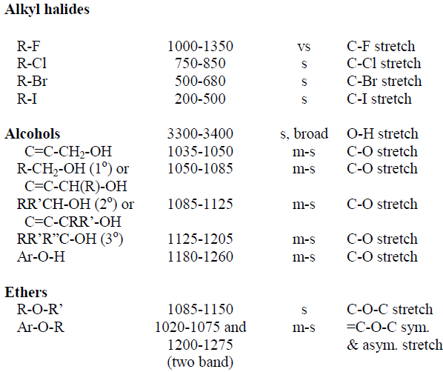

Slide 37
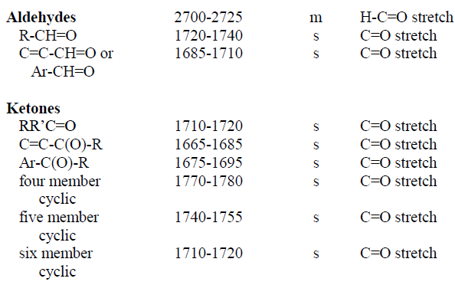

Slide 38
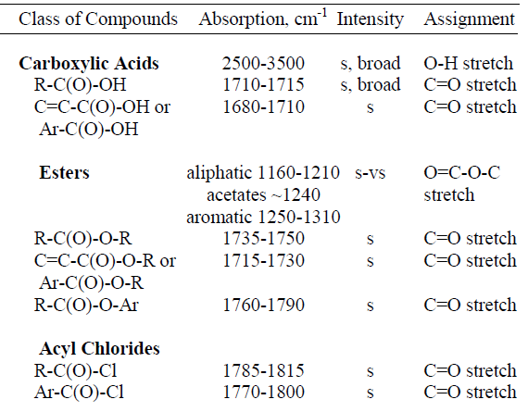

Slide 39
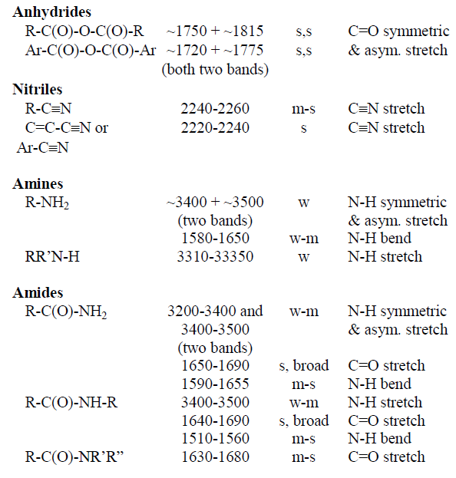

Slide 40
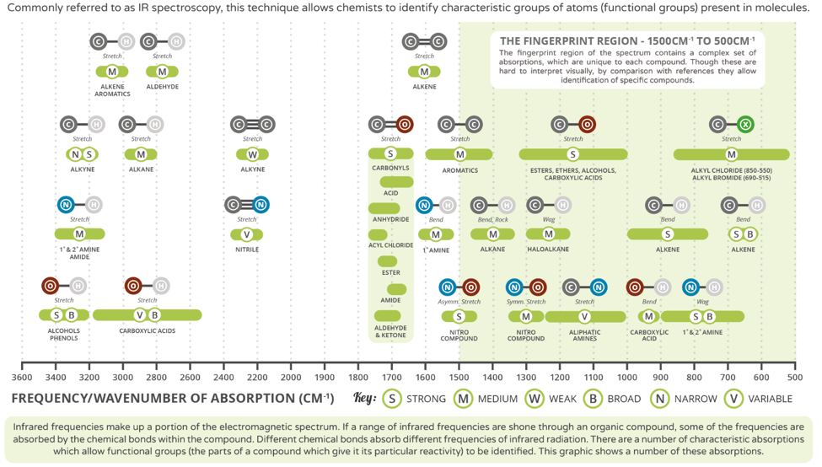

Slide 41
Applications of Infrared Spectroscopy
Detection of Functional groups
Confirmation of the identity of Compounds
Estimation of the Purity of Samples
Study of Hydrogen Bonding
Calculation of Force Constants
Orientations in aromatic Compounds
Study of the Progress of Reactions

