Slide 1
Embpy: A Package to Generate and Benchmark Embeddings (with Alejandro)

Slide 2
Motivation
A lot of perturbation models are coming out
A lot of this models try to incorporate prior knowledge into them using embeddings from multiple sources (genes, molecules and proteins)
Easy-to-get embeddings package followed by a thorough benchmark of this perturbation models with different embeddings where we would also develop metrics to test which embeddings are best

Slide 3
Types of Embeddings
Genes Small Molecules Text Embeddings
Borzoi ChemBerta LLM -> Embeddings
Enformer MolFormer
ESM2, ESMC RDKit
Evo2 (If I can install it) Morgan Fingerprint

Slide 4
Next Steps
Compare the different embeddings with similarity metrics
Benchmarking models (starting with Prophet) on the best embeddings
Define proper metrics, similar to scIB to tell us which embeddings are the best across a variety of metrics

Slide 5
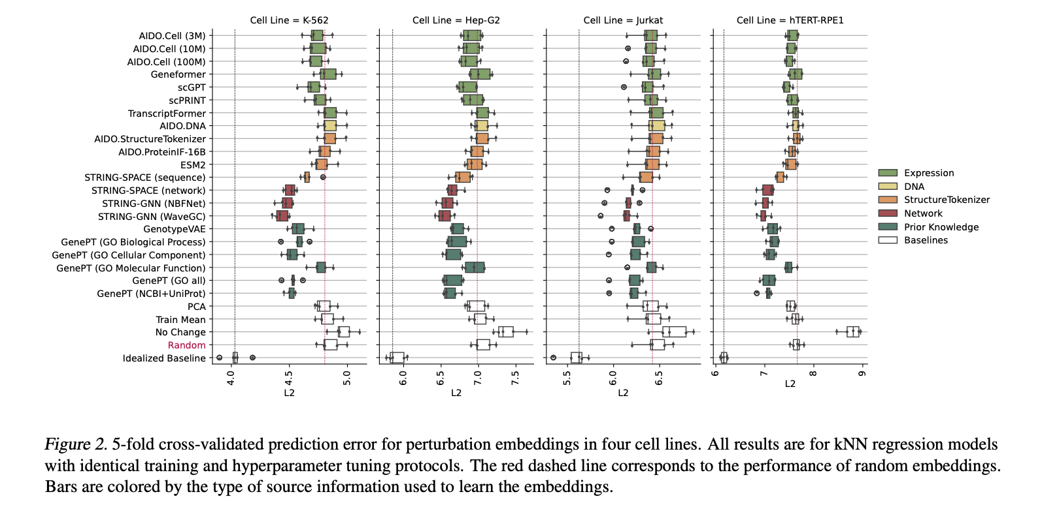
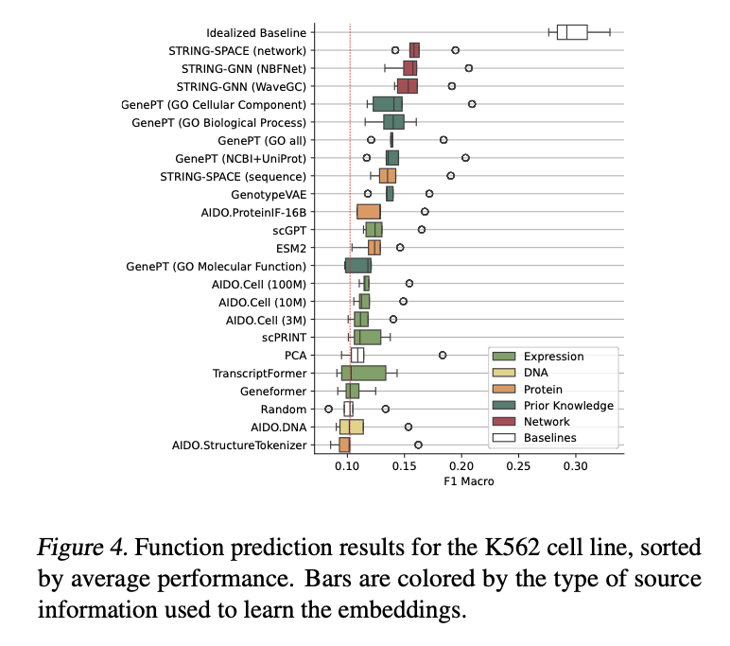
Multimodal Benchmarking of Foundation Model Representations for Cellular Perturbation Response Prediction
Tasks (On Perturb-Seq data, Nadig et al. (2024)) :
1 - Pseudobulk residual expression prediction :
How a perturbation alters gene expression, by regressing from its embedding to the average change in gene expression relative to control
2 – Function Prediction :
Compute Differentially Expressed genes for each perturbation
Perform gene set enrichment analysis against the gene ontology terms
3 – Train two types of models on the embeddings :
Expression Prediction (k-nearest neighbors)
Function Prediction (Logistic Regression)

