Slide 1

Title : Smart Parking System Using ESP32, MQTT & Node-RED
Indian Institute Of Information Technology, Design & Manufacturing, Kurnool
SAMSUNG INNOVATION CAMPUS INTERNSHIP (Oct 2025 – Jan 2026)
Krishna Teja Regintala (122EC0045)

Slide 2
Outline
Objective
Scope
Introduction
Detailed Description of this Project
Equipment/Tools Required
Implementation Details
Results and Discussions
Future Work
Summary

Slide 3
Objective
To develop an IoT-based Smart Parking System for real-time parking monitoring.
To automatically detect vehicle entry, exit, and slot occupancy using sensors.
To provide real-time data visualization and alerts using MQTT and Node-RED.
Scope
Can be implemented in shopping malls, hospitals, and campuses for efficient parking management.
Helps in reducing traffic congestion and fuel wastage in urban areas.
Can be extended to smart city applications with scalability and automation.

Slide 4
Introduction
The Internet of Things (IoT) enables devices to communicate and exchange data in real time.
Rapid urbanization and increasing vehicles have created serious parking challenges.
Traditional parking systems lack automation and real-time monitoring.
Smart Parking Systems use sensors and IoT technology to detect vehicle presence.
Data is processed using a microcontroller (ESP32) and transmitted via MQTT.
A Node-RED dashboard provides real-time visualization of parking status.
This system improves efficiency, convenience, and smart city integration.

Slide 5
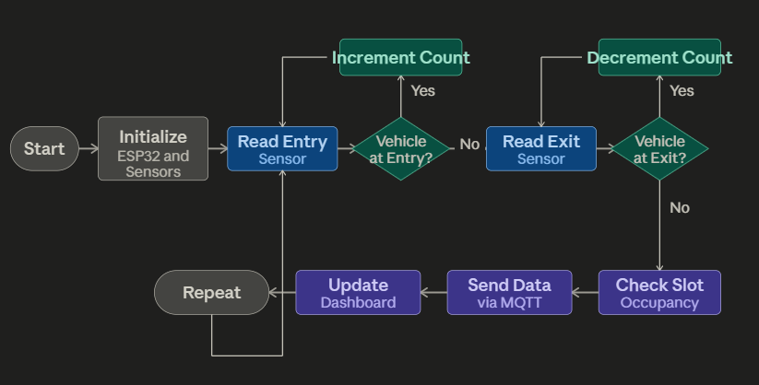
System Architecture

Slide 6
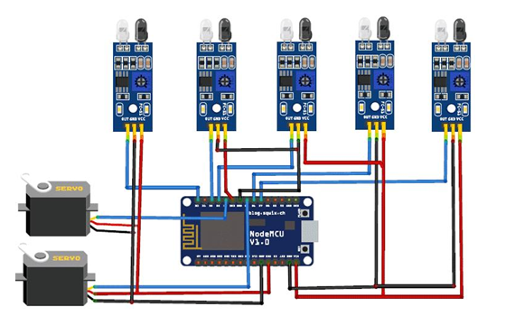
Detailed Description of this Project
The system is an IoT-based Smart Parking Solution for real-time monitoring.
Ultrasonic sensors detect vehicle entry, exit, and slot occupancy.
The ESP32 microcontroller processes sensor data and controls the system.
Data is transmitted using the MQTT protocol for efficient communication.
A Node-RED dashboard displays real-time parking status and slot availability.

Slide 7
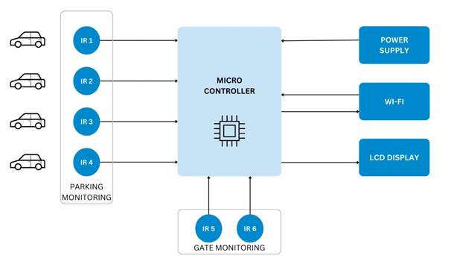
Detailed Description
The system follows a layered architecture (Sensor → ESP32 → MQTT → Dashboard).
Entry/Exit sensors maintain accurate vehicle count.
Slot sensors detect occupied/free status using distance measurement.
The system uses event-driven communication to reduce network load.
Provides features like real-time monitoring, alerts, and remote access.

Slide 8
Equipment/Tools Required
Microcontroller: ESP32 WROOM-32
Sensors: Ultrasonic Sensors (HC-SR04) ,DHT11 Temperature & Humidity Sensor
Hardware Components: LEDs (status indication) ,Connecting wires & Breadboard, Power supply
Software Tools: Arduino IDE, MQTT Broker (EMQX), Node-RED Dashboard

Slide 9
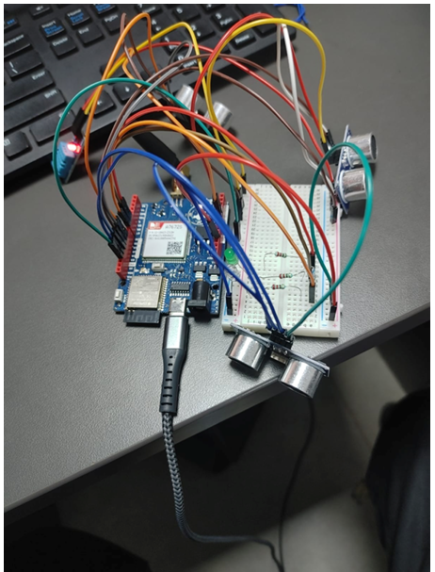
Hardware Implementation
Ultrasonic sensors are placed at entry, exit, and parking slots.
Sensors detect vehicle presence using distance measurement.
ESP32 acts as the central processing unit.
Components are connected through GPIO pins and powered supply.
LEDs are used for status indication (Free/Occupied).
Hardware Setup of Smart Parking System

Slide 10
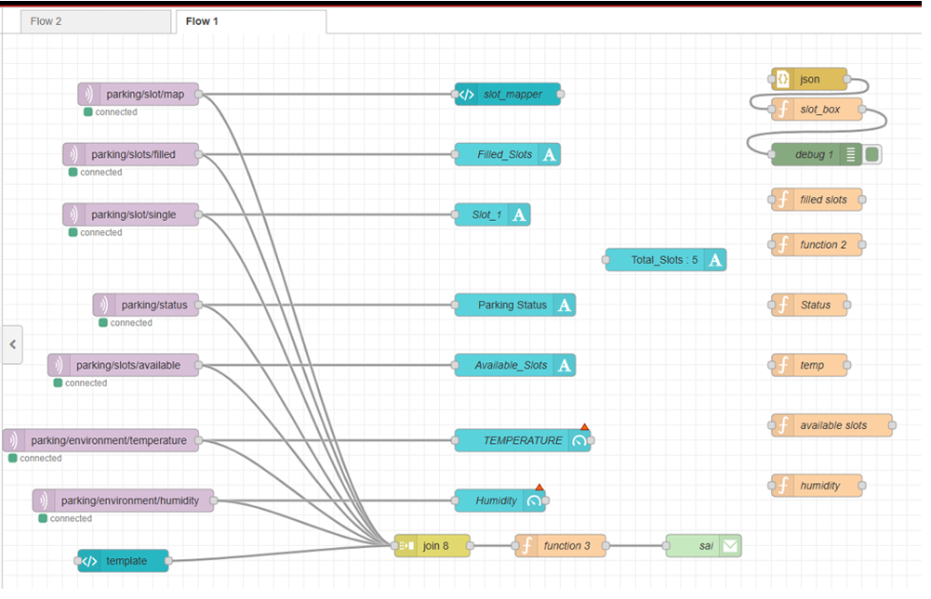
Software Implementation
Program developed using Arduino IDE (Embedded C/C++).
ESP32 reads sensor data and processes vehicle count & slot status.
Data is transmitted using MQTT publish– subscribe protocol.
Node-RED subscribes to MQTT topics and updates dashboard.
Topics include:
parking/status
parking/slots/available
parking/environment
Node-RED Flow for Smart Parking System

Slide 11
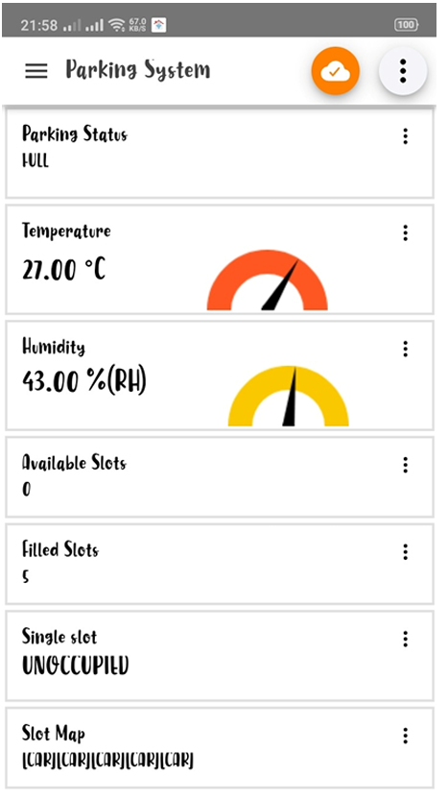
Results and Analysis
Mobile Monitoring using MQTT Application
The system provides real-time parking status including filled and available slots.
Data is displayed on Node-RED dashboard with clear visualization.
ESP32 serial monitor shows live updates of vehicle count and sensor data.
Mobile MQTT application enables remote monitoring of parking status.
The system responds instantly to vehicle entry and exit events.

Slide 12
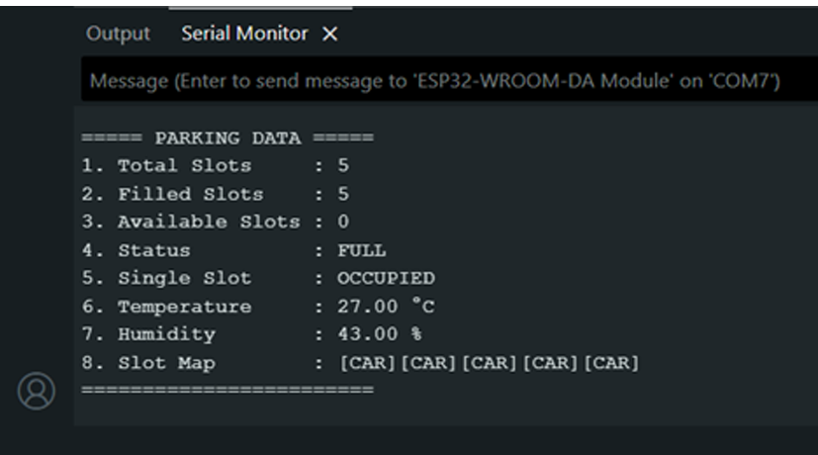
Results
High Accuracy: Vehicle detection achieved accurate results in all test cases.
Low Latency:
Sensor detection < 1 sec
MQTT transmission < 1 sec
Dashboard updates are instant
Reliable System: Continuous operation showed stable performance.
Efficient Monitoring: Real-time updates reduce manual effort and errors.
Serial Monitor Output of Smart Parking System

Slide 13
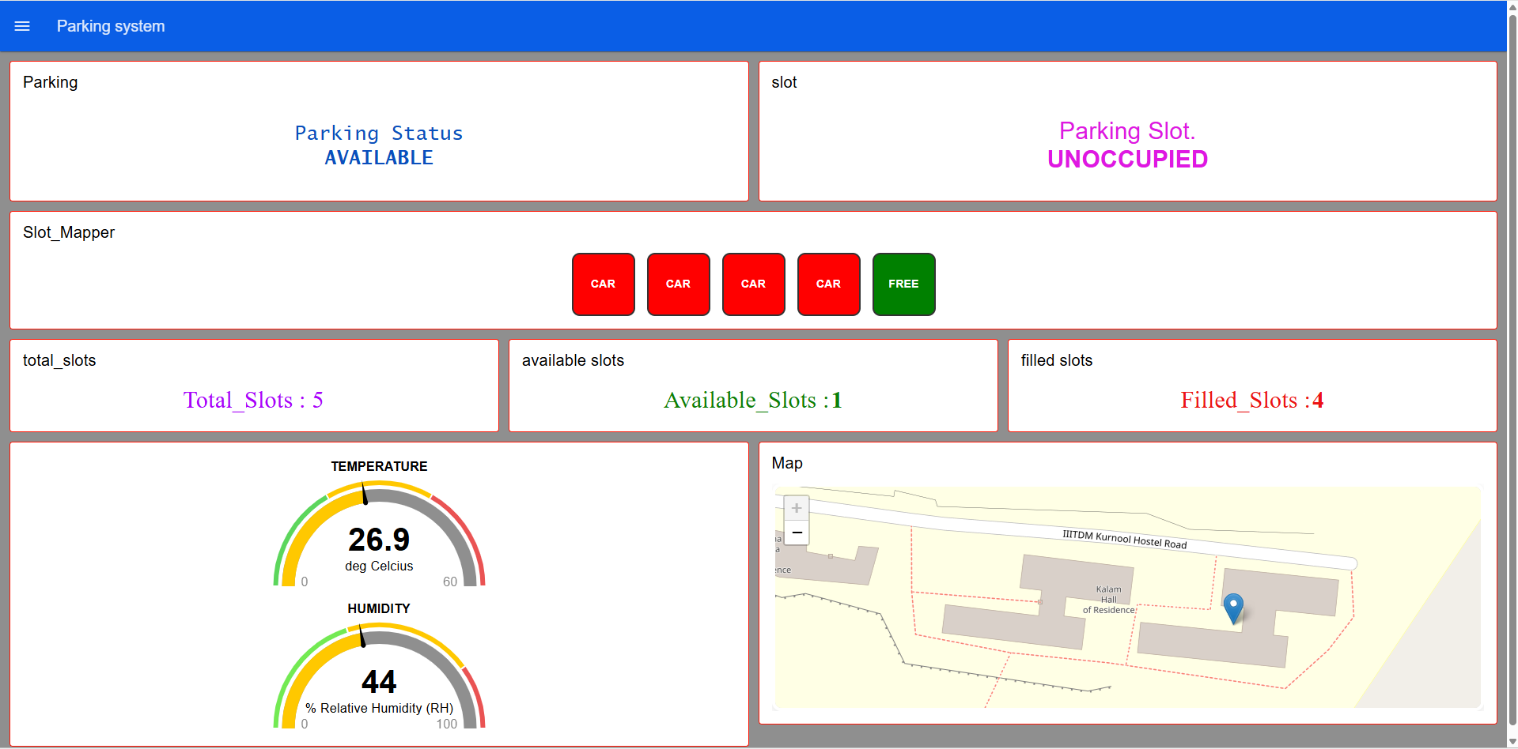
Smart Parking Dashboard

Slide 14
Performance Analysis
Test Case | Actual Count | Detected Count
Test 1 | 3 | 3
Test 2 | 5 | 5
Test 3 | 2 | 2
Test 4 | 4 | 4
Vehicle Detection Accuracy:
System achieved 100% accuracy in all test cases
Actual count matched detected count for all vehicles
Response Time:
Sensor Detection: < 1 second
MQTT Transmission: < 1 second
Dashboard Update: Instant
System Reliability:
System tested continuously with stable performance
No significant errors observed
MQTT ensured reliable data communication

Slide 15
Conclusion
The project successfully developed an IoT-based Smart Parking System for real-time monitoring.
The system enables automatic vehicle detection and slot management using sensors and ESP32.
Integration of MQTT and Node-RED ensures efficient communication and visualization.
Achieved high accuracy, low latency, and reliable performance in real-time conditions.
The system is cost-effective, scalable, and suitable for smart city applications.

