Slide 1

Indian Institute of Information Technology
Design And Manufacturing Kurnool.
Department of Electronics and Communication Engineering
Hardware-in-the-Loop (HIL) System for DC–DC Converter.
Final Year Project (July 2025 – April 2026)
Guided by : Dr. KV Eswaramoorthy.
- Krishna Teja Regintala (122EC0045)

Slide 2
Objective
To design and implement an FPGA-based Buck Converter using PWM control.
To develop a Hardware-in-the-Loop (HIL) framework using MATLAB and FPGA.
To achieve real-time output voltage regulation and validation using closed-loop control.
To analyze and compare open-loop and closed-loop (PI controller) performance.
Scope
Buck converter is implemented in hardware using ZedBoard FPGA.
Other converters are analyzed in simulation only for comparison.
It provides a scalable framework applicable to power electronics, renewable energy, and electric vehicle systems.

Slide 3
Introduction
DC–DC converters are widely used for voltage regulation in EVs, renewable energy, and embedded systems.
Among them, the buck converter (step-down) is simple and widely used in practical applications.
This project focuses on modeling and controlling a buck converter using a discrete PI controller.
The controller and PWM logic are implemented on FPGA (Zynq-7000) using HDL workflow and Vivado.
The system is validated through real-time operation using HIL approach and hardware deployment.

Slide 4
Detailed Description of the Project
What is HIL ? . “HIL is a system where the plant (converter) is simulated, and the controller is tested in real time.” Why HIL for dc-dc conv? .
Safety: No risk to real hardware.
Cost-effective: Low cost compared to real time simulators (SpeedGoat/OPAL-RT).
Efficiency: Faster testing and parameter tuning.
Scalability: Useful across converters and industries and Real -time Feedback .
Academic & Industrial Relevance .
In this project, HIL is specifically used to test and validate buck converter control in real-time before building actual hardware.

Slide 5
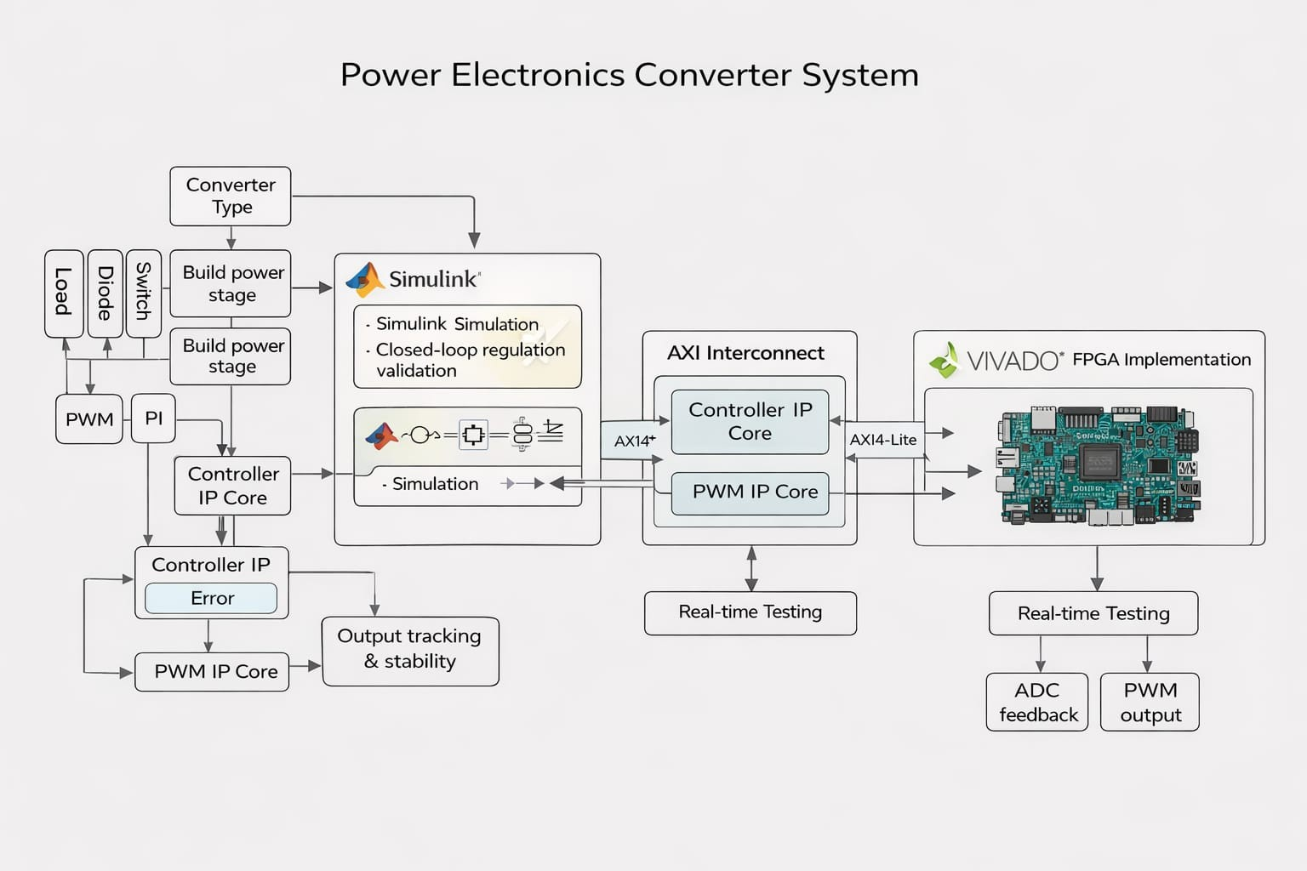
Total Block Diagram of the Project :

Slide 6
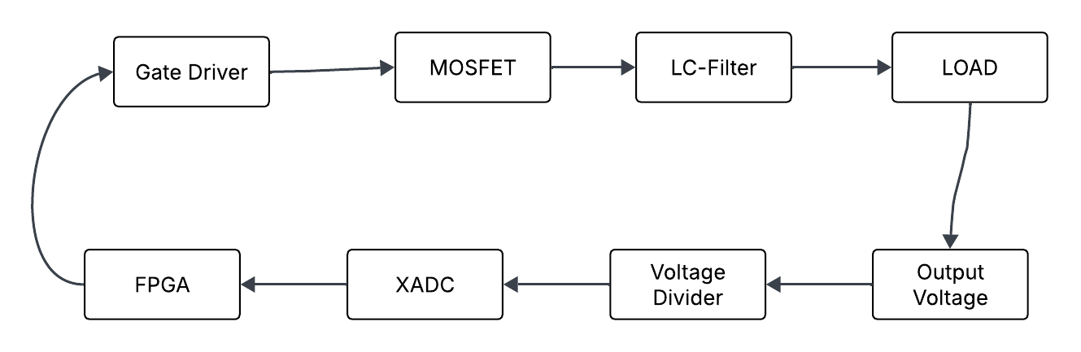
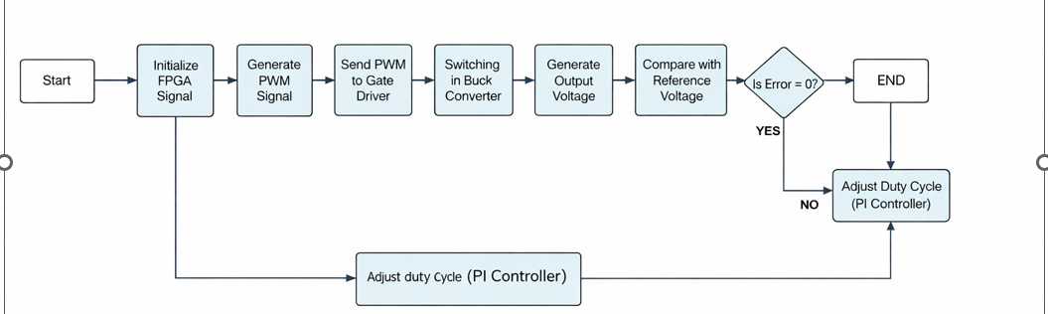
PWM_out
V_out
Feedback signal
Scaled voltage
V_out
Hardware Block diagram of FPGA Controlled Buck Converter System
Closed-Loop Control Flow of Buck Converter

Slide 7
Equipment/Tools Required
Tools and Technologies Required :
MATLAB & Simulink – Modeling and PI control design
Simscape Electrical – Buck converter simulation
HDL Workflow Advisor – FPGA IP generation
Xilinx Vivado – Synthesis, implementation & bitstream
ZedBoard (Zynq-7000) – Real-time control platform
Buck Converter Hardware Kit (Pre-built) – Experimental validation
Digital Storage Oscilloscope (DSO) – PWM & output waveform observation

Slide 8
Implementation Details
Phase-1 : Simscape Modeling of Buck Converter.
Phase-2 : PI Controller Design & PWM Logic Development
Phase-3 : Discrete Conversion + Fixed-Point Conversion(fixdt(1,16))
Phase-4 : HDL Workflow – FPGA IP Core Generation of Controller and PWM
Phase-5 : Vivado IP Integration , Synthesis , Implementation and Bitstream Generation
Phase-6 : FPGA Deployment on Zynq-7000 (Hardware Testing).
Phase-7 : Closed Loop Hardware Validation and Final Demonstration

Slide 9
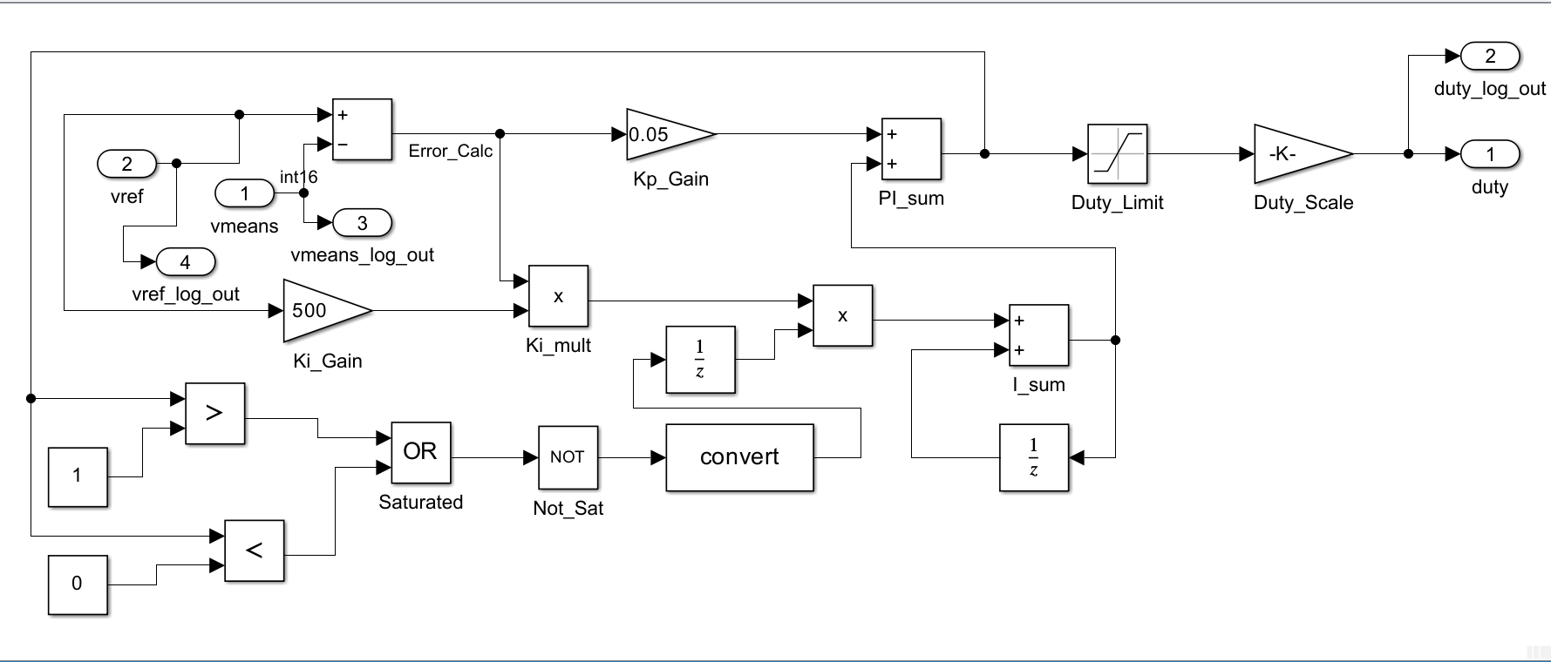
Simulations and Results:
Common Digital PI Controller Architecture:

Slide 10
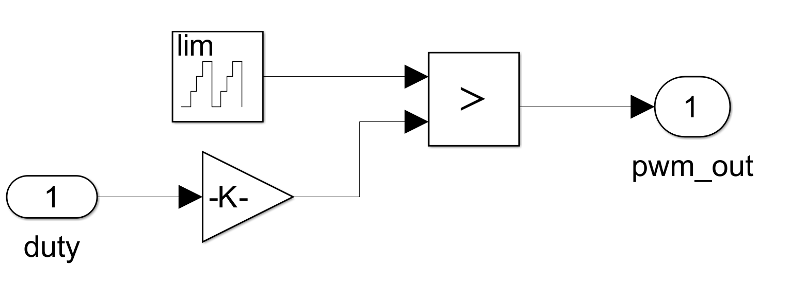
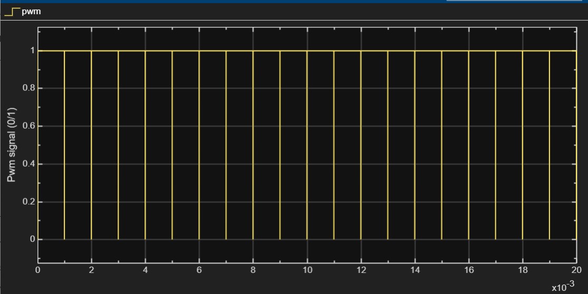
PWM Generator :
PWM Waveform:

Slide 11
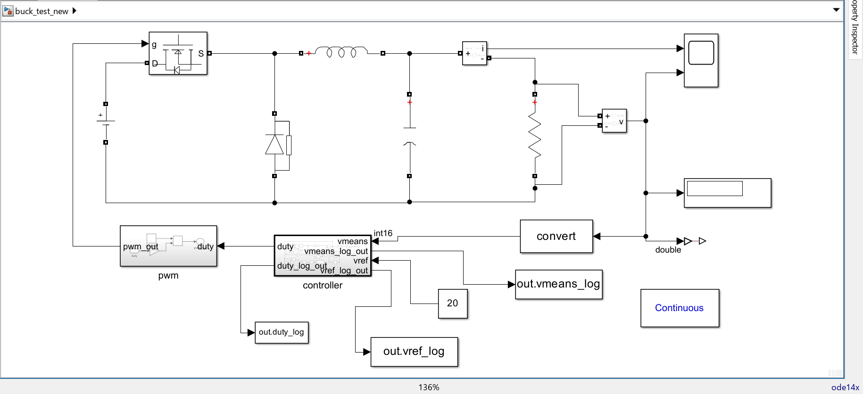
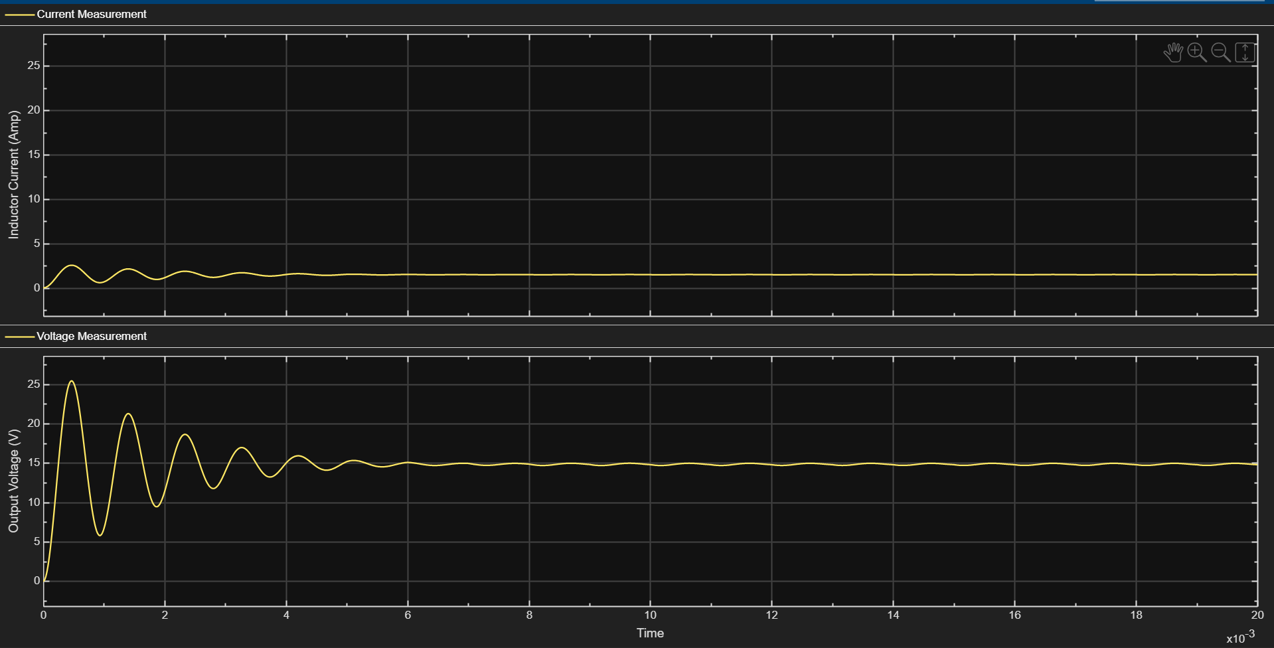
BUCK CIRCUIT: (Step-Down)
V_out = D.V_in
1. The buck converter steps down the input voltage using PWM-controlled switching.
2. Output voltage rises until it matches the reference, then settles as the PI controller adjusts the duty cycle.
3. Inductor current ripple reduces as the system reaches steady state (CCM in your sims).
4. Voltage ripple is small because the LC filter smooths the switching waveform.

Slide 12
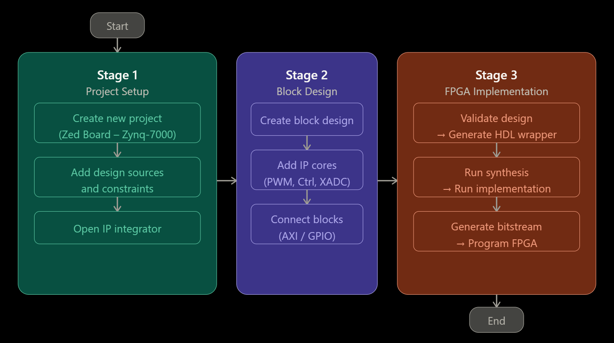
VIVADO FLOW CHART

Slide 13
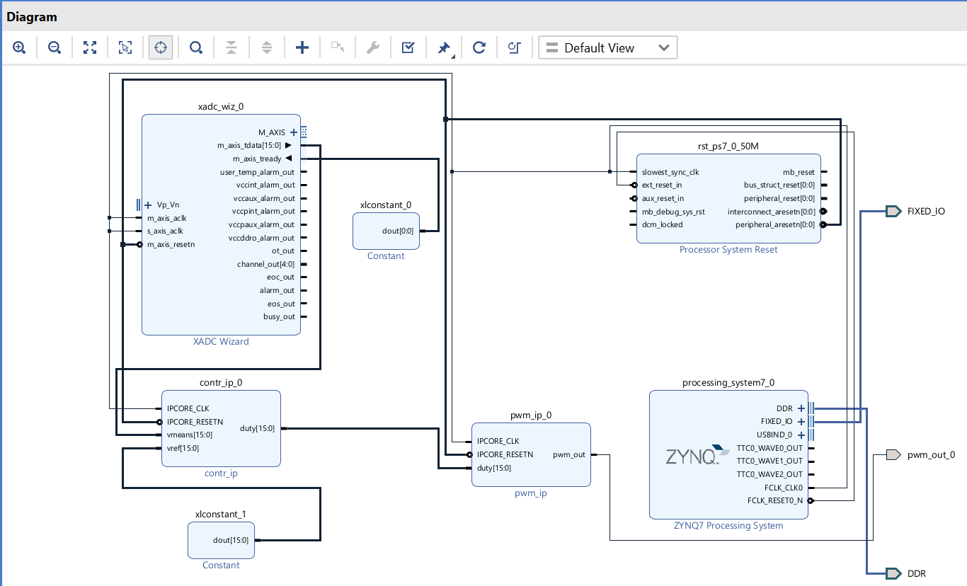
Vivado Block Design of Controller and PWM IP Integration on Zynq-7000 :

Slide 14
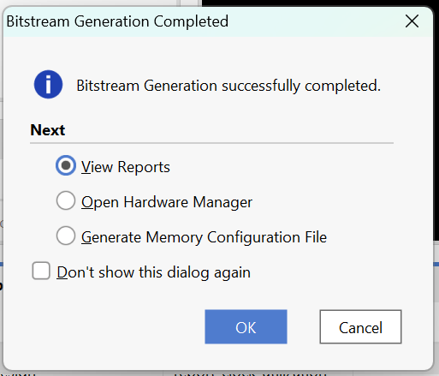
Bitstream generation Status for hardware :
FPGA Resource Utilization Report : { report_link }
Slice LUTs: 566 / 53200 (1.06%)
Slice Registers: 776 / 106400 (0.73%)
Timing Slack (WNS): +3.033 ns
Target Clock: 100 MHz
Timing Constraints: Successfully Met
Timing Analysis Result: { report_link }
Target Clock Frequency: 100 MHz
Worst Negative Slack (WNS): +3.033 ns
Timing Status: Constraints met successfully
Design operates reliably within required timing limits
Synthesis completed successfully
Implementation completed without critical errors
Bitstream generated for Zed Board deployment
Design ready for hardware verification
Hence, The design utilizes less than 2% of FPGA resources, leaving sufficient margin for scaling and future integration.

Slide 15
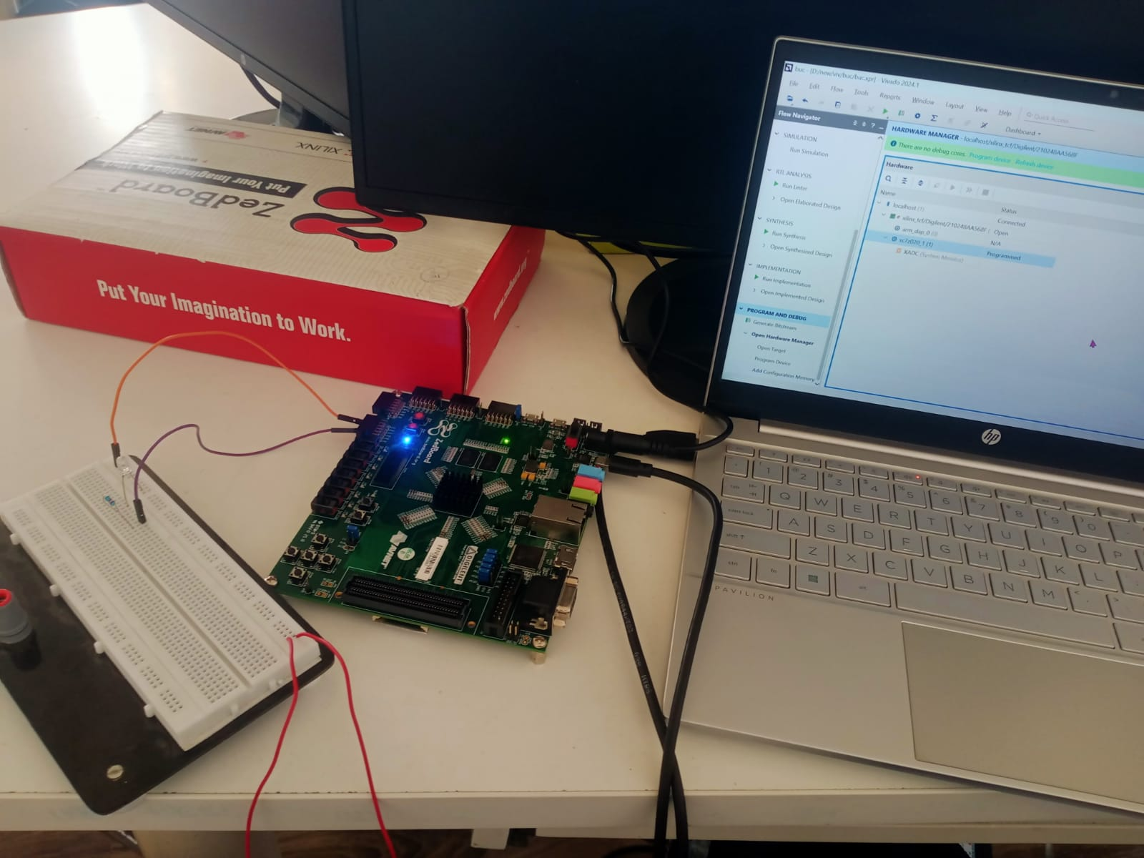
LED Verification
Before connecting to hardware,
PWM signal is verified using onboard LEDs.
• Low frequency → LED blinking
• High frequency → LED brightness variation
This confirms correct PWM generation.

Slide 16
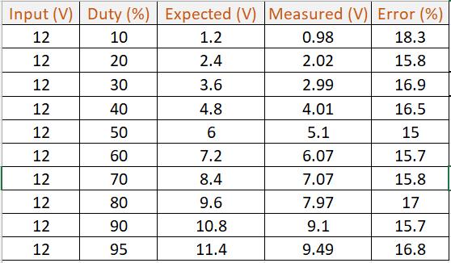
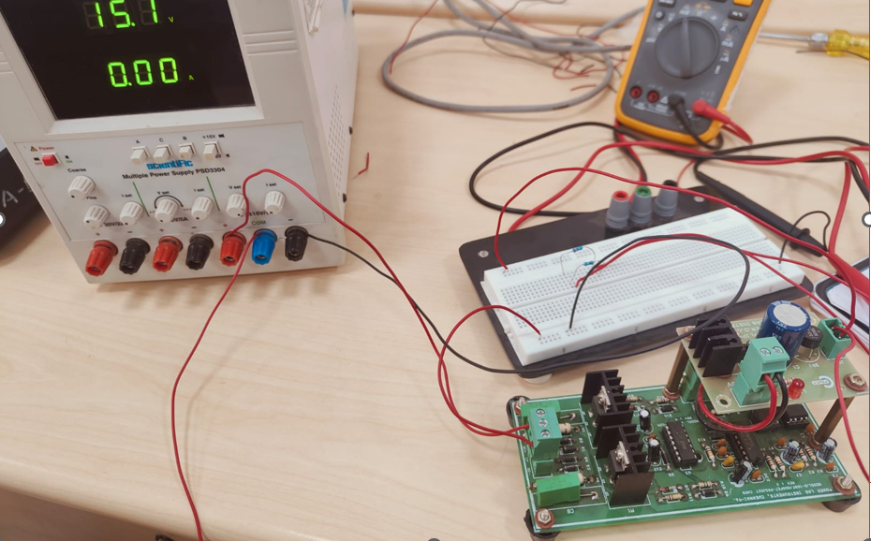
OPEN-LOOP BUCK CONVERTER HARDWARE SETUP AND RESULTS
In open-loop operation, the duty cycle is varied manually, and the corresponding output voltage is measured.
Open-Loop Performance

Slide 17
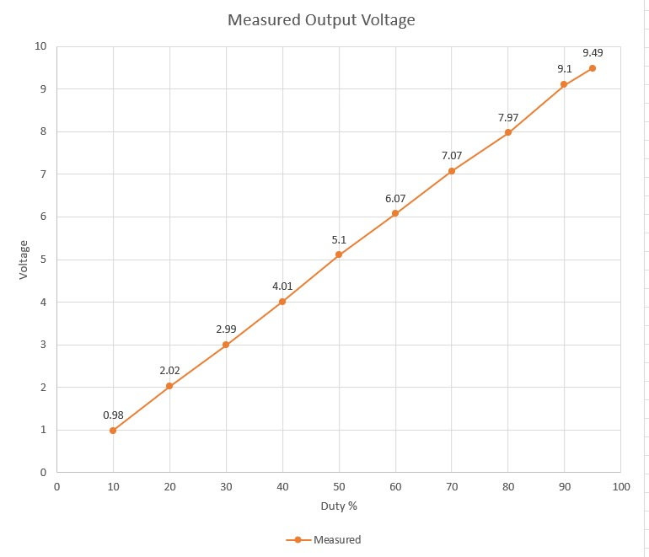
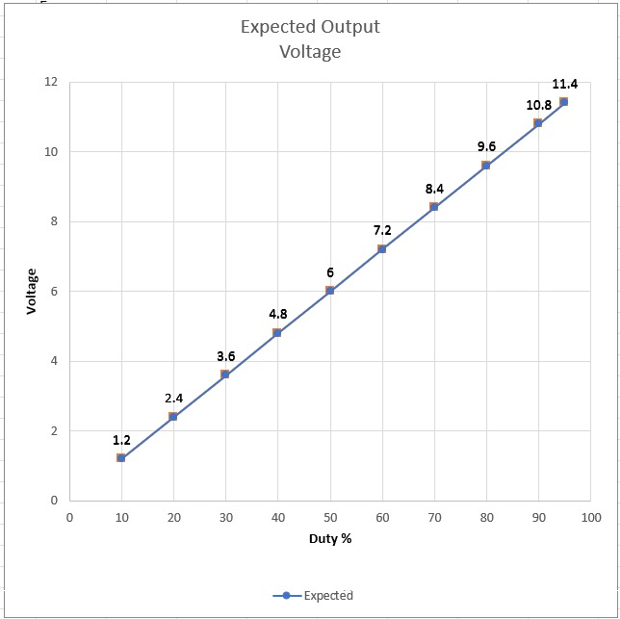
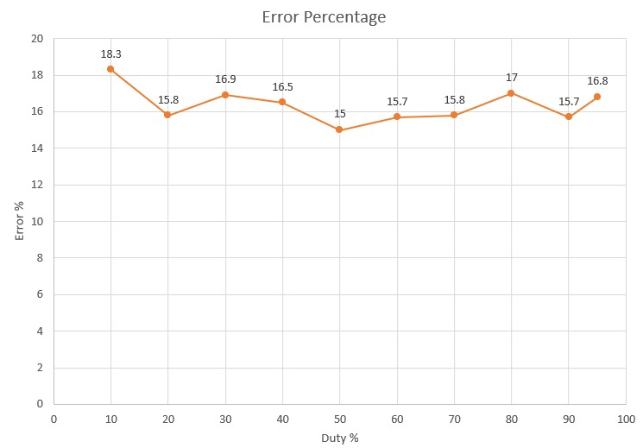
OPEN LOOP Characteristics :
Duty Cycle(%) Vs Votage(V)
(Measured and Expected)
Error(%) Vs Duty Cycle(%)

Slide 18
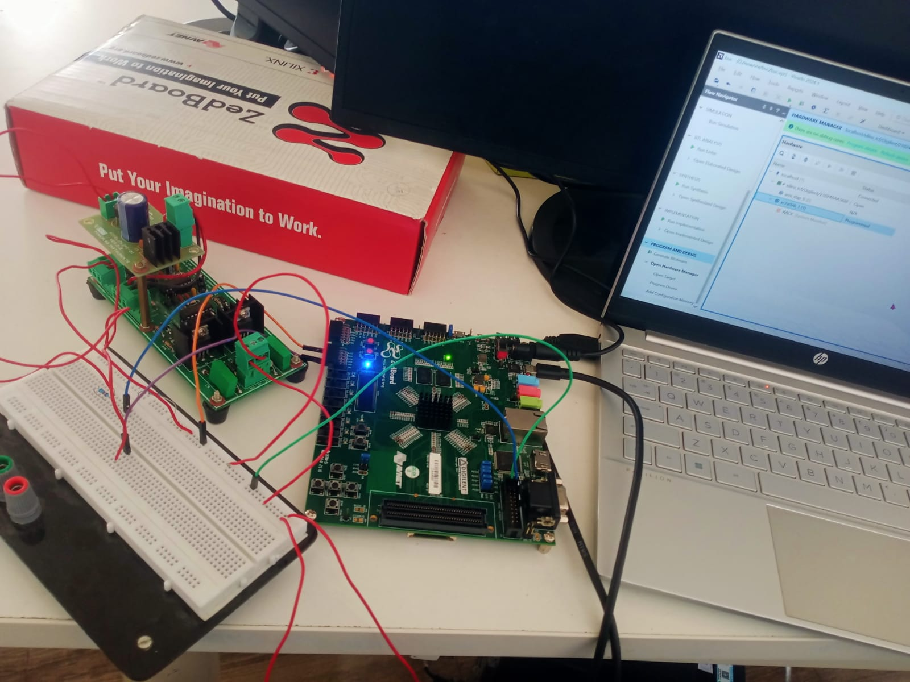
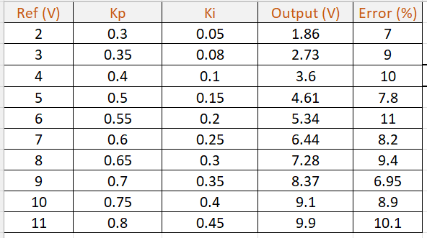
CLOSED-LOOP BUCK CONVERTER HARDWARE SETUP AND RESULTS
In closed-loop operation, feedback is used to regulate the output voltage to a desired reference value.
Closed-Loop Performance

Slide 19
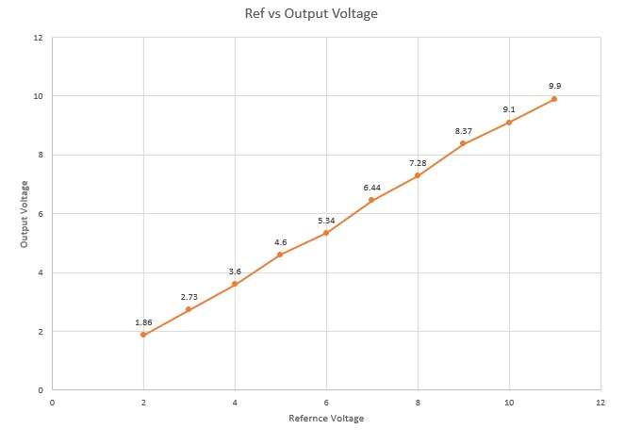
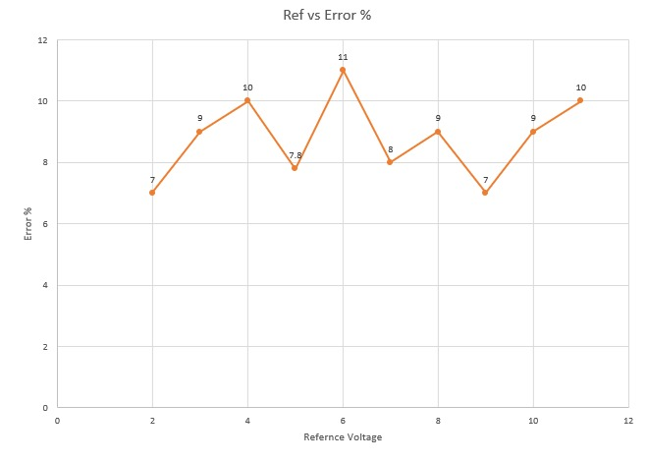
Closed-Loop Characteristics
In closed-loop operation, the output voltage remains close to the reference value, demonstrating effective voltage regulation.

Slide 20
Comparison Table
Conclusion
FPGA-based control works effectively
Closed-loop improves performance
Real-time implementation
The system demonstrates reliable real-time performance on FPGA hardware.
Parameter | Open Loop | Closed Loop
Control | No feedback | PI feedback
Error | ~ 16 % | ~ 6-10 %
Stability | Poor | Good
Accuracy | Low | High
Future Scope
Extend to Boost/Buck-Boost
Improve efficiency
Advanced controllers (PID, adaptive)

Slide 21
Literature Survey
Author(s) & Year | Work Done in Paper | Relevance to My Project
Ramos, Hernández & Trujillo (2017) | Performed HIL functional tests for Buck, Boost, and Buck-Boost converters to validate control strategies. | Directly matches my work since I am simulating and testing multiple DC–DC converter topologies in HIL.
Cervantes, Ramírez, Téllez-Anguiano et al. (2020) | Designed an HIL scheme for DC–DC converters using LabVIEW FPGA for real-time testing. | Very relevant since my project also uses LabVIEW FPGA + ZedBoard for implementing converter HIL.
Washington & Delgado (2008) | Discussed how HIL simulation improves design efficiency and testing capability in embedded systems. | Provides strong justification of why HIL is important — efficiency, cost, and safer prototyping.
Robert, Monthéard, Combet & Gavelle (2022) | Developed HIL simulation of a high-frequency interleaved converter using a low-cost FPGA platform. | Shows how low-cost FPGA boards can be used instead of expensive HIL systems — same goal as mine.
Pintilie, Hedeşiu, Rusu et al. (2023) | Implemented FPGA-based real-time simulation of a Flyback converter using graphical programming tools. | Supports my inclusion of Flyback topology in converter models and highlights FPGA + graphical tools.
Ould-Bachir, Blanchette & Al-Haddad (2015) | Proposed a network tearing technique for FPGA-based real-time simulation of power converters. | Gives advanced FPGA modeling methods that can improve accuracy of my HIL converter models.

Slide 22
References :
[1] G. A. Ramos, M. E. Hernández and M. D. Trujillo, "Function test by HIL for DC-DC converters type: Buck, boost and buck-boost," 2017 IEEE Workshop on Power Electronics and Power Quality Applications (PEPQA), Bogota, Colombia, 2017, pp. 1-6, doi: 10.1109/PEPQA.2017.7981647. {URL}
[2] M. H. Cervantes, M. C. G. Ramírez, A. C. Téllez-Anguiano, F. M. Cárdenas, J. C. Gómez and A. M. Patiño, "Design of a Hardware in the Loop scheme in DC-DC converters using LabVIEW FPGA," 2020 IEEE International Autumn Meeting on Power, Electronics and Computing (ROPEC), Ixtapa, Mexico, 2020, pp. 1-6, doi: 10.1109/ROPEC50909.2020.9258691. {URL}
[3] C. Washington and S. Delgado, "Improve design efficiency and test capabilities with HIL Simulation," 2008 IEEE AUTOTESTCON, Salt Lake City, UT, USA, 2008, pp. 593-594, doi: 10.1109/AUTEST.2008.4662686.{URL}

Slide 23
[4] T. Robert, R. Monthéard, V. Combet and M. Gavelle, "Hardware-In-the-Loop Simulation of a High Frequency Interleaved Converter based on a Low-Cost FPGA Platform," IECON 2022 – 48th Annual Conference of the IEEE Industrial Electronics Society, Brussels, Belgium, 2022, pp. 1-6, doi: 10.1109/IECON49645.2022.9968950 {URL}.
[5] L. -N. Pintilie, H. -C. Hedeşiu, C. -G. Rusu, I. -C. Gros, V. -M. Suciu and A. -M. Păcuraru, "FPGA based Real-Time simulation of FlyBack converter using graphical programming tools," 2023 10th International Conference on Modern Power Systems (MPS), Cluj-Napoca, Romania, 2023, pp. 01-08, doi: 10.1109/MPS58874.2023.10187573.{URL}
[6] T. Ould-Bachir, H. F. Blanchette and K. Al-Haddad, "A Network Tearing Technique for FPGA-Based Real-Time Simulation of Power Converters," in IEEE Transactions on Industrial Electronics, vol. 62, no. 6, pp. 3409-3418, June 2015, doi: 10.1109/TIE.2014.2365752. {URL}

Slide 24
Thank You For Your Attention

