Slide 1
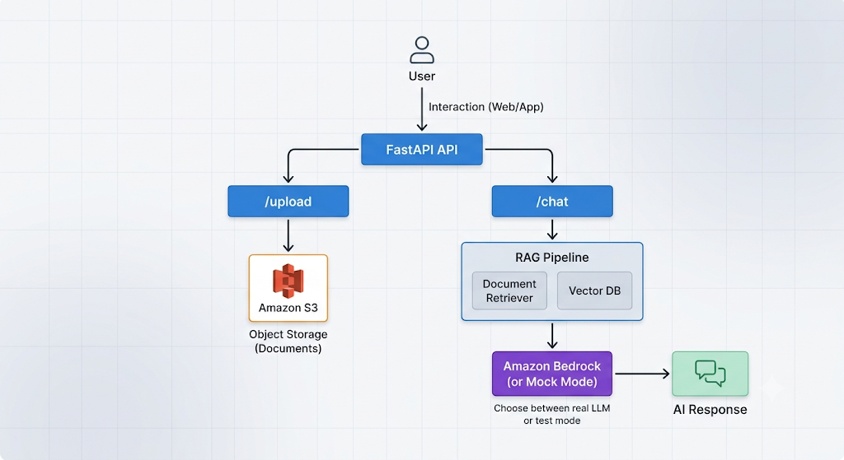
GenAI Document Chatbot
This project is a GenAI Document Chatbot built using Python, FastAPI, Amazon Bedrock, and Amazon S3.
Users can upload documents, and the chatbot answers questions based on the uploaded content using a Retrieval-Augmented Generation (RAG) pipeline.

Slide 2

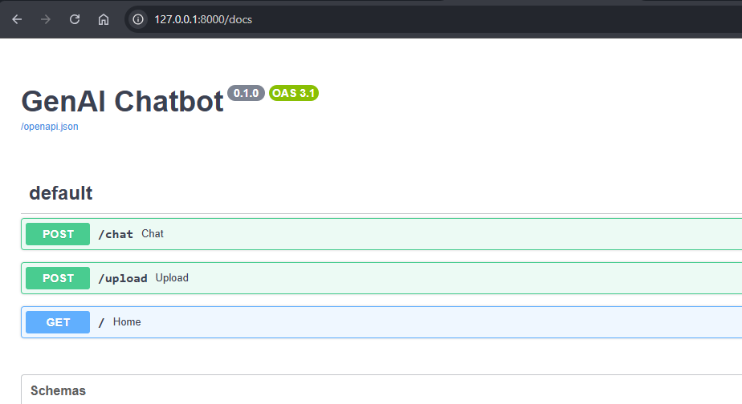
Project Setup
Create and activate a virtual environment:
python -m venv .venv
.venv\Scripts\activate
Install Packages
pip install fastapi uvicorn boto3 python-dotenv
pip freeze > requirements.txt
Create a .env file in the project root with the following values:
AWS_REGION=your-aws-region
MODEL_ID=your-bedrock-model-id
USE_MOCK=true
S3_BUCKET=your-s3-bucket-name
Run the application
Swagger UI:
http://127.0.0.1:8000/docs
uvicorn app.main:app --reload

Slide 3
How the Project Works
1. Upload to S3
The /upload endpoint receives a file from the user and forwards it to the S3 service layer.
Implementation details:
app/api/upload.py exposes the upload endpoint.
app/services/s3.py uses boto3.client("s3") to upload the file object into the configured bucket.
-he response includes a success message and the uploaded file name.
2. Document Processing for RAG
When a PDF is uploaded, the application uses a standard RAG pipeline:
1. Extract text from the PDF using pypdf.
2. Split the text into overlapping chunks.
3. Convert each chunk into an embedding using `SentenceTransformer`.
4. Store the embeddings in a FAISS vector index.
The main processing services are:
app/services/parser.py for PDF text extraction
app/services/chunker.py for text chunking
app/services/embeddings.py for embedding generation
app/services/vector_store.py for FAISS vector storage

Slide 4
3. Retrieval Step
The /chat endpoint receives the user's question and sends it through the retrieval flow:
1. The question is converted into an embedding.
2. The vector store searches for the most relevant document chunks.
3. The retrieved chunks are returned as context.
This is handled by:
app/api/chat.py
app/services/retriever.py
4. Bedrock Integration
The retrieved context is combined with the question into a prompt, and that prompt is sent to Amazon Bedrock.
Implementation details:
app/services/prompt_builder.py builds the RAG prompt.
app/services/bedrock.py creates a Bedrock runtime client and calls client.converse(...) when USE_MOCK=false
if USE_MOCK=true, the project returns a mock response instead of making a real Bedrock call.

Slide 5
5. End-to-End RAG Flow
User uploads a document.
Document is stored in S3.
Text is parsed, chunked, embedded, and indexed.
The user asks a question.
The system retrieves the most relevant chunks.
A prompt is created with the retrieved context.
Amazon Bedrock generates the final answer.
Example API Endpoints
POST /Upload → Upload a PDF or document file to S3.
POST /chat → Send a user question and receive an answer grounded in the uploaded document context.
Note:
USE_MOCK=true is useful for local testing without AWS Bedrock access.
The current implementation uses a simple in-memory FAISS index for the local vector search workflow.
In production, you would typically persist the vector index and document metadata separately.

