Slide 1

Enterprise Agentic AI Platform using RAG
Subtitle
Document Intelligence Platform
Built using Python, FastAPI, FAISS and Agentic AI
Project Goals
Build a RAG-based document chatbot.
Enable semantic document search.
Implement specialized AI agents.
Design a modular enterprise architecture. .

Slide 2
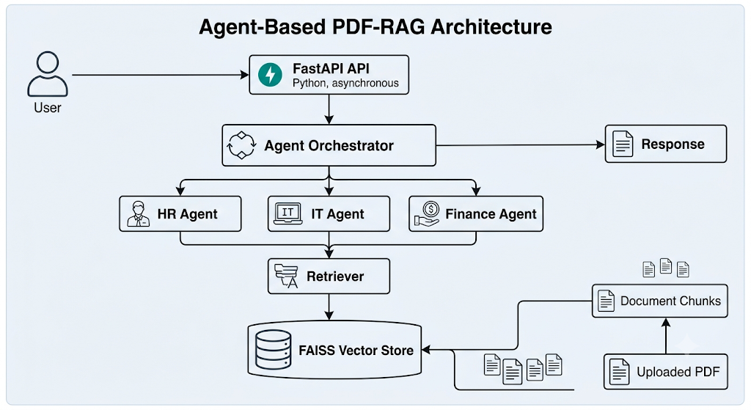

Slide 3
Project Setup
Create and activate a virtual environment:
python -m venv .venv
.venv\Scripts\activate
Install Packages
pip install fastapi uvicorn boto3 python-dotenv
pip freeze > requirements.txt
Create a .env file in the project root with the following values:
AWS_REGION=your-aws-region
MODEL_ID=your-bedrock-model-id
USE_MOCK=true
S3_BUCKET=your-s3-bucket-name
Run the application
uvicorn app.main:app --reload
Swagger UI:
http://127.0.0.1:8000/docs

Slide 4
How the Project Works
Document Upload
The /upload endpoint receives a PDF document from the user and stores it in the local upload directory.
2. Document Processing for RAG
Once the document is uploaded, the application processes it through the RAG pipeline.
3. Agent-Based Query Processing
The /agent-chat endpoint receives the user's question and forwards it to the Agent Orchestrator.
4. Semantic Retrieval
After the appropriate agent is selected, the Retrieval Service performs semantic search.
5. Prompt Generation
The retrieved document context is combined with the user's question to build a structured RAG prompt.
6. LLM Integration
The generated prompt is sent to the Language Model layer.
Current Implementation
When
USE_MOCK_LLM=true
the application returns responses using a Mock LLM for local development.
Future Implementation
When
USE_MOCK_LLM=false
the same prompt will be sent to Amazon Bedrock using the Bedrock Runtime API.

Slide 5
7. Agent Orchestration
The Agent Orchestrator acts as the central decision-making component.
Example API Endpoints
Method | Endpoint | Description
POST | /upload | Upload a PDF document
POST | /embed | Generate embeddings and update the FAISS index
POST | /retrieve | Retrieve relevant document chunks
POST | /ask | Perform RAG-based question answering
POST | /agent-chat | Route questions through the Agent Orchestrator and generate intelligent responses

Slide 6
End-to-End Agentic RAG Flow
User uploads a PDF document.
The document is stored locally.
Text is extracted from the PDF.
The text is split into chunks.
Embeddings are generated.
Embeddings are stored in the FAISS vector database.
The user submits a question.
The Agent Orchestrator selects the appropriate agent.
The Retrieval Service finds the most relevant document chunks.
The Prompt Builder creates the final RAG prompt.
The Mock LLM (or Amazon Bedrock) generates the response.
The generated answer is returned to the user along with the relevant document sources.
Notes:
USE_MOCK_LLM=true allows the project to be developed and tested locally without requiring Amazon Bedrock access.
USE_MOCK_LLM=false enables integration with Amazon Bedrock for production deployments.

