Slide 1
Embedded Operating Systems and Linux
Thejeswarareddy R 22-Aug-2018

Slide 2
Agenda
What is an embedded Operating System
Who are the players
Linux as an embedded OS
Tools and development
Applications and products
The embedded OS market
Embedded OS Resources

Slide 3
OS Flavors
Desktop
  Windows (9X, XP Home, XP/2000 Pro)
  Mac
Server
  Windows (XP/2000 Server &Advanced Server)
  Unix Varieties
Embedded
  Many

Slide 4
What is an Embedded OS?
An "embedded system" is any computer system or computing device that performs a dedicated function or is designed for use with a specific embedded software application.
Embedded systems may use a ROM-based operating system or they may use a disk-based system, like a PC. But an embedded system is not usable as a commercially viable substitute for general purpose computers or devices.

Slide 5
What makes a good Embedded OS?
Modular
Scalable
Configurable
Small footprint
CPU support
Device drivers
etc, etc, etc...

Slide 6
What is Real Time?
“A real time system is one in which the correctness of the computations not only depends upon the logical correctness of the computation but also upon the time at which the result is produced. If the timing constraints of the system are not met, system failure is said to have occurred.”
- Donald Gillies

Slide 7
What is Real Time?
“Real time in operating systems:
The ability of the operating system to provide a required level of service in a bounded response time.”
- POSIX Standard 1003.1

Slide 8
Hard vs. Soft Real Time
Hard
  guaranteed worst-case response times
  absolutely, positively, first time every time
Soft
  Kinda, sorta, usually

Slide 9
What makes a good RTOS?
Multi-threaded and pre-emptible
Thread priority has to exist because no deadline driven OS exists
Must support predictable thread synchronization mechanisms
A system of priority inheritance must exist

Slide 10
Who are the Embedded OS players?
Wind River Systems
  VxWorks
  pSOS
QNX Software Systems
  QNX
Green Hills Software
  Integrity

Slide 11
Who are the Embedded OS players?
Mentor Graphics
  VRTX
Palm Computing
  PalmOS
Symbian
  SymbianOS

Slide 12
Microsoft
Embedded NT/XP
  “Real-time” control
Windows CE (CE.NET)
  Internet devices
Pocket PC 2002
  Handheld PC’s and PDA’s

Slide 13
Commercial Embedded Linux
AMIRIX Embedded Linux
  derived from Debian
Coollogic Coollinux
  combines Linux and Java for Internet apps
Coventive Xlinux
  kernel can be as small as 143KB
Esfia RedBlue Linux
  400K, designed for wireless apps

Slide 14
Commercial Embedded Linux
KYZO Pizza Box Linux
  SAMBA based file, print, CD server
Lineo Embedix
  supports real time and high availability apps
LynuxWorks BlueCat
  general purpose embedded solution
MontaVista Linux
  general purpose embedded solution

Slide 15
Commercial Embedded Linux
Neoware NeoLinux
  Red Hat derived for information appliances
PalmPalm Tynux
  Internet appliuance and multimedia
Red Hat Embedded Linux
  general purpose embedded solution
RedSonic Red-Ice Linux
  runs from DiskonChip or CompactFlash

Slide 16
Commercial Embedded Linux
RidgeRun DSP Linux
  for multimedia, wireless, RT on DSP
TimeSys Linux GPL
  low latency enhanced kernel
Tuxia TASTE
  distro targets Internet appliances
Vital Systems vLinux
  for ARM based embedded apps

Slide 17
Open Source Embedded Linux
Embedded Debian Project
  convert Debian to an embedded OS
ETLinux
  for PC104 SBC’s
uCLinux
  for microprocessors that don’t have MM
uLinux (muLinux)
  distro fits on a single floppy

Slide 18
Commercial Linux RTOS
FSMLabs - Open RT Linux
Lineo - Embedix Realtime
LynuxWorks - BlueCat RT
MontaVista Software - Real Time Extensions
REDSonic - REDICE Linux
TimeSys - Linux/Real-Time

Slide 19
Open Source Linux RTOS
ART Linux - real time extension based on RTLinux
KURT - event schedules with 10us resolution
Linux-SRT - for soft real time apps like multimedia
Qlinux - provides Quality of Service guarantees
RTAI - “hard” Real Time Application Interface

Slide 20
RTLinux
A “hard real-time” mini operating system
runs Linux as it’s lowest priority execution thread
Linux thread completely preemptible
Real time threads and interrupt handlers never delayed by non-realtime operations
Supports user level programming
MiniRTL implementation fits on a floppy

Slide 21
What’s so special about Linux?
Multiple choices vs. sole source
Source code freely available
Robust and reliable
Modular, configurable, scalable
Superb support for networking and Internet
No runtime licenses
Large pool of skilled developers

Slide 22
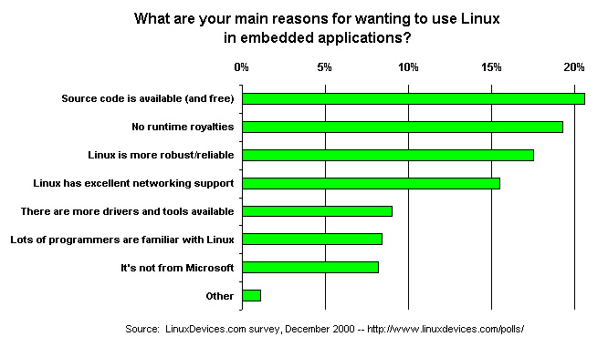
What’s so special about Linux?

Slide 23
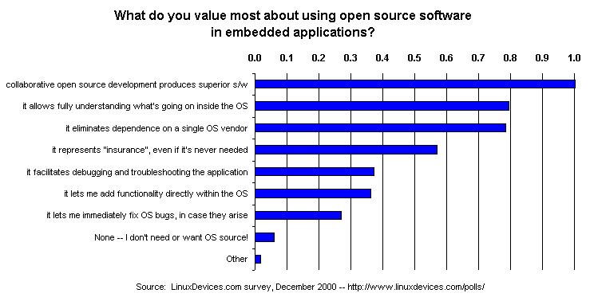
What’s special about Open Source?

Slide 24
What CPU’s will it run on?
Intel X86
MIPS
ARM
StrongARM
PowerPC
Hitachi SuperH

Slide 25
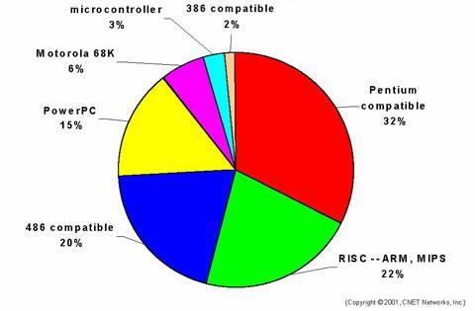
Projected Target CPU’s

Slide 26
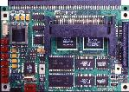
Single Board Computers
      Little Board (5.75 x 8.0 in.) -- complete systems on a single compact board, expandable with plug-on function modules
      ISA "slot boards" (full-length, 13.8 x 4.8 in.; half-length, 7.1 x 4.8 in.) -- IBM PC plug-in cards which could function as standalone SBCs backplanes)
      PC/104 modules (3.6 x 3.8 in.) -- compact, rugged, self-stacking modules featuring a reliable pin-and-socket board-to-board expansion bus

Slide 27
Single Board Computers with PCI
      PC/104-Plus -- PCI added to PC/104
      EBX -- PC/104-Plus added to Little Board

Slide 28
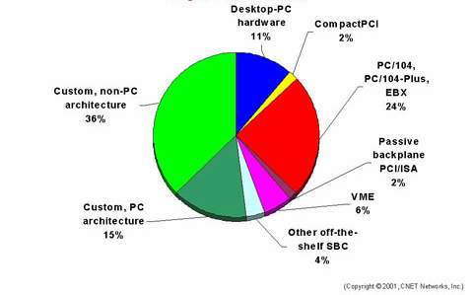
Target Devices

Slide 29
Any Development Tools Available?
QT/Embedded
Other GUI/Windowing toolkits
Arcom Control Systems
GNUPro Tools
Vendor specific
Standard Linux toolset

Slide 30
C or C++ for Development?
In general C is a better choice
  Advanced OOP features can cause code bloat
  C++ compilers can generate many routines for a single function
  Virtual methods and polymorphism slow program launch times significantly
Size really does matter

Slide 31
What’s It Being Used For?
Control and Monitoring Applications
Industrial Controllers
TV Set Top Boxes (TiVO)
Handheld PDA’s
Automobile Computers
Telecomm and Networking Hardware
Myriad and sundry other uses...

Slide 32
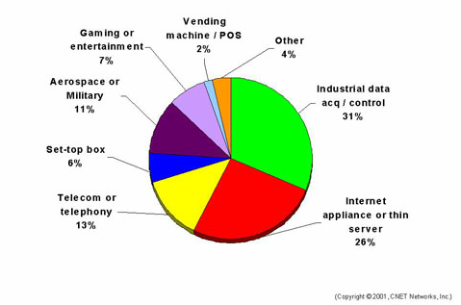
Target Applications

Slide 33
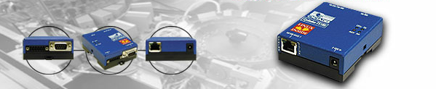
Cyclades TS-100
Netlinos OS
Dual 50MHz PowerPC
16MB SDRAM 4MB Flash
Ethernet/Serial/RS485
Size of a deck of cards

Slide 34
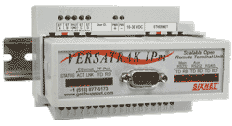
Sixnet VersaTRAK IPm
Embedded Linux
PowerPC CPU
16MB DRAM 16MB Flash
Serial & Ethernet Ports
Linux and IEC1131 Programming/Modbus

Slide 35
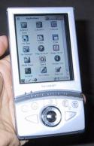

Sharp Zaurus
Lineo Embedix
206 MHz StrongARM
64 MB DRAM 16MB Flash
3.5” display (320x240) 64K colors
Opera browser & Qtopia
QT/Embedded GUI

Slide 36
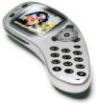

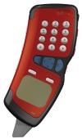
Cell and Web Phones
Telepong Mobile Phone
GITWiT Mobile Phone
Aplio/PRO IP Phone

Slide 37
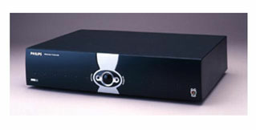
TiVO Set Top Box
Home grown port of Embedded Linux
54MHz PowerPC
Multi GB hard disk

Slide 38
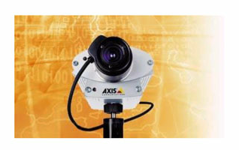
Axis 2120 Network Camera
uCLinux
Built-in Ethernet port
100 MHz ETRAX CPU
16 MB RAM

Slide 39
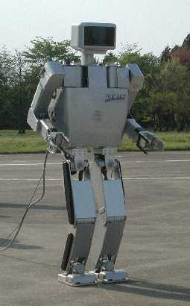
Humanoid Robots
Univ. of Tokyo/Kawanda Ind.
Dual Pentium CPU
RT-Linux
Height: 53 inches
Weight: 121 lbs.
Isamu

Slide 40
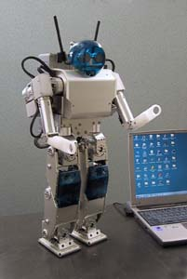
Humanoid Robots
HOAP
Fujitsu
RT-Linux
Height: 48 cm
Weight: 6 kg
100 units/yr

Slide 41

The Embedded OS Market 2018

Slide 42
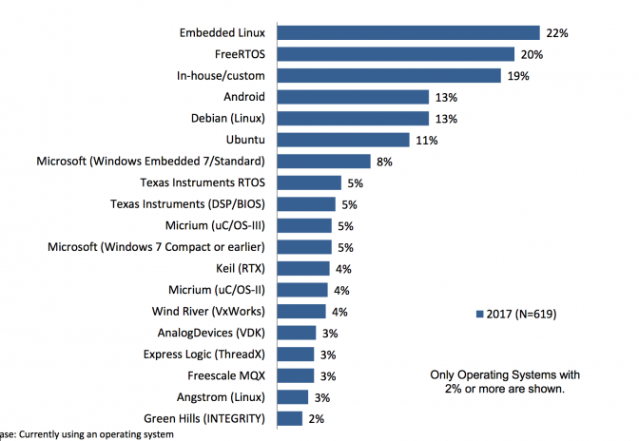
Growth of Embedded Linux

Slide 43
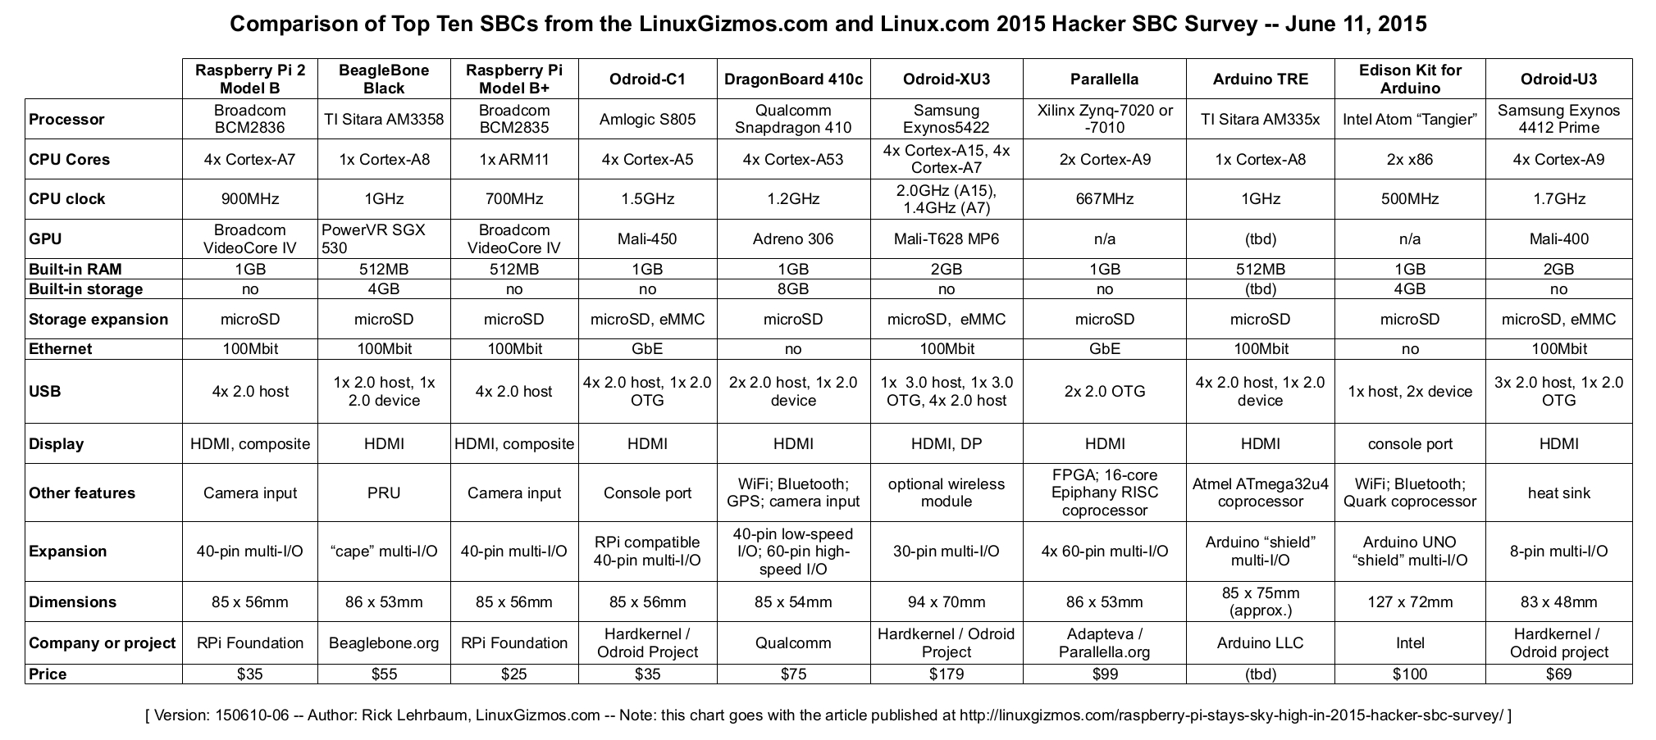
Boards and Comparison

Slide 44
For Further Info
Web Sites
Embedded Link:
http://www.keil.com/pack/doc/CMSIS/General/html/index.html
LinuxDevices.com
http://www.linuxdevices.com/
Embedded Linux Consortium http://www.embedded-linux.org/index.php3
All Linux Devices
http://alllinuxdevices.com/
Embedded Linux StarGate
http://linux-embedded.com/

Slide 45
For Further Info
Web Sites/Magazines
Dr. Dobbs Embedded Systems
http://www.ddjembedded.com/about/
Embedded Linux Journal
http://embedded.linuxjournal.com/
Embedded Systems Programming http://www.embedded.com/mag.htm

Slide 46
My Links:
https://about.me/thejeswarareddy
https://thejeswarareddyr.blogspot.in/
http://cprogrammingb2e.blogspot.in/
http://shellscriptingbyrtr.blogspot.in/
Email:
  theja0473@gmail.com

