Slide 1

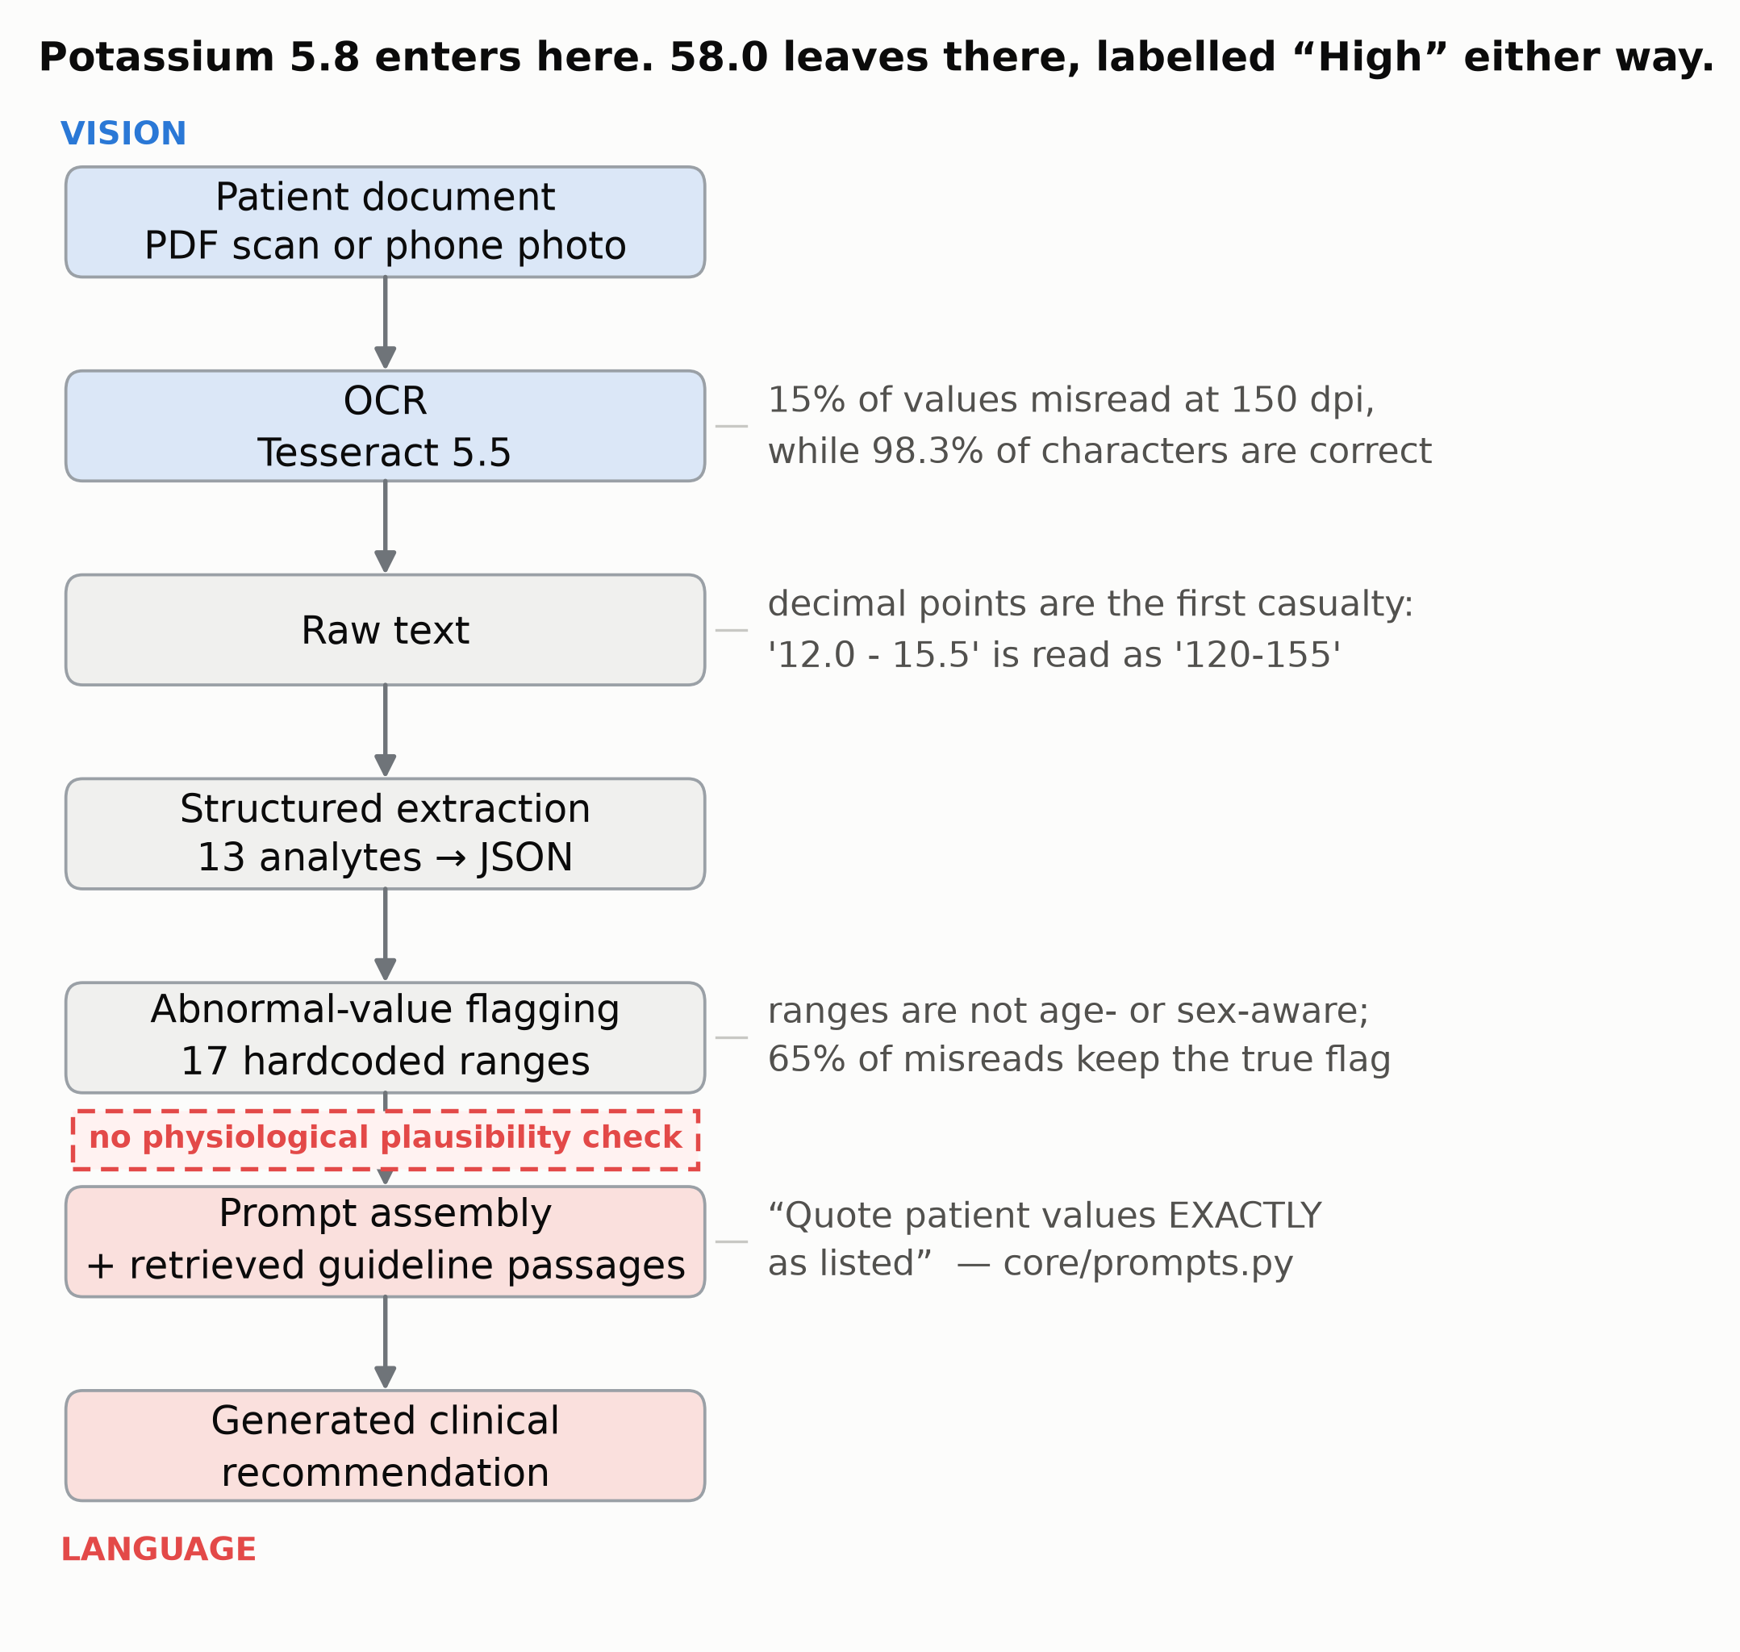
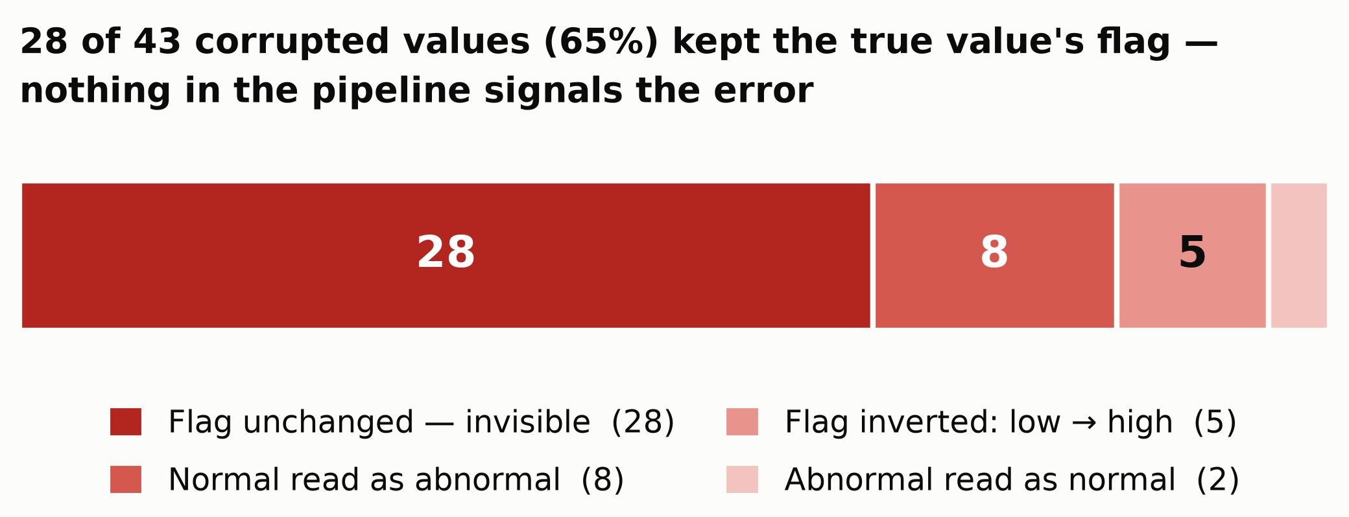
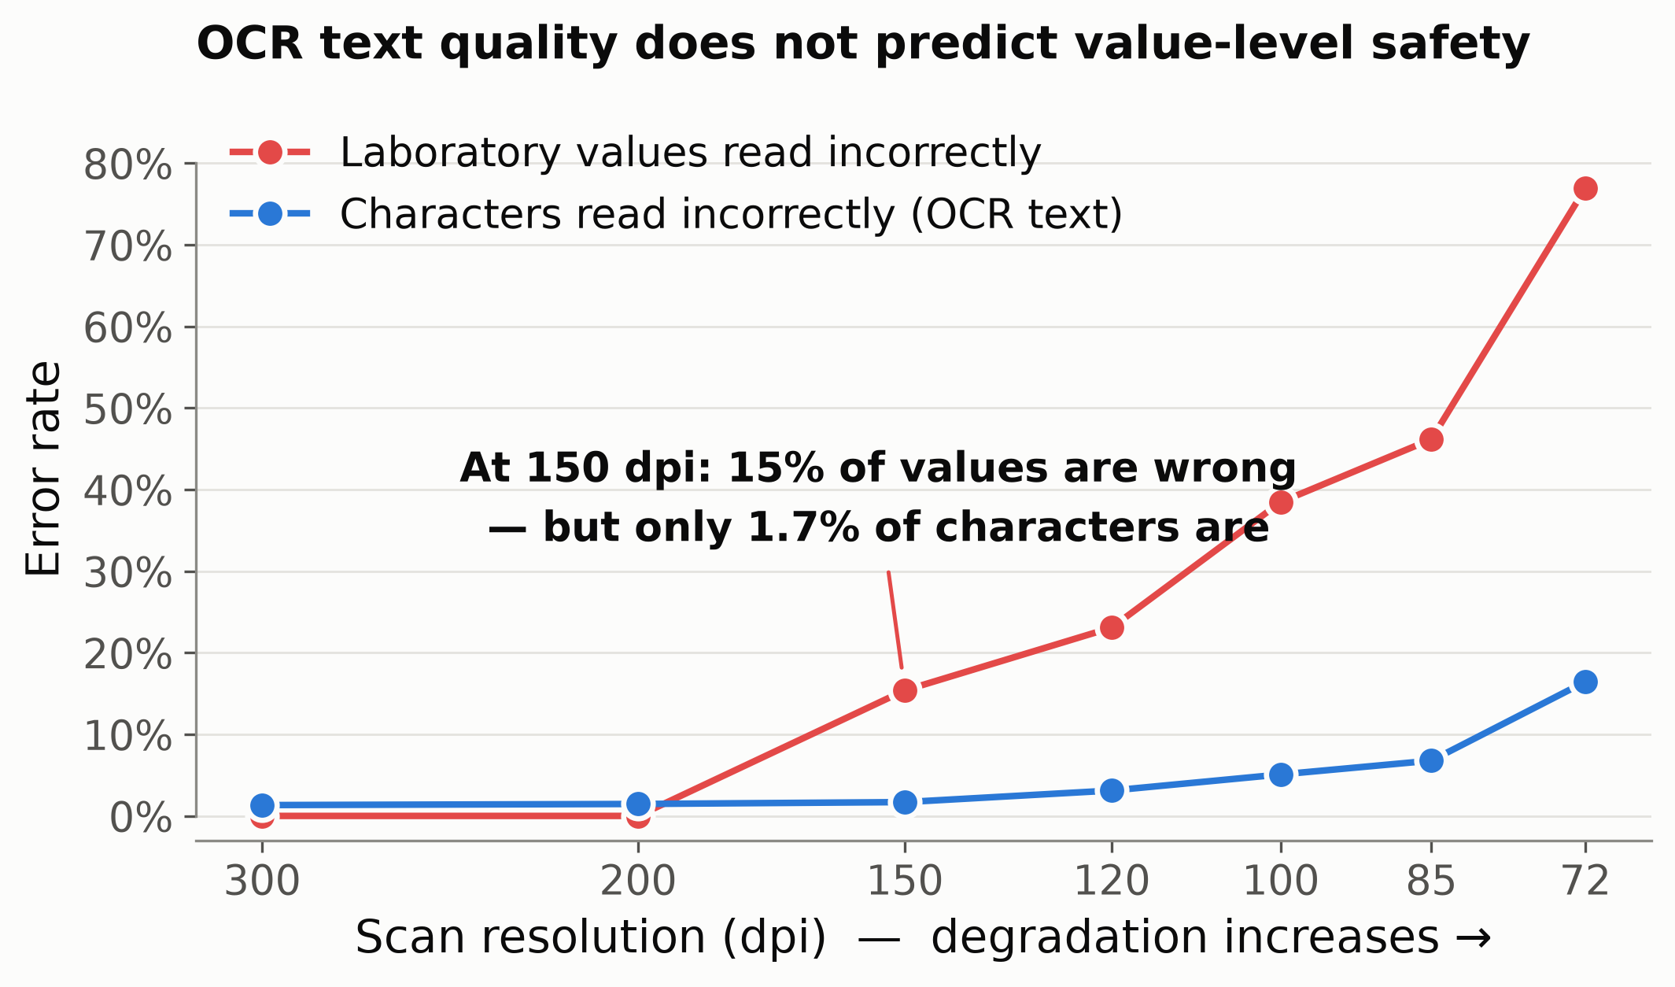
Silent Corruption in Clinical AI
At 150 dpi, 98.3% of characters are read correctly — and 15% of laboratory values are wrong
Mohammed Jabir Hussain Shaik
MSc Artificial Intelligence, School of Electronics, Electrical Engineering and Computer Science, Queen's University Belfast · mshaik01@qub.ac.uk
code, data & harness
Why this matters
• Clinical AI increasingly ingests patient records as images — scans, faxes, phone photographs — not structured data.
• Every stage from pixel to generated sentence is lossy: OCR, extraction, abnormal-value flagging, prompt assembly.
• RAG systems are evaluated on retrieval and answer quality — almost never on whether the patient's own numbers survived.
• A wrong but still plausible value crosses the same threshold as the truth, so the alarm the clinician sees is identical.
• If nothing can say “this reading is suspect”, a decimal point lost in a scan becomes a clinical recommendation.
What I did
• Built a RAG clinical decision support prototype: React, FastAPI, Qdrant, Tesseract OCR, LLM generation. Code is public.
• Injected controlled image faults into a synthetic discharge summary with machine-readable ground truth for 13 analytes.
• 32 conditions — resolution, blur, JPEG, rotation, noise, composites — 5 seeds where stochastic. 832 observations.
• Added a calibration gate: no result unless the clean render gives 13/13. My first run failed it — my own parser's bug.
• Measured at three levels: characters, extracted values against truth, and the flag the clinician would be shown.
Figure 1. The measured pipeline. Vision at the top, language at the bottom, five lossy stages between — and no check that a value is physiologically possible.
Figure 3. What the flagging layer did with each of the 43 corrupted values.
What I found
1. Text quality does not predict value safety.
At 150 dpi — a routine scanner setting — 98.3% of characters are correct and 15% of values are wrong. Resolution dominates: at 300 dpi, blur to σ 2.0, JPEG to q15, rotation to 5° and noise to σ 20 were each harmless.
2. 65% of corruptions are invisible.
Of 43 wrong values, 28 produced the same abnormal-value flag as the truth. Potassium 5.8 → 58.0 mEq/L is still “High”; troponin 0.07 → 7.0 is still “Critical”. 60% were pure decimal-place shifts.
3. It reaches the generated output.
The corrupted value is quoted verbatim in the generated recommendation in 5 of 6 generations at 100 dpi and 4 of 6 at 150 dpi — the prompt instructs the model to quote values exactly. Whether the recommendation itself changes was not stable across generations; that needs a larger, properly powered comparison.
Figure 2. Error at two levels against scan resolution; both are fractions on one axis. 13 analytes per point. Blur, JPEG, rotation and noise at 300 dpi were each harmless until a cliff (see repository).
What this does not show
One synthetic document, 13 analytes, one layout, one OCR engine (Tesseract 5.5.1). Degradations are synthetic approximations, not real scans. Extraction used a deterministic row parser; the deployed LLM extractor is untested. Flags follow the system's own hardcoded ranges, which are not age- or sex-aware. Plausibility envelopes are my own construction, not a clinical standard. Generation used one 3B local model, six samples per condition. No clinician has judged whether any corruption would change management. This is a preliminary fault-injection study on a research prototype — not a validated or deployable system.
Grounding tells you where a number came from. It does not tell you whether it was read correctly.
References
Gao, Y. et al. Retrieval-Augmented Generation for Large Language Models: A Survey. arXiv:2312.10997, 2023.
Amugongo, L. M. et al. Retrieval augmented generation for large language models in healthcare: a systematic review. PLOS Digital Health 4(6): e0000877, 2025.
Lu, Y., Zhao, X., Wang, J. ClinicalRAG: Enhancing Clinical Decision Support through Heterogeneous Knowledge Retrieval. Workshop on Knowledgeable Language Models, ACL 2024.
Ben Abacha, A., Demner-Fushman, D. A question-entailment approach to question answering. BMC Bioinformatics 20:511, 2019. (MedQuAD)
Synthetic patient data throughout — no real patient information was used. · Vision and Language Symposium, Queen's University Belfast

